Slide 1
Towards Practical MK-TFHE:
Parallelizable, Quasi-linear and Key-compatible
민선홍, 암호 및 프라이버시 연구실
Seonhong Min, Cryptography and Security Lab
2022-12-01

Slide 2



What is Homomorphic Encryption?
m
m
f(x, y)
1
2
m
m
f( , )
1
2

Slide 3

What is Homomorphic Encryption?
m
m
1
2
Encrypt
~
f(x, y)
Decrypt
m
m
f( , )
1
2

Slide 4
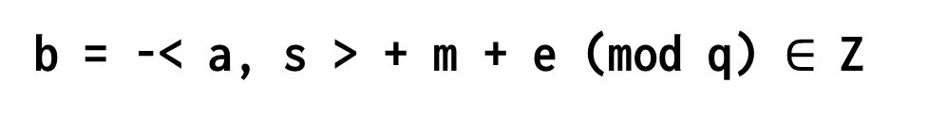
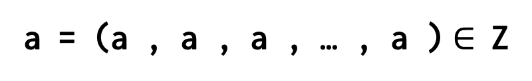
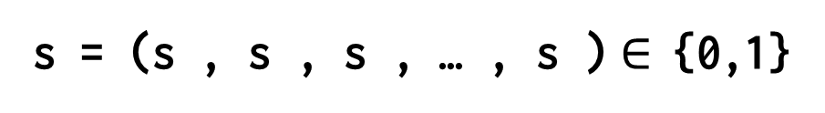
Form of LWE ciphertexts
Secret Key:
→
n
s = (s , s , s , … , s )$∈$ {0,1}
1
2
3
n
→
n
a = (a , a , a , … , a )$∈$ Z
Ciphertext:
1
2
3
n
q
→
→
b = -< a, s > + m + e (mod q) $∈$ Z
q
→
It is hard to distinguish the distribution of (a, b) from
uniform random distribution over Z
n+1
q

Slide 5
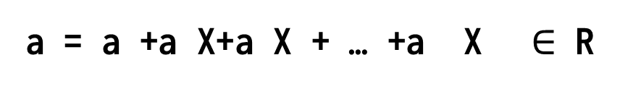

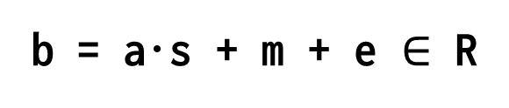
Form of (R)LWE ciphertexts
Base ring:
N
R = Z [X]/<X +1>
q
q
Secret Key:
2
N-1
S = s +s X+s X + … +s X $∈$ R
0
1
2
N-1
q
2
N-1
a = a +a X+a X + … +a X $∈$ R
Ciphertext:
0
1
2
N-1
q
b = a·s + m + e $∈$ R
It is hard to distinguish the distribution of (a, b) from
uniformly random distribution over R
2
q

Slide 6
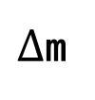
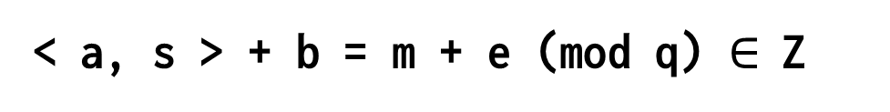
Decryption of LWE ciphertext
Decryption:
→
→
< a, s > + b = m + e (mod q) $∈$ Z
Usually encode the message in the MSB,
and the error in the LSB.
$∆$m
e

Slide 7
Boostrapping is needed
Addition:
(m +e ) + (m +e ) = (m +m ) + (e +e )
1
1
2
2
1
2
1
2
Multiplication:
(m +e ) * (m +e )
= (m m ) + (m e +m e +e e )
1
1
2
2
1
2
1
2
2
1
1
2
The error increases as one perform homomorphic operations.

Slide 8
Boostrapping is needed
Bootstrapping!

Slide 9
Type of HE schemes
BGV/FV : Integer Arithmetic (Finite Field)
CKKS(HEAAN) : Approximate Number Arithmetic
TFHE/FHEW : (Mainly) Boolean Arithmetic
(R)GSW : Supplementary scheme

Slide 10





Limitation of HE
m
m
1
3
m
2
m
4

Slide 11
What is Multi-key HE?
m
m
1
3
s
s
1
3
m
m
m
m
f( , , , )
1
2
3
4
m
m
2
4
s
s
2
4

Slide 12
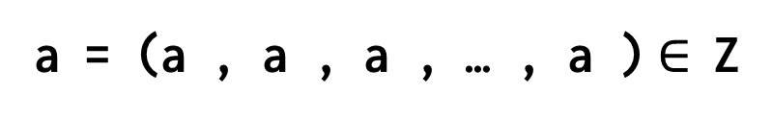
Form of MK-(R)LWE ciphertexts
Secret Key:
→
→
→
→
→
n✕k
s = (s , s , s , … , s )$∈$ {0,1}
1
2
3
k
→
→
→
→
→
n✕k
a = (a , a , a , … , a )$∈$ Z
Ciphertext:
1
2
3
k
q
b = -< a, s > + m + e (mod q) $∈$ Z
q
→
→
Decryption can be done by publish <a , s >
and adding them to b so that we get m + e.
i
i

Slide 13
CCS19 (First MKTFHE scheme)
Hybrid Product
Multiplication between single-key RGSW and MK-RLWE
O(k) time complexity
Single-key RGSW should be “structured”
In CCS19 scheme, bootstrapping requires nk hybrid products
and it results in O(nk ) time complexity.
2

Slide 14
Our Contribution
Improved Hybrid Product
x2 speedup compared to the previous work
(Slightly) better noise variance
Generalized External Product
Mult between arbitrary single-key RGSW and MK-RLWE
O(k) time complexity

Slide 15
Our Idea
Phase 1
Execute bootstrapping party-wise with RGSW
kn RGSW multiplications, O(nk) time complexity
Phase 2
Merge them via generalized external product
k external prod, O(k ) time complexity
2

Slide 16
Advantages
Parallelizable
CCS19 was not algorithmically parallelizable
Phase 1 of our scheme is parallelizable
Quasi-linear time complexity
2
O(nk+k ) time complexity
n ≈ 600, k ≤ 32, therefore almost linear.
Key-compatible
CCS19 uses structured RGSW bootstrapping key.
Our scheme uses conventional bootstrapping key, with additional relinearization key.

Slide 17
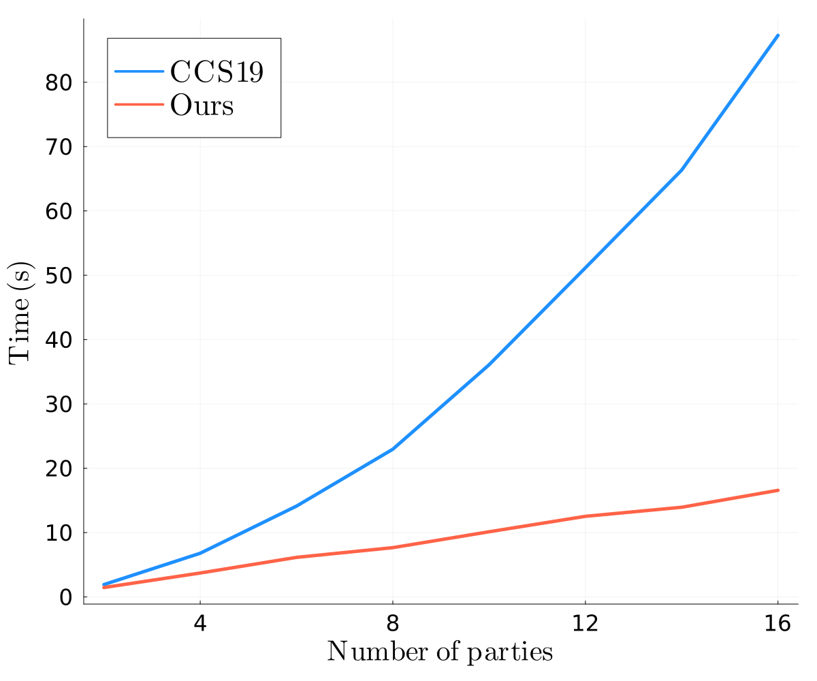
Performance

Slide 18
감사합니다.
Thank you for listening.

