Slide 1
Running ASP.NET Core Apps without a server? WHAT?!?!?!
Isaac Levin

Slide 2









https://www.isaaclevin.com
@isaaclevin
https://www.coffeeandopensource.com
@isaacrlevin
@isaacrlevin@fosstodon.org

Slide 3
How did we use to build Web Apps?

Slide 4
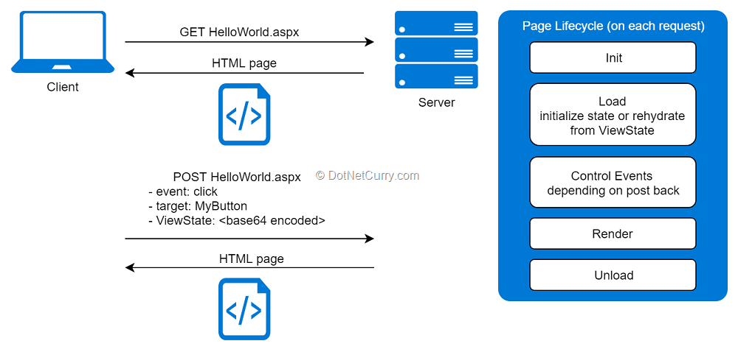
The Web Forms Era (2002-2008)
Notes:
At the time, VB6 was dying, Windows Forms was the predominant way to build .NET apps.
The ability to drag and drop visual elements inside Visual Studio was an impressive developer experience at the time.
Web Forms was created to be a similar design experience as WinForms, but for the web
Follow Page/Controller pattern
Fixed set of provided controls with fired up postback experiences
Built in State Management and life cycle hooks

Slide 5
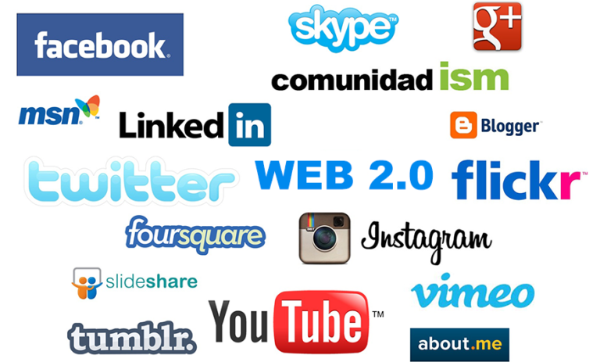
Web 2.0 (~2005)
Notes:
In the early 2000s, more and more websites began to focus on user experience (limiting trips to server)
HTML, CSS and Javascript begin to experience hyper growth
ASP.NET introduced “script callbacks” (allowing server side methods to be called through an XMLHttpRequest
The term AJAX (Asynchronus Javascript and HTML) became more and more prevalent
AJAX Toolkit introduced for WebForms in 2007 (on Codeplex!!!!), bringing drag and dropable controls to bring Web 2.0 experiences (like datepickers, accordians, etc)
And later in 2007, with .NET Framework 3.5 , Microsoft AJAX was included in the box
What else came out in 3.5 that changed our lives as developers? (LINQ)

Slide 6
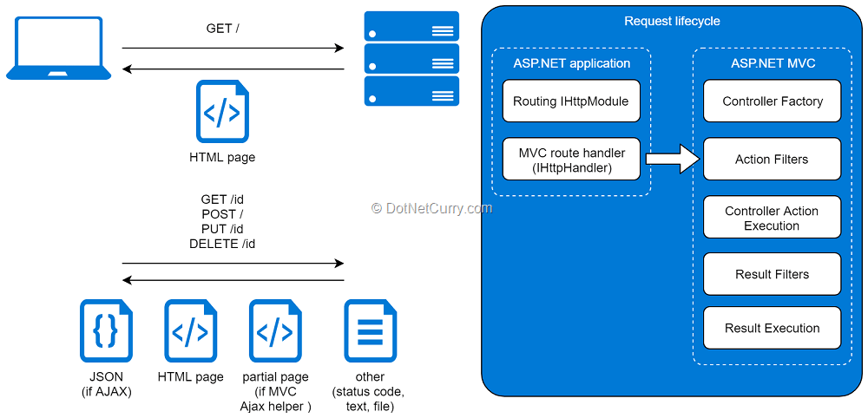
MVC (2008-2014)
Notes:
After Web 2.0 began, the web started moving fast.
Web Forms, though easy to get started, hid a TON from developers, and was not flexible in a lot of cases
Javascript integration was becoming a requirement, not a nice to have
JSON passes XML as the predominant way to send AJAX requests, and using ASMX or WCF, though still very popular, did not play well
ASP.NET MVC was announced in late 2007 and was going to be open source and followed certain principals
Follows the separation of concerns design principle
Grants full control over the generated HTML
Provides first class support for TDD (test driven development)
Integrates with existing ASP.NET infrastructure (Caching, Session, Modules, Handlers, IIS hosting, etc.)
Pluggable. Appropriate hooks to be provided so components like the controller factory or the view engine can be replaced
Uses the ASPX view engine (without View State or postbacks) by default, but allows other view engines to be used like the one from MonoRail, etc.
Supports IoC (inversion of control) containers for controller creation and dependency injection on the controllers
Provides complete control over URLs and navigation
Followed well known Model View Controller pattern with goal to not hide the inner workings to developers
As always, developers began to ask “Web Forms or MVC”
jQuery released in 2006 and quickly becomes the standard for AJAX and is bundled in with .NET Framework
By 2010, we also see the emergence of javascript frameworks, like backbone, knockout, and angular js
Over the next few years, the release of Nuget makes it much easier for .NET developers to get 3rd party dependencies and we also get Web API, which to the developer used the VC of MVC to house REST-based web services
At this time, we have the One ASP.NET idea, meaning all the different ways to build for the web in one product, and life is great
Than NodeJS and NPM showed up, React arrives in 2013, the MEAN stack becomes heavily favored over the “bloated, Windows only” ASP.NET

Slide 7
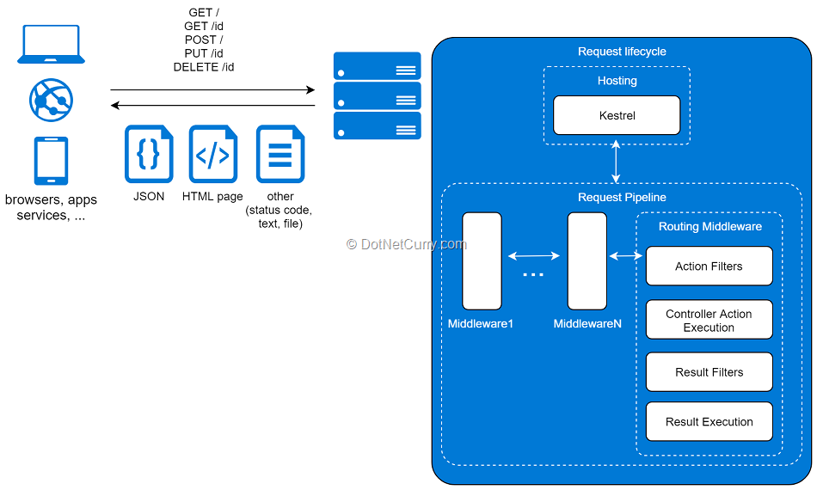
ASP.NET Core (2014-today)
Notes:
Well .NET lost to JS frameworks… now what?
.NET was nearly 12 years old at this point, and One ASP.NET had been achieved but the team saw the horizon, so ASP.NET vNext work began
So what was ASP.NET vNext? Simply to have a version of ASP.NET that ran on *nix and osx environments, similar to the very popular Mono project, which was community driven
The roots of the next evolution of ASP.NET was seen in things like Project Kitana and OWIN (open web interface for .NET) where the goal was to be “less bloated, nimble”
One additional thing that was a tenant of ASP.NET vNext was it being completely OSS, even more so than MVC, where all work would be done in the open and on GitHub.com
This involved basically rewriting the entire hosting stack and request pipeline, allowing for more modular delivery of functionality and the ability to configure PER target
ASP.NET Core 1.0 launches in June 2016, after 2 years of development. And a year later in August 2017 the 2nd version was released (I was at Build when Preview 1 was announced)
2.0 was the first showing of Razor Pages, which brought a Page Controller pattern to ASP.NET Core. This was built on top of MVC and allowed the ability to use the MVVM pattern
V 3.0 came out in September 2019 and finally 3.1 at the end of that year
Than a problem appeared. Naming the next version NET Core 4 is a terrible idea for obvious reasons. The team decided to drop the Core nomenclature and skip to v 5. Now we are at version 7 and a new version will come out in November every year

Slide 8









But what if I want Web 2.0?

Slide 9
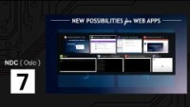
But what if you didn’t need JavaScript?
Notes:
NDC Oslo 2017
Steve Sanderson shows an “experiment” that he thinks might be interesting
https://www.youtube.com/watch?v=MiLAE6HMr10

Slide 10
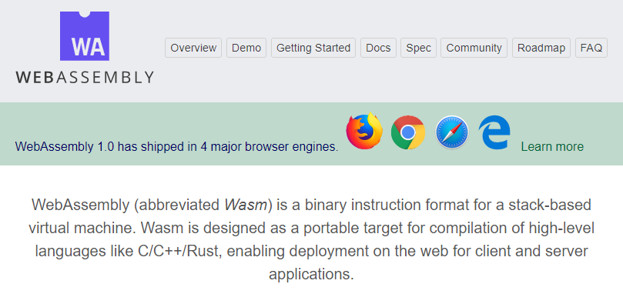
Meet WASM
Notes:
For most of us that have watched modern .NET since that time we know what happens next, but let’s talk a little about how we got to where we are.
In that video, Steve also shows Web Assembly, released in March of 2017
Portable binary code format that aims to support ANY language
This translate into being able to execute code written in nearly any programming language inside the browser sandbox if the application is compiled the right way
It is supported in 4 of the largest browsers in the world

Slide 11
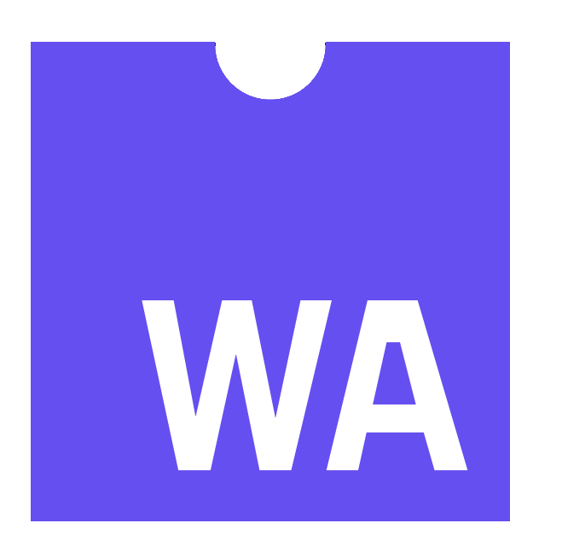


But how do I use WASM with .NET
https://...
Pros
> Thin client
> Full runtime
> Simpler arch.
Cons
> No offline
> Latency
> Server resources
DOM
Notes:
Ok, so at this point we have WASM and we have a cool demo using C# runs in the browser, now what?
That is when Blazor comes in
Uses Web Assembly and the monoruntime to allow Web 2.0 experiences in the browser with a programming language that typically requires a server (ASP.NET Core Kestrel for iinstance)

Slide 12
Why would I do this?
Modern languages (C#)
.NET ecosystem
Performance
Full-stack
Tools
Stable & mature

Slide 13
ASP.NET CORE EXPERIENCES
SERVER-SIDE RENDERING
AOT COMPLILATION
FORMS & VALIDATION
HOT RELOAD
PUBLISHING
Blazor
CUSTOM ELEMENTS
LOCALIZATION
SMALLER APP SIZES
AUTO REBUILD
CUSTOM BUNDLING
SVG SUPPORT
ERROR BOUNDARIES
RENDER COMPONENTS IN JS

Slide 14
In what ways can I host Blazor WASM apps?

Slide 15


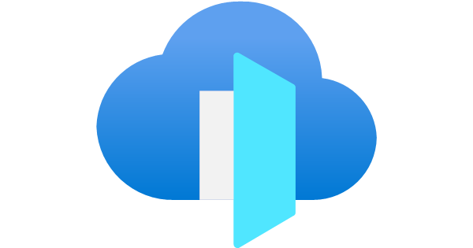


Blazor WASM with Azure Storage
Azure
User
Azure Front Door
Azure Storage
Blazor WASM

Slide 16
Deploying .NET Apps to Azure Storage

Slide 17





Deploy Blazor WASM to GitHub Pages
Blazor WASM App
GitHub Action
Deployment
Git Push
Push Trigger
GitHub User
End Users
Git Repo
GitHub Pages
Workflow File

Slide 18
Deploying .NET Apps to GitHub Pages

Slide 19
But what if I need
Fast
Interactive
Flexibility

Slide 20
Look to the horizon
MVC / Razor Pages
Blazor
Blazor SSR

Slide 21

Thanks!
Any questions?
You can find me at:
@isaacrlevin

