Slide 1
How I Learned to Stop Worrying and Love the CLI
Isaac Levin – Senior Product Marketing manager @Microsoft
Isaac.Levin@microsoft.com

Slide 2



@isaacrlevin
@isaacrlevin
</> https://www.isaaclevin.com

Slide 3
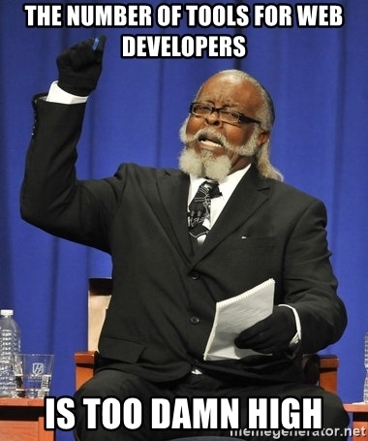



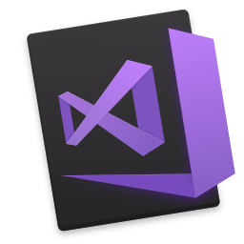



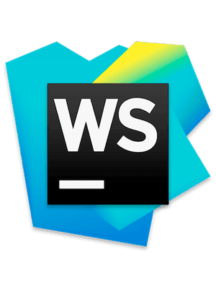




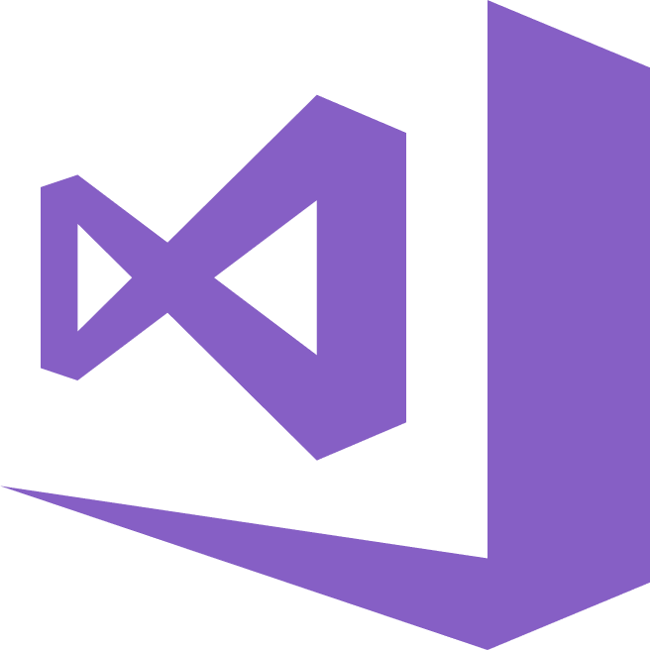
Too many tools!!!

Slide 4

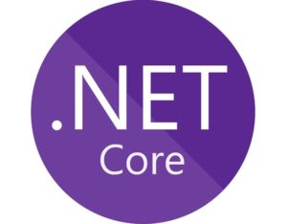


A opinionated solution to the problem

Slide 5
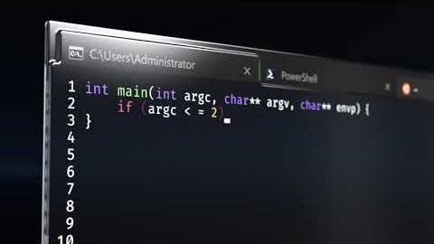
Look, new stuff!!!
Introducing Windows Terminal
Multiple Tabs
Beautiful Text
Settings and configurability
Available as OSS on GitHub or via Windows Store
Beta at this point, with release later this year

Slide 6

Git BASH
Robust wrapper for managing git repositories
Seamless hook into Unix bash and Windows cmd
Easy way to manage credentials
Works against GitHub, Bitbucket and VSTS repos

Slide 7

Dotnet cli
Project creation 1st class support for command line
Cross-platform (runs everywhere)
Extensible via Global tools (aka create your own)
Integrates with ALM Tools (Azure DevOps)

Slide 8

Angular cli
Installed via NPM
Used to initialize, develop, scaffold and maintain
Removed barrier to entry in creating apps
Runs on top of Webpack, taking away complexity

Slide 9

Azure cli
Administrating and Managing Azure Resources
Can run locally or in Azure Cloud Shell
Authentication gracefully handled with Azure Login
Extensible modules developed by anyone

Slide 10
A VERY LONG DEMO

Slide 11

Questions and thank you!!!

Slide 12
Resources – https://aka.ms/levin-cli
Microsoft Terminal Repo
Git Bash
https://git-scm.com
25 part video series - https://aka.ms/github-youtube-playlist
Dotnet CLI
https://docs.microsoft.com/dotnet/core/tools
DotNet Core CLI Tutorial - https://www.youtube.com/watch?v=v-s4oRELWrM
DotNet CLI Global Tools - https://github.com/natemcmaster/dotnet-tools
Angular CLI
https://cli.angular.io/
Angular Talk from John Papa - https://www.youtube.com/watch?v=h7eVZg3j_Lk
Azure CLI
https://docs.microsoft.com/cli/azure
Tips & Tricks with Azure CLI - https://www.youtube.com/watch?v=qMSu3gxIU7c
Gig (.gitignore generator)
https://www.gitignore.io

