Slide 1
How I Learned to Stop Worrying and Love the CLI
Isaac Levin – application development manager @Microsoft
Isaac.Levin@microsoft.com

Slide 2



@isaac2004
@isaac2004
</> https://www.isaaclevin.com

Slide 3
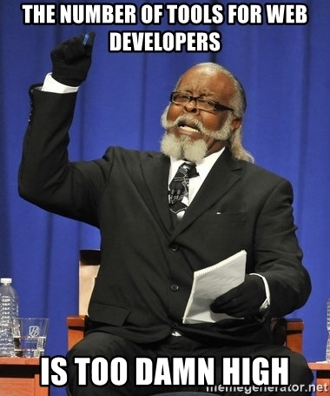













Too many tools!!!

Slide 4




A opinionated solution to the problem

Slide 5
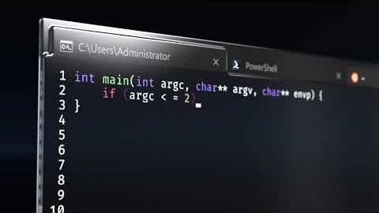
Look, new stuff!!!
Introducing Windows Terminal
Multiple Tabs
Beautiful Text
Settings and configurability
Available as OSS on GitHub
Experimental at this point, with release later this year

Slide 6

Git BASH
Robust wrapper for managing git repositories
Seamless hook into Unix bash and Windows cmd
Easy way to manage credentials
Works against GitHub, Bitbucket and VSTS repos

Slide 7

Dotnet cli
Project creation 1st class support for command line
Cross-platform (runs everywhere)
Extensible via Global tools (aka create your own)
Integrates with ALM Tools (Azure DevOps)

Slide 8

Angular cli
Installed via NPM
Used to initialize, develop, scaffold and maintain
Removed barrier to entry in creating apps
Runs on top of Webpack, taking away complexity

Slide 9

Azure cli
Administrating and Managing Azure Resources
Can run locally or in Azure Cloud Shell
Authentication gracefully handled with Azure Login
Extensible modules developed by anyone

Slide 10
A VERY LONG DEMO

Slide 11

Questions and thank you!!!

Slide 12
Resources – https://aka.ms/levin-cli
Microsoft Terminal Repo
Git Bash
https://git-scm.com
25 part video series - https://aka.ms/github-youtube-playlist
Dotnet CLI
https://docs.microsoft.com/dotnet/core/tools
DotNet Core CLI Tutorial - https://www.youtube.com/watch?v=v-s4oRELWrM
DotNet CLI Global Tools - https://github.com/natemcmaster/dotnet-tools
Angular CLI
https://cli.angular.io/
Angular Talk from John Papa - https://www.youtube.com/watch?v=h7eVZg3j_Lk
Azure CLI
https://docs.microsoft.com/cli/azure
Tips & Tricks with Azure CLI - https://www.youtube.com/watch?v=qMSu3gxIU7c
Gig (.gitignore generator)
https://www.gitignore.io
Don’t Take a Picture of this slide,
Use these QR Codes
Top Code is Reference Materials
Bottom Code is Survey
Come up showing your completed forms to get stickers!

