Slide 1
[12 – JavaFX #4] 고급 자바 프로그래밍
배재대학교 컴퓨터공학과 이경희 (leekhe@pcu.ac.kr)

Slide 2
II-2. JavaFX (4)

Slide 3
JavaFX 컨트롤
Button 계열
Button, CheckBox, RadioButton, ToggleButton
입력 컨트롤
Label, TextField, TextArea, PasswordField, ComBox, DatePicker, HTMLEditor
View 계열
ListView, TableView, ImageView
미디어 관련
Slider, ProgressBar, ProgressIndicator
Chart 계열
PieChart, LineChart, AreaChart, BarChart, BubbleChart, ScatterChart

Slide 4
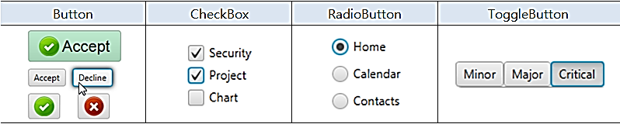
JavaFX 버튼 컨트롤
버튼 컨트롤
마우스로 클릭 가능한 컨트롤
ButtonBase 클래스를 상속받는 하위 클래스들

Slide 5
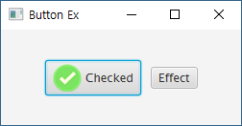
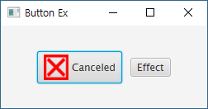
[예제 JFX-26] Button 예제 (1)
“Main.java”의 일부
...
public void start(Stage primaryStage) throws Exception {
HBox root = new HBox();
root.setAlignment(Pos.CENTER); root.setSpacing(10.0);
// 이미지를 포함하는 버튼 생성
Image imgCheck = new Image(getClass().getResourceAsStream("check.png"));
Button btn1 = new Button("Checked", new ImageView(imgCheck));
// 이벤트 처리: 버튼의 이미지와 텍스트를 변경
Image imgCancel = new Image(getClass().getResourceAsStream("cancel.png"));
btn1.setOnAction(event -> {
if(btn1.getText().equals("Checked")) {
btn1.setText("Canceled");
btn1.setGraphic(new ImageView(imgCancel));
} else {
btn1.setText("Checked");
btn1.setGraphic(new ImageView(imgCheck));
}
});
…

Slide 6
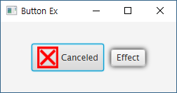
[예제 JFX-26] Button 예제 (2)
“Main.java”의 일부(계속)
...
// 버튼에 그래픽 효과 추가
Button btn2 = new Button("Effect");
DropShadow shadow = new DropShadow();
btn2.addEventHandler(MouseEvent.MOUSE_ENTERED,
event -> btn2.setEffect(shadow));
btn2.addEventHandler(MouseEvent.MOUSE_EXITED,
event -> btn2.setEffect(null));
root.getChildren().addAll(btn1, btn2);
Scene scene = new Scene(root, 250, 100);
primaryStage.setTitle("Button Ex");
primaryStage.setScene(scene);
primaryStage.show();
}
…

Slide 7
[예제 JFX-27] CheckBox 예제 (1)
“Main.java”의 일부
...
public void start(Stage primaryStage) throws Exception {
HBox root = new HBox();
root.setPadding(new Insets(20));
String names[] = new String[] {"Up", "Stop", "Down"};
CheckBox[] cbArr = new CheckBox[names.length];
Label[] laArr = new Label[cbArr.length];
VBox left = new VBox();
left.setSpacing(10);
HBox right = new HBox();
right.setSpacing(10);
right.setAlignment(Pos.CENTER);
root.getChildren().addAll(left, right);
…

Slide 8
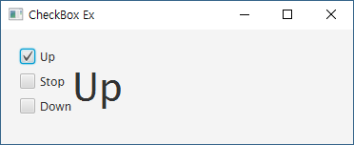
[예제 JFX-27] CheckBox 예제 (2)
“Main.java”의 일부(계속)
...
// 체크박스와 레이블을 생성하여 화면에 배치
for(int i = 0; i < names.length; i++) {
Label la = laArr[i] = new Label();
la.setFont(new Font(40));
right.getChildren().add(la);
if(i == 0) la.setText(names[i]);
CheckBox cb = cbArr[i] = new CheckBox(names[i]);
left.getChildren().add(cb);
if(i == 0) cb.setSelected(true);
…

Slide 9
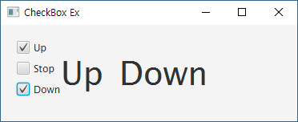
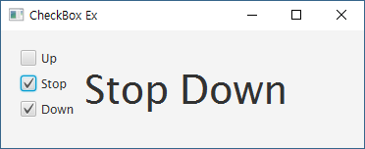
[예제 JFX-27] CheckBox 예제 (3)
“Main.java”의 일부(계속)
...
// 속성 감시를 이용한 이벤트 처리
// cb.setUserData(names[i]);
cb.selectedProperty().addListener(new ChangeListener<Boolean>() {
public void changed(ObservableValue<? extends Boolean> obs,
Boolean oldVal, Boolean newVal) {
if(newVal == true)
la.setText(cb.getText());
// la.setText(cb.getUserData().toString());
else
la.setText(null);
}
});
}
Scene scene = new Scene(root, 370, 120);
primaryStage.setTitle("CheckBox Ex");
primaryStage.setScene(scene);
primaryStage.show();
}
…

Slide 10
[예제 JFX-28] RadioButton 예제 (1)
“Main.java”의 일부
...
public void start(Stage primaryStage) throws Exception {
// 컨테이너 배치
HBox root = new HBox();
root.setPadding(new Insets(20));
VBox left = new VBox();
left.setSpacing(10);
HBox right = new HBox();
right.setPrefWidth(150);
right.setSpacing(10);
right.setAlignment(Pos.CENTER);
root.getChildren().addAll(left, right);
…

Slide 11
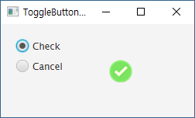
[예제 JFX-28] RadioButton 예제 (2)
“Main.java”의 일부(계속)
...
// 토글그룹, 토글버튼, 이미지 뷰 생성 및 배치
ToggleGroup group = new ToggleGroup();
RadioButton rb1 = new RadioButton("Check");
RadioButton rb2 = new RadioButton("Cancel");
rb1.setToggleGroup(group); rb1.setSelected(true);
rb2.setToggleGroup(group);
left.getChildren().addAll(rb1, rb2);
Image img1 = new Image(getClass().getResourceAsStream("check.png"));
ImageView iv = new ImageView(img1);
right.getChildren().add(iv);
…

Slide 12
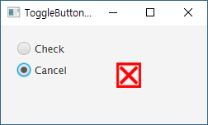
[예제 JFX-28] RadioButton 예제 (3)
“Main.java”의 일부(계속)
...
// 속성 감시를 이용한 이벤트 처리
rb1.setUserData("check.png"); rb2.setUserData("cancel.png");
group.selectedToggleProperty().addListener(new ChangeListener<Toggle>() {
public void changed(ObservableValue<? extends Toggle> obs,
Toggle oldVal, Toggle newVal) {
if(group.getSelectedToggle() != null) {
Image img = new Image(getClass().getResourceAsStream(
group.getSelectedToggle().getUserData().toString()));
iv.setImage(img);
}
}
});
Scene scene = new Scene(root, 250, 120);
primaryStage.setTitle("ToggleButton Ex");
primaryStage.setScene(scene);
primaryStage.show();
}
…

Slide 13
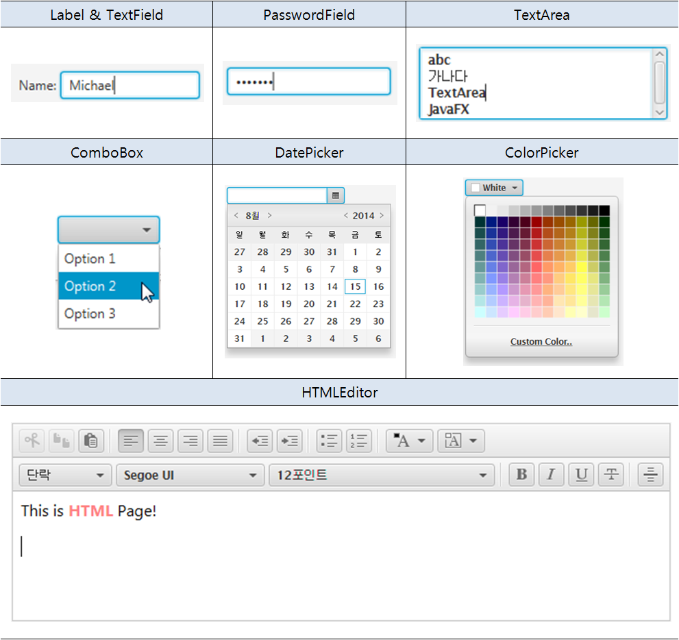
JavaFX 입력 컨트롤
입력 컨트롤

Slide 14
Label
일반적인 사용법
주요 메소드
setFont()
setTextFill(), setWrapText()
setRotate()
setTranslateX(), setTranslateY()
setScaleX(), setScaleY()
Image img = new Image(getClass().getResourceAsStream("search.png");
Label la = new Label("Search");
La.setGraphic(new ImageView(img));

Slide 15

[예제 JFX-29] Label 예제 (1)
“Main.java”의 일부
...
public void start(Stage primaryStage) throws Exception {
HBox root = new HBox();
root.setPadding(new Insets(10));
root.setSpacing(10);
Image img = new Image(getClass().getResourceAsStream("search.png"));
Label la1 = new Label("Search");
la1.setGraphic(new ImageView(img));
la1.setFont(new Font("Arial", 30));
la1.setTextFill(Color.BLUE);
Label la2 = new Label("Values");
la2.setFont(Font.font("Cambria", 32));
la2.setRotate(270);
la2.setTranslateY(50);
Label la3 = new Label("A label to be wrapped");
la3.setPrefWidth(100);
la3.setWrapText(true);
la3.setTranslateY(50);
…

Slide 16
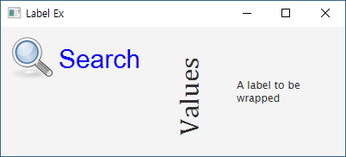
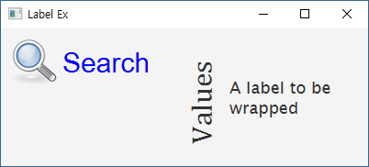
[예제 JFX-29] Label 예제 (2)
“Main.java”의 일부(계속)
...
la3.setOnMouseEntered(event -> {
la3.setScaleX(1.5);
la3.setScaleY(1.5);
});
la3.setOnMouseExited(event -> {
la3.setScaleX(1);
la3.setScaleY(1);
});
root.getChildren().addAll(la1, la2, la3);
Scene scene = new Scene(root, 400, 150);
primaryStage.setScene(scene);
primaryStage.setTitle("Label Ex");
primaryStage.show();
}

Slide 17
TextField
일반적인 사용법
주요 메소드
setText(), getText()
setPrefColumnCount()
setPromptText() // 도움말 출력
clear()
TextField address = new TextField();
address.setPrefColumnCount(20);

Slide 18
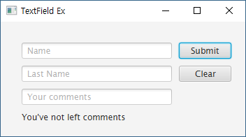
[예제 JFX-30] TextField 예제 (1)
“root.fxml” 작성 (Scene Builder 활용)
TextField
- id: name
- prefColumnCount: 20
- promptText: “Name”
TextField
- id: lastName
- prefColumnCount: 20
- promptText: “Last Name”
GridPane (2 x 4)
- prefWidth: 350
- prefHeight: 150
- hgap: 10
- vgap: 10
- padding: 20
*fx:controller 속성 등록
Button
- id: submit
- prefWidth: 80
Button
- id: clear
- prefWidth: 80
Label
- id: label
TextField
- id: comment
- prefColumnCount: 20
- promptText: “Your comments”

Slide 19
[예제 JFX-30] TextField 예제 (2)
“root.fxml”의 일부
...
<GridPane ... fx:controller="application.RootController">
<children>
<TextField fx:id="name" prefColumnCount="20" ... />
…
</children>
</GridPane>

Slide 20
[예제 JFX-30] TextField 예제 (3)
“Main.java”의 일부
...
public class Main extends Application {
@Override
public void start(Stage primaryStage) throws Exception {
Parent root = FXMLLoader.load(getClass().getResource("root.fxml"));
Scene scene = new Scene(root);
primaryStage.setScene(scene);
primaryStage.setTitle("TextField Ex");
primaryStage.show();
}
public static void main(String[] args) {
launch(args);
}
}

Slide 21
[예제 JFX-30] TextField 예제 (4)
“RootController.java”의 일부
...
public class RootController implements Initializable {
@FXML TextField name, lastName, comment;
@FXML Button submit, clear;
@FXML Label label;
@Override
public void initialize(URL arg0, ResourceBundle arg1) {
// TODO Auto-generated method stub
clear.setOnAction(new EventHandler<ActionEvent>() {
public void handle(ActionEvent e) {
name.clear();
lastName.clear();
comment.clear();
label.setText("You've not left comments");
}
});
…

Slide 22
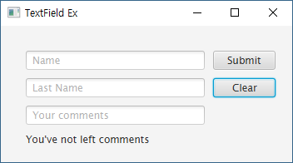
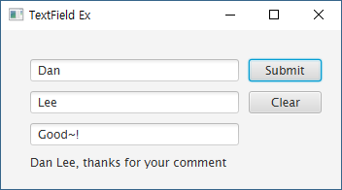
[예제 JFX-30] TextField 예제 (5)
“RootController.java”의 일부(계속)
...
submit.setOnAction(new EventHandler<ActionEvent>() {
public void handle(ActionEvent e) {
if(!comment.getText().isEmpty() && comment.getText() != null)
label.setText(name.getText() + " " + lastName.getText()
+ ", thanks for your comment");
else
label.setText("You've not left comments.");
}
});
}
}

Slide 23
TextArea
생성자
TextArea()
TextArea(String text)
주요 메소드
setText(), getText()
setWrapText()
setEditable()
setPrefColumnCount(), setPrefRowCount()
appendText()
selectRange()
setCaretPosition(), getCaretPosition()

Slide 24
[예제 JFX-31] TextArea 예제 (1)
“Main.java”의 일부
...
public void start(Stage primaryStage) throws Exception {
BorderPane root = new BorderPane();
root.setPadding(new Insets(10));
TextArea ta = new TextArea();
ta.setWrapText(true);
ta.setEditable(false);
ta.setMaxSize(Double.MAX_VALUE, Double.MAX_VALUE);
GridPane bottom = new GridPane();
bottom.setHgap(15);
TextField tf = new TextField();
tf.setPrefColumnCount(40);
Button btn = new Button("Submit");
bottom.add(tf, 0, 0, 2, 1);
bottom.add(btn, 2, 0, 1, 1);
…

Slide 25
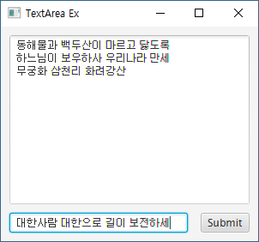
[예제 JFX-31] TextArea 예제 (2)
“Main.java”의 일부(계속)
...
EventHandler<ActionEvent> handler = new EventHandler<ActionEvent>() {
public void handle(ActionEvent e) {
ta.appendText(tf.getText() + "\n");
ta.selectPositionCaret(ta.getLength());
tf.clear();
}
};
tf.setOnAction(handler);
btn.setOnAction(handler);
root.setCenter(ta);
root.setBottom(bottom);
BorderPane.setMargin(bottom, new Insets(10, 0, 0, 0));
Scene scene = new Scene(root, 300, 250);
primaryStage.setScene(scene);
primaryStage.setTitle("TextArea Ex");
primaryStage.show();
}

Slide 26
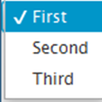
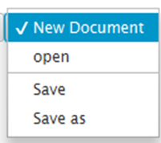
ChoiceBox
생성 방법(예)
ChoiceBox<String> cb1 = new ChoiceBox<String>();
cb.getItems().addAll("First", "Second", "Third");
cb1.setValue("First");
ChoiceBox<Object> cb2 = new ChoiceBox<Object>();
cb2.setItems(FXCollections.observableArrayList(
"New Document",
"open",
new Separator(),
"Save",
"Save as"
)
);
cb2.setValue("New Document");

Slide 27
[예제 JFX-32] ChoiceBox 예제 (1)
“Main.java”의 일부
...
public void start(Stage primaryStage) {
FlowPane root = new FlowPane();
root.setPadding(new Insets(10)); root.setHgap(10);
Label la = new Label("Hello");
la.setStyle("-fx-font: 25 Consolas;");
String greetings[] = new String[]{"Hello", "Hola", "안녕하세요"};
ChoiceBox<String> cb = new ChoiceBox<String>();
cb.getItems().addAll("English", "Spanish", "Korean");
cb.getSelectionModel().selectedIndexProperty()
.addListener(new ChangeListener<Number>() {
public void changed(ObservableValue<? extends Number> obv,
Number val, Number newVal) {
la.setText(greetings[newVal.intValue()]);
}
});
cb.setValue("English");
cb.setTooltip(new Tooltip("Select language"));
…

Slide 28
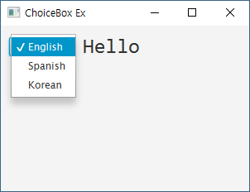
[예제 JFX-32] ChoiceBox 예제 (2)
“Main.java”의 일부(계속)
...
root.getChildren().addAll(cb, la);
Scene scene = new Scene(root, 300, 200);
primaryStage.setTitle("ChoiceBox Ex");
primaryStage.setScene(scene);
primaryStage.show();
}

Slide 29
ComboBox
생성 방법(예)
이벤트 처리
ComboBox<String> cb = new ComboBox<String>();
cb.getItems().addAll(
"English",
"Spanish",
"Korean"
);
cb.getSelectionModel().selectedIndexProperty()
.addListener(new ChangeListener<Number>() {
public void changed(ObservableValue<? extends Number> obv,
Number val, Number newVal) {
// 이벤트 처리 코드
}
});

Slide 30
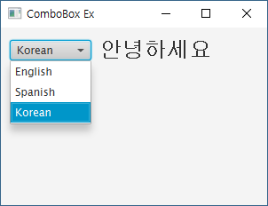
[예제 JFX-33] ComboBox 예제
“Main.java”의 일부
...
public void start(Stage primaryStage) {
FlowPane root = new FlowPane();
root.setPadding(new Insets(10)); root.setHgap(10);
Label la = new Label("Hello");
la.setStyle("-fx-font: 25 Consolas;");
String greetings[] = new String[]{"Hello", "Hola", "안녕하세요"};
ComboBox<String> cb = new ComboBox<String>();
cb.getItems().addAll("English", "Spanish", "Korean");
cb.getSelectionModel().selectedIndexProperty()
.addListener(new ChangeListener<Number>() {
public void changed(ObservableValue<? extends Number> obv,
Number val, Number newVal) {
la.setText(greetings[newVal.intValue()]);
}
});
cb.setValue("English");
cb.setTooltip(new Tooltip("Select language"));
root.getChildren().addAll(cb, la);
…

Slide 31
DatePicker
생성 방법(예)
선택된 날짜 읽기
DatePicker dp1 = new DatePicker(LocalDate.of(2020, 11, 26));
// 또는
DatePicker dp2 = new DatePicker();
dp2.setValue(LocalDate.now());
LocalDate value = dp1.getValue();
int year = value.getYear();
int month = value.getMonthValue();
int day = value.getDayOfMonth();

Slide 32
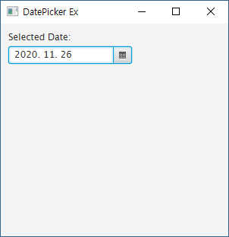
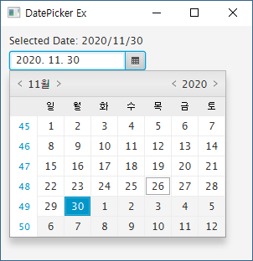
[예제 JFX-34] DatePicker 예제
“Main.java”의 일부
...
public void start(Stage primaryStage) {
VBox root = new VBox();
root.setPadding(new Insets(10)); root.setSpacing(5);
Label la = new Label("Selected Date: ");
DatePicker dPick = new DatePicker();
dPick.setValue(LocalDate.now());
dPick.setShowWeekNumbers(true);
dPick.setOnAction(event -> {
LocalDate value = dPick.getValue();
la.setText("Selected Date: " + value.getYear()
+ "/" + value.getMonthValue() + "/" + value.getDayOfMonth());
});
root.getChildren().addAll(la, dPick);
Scene scene = new Scene(root, 300, 280);
primaryStage.setScene(scene);
primaryStage.setTitle("DatePicker Ex");
primaryStage.show();
}
…

Slide 33
ColorPicker
생성 방법(예)
색상 얻기 및 변경
getValue(), setValue()
ColorPicker cp = new ColorPicker();
cp.setValue(Color.RED);
// 컨테이너의 배경
root.setStyle(“-fx-background-color: black”);
// 컴포넌트의 배경
circle.setFill(cp.getValue());

Slide 34
[예제 JFX-35] ColorPicker 예제 (1)
“Main.java”의 일부
...
public void start(Stage primaryStage) {
VBox root = new VBox();
root.setPadding(new Insets(10));
root.setSpacing(10);
root.setStyle("-fx-background-color: gray");
Circle cl = new Circle(50);
cl.setFill(Color.BLUE);
ColorPicker cPick1 = new ColorPicker();
cPick1.setValue(Color.BLACK);
cPick1.setOnAction(event -> {
root.setStyle("-fx-background-color: #"
+ cPick1.getValue().toString().substring(2));
});
…

Slide 35
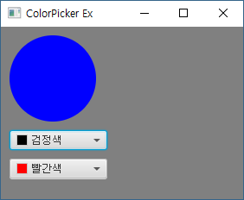
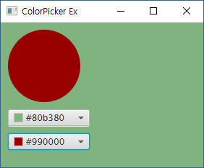
[예제 JFX-35] ColorPicker 예제 (2)
“Main.java”의 일부
...
ColorPicker cPick2 = new ColorPicker();
cPick2.setValue(Color.RED);
cPick2.setOnAction(event -> {
cl.setFill(cPick2.getValue());
});
root.getChildren().addAll(cl, cPick1, cPick2);
Scene scene = new Scene(root, 280, 200);
primaryStage.setScene(scene);
primaryStage.setTitle("ColorPicker Ex");
primaryStage.show();
}
…

Slide 36
Q & A

