Slide 1
Breast Cancer Prediction
Isaac Afedia
ITE 5201 Humber College

Slide 2
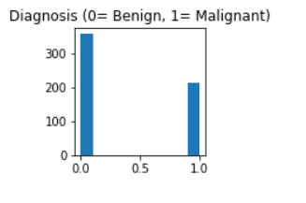
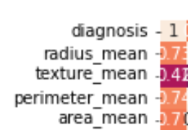
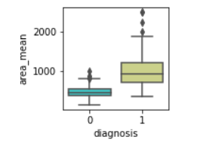
Problem Statement and Dataset Discussion
perimeter_worst
concavity_mean
Breast Cancer Prediction Using the physical attributes.
> The Cancer Prediction Dataset contains features computed from a digitized image of a fine needle aspirate of a breast mass. They describe the characteristics of the Cell Nuclei
> Dataset contains area mean, radius mean, perimeter mean, compactness mean, etc.
>And my Target is: Diagnosis

Slide 3
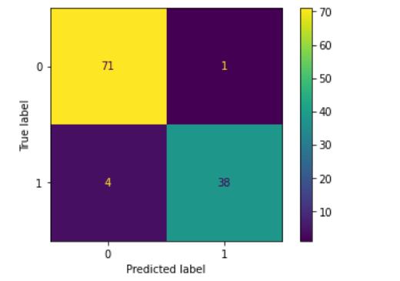
Proposed Logistic Regression and Perceptron Model
I used the Logistic regression and Perceptron Models for my prediction because my problem is classification problem and I need to predict whether a tumor with the specification is a benign(noncancerous) or Malignant(cancerous).

Slide 4
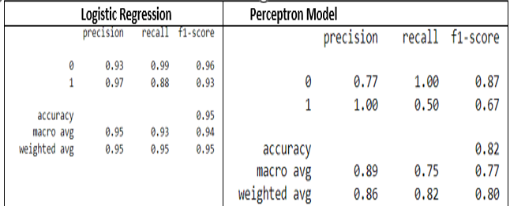
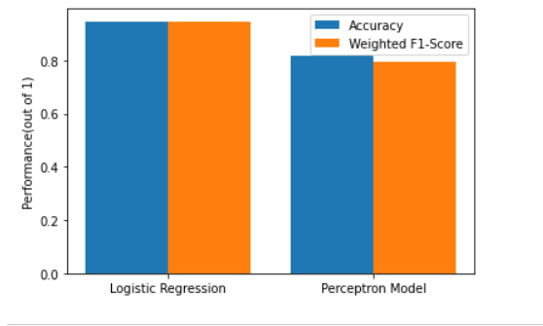
Results and Discussion
As seen in the plot, Logistic regression has a better performance than Perceptron model with respect to f1-score and Accuracy

