Slide 1

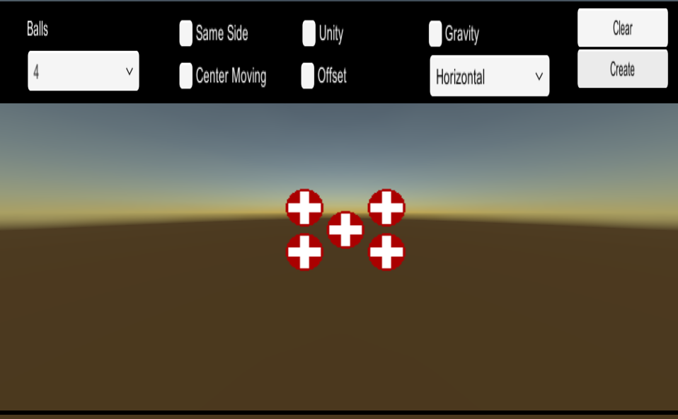
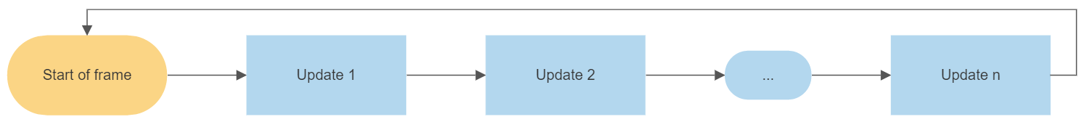
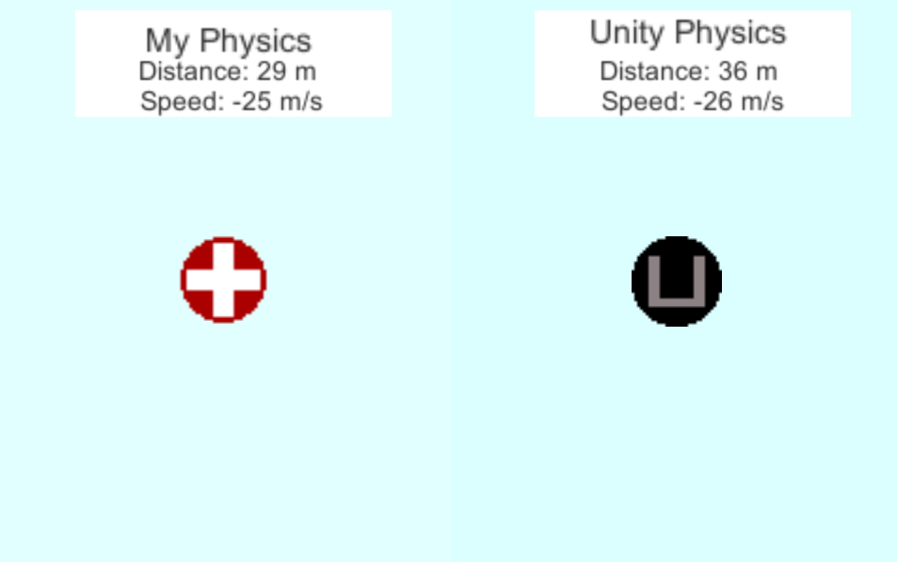
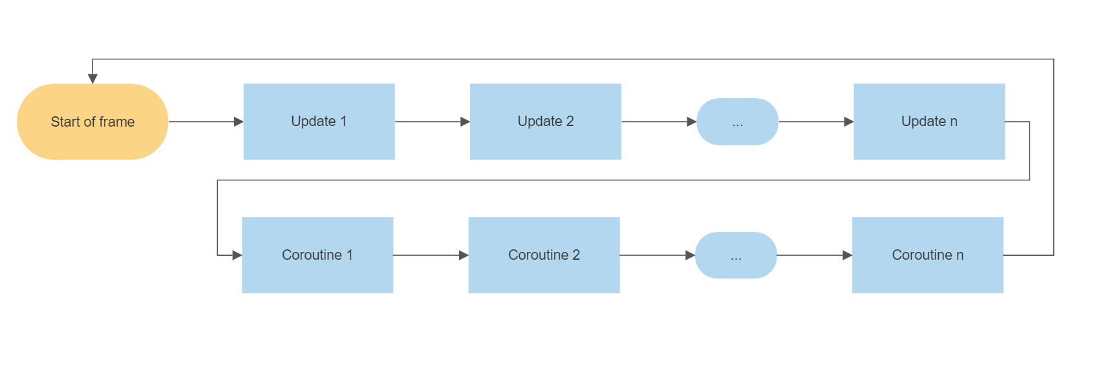
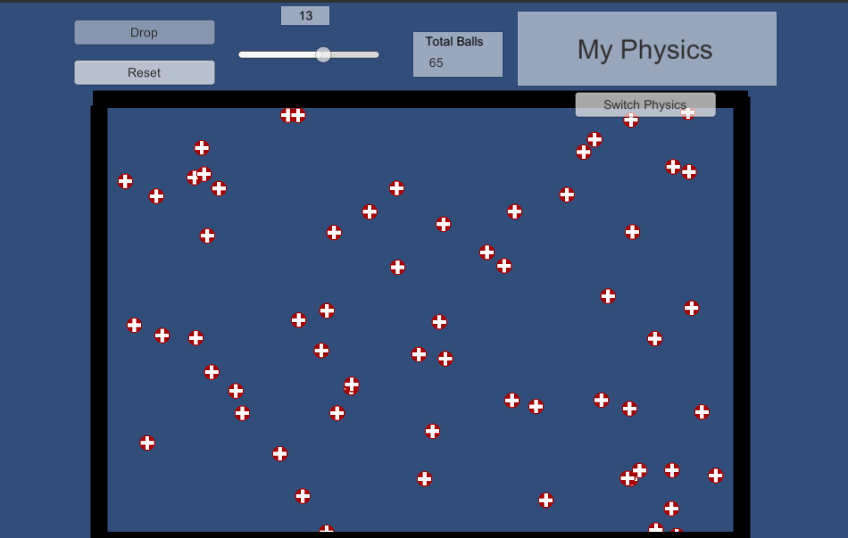
Replication of Unity’s Physics Engine
By: Isaac Brinkman Advisor: Dr. Choong-Soo Lee
Goal
Testing
Challenges
Create a replication of Unity’s physics engine in order to gain a better understanding for the underlying code hidden from the normal game developer. As well as customize the engine in order to make it easier to do certain processes.
The first environment I created was a simple 4 ball max elastic collision simulator. Users can enter different values that allow for changes in the environment and watch how Unity handles the collision versus how my physics engine handles the collision. My simulation is almost identical to Unity’s with no significant drop in frame rate.
The second environment was a gravity tester. Two balls drop one using Unity’s engine one using my engine. Distinction in distance can be seen with a darkening color. Although they don’t line up perfectly my algorithm utilizes gravity constant and terminal velocity to create a realistic fall.
The final environment I set up was to allow as many objects as the user wants in order to maximize the amount of collisions that could be set up until the frame rate dropped to essentially 0. At around 1000 balls Unity would start to drop frames and inaccurately calculate collisions. My engine was able to get to around 50 before doing the same.
The main challenge was understanding and manipulating Unity’s update system in order to ensure objects collide appropriately. Normally Unity’s update runs linearly.
The issue with this is that if Object 1 collides with Object 2, Object 1 computes its velocity based on Objects 2 velocity and then updates its velocity. When Object 2’s update is called it is now calculating it’s new velocity on Object 1’s already updated velocity. Hence, Object 2’s new velocity is wrong.
To fix this problem I utilized Unity’s built in Coroutine function. This allows for calculations to be made in the Update function and using the Coroutine waiting until all updates are called to update the velocities.
Introduction
Unity’s physics engine allows for thousands of objects to be handled in a single frame (less than a second). This handling involves adding forces (friction, gravity, etc.), collision computations, and other calculations. In my research I didn’t expect to be able to handle so many objects, but rather I set out to have a better understanding of the processes behind Unity’s physics that are often ignored.
Differences
Unity:
Bounciness and friction factors
Collisions between complex shapes
Rotation in collision
My Physics:
Set Bounciness of 1 and friction of 0
Collision between squares and circles
No Rotation on collision
Realtime video:
Future Development
References
While there are almost limitless possibilities to add next some of the simpler developments, I plan on making include:
Implementing a closest pair of points algorithm in order to maximize effieciency
Friction and bounciness variables
Rotation on collision
Design
The design of my physics engine was like that of Unity’s. Each object has both a rigid body and a collision script attached. The rigid body script handles the physics operations such as velocity and gravity, where the collision script handles collisions. The idea behind the scripts was to have each object knowing how to react to what is happening to it rather than having one observer that handles all the collisions itself. This was to best simulate real-world physics.
Unity Download: https://unity3d.com/get-unity/download
Gravity: https://gamedev.stackexchange.com/questions/15708/how-can-i-implement-gravity/41917#41917
Collisions: https://opentextbc.ca/physicstestbook2/chapter/collisions-of-point-masses-in-two-dimensions/
Project download: https://github.com/isaacBrinkman/PhysicsEngine

