Slide 1

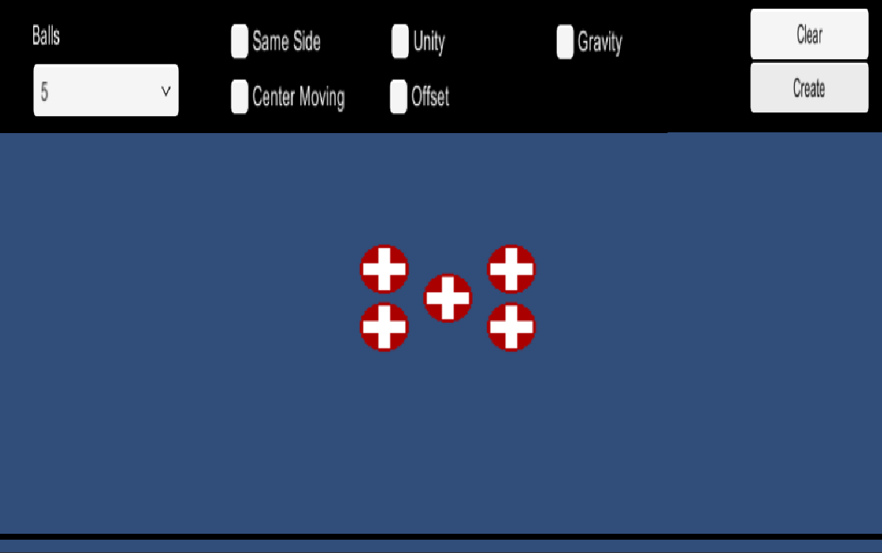
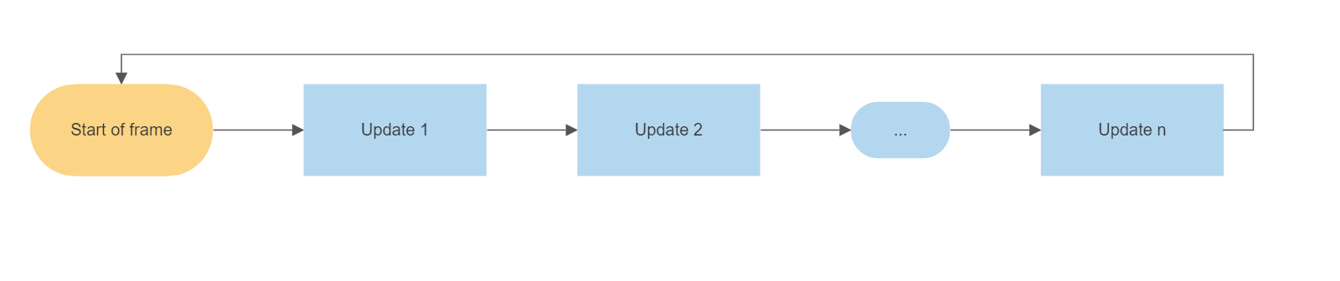
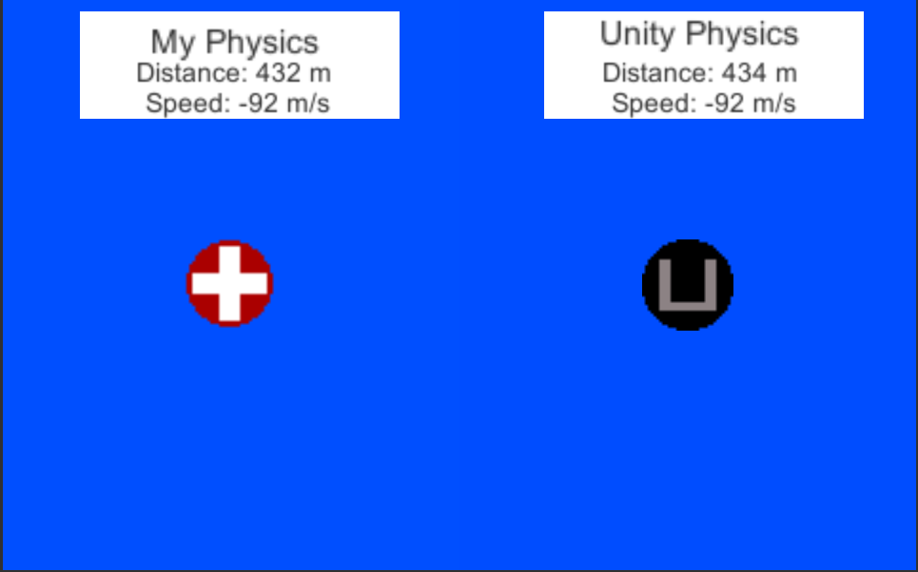
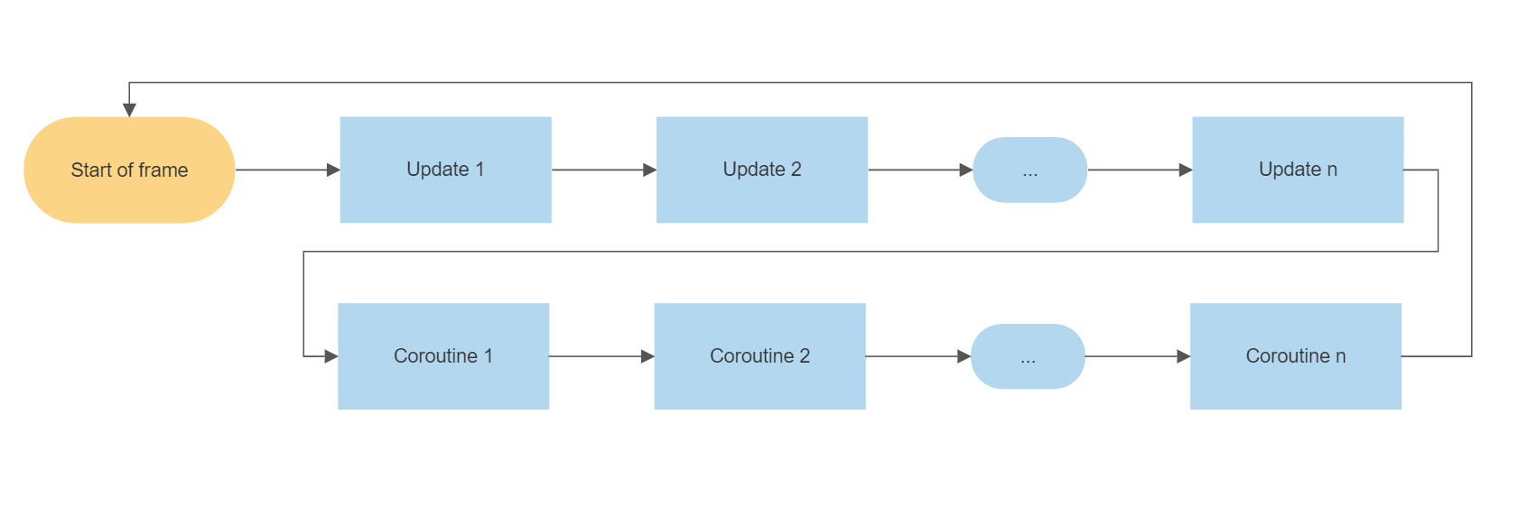
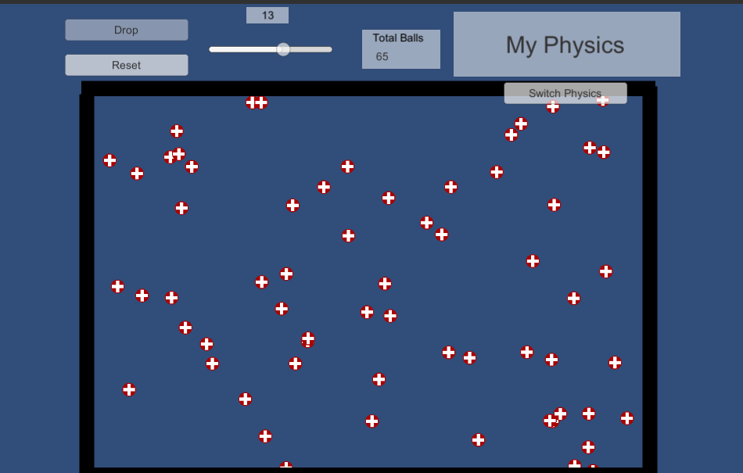

Replication of Unity’s Physics Engine
By: Isaac Brinkman Advisor: Dr. Choong-Soo Lee
Goal
Testing
Challenges
Create a replication of Unity’s physics engine in order to gain a better understanding for the underlying code hidden from the normal game developer. As well as customize the engine in order to make it easier to do certain processes.
The first environment I created was a simple 5 ball max collision simulator. Users can enter different values that allow for changes in the environment and watch how Unity handles the collision versus how my physics engine handles the collision. My simulation is almost identical to Unity’s with no significant drop in frame rate.
The second environment was a gravity simulation. Two balls drop one using Unity’s engine one using my engine. Distinction in distance can be seen with a darkening blue color. By using the gravity constant 9.87m/s and a built-in variable Time.deltaTime to account for changes in frame rate the two balls fall in near perfect sync.
The final environment I set up was to allow as many objects as the user wants in order to maximize the amount of collisions until the frame rate dropped to essentially 0. Unity would start to drop frames and inaccurately calculate collisions at around 1000 objects. My engine was able to get to around 50 before doing the same.
The main challenge was understanding and manipulating Unity’s update system in order to ensure objects collide appropriately. Normally Unity’s update runs linearly.
The issue with this is that if Object 1 collides with Object 2, Object 1 computes its velocity based on Objects 2 velocity and then updates its velocity. When Object 2’s update is called it is now calculating it’s new velocity on Object 1’s already updated velocity. Hence, Object 2’s new velocity is wrong.
To fix this problem I utilized Unity’s built in Coroutine function. This allows for calculations to be made in the Update function and then waiting until all until all computations to be made to change values, resulting in correct collisions.
Before the Coroutines two objects would likely get stuck inside one another, but by using the Coroutine this problem no longer happens.
Introduction
Unity’s physics engine allows for thousands of objects to be handled in a single frame (less than a second). This handling involves adding forces (friction, gravity, etc.), collision computations, and other calculations. Many of these processes happen without the developer knowing what exactly is going on and the effects it will have on the game they are creating. In recreating this, I gained insight in how the Unity Engine handles complex physics operations.
Differences
Unity:
Bounciness and friction factors
Collisions between complex shapes
Rotation on collision
My Physics:
Set Bounciness of 1 and friction of 0
Collision between squares and circles
No Rotation on collision
Realtime video:
Future Development
References
While there are almost limitless possibilities to add next, some of the simpler developments I plan on making include:
Implementing a closest pair of points algorithm in order to maximize efficiency
Friction and bounciness variables
Rotation on collision
Design
Unity Download: https://unity3d.com/get-unity/download
Gravity: https://gamedev.stackexchange.com/questions/15708/how-can-i-implement-gravity/41917#41917
Collisions: https://opentextbc.ca/physicstestbook2/chapter/collisions-of-point-masses-in-two-dimensions/
Project download: https://github.com/isaacBrinkman/PhysicsEngine
The design of my physics engine was like that of Unity’s. Each object has both a rigid body and a collision script attached. The rigid body script handles the physics operations such as velocity and gravity, where the collision script handles collisions. Each component factors in it’s own velocity, mass, and position as well as that of which it is interacting with to computes it’s own values for the next frame.

