Slide 1

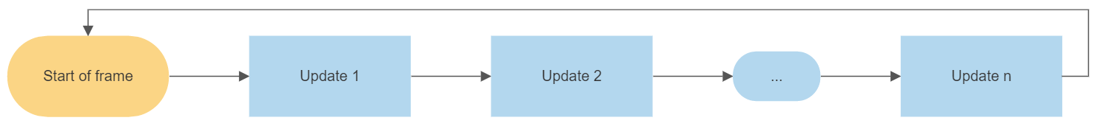
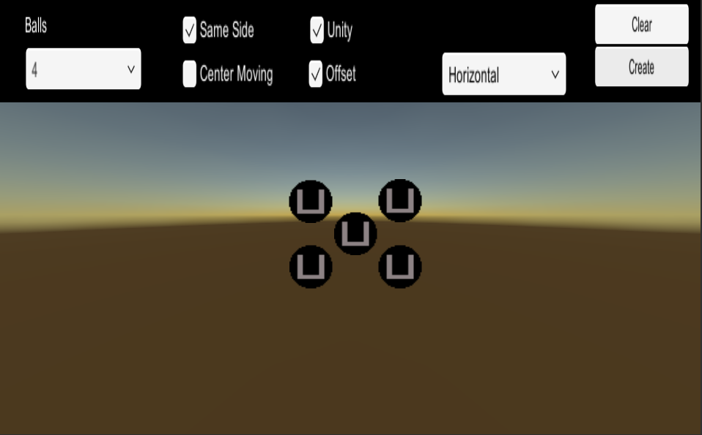
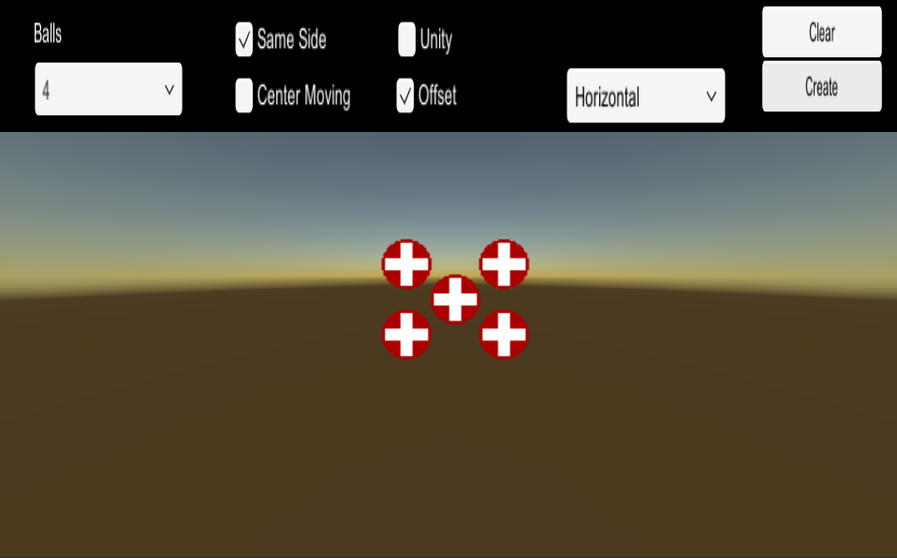
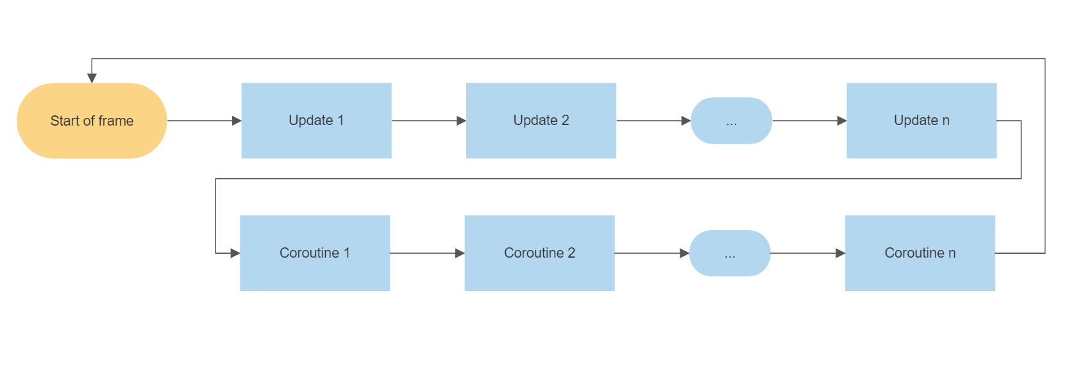
Replication of Unity’s Physics Engine
By: Isaac Brinkman Advisor: Dr. Choong-Soo Lee
Goal
Testing
Challenges
Create a replication of Unity’s physics engine in order to gain a better understanding for the underlying code hidden from the normal game developer. As well as customize the engine in order to make it easier to do certain processes.
The first environment I created was a simple 4 ball max elastic collision simulator. Users can enter different values that allow for changes in the environment and watch how Unity handles the collision versus how my physics engine handles the collision. My simulation is almost identical to Unity’s with no significant drop in frame rate.
The main challenge was understanding and manipulating Unity’s update system. Normally Unity’s update runs linearly.
For my physics engine this wouldn’t work. I needed a way to update objects after update had been called. This was accomplished using coroutines.
Introduction
Unity’s physics engine allows for thousands of objects to be handled in a single frame (less than a second). This handling involves adding forces (friction, gravity, etc.), collision computations, and other calculations. In my research I didn’t expect to be able to handle so many objects, but rather I set out to have a better understanding of the processes behind Unity’s physics that are often ignored
Realtime video:
Differences
Future Development
References
Unity:
Bounciness and friction factors
Collisions between complex shapes
Rotation in collision
My Physics:
Set Bounciness of 1 and friction of 0
Collision between squares and circles
No Rotation on collision
Unity Download: https://unity3d.com/get-unity/download
Gravity: https://gamedev.stackexchange.com/questions/15708/how-can-i-implement-gravity/41917#41917
Collisions: https://opentextbc.ca/physicstestbook2/chapter/collisions-of-point-masses-in-two-dimensions/
For project download: https://github.com/isaacBrinkman/PhysicsEngine
While there are almost limitless possibilities to add next some of the simpler developments I plan on making include:
Implementing a closest pair of points algorithm in order to maximize frame rate
A simulation testing how many objects can be placed before frame rate drops to zero
Rotation on collision

