Slide 1

Trend in global life expectancy over a decade taking socioeconomic and political factors into play
Isaac Adebayo, Charnisha Azubuike, and
Michella Maddox-McGhee
Wednesday, April 22, 2026

Slide 2

Project Introduction
This project examines global life expectancy trends (2001–2019) using World Bank data
Focuses on how socioeconomic, environmental, and political factors shape health outcomes
Analyzes variables such as:
Healthcare and education spending
Unemployment and income group
Environmental indicators (CO₂)
Governance factors (e.g., corruption)
The goal is to understand how non-medical factors influence population health and longevity.

Slide 3
Project Goals
Analyze changes in life expectancy across countries before COVID-19
Examine the relationship between life expectancy and key socioeconomic factors
Identify which factors have the strongest influence on longevity
Big Picture Goal:
Provide insights that can inform:
Public health strategies
Policy decisions on resource allocation
Broader understanding of health inequities

Slide 4
Dataset
Overview
Source: Kaggle (World Bank)
Time Frame: 2001–2019
Observations: 3,307
Variables: 16
Key Variables:
Life Expectancy
Undernourishment
CO₂ Emissions
Health & Education Spending
Unemployment, Corruption
Sanitation & Disease Categories
Data Quality & Limitations
Countries: 174
Regions / Income Groups: 7 each
Missing Data (Key Issues):
Corruption (High missing ⚠️)
Education (High missing ⚠️)
Sanitation (Moderate missing)
No Missing Data:
Injuries
Communicable
Non-Communicable

Slide 5
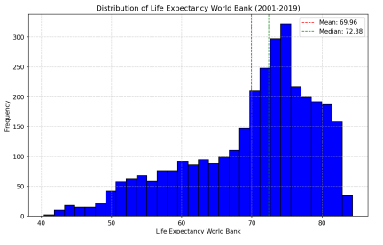
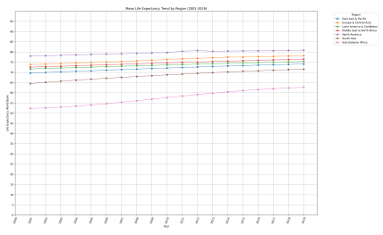
Exploratory analysis of data
Life Expectancy: World Bank
Mean Life Expectancy Trend by Region

Slide 6
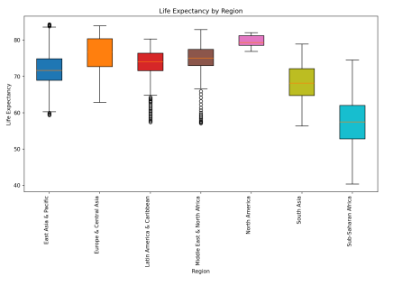
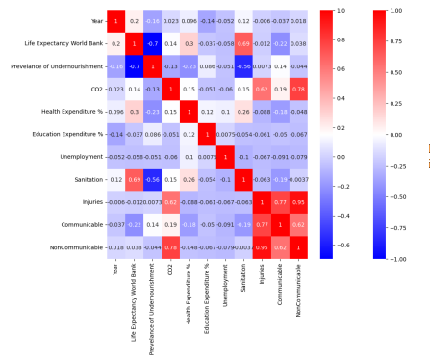
Exploratory analysis of data
Life Expectancy By Region
Correlation matrix of colums contributing to global life expectancy

Slide 7
Visualization Techniques Used
Exploratory Data Analysis (EDA)
Choropleth Map (geospatial)
Histogram (distribution analysis)
Line Graph (time series analysis)
Multiple Line Graph (multivariate time series comparison)
Scatter Plot (bivariate relationship analysis)
Bar Graph (categorical comparison)
Log-Scaled Bar Graph (scaled comparitive analysis)
Box Plot (distribution summary; median, IQR, outliers)
Correlation Matrix/Correlogram (multivariate relationship analysis)
Pie Chart (proportional distribution)

Slide 8
Visualization Techniques Used cont’d
Model Evaluations
Histogram (train-test-split evaluation)
Training vs. Validation Loss Curve (model performance over epochs)
True vs. Predicted Scatterplot (regression performance evaluation)

Slide 9
Visualization Techniques Used cont’d
Model Interpretability
SHAP Summary Plot (global feature importance distribution)
SHAP Waterfall Plot (local feature contribution breakdown)
SHAP Decision Plot (cumulative feature contribution path)

Slide 10
Conclusion & Key Takeaways
Global life expectancy has improved over time, but significant disparities still exist across regions
Undernourishment and sanitation are the strongest drivers of longevity, highlighting the importance of basic living conditions over advanced interventions
Predictive modeling showed that geographic region (especially Sub-Saharan Africa) plays a major role in life expectancy outcomes, reflecting structural inequalities
More injuries and disease burden are strongly associated with higher mortality rates, reinforcing the need for prevention-focused strategies
Policy Implication: Countries should allocate resources based on their most impactful factors (e.g., nutrition, sanitation, disease control) rather than uniform spending
Limitations: Missing data and underrepresentation of certain countries may affect accuracy
Future Direction: Expand analysis to include within-country disparities (ethnicity, culture, socioeconomic groups) for more precise insights

Slide 11
References
Google. (2026). Code Debugging for EDA and Visualization and hyperparameter explanation. Gemini 2.5 Flash.
Life Expectancy and Socio-Economic (World Bank dataset). (Accessed January 2026). Kaggle dataset.
World Bank Group. (2026). “Life expectancy at birth, total (years)” dataset. World Bank Open Data.

Slide 12
Q & A
Thank you.

