Slide 1
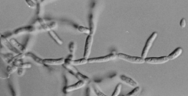
SBC.07107 - Bioinformatics
Group-F presentation
Isaac Ambrogetti/ Augustin Beaud/ Morgane Gull / Tom Lüthi

Slide 2
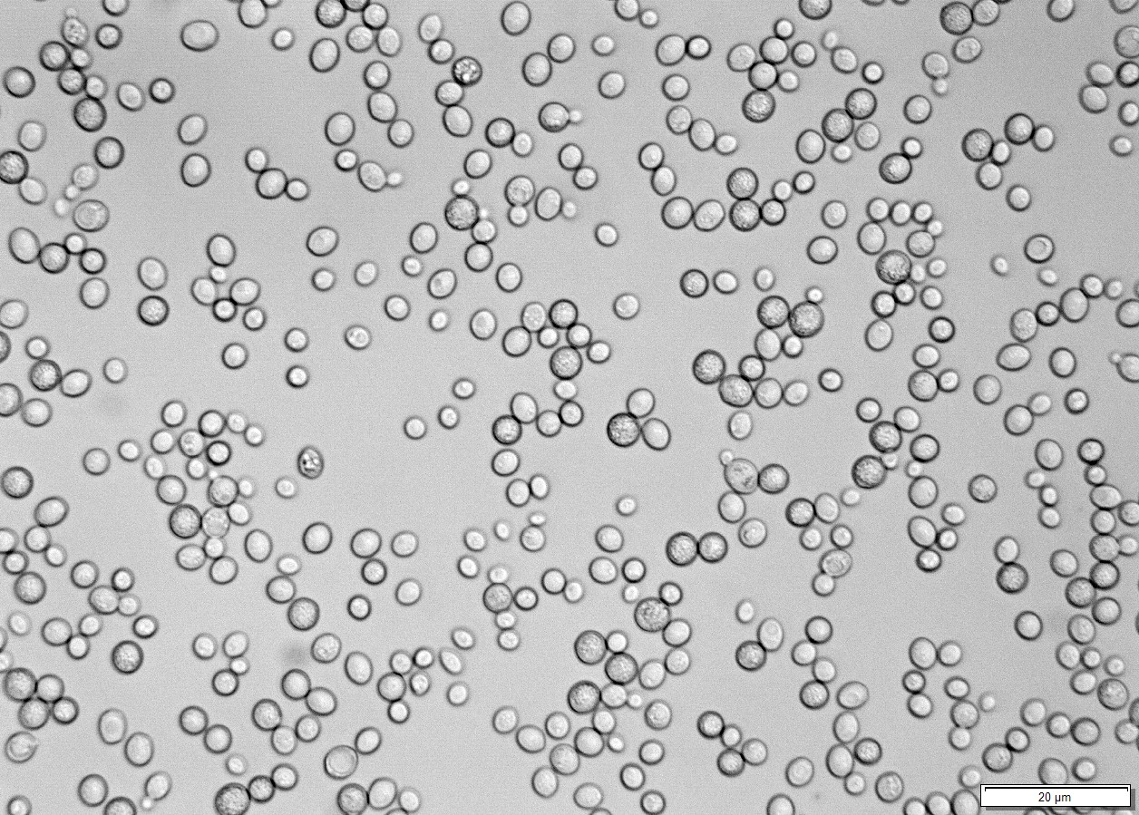
Yeast Mutants
Introduction
Saccharomyces cerevisiae – switches from unicellular to filamentous growth phenotype under specific environmental and genetic conditions
phenotype transition regulated by Mitogen-Activated Protein Kinase (MAPK) pathway – filamentous (fMAPK) pathway
WT strain carries a ste4 mutation (∑1278b/ste4∆) disrupting fMAPK pathway
4 strains (B4c3, F24c1, J44c1, M56c2) selected (SD-HIS + 10 mM 3-ATA) – restore fMAPK pathway
Strain | Position of Mutation | Type of Mutation | Alteration | Affected Gene
B4c3 | VII: 1067506 | frameshift (HIGH) | TCC → AXC | IMA1
B4c4 | VII: 576228 | stop gained (HIGH) | TGG → TGA | KSS1
B4c5 | XII: 1003220 | missense (MODERATE) | GTT → CTT | IMD3
B4c6 | XV: 172670 | missense (MODERATE) | ACC → AAC | IRA2
F24c1 | VIII: 275671 | stop_gained (HIGH) | TCT → TTT | STE12
J44c1 | IV: 527747 | missense (MODERATE) | ACT → ATT | ENA5
J44c2 | XII: 851652 | missense (MODERATE) | ACT → ATT | STE11
M56c1 | VII: 481460 | missense (MODERATE) | GTC → GTG | PMA1
M56c2 | VI: 124983 | stop_gained (HIGH) | TCA → TAA | BLM10
FUS1-LacZ expressionlevel = Hyperactivity of fMAPK pathway
High | Medium | Low
Notes:
- Saccharomyces cerevisiae – switches from unicellular to filamentous growth phenotype under specific environmental and genetic conditions
phenotype transition regulated by Mitogen-Activated Protein Kinase (MAPK) pathway – filamentous (fMAPK) pathway
WT strain carries a ste4 mutation (∑1278b/ste4∆) disrupting fMAPK pathway
- STE4 : encodes the β subunit of the heterotrimeric G-protein (Gβ) that functions together with STE18 (Gγ) and GPA1 (Gα). In yeast, these proteins sit downstream of a G-protein–coupled receptor (GPCR) that senses environmental or mating signals.
In the fMAPK (filamentous growth) pathway:
When a cell senses nutrient limitation or other stimuli, the receptor activates GPA1 (Gα) to release the Gβγ dimer (STE4–STE18).
STE4–STE18 then activates the MAPK cascade by:
Recruiting STE20 (a p21-activated kinase),
Which activates STE11 (MAPKKK),
Which phosphorylates STE7 (MAPKK),
Which activates KSS1 (MAPK),
Which then activates the transcription factor STE12, leading to filamentous gene expression (including FUS1, FLO11, etc.).
🧬 2. Meaning of FUS1-LacZ expression level = hyperactivity of fMAPK pathway
FUS1 is a gene normally turned on during mating and filamentous growth in yeast.
It is under control of the Ste12 transcription factor, which is activated by the fMAPK signaling cascade.
Therefore:
The FUS1-LacZ fusion acts as a reporter for fMAPK activity.
When fMAPK is active → FUS1 promoter turns on → LacZ (β-galactosidase) is produced → Measured as high expression.
When fMAPK is inactive → low or no FUS1-LacZ expression.
So in this experiment:
High FUS1-LacZ expression = Hyperactivation of the fMAPK pathway, meaning the pathway is overactive (e.g., due to a mutation that removes inhibition or mimics activation).
Low FUS1-LacZ expression = Inactivation of the pathway, as in ste4Δ mutants.
🧩 In context of your suppressor project:
The ste4Δ strain has an inactive fMAPK pathway → no FUS1-LacZ expression.
Suppressor mutants may restore FUS1-LacZ activity, showing that other mutations reactivated or bypassed the pathway.
Measuring FUS1-LacZ expression or growth on SD-HIS + 3-ATA provides a phenotypic readout for fMAPK pathway activity.

Slide 3
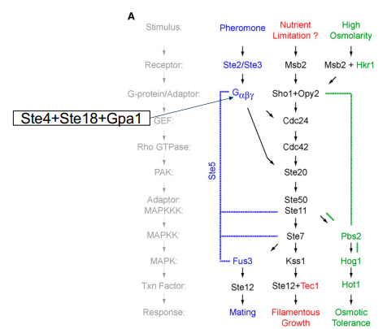
Suppressor mutation of fMAPK pathway
MAPK pathway :
Candidates:
STE11: Serine/threonine protein kinase required for cell-type-specific transcription and signal transduction in yeast. It is thought that it phosphorylates the STE7 protein kinase which itself, phosphorylates the FUS3 and or KSS1 kinases
KSS1: MAP kinase that regulates yeast mating and filamentation by phosphorylating downstream targets and controlling the transcription factor Ste12
STE12: Transcription factor that is activated by a MAPK signaling cascade; activates genes involved in mating or pseudohyphal/invasive growth pathways; cooperates with Tec1p transcription factor to regulate genes specific for invasive growth..
Notes:
Can mutations in STE12, STE11, or KSS1 restore the ste4Δ phenotype?
Yes — potentially, but only activating (gain-of-function) mutations could do this.
Here’s how each could act as a suppressor of ste4Δ:
STE11 (MAPKKK)
Gain-of-function mutation that makes STE11 active without upstream STE20 or STE4 signaling.
Constitutively activates the MAPK cascade (STE7 → KSS1 → STE12), even in absence of STE4.
KSS1 (MAPK)
Mutation that keeps KSS1 in a phosphorylated or active-like state
Directly activates transcription factors (like STE12) controlling filamentous genes.
STE12 (transcription factor)
Mutation that relieves repression (e.g., reduced Dig1/Dig2 inhibition) or increases activity.
Increases expression of filamentation genes (FUS1, FLO11) even without MAPK signaling.

