Slide 1
The structure and function of the global citrus rhizosphere microbiome
Ambrogetti Isaac | Metagenomics 2023

Slide 2
Why studying Citrus rhizosphere?
Citrus originated in southeast Asia
Citrus production covers 9 million hectares producing 143 million tons in 2019*, the largest fruit crop
Environmental and disease pressures
Harnessing plant microbiome for sustainable agriculture International Citrus Microbiome Consortium (2015)
* FAO report: ‘Citrus fruit fresh and processed statistical bulletin 2020’

Slide 3
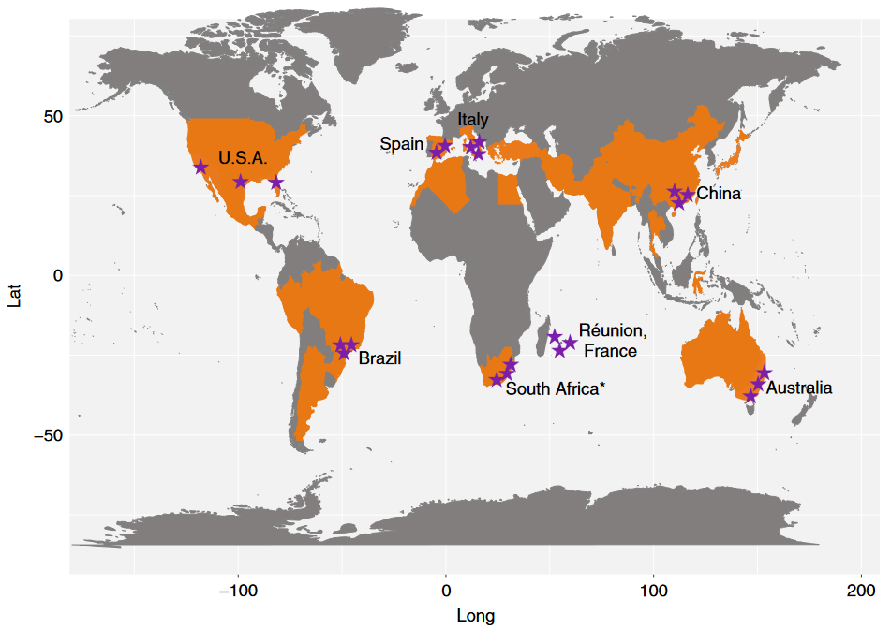
Sampling
6 continents, 8 countries, 23 locations
7 different soil types
6 climate types
5.2 ≤ pH ≤ 8.8
Variable C, N, P composition
12 different citrus varieties
Bulk soil and rhizosphere samples for each location
20 bulk soil samples
23 rhizosphere samples

Slide 4
Sequencing methods
Amplicon sequencing:
16S rDNA ~ 21.9 and 22.8 thousand high-quality reads
ITS2 ~ 21.5 and 22.6 thousand high-quality reads
Shotgun metagenomic sequencing
231 mln pair-end reads (150 bp)
Citrus host reads removal
De novo assembly
Pair-end reads merged using FLASH software
OTU obtained using UPARSE pipeline
Deletion of useless OTUs and merged sequences

Slide 5
Sequencing methods
48.3% of the reads used of metagenomic contig construction
230 mln metagenes predicted
Clustered into 183 mln non-redundant genes (unigenes)
40% of unigenes got taxonomic annotation
99% prokaryotes

Slide 6
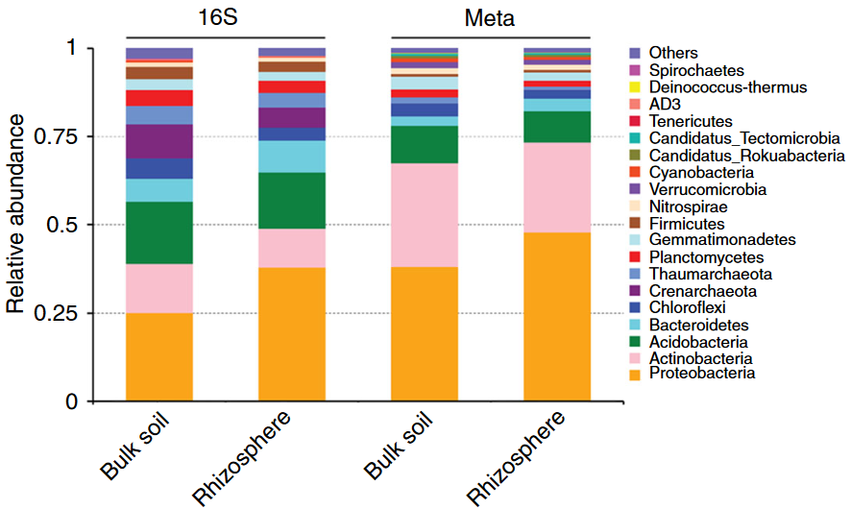
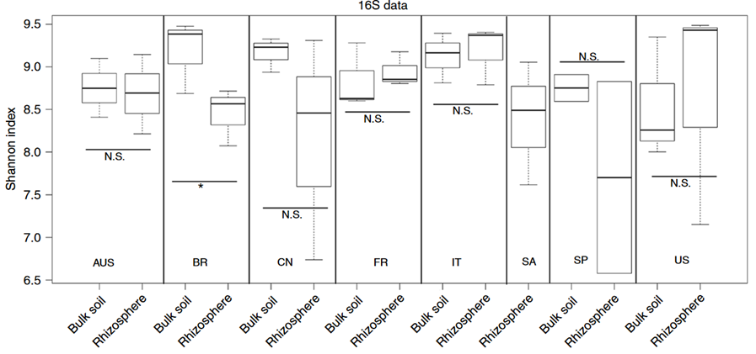
Taxonomic distribution and diversity comparisons in citrus rhizosphere and bulk soil microbiomes
Alpha-diversity was calculated for each sample using the Shannon index based on the normalized OTU abundance table using the rarefied method.
Alpha-diversity comparison between the bulk soil and rhizosphere samples from each location based on the Shannon index using the 16S data; N.S. no significant, *P-value < 0.05. One-sided t-test; center value represents the median of Shannon index.
Phyla-level distributions in the bulk soil and rhizosphere samples based on 16S amplicon and metagenomic data.

Slide 7
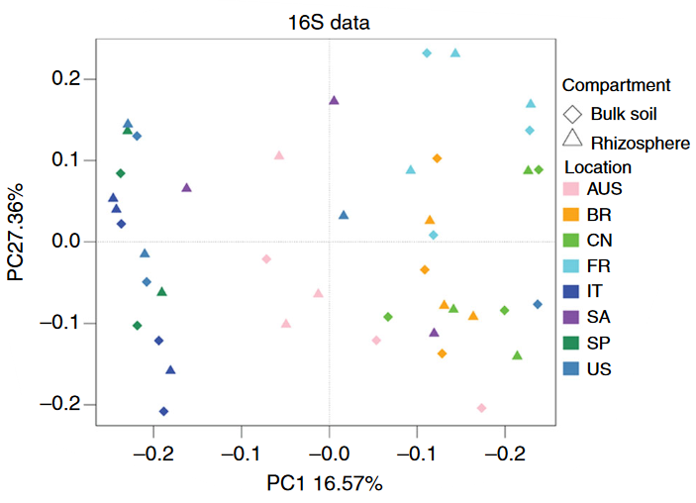
Taxonomic distribution and diversity comparisons in citrus rhizosphere and bulk soil microbiomes
PCoA based on the unweighted UniFrac distance between the bulk soil and rhizosphere for each location using the 16S data.
Notes:
Did the same two graphs for ITS2 but they left them behind in further analysis, so I decided not to bring them up.

Slide 8
Comparing relative abundances
At Phylum level
Amplicon-based sequencing
Enriched
Proteobacteria
Bacteroidetes
Depleted
Euryarchaeota
Crenarchaeota
Metagenomic sequencing
Enriched
Proteobacteria
Depleted
Thaumarchaeota
No fungal phyla exhibited any significant difference at phylum level

Slide 9
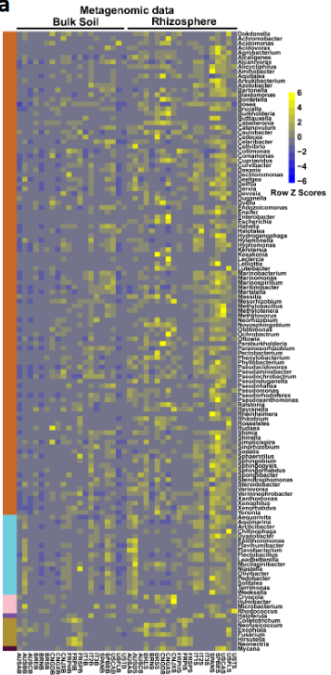
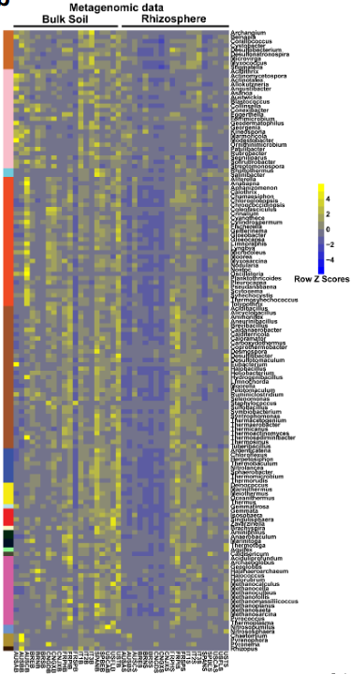

Comparing relative abundances
b
At Genus level
a
The relative abundance of rhizosphere-enriched genera.
b
The relative abundance of rhizosphere-depleted genera.

Slide 10
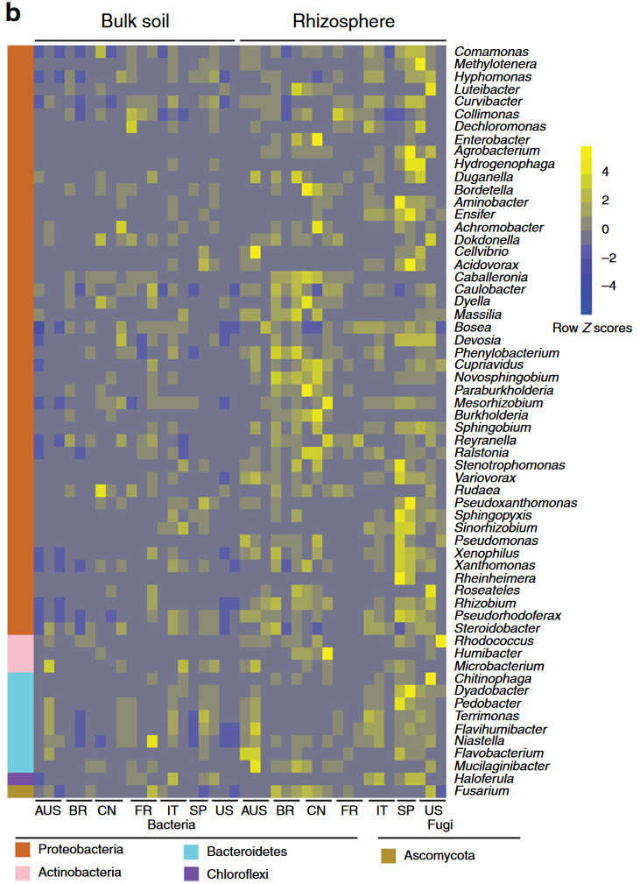
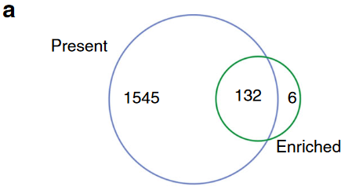
Characterization of the core citrus rhizosphere microbes
Defining rhizosphere’s core taxa:
Genera enriched
Present in more than 75% of the samples
Relative abundances of the 60 most relatively abundant core rhizosphere genera across locations and compartments based on metagenomic data.

Slide 11
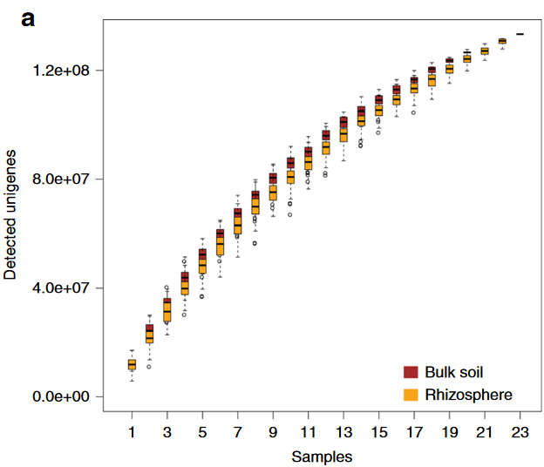
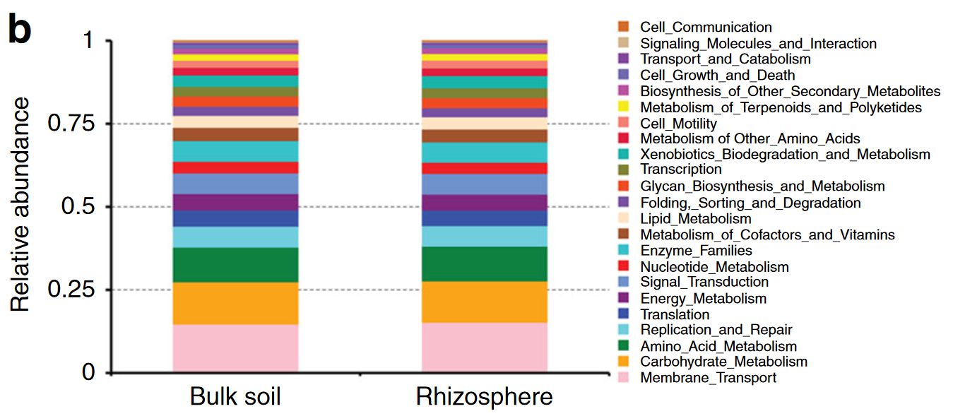
Characterization of the core function of the citrus rhizosphere microbiome
Rarefaction Analysis
Blasting unigenes sets against KEGG Orthology (KO) database

Slide 12
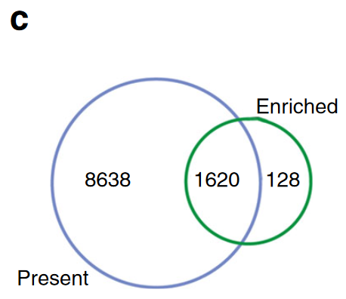
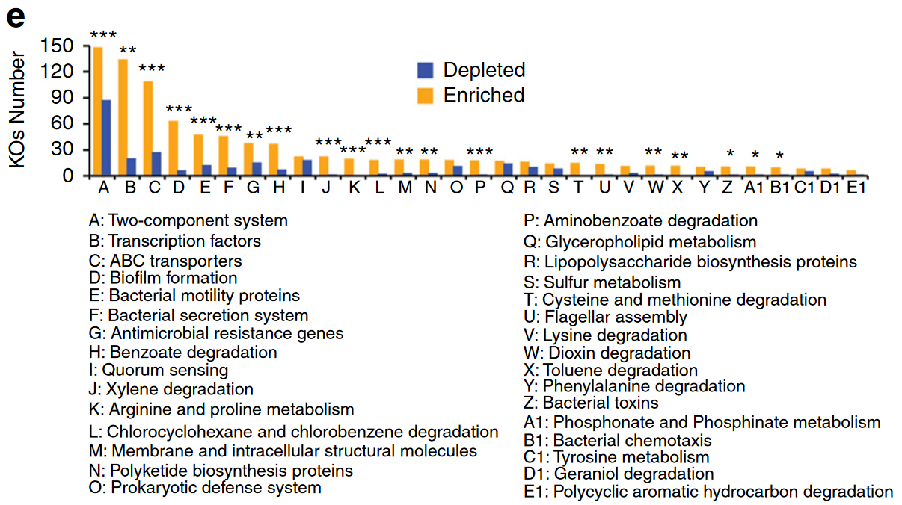
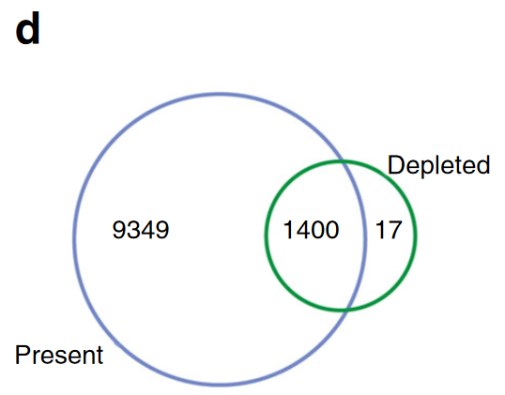
Characterization of the core function of the citrus rhizosphere microbiome
Distributions of the rhizosphere core KOs in the KEGG level 2 pathways. *corrected P-value < 0.05; **corrected P-value < 0.01; ***corrected P-value < 0.001

Slide 13
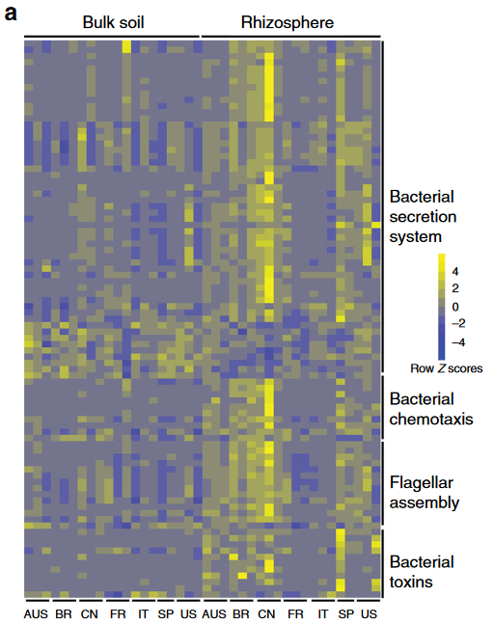
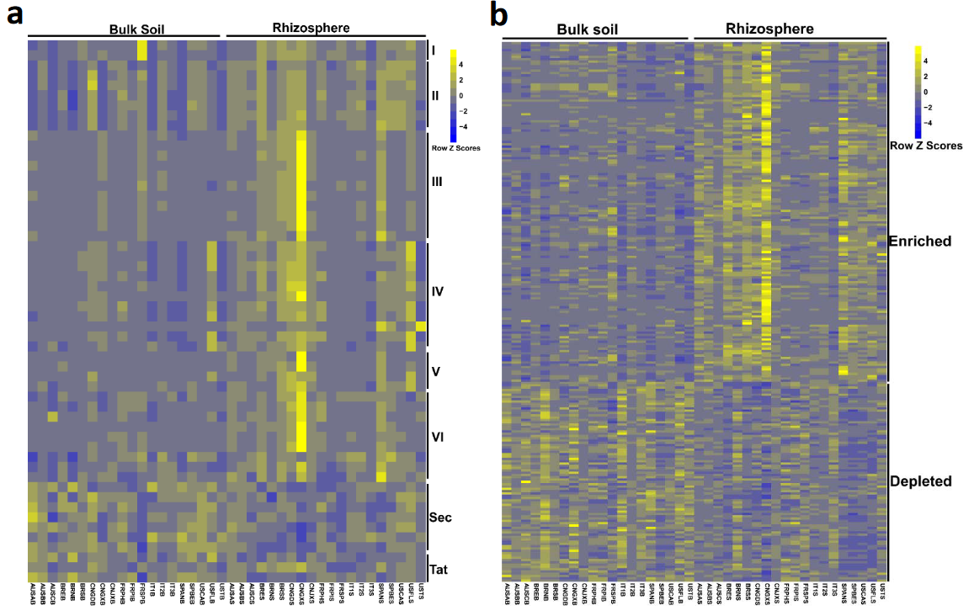
Characterization of the core function of the citrus rhizosphere microbiome
The relative abundance of core and universally depleted KOs for rhizosphere microbiome involved in bacterial secretion system, including type I, II, III, IV, V, VI, Sec and Tat (a) and two component system (b)
Relative abundances of core rhizosphere KOs involved in
microbe–host interaction-related pathways across locations and compartments
Notes:
!! ADD MORE SCRIPT FROM PAPER !!

Slide 14
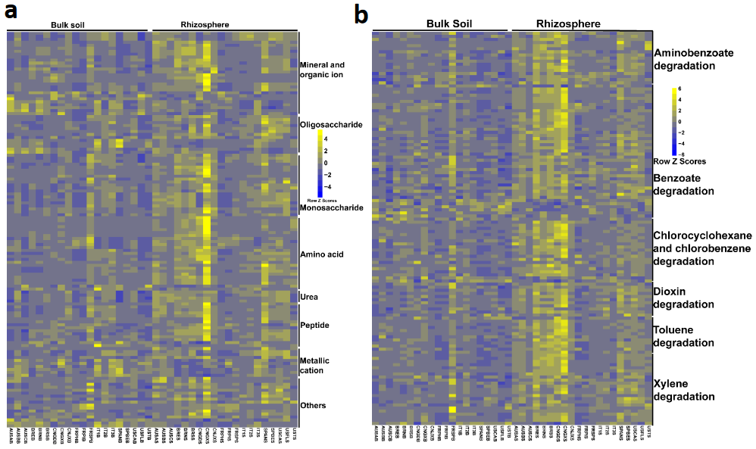
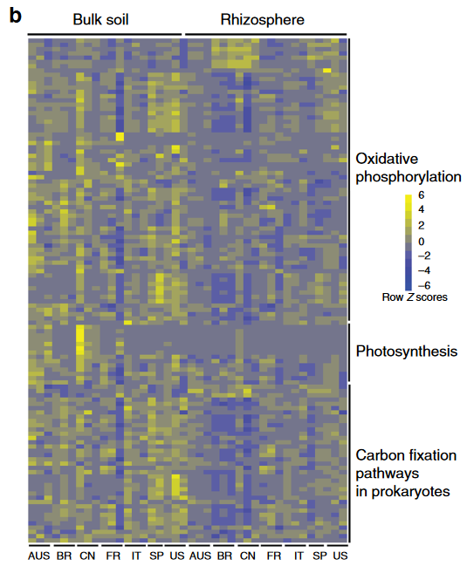
Characterization of the core function of the citrus rhizosphere microbiome
The relative abundance of core and universally depleted KOs for rhizosphere microbiome involved in ABC transporters (a) and xenobiotics biodegradation and metabolism (b).
Relative abundances of universal rhizosphere-depleted KOs involved in energy metabolism across locations and compartments.

Slide 15
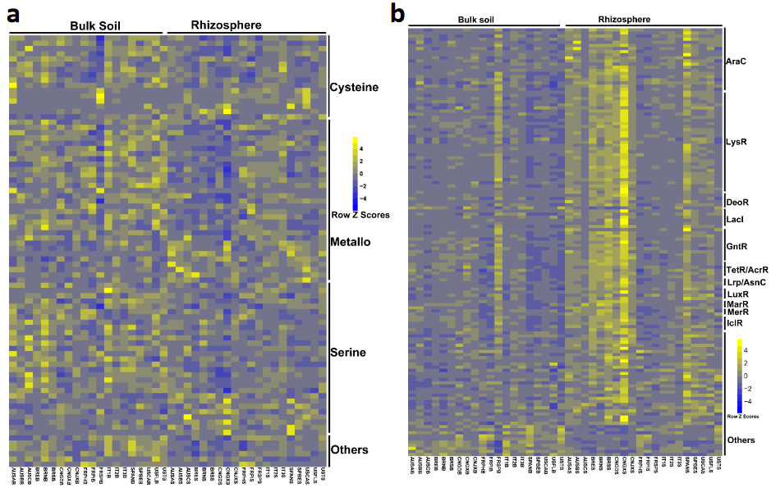
Characterization of the core function of the citrus rhizosphere microbiome
The relative abundance of core and universally depleted KOs for rhizosphere microbiome involved in peptidases (a) and transcription factors (b)

Slide 16
Conclusions
Few bacterial taxa predominate in any given soil
Proteobacteria (Enriched)
Actinobacteria
Acidobacteria
Bacteroidetes (Enriched)
Host-driven microbiome selection
Citrus rhizosphere components under field conditions were similar
Plant factors driving community assembly may be common between plant species
Coevolution of host-microbe and microbe-microbe interactions can be logically linked to the conditions present in the rhizosphere
Prevention of pathogenic infection in plants due to plant’s beneficial microbes

Slide 17
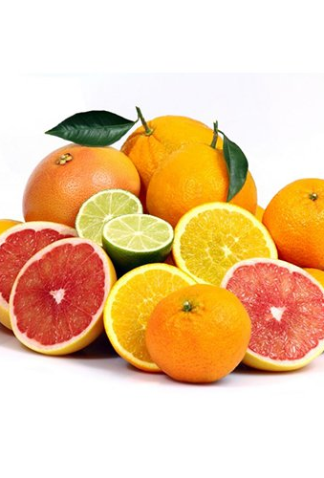
Hopefully, a better understanding of interactions between plants and microbiome will be enable the utilization of such microbes to improve citrus health and productivity

