Slide 1

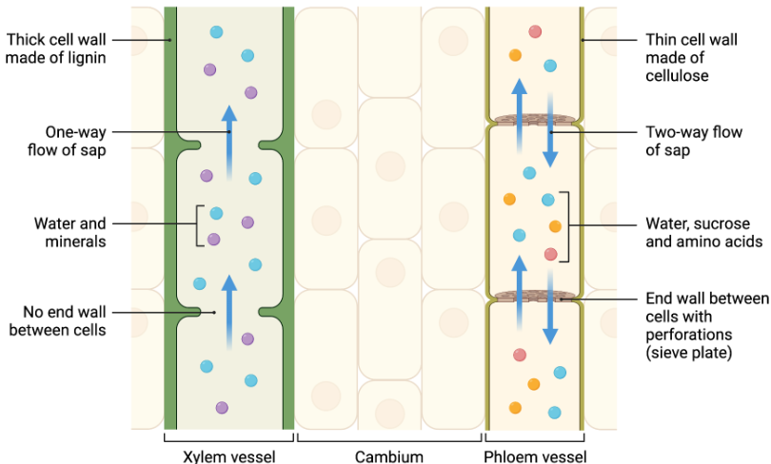
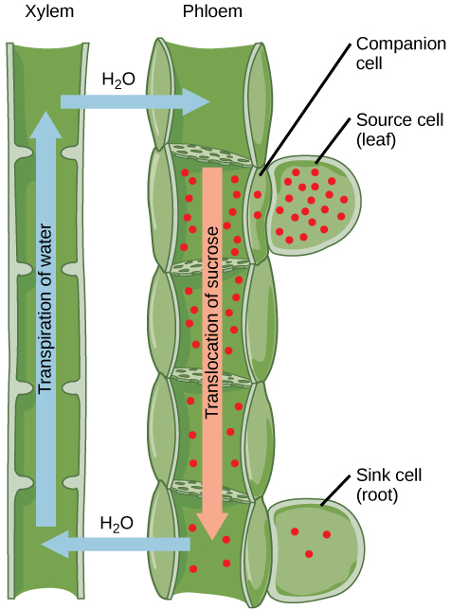
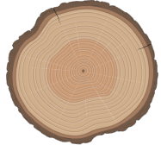
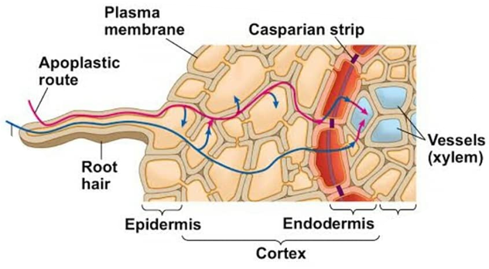
How plant cell wall form structures allowing movement of solutes within the plant
University of Bologna Isaac Ambrogetti
Plant vascular cells originate from procambial cells, which are vascular stem cells. These cells origin structures that are able to support water solutions flow thanks to the cell wall particular structures that broadly differentiate in xylem and phloem. In this poster I want to describe the cell wall structures of phloem and xylem, together with how the cell wall structure allow the water solutions to flow within the plants’ vascular tissues, going through transpiration, root pressure (or osmotic pressure) and bulk pressure.
1.1 Xylem
The primary function of xylem is as a water-conducting tissue. Xylem tissue consists of a variety of specialized, water-conducting cells known as tracheary elements:
Tracheids (pit membranes presence) less specialized.
Vessel (lack cell wall in horizontal areas) from empty tubes
Both are narrow, hollow and elongated, and they present a primary and secondary cell wall thickened with lignin.
1.2 Phloem
Its primary function is to conduct water, sucrose, amino acids and information from leaves to the rest of the plant. It is composed of various specialized cells divided by the sieve plates, which are porous cell walls between phloem cells that allow the flow. Phloem cells are alive and function thanks to their companion cells.
2 Transpiration and Root Pressure (Osmotic pressure)
Thanks to xylem water can reach the leaves where transpiration takes place. The water molecule evaporates through stomata and create depression that induce the flow of water and minerals against the gravity force.
During night or colder periods where transpiration do not occur properly, the root pressure allow the intake of water from the roots that is able to keep the xylem solute flow. This process happen thanks to the osmotic gradient that forms in the plant roots, where it is fundamental the presence of the Caspary band.
3 Translocation
Red dots represent sugar molecules that have their origin in photosynthesizing cells in the leaf (the source). Sugar is loaded into the sieve tube via the companion cells at the
source. With the increased concentration of sugars, the water potential is decreased and water enters the sieve tube by osmosis. Sugar is removed (unloaded) at the sink, and the sugar concentration falls; as a result the water potential increases, and water leaves the sieve tube. With the movement of water into the sieve tube at the source and out of it at the sink, the sugar molecules are carried passively by the water along the concentration gradient between source and sink.
Conclusion
The vascular tissue is a very complex and evolved organ present in every plant. It enable the plant to uptake water and minerals without allowing the entrance of pathogens from the soil, and it uses physical and chemical properties to distribute nutrients along the whole plant. These mechanisms evolved through millions of years and allowed the develop of the human specie in this planet, it is important to understand them.

