Slide 1

Introduction to Ansible
Arvin R
Technology Consultant

Slide 2

Agenda
1. Ansible Overview
2. Architecture of Ansible
3. Installation of Ansible
4. Configuration of Ansible
5. Configuration Management With Ansible

Slide 3
What is Ansible
➔ Ansible is an open-source configuration management and
provisioning tool, similar to Chef and Puppet.
➔ It uses SSH to connect to servers and run the configured
Tasks. Ansible lets you control and configure nodes from a
single machine.
➔ What makes it different from other management software is
that Ansible uses SSH infrastructure. The project was founded
in 2013 and bought by Red Hat in 2015.

Slide 4
Why Ansible
No Agent- As long as the box can be ssh’d into and it has python,
it can be configured with Ansible.
● Declarative Not Procedural- Other configuration tools tend to be
procedural do this and then do that and so on. Ansible works by
you writing a description of the state of the machine that you want
and then it takes steps to fulfill that description.
● Tiny Learning Curve- Ansible is quite easy to learn. It doesn’t
require any extra knowledge.

Slide 5
Ansible Use Cases
Provisioning
Configuration Management
App Deployment
Continuous Delivery
Security & Compliance
Orchestration

Slide 6
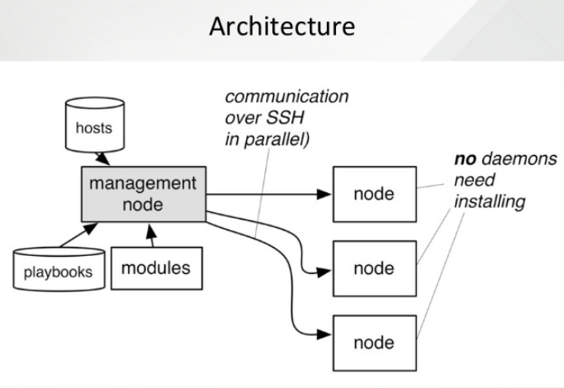
Architecture of Ansible

Slide 7
Ansible Installation
For debian base :
Install packages below on the Server Machine
sudo apt-get install python-yaml python-jinja2 python-paramiko python-crypto python-keyczar ansible
Install packages below on the client Machines
sudo apt-get install python-crypto python-keyczar

Slide 8
Ansible Installation
For CentOS/Redhat :
Control Node
sudo apt-add-repository ppa:ansible/ansible
sudo apt update
sudo apt install ansible
sudo ansible --version ( to verify version of ansible )

Slide 9
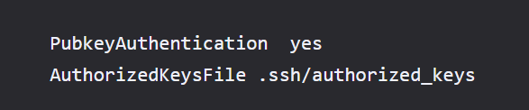
Create the RSA Key Pair
The first step is to create the key pair on the Control Node:
$sudo ssh-keygen –t rsa
Enter file in which to save the key (/home/test/.ssh/id_rsa):
Enter no password for the next prompt
Copy the Public Key to client Node
$sudo ssh-copy-id root@<Client IP ADDRESS>
$sudo vi /etc/ssh/sshd_config

Slide 10
Ansible Concepts
Inventory
Playbooks
Roles
Tasks / Handlers / Vars
Modules

Slide 11
Inventory
The Inventory is a description of the nodes that can be accessed
by Ansible. By default, the Inventory is described by a
configuration file, whose default location is in./etc/ansible/hosts
The configuration file lists either the IP address or hostname of
each node that is accessible by Ansible.
Every host is assigned to a group such as web servers, db
servers etc. The inventory file can be in one of many formats
such as yaml, INI etc

Slide 12
Example of an Inventory file
mail.example.com
[webservers]
foo.example.com
bar.example.com
[dbservers]
one.example.com
two.example.com
three.example.com

Slide 13
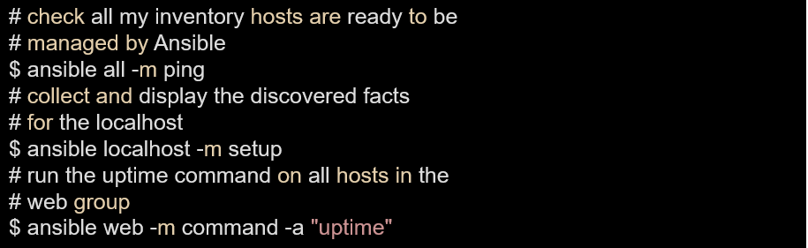
Examples of ansible commands

Slide 14
Roles
What is the best way to organize your playbooks? The short answer is to use roles! Roles are ways of automatically loading certain vars_files, tasks, and handlers based on a known file structure. Grouping content by roles also allows easy sharing of roles with other users.
Example project structure:
roles/
files/
templates/
tasks/
handlers/
vars/
defaults/
meta/

Slide 15
Tasks
Tasks are the application of a module to perform a specific unit of work.
file: A directory should exist
yum: A package should be installed
service: A service should be running
template: Render a configuration file from a template
get_url: Fetch an archive file from a URL
git: Clone a source code repository

Slide 16
Example Tasks in a Play
---
- hosts: webservers
tasks:
- name: install apache2
apt: name=apache2 state=latest

Slide 17
Handler Tasks
Handlers are special tasks that run at the end of a play if notified by another task when a change occurs.
If a configuration file gets changed notify a service restart task that it needs to run.

Slide 18
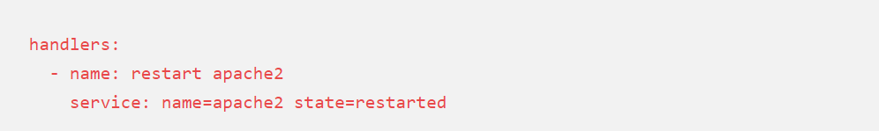
Example Handler Task in a Play
---
- hosts: webservers
tasks:
- name: install apache2
apt: name=apache2 state=latest

Slide 19
Modules
Modules are bits of code transferred to the target system and
executed to satisfy the task declaration. Ansible ships with
several hundred today!
apt/yum
copy
file
get_url
git
ping
debug
service
synchronize
template

Slide 20
References
docs.ansible.com

Slide 21
Thank You

