Slide 1
Causal prediction under variable speed
Final validation study · 12-minute speaking target · FINAL_DATE_UNCONFIRMED
Can a compact causal model explain vibration efficiently—and leave interpretable residuals?
• Best measured validation configuration: lpv_L256_s17_a1
• Common-index MSE: 0.3612; independent test unavailable
• 200 separate fault-candidate records processed; physical fault accuracy unverified
MECG 7780 · Validation study · Generated from saved experiment outputs
1
Notes:
Speaking target: 29 seconds.
Introduce the engineering aim: predict the next sample causally, compare accuracy and cost, then inspect raw and residual diagnostic descriptors. The complete split upload now enables independent analysis of all 200 fault-candidate records. These are descriptive results without verified physical fault labels, not a validated diagnostic classifier.

Slide 2
Data, provenance and limits
One reference trace and one validation trace; no independent test
• Train: 24,000 samples · Validation: 24,000 samples · fs = 3,200 Hz
• Provided x and spdnorm are used exactly; no record-wise rescaling
• Speed trajectory correlation: 0.999999571
• Speed units / reference health state unverified; normalized x is dimensionless
• Fault candidates: 200 separate 10-second records in 20 MAT parts
• sigtest.mat and sigfault2.mat not supplied
MECG 7780 · Validation study · Generated from saved experiment outputs
2
Notes:
Speaking target: 44 seconds.
The two reference/validation files each contain 24,000 samples at 3,200 Hz. The newly available twenty MAT parts preserve 200 separate candidate records, each 32,000 samples or 10 seconds. No records are flattened together. No second normalization is applied to supplied fault x. Speed physical units and health labels remain unverified.

Slide 3
Causality before model complexity
Each target uses observed history only
Observed history
x[t−L:t], s[t−L:t]
Past-only windows
no target values
Causal model
x̂[t]
Residual
e[t] = x[t] − x̂[t]
→
→
→
Example: x[64] uses samples 0…63 only. One-step teacher forcing; no x[64] in model inputs.
MECG 7780 · Validation study · Generated from saved experiment outputs
3
Notes:
Speaking target: 49 seconds.
Point to the ordering. For lag L, x[L] sees x[0:L], and speed inputs stop at L−1. Teacher forcing means previously measured vibration is available; this is not a free-running forecast. For causal models, changing future samples cannot change earlier predictions.

Slide 4
The conventional comparison
AR/ridge and LPV-AR surrogate; no replicated Spa LPV-ARMA score
Ridge AR: minimize ‖y − Xb‖² + α‖b‖², α = 1
• Zero, training-mean and persistence sanity checks
• OLS and ridge AR; ARX appends past speed and speed²
• LPV-AR: lag coefficients vary polynomially with speed at t−1
• Measured ridge AR(256) validation MSE: 0.420058 (zero: 1.104077)
• LPV-AR surrogate has no ARMA innovation recursion; no exact paper reproduction
MECG 7780 · Validation study · Generated from saved experiment outputs
4
Notes:
Speaking target: 49 seconds.
Explain ridge as squared-error fitting with a coefficient-size penalty. The LPV-AR surrogate expands past vibration with speed and speed-squared interactions, but has no moving-average innovation recursion or lecturer-paper sparse estimation. It is not Spa LPV-ARMA. No published score is invented.

Slide 5
Three compact neural ideas
MLP lag mapping · GRU state · causal dilated TCN
MLP
lag vector → scalar
GRU
update / reset gates
TCN
causal dilations
Three separate model alternatives; compact networks, bounded epochs and recorded seeds. TCN: two kernel-3 convolutions per block; receptive field = 1 + 4 Σ dilation.
MECG 7780 · Validation study · Generated from saved experiment outputs
5
Notes:
Speaking target: 54 seconds.
MLP maps a finite history to a scalar; the GRU summarizes a unidirectional sequence with update/reset gates; the TCN uses left-only padded convolutions and increasing dilations. Two convolutions per block give receptive field 1+4 times the sum of dilations. Limited training budgets must be disclosed.

Slide 6
Speed-conditioning: contribution and controls
A project-level adaptation; not a world-first claim
Past speed s[k]
Small linear map
γ(s), β(s)
h[k] × gain
+ offset
Causal prediction
→
→
→
Hypothesis: operating-speed information helps beyond extra capacity. Controls: late concatenation, larger unconditioned TCN and off-line phase-shifted speed (negative control only).
MECG 7780 · Validation study · Generated from saved experiment outputs
6
Notes:
Speaking target: 54 seconds.
FiLM is an established conditioning mechanism. Here each past temporal feature receives a bounded gain and offset from that position's observed speed. Compare to unconditioned same-core TCN, late speed concatenation, a larger unconditioned capacity control and an explicitly off-line phase-shifted-speed negative control. The shifted control is excluded from causal recommendations.

Slide 7
Measured validation performance
Every model evaluated at exactly t = 256…23999 (zero-based)
Model | Lag | MSE | Parameters | Train s | Record s
lpv | 256 | 0.3612 | 769 | 0.766 | 0.123
ar | 256 | 0.4201 | 257 | 0.069 | 0.007
ols | 256 | 0.4201 | 257 | 0.264 | 0.006
arx | 256 | 0.4278 | 259 | 0.064 | 0.008
mlp | 64 | 0.4505 | 2113 | 1.490 | 0.007
tcn | 128 | 0.4545 | 2425 | 26.812 | 0.536
speed_tcn | 128 | 0.4582 | 2617 | 52.985 | 1.260
late_tcn | 64 | 0.4633 | 2026 | 19.411 | 0.413
Best observed configuration per family; validation-selected. Timing includes checkpoint load, window construction and scoring. Full CSV retains every run.
MECG 7780 · Validation study · Generated from saved experiment outputs
7
Notes:
Speaking target: 69 seconds.
Read the table as measured validation performance, not test performance. The top row is an observed best configuration and its selection used this validation trace. Inspect the full CSV for all seeds and contexts rather than interpreting a single winning row as a population estimate.

Slide 8
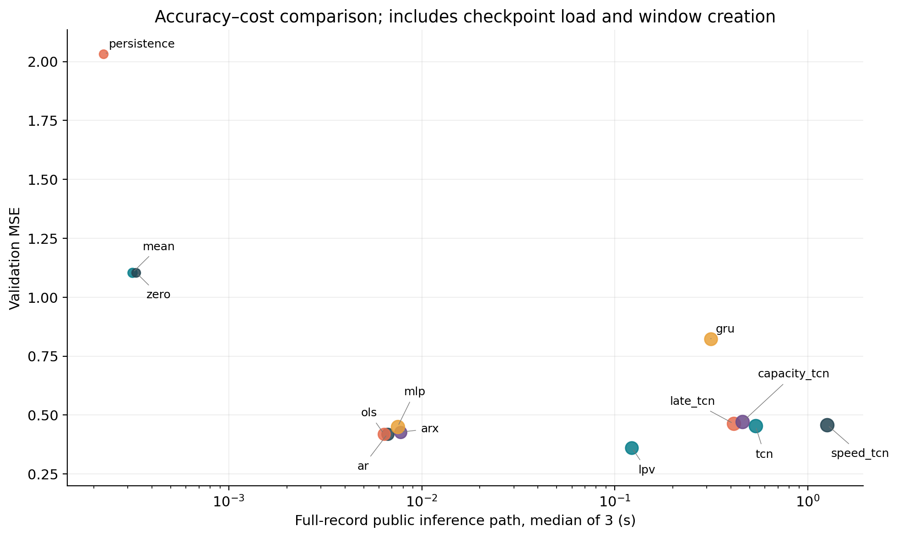
Accuracy has a computational cost
CPU-only, measured public inference path; GPU benchmarks not run
• Best model fit: 0.766 s
• Best model record path: 0.123 s
• Ridge AR(256): 0.0066 s / record
• Includes checkpoint load + windows; 3 repeats
Measured CPU wall time; details: reports/timing_and_hardware.md; no GPU measurements.
MECG 7780 · Validation study · Generated from saved experiment outputs
8
Notes:
Speaking target: 54 seconds.
Report CPU wall time and the actual timing boundary. The public inference path includes checkpoint deserialization, window preparation and full-record prediction; one warm-up and three repeats are used. These are not isolated kernel latencies. Linear fitting is float64 and neural fitting float32. GPU time was not measured.

Slide 9
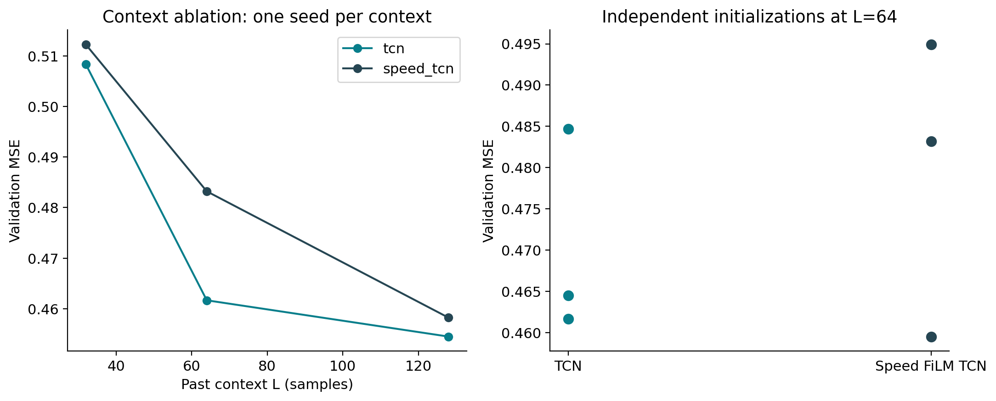
Does conditioning help consistently?
Context, seed and capacity controls; do not select only favorable seeds
• speed_tcn: 0.4792 ± 0.0180 (3 seeds); tcn: 0.4703 ± 0.0125 (3 seeds)
• FiLM mean MSE: 1.90% higher
• Full controls: model_ablation.csv
Same validation targets for every context; points are initialization repeats, not independent recordings.
MECG 7780 · Validation study · Generated from saved experiment outputs
9
Notes:
Speaking target: 64 seconds.
The seed summary reflects initialization variability, not machine-to-machine variability. Context effects are compared on common target indices. A speed gain can depend on capacity, optimization and nearly matched operating histories. If the speed model loses, retain the result; novelty is a falsifiable experimental proposal.

Slide 10
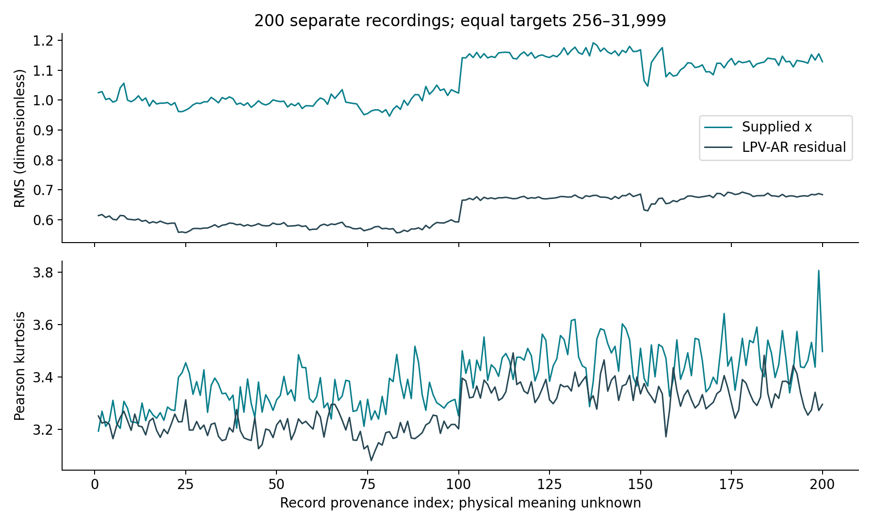
A residual does not prove a defect
Prediction accuracy and diagnostic utility are distinct objectives
200 separate candidate records; equal 31,744-sample segments; dimensionless x/residual.
MECG 7780 · Validation study · Generated from saved experiment outputs
10
Notes:
Speaking target: 44 seconds.
Every supplied fault-candidate record is scored using previously trained reference predictors with no fault-data retraining. All models and raw features use the same 256-sample burn-in and remaining 31,744 samples per record. The displayed RMS trajectories are descriptive: record-index trends are not fault-onset labels, and reduced RMS is not detection accuracy.

Slide 11
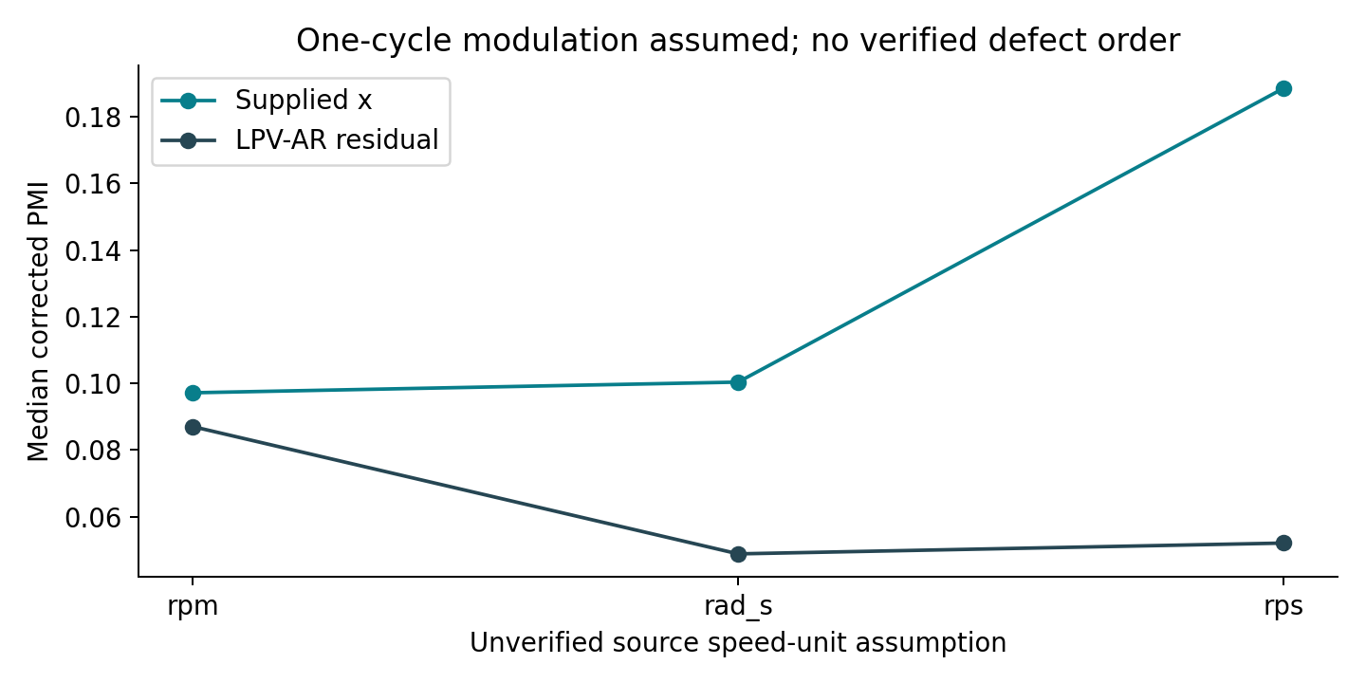
PMI and angular resampling need assumptions
Explicit speed units; literal versus corrected MATLAB indexing
Actual fault-candidate descriptors; speed units / order are assumptions. Literal PMI lag T−1; corrected T.
MECG 7780 · Validation study · Generated from saved experiment outputs
11
Notes:
Speaking target: 54 seconds.
The angle-domain indicators are computed under explicitly named RPM, revolutions-per-second and radians-per-second assumptions; none establishes the true speed unit. The literal MATLAB coarse index selects lag T minus one while the corrected branch selects T. The sensitivity plot compares actual record descriptors across these choices, not physical fault probabilities.

Slide 12
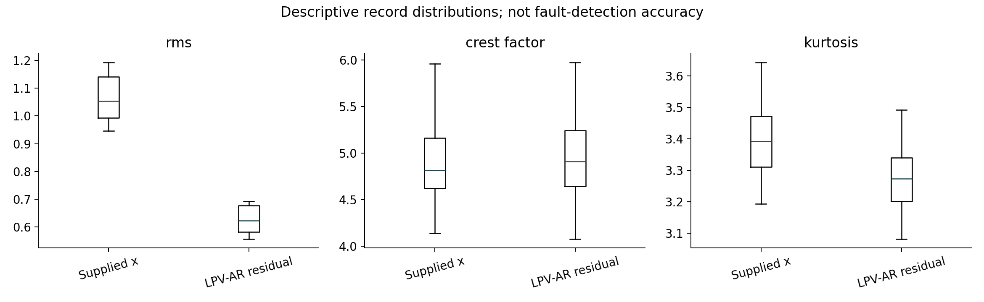
Unlabeled records: measured descriptors
Record-wise raw/residual features; no invented health classes
Actual record-wise distributions; no verified classes. RMS / kurtosis / CK / PMI describe signals, not fault accuracy.
MECG 7780 · Validation study · Generated from saved experiment outputs
12
Notes:
Speaking target: 39 seconds.
All candidate records now have real raw/residual feature measurements. Compare the displayed distributions and note speed dependence, normalization and equal segment length. There are no verified healthy/faulty classes, onset dates or severity values. A model with small residual MSE can also suppress periodic content. Consequently no ROC, F1 or sensitivity is justified and diagnostic model choice must remain provisional.

Slide 13
Limits of inference
Validation selection, one trace, repeated speed trajectory, unknown labels
• Only one short validation recording, reused for epoch/model selection
• Speed trajectories are almost identical: unseen-speed transfer untested
• Short neural training budget; rankings are budget-specific
• Physical speed unit / health labels unverified; patterns remain descriptive
• Spa LPV-ARMA exact comparison unavailable; final dates conflict in the PDF
MECG 7780 · Validation study · Generated from saved experiment outputs
13
Notes:
Speaking target: 44 seconds.
The transfer blocker has been resolved using the twenty split MAT files. Remaining limitations are unknown health labels and physical speed unit, validation reuse for model selection, only one short validation trace and nearly matched speed histories, and incomplete publisher access for exact Spa LPV-ARMA replication. Descriptive fault-record patterns do not resolve these inferential limits.

Slide 14
What the evidence supports
Recommend using the measured table; validate on independent records next
• Measured best: lpv_L256_s17_a1, validation MSE 0.3612
• LPV-AR beats the tested neural models under this budget
• FiLM speed-TCN mean MSE is 1.90% higher than TCN (3 seeds)
• 200 separate fault-candidate records processed; physical fault accuracy unverified
• Next evidence: independent test and verified physical speed units / health labels
MECG 7780 · Validation study · Generated from saved experiment outputs
14
Notes:
Speaking target: 49 seconds.
Answer RQ1 using the saved common-index validation table, and RQ2 using the measured CPU costs. Speed-FiLM does not improve mean validation MSE across the matched seeds. RQ4 now has real record-wise raw/residual and angular-assumption evidence, but physical fault accuracy remains unidentifiable without labels. Recommend inspecting both raw and model residual descriptors rather than declaring a physical fault winner.

Slide 15
Sources and reproducibility
Editable decks generated from project outputs; exact CSVs and checkpoints retained
• Chen et al. (2025), MSSP 224, 112161. doi:10.1016/j.ymssp.2024.112161
• Bai, Kolter & Koltun (2018), TCN. Original author implementation accessed
• Perez et al. (2018), FiLM. Original author implementation accessed
• Full evidence status: research/literature_matrix.csv and source_access_log.md
• Rebuild: python scripts/build_presentations.py; inputs: reports/results_summary.csv
MECG 7780 · Validation study · Generated from saved experiment outputs
15
Notes:
Speaking target: 24 seconds.
Direct the audience to the verified literature matrix and access log. The course citation motivates speed-dependent modeling; author repositories support TCN and FiLM implementation concepts. Original TCN and FiLM studies were not gearbox validation studies. All claims here map to stored tables, configurations and figures.

