Slide 1
Predicting variable-speed vibration
Project progress · 8-minute speaking target · Author / group: add names
Can a compact causal model explain vibration efficiently—and leave interpretable residuals?
• Best measured validation configuration: lpv_L256_s17_a1
• Common-index MSE: 0.3612; independent test unavailable
• 200 separate fault-candidate records processed; physical fault accuracy unverified
MECG 7780 · Validation study · Generated from saved experiment outputs
1
Notes:
Speaking target: 35 seconds.
Introduce the engineering aim: predict the next sample causally, compare accuracy and cost, then inspect raw and residual diagnostic descriptors. The complete split upload now enables independent analysis of all 200 fault-candidate records. These are descriptive results without verified physical fault labels, not a validated diagnostic classifier.

Slide 2
A causal prediction task
Previously observed samples predict the next sample; no future vibration
Observed history
x[t−L:t], s[t−L:t]
Past-only windows
no target values
Causal model
x̂[t]
Residual
e[t] = x[t] − x̂[t]
→
→
→
Example: x[64] uses samples 0…63 only. One-step teacher forcing; no x[64] in model inputs.
MECG 7780 · Validation study · Generated from saved experiment outputs
2
Notes:
Speaking target: 45 seconds.
Point to the ordering. For lag L, x[L] sees x[0:L], and speed inputs stop at L−1. Teacher forcing means previously measured vibration is available; this is not a free-running forecast. For causal models, changing future samples cannot change earlier predictions.

Slide 3
What the accessible data establish
Measured audit; labels and calibration are not invented
• Train: 24,000 samples · Validation: 24,000 samples · fs = 3,200 Hz
• Provided x and spdnorm are used exactly; no record-wise rescaling
• Speed trajectory correlation: 0.999999571
• Speed units / reference health state unverified; normalized x is dimensionless
• Fault candidates: 200 separate 10-second records in 20 MAT parts
• sigtest.mat and sigfault2.mat not supplied
MECG 7780 · Validation study · Generated from saved experiment outputs
3
Notes:
Speaking target: 50 seconds.
The two reference/validation files each contain 24,000 samples at 3,200 Hz. The newly available twenty MAT parts preserve 200 separate candidate records, each 32,000 samples or 10 seconds. No records are flattened together. No second normalization is applied to supplied fault x. Speed physical units and health labels remain unverified.

Slide 4
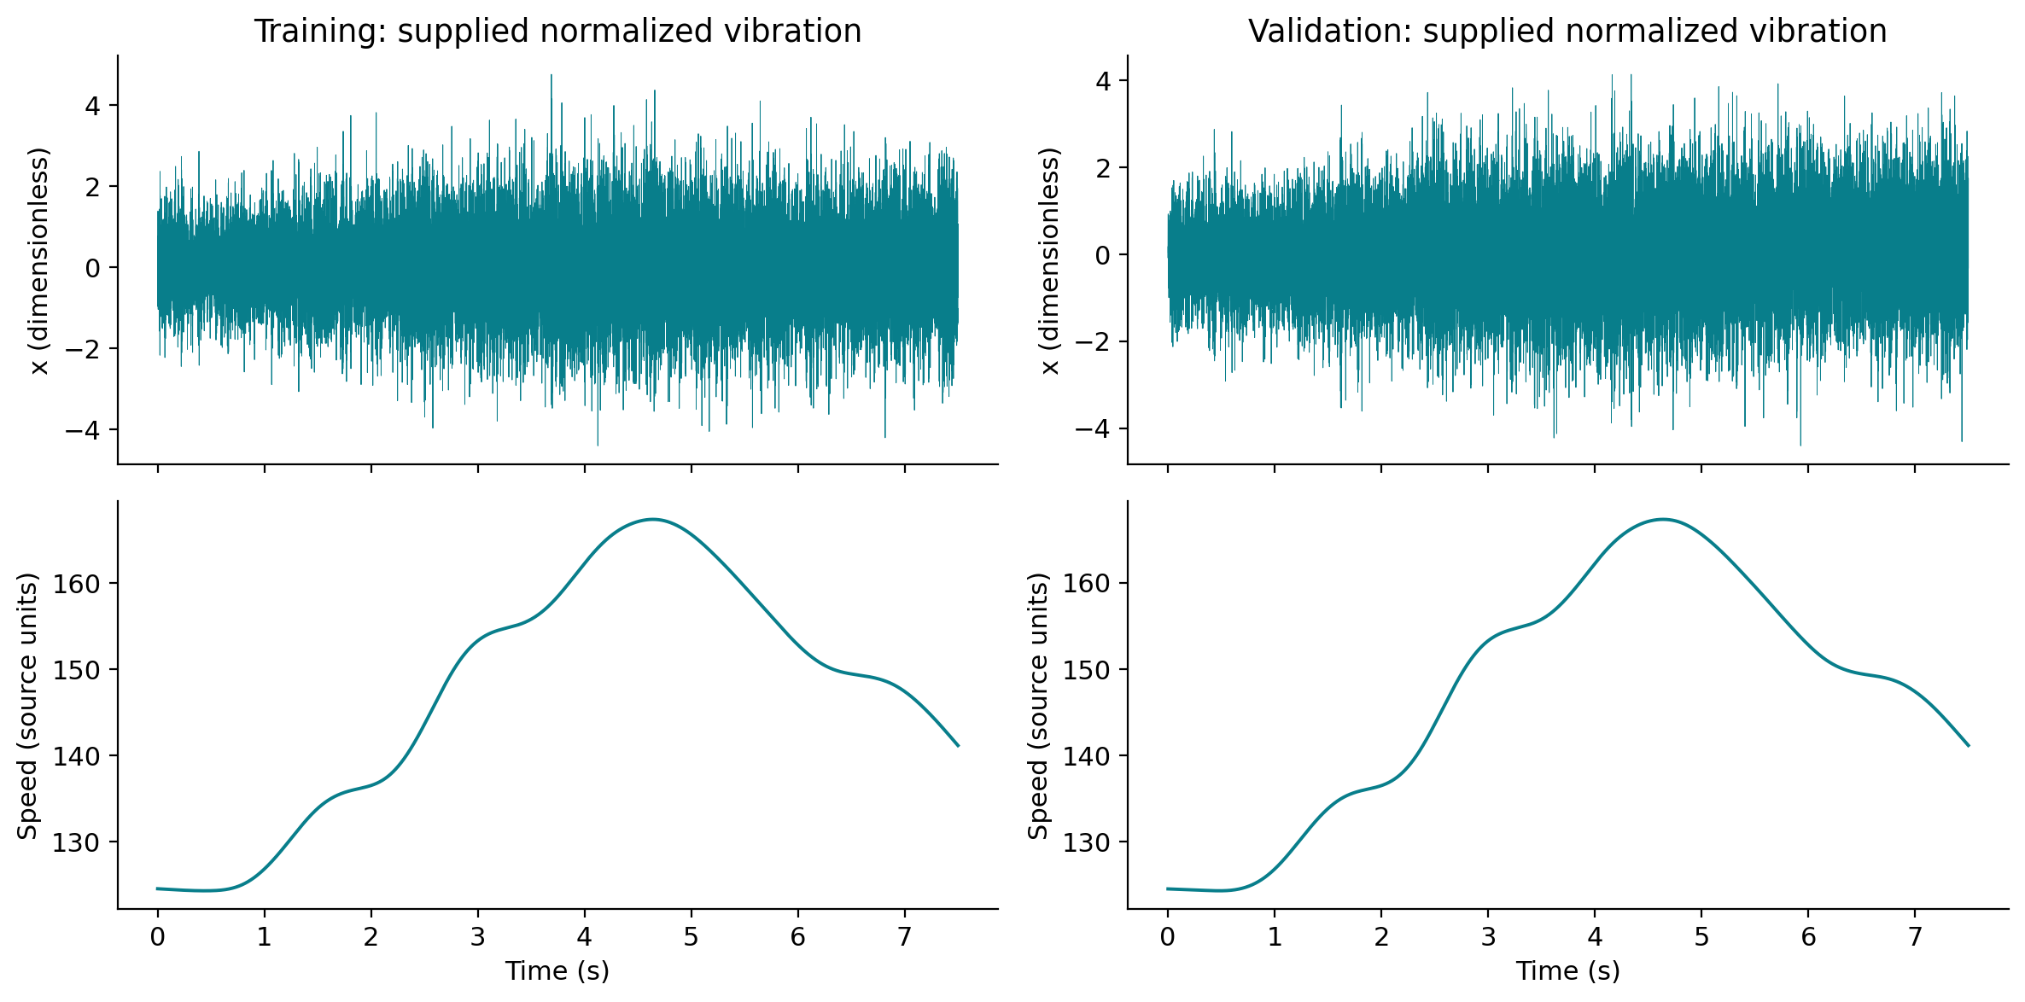
Operating speed changes the signal
Train and validation each contain one 7.5-second recording
Source: data/raw/sigtrain.mat and sigvalid.mat; hashes in data/manifest.json.
MECG 7780 · Validation study · Generated from saved experiment outputs
4
Notes:
Speaking target: 45 seconds.
Describe the actual speed trajectory and amplitude/frequency variation without assigning unverified gear tooth counts or shaft units. The two speed traces are nearly identical. Correlation is not proof of leakage, but it sharply limits conclusions about unseen operating histories.

Slide 5
A fair evaluation contract
One-step teacher forcing · common burn-in · validation only
• Fit on sigtrain; select epochs/configurations using sigvalid
• Score all models at zero-based indices 256…23,999: 23,744 targets
• Observed past vibration; speed available only through t−1
• No random window split presented as independent generalization
• Validation is reused for selection: final unbiased test performance remains unknown
MECG 7780 · Validation study · Generated from saved experiment outputs
5
Notes:
Speaking target: 50 seconds.
Every score uses the same 23,744 validation targets after a 256-sample burn-in, so changing lag does not change the scored sample population. Validation also selects neural epoch and model configuration; it is therefore optimistic for final generalization. No test file exists here.

Slide 6
Strong baselines come first
Least squares, ridge regularization and speed-dependent coefficients
Ridge AR: minimize ‖y − Xb‖² + α‖b‖², α = 1
• Zero, training-mean and persistence sanity checks
• OLS and ridge AR; ARX appends past speed and speed²
• LPV-AR: lag coefficients vary polynomially with speed at t−1
• Measured ridge AR(256) validation MSE: 0.420058 (zero: 1.104077)
• LPV-AR surrogate has no ARMA innovation recursion; no exact paper reproduction
MECG 7780 · Validation study · Generated from saved experiment outputs
6
Notes:
Speaking target: 55 seconds.
Explain ridge as squared-error fitting with a coefficient-size penalty. The LPV-AR surrogate expands past vibration with speed and speed-squared interactions, but has no moving-average innovation recursion or lecturer-paper sparse estimation. It is not Spa LPV-ARMA. No published score is invented.

Slide 7
Compact nonlinear alternatives
MLP, unidirectional GRU and explicitly causal dilated TCN
MLP
lag vector → scalar
GRU
update / reset gates
TCN
causal dilations
Three separate model alternatives; compact networks, bounded epochs and recorded seeds. TCN: two kernel-3 convolutions per block; receptive field = 1 + 4 Σ dilation.
MECG 7780 · Validation study · Generated from saved experiment outputs
7
Notes:
Speaking target: 55 seconds.
MLP maps a finite history to a scalar; the GRU summarizes a unidirectional sequence with update/reset gates; the TCN uses left-only padded convolutions and increasing dilations. Two convolutions per block give receptive field 1+4 times the sum of dilations. Limited training budgets must be disclosed.

Slide 8
A falsifiable speed-conditioning proposal
Established FiLM, adapted to observed past speed
Past speed s[k]
Small linear map
γ(s), β(s)
h[k] × gain
+ offset
Causal prediction
→
→
→
Hypothesis: operating-speed information helps beyond extra capacity. Controls: late concatenation, larger unconditioned TCN and off-line phase-shifted speed (negative control only).
MECG 7780 · Validation study · Generated from saved experiment outputs
8
Notes:
Speaking target: 55 seconds.
FiLM is an established conditioning mechanism. Here each past temporal feature receives a bounded gain and offset from that position's observed speed. Compare to unconditioned same-core TCN, late speed concatenation, a larger unconditioned capacity control and an explicitly off-line phase-shifted-speed negative control. The shifted control is excluded from causal recommendations.

Slide 9
Residuals are diagnostic candidates
Python numerical validation is separate from real fault evidence
Residual / raw
Explicit-unit
angle grid
Envelope + ACF
CK / PMI
with caveats
→
→
→
Literal MATLAB PMI selects lag T−1; corrected variant selects T. Numerical tests and explicit unit assumptions support descriptive indicators; physical fault accuracy is unverified.
200 separate fault-candidate records processed; physical fault accuracy unverified
MECG 7780 · Validation study · Generated from saved experiment outputs
9
Notes:
Speaking target: 55 seconds.
The angle-domain indicators are computed under explicitly named RPM, revolutions-per-second and radians-per-second assumptions; none establishes the true speed unit. The literal MATLAB coarse index selects lag T minus one while the corrected branch selects T. The sensitivity plot compares actual record descriptors across these choices, not physical fault probabilities.

Slide 10
Evidence, blockers and next steps
Updated PDF rubric: organization 4 · clarity 6 · understanding 8 · novelty 2%
• Measured best: lpv_L256_s17_a1, validation MSE 0.3612
• LPV-AR beats the tested neural models under this budget
• FiLM speed-TCN mean MSE is 1.90% higher than TCN (3 seeds)
• 200 separate fault-candidate records processed; physical fault accuracy unverified
• Next evidence: independent test and verified physical speed units / health labels
MECG 7780 · Validation study · Generated from saved experiment outputs
10
Notes:
Speaking target: 35 seconds.
Summarize completed audit, trained and saved causal predictors, all 200 candidate records processed independently, tested numerical features and reproducible plots. Remaining needs are calibrated speed units, physical health labels and independent test data, plus clarification of the course date conflict. No additional upload is needed for the completed 200-record study.

