Slide 1
Iter: A METAR Browsing & Flight Charting Mobile Application
Isaac Braun
School of Computing
Southern Adventist University

Slide 2
Issue
Small business and private pilots do not have an efficient and accessible method of viewing current and forecasted METAR data alongside flight path charting based on that weather data.
The lack of this resource hinders a pilot’s capability to plan the most efficient and safe flight.

Slide 3
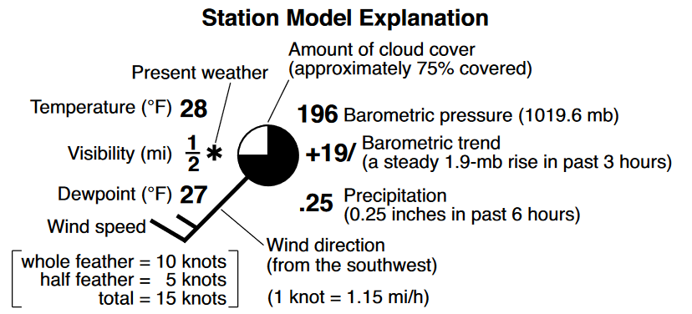
Setting: METARs
METAR Details
METAR STATION MODEL
Top Global Format for Communicating Observable Weather Data
Highly Standardized
Text + Graphical Formats

Slide 4
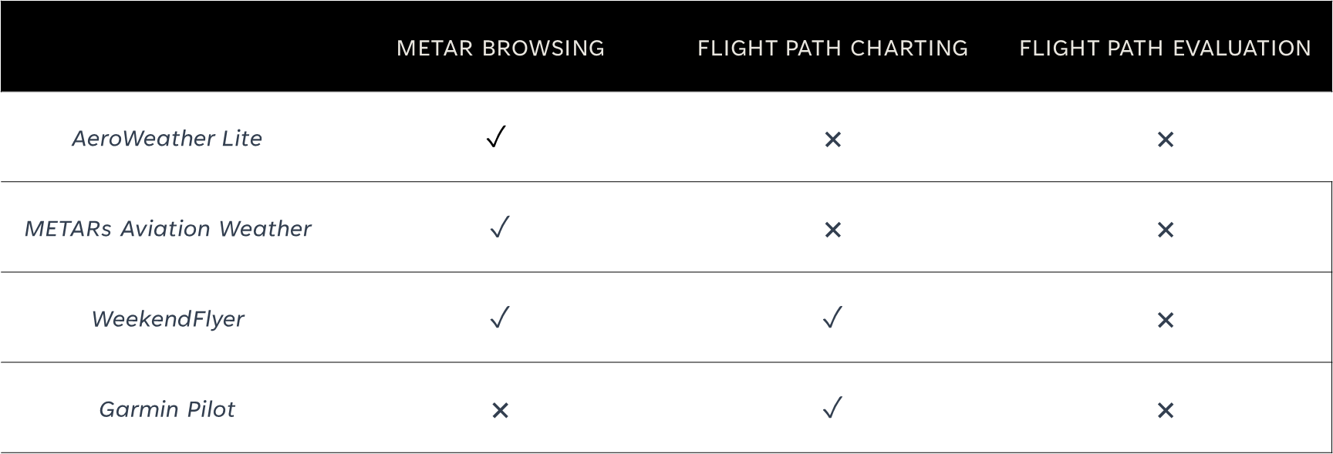
Setting: Existing Applications
​ | METAR BROWSING | FLIGHT PATH CHARTING | FLIGHT PATH EVALUATION
AeroWeather Lite | $$✓$$ | × | ×
METARs Aviation Weather | ✓ | × | ×
WeekendFlyer | ✓ | ✓ | ×
Garmin Pilot | × | ✓ | ×

Slide 5
Proposed Product: Iter
Cross-Platform Mobile Application Using React Native
Provide Desired Features
  Forecasted METAR Browsing, Exploded METAR View, Dual Flight Path Charting, Flight Path Evaluation
  Aesthetically Pleasing
Support
  Deployable on iOS 14+
  Deployable on Android 11+

Slide 6
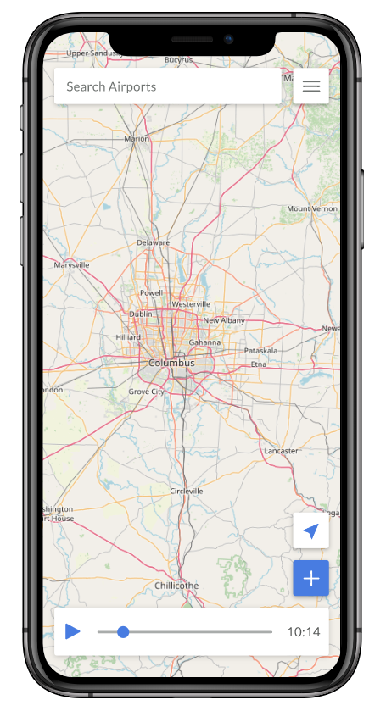
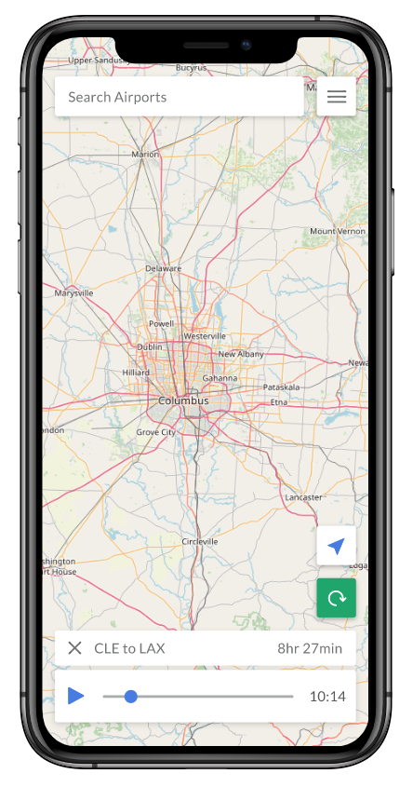
Home - Browse
Home - Saved Path

Slide 7
Development Sprints
S1
Design, Map Unit, Weather API Calling Unit
S2
METAR Station Model Unit, METAR Placer Unit, Forecast/Timeline Unit
S3
Detailed View / Search Module, Begin Flight Path Module
S4
Flight Path Module, Flight Path Evaluation Module

Slide 8
Testing
Test-Driven Development
Acceptance Testing
Tests Written Before Code
Jest Used for Most Tests
Detox Used for System Testing
Pass Rates
  Unit: 98%
  Module: 95%
  Integration & System: 90%
Survey Completed by User Test Group
Asked to Complete Steps to Reach Desired Outcomes
Grade Ease and Efficiency (1-10)
Pass Rates
  Acceptance Tests: 100%
  Grading: Average ≥ 7

Slide 9
Conclusion
No Efficient and Accessible Method
Hinders Ability to Plan the Best and Most Safe Flight
Iter Will Fill This Specific but Highly Important Area

