Slide 1

Iter: A METAR Browsing & Flight Charting Mobile Application
Isaac Braun
School of Computing
Southern Adventist University

Slide 2
The Issue
Small business and private pilots do not have an efficient and accessible method of viewing both current and forecasted METAR data alongside flight path charting/comparison on a mobile device.

Slide 3
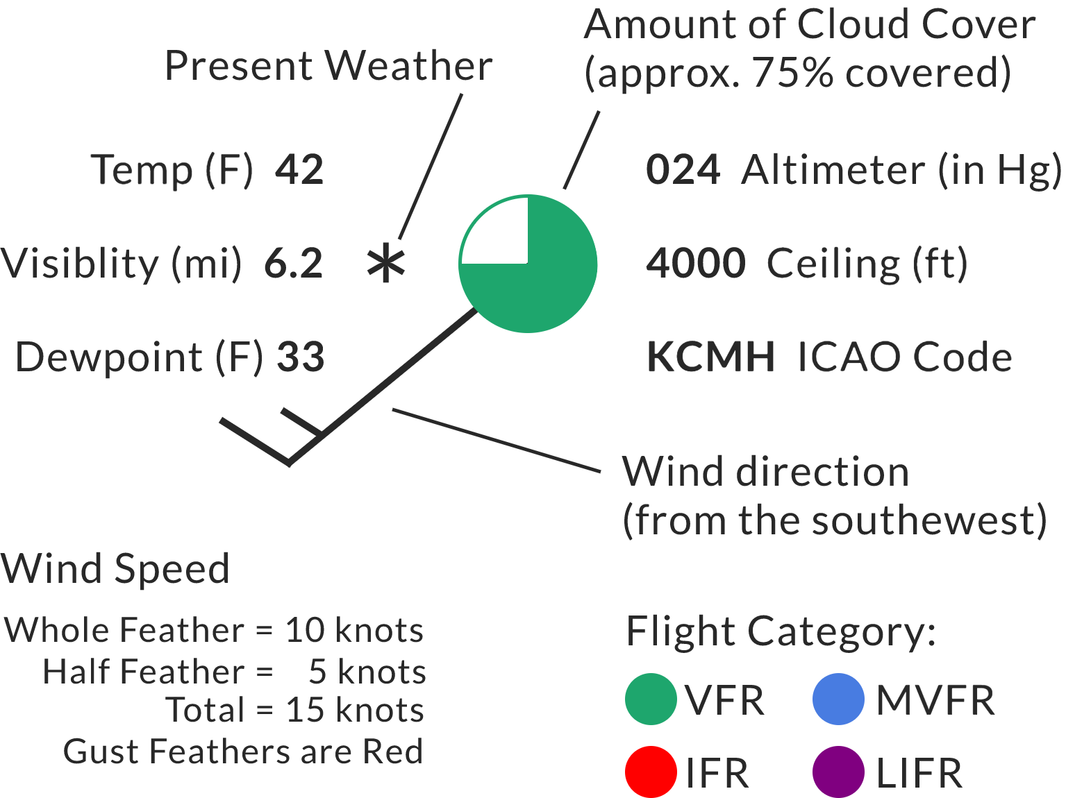
What is a METAR?
Standardized Global Format for Communicating Observable Weather Data
Text + Graphical Formats
Modified Station Model

Slide 4
The Solution: Iter
Cross-Platform Mobile Application Developed Using React Native
Provides Desired Features
Current + Forecasted METAR Browsing
Decoded METAR Data
Dual Flight Path Charting
Automated Flight Path Comparison

Slide 5
The Process
S1
21 hrs
Design, Research Weather APIs, Weather API Calling Unit, Map Unit
S2
31 hrs
METAR Station Model Unit, Detailed View Module, Forecast/Timeline Unit
S3
26 hrs
Search Module, Flight Path Module
S4
30 hrs
Flight Path Comparison Module, Testing/Optimization

Slide 6
Testing
Acceptance Testing
Attempted Test-Driven Development
Survey Completed by User Test Group
Asked to Complete Steps to Reach Desired Outcomes
Grade Ease and Efficiency (1-10)
Pass Rates
Acceptance Tests: 100%
Grading: Average ≥ 7
Tests Written Before Code
Jest Used for Most Tests
Detox Used for System Testing
98% Pass Rate

Slide 7
Demo

Slide 8
Retrospective and The future
Cross-Platform Ease
Search Functionality Struggles
Continued Development
App Store Deployment

Slide 9
Questions?

