Slide 1
Grad-CAM

Slide 2
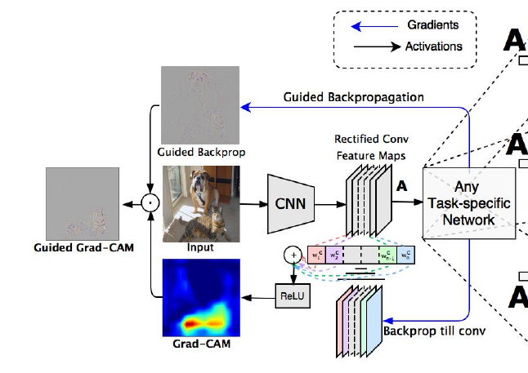

Slide 3
Task and Model
Mnist Classification
CNN with FC and sigmoid function

Slide 4
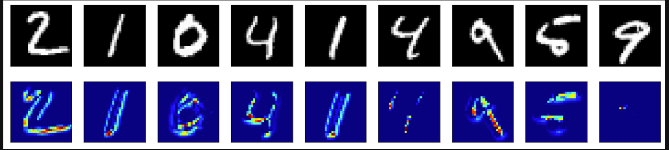

Slide 5
Code
https://github.com/isaacchen96/Grad-CAM/blob/main/grad_cam.ipynb

