Slide 1
INFER
Intelligent Navigation and Facility Environment Reasoning
User guide · open a building, read 3D / plan / graph, route, what-if, share
Internship proof-of-concept · internal use

Slide 2
What INFER does
Turns a static IFC / IndoorGML file into something you can route through — without changing the BIM.
Ingest IFC or IndoorGML on this PC (spaces, doors, stairs, furniture).
Show 3D BIM, a 2D plan, and a room connectivity graph.
Right-click two points (or nearest exit) for a walkable path around desks.
Double-click a door or a room to close it for this session.
Evacuation heat + worst bottlenecks. Share GLB / QR (USDZ on iPhone).
INFER · internship POC · not for life-safety sign-off
1

Slide 3

The workspace: three panes
3D — orbit or fly; storey clip is independent of 2D.
2D — IFC drawing or Navmesh routing.
Graph — rooms as a network (not where you pick paths).
Control tray — find / remove / restore by name.
Refresh clears memory — open the file again.
Real UI (before a model is loaded). Top bar: INFER · model menu · theme.
INFER · internship POC · not for life-safety sign-off
2

Slide 4
Open a model
Top bar → model name → Open model… · or the Open model button on an empty pane.
Accepts .ifc, .ifczip, .gml, .indoorgml.
Pipeline: upload → extract → footprints → Geometry-rules graph.
A large building can take minutes (furniture meshes).
Watch the dialog progress and the status line.
Files stay under data/ on this PC — not the cloud.
INFER · internship POC · not for life-safety sign-off
3

Slide 5
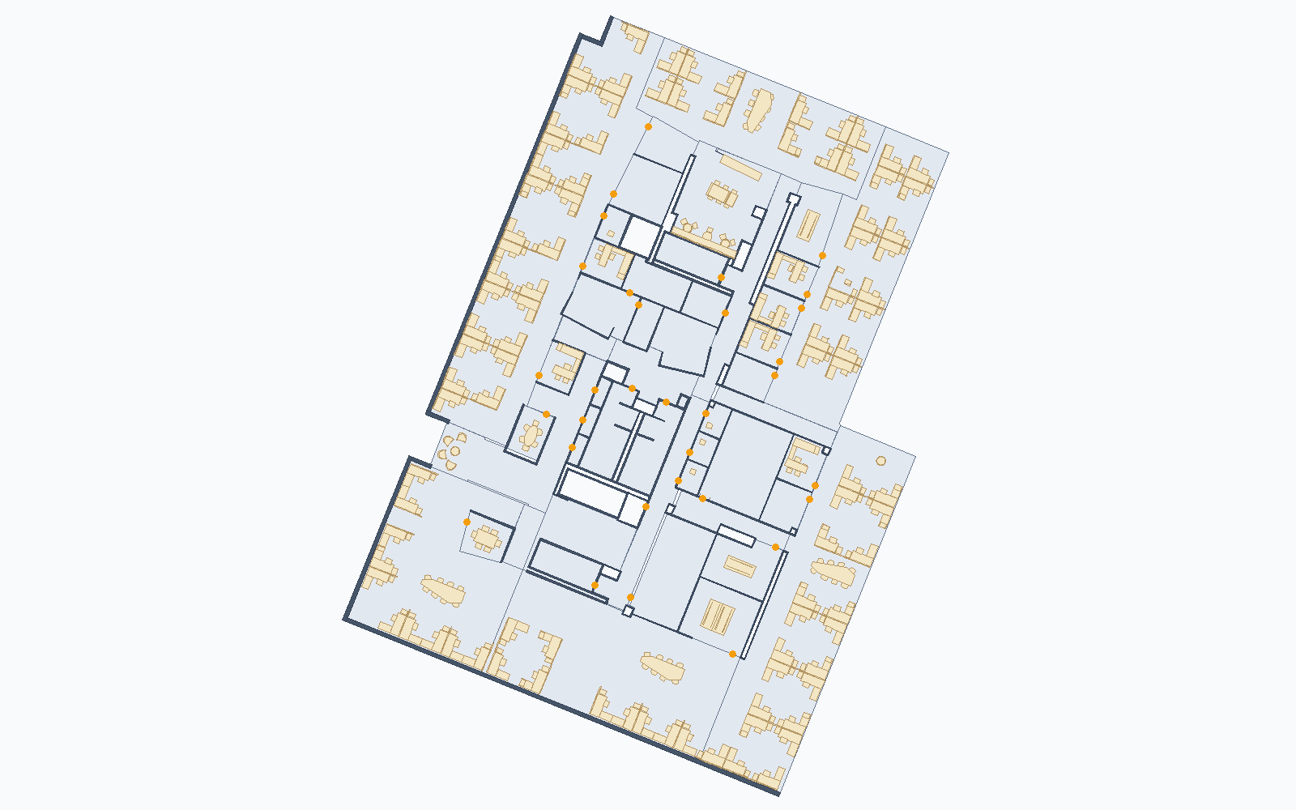
2D Viewer — the floorplan
Same footprints the app draws. Example: Trapelo existing-conditions, Floor 2.
INFER · internship POC · not for life-safety sign-off
4

Slide 6
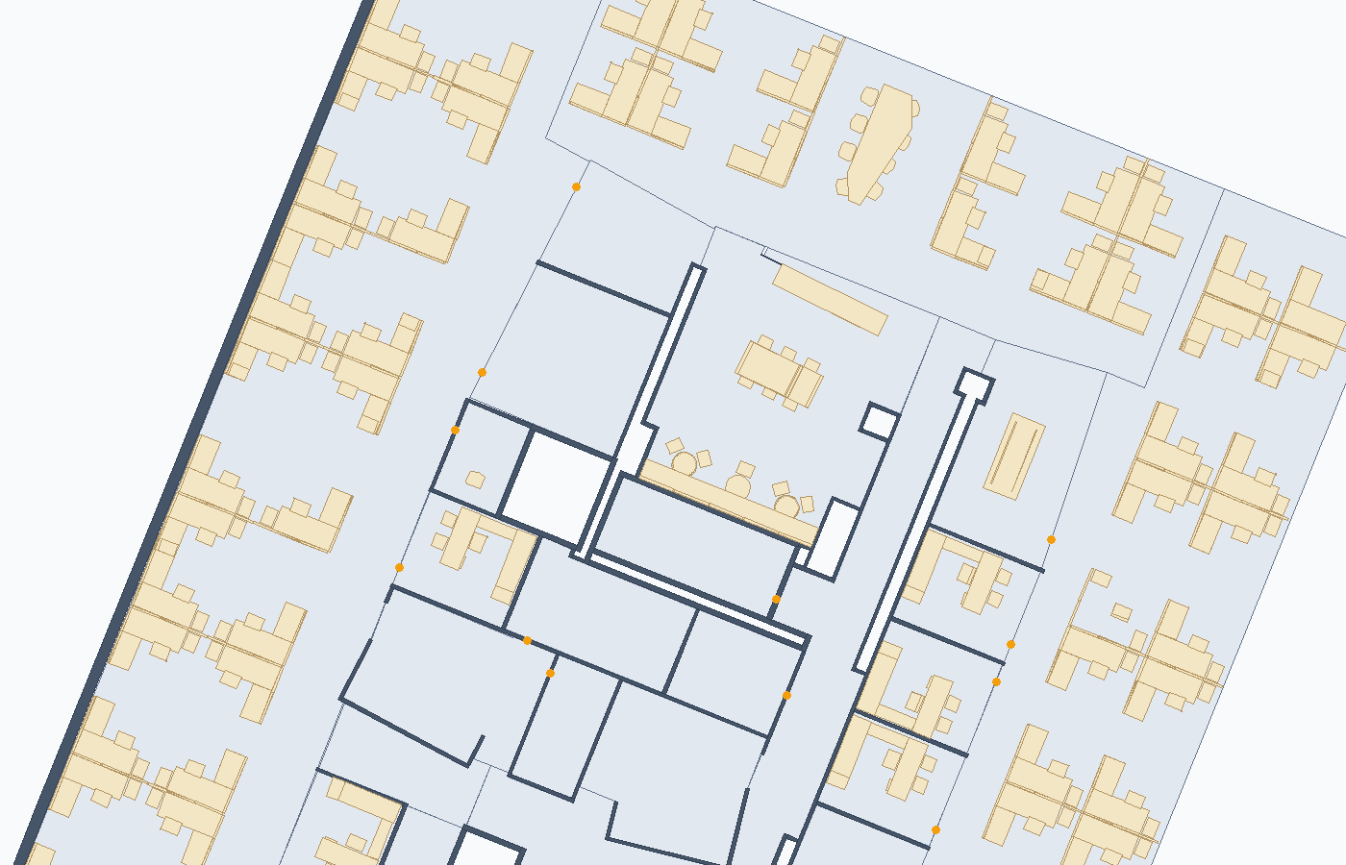
How to read the plan
Grey fill — rooms (walkable space).
Cream — true furniture occupancy, not a convex box.
Chair wells stay empty — you can walk there.
Amber glyphs — IFC doors (swing/slide when known).
Blue disc — 3D camera on this storey.
Legend toggles layers; furniture off ≠ ignored by routing.
INFER · internship POC · not for life-safety sign-off
5

Slide 7
3D Viewer
Independent storey clip from the 2D dropdown. IndoorGML uses extruded footprints, not BIM.
Orbit — drag around the building.
Fly — WASD, Space up, Shift down, Ctrl faster.
IFC tab — real mesh. Navmesh tab — portals / walkable overlay.
Camera disc on the 2D plan tracks this viewpoint.
INFER · internship POC · not for life-safety sign-off
6

Slide 8
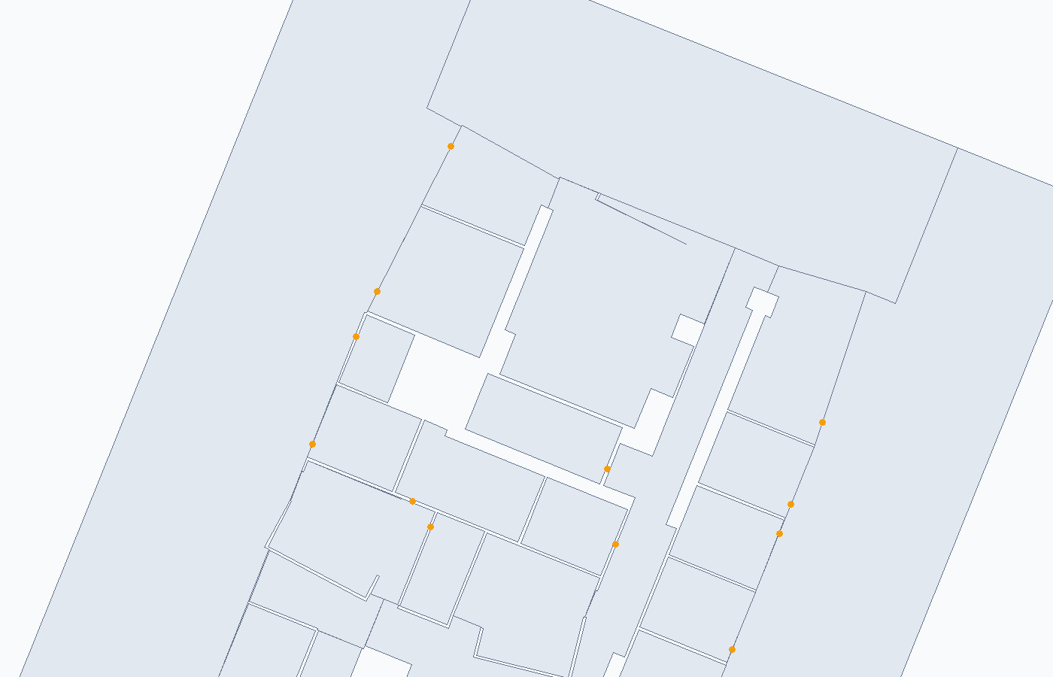
Ask for a route (Navmesh tab)
Switch 2D from IFC (drawing) to Navmesh.
Route: right-click start, then end (other floor is OK).
Nearest exit: right-click once.
Long right-click clears the path.
Path stays ~40 cm off walls and goes around desks.
INFER · internship POC · not for life-safety sign-off
7

Slide 9
What-if: block a door or a room
Session overlay only — the IFC file is never rewritten.
Navmesh: left-click selects (after a short delay).
Double-click a portal — slash on the door; routing treats it as closed.
Double-click a space — pale fill + slash; the whole room is closed.
Double-click again to unblock, or use “N blocked · clear”.
This is not Remove: Control / Graph right-click takes an entity out of the live model until you restore it.
INFER · internship POC · not for life-safety sign-off
8

Slide 10
Evacuation load
Every unblocked room walks to its nearest exit (stairs/lifts included).
Heat on doors and stairs; larger rooms count more (area proxy, not a headcount file).
Blocking a door or room changes the heat.
Worst bottlenecks list — click a row to jump 2D storey and fly 3D there.
A planning sketch, not a fire-engineer’s model.
INFER · internship POC · not for life-safety sign-off
9

Slide 11
Graph Viewer
Rooms as nodes. Most door nodes are hidden. Everyday paths: right-click the floorplan, not here.
Geometry rules (default) — IFC plus healed doors / openings / stairs. Use this to route.
IFC relations — authored links only; often too sparse on real exports.
No TopologicPy in the UI — that API variant is an unfinished stub.
Colours: yellow door heal, green opening, purple stair; grey = IFC. Red ring = nested parent.
Right-click node/link to remove or disable; restore from Control.
INFER · internship POC · not for life-safety sign-off
10

Slide 12
Control tray and sharing
Control (right): filter by level / category, search, Remove / restore.
When a navmesh route exists, Share on the top bar.
GLB download; USDZ on iPhone; short-lived link + QR on the same network.
Best 3D export if the 3D pane is open and IFC has finished loading.
INFER · internship POC · not for life-safety sign-off
11

Slide 13
Say this in a demo
This is a POC. Do not treat paths or exits as certified life-safety.
IFC quality matters — missing rooms or doors leave gaps.
Refresh loses the UI session; derived files remain on disk.
2D shows one storey; a multi-storey route draws the piece on the floor you are viewing.
If it will not route: IFC tab, missed region, blocked door/room, or IFC-only graph.
INFER · internship POC · not for life-safety sign-off
12

Slide 14
A five-minute walkthrough
1. Open model… and wait until the toast shows spaces and links.
2. 2D IFC tab → pick a storey → Legend if needed. Orbit or Fly in 3D.
3. Navmesh → Route → right-click two rooms (try another floor for the second click).
4. Nearest exit. Double-click a door, then a room; repeat the route.
5. Evacuation load + bottlenecks. Share if you want the 3D hand-off.
INFER · internship POC · not for life-safety sign-off
13

