Slide 1
INFER
Intelligent Navigation and Facility Environment Reasoning
User guide · how to open a building, read the plan, and ask for a walkable route
Internship proof-of-concept · internal use

Slide 2
What INFER does
Turns a static IFC / IndoorGML file into something you can route through — without changing the BIM.
Ingest the model on this machine (spaces, doors, stairs, furniture).
Draw a 2D plan and a connectivity graph.
Click two points (or one point + nearest exit) for a walkable path.
Optionally block a door or view evacuation heat on portals.
Share the route as a 3D file or a short-lived link / QR.
INFER · internship POC · not for life-safety sign-off
1

Slide 3
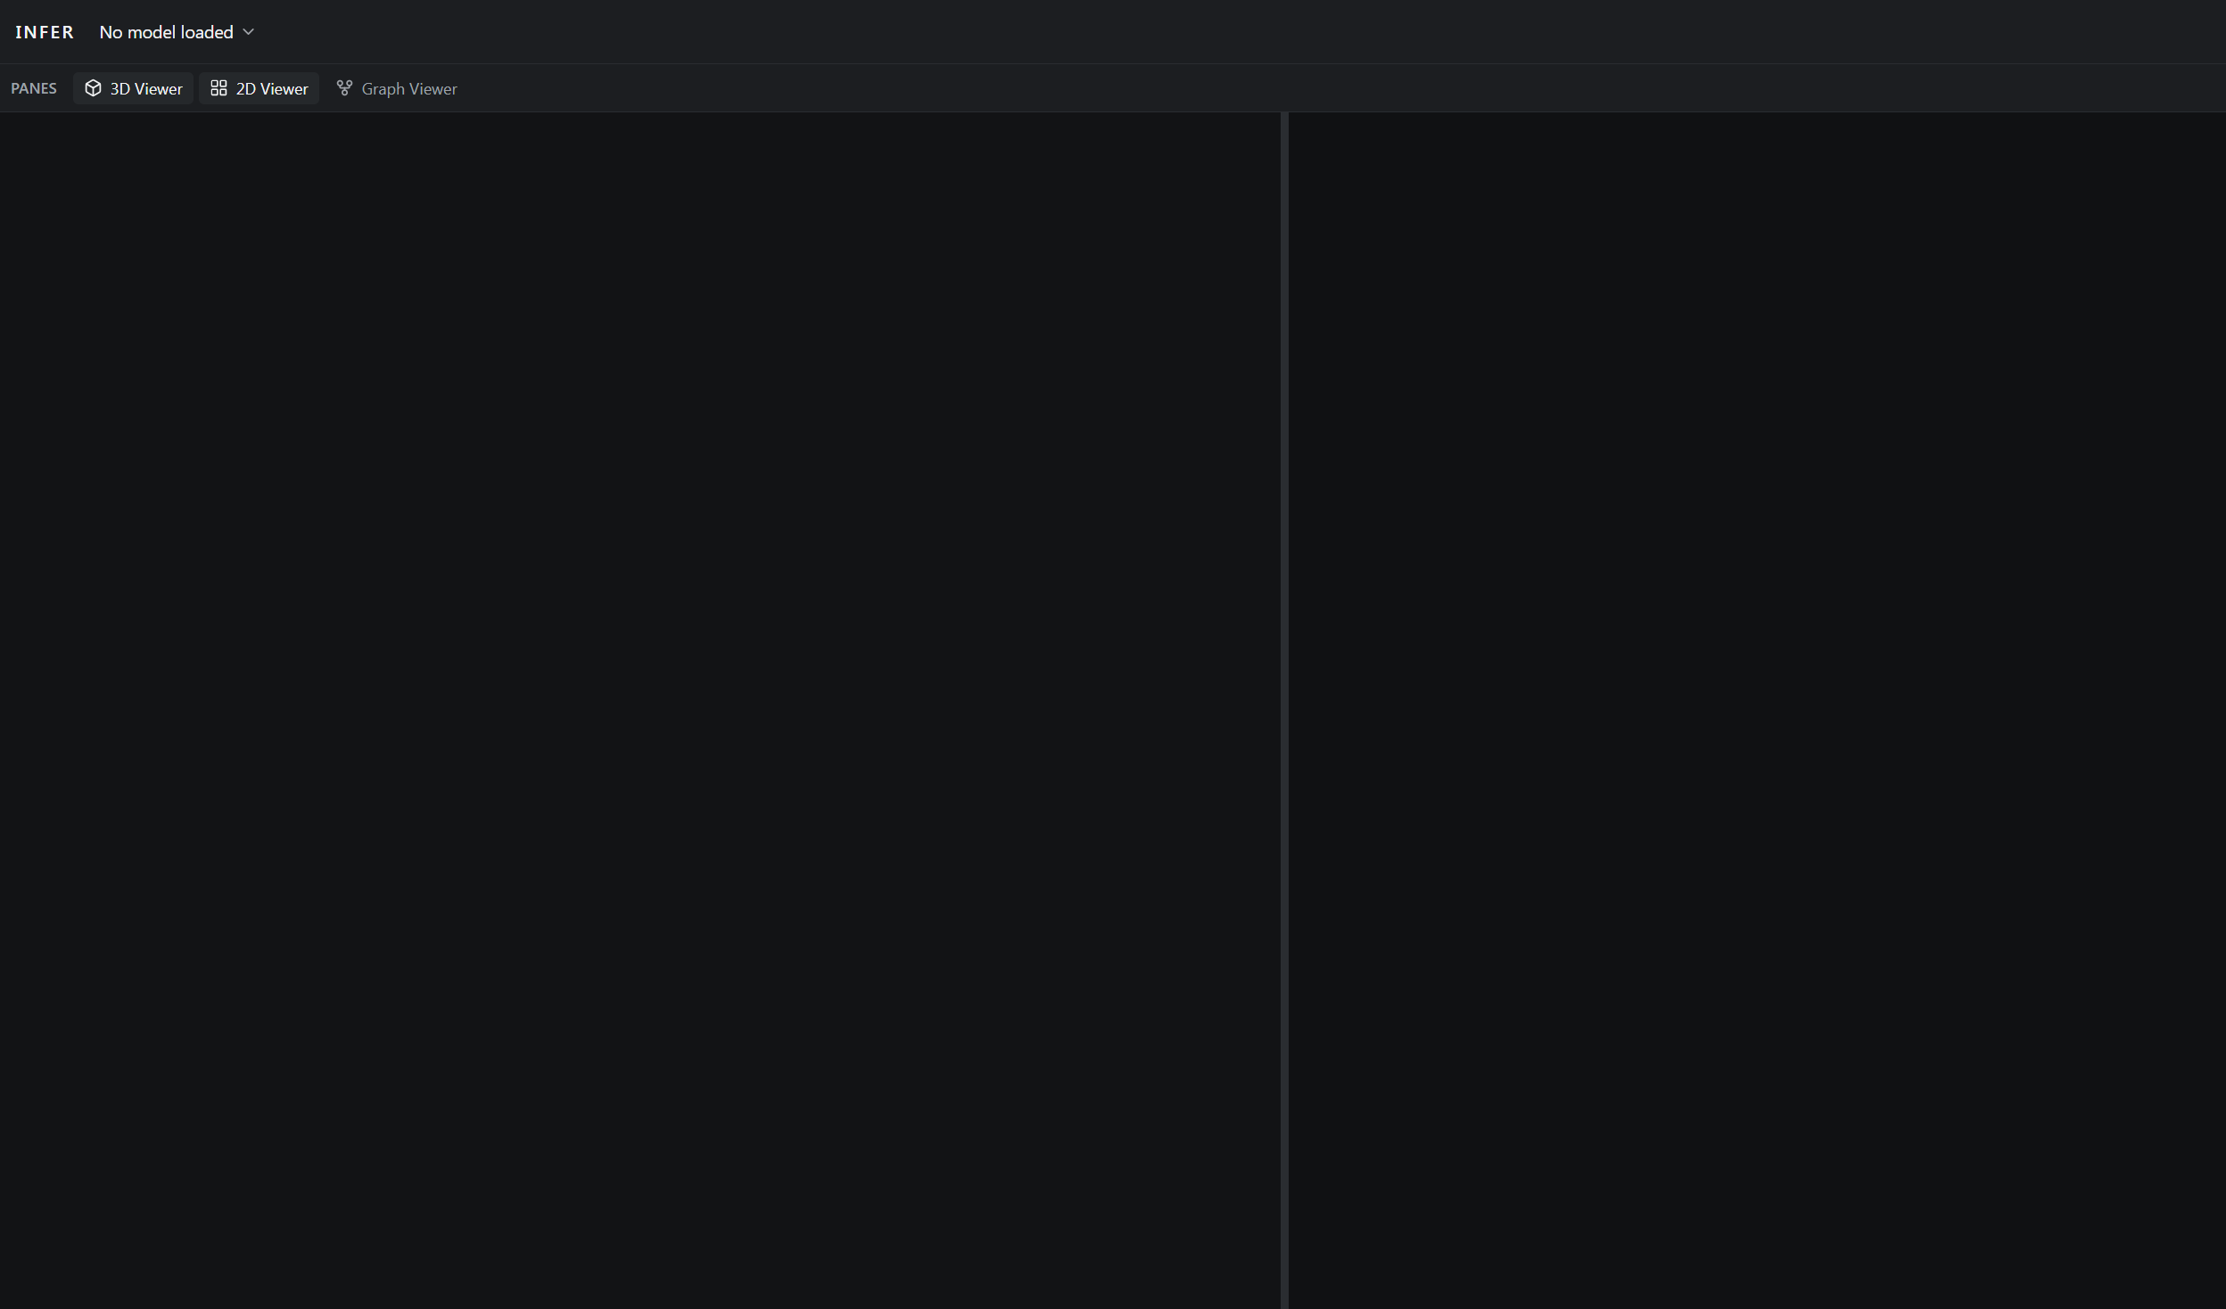
The workspace: three panes
3D Viewer — orbit or fly the BIM.
2D Viewer — one storey plan + routes.
Graph Viewer — rooms as a network.
Open / close panes from the bar.
Refresh clears the session — open the file again.
Real UI (before a model is loaded). Top bar: INFER · model menu · theme.
INFER · internship POC · not for life-safety sign-off
2

Slide 4
Open a model
Top bar → model name → Open model… · or the Open model button on an empty pane.
Accepts .ifc, .ifczip, .gml, .indoorgml.
Pipeline: upload → extract → footprints → geometry graph.
A large building can take minutes (furniture meshes).
Watch the dialog progress and the status line.
Files stay under data/ on this PC — not the cloud.
INFER · internship POC · not for life-safety sign-off
3

Slide 5
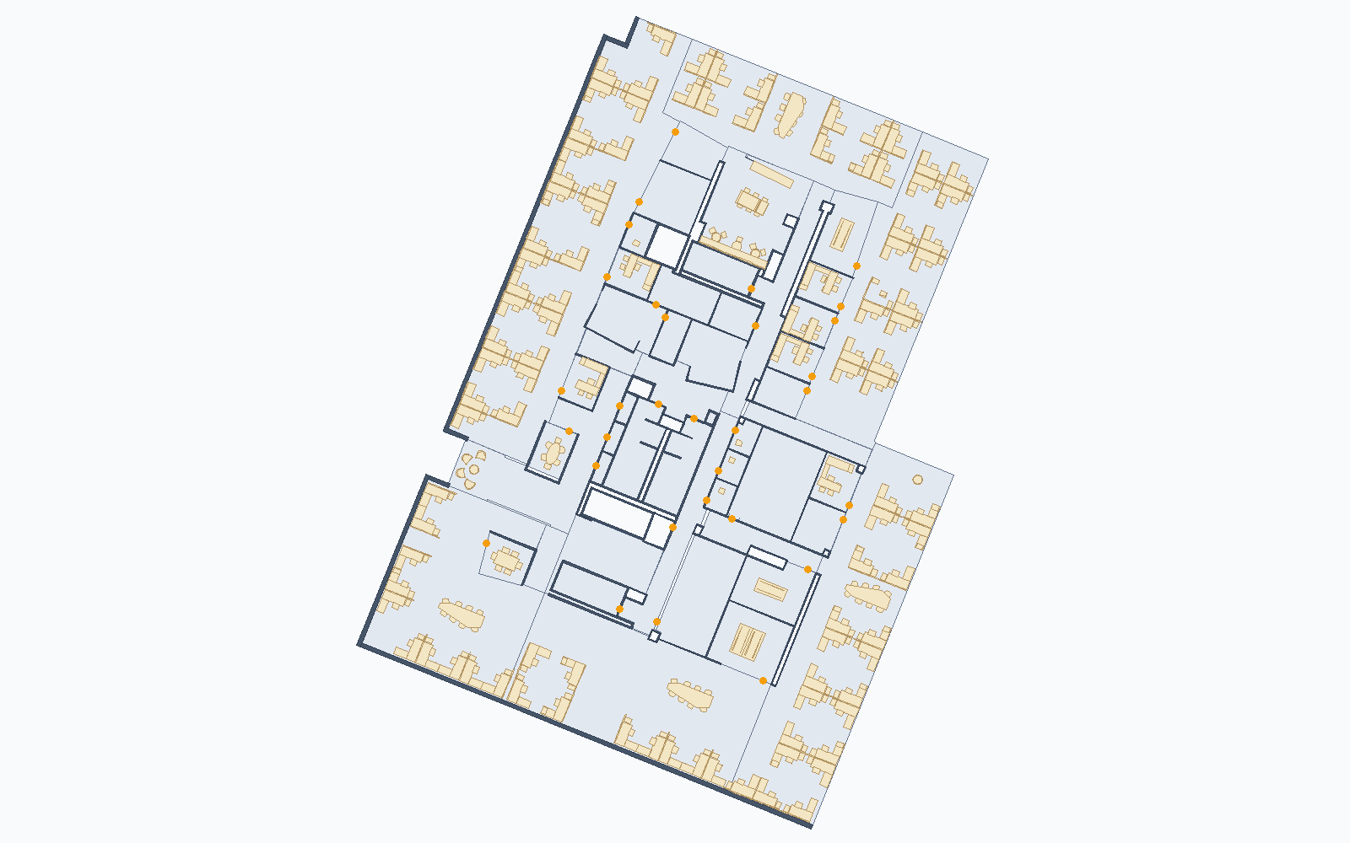
2D Viewer — the floorplan
Same footprints the app draws. Example: Trapelo existing-conditions, Floor 2.
INFER · internship POC · not for life-safety sign-off
4

Slide 6
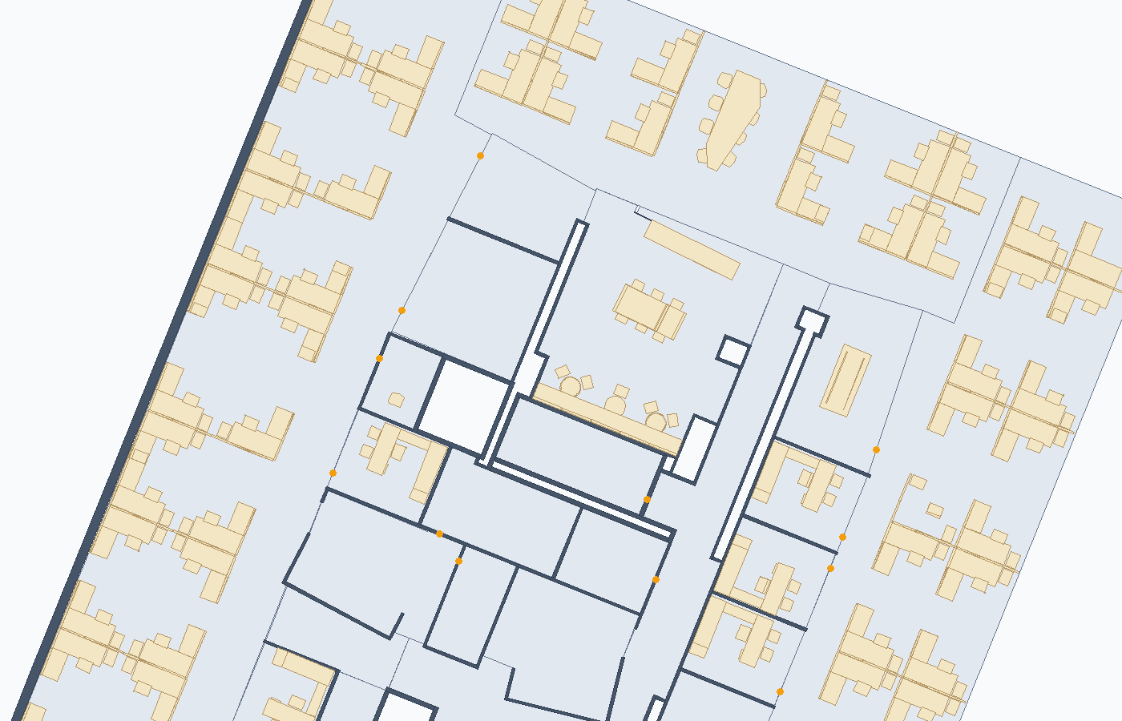
How to read the plan
Grey fill — rooms (walkable space).
Cream — furniture occupancy.
Not a rubber-band box around the cubicle.
Chair wells stay empty — you can walk there.
Amber dots — doors.
Legend toggles layers if it is too busy.
INFER · internship POC · not for life-safety sign-off
5

Slide 7
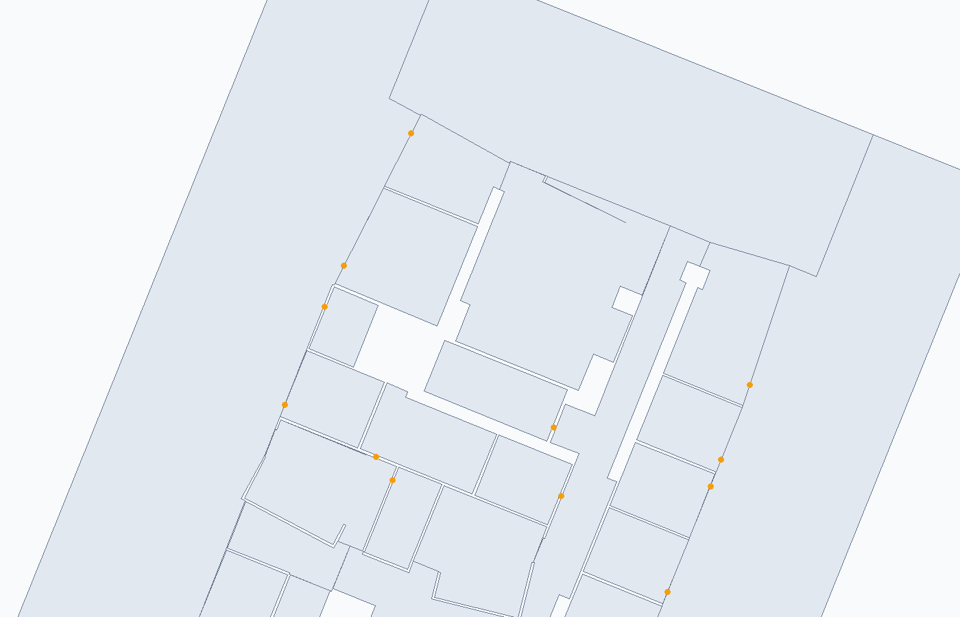
Ask for a route (Navmesh tab)
Switch 2D Viewer from IFC to Navmesh.
Route: right-click start, then end (other floor is OK).
Nearest exit: right-click once.
Long right-click clears the path.
Path stays ~40 cm off walls and goes around desks.
INFER · internship POC · not for life-safety sign-off
6

Slide 8
What-if and evacuation load
Double-click a door portal on Navmesh to block it for this session (file unchanged).
Evacuation load: every room walks to its nearest exit; hot doors/stairs carry more traffic.
Larger rooms count more than tiny ones — a sketch, not a fire-engineer’s model.
Blocking a door changes both the click-route and the heat.
Control panel (right): search by level / name, remove or restore entities.
INFER · internship POC · not for life-safety sign-off
7

Slide 9
Graph Viewer
Rooms (and stairs/lifts) as nodes. Most door nodes are hidden so you can read the picture.
Default graph after ingest is Geometry — IFC plus healed links (use this to route).
IFC-only is often too sparse on real exports.
Colours: yellow door heal, green opening, purple stair; grey = authored IFC.
Right-click a node or link to remove / disable; restore from Control.
Everyday paths: right-click the floorplan, not the graph.
INFER · internship POC · not for life-safety sign-off
8

Slide 10
3D Viewer and sharing
3D: Orbit, or Fly (WASD, Space up, Shift down, Ctrl faster).
Optional navmesh overlay; 3D storey clip is independent of the 2D level dropdown.
When a navmesh route exists, Share on the top bar: GLB download, USDZ on iPhone, or QR link.
Best export if the 3D pane is open and the IFC has finished loading.
INFER · internship POC · not for life-safety sign-off
9

Slide 11
Say this in a demo
This is a POC. Do not treat paths or exits as certified life-safety.
IFC quality matters — missing rooms or doors leave gaps.
Refresh loses the UI session; derived files remain on disk.
2D shows one storey; a multi-storey route draws the piece on the floor you are viewing.
If it will not route: you are on the IFC tab, the click missed a region, or a portal is blocked.
INFER · internship POC · not for life-safety sign-off
10

Slide 12
A five-minute walkthrough
1. Open model… and wait until the toast shows spaces and links.
2. 2D Viewer → pick a storey → IFC tab: show rooms and furniture.
3. Navmesh tab → Route → right-click two rooms (try another floor for the second click).
4. Nearest exit from the same start. Then block a door and repeat.
5. Turn on Evacuation load. Share the route if you want the 3D hand-off.
INFER · internship POC · not for life-safety sign-off
11

