Slide 1



SC2001 SCSA PROJECT 1
Group 3:
Ho Jian Feng
Isaac Chun
J’sen Ong
Notes:
im jsen , this isaac and jianfeng

Slide 2
1. ALGORITHM IMPLEMENTATION
Notes:
first lets talk about the algorithm implementation

Slide 3
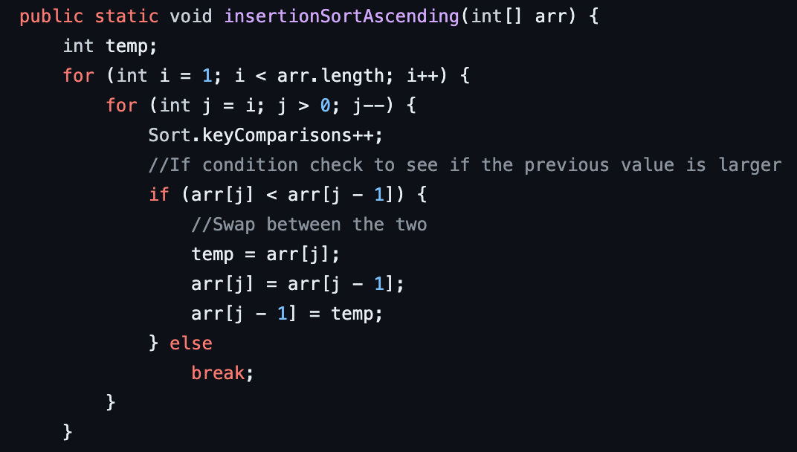
INSERTION SORT
Notes:
insertion sort is an efficient sorting algorithm for small datasets - is a strength that we will be taking advantage of in our hybrid sort implementation

Slide 4
MERGE SORT (TWO WAYS)
IN-PLACE
AUXILIARY
Sort elements within the same memory location
+ Memory efficient
- More complex compared to auxiliary (right-shifting)
Uses separate auxiliary array to perform merge step
+ Easier to implement (does not involve manipulating the original array)
- Memory intensive
Notes:
Next, merge sort - theres 2 different implementations of mergesort in-place and auxiliary. Each has its own advantages and tradeoffs, for inplace since it sort elements within the same memory location it is more memory efficient compared to auxiliary that uses separate array to perform merging . However, it is more complex to implement because of its right shifting approach to make space for the merged values

Slide 5
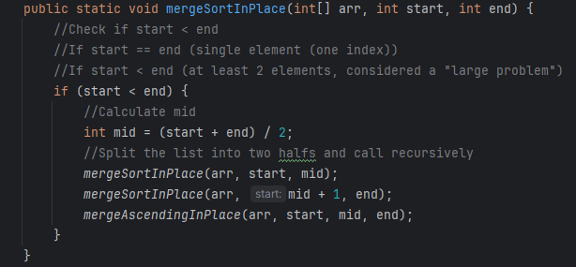
ALGORITHM IMPLEMENTATION
In-Place Merge sort:
Designed to sort an array without using additional memory space for merging
It modifies the original array during the sorting process
To merge two subarrays, it uses the same array by shifting elements as needed to create space to insert element
Notes:
so as i have mentioned in the previous slide, in-place merge sort modifies the original array during the sorting process, and right shift to create space for the merged values

Slide 6
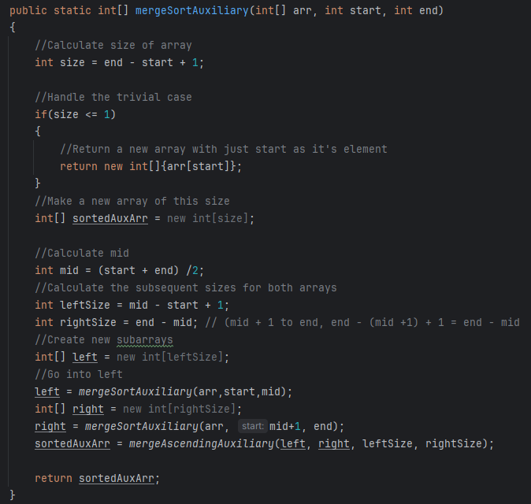
ALGORITHM IMPLEMENTATION
Auxiliary Merge sort:
Designed to use additional memory (separate temporary array) for merging the subarrays
It keeps the original input array unchanged and creates a separate array for merging and sorting which is assigned to the original array after completion
Notes:
next, auxiliary, we use a seperate temporary array and keep the original input array unchanged then assign it to the original array after completion

Slide 7
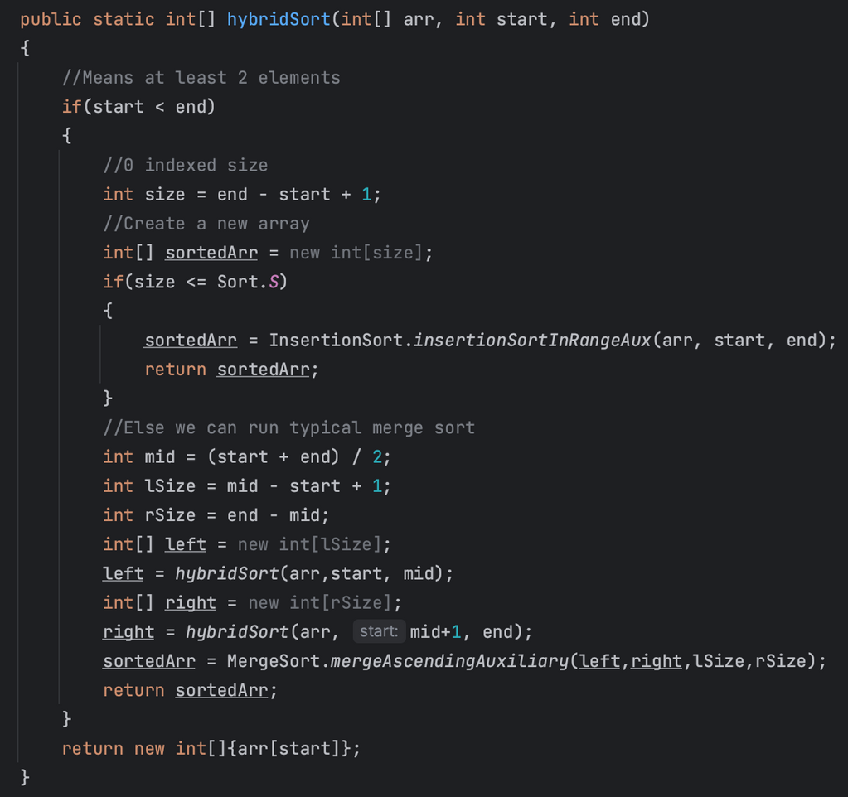

ALGORITHM IMPLEMENTATION
Hybrid Sort:
Merge Sort + Insertion Sort
Set an optimal integer S as a threshold for the size of subarrays
When size of subarrays <= S, the algorithm performs insertion sort on the subarrays
Insertion
Merge
Notes:
next i will be talking about hybrid sort, hybrid sort basically combines both insertion and merge sort algorithm, as we know, merge is efficient for large datasets but it incurs recursion overheads whereas insertion sort is efficient for small datasets but it has a low overhead
by using merge for most of the sorting process and switching to insertion sort for smaller subarrays, we can optimize overall sorting performance.
this can be done by setting an optimal interger S as a threshold for the size of subarrays, we use merge sort for any arrays with size > the threshold S. When the size of the subarray is less than or equal to S, we switch to insertion sort. This approach reduces the overheads associated with merge sort
's recursive calls on small arrays.

Slide 8
2. ANALYZING TIME COMPLEXITY
Notes:
We will now analyze and derive the time complexity of hybrid sort

Slide 9


THEORETICAL TIME COMPLEXITY OF
HYBRIDSORT
The time complexity of insertion sort for a single subarray of S elements:
Best case : O(S)
Worst case : O(S^2)
Since there are (N/S) such blocks each of size S, we get the time complexity of applying insertion sort as:
Best case : (N/S) * (S) = O(N)
Worst case : (N/S) * (S^2) = O(NS)
Notes:
The time complexity of insertion sort for a array of S elements is O(S), and its worst case is O(S^2)
There would be N/S blocks to do insertion sort on, and since for the best case, each subarray would only be considered S times, then the complexity becomes O(n). For the worst case, since each sub array would have S^2 comparisons, then the complexity becomes NS

Slide 10
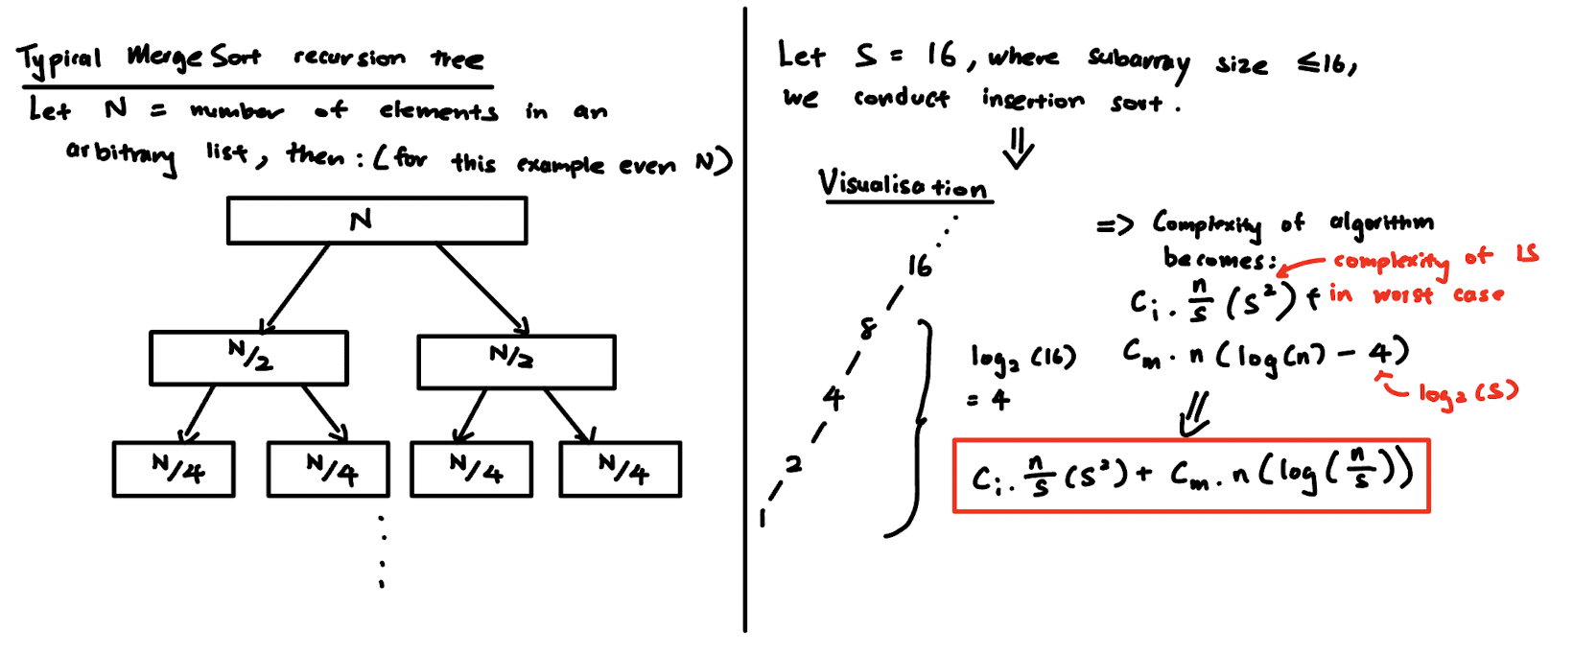
Notes:
Now to introduce a little into hybrid sort. On the left, we see a typical merge sort recursion tree, given an even N.

Slide 11
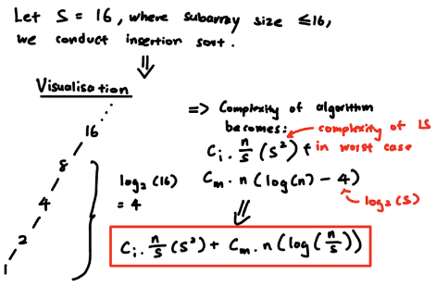
THEORETICAL TIME COMPLEXITY OF
HYBRIDSORT
The time complexity of merge sort on a single array of N elements:
Best case : O(N logN)
Worst case : O(N logN)
The time complexity is now:
Best case : N * (logN - logS) = O(N log(N/S))
Worst case : N * (logN - logS) = O(N log(N/S))
Notes:
Suppose we pick S = 16, where S is the threshold before conducting insertion sort. The constant factor of insertion sort is little and has also little overhead operations. If S = 16, we would have saved 4 subsequent levels of recursion, which would have added considerable overhead.
Hence, we would only do merge sort on log(n) - the levels we saved, which is log (S).
Therefore, we can calculate the complexity of hybrid sort to be some constant factor ci * n/s(s^2) + some factor cm. n(log n/s).

Slide 12
THEORETICAL TIME COMPLEXITY OF
HYBRIDSORT
THEREFORE THE TIME COMPLEXITY OF HYBRID SORT (INSERTION + MERGE) IS:
(Time complexity of InsertionSort applied to subarrays of size <= S) + (Time complexity of Mergesort applied to subarrays > S)
BEST CASE: N + N * LOG(N/S)
WORST CASE: NS + N * LOG(N/S)
Notes:
The time complexity of hybrid sort would then be the following in the best and worst case.

Slide 13
SUMMARY
Merge Sort
Insertion Sort
Hybrid Sort
Best Case
nlog(n)
n
n + nlog(n/S)
Worst Case
nlog(n)
n^2
nS + nlog(n/S)
Average Case
nlog(n)
n^2
nS + nlog(n/S)
Notes:
Summary of time complexity mentioned so far

Slide 14
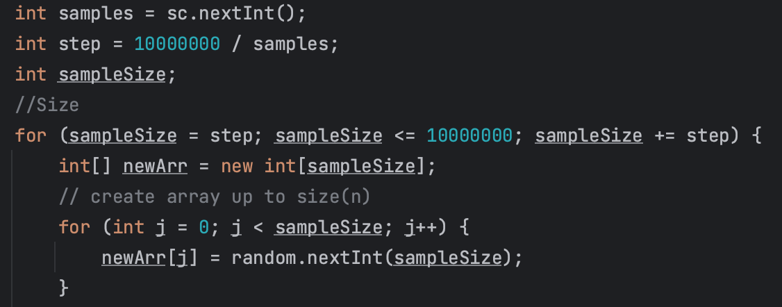
GENERATE INPUT DATA
1000 samples were taken out of 10m elements (10k, 20k, 30k, ..., 10m)
A random array is created at each step for sorting
Notes:
We took 1000 samples out of 10m elements so that we would get 1000 points to plot without much interpolation

Slide 15
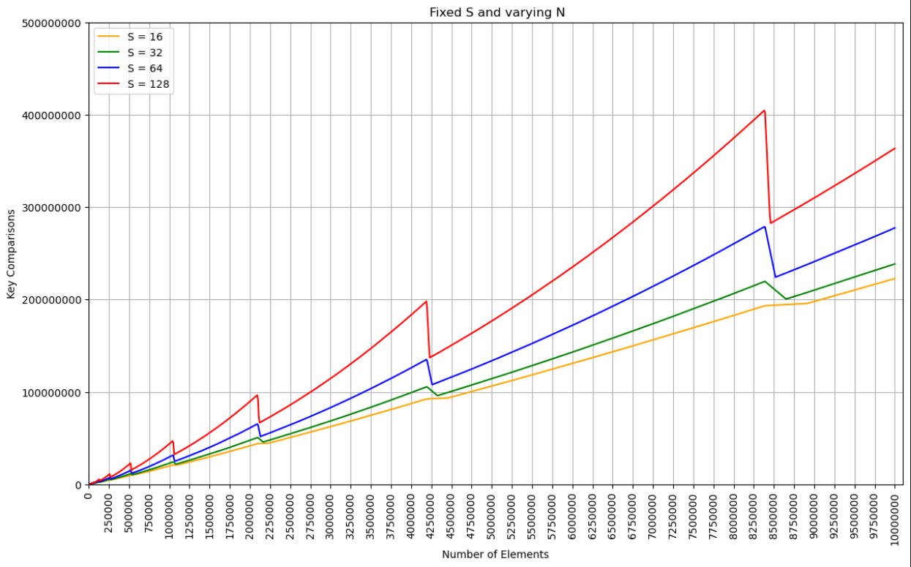
1. FIXED S & VARYING "N" INPUT LIST
Notes:
We first fix the value of S. As n increases, the proportion of elements undergoing insertion sort becomes lower. At the crossover point which is S, hybrid sort switches to mergesort which is more capable of sorting larger size arrays. Hence, at these crossover points, the key comparison decreases relative to the worst-case comparisons of insertion sort. This implies that hybrid sort has overall improved sorting performance for larger datasets.

Slide 16
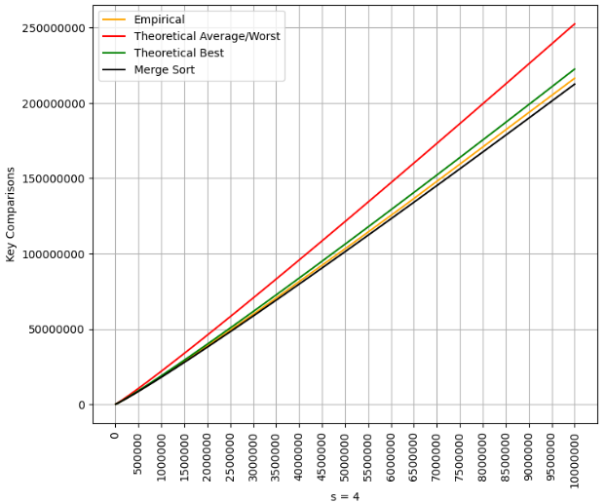
1. FIXED S & VARYING "N" INPUT LIST
Notes:
As s tends to be a very small value, insertion sort is carried out way less, and merge sort becomes dominant. We can see that the empirical results become very close to the theoretical complexity of merge sort which is n(logn)

Slide 17
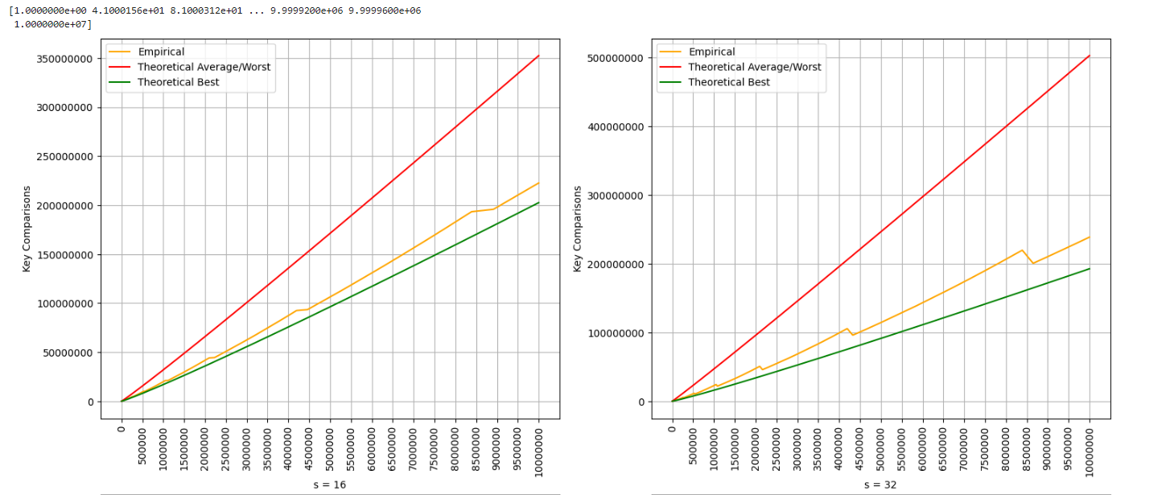
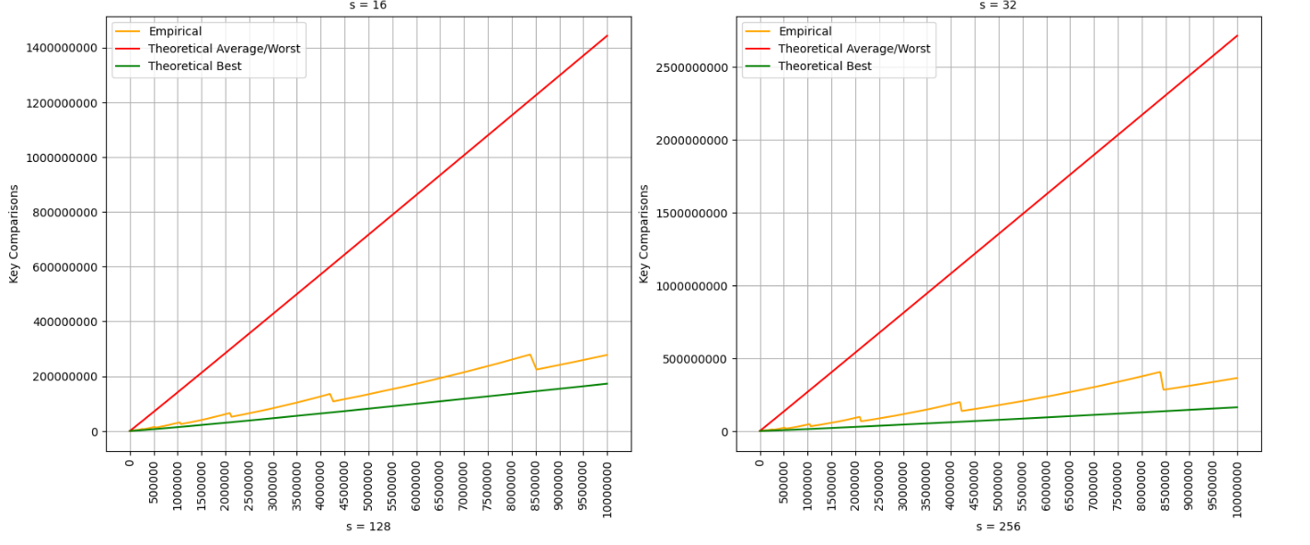
1. FIXED S & VARYING "N" INPUT LIST
LEGEND
THEORETICAL WORST
THEORETICAL BEST
EMPIRICAL
BEST CASE
N + N * LOG(N/S)
WORST CASE
NS + N * LOG(N/S)
Notes:
Plotting out the theoretical worst and best of hybrid sort for each S, we can notice that on average, it performs closer to the theoretical best at low N, and increases in key comparisons steadily as N increases.

Slide 18
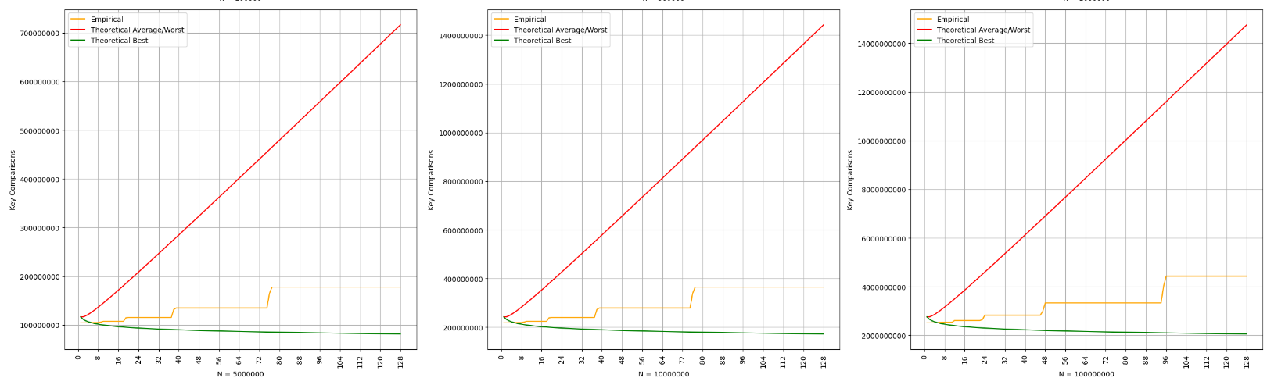
2. FIXED N & VARYING "S" INPUT LIST
LEGEND
THEORETICAL WORST
BEST CASE
N + N * LOG(N/S)
THEORETICAL BEST
EMPIRICAL
WORST CASE
NS + N * LOG(N/S)
Notes:
Fixing the value of N and varying S, we notice that there is a plateau at all graphs at certain points as S increases. This is because each sub array is divided into 2 at each iteration, creating an interval in between these two depths. Hence, if S falls between these two intervals, it would result in the same behaviour throughout that interval until the S value is finally > the initial depth.

Slide 19
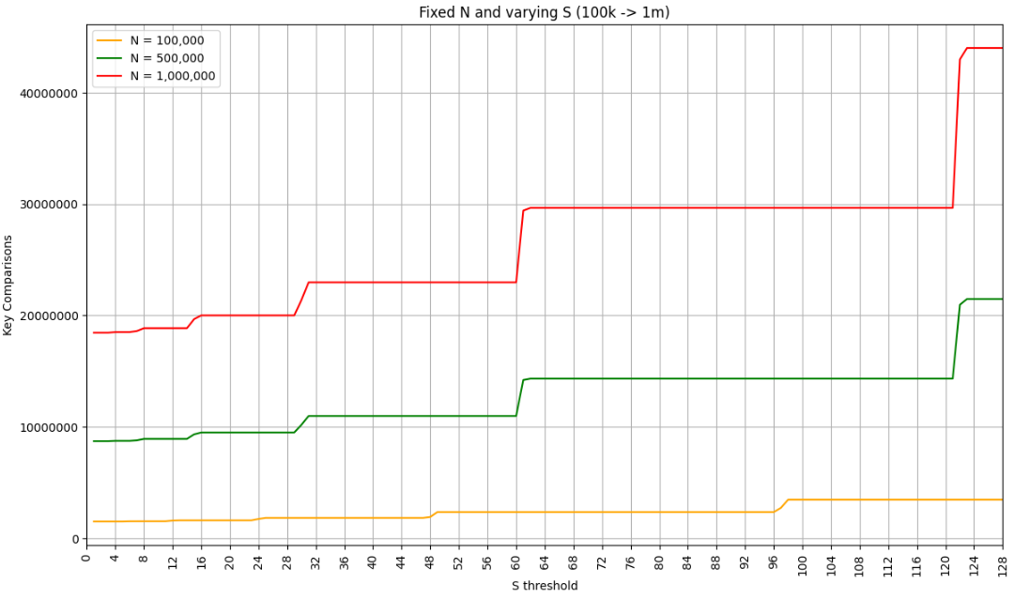
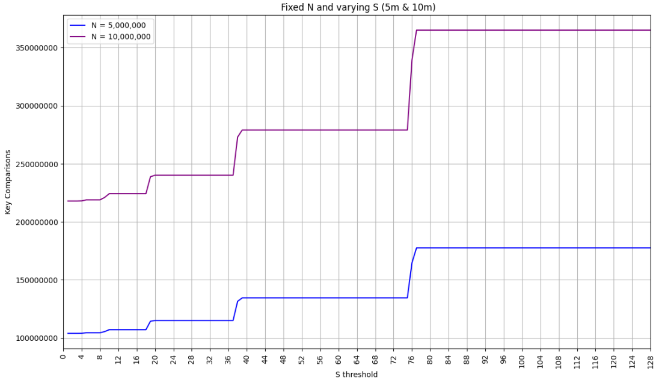
2. FIXED N & VARYING "S" INPUT LIST
LEGEND
N = 10,000,000
N = 5,000,000
N = 1,000,000
N = 500,000
N = 100,000
Notes:
This behavior exists throughout varying sizes of N. We notice that if an array size is x2 of another array size, they both will plateau at the same S because the arrays are divided into 2 each time.

Slide 20
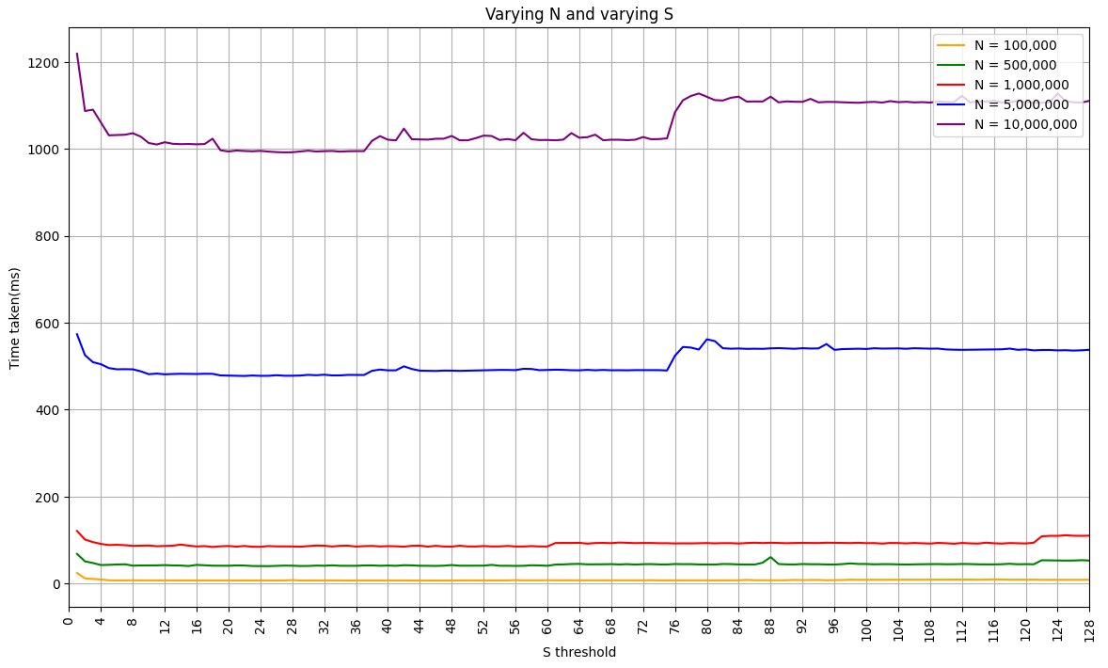
TIME TAKEN VS
S THRESHOLD
OPTIMAL S THRESHOLD:
S = 37
As S> 37, time taken starts increasing after initial decrease
S is now the maximised value to lower recursion overhead before the benefits wear off for large N
Notes:
The optimal S value involves a trade-off between minimizing the overhead of merge sort and taking advantage of insertion sort's efficiency for small subarrays. Hence, our optimal value is 37 as it is the max value before time taken starts to increase again.

Slide 21
4. COMPARISON WITH LECTURE’S MERGESORT
Notes:
Finally, we compare the performance of our algorithm with the lecture's merge sort that uses in place shifting

Slide 22
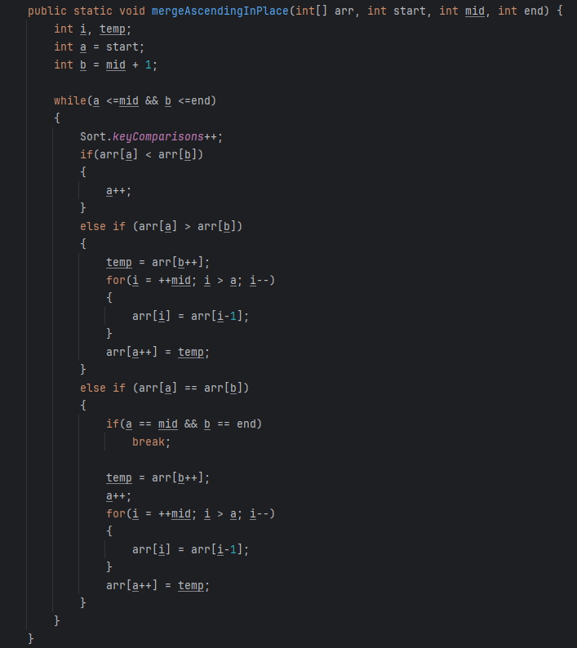
LECTURE MERGE SORT
THE RIGHT SHIFTS IN PLACE OF ELEMENTS DO NOT CHANGE KEY COMPARISONS
Huge amount of time taken to do right shifts as n->inf
Notes:
The merge sort for the lecture does many right shifts in place of elements, which are not counted in the key comparisons.
This takes a huge amount of time as n-> inf

Slide 23
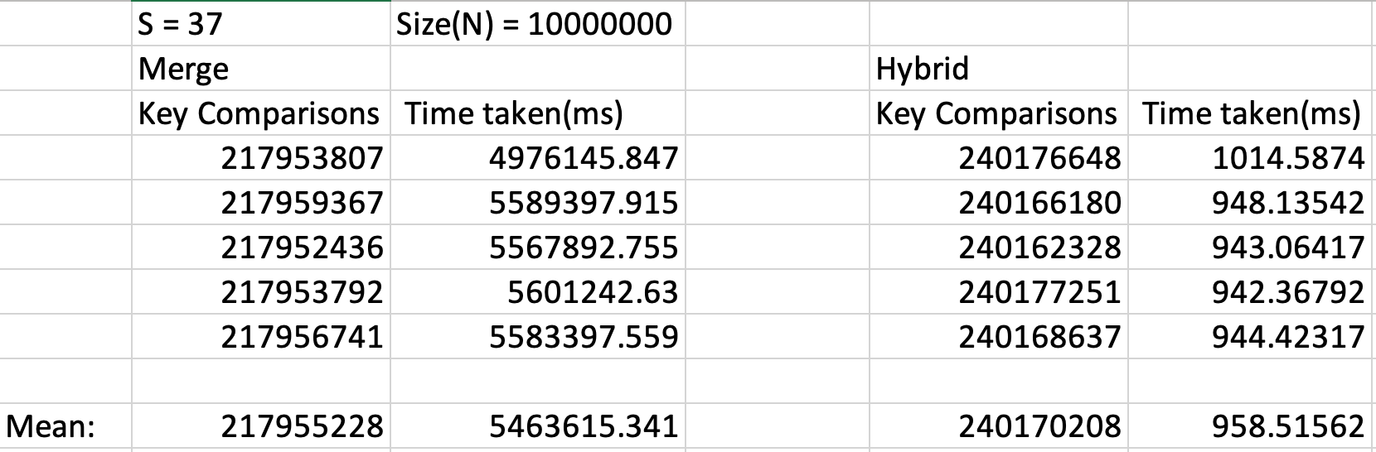
LECTURE MERGE SORT (5 SAMPLES)
RESULTS:
Key Comparisons: Lecture Mergesort < Hybrid Sort
Time taken: Lecture Mergesort > Hybrid Sort
Notes:
Comparing the lecture's merge sort against our hybrid sort with our optimal S, the key comparison of the merge sort is < our hybrid sort, but as mentioned, the time taken is exponentially higher, with each iteration taking around 1.3 to 1.7 hrs depending on array. This is due to the right shifting.

Slide 24
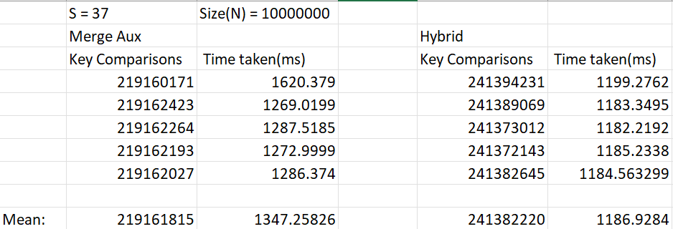
AUX MERGE VS HYBRID (5 SAMPLES)
RESULTS:
Key Comparisons: Aux Mergesort < Hybrid Sort
Time taken: Aux Mergesort > Hybrid Sort
Notes:
Another alternative is to use an auxiliary list to merge as mentioned earlier, and in this case, the same result is present, where the key comparison of an aux merge is < our hybrid, but the time taken for hybrid is faster.

Slide 25
CONCLUSION
OPTIMAL S: 37
Recursion overhead increases runtime (varies between languages used) until it overpowers larger key comparisons
Finding the optimal S varies between the type of data used and on varying needs
Notes:
Hence in conclusion, we found our optimal S to be 37. And, recursion overhead increases runtime. However, this varies between languages, especially in Java as it must create a method call block, which is repeated at each stage of recursion. Still, as the amount of recursions increases, it overpowers larger key comparisons in terms of time.
Lastly, finding the optimal S varies between the type of data used and on varying needs, and S always has to be altered based on the data and software we are working with.

Slide 26
THANK YOU

