Slide 1
CSS430 OS Structures Textbook Chapter 2
Instructor: Prof. Dimpsey
e-mail: dimpsey@uw.edu

Slide 2
Interrupts / System Calls
Gateway To the kernel

Slide 3
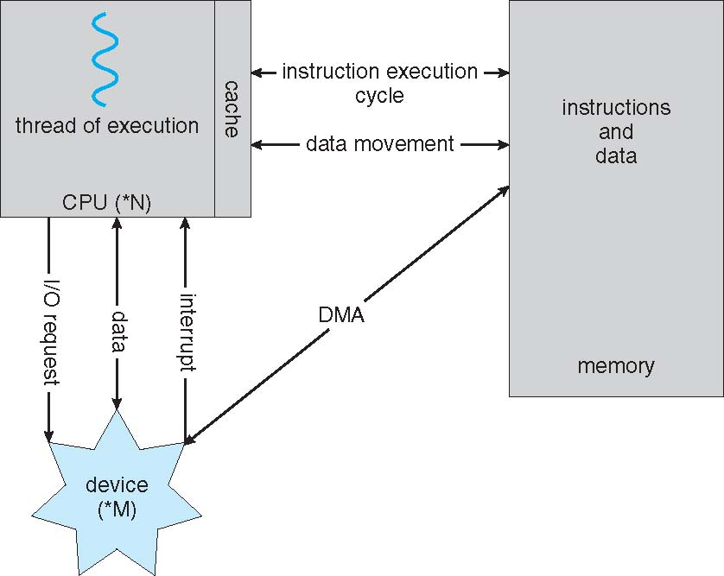
How all Modern Computers Work

Slide 4
Kernel v. User Mode
Purpose
With resource sharing, many programs could be affected by a bug in one program.
Incorrect or malicious resource accesses cause a hardware trap to the operating system.
Dual-Mode Operation
Implemented using hardware protection provided by the CPU
User mode: no privileged instructions allowed.
Kernel mode: privileged instructions allowed.

Slide 5
How a system call works
Hardware support differentiates two modes of operations.
1) User Mode – execution done on behalf of a user.
2) Kernel Mode Monitor mode– execution done on behalf of OS
Switching between two modes
Device interrupts, hardware traps, system calls cause a trap to the kernel mode
The operating system returns to the user mode after servicing requests.
user process
user process
executing
system call
return from system call
user mode
(mode bit=1)
trap
mode bit=0
return
mode bit=1
kernel
kernel mode
(mode bit=0)
execute system call

Slide 6
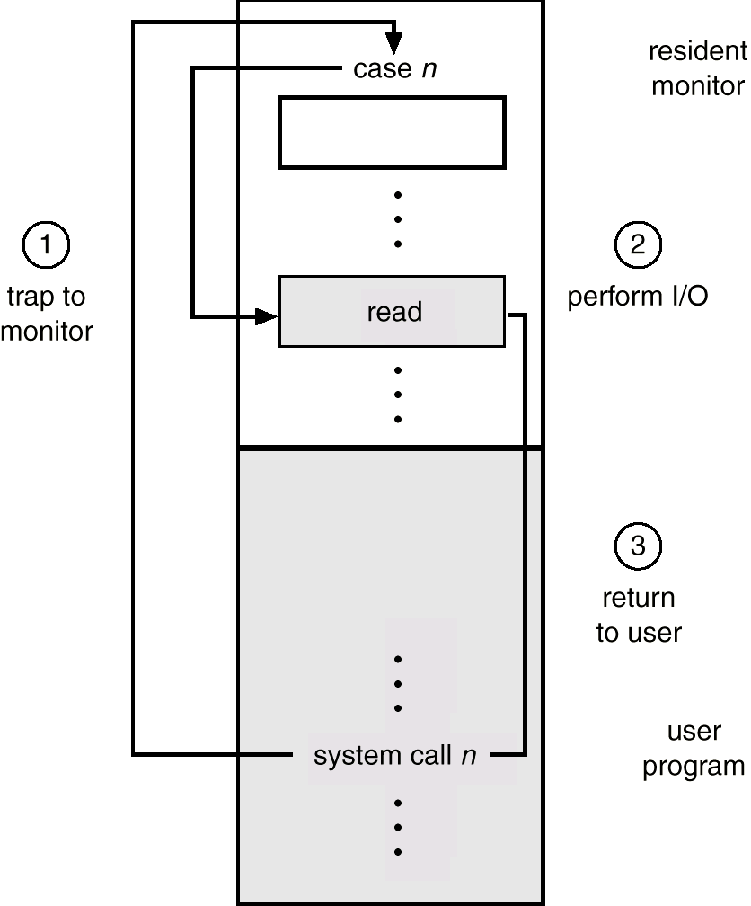
System Calls

Slide 7
Synchronous I/O
Requesting process does not make forward progress while waiting on I/O
Requesting process
waiting
user
Device Driver
kernel
Interrupt Handler
Hardware
data transfer
time

Slide 8
Async I/O
Asynchronous I/O returns control to a user program without waiting for the I/O to complete.
When the I/O is completed
An interrupt sent to CPU
Interrupt handler runs
Temporarily stops executing the user program
Handles the I/O device.
Requesting process
continuing
user
Device Driver
kernel
Interrupt Handler
Hardware
data transfer
time

Slide 9
Operating System
CORE FEATURES

Slide 10
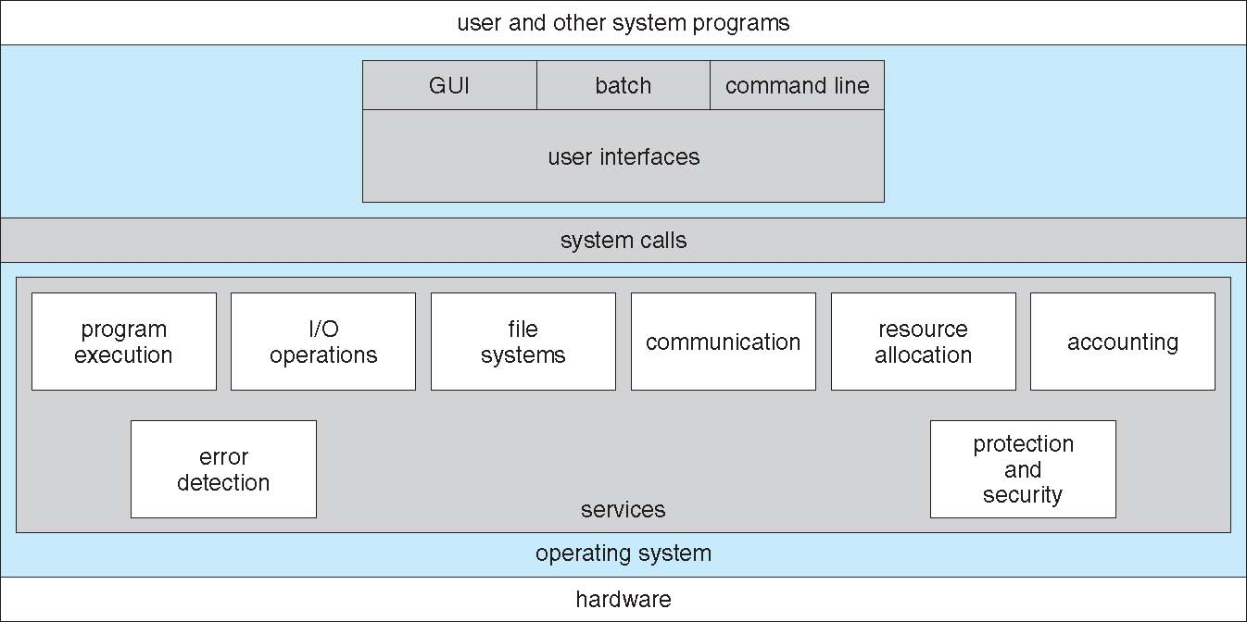
A View of OS Services

Slide 11
Fork
Let’s Code!
https://www.youtube.com/watch?v=mM_CjzSBHMY

Slide 12
Class Bell
1.7.2021

Slide 13
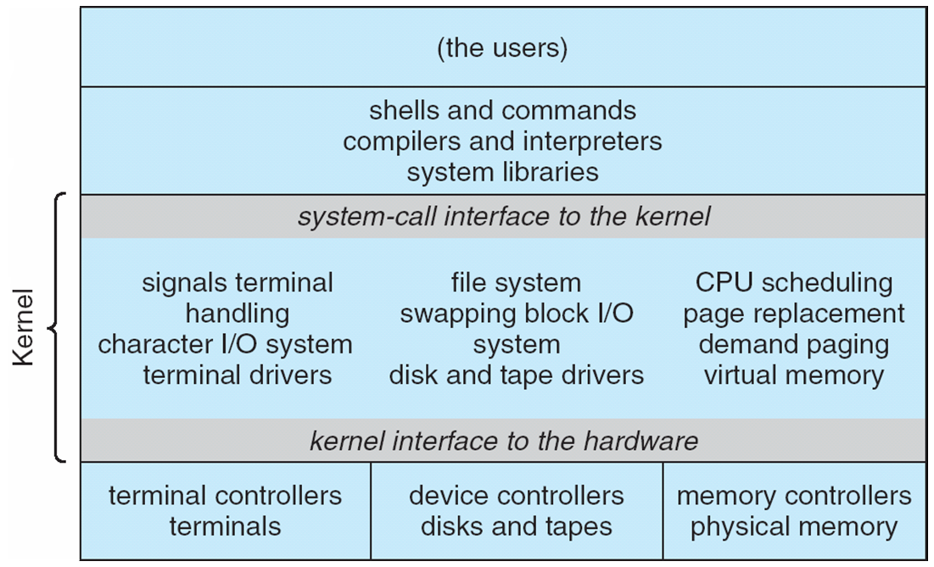
Traditional UNIX System Structure

Slide 14
Process Management
A program running within a process needs:
CPU Execution Time (allocation)
Memory (for instructions and data)
Files
I/O Devices (network, keyboards, graphics, printers, …)
Process is the fundamental unit of work in a system.
Operating System Processes (system code)
User Processes (user code)
A process can have 1 or more (concurrent) threads
Each thread has a program counter on a program sequence
Each thread is considered a separate execution sequence

Slide 15
Process Management Activities
Scheduling of processes and threads
Creating/Deleting processes (system and user)
Suspending and Resuming processes
Process Synchronization
Process Communication

Slide 16
Memory Management
Main Memory
CPUs are only able to access programs and data in main memory.
Very large, but volatile and varies in speed
Contains bytes or words each with their own address
Programs/Executables
Mapped to absolute addresses
Loaded into main memory
Accessible to multiple threads (via different program counters)
Three Major OS Memory Management activities:
Keeping track of memory used and by whom
Deciding which processes and data to move in/out of memory.
Allocating and Deallocating memory as necessary.

Slide 17
File System Management
File
The logical unified view of information storage
Logical storage unit abstracted from the details of the device by OS
File System
Controls access from multiple users (e.g. read, write, append)
Organizes the structure (e.g. directories / subdirectories of files)
Interacts with storage device drivers (abstracting details)
Often works closely interacting with memory manager

Slide 18
File System Management Activities
Creating and Deleting files
Creating and Deleting folders(directories) to organize files
Primitives for manipulating files and directories
Mapping files to secondary storage media
Backing up files to non-volatile storage media

Slide 19
Mass-Storage Management
Disks used to store data that
does not fit in main memory
must be kept for a “long” period of time.
Speed of computer operation hinges on disk subsystem and its algorithms
OS activities
Free-space management
Storage allocation
Disk scheduling

Slide 20
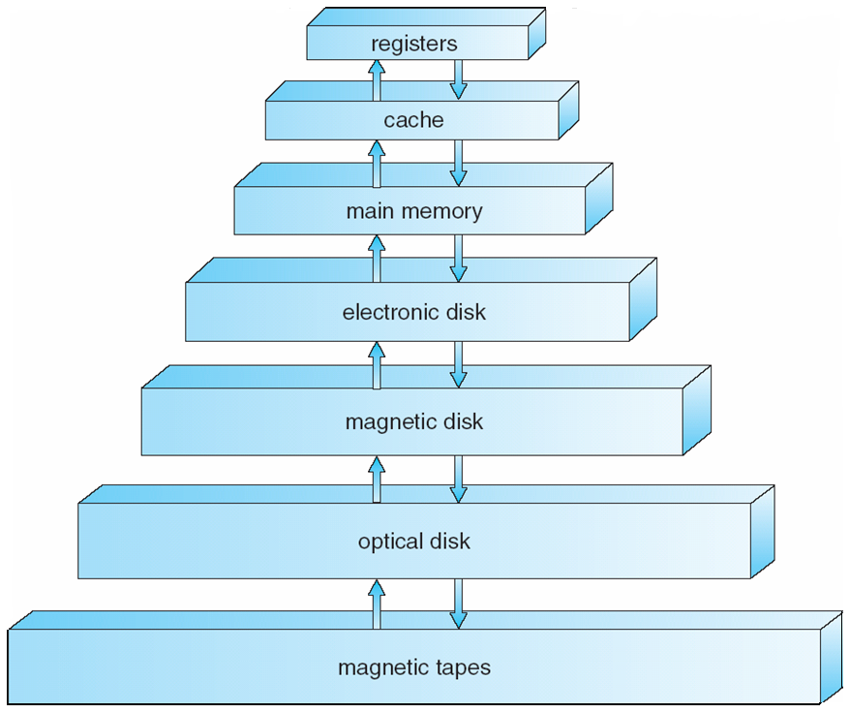
Storage-Device Hierarchy

Slide 21
Caching
Important principle, performed at many levels in a computer
Hardware
operating system
Database
Applications
Information in use copied from slower to faster storage temporarily
Faster storage (cache) checked first to determine if information is there
If it is, information used directly from the cache (fast)
If not, data copied to cache and used there
Cache smaller than storage being cached
Cache management important design problem
Cache size and replacement policy

Slide 22
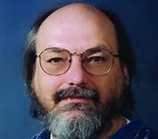
Computer Scientist of the week
Ken Thompson
Inventor of Unix with Dennis Ritchie at Bell labs
Kernel, Shell, Utilities
Goals: simple, communal
Inventor of B- -predecessor of C
UTF-8 Encoding
Turing award in 1983
Co-creator GO
Current user of Linux OS ☺.

Slide 23
Traditional UNIX System Structure

Slide 24
Other OS Functions
Network
Communication backbone between systems
Allows for distributed computing
Supporting various network protocols
FTP, NFS, HTTP
TCP/UDP
IP
Protection/Security
Authentication (password, defending ext. I/O, bytecode verifier )
Access authorization (access mode, javsandbox a model)
Cryptography

Slide 25
OS Features
Process Management Week 2-6
Main Memory Management Week 6-8
File Management Week 8-9
Distributed Systems Week 10
Networking CSS432
Protection System Week 10
Command-Interpreter System Today

Slide 26
Pipe
Let’s Code

Slide 27
Program 1
INTRO

Slide 28
Command Interpreters (Shells)
The program that reads and interprets control statements
Command-line interpreter (in DOS)
Shell (in UNIX)
What control statements can you pass the shell?
Program execution: a.out, g++, vim, emacs
Process management: ps, kill, sleep, top, nice, pstack
I/O operations: lpr, clear, lprm, mt
File-system manipulation: ls, mkdir, mv, rm, chmod, [u]mount
Communication: write, ping, mesg
Uses $PATH to find commands

Slide 29
Shell (bash)
Fork, exec, wait and dup are System calls
# ssh dimpsey@uw1-320-15.uwb.edu
sshd
fork, exec and wait
$
bash
(1) fork & wait
(7) exit
(4) exec
(5) exit
Shell
wc -l
(3) fork & wait
Shell
who
$ who | wc -l
(6) exec
cin
cout
(2) pipe

Slide 30
Class Bell
1.7.2021

Slide 31
Announcements / Agenda
Program 1: Due Jan 22
Homework 2: Due Jan 21
Agenda
Microkernel Review
Program 1 Questions
System Call Review
Exec-Pipe Example
Virtualization
The Process

Slide 32
Case Study of message passing system Mach
Mach communication is message based
Tasks are units of execution
File system is task-based
Device drivers are task-based
All Systems task based
Tasks have mailboxes for communication
Task gets two mailboxes at creation- Kernel and Notify
Mailboxes/ports created with port_allocate()call
System calls are messages
Three system calls needed for message transfer:
msg_send(), msg_receive(), msg_rpc
Excellent separation of concerns and modularization of subsystems
Device Driver cannot take down kernel
Filesystem cannot take down the kernel
Generally suffers from performance issues. Message passing is expensive!

Slide 33
Program 1
Questions?

Slide 34
DISCUSSION
Timers can be used to compute the current time. How do operating systems acquire and manage to keep accurate time?
What is a context switch and what does an OS do during a context switch?
Why does a segmentation fault in my in my C++ program not effect other users?
What are the major areas of a processes virtual memory?

Slide 35
System Calls
The DOORWAY TO THE KERNEL

Slide 36
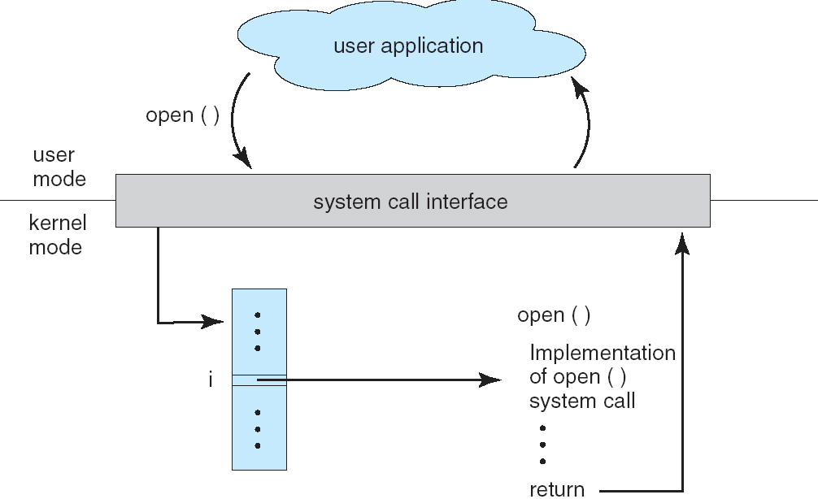
System Calls

Slide 37
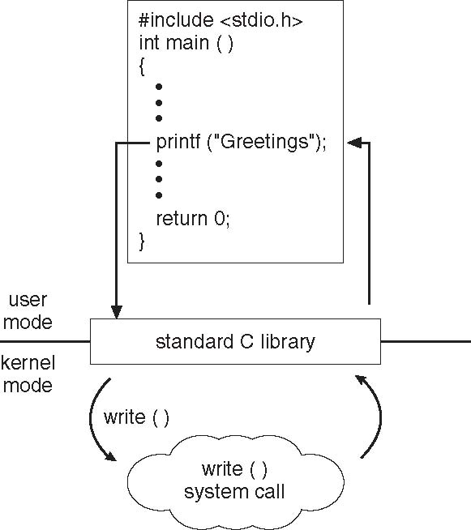
Standard C Library Example
C program invoking printf() library call, which calls write() system call

Slide 38
System Call Parameter Passing
Often, more information is required than simply identity of desired system call
Exact type and amount of information vary according to OS and call
Three general methods used to pass parameters to the OS
Simplest: pass the parameters in registers
In some cases, may be more parameters than registers
Parameters stored in a block, or table, in memory, and address of block passed as a parameter in a register
This approach taken by Linux and Solaris
Parameters placed, or pushed, onto the stack by the program and popped off the stack by the operating system
Block and stack methods do not limit the number or length of parameters being passed

Slide 39
System Calls
Process control
end, abort
load, execute
create process, terminate process
get process attributes, set process attributes
wait for time
wait event, signal event
allocate and free memory
File management
create ﬁle, delete ﬁle
open, close
read, write, reposition
get ﬁle attributes, set ﬁle attributes
Device management
request device, release device
read, write, reposition
get device attributes, set device attributes
logically attach or detach devices
Information maintenance
get time or date, set time or date
get system data, set system data
get process, ﬁle, or device attributes
set process, ﬁle, or device attributes
Communications
create, delete communication connection
send, receive messages
transfer status information
attach or detach remote devices

Slide 40
Exec and Pipe
Let’s Code!

Slide 41
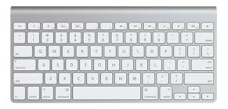
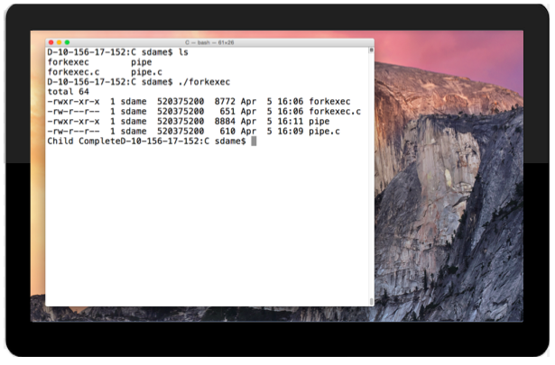
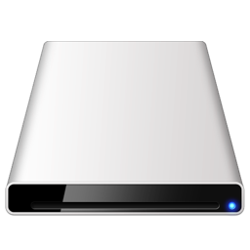

File Descriptors
File Descriptors
Name | File No | Description
Std In | 0 | Key Input
Std Out | 1 | Out from Console
Std Error | 2 | Error Output to Console
Hdrive file | 3 | R/W File
… | … | …
CD ROM file | 7 | R/O File
… | … | …
Hdrive file | 42 | W/O File
Device Layer
/dev/input
/dev/tty
/dev/sda
/dev/sr0

Slide 42
Class Bell
1.14.2021

Slide 43
Virtualization

Slide 44
Virtualization: VMWare, HyperV, …
non-virtual machine
virtual machine system
Processes
Processes
Processes
Processes
Programming
Interface
Kernel
(ex. RedHat)
Kernel
(ex. Win10)
Kernel
(ex. Ubuntu)
VM1
VM2
VM3
Kernel
(ex. RedHat)
“Bare-metal” OS (e.g. Mac OSX)
Hardware
Hardware

Slide 45
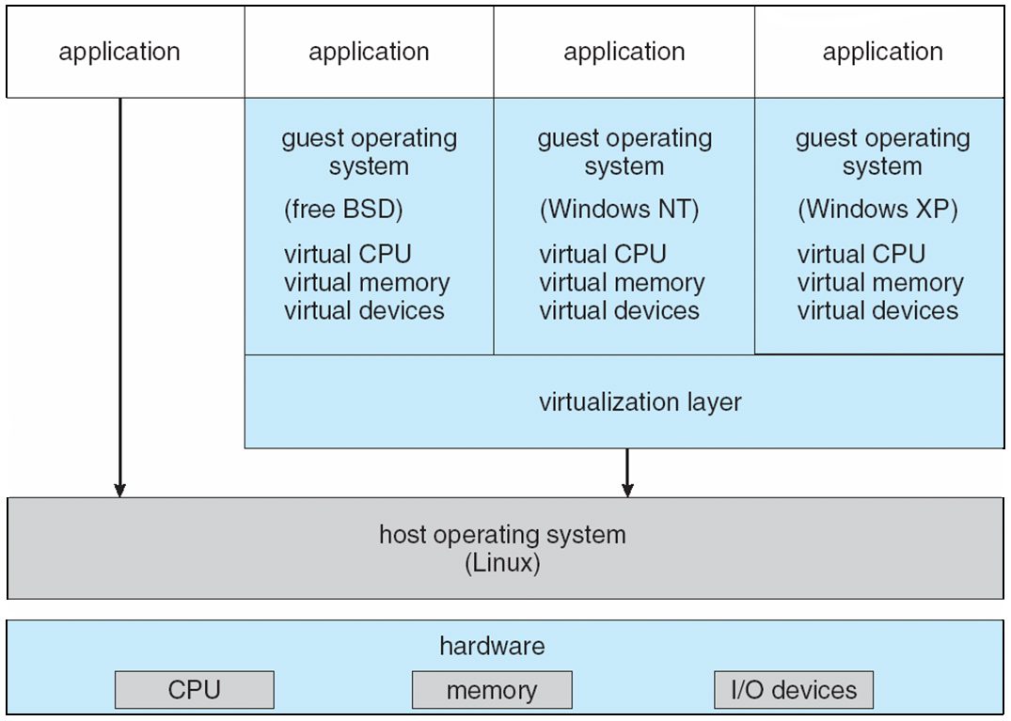
VMware Architecture

Slide 46


Virtualization in the cloud
http://azure.microsoft.com/en-us/
http://aws.amazon.com/ec2/

Slide 47
Java
Arch Overview

Slide 48
Java Technology
Programming-language specification
C++-like object oriented programming language
No system-dependent descriptions
Variable sizes are universally defined over different machines
No direct operating system calls are supported
Automatic memory operations: no delete
Multithreaded support
Application-programming interfaces (API)
Various system-provided classes: graphics and I/O
Virtual-machine specification
Interpretation of architecturally independent bytecode

Slide 49
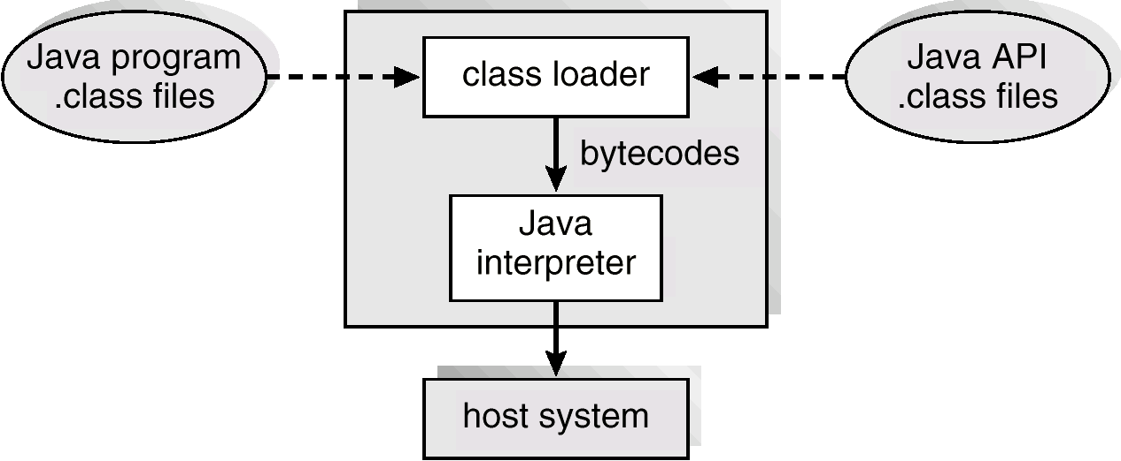
Java Virtual Machine (JRE)

Slide 50
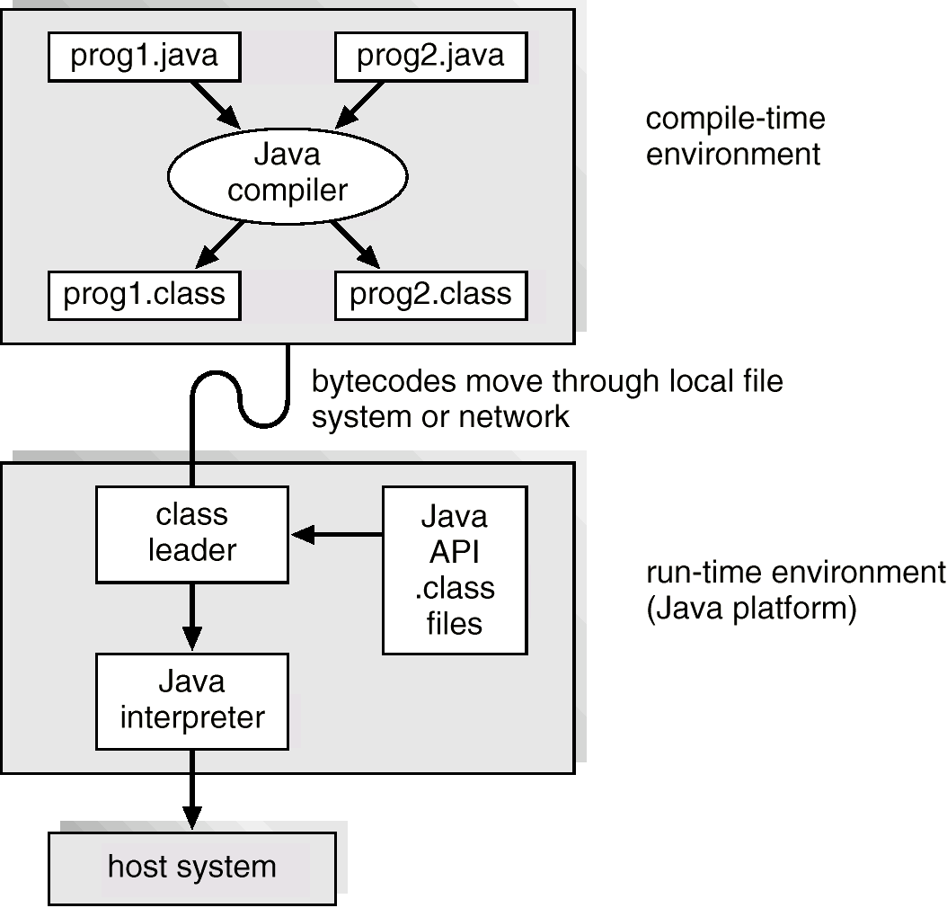
Java Development Environment: (SDK)

Slide 51
JVM provides similar features as OS
JVM is another form of virtualization
“Process Management”
Loading/Executing
Threads
Scheduler
Synchronization
Memory Management
Allocation
Heap
Garbage Collection
File Management
IO through layers on top of OS
JIT compilers introduced for speed
Byte codes not interpreted
Compiled to machine code

Slide 52
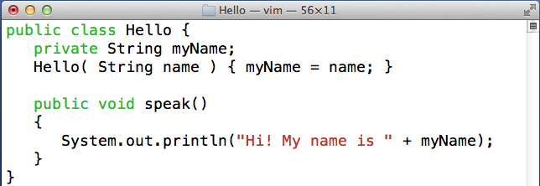
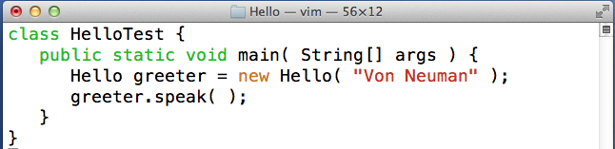
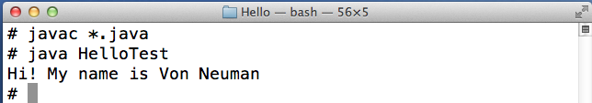
Java Program
Java Program
Hello class
+
a method
Test class
has
main()
compile &
execute
HelloTest

Slide 53
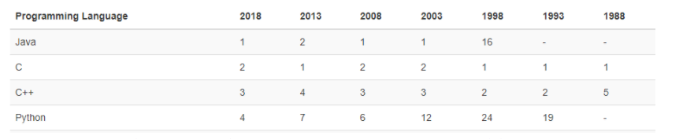
CLASS DISCUSSION
Why did Java become so popular?

