Slide 1
CSS430 Process Management Textbook Chapter 3
Instructor: Professor Dimpsey
e-mail: dimpsey@uw.edu

Slide 2
Processes

Slide 3
Process
Process: a program in execution
Sometimes a process is referred to as a job
A process includes:
Program counter
Stack (local variables)
Data section (global data)
Text (code)
Heap (dynamic data)
Files (stdin, stdout, stderr, other file descriptors)
Pointers to other metadata

Slide 4
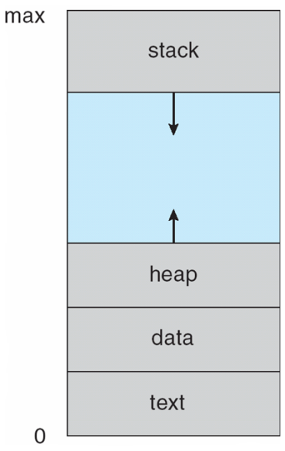
Process Address Space

Slide 5
Process Control Block
All of the information needed to keep track of a process when switching context.
PCBx
Process ID
Process State
.
.
Code (Text)
.
.
.
Flags, Switches, Priority
Program Counter (PC)
CPU Registers
Data
Memory Limits
List of Open Files
More...

Slide 6
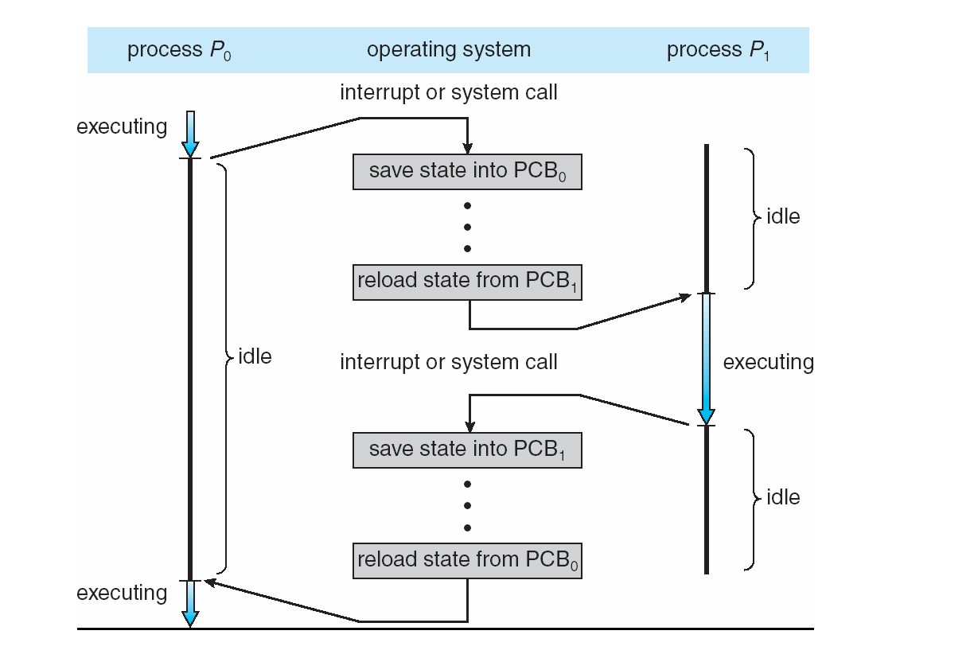
Context Switch
PCB0
PCB1
Process ID
Process ID
Process State
Process State
Flags, Switches, Priority
Flags, Switches, Priority
Program Counter (PC)
Program Counter (PC)
CPU Registers
CPU Registers
Memory Limits
Memory Limits
List of Open Files
List of Open Files
More...
More...
PCB0
PCB1
Process ID
Process ID
Process State
Process State
Flags, Switches, Priority
Flags, Switches, Priority
Program Counter (PC)
Program Counter (PC)
CPU Registers
CPU Registers
Memory Limits
Memory Limits
List of Open Files
List of Open Files
More...
More...
PCB0
PCB1
Process ID
Process ID
Process State
Process State
Flags, Switches, Priority
Flags, Switches, Priority
Program Counter (PC)
Program Counter (PC)
CPU Registers
CPU Registers
Memory Limits
Memory Limits
List of Open Files
List of Open Files
More...
More...

Slide 7
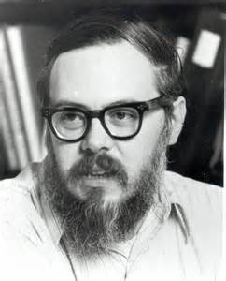
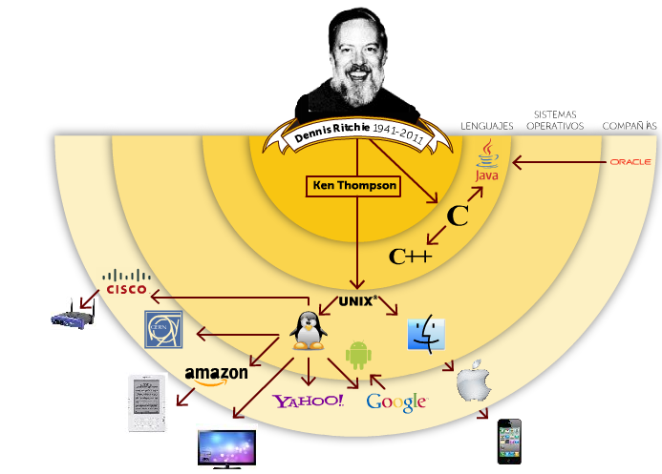
Computer Scientist of the week
Dennis Ritchie
Inventor of Unix with Ken Thompson
Kernel, Shell, Utilities
Goals: simple, communal
Inventor of C
Turing award in 1983
http://www.bing.com/videos/search?q=dennis+ritchie+&FORM=HDRSC3#view=detail&mid=DB6306C75D1B677FD6AADB6306C75D1B677FD6AA

Slide 8
Process State Diagram
new
terminated
admitted
interrupt
exit
ready
running
Scheduler dispatch
I/O or event
completion
I/O or event
wait
waiting
https://www.youtube.com/watch?v=JhWREa77Z88

Slide 9
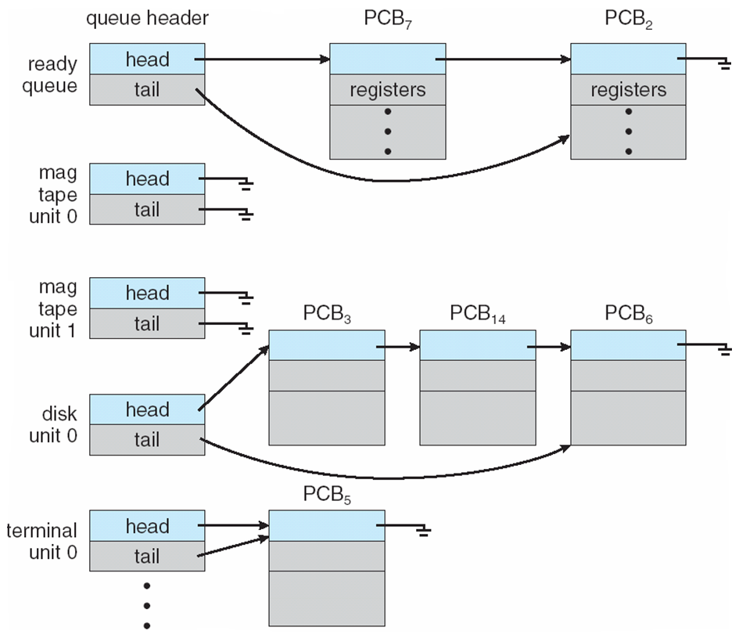
Process Scheduling Queues

Slide 10
Process Schedulers
Long-Term Scheduler (“Job Scheduler”)
Brings processes into the READY list
Period: seconds to minutes
Generally not used for UNIX, Windows systems
Medium Term Scheduler (“Swapper”)
Swaps inactive processes to disk
Brings back swapped processes on demand
Short-Term Scheduler (“CPU Scheduler”)
Selects processes from the READY list
Allocates CPU time to the process (quantum)
Period: 10s to 100s of milliseconds

Slide 11
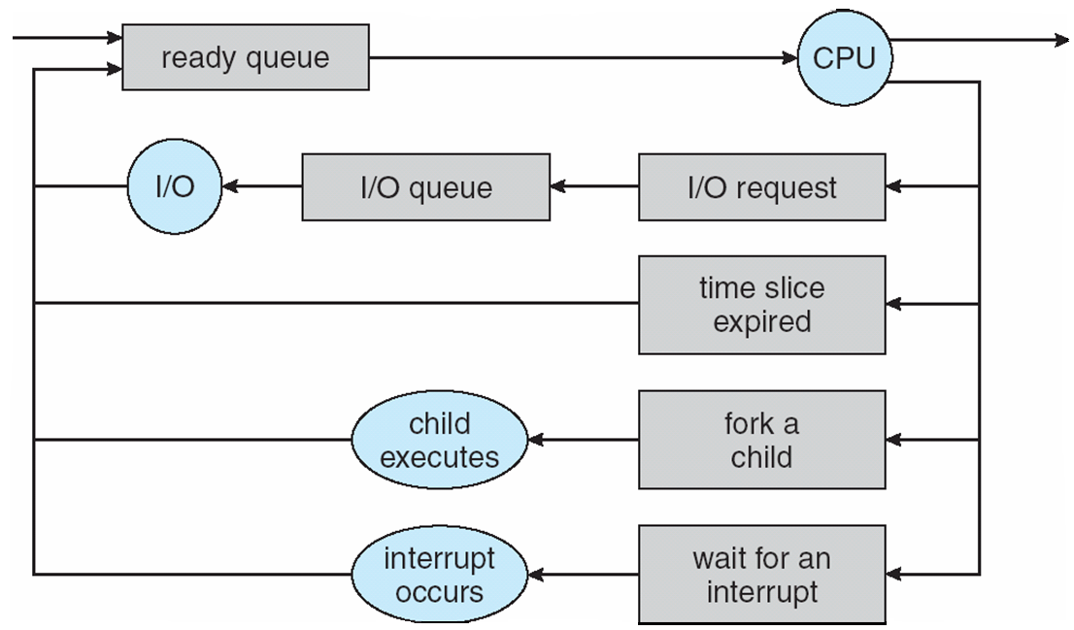
Representation of Process Scheduling
Long-term scheduler
picks up a process from
ready queue every
secs to mins
Short-term scheduler
picks up a process from
ready queue every
10-100ms
Med-term scheduler
swaps I/O waiting processes
in and out of memory

Slide 12
Process Creation
Parent process creates children processes.
pid: process identifier
Resource sharing
Resource inherited by children: file descriptors, shared memory and system queues
Resource not inherited by children: address space
Execution
Parent and children execute concurrently.
Parent blocks on wait() system call until children terminate.
UNIX examples
fork() system call creates new process.
execlp system call used after a fork() to replace the process’ memory space with a new program.
CSS430-unique ThreadOS: SysLib.exec and Syslib.join

Slide 13
Fork
a.out
child
duplicated
a.out
ls
synchronized

Slide 14
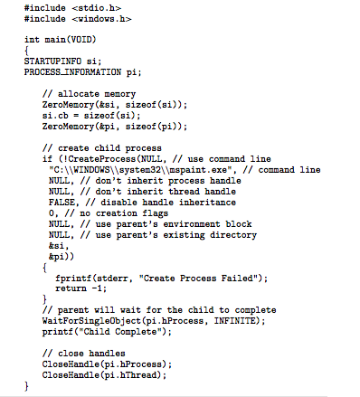
Win32 Process Creation

Slide 15
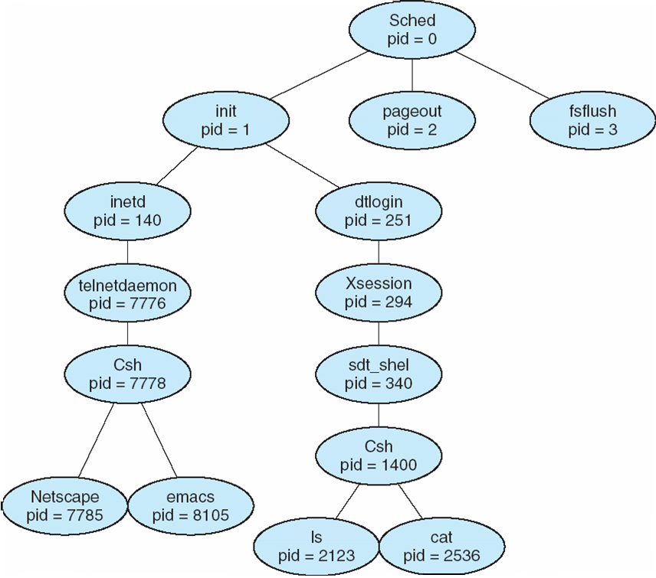
Unix: A Tree of Processes

Slide 16
Process Termination
Process termination occurs when
Last statement is executed
exit() system called explicitly
Upon process termination
Termination code is passed from:
child (via exit()) → parent (via wait()).
Process resources are de-allocated by OS.
Parent may terminate execution of children processes via kill()) when:
Child has exceeded allocated resources.
Task assigned to child is no longer required.
Parent is exiting (cascading termination).
Some operating systems do not allow child to continue if its parent terminates.

Slide 17
Zombies and Orphans
Zombie Process
When exited/killed a Child goes into Zombie state until parent reaps exit data via wait()
SIGCHLD signal sent to parent on exit of child
Process is in terminated state and metadata stays in process table
When parent returns from wait() the space in process table is cleaned up
Orphan Process
A process which is executing whose parent has terminated
These processes get adopted by init process (PID=1)
Init reaps orphans automatically

Slide 18
CLASS DISCUSSION
What are the differences between CPU bound and I/O bound processes?
What is another name for the text section in a process and what does it contain? A process can have multiple threads, where would the stack for a thread be allocated from?
Where does the heap in Java reside?
What are the lengths of typical operating system scheduling quantum's?

Slide 19
Class Bell
1.19.2021

Slide 20
Announcements/Agenda
Announcements
HW2: Due 1/21
P1: Due 1/22
Assigned both HW3 and Program 2. Subject: Threads
Agenda
Program 1 Questions
IPC
RPC
ICA #2

Slide 21
Process Communication

Slide 22
Cooperating Processes
Process independency
Processes belonging to different users do not affect each other
Unless they give each other certain access permissions
Process Cooperation
Processes spawned from the same user process share some resources
Communicate with each other through these resources
Common Communication Mechanisms
Pipes
Message Queues
Shared Memory
Files

Slide 23
Process Communication Attributes (preview)
Message Passing v. Shared Memory
Direct v. Indirect
Blocking v. non-blocking (sync v. async)
Buffered v. Non-Buffered
Remote v. Local

Slide 24
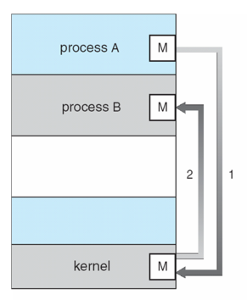
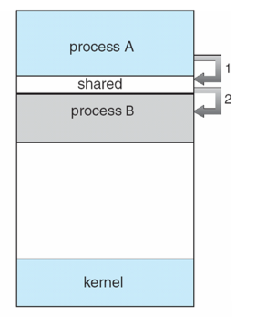
Communication Models
Message Passing | Shared Memory

Slide 25
Message Passing
Message system: processes communicate with each other without resorting to shared variables.
IPC facility provides two operations:
send(message) – message size fixed or variable
receive(message)
If P and Q wish to communicate, they need to:
Establish a communication link between them
Exchange messages via send/receive
Implementation of communication link
Physical (e.g., shared memory, hardware bus)
Logical (e.g., logical properties)

Slide 26
Direct Communication
Processes must name each other explicitly:
send (P, message) – send a message to process P
receive(Q, message) – receive a message from process Q
How can a process locate its partner?
Processes are created and terminated dynamically and thus a partner process may have gone.
Direct communication takes place between a parent and its child process in many cases.
Example: pipe(fd)

Slide 27
Producer-Consumer Problems
who | wc -l
who
pipe
wc -l
turing tty1 Apr 1 14:14
eckart tty2 Apr 2 15:19
mauchley tty3 Apr 2 15:30
Output:
3
Producer process:
who produces a list of current users.
Consumer process
wc receives it for counting # of users (i.e. lines).
Communication link:
OS provides a pipe.

Slide 28
Direct Communication
Filename: pipe.c
2
parent
fd[0], fd[1]
child
fd[0], fd[1]
Child process
“Hello...”
“Hello...”
4
3
1
pipe
Parent process

Slide 29

Computer Scientist of the Week
Doug McIlroy
Mathematician, Engineer, Programmer
Adjunct Professor, Dartmouth University
Inventor of Unix Pipes!
Pioneer in component based software engineering
The real hero of programming is the one who writes negative code
Philosophy
Write programs that do one thing and do it well
Write programs to work together
Write programs to handle text streams because that is a universal interface

Slide 30
Indirect Communication: Message Queues
Messages are directed and received from mailboxes, queue or port
Each mailbox/port has a unique id.
Processes can communicate only if they share a mailbox
Processes must know only a mailbox id. They do not need to locate their partners

Slide 31
Let’s code…
MSGRCV and MSGSND

Slide 32
msg_snd.cpp → msg_rcv.cpp
Message queue
(id = msgid)
0
1
2

Slide 33
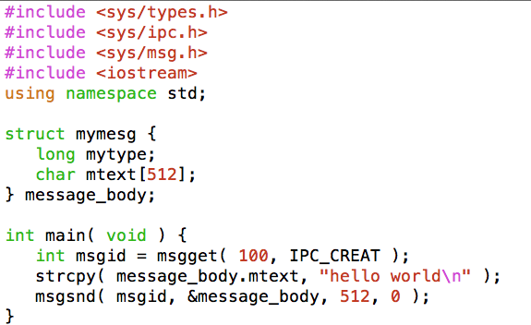
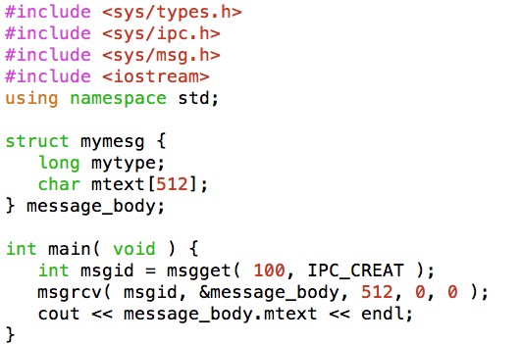
Message Queues
msg_snd.cpp
msg_rcv.cpp
key=100
key=100
Message queue
(id = msgid)
Some other process can
also enqueue and
dequeue a message
(on the same key)
0
1
2

Slide 34
Blocking / Non-Blocking
Sending Process
Non-Blocking – Sends and resumes execution
Blocking – Sender is blocked until message is received or accepted by buffer.
Receiving Process
Non-Blocking – receives valid or NULL
Blocking – Waits until message arrives

Slide 35
Buffering
Established by creating a shared memory area between Producer and Consumer
Queue of messages implemented in one of three ways
1) Zero capacity: 0 messages Producer must wait for Consumer (rendezvous).
2) Bounded capacity: finite length of n messages. Producer must wait if link is full (This happens in practical world like sockets).
3) Unbounded capacity: “infinite” length Producer never waits. (Non-blocking send)

Slide 36
Shared Memory
Segments of the virtual address space of processes are shared
Multiple mechanisms
Multiple implementations depending on UNIX variety
Identified by KEY (unique int)
Mechanics:
shmget: shared memory segment get
ID = shmget(KEY)
shmat: attach to shared memory segment
pointer = shmat(ID)
pointer now points to memory
Buffer management/synchronization is job of the user
See also (for C++ references): Beej's Guide to Unix IPC - shm

Slide 37
Let’s Code
SHARED MEMORY

Slide 38
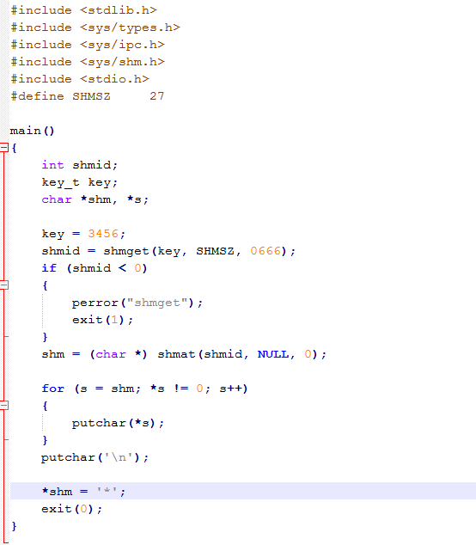
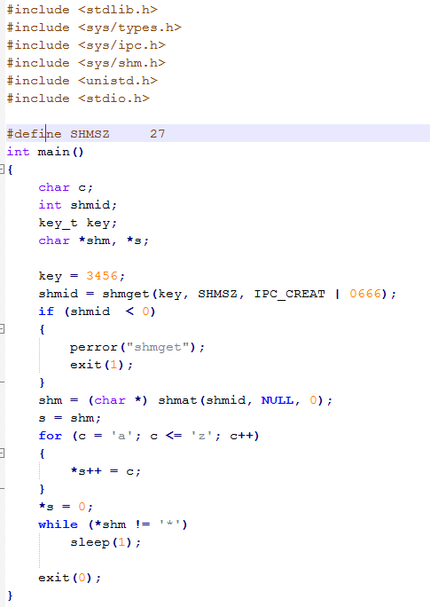
Shared Memory Example

Slide 39
CLASS DISCUSSION
Provide a short history of System V and BSD; how does POSIX relate to this?
What do the msg_snd and msg_rcv system calls do?
What are typical usages of IPC?

Slide 40
BSD v. System V
msgsnd, msgrvc are System V system calls
System V
AT&T released System V in 1983. One of first commercial Unixes
Four versions available: 1, 2, 3, 4
Attempt at Unix unification/standardization
Today: HP-UX, AIX, and Solaris all support SysV
BSD
Berkeley Unix
Parallel attempt at Unix unification/standardization
Efforts like POSIX has pulled key features from each standard so Unixes are similar

Slide 41
IN CLASS CODING / Pop Quiz
Break up into groups of 2-3
Write code which
Creates a pipe for communication
Forks a child processes
Executes the command ls –l in the child and pipes output to pipe
Parent reads from Pipe and outputs ls –l
Turn in code in front (no grade)

Slide 42
Process Communication Attributes (recall)
Message Passing v. Shared Memory
Direct v. Indirect
Blocking v. non-blocking (sync v. async)
Buffered v. Non-Buffered
Remote v. Local

Slide 43
Client-Server Systems Remote System Communication
Sockets
Remote Procedure Calls (RPC)
Remote Method Invocation (RMI)

Slide 44
Sockets
A socket is defined as an endpoint for communication
Concatenation of IP address and port
The socket 161.25.19.8:1625 refers to port 1625 on host 161.25.19.8
Communication consists between a pair of sockets
Common Ports:
23: telnet server
21: ftp server
80: HTTP/Web Server
Ports <1024 are “well known”
IP: 127.0.0.1 is loopback

Slide 45
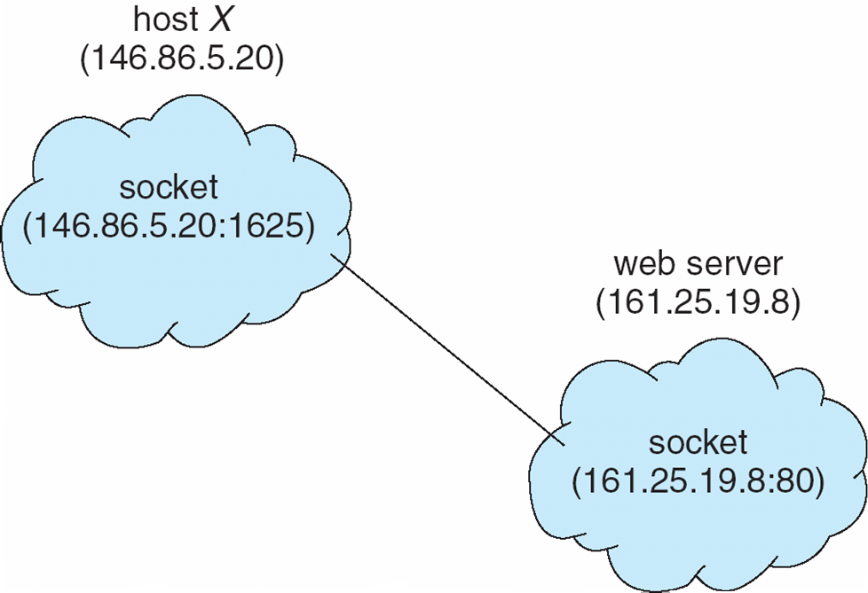
Socket Communication

Slide 46
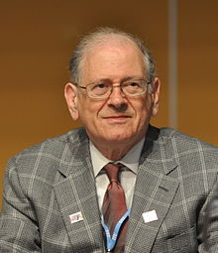
Computer Scientist of the Week
Bob Kahn
One of the Inventors of TCP (Transmission Control Protocol)
One of the Inventors of IP (Internet Protocol)
Father of the internet
72: Joined DARPA working on IPTO
Demonstrated ARPANET by connecting 20 computers
Proved viability of Packet Switching
Started governments Strategic Computing Initiative
2004 Turing award winner
http://www.npr.org/templates/story/story.php?storyId=4809641

Slide 47
Coding…
SOCkets

Slide 48
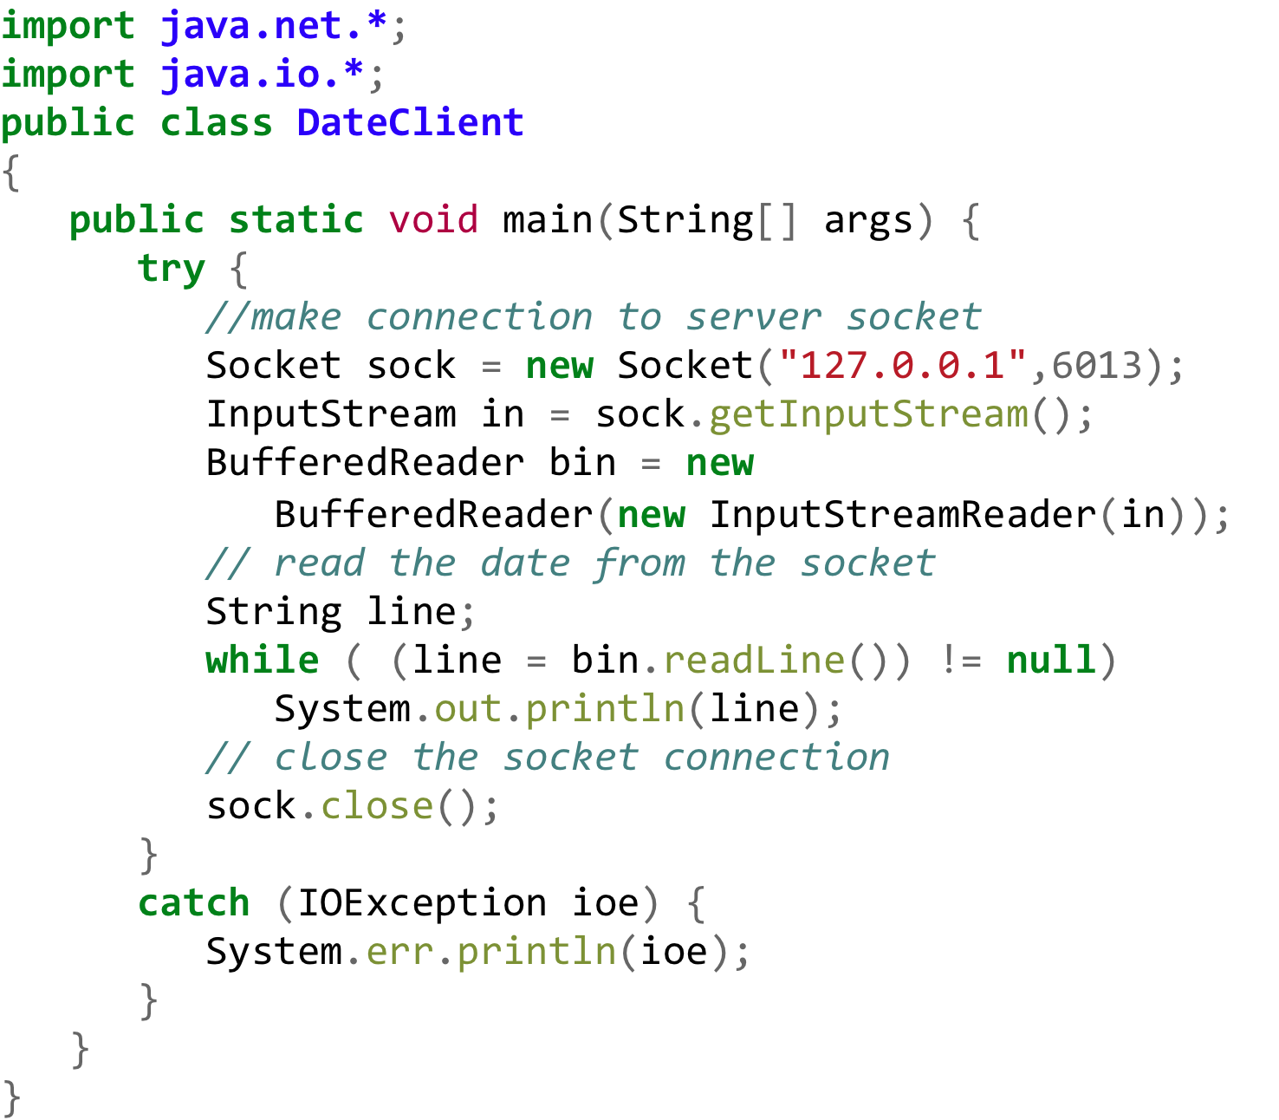
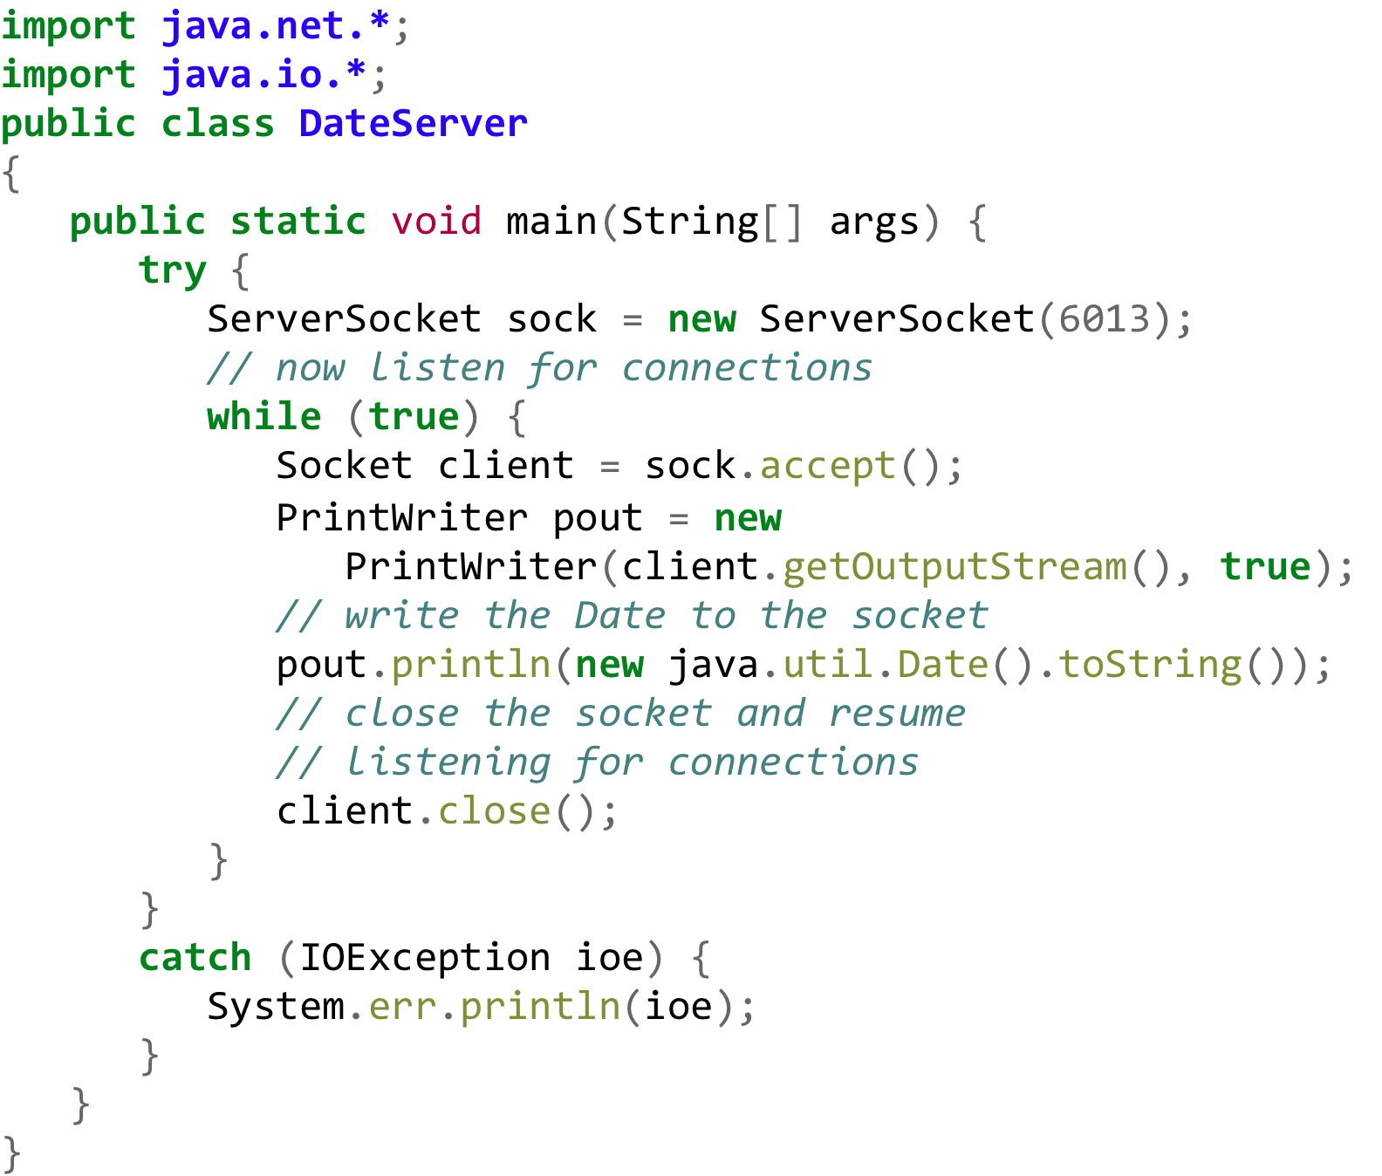
Socket Client-Server

Slide 49

Computer Scientist of the Week
Vint Cerf
One of the Inventors of TCP (Transmission Control Protocol)
One of the Inventors of IP (Internet Protocol)
Father of the internet
Joined DARPA working on IPTO
2004 Turing award winner
Currently VP at Google
Known for his dapper dress
http://www.bbc.com/news/science-environment-31450389

Slide 50
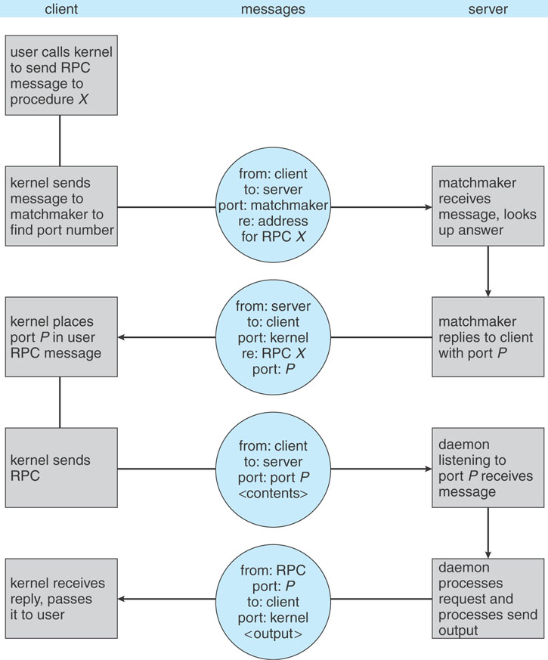
RPC: Remote Procedure Calls
C/C++ Only
UDP Based
Procedural based calls

Slide 51
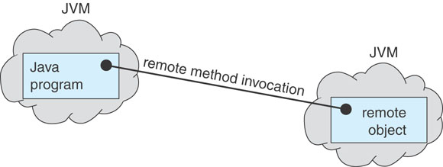
RMI
Java Based / Objects
Rich data types can be passed back and forth but must be serializable
TCP Based Communications (i.e. more reliable)

Slide 52
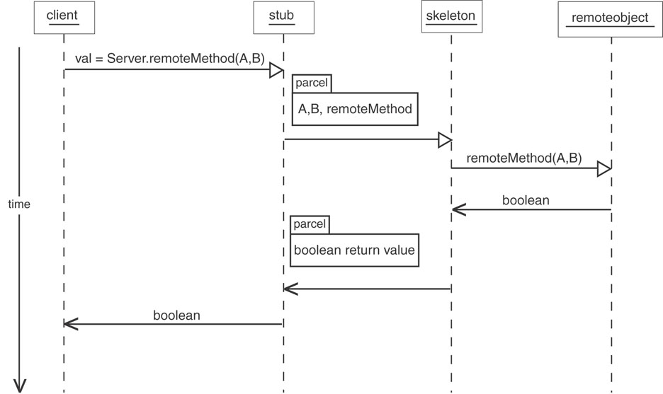
Sequence Diagram (RMI)
Stub provides an interface on the client side, which maps to a port on the remote side.
Marshalling - involves packaging the parameters into a form that can be transmitted over a network

Slide 53
Process Communication Attributes (summary)
Direct v. Indirect
Blocking v. non-blocking (sync v. async)
Buffered v. Non-Buffered
Remote v. Local

Slide 54
ICA2
Consider four different types of inter-process communication (IPC).
Pipe: implemented with pipe, read, and write
Socket: implemented with socket, read, and write
Shared memory: implemented shmget, shmat, and memory read/write
Shared message queue: implemented with msgget, msgsnd, and msgrcv
QUESTIONS
Is the type based on direct communication?
Does the type require parent/child process relationship?
If we code a produce/consumer program, does the type of communication require us to implement process synchronization ourselves?
Does the communication allow communicate with a process running on a remote computers?
Does the communication type utilize file descriptors?
Does the communication type require a specific data structure to transferring the data?

Slide 55
In-Class Assignment 2
Type | Direct? | Parent/ Child? | Sync? | Remote? | File Descriptor? | Data Type?
Pipe
Socket
Shared Memory
Message

