Slide 1
CSS430 Threads Textbook Chapter 4
Instructor: Prof. Dimpsey
e-mail: dimpsey@uw.edu

Slide 2
Announcements / Agenda
Announcements
HW2: Graded
Program 2: Due 1/31?
HW3: Due 1/29
Process State Diagram: https://www.youtube.com/watch?v=JhWREa77Z88
Multi-threaded Server: https://www.youtube.com/watch?v=spDpR2qr-Fs
Agenda
ICA 2: IPC/RPC
Threads
Program II: Deep Dive

Slide 3
HW2 Rubric
Problem | Points
3.11 | 3
3.13 | 3
Complete | 4
Course Grades
40% Exams: Midterm / Final
50% Programs (5)
10% Homeworks+ICAs: 8-10

Slide 4
ICA2
Consider four different types of inter-process communication (IPC).
Pipe: implemented with pipe, read, and write
Socket: implemented with socket, read, and write
Shared memory: implemented shmget, shmat, and memory read/write
Shared message queue: implemented with msgget, msgsnd, and msgrcv
QUESTIONS
Is the type based on direct communication?
Does the type require parent/child process relationship?
If we code a produce/consumer program, does the type of communication require us to implement process synchronization ourselves?
Does the communication allow communicate with a process running on a remote computers?
Does the communication type utilize file descriptors?
Does the communication type require a specific data structure to transferring the data?

Slide 5
In-Class Assignment 2
Type | Direct? | Parent/ Child? | Sync? | Remote? | File Descriptor? | Data Type?
Pipe
Socket
Shared Memory
Message

Slide 6
Threads.

Slide 7
Thread Concepts
Process-oriented computing
Multithreaded computing
code
files
data
code
files
data
thread
code
files
data
process
code
files
data
code
files
data
process
Operating System
Operating System

Slide 8
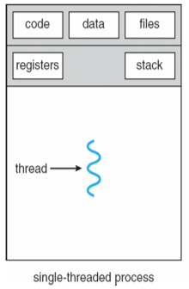
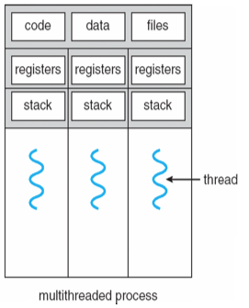
Single vs. Multithreaded Processes
Processes
Contains Address space, code, data, and files
Heavyweight in terms of creation/termination/context switching
Threads
Shares address space, code, data and files w/threads in process
Lightweight in terms of creation/termination/context switching
What is uniquely carried by each thread?

Slide 9
Thread Benefits
Responsiveness
Create new threads to process requests while receiving new requests
Resource sharing
Threads share an address space, files, code, and data
Economy
~25-30x faster to create new threads vs. processes
~ 5x faster to context switch
Scalability
Better utilization of multiprocessor architecture

Slide 10
Multithreaded Server
new Thread to service each Request
Client
Request
Server
Thread
Thread
Thread
Listen for
additional
requests
https://www.youtube.com/watch?v=spDpR2qr-Fs

Slide 11
Multithreaded Server Benefit: Responsiveness
Clients
Web Server
DB1
DB2
CGI
http
pages

Slide 12
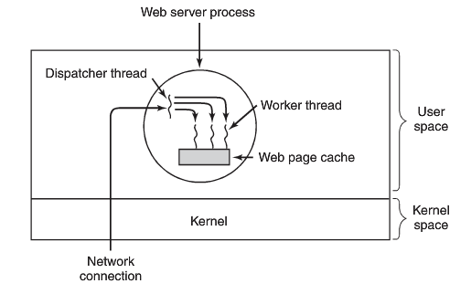
Web Server Workers

Slide 13
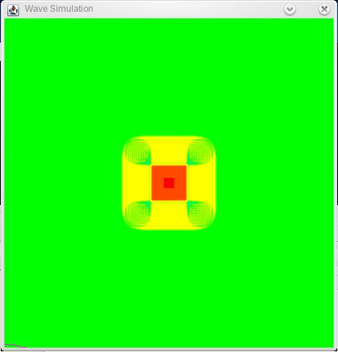
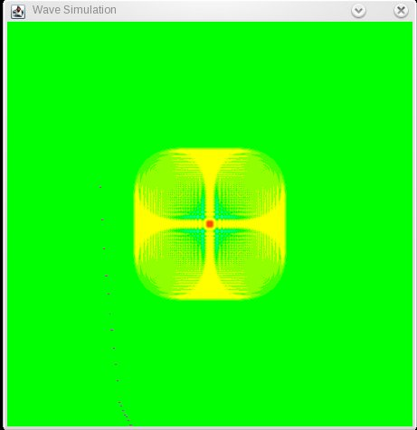

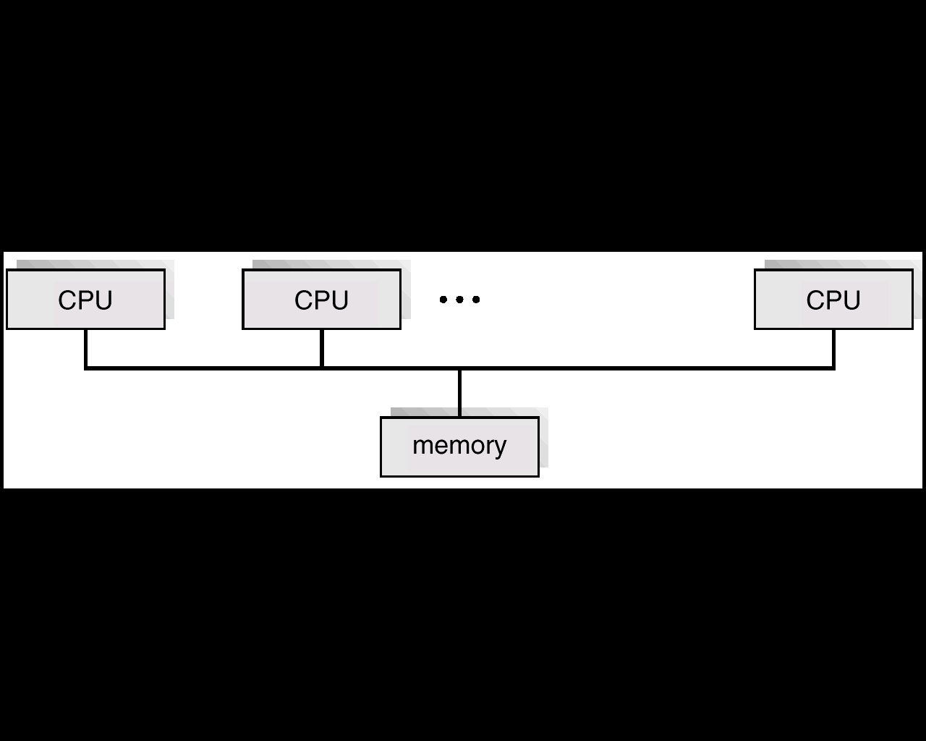
Benefit: Utilization of multicore multiprocessor architecture
time = t
time = t + x
Place code, files and data in the main memory.
Distribute threads to each of CPUs, and
Let them execute in parallel.
time = t + 2x
…
code
files
data
data

Slide 14
Thread Implementations
User v kernel Threads
JAVA v C/C++

Slide 15
Utilizing threads from Java vs. C/C++
Java
Java is a language AND runtime environment (JVM)
Java threads are built into the Java API and support is provided in the JVM
Hence, highly Portable
C/C++
C/C++ are languages (not runtime env)
Thread support is provided by the platform that C/C++ applications execute on
Libraries (e.g., Pthreads)
OS/System Calls (Win32 Threads)

Slide 16
Pthreads
A POSIX standard (IEEE 1003.1c) API for thread creation and synchronization to enforce portability.
API specifies behavior of the thread library, implementation is up to development of the library
Common in UNIX operating systems (Solaris, Linux, Mac OS X)

Slide 17
Let’s Code!
PTHREADS

Slide 18
Pthreads

Slide 19
User and Kernel Threads
User Threads
Thread Management Done by User-Level Threads Library
Examples
POSIX Pthreads
Java threads
Kernel does not care how many user threads exist.
Kernel Threads
Supported by the Kernel
Examples (all modern OS have support for threads)
Linux
Windows
Solaris lightweight processes

Slide 20
Many-to-One Model
Many user-level threads mapped to a single kernel thread.
Used on systems that do not support kernel threads.
Examples: Solaris Green Threads, GNU Portable Threads
user thread
PRO | CONS
Fast | Non preemption or version complicated to handle preemption and I/O No use of MP architecture
k
kernel thread

Slide 21
One-to-One Model
Each user-level thread maps to kernel thread.
Examples
Windows
Linux
Solaris 9 or later
PRO | CONS
1. Everything supported by OS 2. Uses MP architecture | Slower than many-to-one model. Too many threads do not help
user thread
k
k
k
k
kernel thread

Slide 22
Many-to-Many Model
Examples
Windows XP fiber library
AIX Pthreads
HP_UX
user thread
k
k
k
kernel thread

Slide 23
CLASS DISCUSSION
Why do threads context switch much faster than processes?
What data structure must threads carry within their own resources? What data structure can they share?
What if we use processes rather than threads for a Web Server? What will be the impact?
What is the difference between Java threads and a threads used in a C++ program?

Slide 24
Program II
Part I

Slide 25
Signals
Sig_example.cpp

Slide 26
Part 1
Implementing multi-thread environment on single thread
setjmp/longjmp used to store thread environment and go back to it
Schedule is non-preemptive, thread calls sthread_yield() to give up process
alarm signal used for time quantum
Only fill in ::
capture()
sthread_yield()
sp: stack pointer; bp: base-pointer
cur_tcb->size_ = (int)((long long int) bp - (long long int) sp);

Slide 27
Class Bell
1/26/2021

Slide 28
Java Threads

Slide 29
Java Threads
Java Threads Created by
Extending thread class
Implementing Runnable Interface
Either mechanism provides a runnable thread that the JVM manages
Of course, underlying operating system gets final say on scheduling

Slide 30
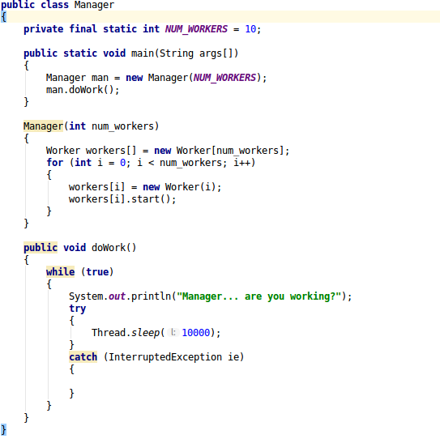
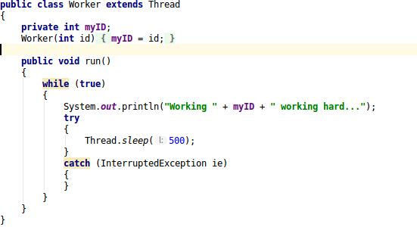
Extending Thread Class

Slide 31
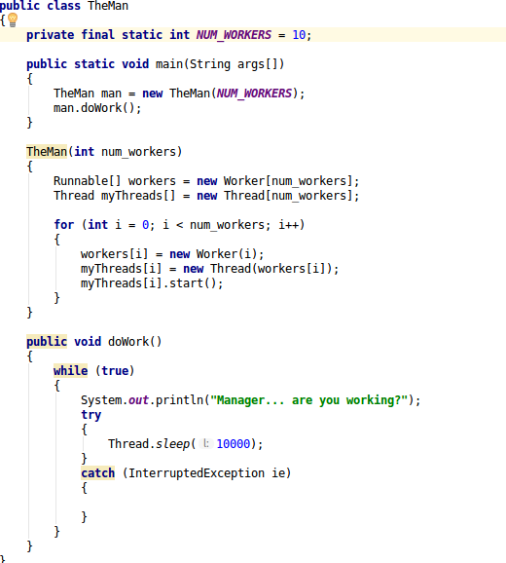
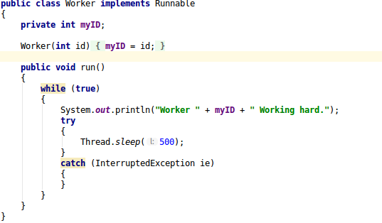
Runnable Interface

Slide 32
Java Thread Management
setPriority( ) – changes this thread’s priority.
sleep() – puts the currently running thread to sleep for a specified amount of time.
Deprecated but available
suspend() – suspends execution of the currently running thread.
resume() – resumes execution of a suspended thread.
stop() – stops execution of a thread.
For more information, visit: JAVA SE7 API THREAD CLASS

Slide 33
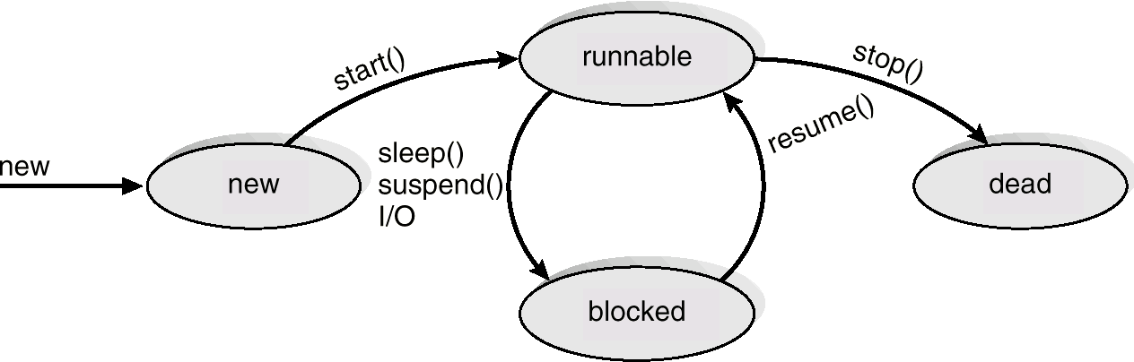
Java Thread States (simple state view)

Slide 34
Thread Life-cycle UML State Model
New
acquire lock, interrupt,
I/O completes
runnable
notify
notifyAll
enter synchronized
statement
wait
sleep
Interval expires
Notify
notifyAll
task completes
wait
issue I/O request
waiting
timed waiting
terminated
blocked

Slide 35
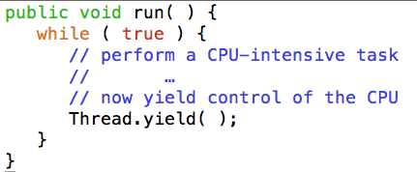
Cooperative multithreading in Java
A thread voluntary yielding control of the CPU is called cooperative multitasking.
Thread.yield( ) is a hint to OS (no guarantee)
Linux does not care about it.
Solaris allows a thread to yield its execution when the corresponding LWP exhausts a given time quantum.
Conclusion: Don’t write programs based on yield( ).

Slide 36
Thread Pools
Benefits: Time and Space
Servicing incoming request is faster with existing threads than creating new threads
Thread Pools limit the total number of threads in the system
Java Executor, ExecutorService
Interfaces introduced in JDK 5
Efficient thread pool implementation which execute Runnable objects (or Callable objects)
newFixedThreadPool(): uses a fixed size thread pool
newCachedThreadPool(): expandable thread pool
newSingleThreadExecutor(): executes a single task at a time

Slide 37
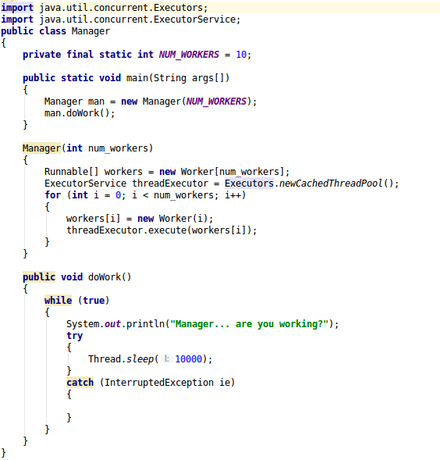
Thread Pools

Slide 38
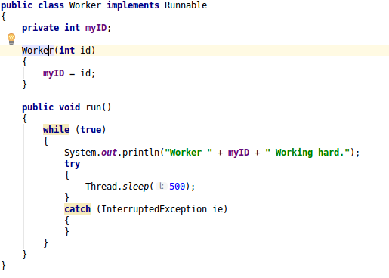
Thread Pools

Slide 39
Program II
Part II

Slide 40
CLASS CHALLENGE
How many processes are created when the familyCreator function is called?
void familyCreator(int x)
{
for (int i = 0; i < x; i++)
{
for (int j = 0; j < i; j++)
{
fork();
}
}
}

Slide 41
Linux Threads
Implementations
What are Linux Processes, Threads, Light Weight Processes, and Process State

Slide 42

Computer Scientist of the Week
Jessie Frazelle
Key innovator/driver in Container
Leading spokesperson/developer/maintainer @Docker
Contributor to Runc, Golang, Kubernetes, and the Linux
Hired by Microsoft last month
https://blog.jessfraz.com/

Slide 43
Lightweight Process (LWP)
Allows for user level thread mapping to kernel threads
Can perform independent system calls
Can incur independent page faults
Multiple LWPs, in the same process, can run in parallel on multiple processors
LWP ID
priority
Intr. mask
registers

Slide 44
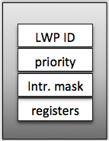
Process Structure
Kernel schedules each light-weight process separately.
Traditional UNIX Process
Multi-threaded Process
Process ID
Process ID
UID GID EUID EGID
UID GID EUID EGID
Directory Entry
Directory Entry
TTY
TTY
Signal Dispatch
Table
Signal Dispatch
Table
Memory Map
Memory Map
LWP1
LWP2
0
stdin
priority
0
stdin
1
stdout
Intr. mask
1
stdout
2
stderr
registers
2
stderr
3
3
CPU Status
File Descriptors
File Descriptors

Slide 45
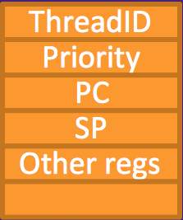
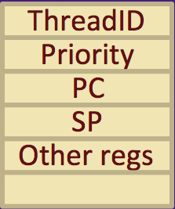
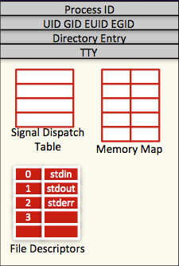

Thread Structure
Process
Thread library runs in a user space.
All threads shared the same address space.
Each thread maintains its own information and stack space.
Once a thread is mapped to a LWP, it runs on a CPU.
Thread3
thread info
Java Threads
stack
red zone
Thread2
thread info
stack
JVM
red zone
Thread1
thread info
stack
Thread1
Thread2
Thread3
red zone
heap
Pthreads
Win32 threads
Thread3
code + global data
Thread to LWP mapping
User mode
Kernel mode
LWP1
LWP2

Slide 46
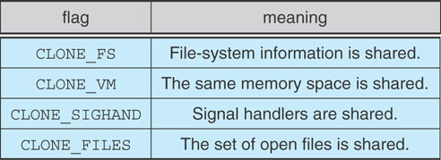
Linux: Thread Implementation
Process provided by traditional fork() system call
Linux doesn’t distinguish between processes and threads; generally uses term Task
Each thread is viewed as a process inside the kernel
Linux rather creates tasks using clone()system call
clone() allows a child task to share the address space of the parent task (process)
Uses flags to manage resources
no flags → fork()

