Slide 1
CSS430 Scheduling Textbook Chapter 5
Instructor: Prof. Dimpsey
e-mail: dimpsey@uw.edu
These slides were adapted from the OSC textbook slides (Silberschatz, Galvin, and Gagne)

Slide 2
CPU Scheduling
Basic Concepts
Scheduling Criteria
Scheduling Algorithms
FCFS
SJF
Priority
Round Robin
Multi-level Feedback Queue
OS Examples
Algorithm Evaluation

Slide 3
Glossary
Term | Definition
PCB | Process Control Blocks
FCFS | First-Come First-Served scheduling algorithm
SJF | Shortest-Job-First scheduling algorithm
RR | Round Robin
FIFO | First In First Out (Queue)
quantum | schedulable time interval (“time slice”)
Foreground | interactive processes
Background | batch (or system) processes
TAT | Turnaround Time

Slide 4
Processes vs. Threads
Recap
One or many threads execute in the context of a process
There exists a nuanced distinction between processes and threads in Linux (e.g., tasks)
In reality: Kernel level threads being scheduled – not processes.

Slide 5
CPU-I/O Burst Cycles
.
.
.
load store
add store
read from file
.
.
.
CPU burst
load store
add store
read from file
Cycle n
CPU burst
wait for I/O
I/O burst
wait for I/O
I/O burst
store increment
index
write to file
CPU burst
Process A
Cycle n+1
store increment
index
write to file
CPU burst
wait for I/O
I/O burst
Process B
wait for I/O
I/O burst
load store
add store
read from file
CPU burst
Cycle n+2
load store
add store
read from file
CPU burst
wait for I/O
I/O burst
wait for I/O
I/O burst
.
.
.
.
.
.

Slide 6
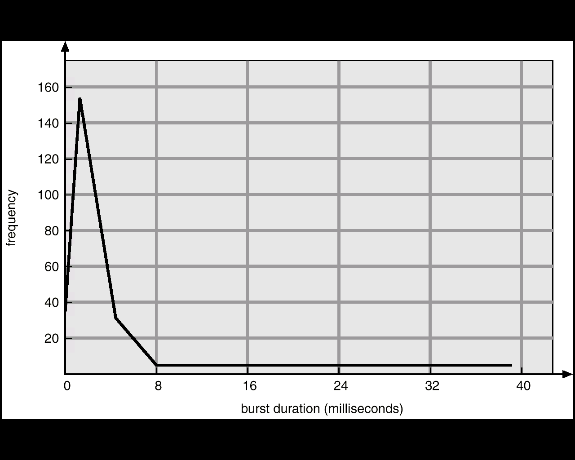
Histogram of CPU-burst Times

Slide 7
CPU Scheduler
Ready
Ready Queue
2
Interrupt
PCBs
I/O
Complete
Short-term
Scheduler
3
Running
Wait
1
Waiting
1 | Running → Waiting
2 | Running → Ready
3 | Waiting → Ready
4 | Running → Termination
Exit
4
Process Termination
UML Process State Diagram

Slide 8
Class Bell
1.28.2021

Slide 9
Announcements / Agenda
Announcements
Program 2: Due tonight
HW4: Due 2/5
Midterm: 2/9
Prep Deck released tomorrow
Program 3: Assigned
Agenda
Program 2 Questions
Scheduling!

Slide 10
Program 1 Rubric
Item | Points
Program builds, executes osh> | 3
ls | 3
ls -l | 3
!! (twice) | 3
sleep 5 & (prompt comes back appropriately and can run another job in foreground) | 3
Ls -l > junk.txt | 3
cat < junk.txt | 3
ps | wc | 3
sleep 5 | ls | 1

Slide 11
Program 2
Turn all in one zip file
Will read port number as argument on command line
Java DateServerMT 7654
Java DateServerMTP 8765
Turn in all .java files needed for your server

Slide 12
CPU Scheduling
Basic Concepts
Scheduling Criteria
Scheduling Algorithms
FCFS
SJF
Priority
Round Robin
Multi-level Feedback Queue
OS Examples
Algorithm Evaluation

Slide 13
What is CPU Scheduling?
Core-1 has just ‘come free’. Question: what Thread from the READY collection should the OS give Core-1 to?
Threads READY to execute
K
Core 0
B
X
A
Core 1
C
D
F
R
M
Core 2
S
H
P
Core 3
Note: we talk about the READY “queue”. But it’s not always a strict queue. Often, just a “collection”

Slide 14
CPU Scheduling
Preemptive: OS can interrupt running thread to schedule new thread
Non-Preemptive: OS waits until the running thread blocks or unilaterally surrenders CPU

Slide 15
Scheduling Criteria: How do we measure Scheduler effectiveness
Term | Definition
CPU Utilization | Typically ranges from 40% to 90% - keep the CPU as busy as possible.
Throughput | Number of processes completed per unit of time.
Turnaround Time (TAT) | Time of process submission to time of completion.
Waiting Time | Total amount of time a process spends waiting in the ready queue.
Response Time | Time a process takes from submission to start of response.
Fairness | Do threads of similar importance getting scheduled? Is starvation possible?
Different scheduling algorithms optimize different criteria.
Different parameters optimized different criteria.

Slide 16
First-Come First-Served (FCFS)
The process that requests the CPU first is allocated the CPU first.
Example: Process Burst Time
P₁ 24
P₂ 3
P₃ 3
Suppose that the processes arrive in the order: P₁ , P₂ , P₃
Suppose that the processes arrive in the order: P₂ , P₃ , P₁ .
Non-preemptive scheduling
Troublesome for time-sharing systems: short process behind long process
P₁
P₂
P₃
Waiting time for P₁ = 0; P₂ = 24; P₃ = 27
Average waiting time: (0 + 24 + 27)/3 = 17
0
24
27
30
P₂
P₃
P₁
Waiting time for P₁ = 6; P₂ = 0; P₃ = 3
Average waiting time: (0 + 3 + 6)/3 = 3
0
3
6
30

Slide 17
CLASS DISCUSSION
Compute average wait time (FCFS) for all unique permutations of P1, P2, P3 where:
How does an OS implement pre-emption?
Which of the criteria are most important?: CPU utilization, throughput, TAT, waiting time, and response time?
Process | CPU Burst Time (msec)
P1 | 34
P2 | 16
P3 | 37

Slide 18
FCFS: Average Waiting Times
CPU Burst Time
(msec)
Average Wait
Time
Permutation
Calculation
P1 P2 P3
P1 P3 P2
P2 P1 P3
P2 P3 P1
P3 P1 P2
P3 P2 P1
34 16 37
34 37 16
16 34 37
16 37 34
37 34 16
37 16 34
(0 + 34 + 50) / 3
(0 + 34 + 71) / 3
(0 + 16 + 50) / 3
(0 + 16 + 53) / 3
(0 + 37 + 71) / 3
(0 + 37 + 53) / 3
28
35
22
23
36
30
174 / 6 = 29

Slide 19
Shortest-Job-First (SJF) Non-pre-emptive
Process | CPU Burst Time
P1 | 7
P2 | 4
P3 | 2
P4 | 3
But how can the OS foretell the future?
How does it know each process’ upcoming “CPU burst time”?
See later!
P₃
P₄
P₂
P₁
P₃
2
5
9
P₃ wait time = 0
P₄ wait time = 2
P₂ wait time = 5
P₁ wait time = 9
P₄
P₂
P₁
(SJF) Average wait time = (0 + 2 + 5 + 9) / 4 = 4
(FCFS) Average wait time = (0 + 7 + 11 + 13) / 4 = 7.75

Slide 20
Shortest-Job-First Pre-emptive
Pn = Newly-arrived Process
Pc = Current Process
If, at arrival time, Pn burst < Pc remaining burst, then give CPU to Pn
Process | Arrival Time | CPU Burst Time
P1 | 0 | 8
P2 | 1 | 4
P3 | 2 | 9
P4 | 3 | 5
0
5
10
15
20
25
30
1
P1
P₁ wait time = 9
P₂ wait time = 0
P₃ wait time = 15
P₄ wait time = 2
P2
P3
P4
6
(STR) Average wait time = (9 + 0 + 15 + 2) / 4 = 6.5
(FCFS) Average wait time = (0 + 7 + 10 + 18) / 4 = 8.75
Think of this as “shortest-time-remaining” (STR)
Analogy: supermarket checkout. STR corresponds to . . . what situation?

Slide 21
Shortest-Job-First (SJF)
Preemptive SJF is superior to non-preemptive SJF.
Provably optimal for lowest avg. waiting time
There are no accurate estimations to know the length of the next CPU burst
We can Predict/Estimate CPU burst based on previous burst
Exponential Averaging Filter (recursive smoothing filter)

Slide 22
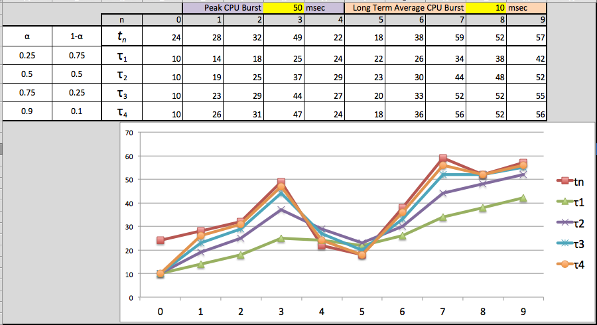
SJF Predicted CPU Burst Example

Slide 23
CLASS DISCUSSION
How does increasing quantum/time-slice impact the different scheduling criteria?

Slide 24
Priority Scheduling
A priority number (integer) is assigned to each Thread: the bigger number, the more important is that Thread
CPU allocated to Thread with highest priority
Pre-emptive, OR
Non-pre-emptive
Problem ≡ Starvation – low priority Threads may never execute
Solution ≡ Aging – as time goes on without getting the CPU, increase that Thread’s priority

Slide 25
Class Bell
2.2.2020

Slide 26
Announcements / Agenda
Announcements
HW 3 Graded!
HW 4: Due 2/5
Midterm: 2/9
Midterm prep deck published
Program 3: 2/12
Agenda
Scheduling!
Program 3
Midterm

Slide 27
What is CPU Scheduling?
Core-1 has just ‘come free’. Question: what Thread from the READY collection should the OS give Core-1 to?
Threads READY to execute
K
Core 0
B
X
A
Core 1
C
D
F
R
M
Core 2
S
H
P
Core 3
Note: we talk about the READY “queue”. But it’s not always a strict queue. Often, just a “collection”

Slide 28
Priority Scheduling Non-preemptive
Process | CPU Burst Time | Priority
P1 | 6 | 3
P2 | 1 | 5
P3 | 3 | 2
P4 | 1 | 1
P5 | 5 | 4
P₂
P₅
P₁
P₃
P₄
1
6
12
15
16
P₂
P₅
P₁
P₃
P₄
(Average waiting time = (0 + 1 + 6 + 12+15)/5 = 6.8

Slide 29
Round Robin Scheduling
Each process is given CPU time in turn, (i.e. time quantum: usually 10-100ms)
...thus waits no longer than ( n – 1 ) * time quantum
time quantum = 20ms
Process | CPU Burst Time (ms) | Wait Time (ms) | TAT (ms)
P1 | 53 | 57+24 = 81 | 134
P2 | 17 | 20 | 37
P3 | 68 | 37 + 40 + 17= 94 | 162
P4 | 24 | 57 + 40 = 97 | 121
AVERAGE | 41ms | 73ms | 114ms
P₁
P₂
P₃
P₄
P₁
P₃
P₄
P₁
P₃
P₃
0
20
37
57
77
97
117
121
134
154
162
P₁(53)
P₁(33)
P₁(13)
57
24
P₂(17)
20
P₃(48)
P₃(68)
P₃(28)
P₃(8)
37
40
P₄(4)
17
P₄(24)
57
40

Slide 30
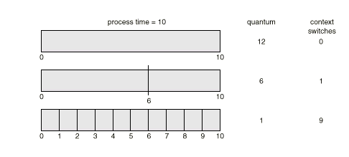
Round Robin Scheduling
Performance (q = quantum)
q large ⇒ FCFS
q small ⇒ q must be large with respect to context switch, otherwise overhead is too high
Trade-off: Throughput (large q) v. Response Time

Slide 31

Scheduling Threads
Who handles scheduling? Kernel or Thread Library?
Library? => Process Contention Scope
Kernel? => System Contention Scope
user-mode
Thread
Library
Kernel-Mode Scheduler
kernel-mode
Kernel-Mode Scheduler

Slide 32
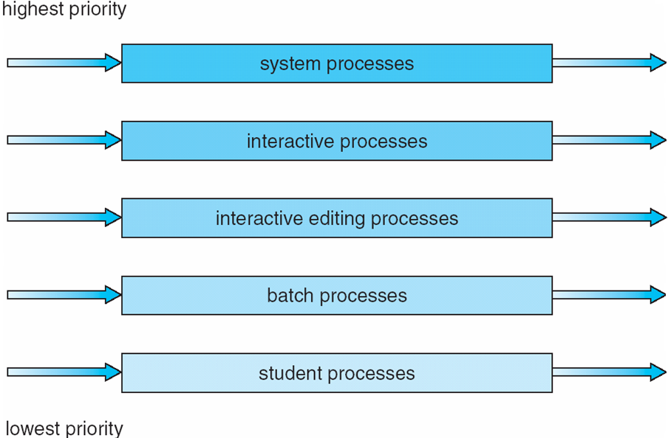
Multilevel Queue Scheduling fixed distribution based on priority
Each queue has its own scheduling algorithm,
foreground (interactive) – RR, 80% CPU time
background (batch) – FCFS, 20% CPU time

Slide 33
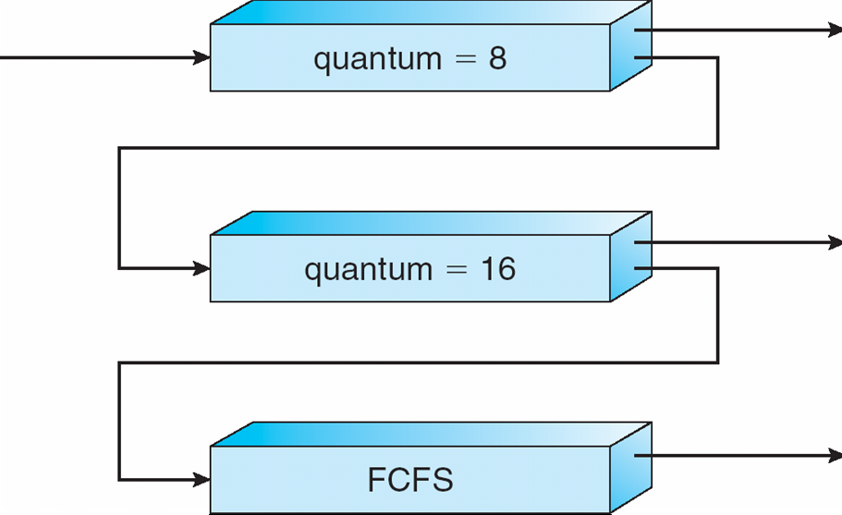
Multilevel Feedback-Queue Scheduling (MFQS) – Variable based on consumption
A new job enters queue Q₀ which is scheduled via FCFS. When it gains CPU, the current job receives 8 milliseconds. If it does not finish in 8 milliseconds, the job is moved to queue Q₁.
At Q₁ job is again scheduled via FCFS and receives 16 additional milliseconds.
If it still does not complete, it is preempted and moved to queue Q₂.

Slide 34
Scheduling Summary
Algorithms used to optimize criteria to allow for fairness, responsiveness, and throughput
Todays OS’es take the best characteristics of all of these:
Round-robin/quantum (fairness)
Preemption
Shortest Job First (IO Boost, Quantum boost)
Priority: real time, interactive jobs
Starvation boosts
Multi-Q level feedback Q
Multiprocessors have additional set of scheduling issues

Slide 35
CLASS DISCUSSION POP QUIZ
Process | Arrival Time | CPU Burst Time
P1 | 0 | 9
P2 | 4 | 4
P3 | 6 | 1
P4 | 8 | 6
What is average wait time, turn around time, and response time
for above processes assuming
FCFS
SJF w/o preemption
SJF w/ preemption
Round-robin with quantum of one time-unit
Multi-Queue with 3 levels – Q 1, 2 and 4

Slide 36
Alg | RT | TAT | WT
FCFS | 4.5 | 9.5 | 4.5
SJF | 3.75 | 8.75 | 3.75
SJF + Pre-emtion | 1.5 | 8 | 3
RR | 0.75 | 10 | 5
MQ | 0 | 9.75 | 4.75
Process | Arrival Time | CPU Burst Time
P1 | 0 | 9
P2 | 4 | 4
P3 | 6 | 1
P4 | 8 | 6

Slide 37
Multiprocessor Scheduling Issues
Where does the scheduler itself run on a multiprocessor system??
Asymmetric multiprocessing: Scheduler runs on one CPU
Symmetric multiprocessing (SMP): Scheduler runs on all CPUs
Which CPU does user code run on?
Processor affinity: hard and soft affinity
Load balancing: push v. pull

Slide 38
Hyper Threading
Multiple cores on same physical chip: Faster and consume less power
Also, multiple threads per core (Intel “hyper-threading”)
Takes advantage of memory stall to make progress on another thread while memory fetch happens
UltraSparc T3 CPU: 16 cores each 8-way multithreaded
c
Compute cycle
m
cache Memory cycle
Thread 1
c
m
c
m
c
m
c
m
c
m
c
m
c
m
c
With hyper-threading : twice as many “c” cycles used
Thread 1
c
m
c
m
c
m
c
m
c
m
c
m
c
m
c
Thread 2
m
c
m
c
m
c
m
c
m
c
m
c
m
c
m

Slide 39
Case Study: Solaris
Constructs:
Processes: contains threads
Kernel Threads: schedulable unit
User Threads: user level thread state
LWP: maps user thread to kernel thread
Solaris 9++: 1-1 mapping between user thread and kernel thread/lwp
Solaris Kernel is fully pre-emptible
170 priorities broken into 6 scheduling classes
Default Scheduling class is TS (TimeShare)
RR, priority, quantum based scheduler
Provides boosts for IO
Fair Share (FSS)/Fixed Priority (FX) are relatively new scheduling classes
RR, priority, quantum based scheduler where processes get “shares” of CPU
Allows for processor sets

Slide 40
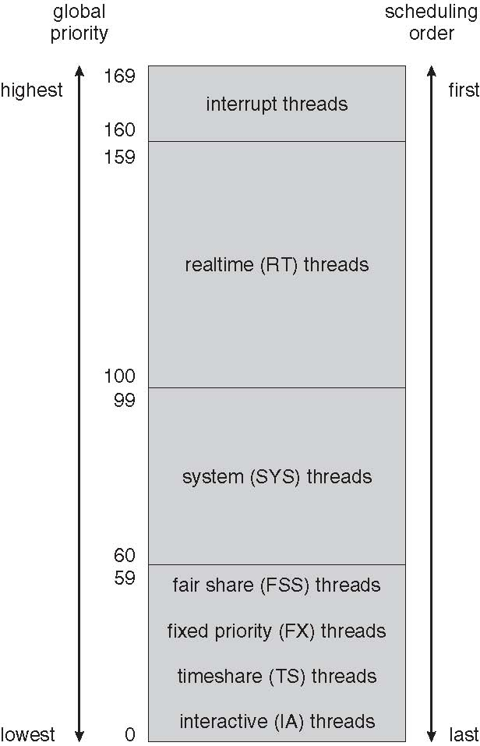
Solaris Scheduling

Slide 41
Algorithm Evaluation
Which Scheduler is BEST?

Slide 42
Algorithm Evaluation
Define the selection criteria
Optimize CPU Utilization OR
Maximize throughput
Real Time Requirements?
Evaluation Methods
Deterministic Modeling (analytic method)
Queueing Models (see Little’s formula next)
Simulations
Data from
Industry Standard Benchmarks
Real workloads
Implementation

Slide 43
Little’s Formula (John Little: 1954)
n
λ * W
n | Average queue length
λ | Average arrival rate for new processes in queue
W | Average waiting time in queue

Slide 44
Little’s Formula
n number of jobs in Q
λ arrival rate
W wait time
n = λ W
in steady state
4 jobs arrive each second
Queue of jobs waiting to be ‘served’
4 jobs finish each second
Average wait time = 3 seconds
n = 4 arrivals/sec * 3 secs = 12 items in queue

Slide 45
Little’s Formula - Examples
Ex: | n | λ (processes/sec) | W (sec) | Narrative
1 | 256 | 1000 |  | What's the average wait time for 1000 p/sec in a 256 element queue?
2 |  | 15000 | 0.1 | How deep should a queue be for a desired wait time of 1/10 sec if processes arrive every 67usec?
3 | 64 |  | 3 | If average wait time is 3 sec and queue depth is 64 what is the average throughput of processes that can be accomodated?

Slide 46
Little’s Formula - Examples
Ex: | n | λ (processes/sec) | W (sec) | Narrative
1 | 256 | 1000 | 0.256 | What's the average wait time for 1000 p/sec in a 256 element queue?
2 | 1501 | 15000 | 0.1 | How deep should a queue be for a desired wait time of 1/10 sec if processes arrive every 67usec?
3 | 64 | 21.3 | 3 | If average wait time is 3 sec and queue depth is 64 what is the average throughput of processes that can be accomodated?

