Slide 1
CSS430 Midterm Study Guide
Instructor: Prof. Dimpsey
e-mail: dimpsey@uw.edu

Slide 2
TextBook
TextBook
Read the Book!
Chapters 1-5
Problems at end of chapter in book are quite good to study
In class discussions are also quite good to study
Creating problems for others would be useful
Read code, Write Code, Solve Problems
Other
Note that material is still fair-game for the test even if we did not explicitly cover in class
Test will focus more heavily on material covered in class

Slide 3
Chapter 1, 2
Operating System History
Overview of system
Von Neumann Arch
Simple linux commands / usage
System Calls: how they work
OS Core Services
Process Management
Memory Management
File System Management
Mass Storage Management
Caching: what, when, how

Slide 4
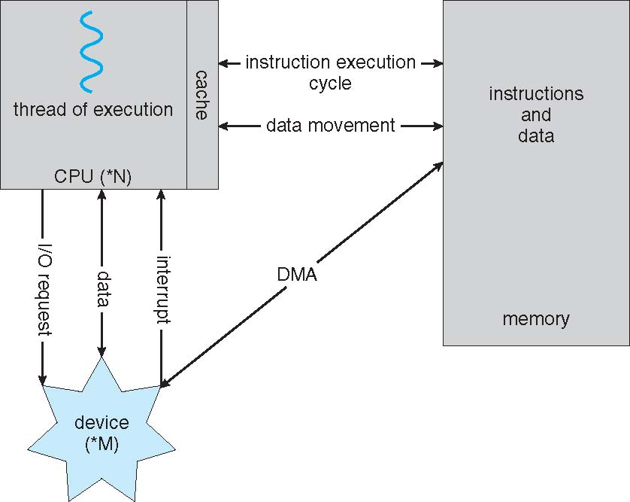
How a Modern Computer Works

Slide 5
Dual-Mode Operations
Provides hardware support to differentiate between at least two modes of operations.
1. User mode – execution done on behalf of a user.
2. Monitor mode (also supervisor mode, system mode, or kernel mode) – execution done on behalf of operating system.
Switching between two modes
Device interrupts, hardware traps, system calls cause a trap to the kernel mode
The operating system returns to the user mode after servicing requests.
user process
user mode
(mode bit=1)
user process
executing
calls
system call
return from system call
kernel
trap
mode bit=0
return
mode bit=1
kernel mode
(mode bit=0)
execute system call

Slide 6
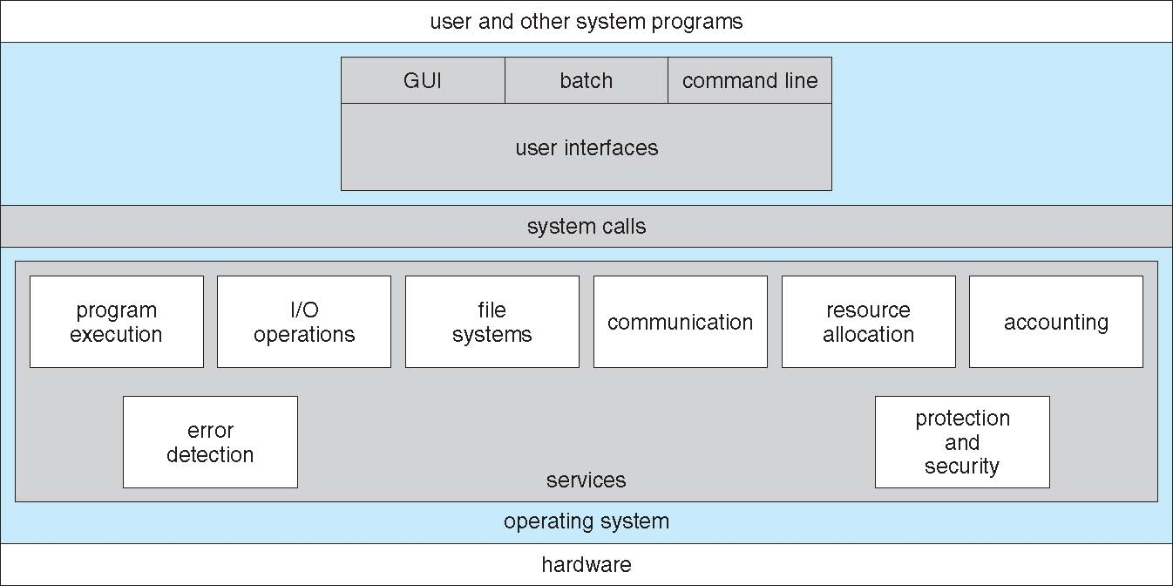
A View of OS Services

Slide 7
Chapter 1, 2
Shell Functioning
Virtualization
Workings of JVM
Mach / Microkernels
Cloud
IAAS, PAAS, SAAS

Slide 8
Shell (bash)
Fork, exec, wait and dup are System calls
# ssh dimpsey@uw1-320-15.uwb.edu
sshd
fork, exec and wait
$
bash
(1) fork & wait
(7) exit
(4) exec
(5) exit
Shell
wc -l
(3) fork & wait
Shell
who
$ who | wc -l
(6) exec
cin
cout
(2) pipe

Slide 9
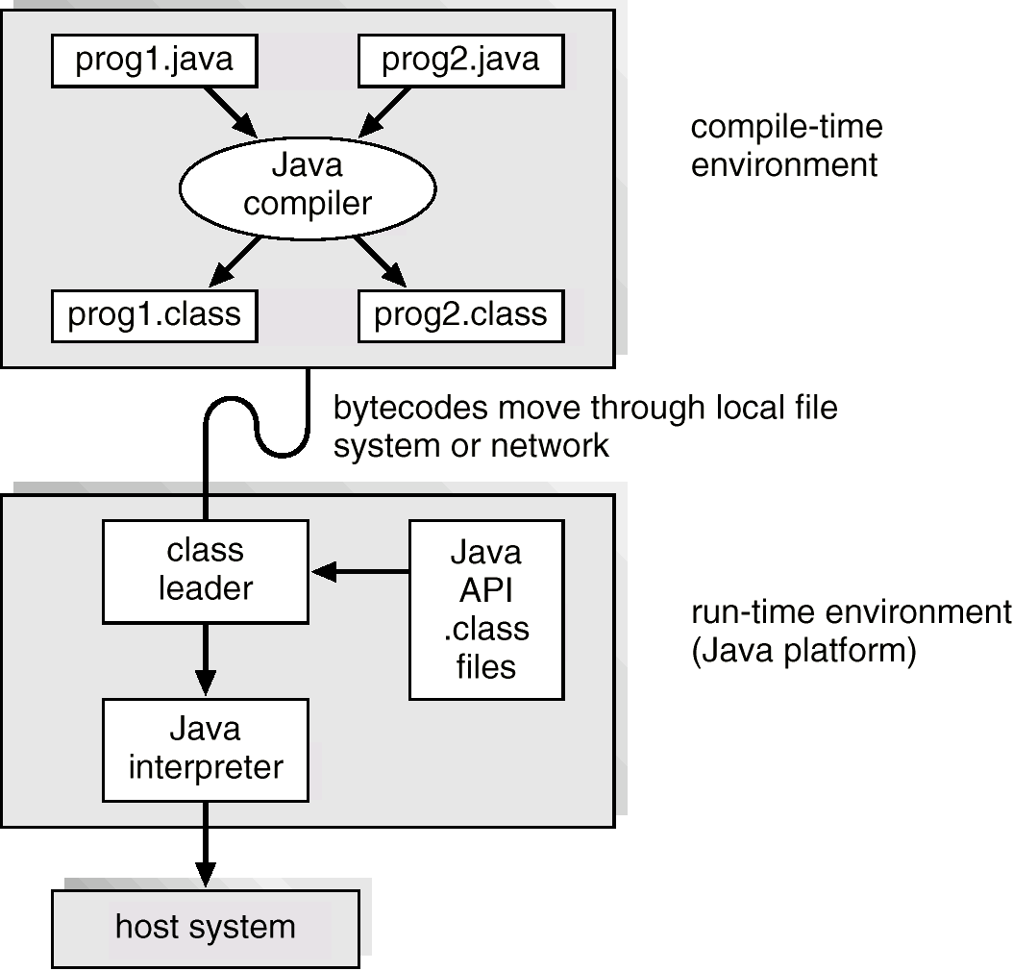
Java Development Environment (SDK)

Slide 10
Chapt 3: Processes
Process Virtual Space layout
Process state diagram
Context Switch
System Calls: Fork/Exec/Wait
Process Trees
Inter-Process Communication (IPC)
Pipe
Message
Shared Memory
Remote Process Communication
Sockets
RPC
RMI

Slide 11
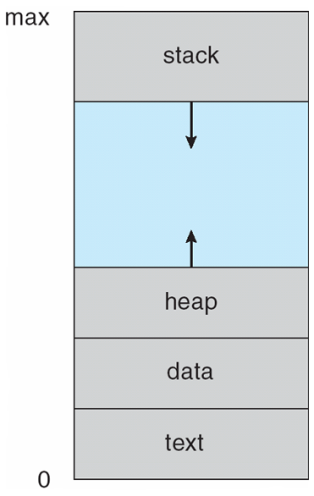
Process Concept
Process – a program in execution; process execution must progress in sequential fashion.
A process includes:
Program counter
Stack (local variables)
Data section (global data)
Text (code)
Heap (dynamic data)
Files (stdin, stdout, stderr, other file descriptors)
Pointers to other metadata

Slide 12
Process State Diagram
new
terminated
admitted
interrupt
exit
ready
running
Scheduler dispatch
I/O or event
completion
I/O or event
wait
waiting

Slide 13
Inter-Process Communication
Mechanisms
Pipe
Message
Shared Memory
Sockets
Attributes
Direct v. Indirect
Blocking v. non-blocking
Buffered v. Non-Buffered
Remote v. Local

Slide 14
Chapt 4: Threads
Process layout of single threaded v. multithreaded apps
Java Threads
Pthreads
Multi-threaded server arch
User v. Kernel Threads
1-1
Many-1
Many-many
Thread Pools
Details of Linux Thread Implementations

Slide 15
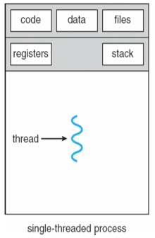
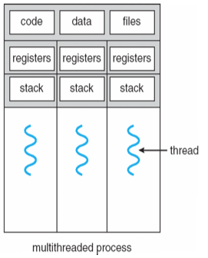
Single vs. Multithreaded Processes
Processes
Contains Address space, code, data, and files
Heavyweight in terms of creation/termination/context switching
Threads
Shares address space, code, data and files w/threads in process
Lightweight in terms of creation/termination/context switching
What is uniquely carried by each thread?

Slide 16
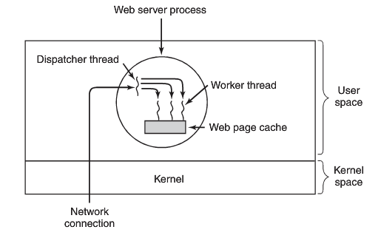
Web Server Workers

Slide 17
Thread Life-cycle UML State Model
New
acquire lock, interrupt,
I/O completes
runnable
notify
notifyAll
enter synchronized
statement
wait
sleep
Interval expires
Notify
notifyAll
task completes
wait
issue I/O request
waiting
timed waiting
terminated
blocked

Slide 18
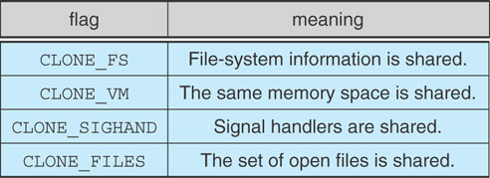
Linux: Thread Implementation
Process provided by traditional fork() system call
Linux doesn’t distinguish between processes and threads; generally uses term Task
Each thread is viewed as a process inside the kernel
Linux rather creates tasks using clone()system call
clone() allows a child task to share the address space of the parent task (process)
Uses flags to manage resources
no flags → fork()

Slide 19
Chapt. 6: Scheduling
IO bound v. CPU bound processes
Scheduler State Diagram
Preemptive v. Non-Preemptive
Scheduling Criteria / metric defns and calculations
Scheduling Algorithsm
FCFS
SJF
SJF Pre-emptive
Round-Robin
Priority
MFQS

Slide 20
CPU Scheduler
Ready
Ready Queue
2
Interrupt
PCBs
I/O
Complete
Short-term
Scheduler
3
Running
Wait
1
Waiting
1 | Running → Waiting
2 | Running → Ready
3 | Waiting → Ready
4 | Running → Termination
Exit
4
Process Termination
UML Process State Diagram

Slide 21
Scheduling Criteria: How do we measure Scheduler effectiveness
Term | Definition
CPU Utilization | Typically ranges from 40% to 90% - keep the CPU as busy as possible.
Throughput | Number of processes completed per unit of time.
Turnaround Time (TAT) | Time of process submission to time of completion.
Waiting Time | Total amount of time a process spends waiting in the ready queue.
Response Time | Time a process takes from submission to start of response.
Different scheduling algorithms optimize different criteria.
Different parameters optimized different criteria.

Slide 22
CLASS DISCUSSION POP QUIZ
Process | Arrival Time | CPU Burst Time
P1 | 0 | 9
P2 | 4 | 4
P3 | 6 | 1
P4 | 8 | 6
What is average wait time, turn around time, and response time
for above processes assuming
FCFS
SJF w/o preemption
SJF w/ preemption
Round-robin with quantum of one time-unit

Slide 23
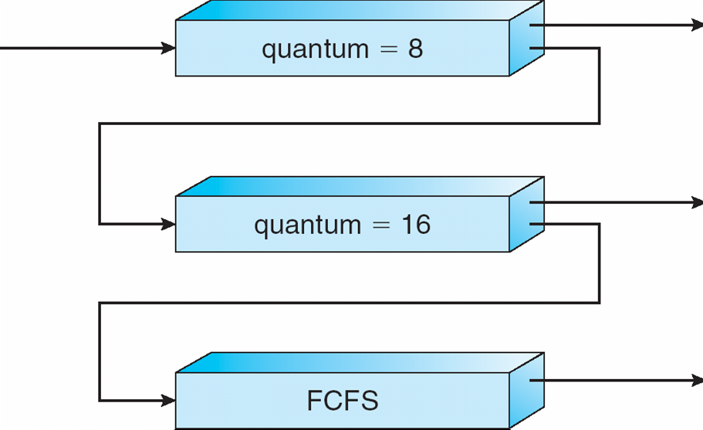
Multilevel Feedback-Queue Scheduling (MFQS) – Variable based on consumption
A new job enters queue Q₀ which is scheduled via FCFS. When it gains CPU, the current job receives 8 milliseconds. If it does not finish in 8 milliseconds, the job is moved to queue Q₁.
At Q₁ job is again scheduled via FCFS and receives 16 additional milliseconds.
If it still does not complete, it is preempted and moved to queue Q₂.

