Slide 1
CSS434 System Models
Textbook Ch2
Professor: Munehiro Fukuda
CSS434 System Models

Slide 2
Outline
Parallel versus distributed systems
Service layers
Platform models
Middleware models
Reasons for distributed systems
CSS434 System Models

Slide 3
Parallel v.s. Distributed Systems
 | Parallel Systems | Distributed Systems
Memory | Tightly coupled shared memory UMA, NUMA | Distributed memory Message passing, RPC, and/or used of distributed shared memory
Control | Global clock control SIMD, MIMD | No global clock control Synchronization algorithms needed
Processor interconnection | Order of Tbps Bus, mesh, tree, mesh of tree, and hypercube (-related) network | Order of Gbps Ethernet(bus), token ring and SCI (ring), myrinet(switching network)
Main focus | Performance Scientific computing | Performance(cost and scalability) Reliability/availability Information/resource sharing
CSS434 System Models

Slide 4
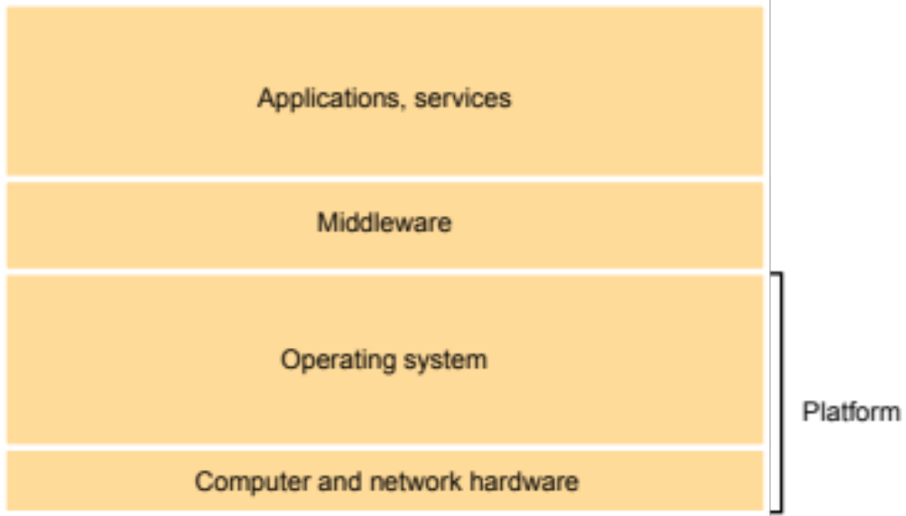
Service Layers in Distributed Systems
CSS434 System Models

Slide 5

Distributed Computing Environment
DCE Applications
Threads
RPC
Distributed Time Service
Security
Distributed File Service
Name
Platforms
CSS434 System Models

Slide 6
Platform Milestones in Distributed Systems
1945-1950s | Loading monitor
1950s-1960s | Batch system
1960s | Multiprogramming
1960s-1970s | Time sharing systems | Multics, IBM360
1969-1973 | WAN and LAN | ARPAnet, Ethernet
1960s-early1980s | Minicomputers | PDP, VAX
Early 1980s | Workstations | Alto
1980s – present | Workstation/Server models | Sprite, V-system
1990s | Clusters | Beowulf
Late 1990s | Grid computing | Globus, Legion
CSS434 System Models

Slide 7
Platforms
Minicomputer model
Workstation model
Workstation-server model
Processor-pool model
Cluster model
Grid computing
CSS434 System Models

Slide 8
Minicomputer Model
Mini-
computer
ARPA
net
Mini-
computer
Mini-
computer
Extension of Time sharing system
  User must log on his/her home minicomputer.
  Thereafter, he/she can log on a remote machine by telnet.
Resource sharing
  Database
  High-performance devices
CSS434 System Models

Slide 9
Workstation Model
Workstation
Workstation
100Mbps
LAN
Workstation
Workstation
Workstation
Process migration
  Users first log on his/her personal workstation.
  If there are idle remote workstations, a heavy job may migrate to one of them.
Problems:
  How to find am idle workstation
  How to migrate a job
  What if a user log on the remote machine
CSS434 System Models

Slide 10
Workstation-Server Model
Client workstations
  Diskless
  Graphic/interactive applications processed in local
  All file, print, http and even cycle computation requests are sent to servers.
Server minicomputers
  Each minicomputer is dedicated to one or more different types of services.
Client-Server model of communication
  RPC (Remote Procedure Call)
  RMI (Remote Method Invocation)
    A Client process calls a server process’ function.
    No process migration invoked
    Example: NFS
Workstation
Workstation
Workstation
100Gbps
LAN
Mini-
Computer
file server
Mini-
Computer
http server
Mini-
Computer
cycle server
CSS434 System Models

Slide 11
Processor-Pool Model
Clients:
  They log in one of terminals (diskless workstations or X terminals)
  All services are dispatched to servers.
Servers:
  Necessary number of processors are allocated to each user from the pool.
Better utilization but less interactivity
100Mbps
LAN
Server 1
Server N
CSS434 System Models

Slide 12
Cluster Model
Workstation
Client
  Takes a client-server model
Server
  Consists of many PC/workstations connected to a high-speed network.
  Puts more focus on performance: serves for requests in parallel.
Workstation
Workstation
100Mbps
LAN
http server2
http server1
http server N
Master
node
Slave
1
Slave
2
Slave
N
1Gbps SAN
CSS434 System Models

Slide 13
Grid Computing
Goal
  Collect computing power of supercomputers and clusters sparsely located over the nation and make it available as if it were the electric grid
Distributed Supercomputing
  Very large problems needing lots of CPU, memory, etc.
High-Throughput Computing
  Harnessing many idle resources
On-Demand Computing
  Remote resources integrated with local computation
Data-intensive Computing
  Using distributed data
Collaborative Computing
  Support communication among multiple parties
Workstation
Super-
computer
High-speed
Information high way
Mini-
computer
Cluster
Super-
computer
Cluster
Workstation
Workstation
CSS434 System Models

Slide 14
Middleware Models
Middleware Models | Platforms
Client-server model | Workstation-server model
Services provided by multiple servers | Cluster model
Proxy servers and caches | ISP server Cluster model
Peer processes | Workstation model
Mobile code and agents | Workstation model Workstation-server model
Thin clients | Processor-pool model Cluster model
CSS434 System Models

Slide 15
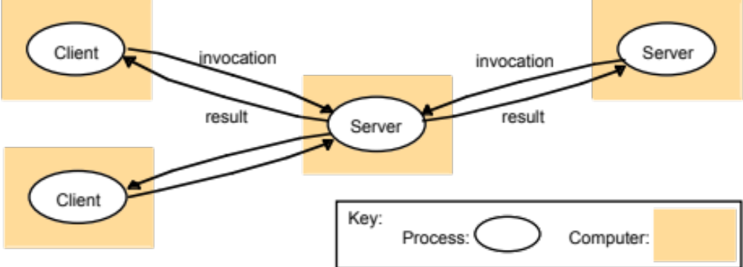
Client-Server Model
File server
DNS server
HTTP server
Workstation
Workstation
Workstation
100Gbps
LAN
Mini-
Computer
file server
Mini-
Computer
http server
Mini-
Computer
cycle server
CSS434 System Models

Slide 16
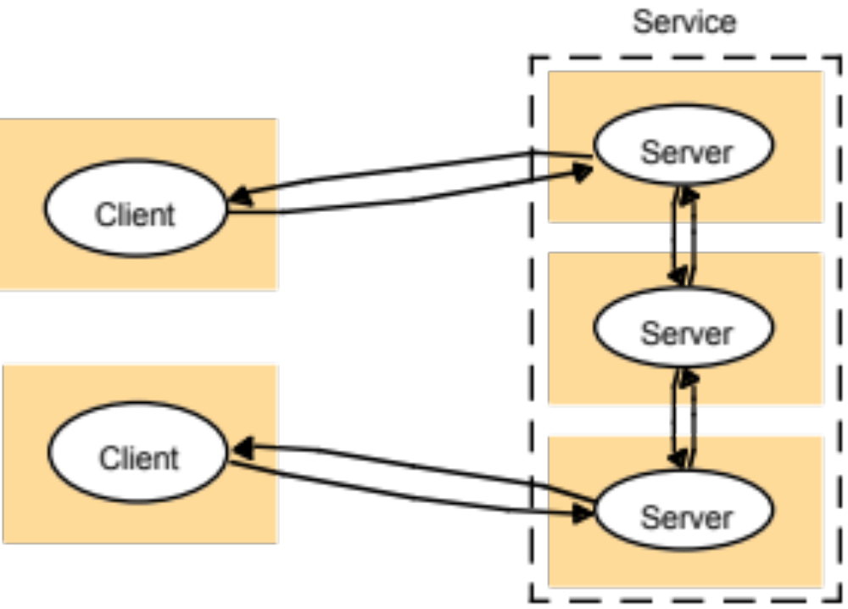
Services Provided by Multiple Servers
Replication
Availability
Performance
Workstation
Workstation
Workstation
100Gbps
LAN
Master
node
Slave
1
Slave
2
Slave
N
Ex. altavista.digital.com DB server
1Gbps SAN
CSS434 System Models

Slide 17
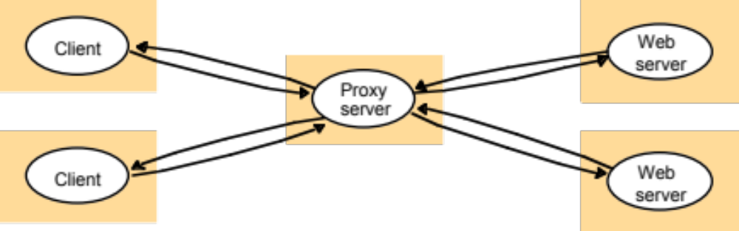
Proxy Servers and Caches
Ex. Internet Service Provider
Workstation
Workstation
Workstation
100Gbps
LAN
Master
node
Slave
1
Slave
2
Slave
N
CSS434 System Models
1Gbps SAN

Slide 18
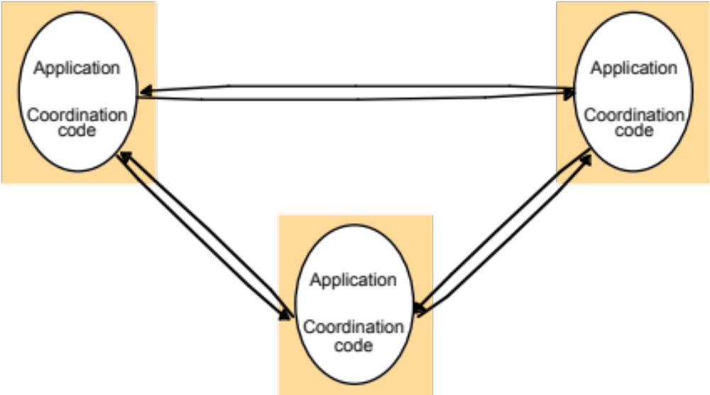
Peer Processes
Distributed whiteboard application
Workstation
Workstation
100Gbps
LAN
Workstation
Workstation
Workstation
CSS434 System Models

Slide 19
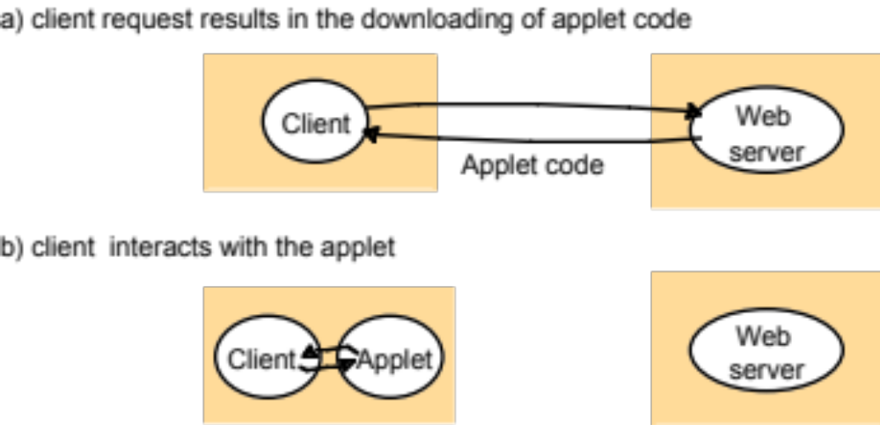
Mobile Code and Agents
Workstation
Workstation
Workstation
100Gbps
LAN
Mini-
Computer
file server
Mini-
Computer
http server
Mini-
Computer
cycle server
CSS434 System Models

Slide 20
Network Computers and Thin Clients
X11
Diskless workstations
Compute server
Network computer or PC
Thin
network
Application
Client
Process
Workstation
Workstation
Workstation
100Gbps
LAN
100Gbps
LAN
Master
node
Slave
1
Slave
2
Slave
N
Server 1
Server N
1Gbps SAN
CSS434 System Models

Slide 21
Reasons for Distributed Computing Systems
Inherently distributed applications
  Distributed DB, worldwide airline reservation, banking system
Information sharing among distributed users
  CSCW or groupware
Resource sharing
  Sharing DB/expensive hardware and controlling remote lab. devices
Better cost-performance ratio / Performance
  Emergence of Gbit network and high-speed/cheap MPUs
  Effective for coarse-grained or embarrassingly parallel applications
Reliability
  Non-stopping (availability) and voting features.
Scalability
  Loosely coupled connection and hot plug-in
Flexibility
  Reconfigure the system to meet users’ requirements
CSS434 System Models

Slide 22
Network v.s. Distributed Operating Systems
Features | Network OS | Distributed OS
SSI (Single System Image) | NO Ssh, sftp, no view of remote memory | YES Process migration, NFS, DSM (Distr. Shared memory)
Autonomy | High Local OS at each computer No global job coordination | Low A single system-wide OS Global job coordination
Fault Tolerance | Unavailability grows as faulty machines increase. | Unavailability remains little even if fault machines increase.
CSS434 System Models

Slide 23
Issues in Distributed Computing System
Transparency (=SSI)
Access transparency
  Memory access: DSM
  Function call: RPC and RMI
Location transparency
  File naming: NFS
  Domain naming: DNS (Still location concerned.)
Migration transparency
  Automatic state capturing and migration
Concurrency transparency
  Event ordering: Message delivery and memory consistency
Other transparency:
  Failure, Replication, Performance, and Scaling
CSS434 System Models

Slide 24
Issues in Distributed Computing System Reliability
Faults
  Omission failure
  Byzantine failure
Fault avoidance
  The more machines involved, the less avoidance capability
Fault tolerance
  Redundancy techniques
    K-fault tolerance needs K + 1 replicas
    K-Byzantine failures needs 2K + 1 replicas.
  Distributed control
    Avoiding a complete fail stop
Fault detection and recovery
  Atomic transaction
  Stateless servers
CSS434 System Models

Slide 25
Flexibility
Ease of modification
Ease of enhancement
User
applications
User
applications
User
applications
User
applications
User
applications
User
applications
Monolithic
Kernel
(Unix)
Monolithic
Kernel
(Unix)
Monolithic
Kernel
(Unix)
Daemons
(file, name,
Paging)
Daemons
(file, name,
Paging)
Daemons
(file, name,
Paging)
Microkernel
(Mach)
Microkernel
(Mach)
Microkernel
(Mach)
Network
Network
CSS434 System Models

Slide 26
Heterogeneity
Data and instruction formats depend on each machine architecture
If a system consists of K different machine types, we need K–1 translation software.
If we have an architecture-independent standard data/instruction formats, each different machine prepares only such a standard translation software.
  Java and Java virtual machine
CSS434 System Models

Slide 27
Exercises (No turn-in)
In what respect are distributed computing systems superior to parallel systems?
In what respect are parallel systems superior to distributed computing systems?
Discuss the difference between the workstation-server and the processor-pool model from the availability view point.
Discuss the difference between the processor-pool and the cluster model from the performance view point.
Discuss about pros and cons of Microkernel.
CSS434 System Models

