Slide 1
Socket Programming for MP 1
CS498 CNO

Slide 2
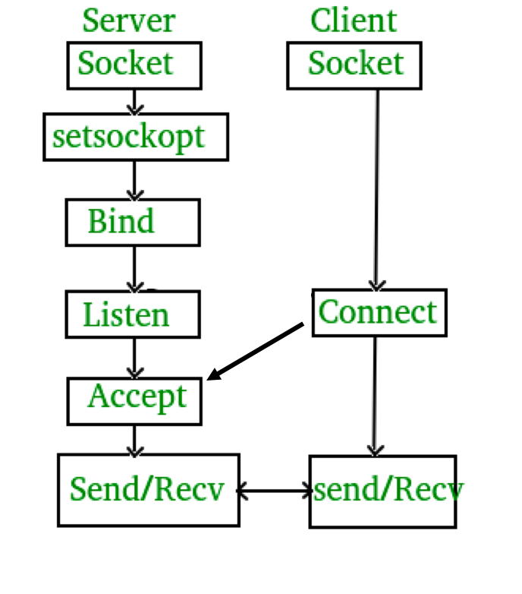
Overview
client.c and server.c in assignment1_files.zip are good examples. Please read them carefully.
Reference: https://beej.us/guide/bgnet/
Server.c:
It creates socket descriptor and keeps waiting for any connection request.
If a request is accepted, it creates a new process for the connection and sends a message to the client.
Client.c:
It creates a socket descriptor and tries to connect to the server.
If the connection is setup, it receives the message from the server.
https://www.geeksforgeeks.org/socket-programming-cc/
Notes:
Beej's Guide to Network Programming

Slide 3
Server: getaddrinfo
We need to get the server’s network address (IP address)
int getaddrinfo(const char *node, const char *service, const struct addrinfo *hints, struct addrinfo **res);
Given node and service, which identify an Internet host and a service, getaddrinfo() returns one or more addrinfo structures, each of which contains an Internet address that can be specified in a call to bind or connect.
getaddrinfo(NULL, PORT, &hints, &servinfo)
PORT: The port that the server keeps listening to. E.g., 3490, 80
hints:
hints.ai_family = AF_UNSPEC; // IPv4/IPv6/Unspecified …
hints.ai_socktype = SOCK_STREAM; // We use TCP. Use SOCK_DGRAM instead if we use UDP
hints.ai_flags = AI_PASSIVE; // Get the local host‘s IP address
Return: servinfo: It contains the "wildcard address", which is used by applications (typically servers) that intend to accept connections on any of the host's network addresses.

Slide 4
Server workflow
Loop through all the returned servinfo and bind to the first we can.
// Create a socket
sockfd = socket(p->ai_family, p->ai_socktype, p->ai_protocol)
// Allow a socket to bind to an address and port that would be in use.
setsockopt(sockfd, SOL_SOCKET, SO_REUSEADDR, &yes, sizeof(int))
// Bind the socket to the address and port specified
bind(sockfd, p->ai_addr, p->ai_addrlen)
// Listen to the port for the connection request from the client
listen(sockfd, BACKLOG)
IPv4/IPv6/Unspecified
…
SOCK_STREAM (TCP)
SOCK_DGRAM (UDP) …
*https://www.geeksforgeeks.org/socket-programming-cc/
*https://docs.microsoft.com/en-us/windows/desktop/WinSock/sol-socket-socket-options
Notes:
#define BACKLOG 10 // how many pending connections queue will hold

Slide 5
Server workflow (cont'd)
In a while(1) loop:
// If receive a connection request, create a new connected socket. If no connection request is received yet, block and wait
new_fd = accept(sockfd, (struct sockaddr *)&their_addr, &sin_size);
// Start a child process to handle the connection, so that the server can continue to accept other new connections.
if (!fork()) { // this is the child process
close(sockfd); // child doesn't need the listener
if (send(new_fd, "Hello, world!", 13, 0) == -1) // send helloworld to client
perror("send");
close(new_fd); // Do not forget to close the socket when everything finished
exit(0);
}
loop
*https://www.geeksforgeeks.org/socket-programming-cc/

Slide 6
Client: getaddrinfo
We need to convert a server’s domain name to an IP address.
E.g., www.yahoo.com -> 98.137.246.7, 98.137.246.8
getaddrinfo(domainName, PORT, &hints, &servinfo)
domainName: Domain name of server. Do not include “http://”
PORT: Port of server that we connect to.
hints:
hints.ai_family = AF_UNSPEC; // IPv4/IPv6/Unspecified …
hints.ai_socktype = SOCK_STREAM; // We use TCP. Use SOCK_DGRAM instead if we use UDP
Return: servinfo: IP addresses
If you know the IP address of the server, this step is unnecessary.
But we assume that the IP address is unknown in MP1!

Slide 7
Client workflow
Loop through all the returned servinfo and connect via the first we can
// Create a socket
sockfd = socket(p->ai_family, p->ai_socktype, p->ai_protocol)
// Connect to the server
connect(sockfd, p->ai_addr, p->ai_addrlen)
// Receive data from the server. In this example, we receive "Hello, world!"
numbytes = recv(sockfd, buf, MAXDATASIZE-1, 0)
// May need to loop until we receive the whole message
// Close the socket when everything is done
close(sockfd);
IPv4/IPv6/Unspecified
…
SOCK_STREAM (TCP)
SOCK_DGRAM (UDP) …
https://www.geeksforgeeks.org/socket-programming-cc/

Slide 8
MP1: HTTP Client programming
Http Server
Task: send a HTTP GET request to the server to receive a file.
File type: any type of content that you could get via HTTP, including text, HTML, images, and more
File size: from a few bytes to 100s of MBs
Can handle errors like 404, invalid arguments
Client programming
Build on the client.c
Use send() that we have learnt.
Then use recv() to receive the response from the server
https://www.geeksforgeeks.org/socket-programming-cc/

Slide 9
HTTP request/response
If want to get the file test.txt from myserver.com, send the following string
GET /test.txt HTTP/1.0\r\n\r\n
A http response example (\r\n is omitted)
HTTP/1.0 200 OK // we also need to handle 404 (optional: 301)
Date: Sun, 10 Oct 2010 23:26:07 GMT
Server: Apache/2.2.8 (Ubuntu) mod_ssl/2.2.8 OpenSSL/0.9.8g
Last-Modified: Sun, 26 Sep 2010 22:04:35 GMT
ETag: "45b6-834-49130cc1182c0"
Accept-Ranges: bytes
Content-Length: 13 // length of the file in bytes.
Connection: close
Content-Type: text/html
\r\n\r\n
Content of the file
Header
Actual content

Slide 10
Some common questions for MP1
Why my code passed the compilation on my local machine but failed with autograder?
Please try to use the same OS and compiler version as the autograder
Ubuntu 20.04 LTS (follow the virtual machine guidance)
g++ (C++98), not clang, gcc, clang++
How to debug my code?
Start a server locally by python3 -m http.server [PORT]
Try to fetch different types of files, e.g. text, html, picture
Try to test the file with various sizes, from KB to MB
Try to test if your program can correctly handle failure cases like no connection

Slide 11
Some useful functions in C
strstr()
strchr()
strcpy()
sprintf()
strlen()
Run “man strstr” to get the manual of function strstr().

Slide 12
Some other tips about testcases
Testcase 2: Your program shall be able to pass a binary file.
Testcase 4: Your program shall be able to handle a filename of length 250+.
Testcase 5: Your program shall be able to find a file within a folder.

Slide 13
Reference
https://beej.us/guide/bgnet/
https://www.geeksforgeeks.org/socket-programming-cc/
https://courses.engr.illinois.edu/cs438/sp2018/lectures/lec02_sockets.pdf
Also useful for MP 2 !

