Slide 1

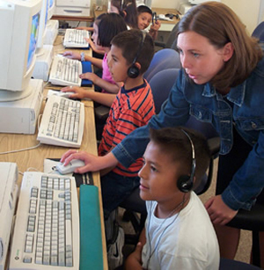
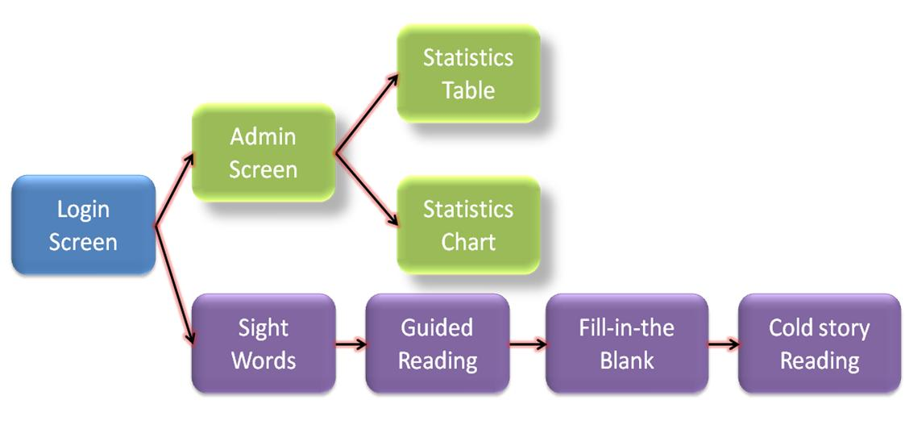
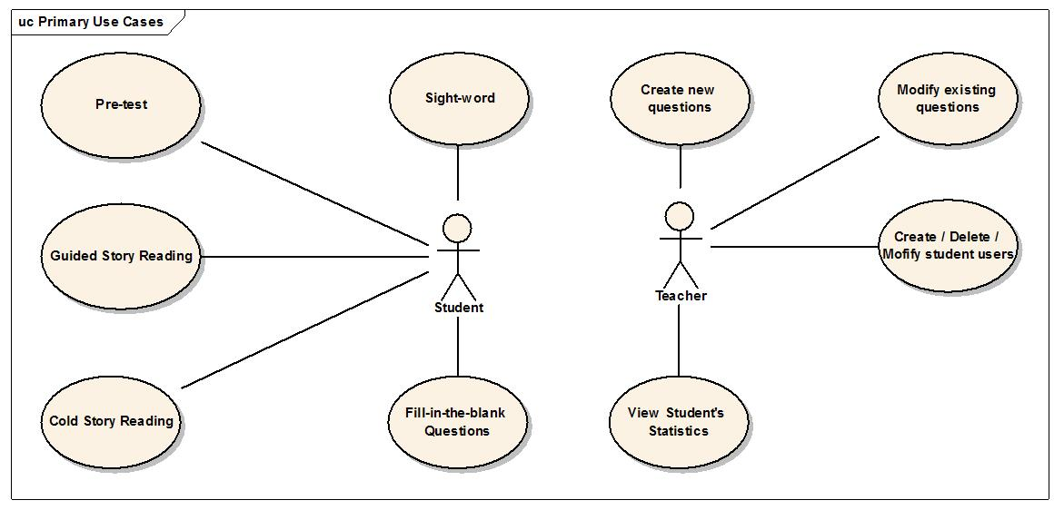
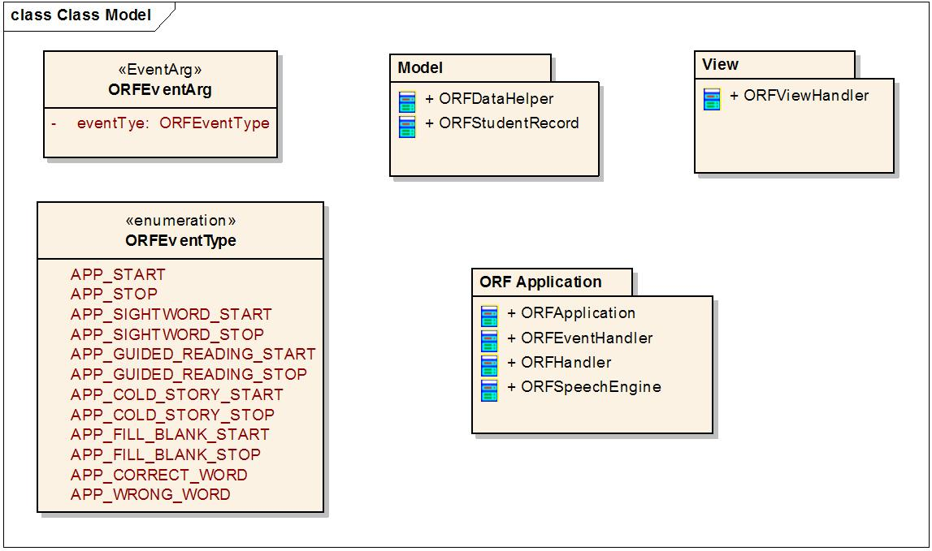

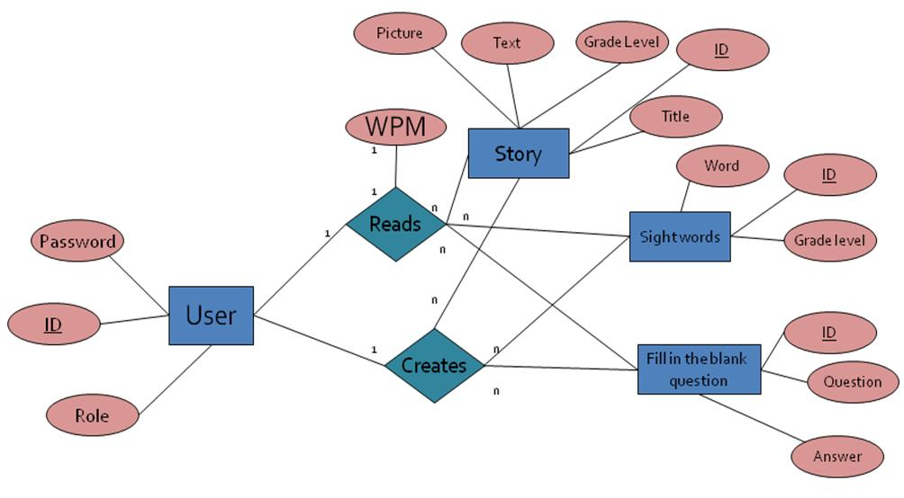
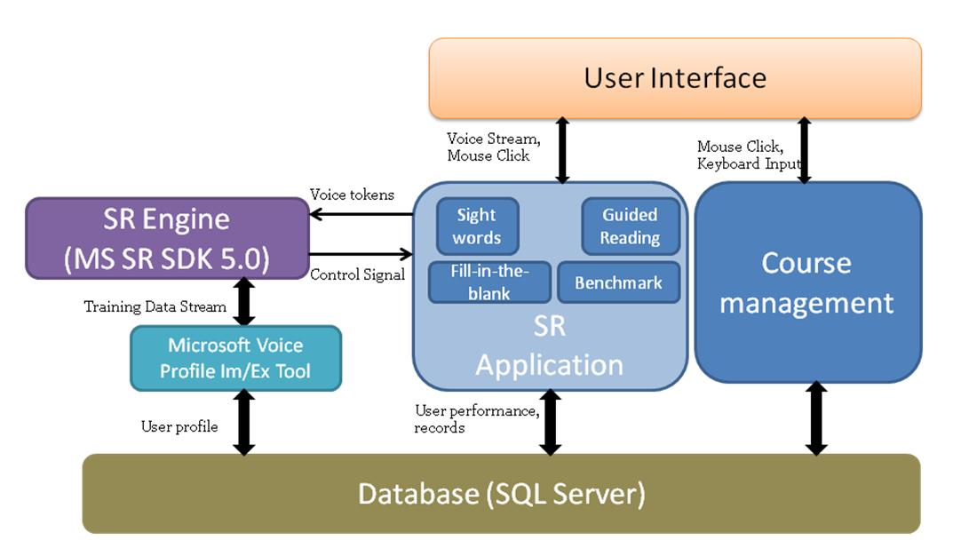
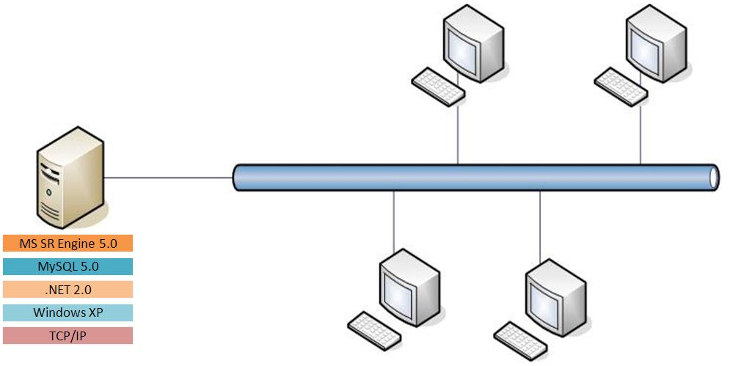

Strategic Operations Center
Strategic Operations Center
Daniel Bedich, Shantanu Bhardwaj, Asanka Nanayakkara, Cyriac Domini Thundathil
http://soctrackdev.herokuapp.com/
Introduction
Software Analysis and Design
Facts
75% of kids who had oral language difficulty at a young age will have reading difficulties in the 3rd grade (1999).
The pupil-teacher ratio is 15.5:1 and the preferred method of ORF training is 1:1.(www.statemaster.com)
Figure 5: Screen Flow Diagram
Figure 6: Use Case Diagram
Problem
Show the flow of tasks that a student is supposed to perform in our system.
Depending on the role of the user, he/she either goes to the top / bottom sequence after login.
Three types of users: Students, Teachers, Administrators
Students have all functions related to oral reading training and that order of scenarios they will get into decided beforehand by the clients.
Teacher functions include monitoring student’s progress in oral reading, adding and modifying reading materials into / from the system and adding new users into the system.
A user in the teacher type can also assume the role of an administrator, having the privileges to create, modify and delete a user.
There is a need for an alternative, engaging system that will assist in this process with minimal instructor supervision.
The system needs to have the ability to track individual student progress, WPM, and problem areas.
Figure 1: Student using computer software under teacher assistance
Project Goals
The new system will make the overall process more efficient by being able to train a group of students at the same time.
Moreover, instructors will be able to assist students in their problem areas by having the proper information available to them.
Bottom line, the system will make the training more efficient, accurate, and effective.
Figure 7: Design Classes Overview
Model View Control (MVC) model in our implementation to decouple the three components from each other.
Model takes care of persistency. Domain classes are captured and implemented in the Model sub-system.
View handles any interaction with the user.
Control acts as the controller of the application.
Current Methods
Figure 2: Silent reading time
At this time, instructors are directing students to silent reading time where the student practices reading on their own—this process is not as efficient as it can be.
The current process lacks the ability to track students' progression, WPM, and other key features that would assist greatly in the training.
Figure 8: Entity-Relation-Diagram
in sight-word test and the fill-in-the-blank test, a WPM of 0 means the student cannot read the word correctly and a WPM of 1 indicates otherwise.
System Architecture
Significance
Group determined the most suitable Voice Recognition sub-system for future use
Well-documented system design and architecture lays the ground work for future development
Organized application code will prove to be beneficial to future development
Future Work
Architecture
Optimize speech recognition subsystem response time
Optimize architecture for system compatibility
Interface
Improve the user interface to be child-friendly and engaging
Adjust interface flow to become more intuitive
Enhance student progress tracking components
Figure 3: System Architecture Diagram
Microsoft Speech Recognition 5.0 and MySQL 5.0, both of which are free and good in performance in their respective areas.
.NET framework 2.0 for our GUI and the skeleton of application.
Windows XP for compatibility concerns.
TCP/IP on top of LAN network is a universal standard used in most labs.
Acknowledgements
A special thanks to Dr. Rajiv Ramnath, Prof. Gwendolyn Cartledge, Lenwood Gibson for initiating this project and Farha Mukri for her insightful help.
Figure 4: System Configuration

