Slide 1

Optimization and Biology-Inspired Agents

Slide 2
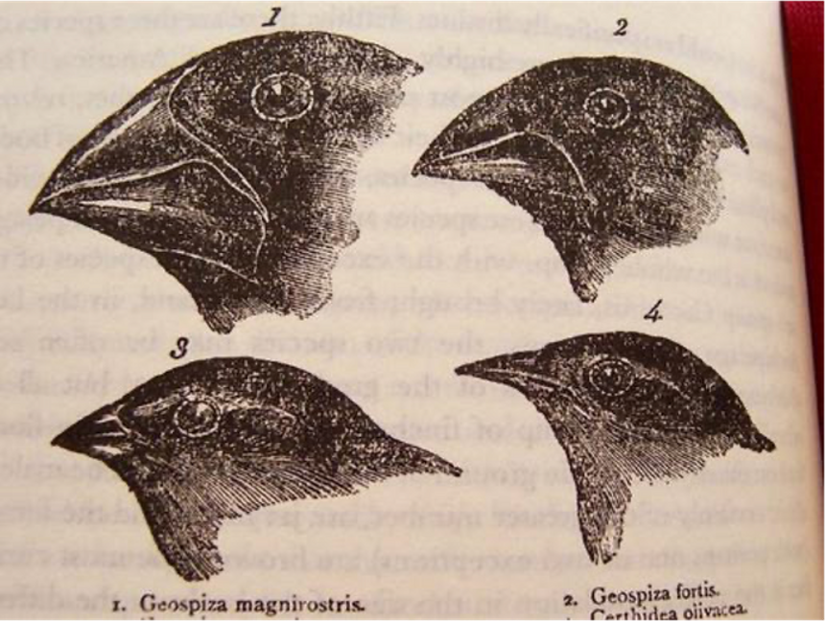
It arose from the need to solve combinatorial optimization problems using the principles and mechanisms of biological evolution.
Its creator was Lawrence J. Fogel (1960), who used these concepts to demonstrate the evolution of finite-state machines.
Later, Rechenberg and Hans-Paul Schwefel (1970) proposed evolutionary strategies for parameter optimization.
John H. Holland (1975) proposed genetic algorithms as a general model that could adapt to any process.
Evolutionary Computation

Slide 3
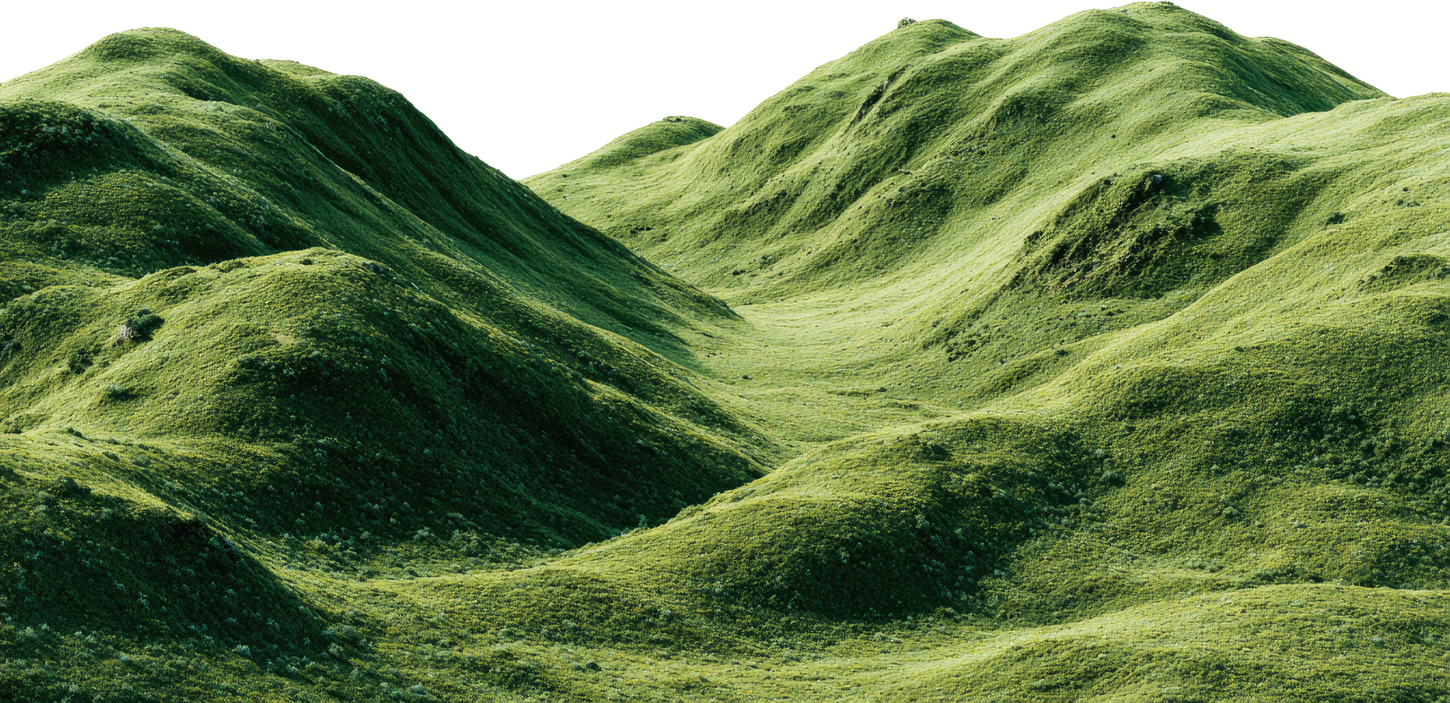
How Can This Help Us Optimize Functions?
Optimization seeks global maximum or minimum solution points and avoids confusing them with local points.
If we treat every point in a function’s solution space as an individual in a species, we can evaluate its fitness and replicate an evolutionary process in which only individuals converging on global maxima or minima survive.
Evolution may be nature’s most elegant and powerful path to adaptation: the fittest individuals pass their traits from one generation to the next to perpetuate the species.
Adaptation: the ability to survive and behave appropriately in relation to the environment.
Heredity: passing traits from individuals to a new generation.
Natural selection: the fittest individuals are more likely to pass on their traits.
Global Maximum
Local Maximum
Global Minimum

Slide 4
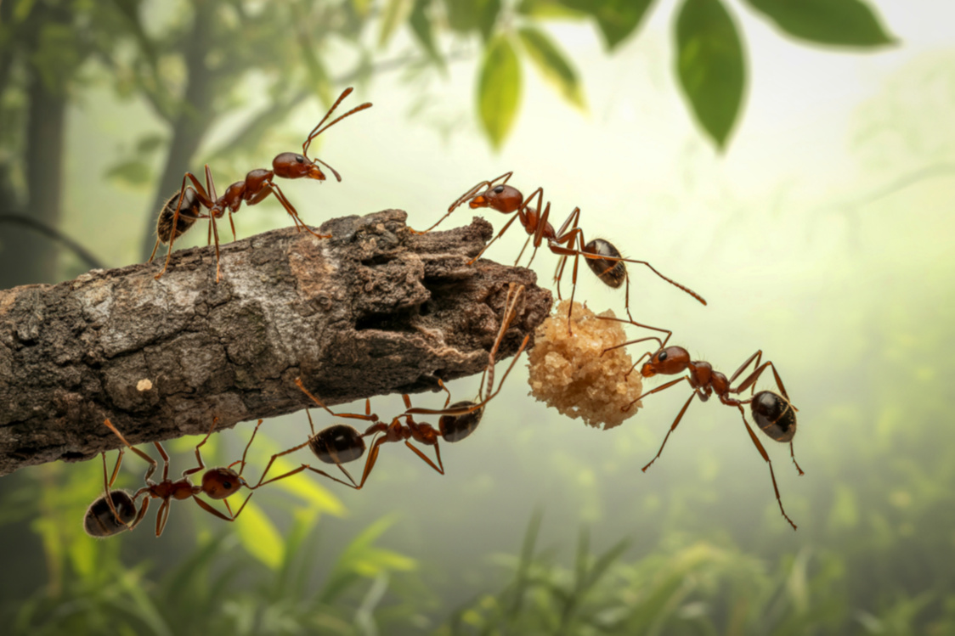
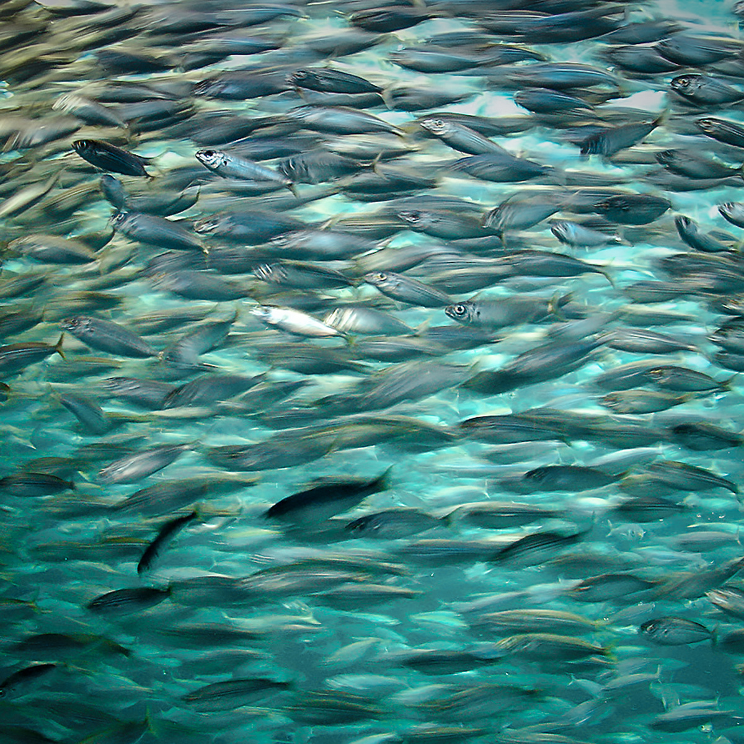
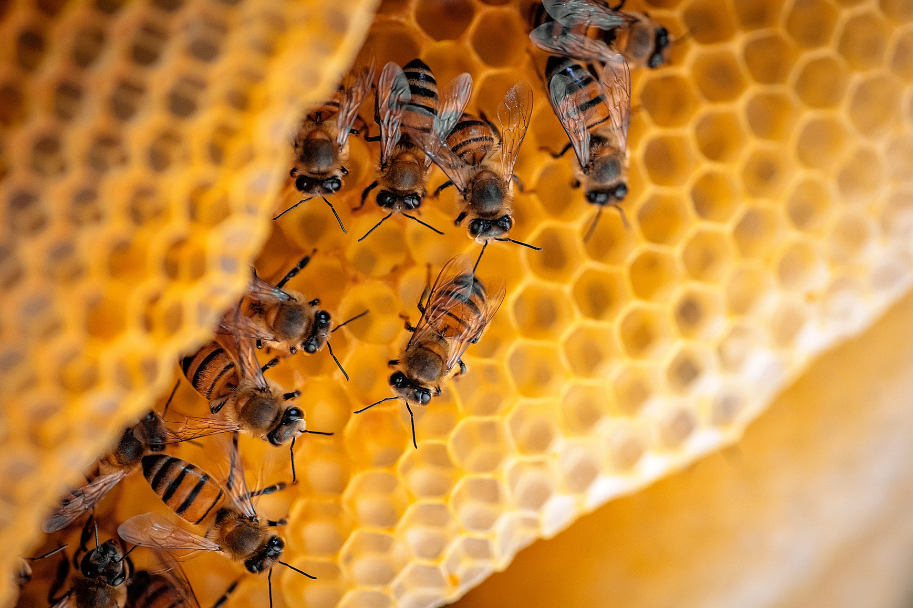
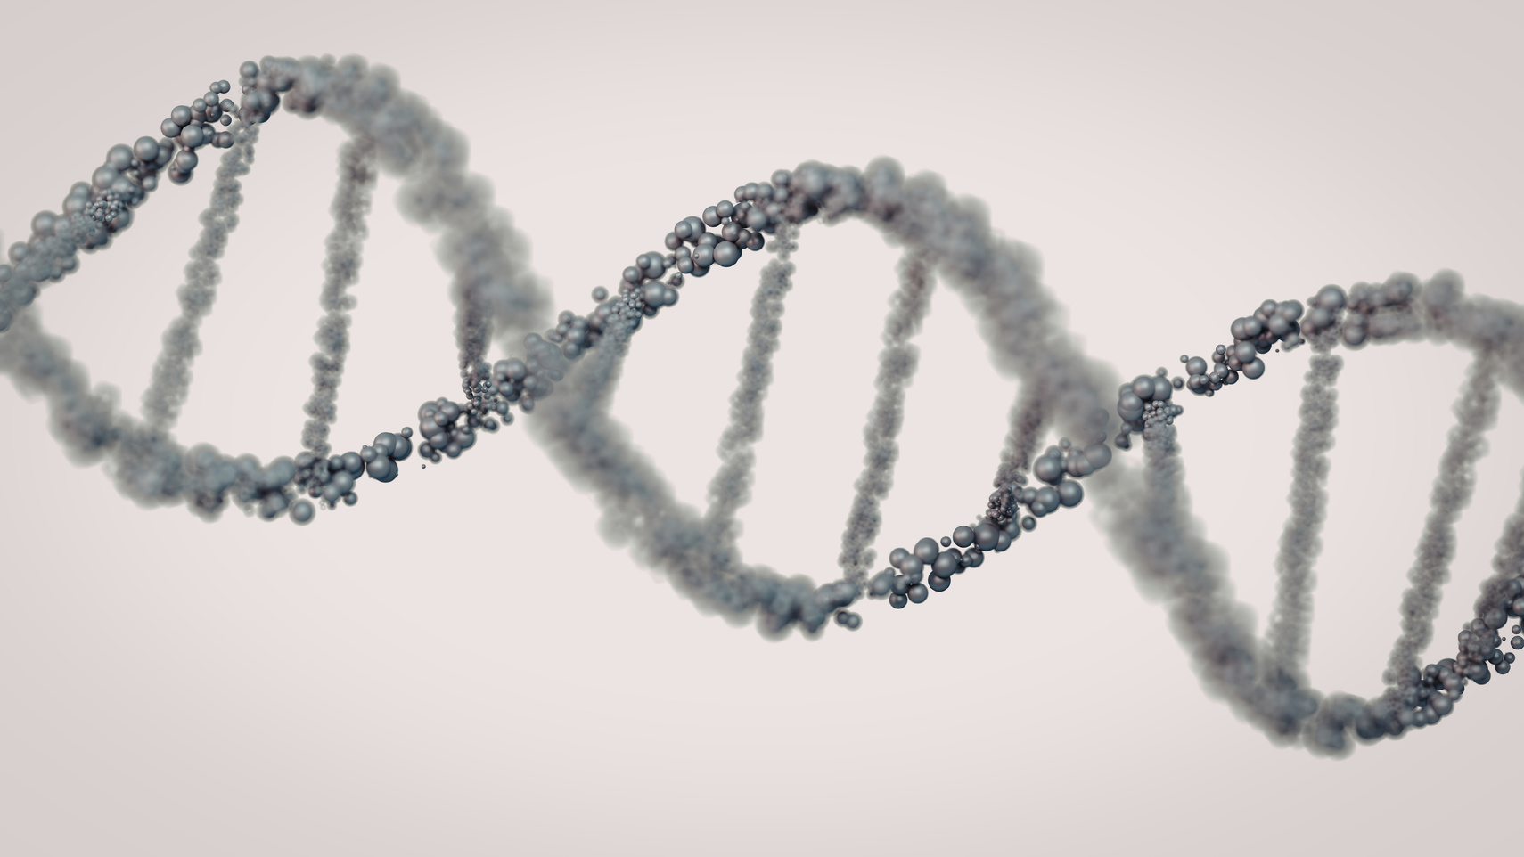
SALFORD & CO.
Bio-Inspired Algorithms

Slide 5

Genetic Algorithms
John Holland - 1992
Code representation:
Individuals: bit strings.
Evaluation: through a fitness function that seeks a point with a higher or lower value
Reproduction: through the crossover operation.
Variation: mutation is emulated by changing a bit with a certain probability.
They result from applying the principles of natural selection to computing:
Variation
Selection
Heredity

Slide 6
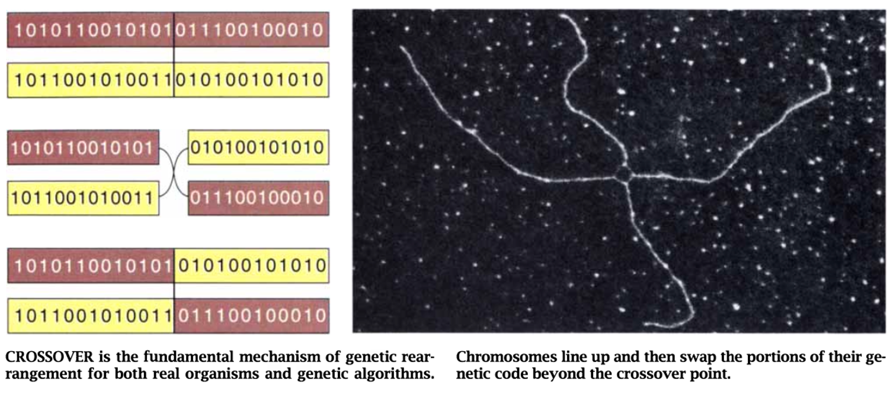
Chromosome
Represents a point in the solution space.
A sequence of 1s and 0s representing a decimal number encoded in binary.
Single point
Crossover
The parents exchange bit sections at the same position
This idea can be generalized to single-point, two-point, or k-point crossover.
h1
Mutation
h2
A bit flip may be generated for each bit in the chromosome depending
on a given probability.

Slide 7
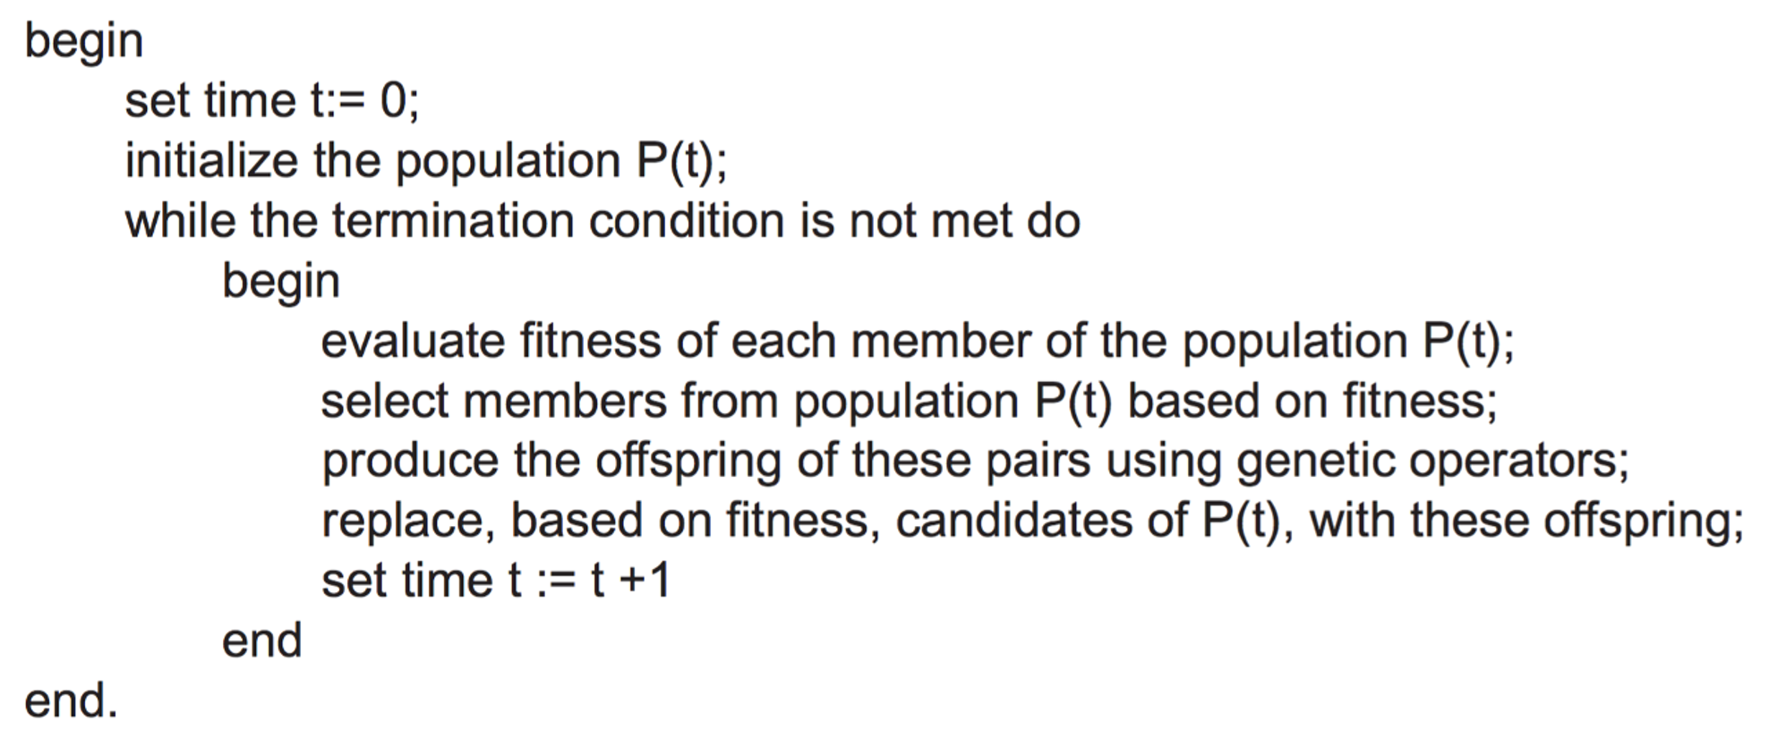

Slide 8
Particle Swarm Optimization
James Kennedy and Russell Eberhart - 1995
Stochastic optimization algorithm
• Inspired by simulations of social behavior in birds and fish, as well as swarm theory.
• Maintains a swarm of particles that move continuously through
the search space, sharing information about the best positions found.

Slide 9

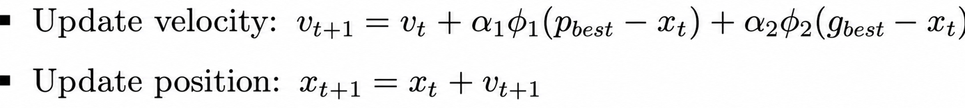
Each particle represents a candidate solution point and has three fundamental properties:
current position x_t
velocity v_t
personal best historical position p_best
The swarm maintains the best position found by any particle in any iteration, g_best.
The parameters φ_1 and φ_2 are random variables uniformly distributed over the interval [0,1].

Slide 10
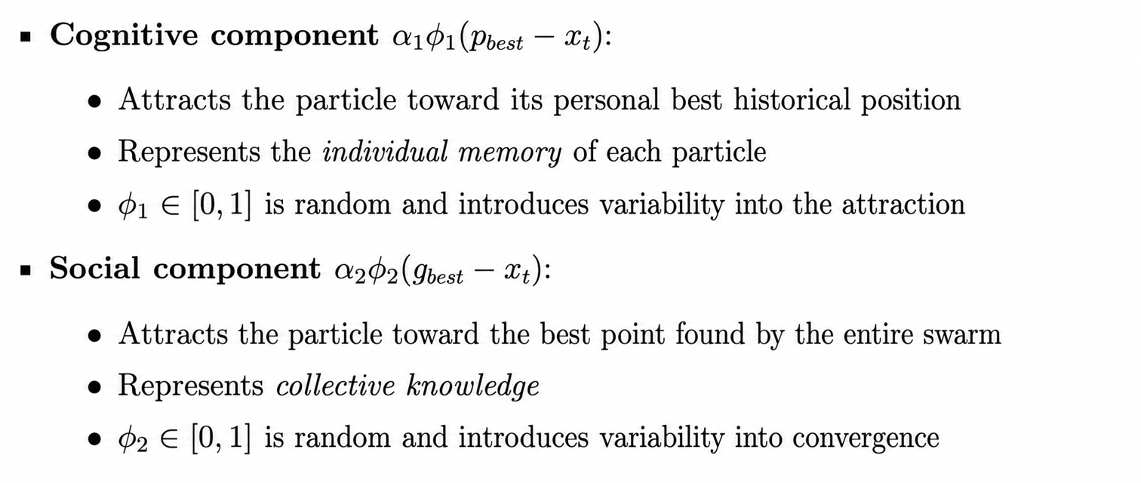
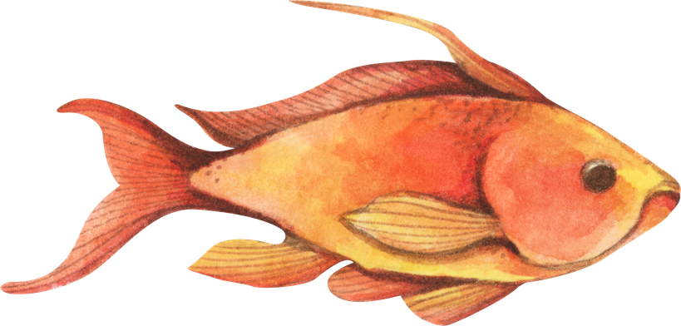
Exploitation
Exploration

Slide 11
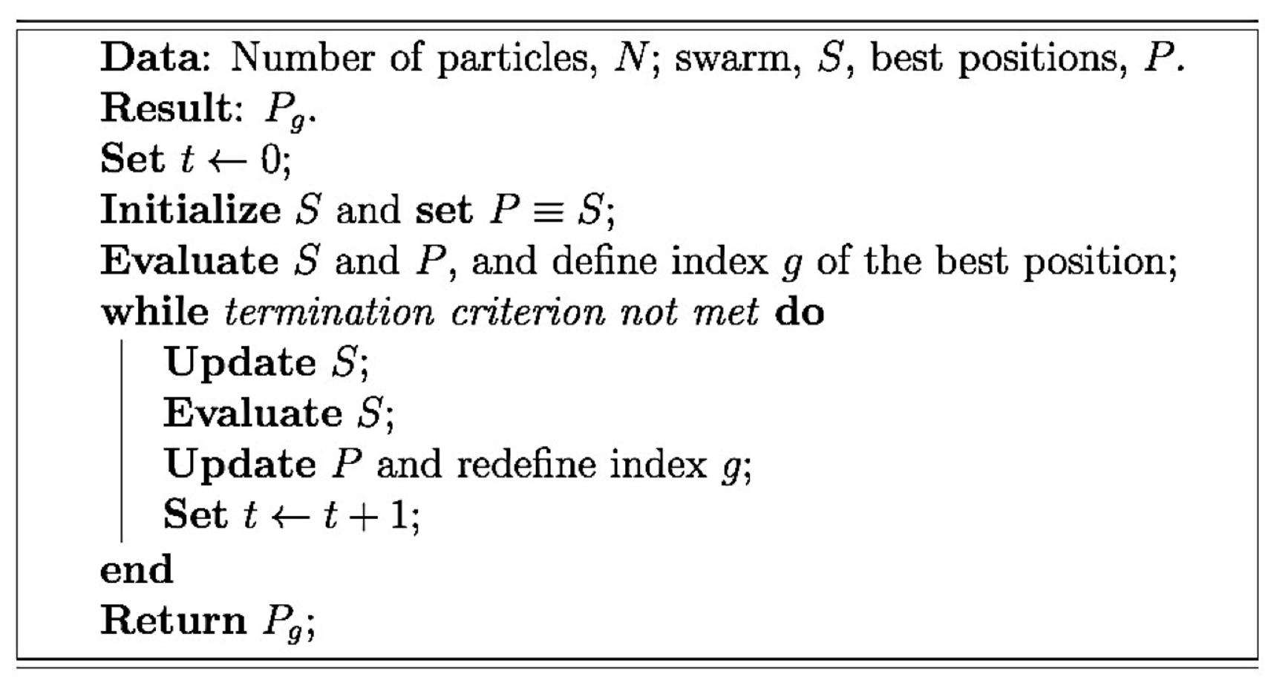

Slide 12
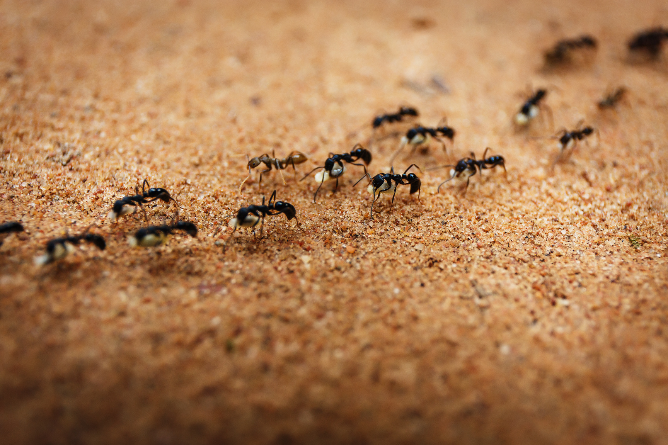
Ant Colony Optimization
Marco Dorigo - 1996
It is based on metaheuristic optimization and was originally proposed to solve combinatorial problems.
It focuses on the behavior of ant swarms and their ability to optimize the paths they follow while searching for food or avoiding obstacles.

Slide 13
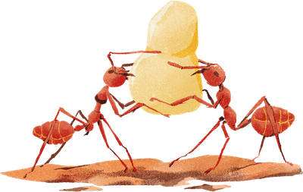
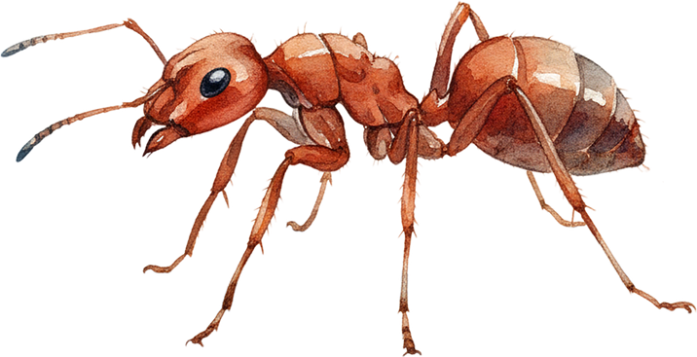
In the real world, ants initially wander at random. When they find food, they return to their colony while leaving pheromone trails.
If other ants find that path, they are likely to follow the trail rather than continue wandering randomly, returning and reinforcing it if they eventually find food.
The goal is to increase pheromone values associated with good solutions and reduce those associated with poor ones. Pheromone evaporation on weak paths makes this possible.

Slide 14
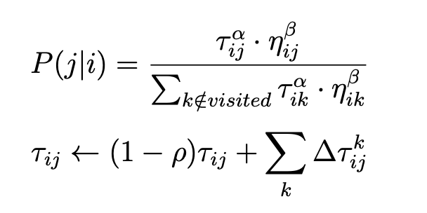
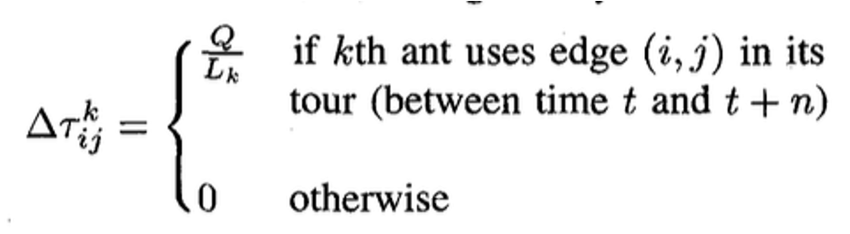
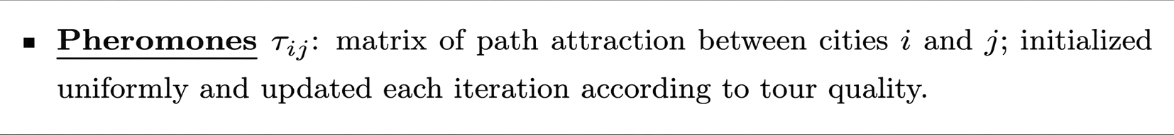
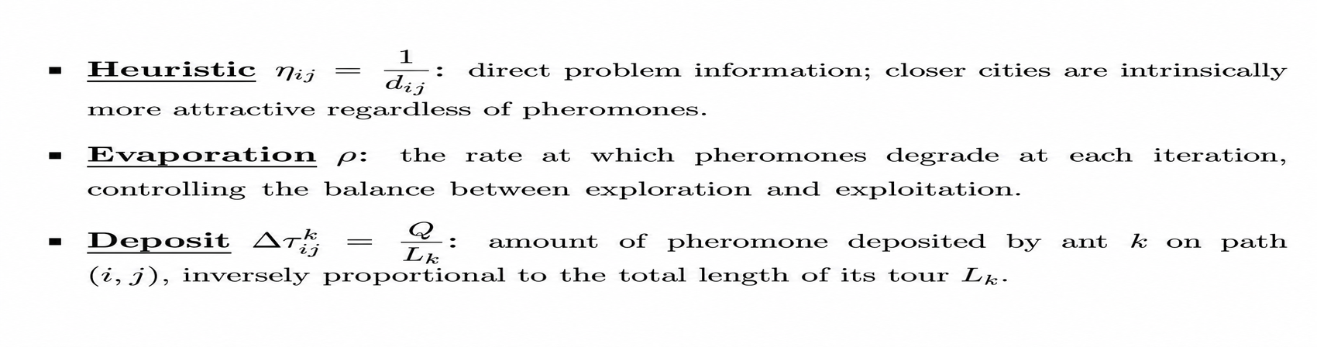

Slide 15
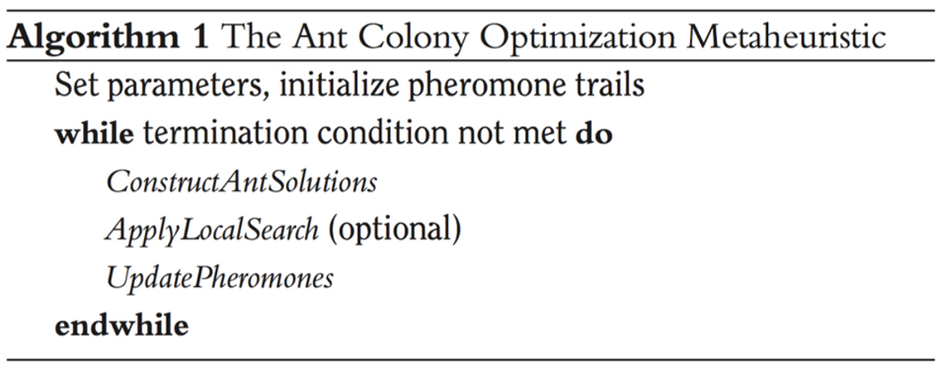

Slide 16
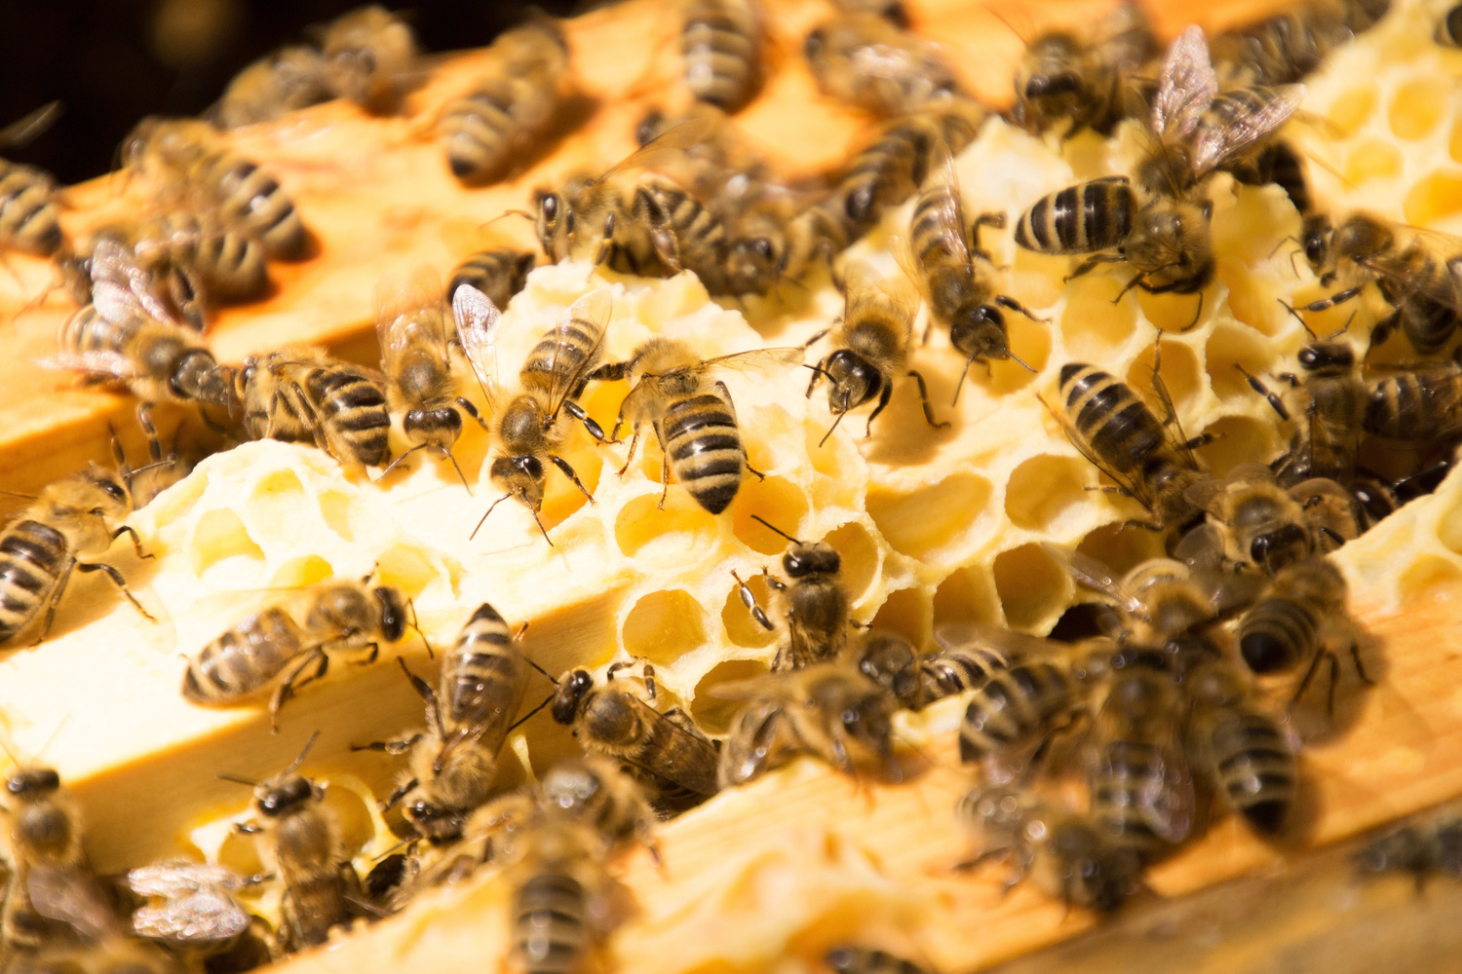
Artificial Bee
Colony
Karaboga - 2007
A swarm-intelligence approach inspired by the behavior of honeybees.
It solves optimization problems by imitating the foraging behavior of bee colonies.

Slide 17
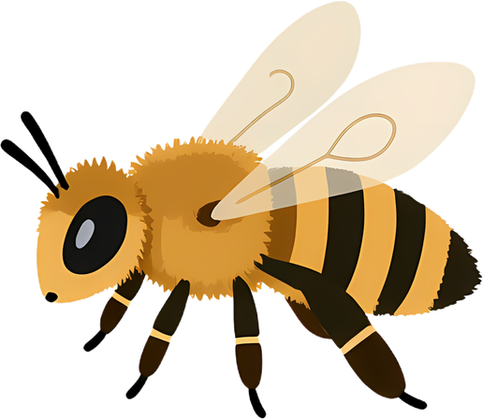
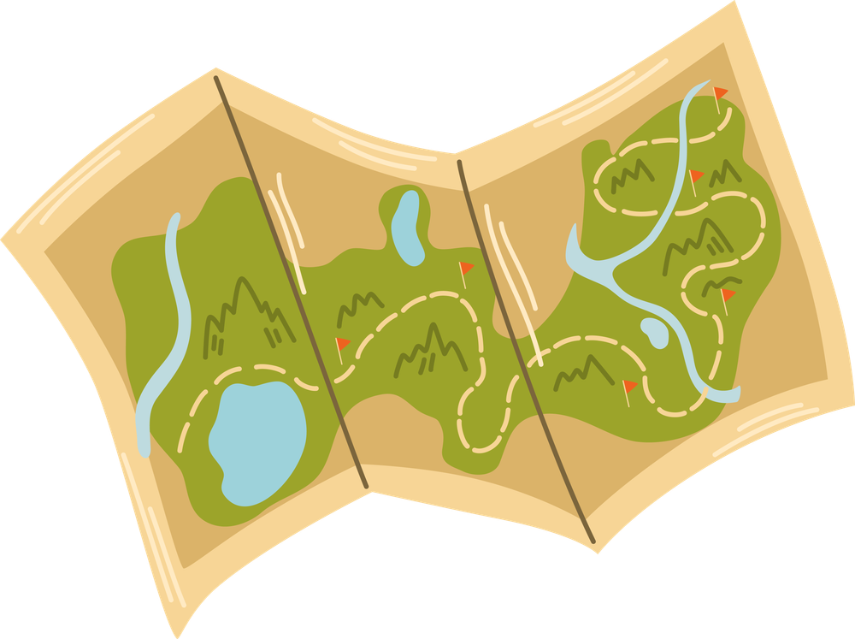
The algorithm has three main components: employed bees, onlooker bees, and scout bees.
Like the survival of a bee colony, the algorithm’s success depends on quickly discovering and efficiently using the best resources.
In the ABC algorithm, onlooker and employed bees perform exploitation in the search space, while scout bees control exploration.

Slide 18
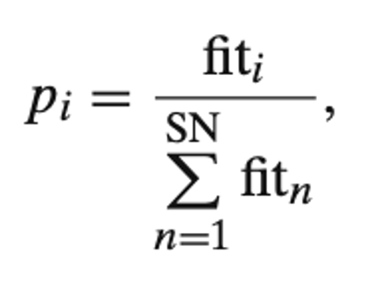
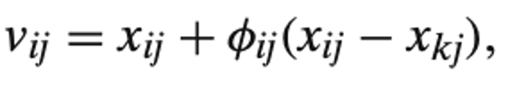
The basic ABC algorithm uses three control parameters: the number of food sources, which equals the number of employed bees (BN) or onlooker bees (SN); the limit value; and the maximum number of cycles (MCN).
Recruitment rate: how quickly the bee colony finds and exploits a new food source. It may represent the speed at which feasible or high-quality solutions to difficult optimization problems can be discovered.
To produce a possible food position: k ∈ {1, 2,..., BN} and j ∈ {1, 2,..., D} are arbitrarily selected indices.

Slide 19
