Slide 1
Outperforming Multiserver SRPT at All Loads
Izzy Grosof
Daniela Hurtado-Lange
Northwestern University

Slide 2
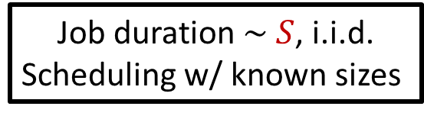
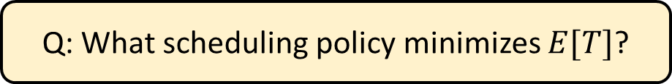




M/G/k Scheduling
Job duration $\sim S$, i.i.d.
Scheduling w/ known sizes
Load $ρ=λE[S]<1$
Poisson($λ$)
$$k$$
Response time $T$
Q: What scheduling policy minimizes $E[T]$?
Shortest Remaining Processing Time?

Slide 3
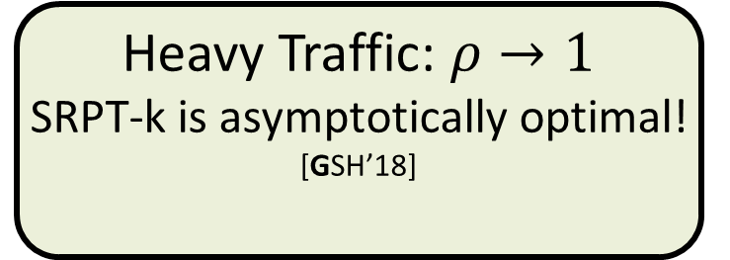

SRPT: Optimal?
SRPT-k
SRPT-k: k jobs with least remaining size.
SRPT-1 is always optimal [Schrage ‘68]. What about SRPT-k?
0
Load $ρ$
1
No arrivals:
SRPT-k is optimal! [McNaughton ’59] + [Conway et al. ’67]
Heavy Traffic: $ρ→1$
SRPT-k is asymptotically optimal! [GSH’18]
Medium load:
??????

Slide 4

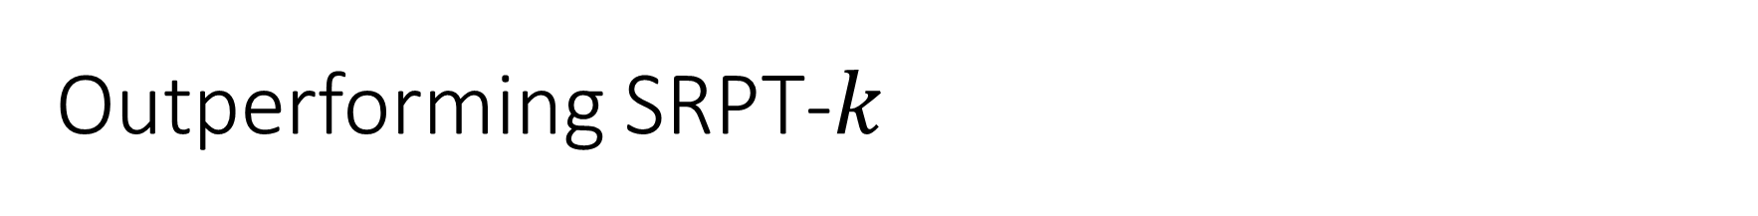
Outperforming SRPT-$k$
Q: Is SRPT-$k$ optimal at medium load?
A: No! We do better! SRPT-Except-$k+1$!
Key idea: Sometimes, prioritize the largest job

Slide 5
Outline
Define SEK policy
Intuition for improvement
Empirical improvement
State theorem: SEK-SMOD improves
Proof sketch for SEK-SMOD

Slide 6
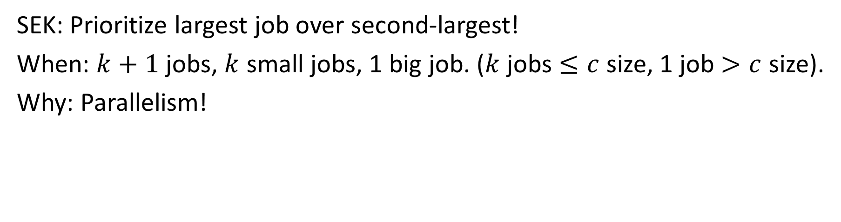
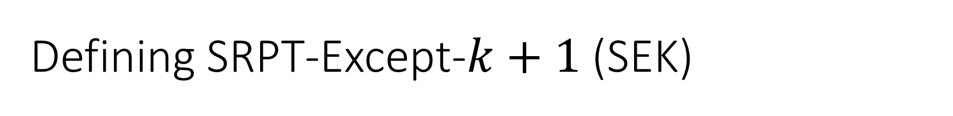
Defining SRPT-Except-$k+1$ (SEK)
SRPT-k
SEK(5)
10
3
3
4
10
4
SEK: Prioritize largest job over second-largest!
When: $k+1$ jobs, $k$ small jobs, 1 big job. ($k$ jobs $≤c$ size, 1 job $>c$ size).
Why: Parallelism!

Slide 7
SEK Intuition
SRPT-k
SEK(5)
10
3
3
4
10
4
13
4
3
0
10
10
7
3
0
Time
Time
10
4
3
4
3
Servers
Servers
Total response time, no arrivals: SRPT: 3 + 4 + 13 = 20. SEK: 3 + 7 + 10 = 20
Duration of full parallelism: SRPT: 4. SEK: 7.
SEK: “Same response time, better parallelism”.

Slide 8
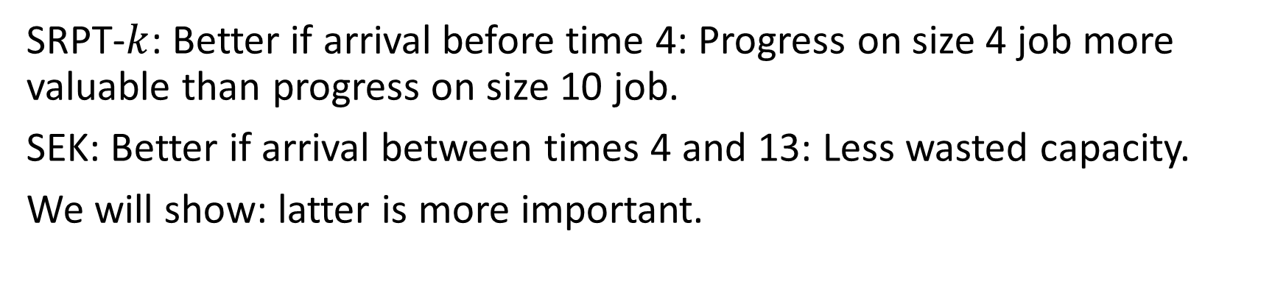
Further SEK Intuition
SRPT-k
SEK(5)
10
3
3
4
10
4
13
4
3
0
10
10
7
3
0
Time
Time
10
4
3
4
3
Servers
Servers
SRPT-$k$: Better if arrival before time 4: Progress on size 4 job more valuable than progress on size 10 job.
SEK: Better if arrival between times 4 and 13: Less wasted capacity.
We will show: latter is more important.

Slide 9
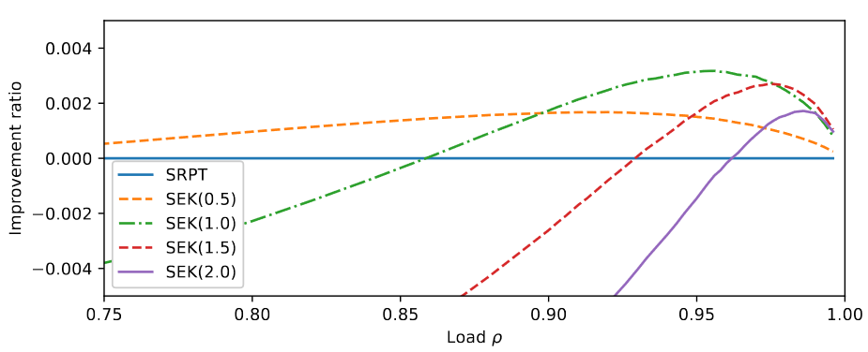

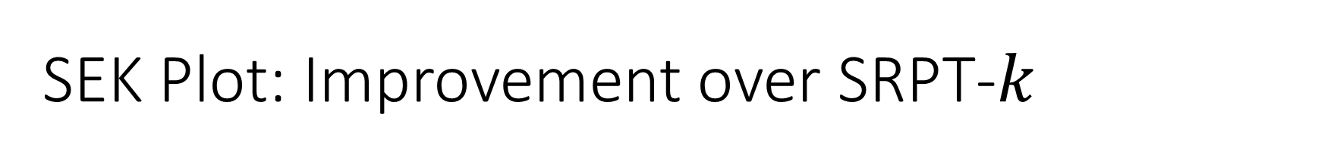

SEK Plot: Improvement over SRPT-$k$
Setting: M/M/2, size Exp(1). Improvement ratio: $1−\frac{E\left[T^{SEK}\right]}{E\left[T^{SRPT}\right]}$
$ρ≤0.996$ simulated

Slide 10

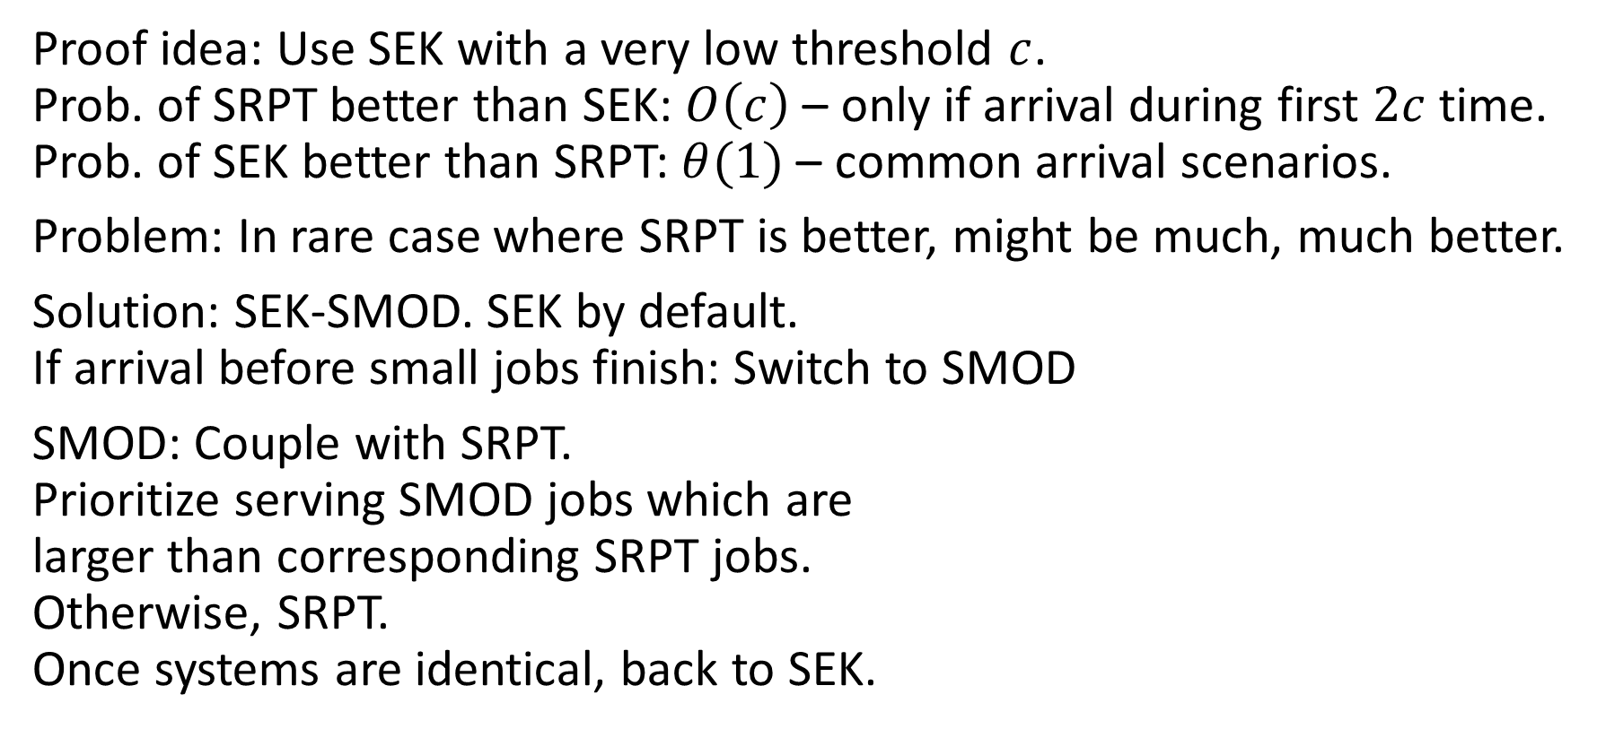
SEK Proof: Tweaked policy SEK-SMOD
10
c
c
Proof idea: Use SEK with a very low threshold $c$. Prob. of SRPT better than SEK: $O\left(c\right)$ – only if arrival during first $2c$ time. Prob. of SEK better than SRPT: $θ(1)$ – common arrival scenarios.
Problem: In rare case where SRPT is better, might be much, much better.
Solution: SEK-SMOD. SEK by default. If arrival before small jobs finish: Switch to SMOD
SMOD: Couple with SRPT. Prioritize serving SMOD jobs which are larger than corresponding SRPT jobs. Otherwise, SRPT. Once systems are identical, back to SEK.
SRPT-k
10
5
2
SMOD
10
5.1
1.9
0.1
Serve!

Slide 11
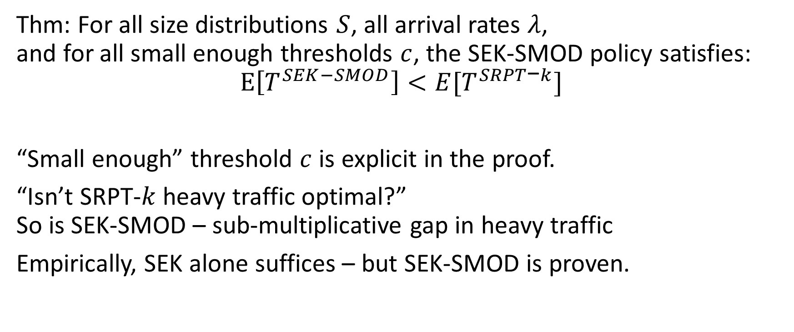
Main result: SEK-SMOD Always Improves
Thm: For all size distributions $S$, all arrival rates $λ$, and for all small enough thresholds $c$, the SEK-SMOD policy satisfies: $$E\left[T^{SEK−SMOD}\right]<E[T^{SRPT\text{−}k}]$$
“Small enough” threshold $c$ is explicit in the proof.
“Isn’t SRPT-$k$ heavy traffic optimal?” So is SEK-SMOD – sub-multiplicative gap in heavy traffic
Empirically, SEK alone suffices – but SEK-SMOD is proven.

Slide 12

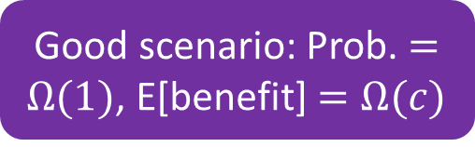
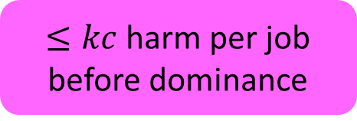
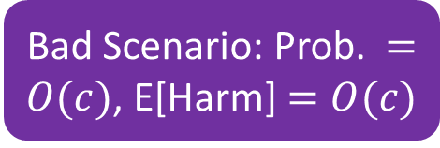
Proof flowchart
SEK, stochastic proofs
/
SEK-SMOD improves on SRPT
Each SEK divergence helps, on average
Good scenario: Prob. $=Ω(1)$, E[benefit] $=Ω(c)$
Neutral Scenario: Benefit $≥0$
Bad Scenario: Prob. $=O(c)$, E[Harm] $=O(c)$
/
$≤kc$ harm per job before dominance
Dominance when largest divergence job completes
SMOD, worst-case proofs
SMOD preserves: Zig-zag, Positive-less-negative, Positive-part monotonicity, Work inequality

Slide 13
Proof intuition: Good, neutral, bad scenarios
Good scenario:
2 jobs better, 1 job worse.
WTS: Common
/
Neutral scenario: everything else
WTS: No harm
Bad scenario:
Delayed for nothing.
WTS: Common, not too bad
3
10
2
10
4
Multiple arrivals
Arrival
c
c
c
SEK
c
SEK
3
10
2
10
4
Arrival
c
c
SRPT
c
c
SRPT

Slide 14



Key idea: Dominance
10
10
$$t=0$$
c
c
c
c
SEK
SRPT
Neutral scenario:
Time 0: SEK [c, c, 10], SRPT [c, c, 10]
Time c: SEK [c, 10-c], SRPT [10]
Time 2c: SEK [10-2c], SRPT [10-c]
Dominance: Every job in SEK is smaller than corresponding job in SRPT.
Thm: Dominance preserved until next SEK divergence.
Implies neutral scenario never hurts SEK.
10-c
10
$$t=c$$
c
SEK
SRPT
10 -2c
10-c
$$t=2c$$
SEK
SRPT

Slide 15
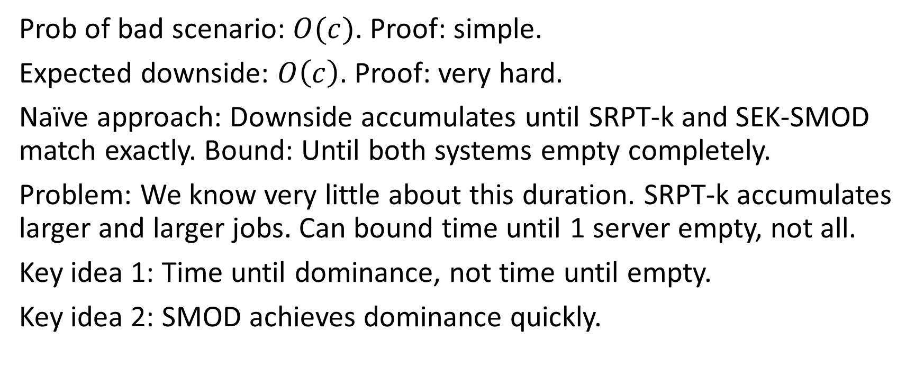
Bad scenario: Intense worst-case argument
Prob of bad scenario: $O(c)$. Proof: simple.
Expected downside: $O\left(c\right)$. Proof: very hard.
Naïve approach: Downside accumulates until SRPT-k and SEK-SMOD match exactly. Bound: Until both systems empty completely.
Problem: We know very little about this duration. SRPT-k accumulates larger and larger jobs. Can bound time until 1 server empty, not all.
Key idea 1: Time until dominance, not time until empty.
Key idea 2: SMOD achieves dominance quickly.

Slide 16
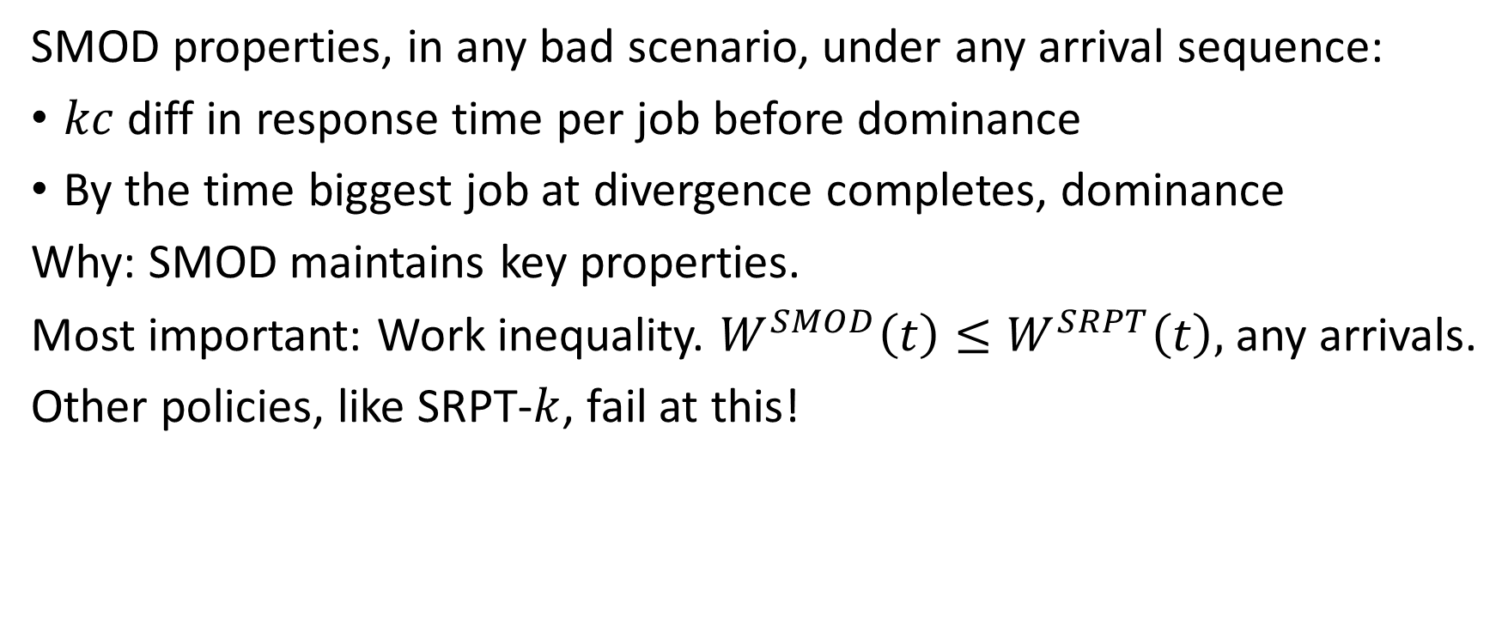
SMOD: Worst case argument
SMOD properties, in any bad scenario, under any arrival sequence:
$kc$ diff in response time per job before dominance
By the time biggest job at divergence completes, dominance
Why: SMOD maintains key properties.
Most important: Work inequality. $W^{SMOD}\left(t\right)≤W^{SRPT}\left(t\right),$ any arrivals.
Other policies, like SRPT-$k$, fail at this!

Slide 17
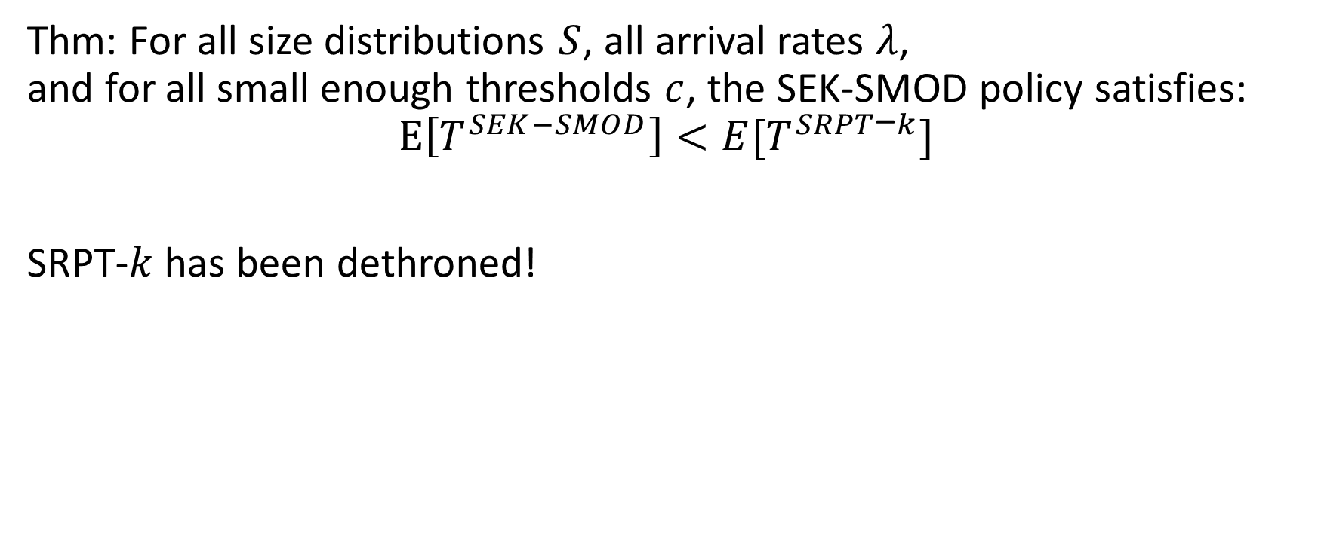
Recap: SEK-SMOD Always Improves
Thm: For all size distributions $S$, all arrival rates $λ$, and for all small enough thresholds $c$, the SEK-SMOD policy satisfies: $$E\left[T^{SEK−SMOD}\right]<E[T^{SRPT\text{−}k}]$$
SRPT-$k$ has been dethroned!

Slide 18


Future directions
More improvement: How much can we achieve?
Reorder even if ultra-large jobs are present.
General principle: When is future parallelism more important than prioritizing small jobs?
$${10}^{10}$$
$${10}^{9}$$
SEK(5)
3
4
10

Slide 19
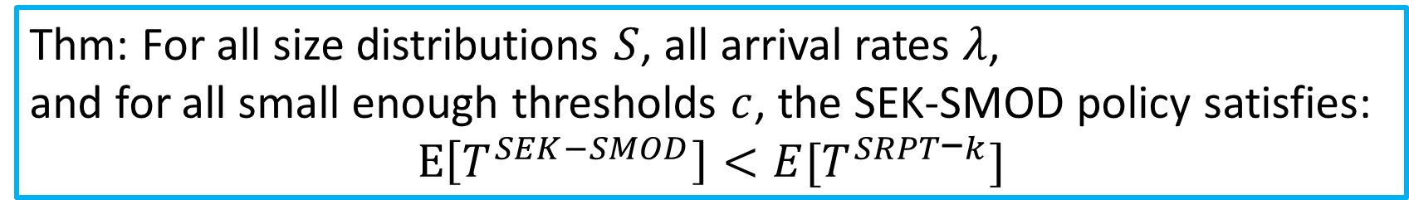
Conclusion
SEK(5)
3
4
10
Thm: For all size distributions $S$, all arrival rates $λ$, and for all small enough thresholds $c$, the SEK-SMOD policy satisfies: $$E\left[T^{SEK−SMOD}\right]<E[T^{SRPT\text{−}k}]$$

