Slide 1
The RESET and MARC Techniques for Multiserver Job Analysis
Isaac Grosof (CMU → GATech → UIUC → Northwestern)
Yige Hong (CMU)
Mor Harchol-Balter (CMU)
Alan Scheller-Wolf (CMU)

Slide 2
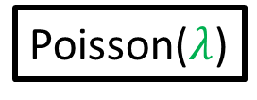



Multiserver-job Model
Modeling large computing systems: Many servers/job.
Job: (duration, server need)
FCFS
2
2
Server need
Poisson($λ$)
$$k$$
Sampled i.i.d. from joint distribution
3
4
1
2
1
Response time $T$
Idle server
Q: What is the mean response time $E[T]$?
Paper in IFIP Performance ‘23
Notes:
Topic of this talk: MSJ model. Different jobs require different numbers of servers. Motivated by big compute clusters, where we see this behavior.

Slide 3
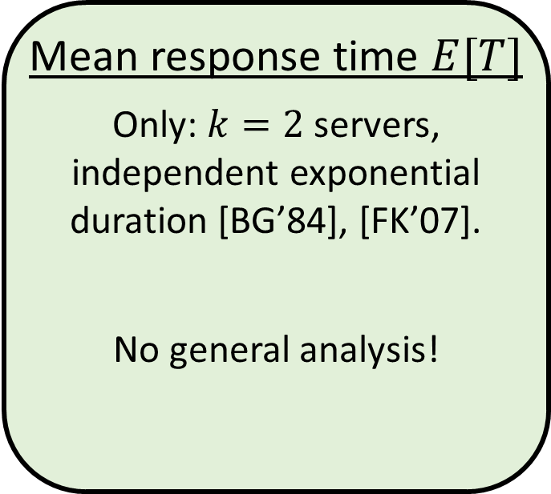
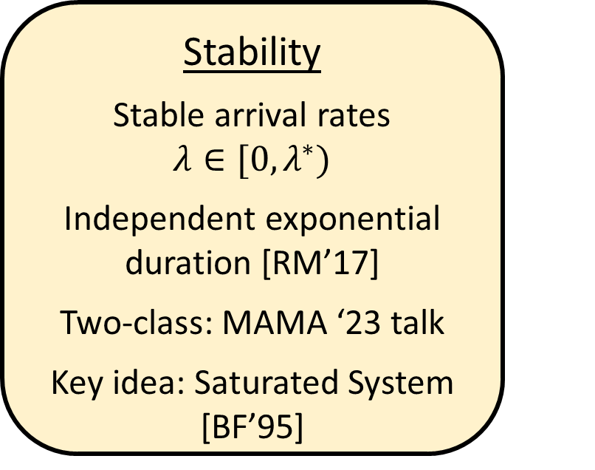
Prior work on MSJ FCFS
Stability
Stable arrival rates $λ∈[0,λ^{∗})$
Independent exponential duration [RM’17]
Two-class: MAMA ‘23 talk
Key idea: Saturated System [BF’95]
Mean response time $E[T]$
Only: $k=2$ servers, independent exponential duration [BG’84], [FK’07].
No general analysis!
Also E[T] analysis for MSJ with scheduling [GHS’22], [GSHS’23], scaling MSJ models [WXH’21], [HW’22].

Slide 4



Result & Key Insight
External service process
$$2μ$$
Result: First Analysis of MSJ FCFS $E\left[T\right]$
Tight in heavy traffic ($λ→λ^{∗})$
Key idea:
MSJ
Markovian Service Rate
2
$$≈$$
3
4
1
2
1

Slide 5
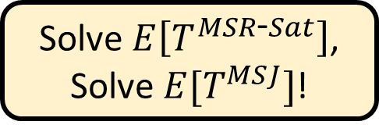
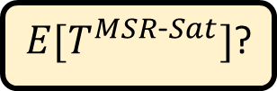

Result & Key Insight
External service process
Saturated System
New job
Result: First Analysis of MSJ FCFS $E\left[T\right]$
Tight in heavy traffic ($λ→λ^{∗})$
Key idea:
2
1
2
1
MSJ
Markovian Service Rate
2
$$≈$$
3
4
1
2
1
RESET
MARC
Solve $E\left[T^{MSR\text{‐}Sat}\right]$,
Solve $E[T^{MSJ}]$!
$E[T^{MSJ}]$?
$E[T^{MSR\text{‐}Sat}]$?

Slide 6


RESET Theorem
Markovian Service
Saturated
MSJ
2
$$≈$$
New job
2
3
4
1
2
1
1
2
1
RESET: Reduction to Saturated for Expected Time
RESET Theorem: $E\left[T^{MSJ}\right]=E\left[T^{MSR\text{‐}Sat}\right]+O_{λ}\left(1\right)$
Intuition: MSJ and MSR-Sat couple perfectly, except if $≤k$ jobs present.

Slide 7
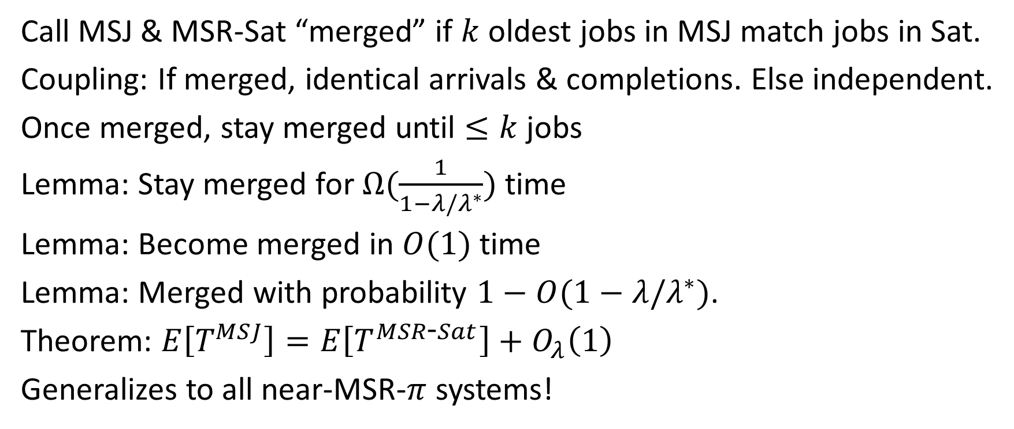


RESET Proof Intuition
Markovian Service
Saturated
MSJ
2
$$≈$$
New job
2
3
4
1
2
1
1
2
1
Call MSJ & MSR-Sat “merged” if $k$ oldest jobs in MSJ match jobs in Sat.
Coupling: If merged, identical arrivals & completions. Else independent.
Once merged, stay merged until $≤k$ jobs
Lemma: Stay merged for $Ω(\frac{1}{1−λ/λ^{∗}})$ time
Lemma: Become merged in $O(1)$ time
Lemma: Merged with probability $1−O(1−λ/λ^{∗})$.
Theorem: $E\left[T^{MSJ}\right]=E\left[T^{MSR\text{‐}Sat}\right]+O_{λ}\left(1\right)$
Generalizes to all near-MSR-$π$ systems!
Unmerged
$$O(1)$$
Merged
$$Ω(\frac{1}{1−λ/λ^{∗}})$$

Slide 8

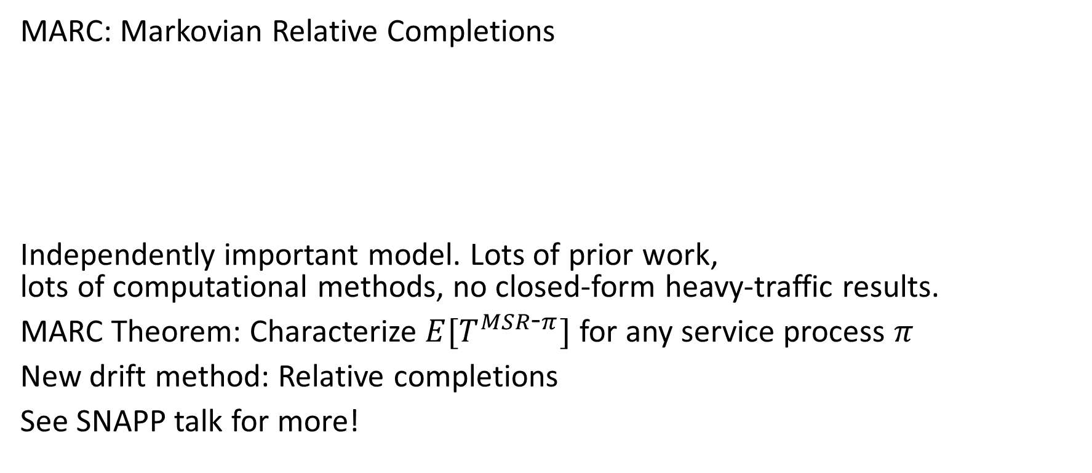


MARC: Analyze Markovian Service Rate system
MARC: Markovian Relative Completions
Independently important model. Lots of prior work, lots of computational methods, no closed-form heavy-traffic results.
MARC Theorem: Characterize $E[T^{MSR\text{‐}π}]$ for any service process $π$
New drift method: Relative completions
See SNAPP talk for more!
MSR-$π$
Service process $π$
$$μ_{y}$$

Slide 9

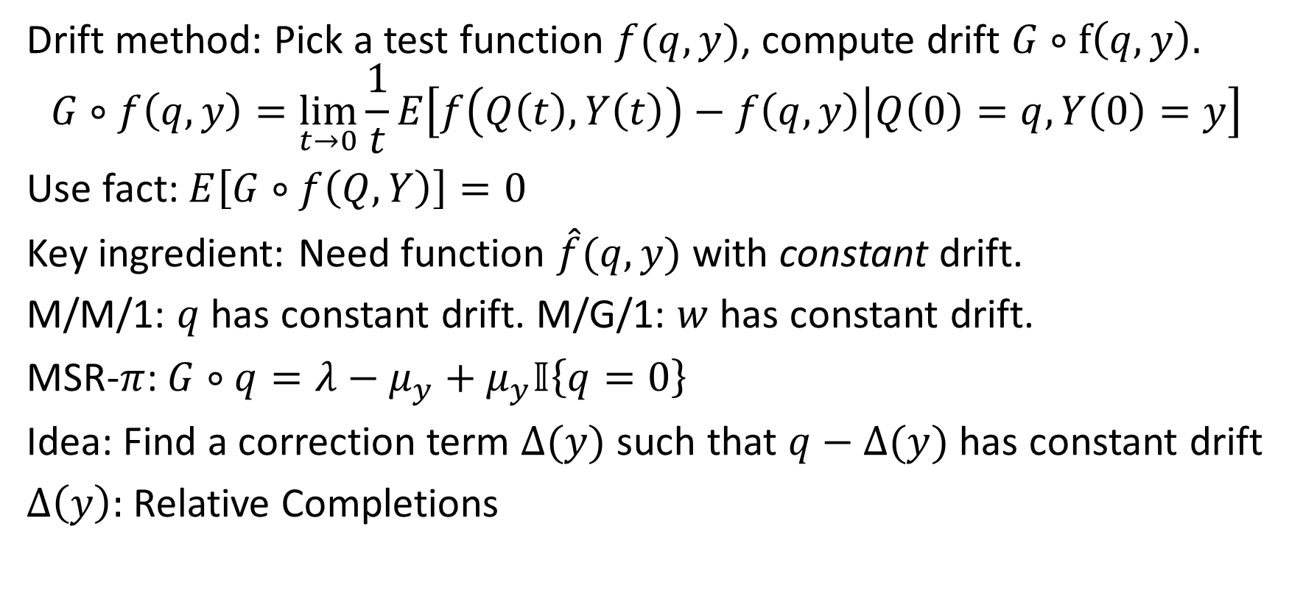


MARC: New drift method
MMSR-$π$
Service process $π$
$$μ_{y}$$
Drift method: Pick a test function $f(q,y)$, compute drift $G∘f\left(q, y\right).$
$$G∘f\left(q,y\right)=\lim_{t→0}\frac{1}{t}E\left[f\left(Q\left(t\right),Y\left(t\right)\right)−f\left(q,y\right) | Q\left(0\right)=q,Y\left(0\right)=y\right]$$
Use fact: $E\left[G∘f\left(Q,Y\right)\right]=0$
Key ingredient: Need function $\hat{f}(q,y)$ with constant drift.
M/M/1: $q$ has constant drift. M/G/1: $w$ has constant drift.
MSR-$π$: $G∘q=λ−μ_{y}+μ_{y}𝕀\left\{q=0\right\}$
Idea: Find a correction term $Δ(y)$ such that $q−Δ(y)$ has constant drift
$Δ\left(y\right):$ Relative Completions

Slide 10
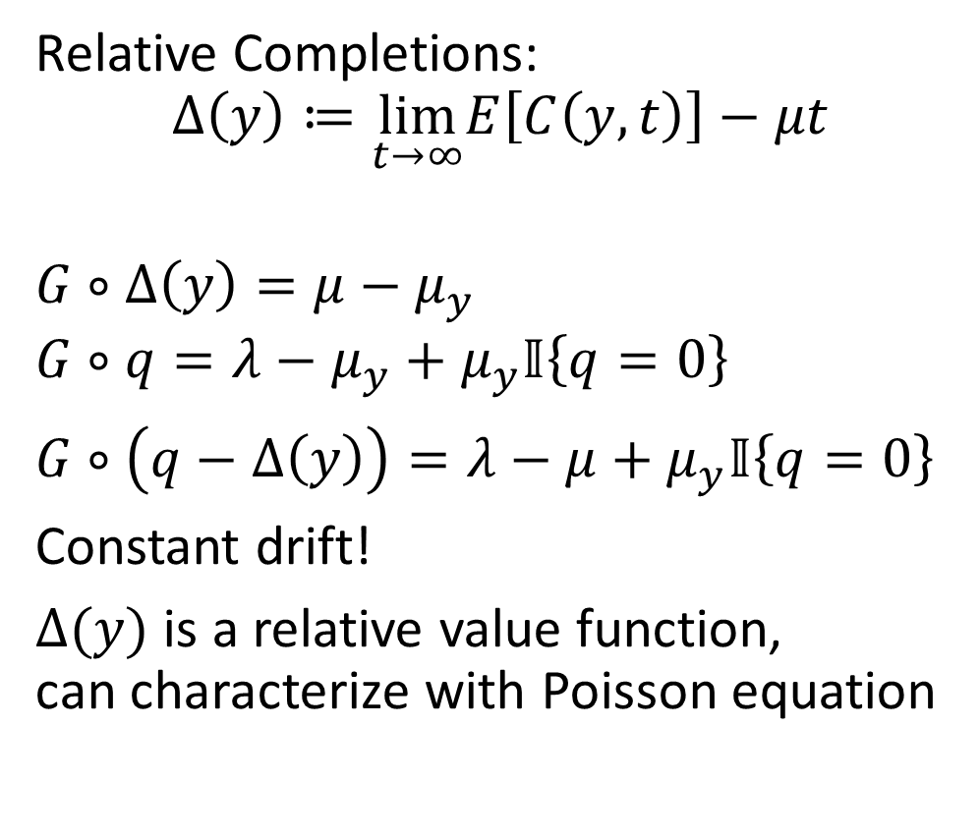






Relative Completions
MMSR-$π$
Service process $π$
$$μ_{y}$$
Relative Completions:
$$Δ\left(y\right)≔\lim_{t→∞}E\left[C\left(y,t\right)\right]−μt$$
$G∘Δ\left(y\right)=μ−μ_{y}$
$G∘q=λ−μ_{y}+μ_{y}𝕀\left\{q=0\right\}$
$G∘\left(q−Δ\left(y\right)\right)=λ−μ+μ_{y}𝕀\left\{q=0\right\}$
Constant drift!
$Δ(y)$ is a relative value function, can characterize with Poisson equation
Drift: $μ_{y}$
Drift: $μ$
Expected completions, starting at $y$
Completions
$μt:$Long-term rate
$$Δ_{π}\left(y\right)$$
Time $t$
Notes:
Move, constant drift

Slide 11

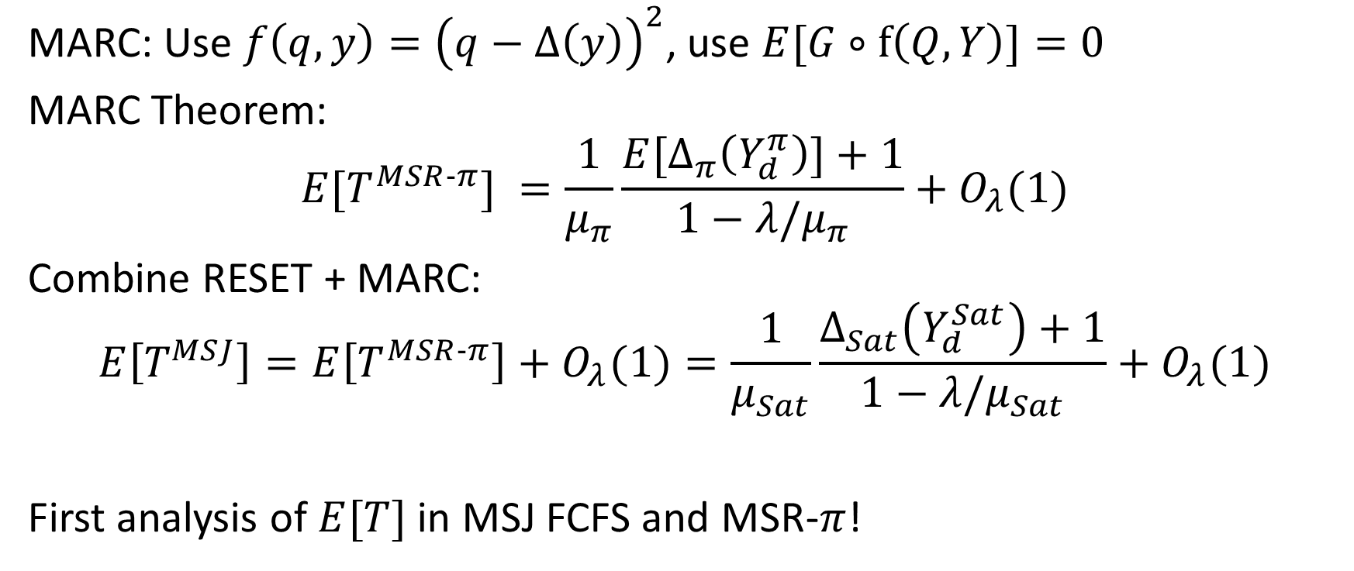
MARC Result and Main Result
MARC: Use $f\left(q,y\right)={\left(q−Δ\left(y\right)\right)}^{2}$, use $E[G∘f\left(Q,Y\right)]=0$
MARC Theorem:
$$E[T^{MSR‐π}] =\frac{1}{μ_{π}}\frac{E[Δ_{π}\left(Y_{d}^{π}\right)]+1}{1−λ/μ_{π}}+O_{λ}(1)$$
Combine RESET + MARC:
$$E\left[T^{MSJ}\right]=E\left[T^{MSR‐π}\right]+O_{λ}(1)=\frac{1}{μ_{Sat}}\frac{Δ_{Sat}\left(Y_{d}^{Sat}\right)+1}{1−λ/μ_{Sat}}+O_{λ}(1)$$
First analysis of $E[T]$ in MSJ FCFS and MSR-$π$!
$Y_{d}$: Departure-average distribution

Slide 12

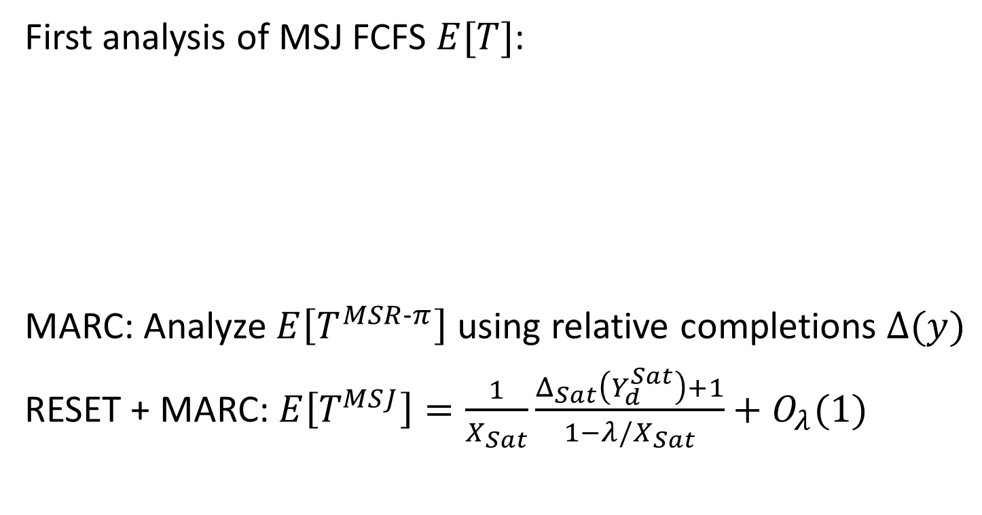

Conclusion
External service process
Saturated System
First analysis of MSJ FCFS $E[T]$:
MARC: Analyze $E\left[T^{MSR‐π}\right]$ using relative completions $Δ(y)$
RESET + MARC: $E\left[T^{MSJ}\right]=\frac{1}{X_{Sat}}\frac{Δ_{Sat}\left(Y_{d}^{Sat}\right)+1}{1−λ/X_{Sat}}+O_{λ}(1)$
New job
2
1
2
1
MSJ
Markovian Service Rate
RESET
2
$$=$$
3
4
1
2
1
$$O_{λ}(1)$$

Slide 13
Bonus: Extensions
Multidimensional resources
Variable server need
Alternative scheduling policies: Limited backfilling
Job locality/contention
Server affinity/heterogeneous servers
Markovian arrival rates

Slide 14

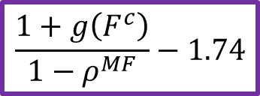

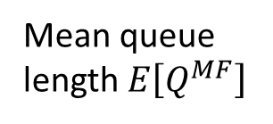
Bonus: Empirical Validation via Simulation
2
Setting: $2$ servers. Jobs: ½ , ½
1
100
75
50
25
0
Simulation
Theory
Within 1% at every point simulated!
$$E\left[Q^{MF}\right]$$
$$\frac{1+g\left(F^{c}\right)}{1−ρ^{MF}}−1.74$$
Mean queue length $E\left[Q^{MF}\right]$
0.8 0.85 0.9 0.95 1
Load $ρ^{MF}=\frac{λ}{X^{MF}}$

