Slide 1

New Lower Bounds on Optimal M/G/k Scheduling
Izzy Grosof
Ziyuan Wang
Northwestern University, IEMS
Ziyuan Wang

Slide 2

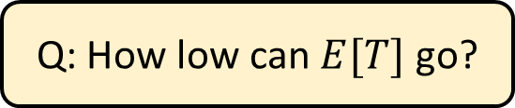




M/G/k Scheduling
Job duration $\sim S$, i.i.d.
Scheduling w/ known sizes
Load $ρ=λE[S]<1$
1/k
1/k
Poisson($λ$)
$$k$$
Response time $T$
Q: How low can $E[T]$ go?
Shortest Remaining Processing Time?

Slide 3
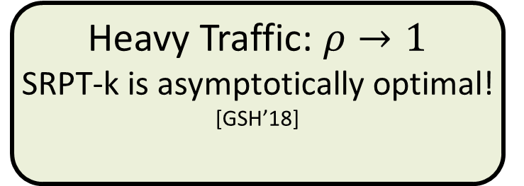

SRPT: Optimal?
SRPT-k
SRPT-k: k jobs with least remaining size.
SRPT-1 is always optimal [Schrage ‘68]. What about SRPT-k?
0
Load $ρ$
1
No arrivals:
SRPT-k is optimal! [McNaughton ’59] + [Conway et al. ’67]
Heavy Traffic: $ρ→1$
SRPT-k is asymptotically optimal! [GSH’18]
Medium load:
??????
We don’t know how close to optimal!

Slide 4



Existing lower bounds
Resource-pooled M/G/1/SRPT
M/G/$∞$ (service time)
$$≥$$
$$≥$$
…

Slide 5

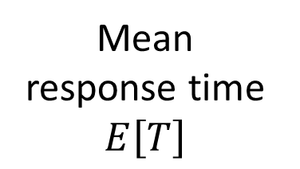

Lower bounds: Plot
Setting: k=2 servers, Exp(1) job size
Recent & ongoing work: SEK is better than SRPT-2!
4
3
2
1
M/G/2/SRPT
4
3
2
1
Constraint on optimal scheduling
Resource pooled M/G/1/SRPT
Mean response time $E\left[T\right]$
M/G/$∞$
0.3 0.4 0.5 0.6 0.7 0.8 0.9
Load $ρ$
Notes:
Lower bound 1: SRPT-1. Heavy traffic optimal
Lower bound 2: M/G/infinity. Light traffic optimal
Our goal: Better lower bounds

Slide 6
This talk: New Lower Bounds
New lower bound framework: Bound based on Work-Integral Number Equality [SGH’21].
Even newer lower bound framework: Increasing speed queue! New system: single-server and multiserver hybrid.
Drift-based analysis, leads to strong lower bounds!

Slide 7


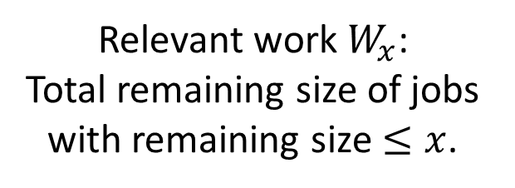
WINE for Lower Bounds
Relevant work $W_{x}$: Total remaining size of jobs with remaining size $≤x$.
Work Integral Number Equality (WINE): [SGH’21]
$$E\left[T^{π}\right]=\frac{E\left[N^{π}\right]}{λ}=\frac{1}{λ}\int_{x=0}^{∞}{\frac{E\left[W_{x}^{π}\right]}{x^{2}}dx}$$
Idea: Lower bound relevant work $E[W_{x}]$, lower bound response time $E\left[T\right]$
Resource pooled SRPT bound: $E\left[W_{x}\right]≥\frac{λ}{2}\frac{E\left[\min{{\left(S,x\right)}^{2}}\right]}{1−ρ_{x}}$
Service time bound (M/G/$∞$): $E\left[W_{x}\right]≥\frac{kλ}{2}E\left[{\min\left(S,x\right)}^{2}\right]$
Combine using WINE!
$$≤x$$

Slide 8
Lower bounds with WINE
Setting: k=2 servers, Exp(1) job size
4
3
2
1
M/G/2/SRPT
WINE combo!
Constraint on optimal scheduling
Resource pooled M/G/1/SRPT
Mean response time $E\left[T\right]$
M/G/$∞$
0.3 0.4 0.5 0.6 0.7 0.8 0.9
Load $ρ$
Notes:
Lower bound 1: SRPT-1. Heavy traffic optimal
Lower bound 2: M/G/infinity. Light traffic optimal
Our goal: Better lower bounds

Slide 9





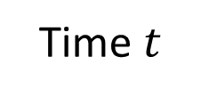

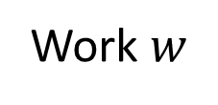





Increasing Speed Queue (ISQ)
$$(w=2.4,i=1/2)$$
Single-server variable-speed queue. State: Amount of work, server speed $\left(w, i\right)$.
Each arrival: Speed increases by $1/k$. Cap at speed 1.
$$2/k$$
$$3/k$$
$$(k−1)/k$$
$$1/k$$
$$…$$
Work $w$
$$1/k$$
$$1$$
$$1$$
$$1$$
Time $t$

Slide 10

Increasing Speed Queue: Recycling
Theorem: $E\left[W^{ISQ\text{−}k}\right]≤E\left[W^{M/G/k/OPT}\right].$
We want lower bounds on relevant work in M/G/k.
Total work: Arrivals only. Relevant work: Recycling as well.
$$≤x$$

Slide 11
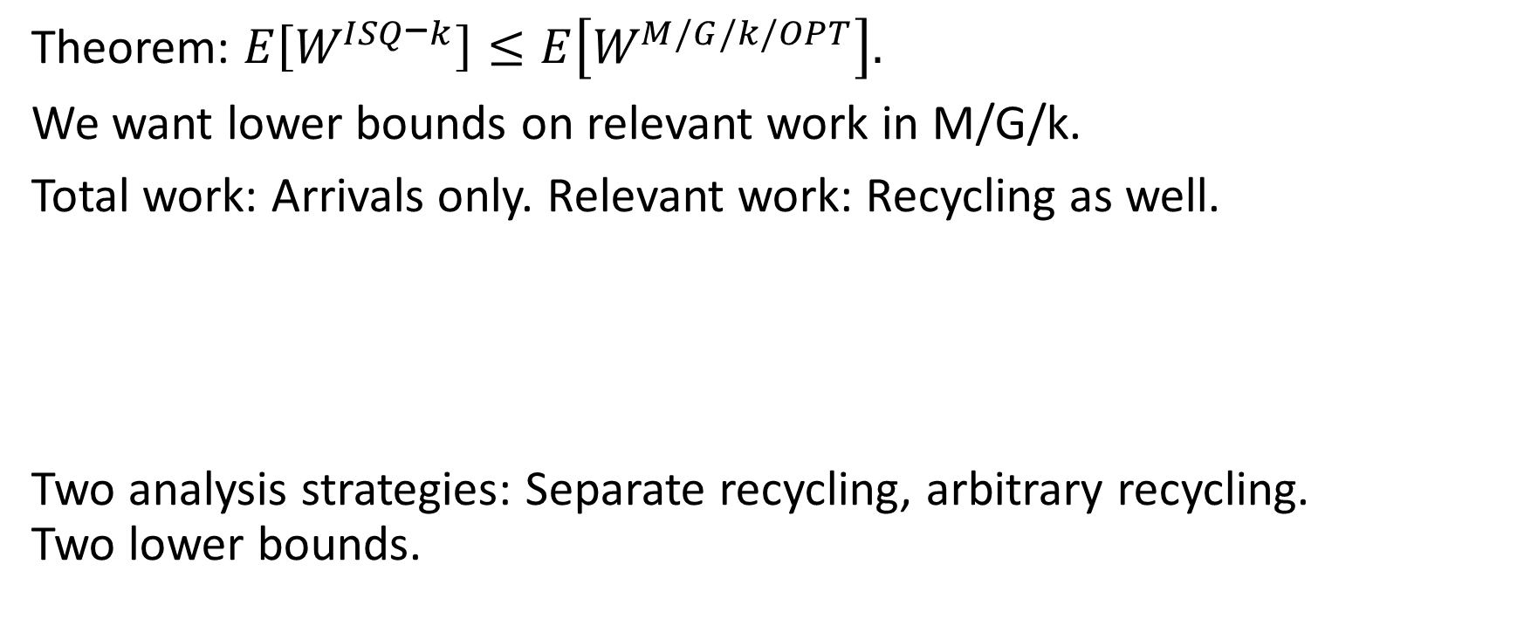

Increasing Speed Queue: Recycling
Theorem: $E\left[W^{ISQ\text{−}k}\right]≤E\left[W^{M/G/k/OPT}\right].$
We want lower bounds on relevant work in M/G/k.
Total work: Arrivals only. Relevant work: Recycling as well.
Two analysis strategies: Separate recycling, arbitrary recycling. Two lower bounds.
$$≤x$$

Slide 12
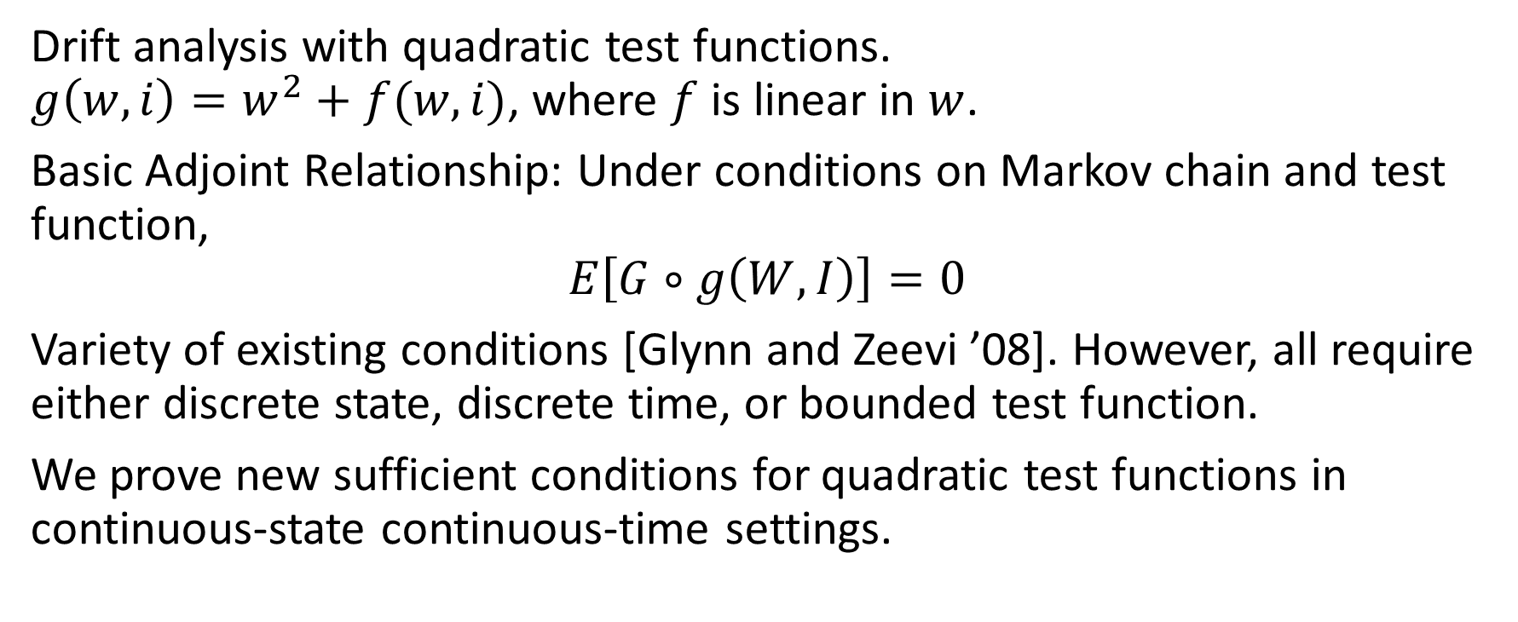
Analyzing ISQ-k
Drift analysis with quadratic test functions. $g\left(w,i\right)=w^{2}+f(w, i)$, where $f$ is linear in $w$.
Basic Adjoint Relationship: Under conditions on Markov chain and test function,
$$E\left[G∘g\left(W,I\right)\right]=0$$
Variety of existing conditions [Glynn and Zeevi ’08]. However, all require either discrete state, discrete time, or bounded test function.
We prove new sufficient conditions for quadratic test functions in continuous-state continuous-time settings.

Slide 13
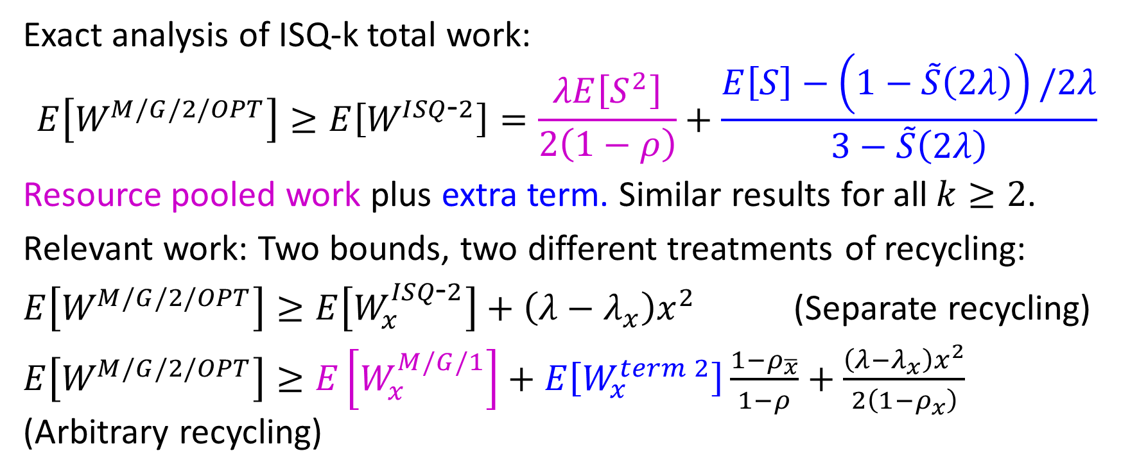
Results: ISQ-k and M/G/k/OPT
Exact analysis of ISQ-k total work:
$$E\left[W^{M/G/2/OPT}\right]≥E\left[W^{ISQ\text{-}2}\right]=\frac{λE\left[S^{2}\right]}{2\left(1−ρ\right)}+\frac{E\left[S\right]−\left(1−\tilde{S}\left(2λ\right)\right)/2λ}{3−\tilde{S}\left(2λ\right)}$$
Resource pooled work plus extra term. Similar results for all $k≥2$.
Relevant work: Two bounds, two different treatments of recycling:
$E\left[W^{M/G/2/OPT}\right]≥E\left[W_{x}^{ISQ\text{-}2}\right]+\left(λ−λ_{x}\right)x^{2}$ (Separate recycling)
$E\left[W^{M/G/2/OPT}\right]≥E\left[W_{x}^{M/G/1}\right]+E\left[W_{x}^{term 2}\right]\frac{1−ρ_{\overline{x}}}{1−ρ}+\frac{\left(λ−λ_{x}\right)x^{2}}{2\left(1−ρ_{x}\right)}$ (Arbitrary recycling)

Slide 14
Lower bounds with ISQ
Setting: k=2 servers, Exp(1) job size
ISQ-based bound!
4
3
2
1
M/G/2/SRPT
4
3
2
1
WINE combo
Constraint on optimal scheduling
Resource pooled M/G/1/SRPT
Mean response time $E\left[T\right]$
M/G/$∞$
ISQ bound constrains much wider range of loads!
0.3 0.4 0.5 0.6 0.7 0.8 0.9
Load $ρ$
Notes:
Lower bound 1: SRPT-1. Heavy traffic optimal
Lower bound 2: M/G/infinity. Light traffic optimal
Our goal: Better lower bounds

Slide 15
Future directions
Track more info than total work?
Matching upper bounds?
Largest remaining size minimizes M/G/k work. Analyze?
Beyond single threshold at a time?
Beyond known size? Beyond preemptive?

Slide 16

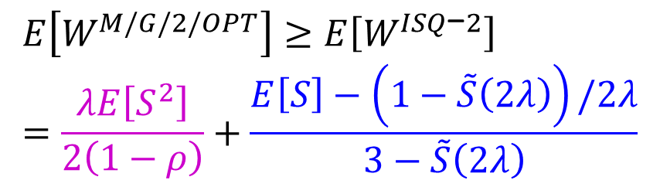

Conclusion
Lower bounds on optimal M/G/k scheduling for $E[T]$
ISQ bound!
4
3
2
1
4
3
2
1
M/G/2/SRPT
Constraint on optimal scheduling
$$E\left[T\right]$$
$$E\left[W^{M/G/2/OPT}\right]≥E\left[W^{ISQ\text{−}2}\right]=\frac{λE\left[S^{2}\right]}{2\left(1−ρ\right)}+\frac{E\left[S\right]−\left(1−\tilde{S}\left(2λ\right)\right)/2λ}{3−\tilde{S}\left(2λ\right)}$$
0.3 0.4 0.5 0.6 0.7 0.8 0.9
Load $ρ$

