Slide 1
Performance Analysis of Multiserver Jobs
Izzy Grosof
They/she
Let’s meet!

Slide 2
Outline of this talk
About me
Consider working with me if you …
My research
Multiserver jobs!

Slide 3

About me
Izzy Grosof, Izzy is short for Isaac.
isaacg1.github.io
Nonbinary: they/she. Feel free to ask about this, and info on my website.
I care about supporting people, whether or not I am your advisor. Let’s chat!

Slide 4




About me: Universities
PhD: Completed July ‘23
Postdoc #1: July ‘23 through February ‘24
Postdoc #2: Feb. ‘24 to summer ‘24
Professor! Started Fall ‘24.

Slide 5




About me: Fun
Nature and Botanical Gardens
Dungeons and Dragons
Computationally generated artwork

Slide 6
Work with me if you like …
Queueing
theory!
Scheduling
theory
Stochastic
Processes
Proving Theorems!
Multiserver
models
Randomness
and probability
Reinforcement
learning and
queueing
Markov chains

Slide 7
Work with me if you want to do theory that matters for computing systems
Goals in computing systems:
Reducing tail latency
Scheduling heterogenous jobs on heterogenous resources
Handling intermittent overload
Scheduling using predictions of service duration
Theory!

Slide 8
Work with me, and I’ll support you
Teaching
Analysis (proving things), writing, presenting, teaching others, health, and more.
Guidance
Suggesting good problems: novel and tractable (Project Ideas on my website).
Support
Support when you take your own research path, emotional support, professional support, etc.
I want to help you, wherever you’re going.

Slide 9
Outline of this talk
About me
Consider working with me if you …
My research
Multiserver jobs!

Slide 10



My research
Scheduling
Multiserver
models
Queueing!
Dive deeper
Reinforcement
learning
Markovian arrivals
and service

Slide 11

Theory of Large-Scale Computing Systems
Datacenters, Supercomputers
1% of world’s electricity
Need systems to be:
Fast: low response time
Efficient: minimal resources
Scheduling is a key tool

Slide 12
Queueing Model for Large-scale Computing
Wait for service
Arrive
Complete
Important modeling features:

Slide 13
Queueing Model for Large-scale Computing
Wait for service
2
3
4
Arrive
Complete
3
2
Important modeling features:
Many servers
Jobs have variable server need & service duration
Use stochastic models, use real data to calibrate models
Sometimes, servers are wasted
No preemption – once we start a job, we have to finish it.
Wasted Server

Slide 14
Important MSJ consideration: Switching
Simple MSJ example: Jobs need 1 or all n servers.
Too frequent switching: Too much waste, bad performance.
Too rare switching: Highly variable completion rate, bad performance.
n
n
n
1
1
1
1
1
1
n
n
Waste!
1
1
1
1
1
1
1
1
1
1
1
1
Time

Slide 15

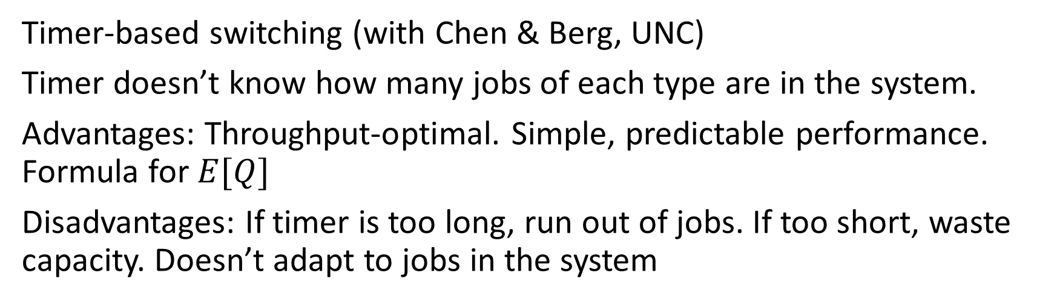


Past work: Timer-based switching
n
n
n
1
1
1
1
1
1
n
n
1
1
1
1
1
1
1
1
1
1
1
1
Time
$$n→1$$
$$1→n$$
Timer-based switching (with Chen & Berg, UNC)
Timer doesn’t know how many jobs of each type are in the system.
Advantages: Throughput-optimal. Simple, predictable performance. Formula for $E[Q]$
Disadvantages: If timer is too long, run out of jobs. If too short, waste capacity. Doesn’t adapt to jobs in the system

Slide 16

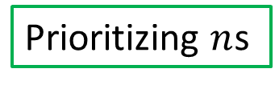

Current work: Prioritize until empty
Prioritizing $n$s
# of $n$s
# of jobs
Wasted capacity
# of $1$s
Time
Empty!
Switch!
Almost empty!
Empty!
Switch!

Slide 17
Current work: Prioritize until almost empty
Prioritizing $n$s
# of $n$s
# of jobs
Wasted capacity
# of $1$s
Time
Empty!
Switch!
Almost empty!
Empty!
Switch!

Slide 18
Current work: Prioritize until almost empty
Prioritizing $n$s
Empty!
Switch!
# of $n$s
# of jobs
# of $1$s
Time
Empty!
Switch!
Almost empty! Empty completely!
Empty!
Switch!
Current goal: Performance analysis – what’s the mean response time?
Further goal: Optimize the “almost empty” cutoff

Slide 19
Future: Generalize to many server needs
4
3
2
2
2
1
1
1
4
4
1
2
1
1
Q: What is “Almost empty” when you have lots of server needs?
Q: Can we define a throughput-optimal policy that switches when almost empty, rather than on a timer?
Let’s try it out on real data from the Quest HPC Cluster, and Google Borg Cluster

Slide 20
Future: Important larges, surplus smalls
In a lot of high-performance queueing contexts:
Large server need: Important! The reason why we made a big cluster
Small server need: Interchangeable. There to fill space, reduce waste.
Model:
Large server need jobs arrive externally, need to be finished soon.
Small server need jobs: Always extra smalls available.
Tradeoff of goals: Latency of larges, throughput of smalls.

Slide 21
Future: Important larges, surplus smalls
1
1
1
1
1
n
Strategies:
Prioritize larges when they arrive.
Pro: Pretty good latency for larges
Con: Some wasted space
Batch together larges into bigger groups
Pro: Less wasted space
Con: Worse latency for larges
Reserve some of the capacity for larges
Pro: Even better latency for larges
Con: Even more waste
1
1
1
1
1
1
1
1
1
Large arrives
1
1
1
1
n
1
1
1
1
1
Large arrives

Slide 22
Future: Important larges, surplus smalls
Q: What is the optimal tradeoff curve between large job mean latency and small job throughput?
Optimal
Large job mean latency
Preference
Small job throughput

Slide 23
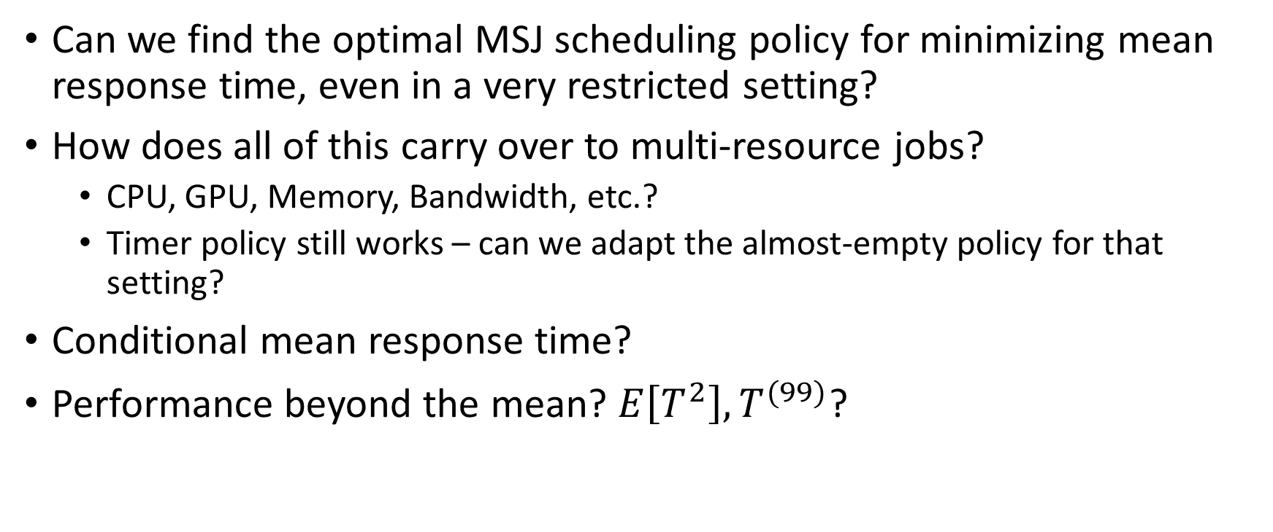
More questions
Can we find the optimal MSJ scheduling policy for minimizing mean response time, even in a very restricted setting?
How does all of this carry over to multi-resource jobs?
CPU, GPU, Memory, Bandwidth, etc.?
Timer policy still works – can we adapt the almost-empty policy for that setting?
Conditional mean response time?
Performance beyond the mean? $E\left[T^{2}\right], T^{(99)}$?

Slide 24
Conclusion
Queueing
theory!
Wait for service
2
Arrive
3
Scheduling
theory
Stochastic
Processes
4
Proving Theorems!
3
Complete
2
Multiserver
models
Randomness
and probability
Wasted Server
n
n
n
1
1
1
1
1
1
n
n
Reinforcement
learning and
queueing
Markov chains
Waste!
1
1
1
1
1
1
1
1
1
1
1
1
Time

