Slide 1
Multiserver Stochastic Scheduling
Izzy Grosof
Industrial Engineering & Management Science

Slide 2

Theory of Large-Scale Computing Systems
Datacenters, Supercomputers
1% of world’s electricity
205 TWh, 140 Mt CO₂, $320B.
Need systems to be:
Fast: low response time
Efficient: minimal resources
Scheduling is a key tool

Slide 3

Abstract Model: Queueing Theory
Arrivals
Response time: $T$
Varying job sizes (inherent work of a job)
Arrivals are a stochastic process
Scheduling policy preemptively determines which job to serve
Modern computing systems: many servers.

Slide 4
Three multiserver models
3
Parallel, one server/job
Multiple servers/job
2
4
1
3
3
1
Start here
Multiple stages of processing (Tandem)
Notes:
Just going to give you an overview of my work in each of these areas.
In the long run, I want to model and analyze the systems you care about

Slide 5
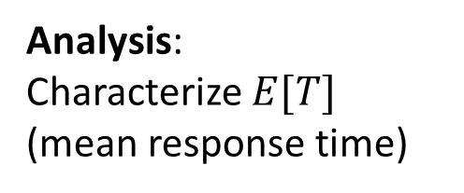
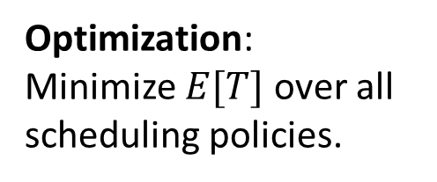
Prior work: Single-server & Multiserver Scheduling
1 server
Multiserver
Analysis: Characterize $E[T]$ (mean response time)
Well understood! [Pollaczek ‘30], [Schrage & Miller ‘66], [Scully ‘18].
Analysis only for First-Come First-Served (FCFS) [Köllerström ‘74 & ‘79]. Nothing for complex scheduling policies.
Optimization: Minimize $E[T]$over all scheduling policies.
Shortest Remaining Processing Time (SRPT) is optimal! [Schrage ‘68].
Entirely open. Negative worst-case results [Leonardi & Raz ‘97].
Notes:
Before I came onto the scene

Slide 6



One server/job (M/G/k) model
Load $ρ=λE\left[S\right]<1$
Size: $S$, i.i.d.
SRPT-k
Poisson($λ$)
k servers
Notes:
Size is amount of service necessary to complete the job.
Load is long-term fraction of busy servers.
Specify Poisson, I.i.d.
How to make optimal? Paper, award.
SRPT-1
SRPT-k? Worst-case not competitive, so not exact optimum, can still say something?
First analysis
Prove opt as rho -> 1

Slide 7
One server/job (M/G/k) model
Load $ρ=λE\left[S\right]<1$
Size: $S$, i.i.d.
SRPT-k
Poisson($λ$)
k servers
Many models:
Free preemption, preempt w/ overhead, no preemption?
Known size, estimate, no info?
This section: Free preemption, known size
Notes:
Size is amount of service necessary to complete the job.
Load is long-term fraction of busy servers.
Specify Poisson, I.i.d.
How to make optimal? Paper, award.
SRPT-1
SRPT-k? Worst-case not competitive, so not exact optimum, can still say something?
First analysis
Prove opt as rho -> 1

Slide 8
One server/job (M/G/k) model
Load $ρ=λE\left[S\right]<1$
Size: $S$, i.i.d.
SRPT-k
Poisson($λ$)
k servers
“SRPT for Multiserver Systems”. Grosof, Scully, Harchol-Balter. IFIP Performance ’18.
Better scheduling: 37% higher completion rate, same resources, same response time.
Notes:
Size is amount of service necessary to complete the job.
Load is long-term fraction of busy servers.
Specify Poisson, I.i.d.
How to make optimal? Paper, award.
SRPT-1
SRPT-k? Worst-case not competitive, so not exact optimum, can still say something?
First analysis
Prove opt as rho -> 1

Slide 9

SRPT-k Optimality
SRPT-k
Theorem (GSH ‘18): $\lim_{ρ→1}{\frac{E\left[T^{SRPT\text{‐}k}\right]}{E\left[T^{OPT\text{‐}k}\right]}=1 }$
SRPT-k yields asymptotically optimal mean response time!
First optimality result in the M/G/k!
We don’t even know what OPT-k is, so how did we prove this?

Slide 10





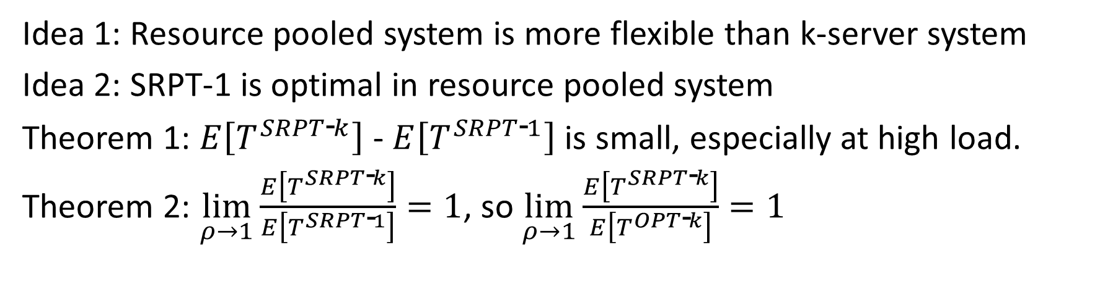
Proof idea: Compare to resource pooled
Speed $1/k$
Speed $1$
SRPT-k
SRPT-1
Speed $1/k$
$$⟺$$
Speed $1/k$
Idea 1: Resource pooled system is more flexible than k-server system
Idea 2: SRPT-1 is optimal in resource pooled system
Theorem 1: $E\left[T^{SRPT\text{‐}k}\right]$ - $E\left[T^{SRPT\text{‐}1}\right]$ is small, especially at high load.
Theorem 2: $\lim_{ρ→1}{\frac{E\left[T^{SRPT\text{‐}k}\right]}{E\left[T^{SRPT\text{‐}1}\right]}=1}$, so $\lim_{ρ→1}{\frac{E\left[T^{SRPT\text{‐}k}\right]}{E\left[T^{OPT\text{‐}k}\right]}=1 }$
Notes:
Compare to SRPT-1
Dream of a Parallel computing person.
Bound W_r: Coupling, worst-case.
W_r -> T: Tagged job, work that runs while tagged job in system
Thm: Bound T.
Thm: Near SRPT-1. OPT.

Slide 11
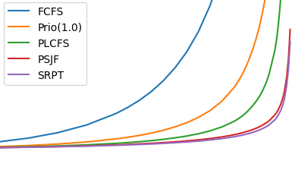

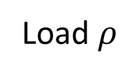
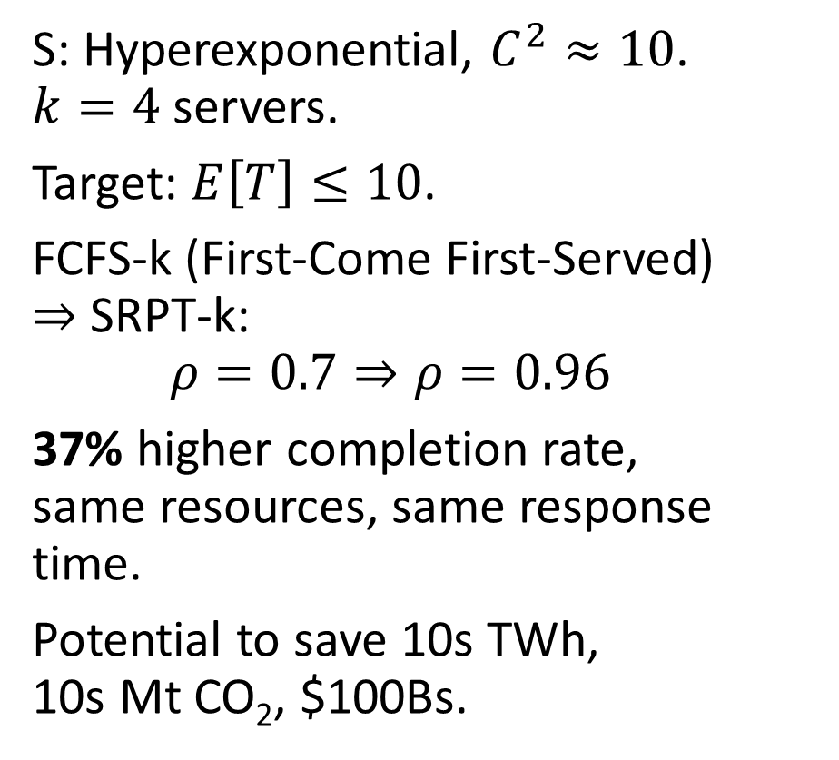
Empirical Impact
S: Hyperexponential, $C^{2}≈10$. $k=4$ servers.
Target: $E\left[T\right]≤10$.
FCFS-k (First-Come First-Served) $⇒$ SRPT-k:
$$ρ=0.7⇒ρ=0.96$$
37% higher completion rate, same resources, same response time.
Potential to save 10s TWh, 10s Mt CO₂, $100Bs.
30
FCFS-k
Prio-k
PLCFS-k
PSJF-k
SRPT-k
25
20
$$E[T]$$
15
10
5
0
0.5
0.6
0.7
0.8
0.9
1.0
Load $ρ$
Notes:
Load rho=0.5 to 1, interesting behavior.
High variance, k=4
Lower is better, SRPT is the best – PSJF policy also really good - we also prove it’s asymptotically optimal in our paper.

Slide 12


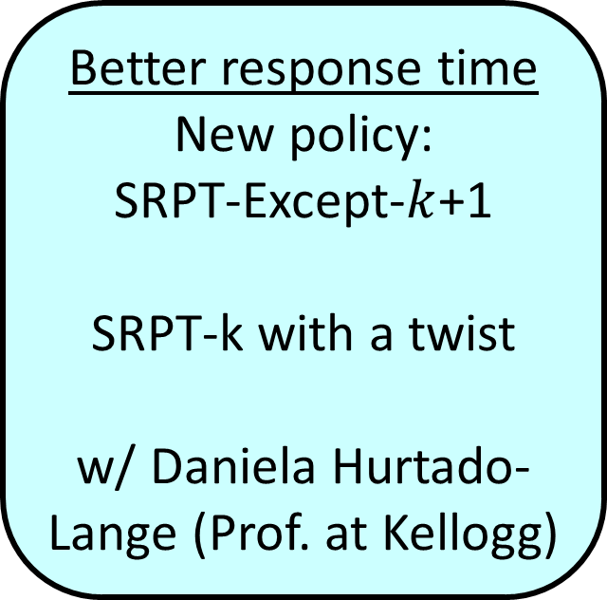
New direction: Medium load
Better lower bounds
Idea: Analyze new system, Increasing-Speed Queue
Resource-pooled SRPT only good at high load
w/ Ziyuan Wang (IEMS PhD student)
Better response time
New policy: SRPT-Except-$k$+1
SRPT-k with a twist
w/ Daniela Hurtado-Lange (Prof. at Kellogg)

Slide 13
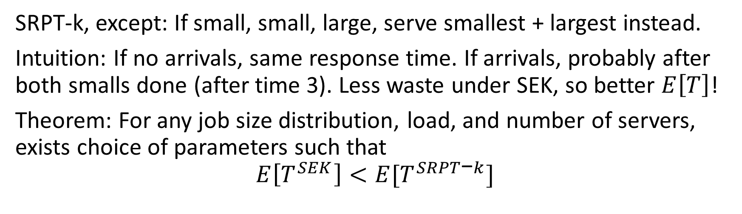
Improve on SRPT-k: SRPT-Except-k+1
SRPT-k
SEK
10
1
1
2
10
2
SRPT-k, except: If small, small, large, serve smallest + largest instead.
Intuition: If no arrivals, same response time. If arrivals, probably after both smalls done (after time 3). Less waste under SEK, so better $E\left[T\right]$!
Theorem: For any job size distribution, load, and number of servers, exists choice of parameters such that
$$E\left[T^{SEK}\right]<E[T^{SRPT\text{−}k}]$$

Slide 14

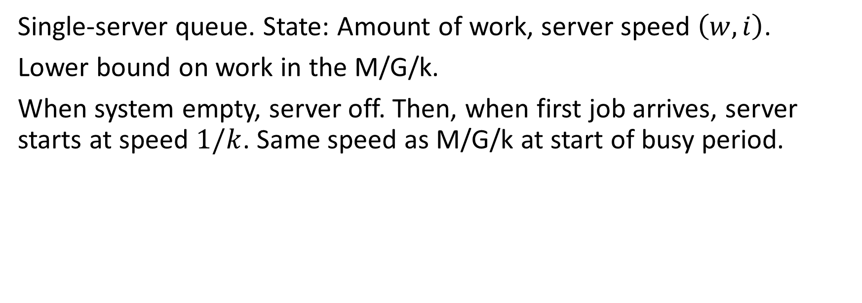
Increasing Speed Queue (ISQ)
$$(w=2.4,i=1/2)$$
Single-server queue. State: Amount of work, server speed $\left(w, i\right)$.
Lower bound on work in the M/G/k.
When system empty, server off. Then, when first job arrives, server starts at speed $1/k$. Same speed as M/G/k at start of busy period.

Slide 15

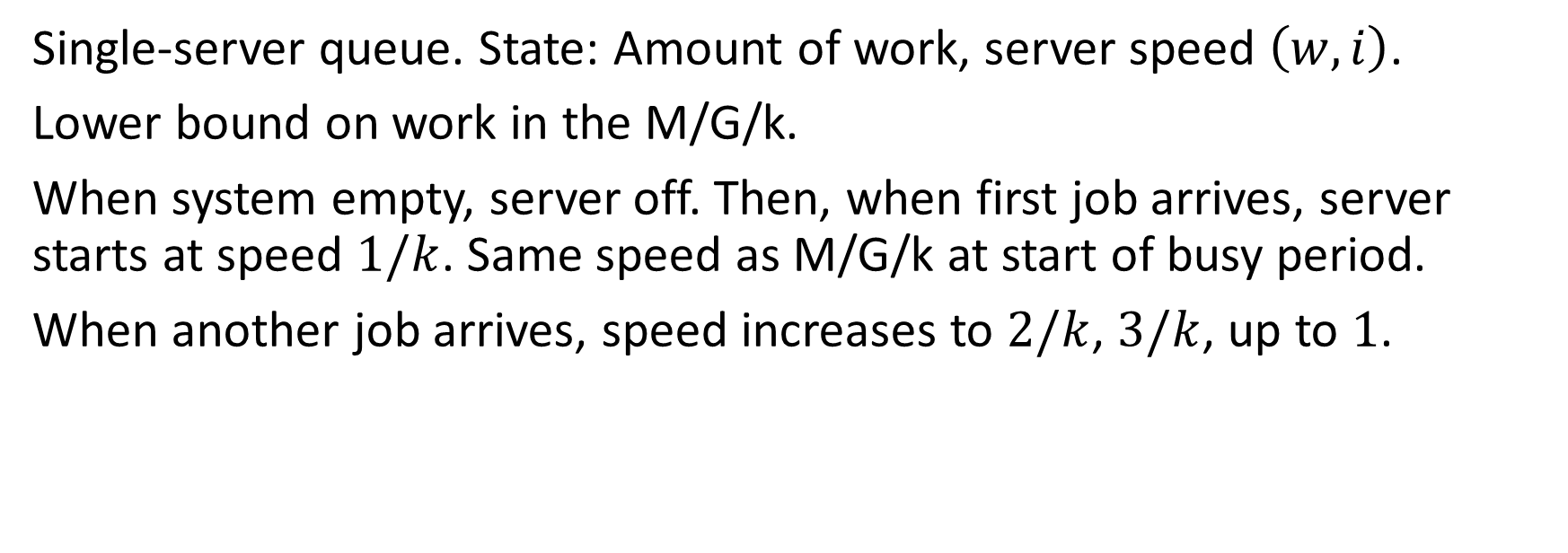
Increasing Speed Queue (ISQ)
$$(w=1.9,i=1/2)$$
Single-server queue. State: Amount of work, server speed $\left(w, i\right)$.
Lower bound on work in the M/G/k.
When system empty, server off. Then, when first job arrives, server starts at speed $1/k$. Same speed as M/G/k at start of busy period.
When another job arrives, speed increases to $2/k$, $3/k$, up to $1$.

Slide 16

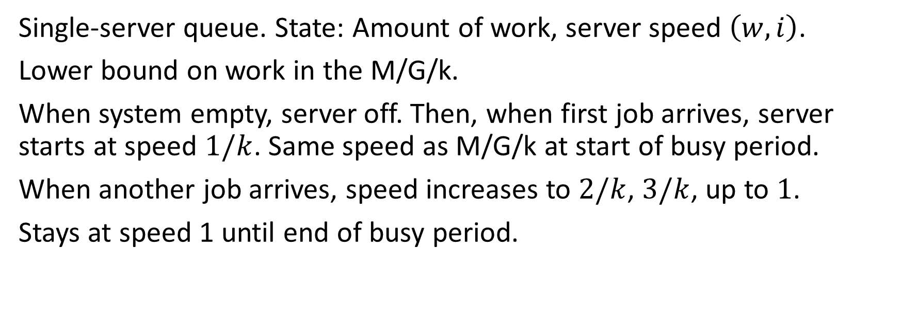
Increasing Speed Queue (ISQ)
$$(w=4.2,i=1)$$
Single-server queue. State: Amount of work, server speed $\left(w, i\right)$.
Lower bound on work in the M/G/k.
When system empty, server off. Then, when first job arrives, server starts at speed $1/k$. Same speed as M/G/k at start of busy period.
When another job arrives, speed increases to $2/k$, $3/k$, up to $1$.
Stays at speed 1 until end of busy period.

Slide 17
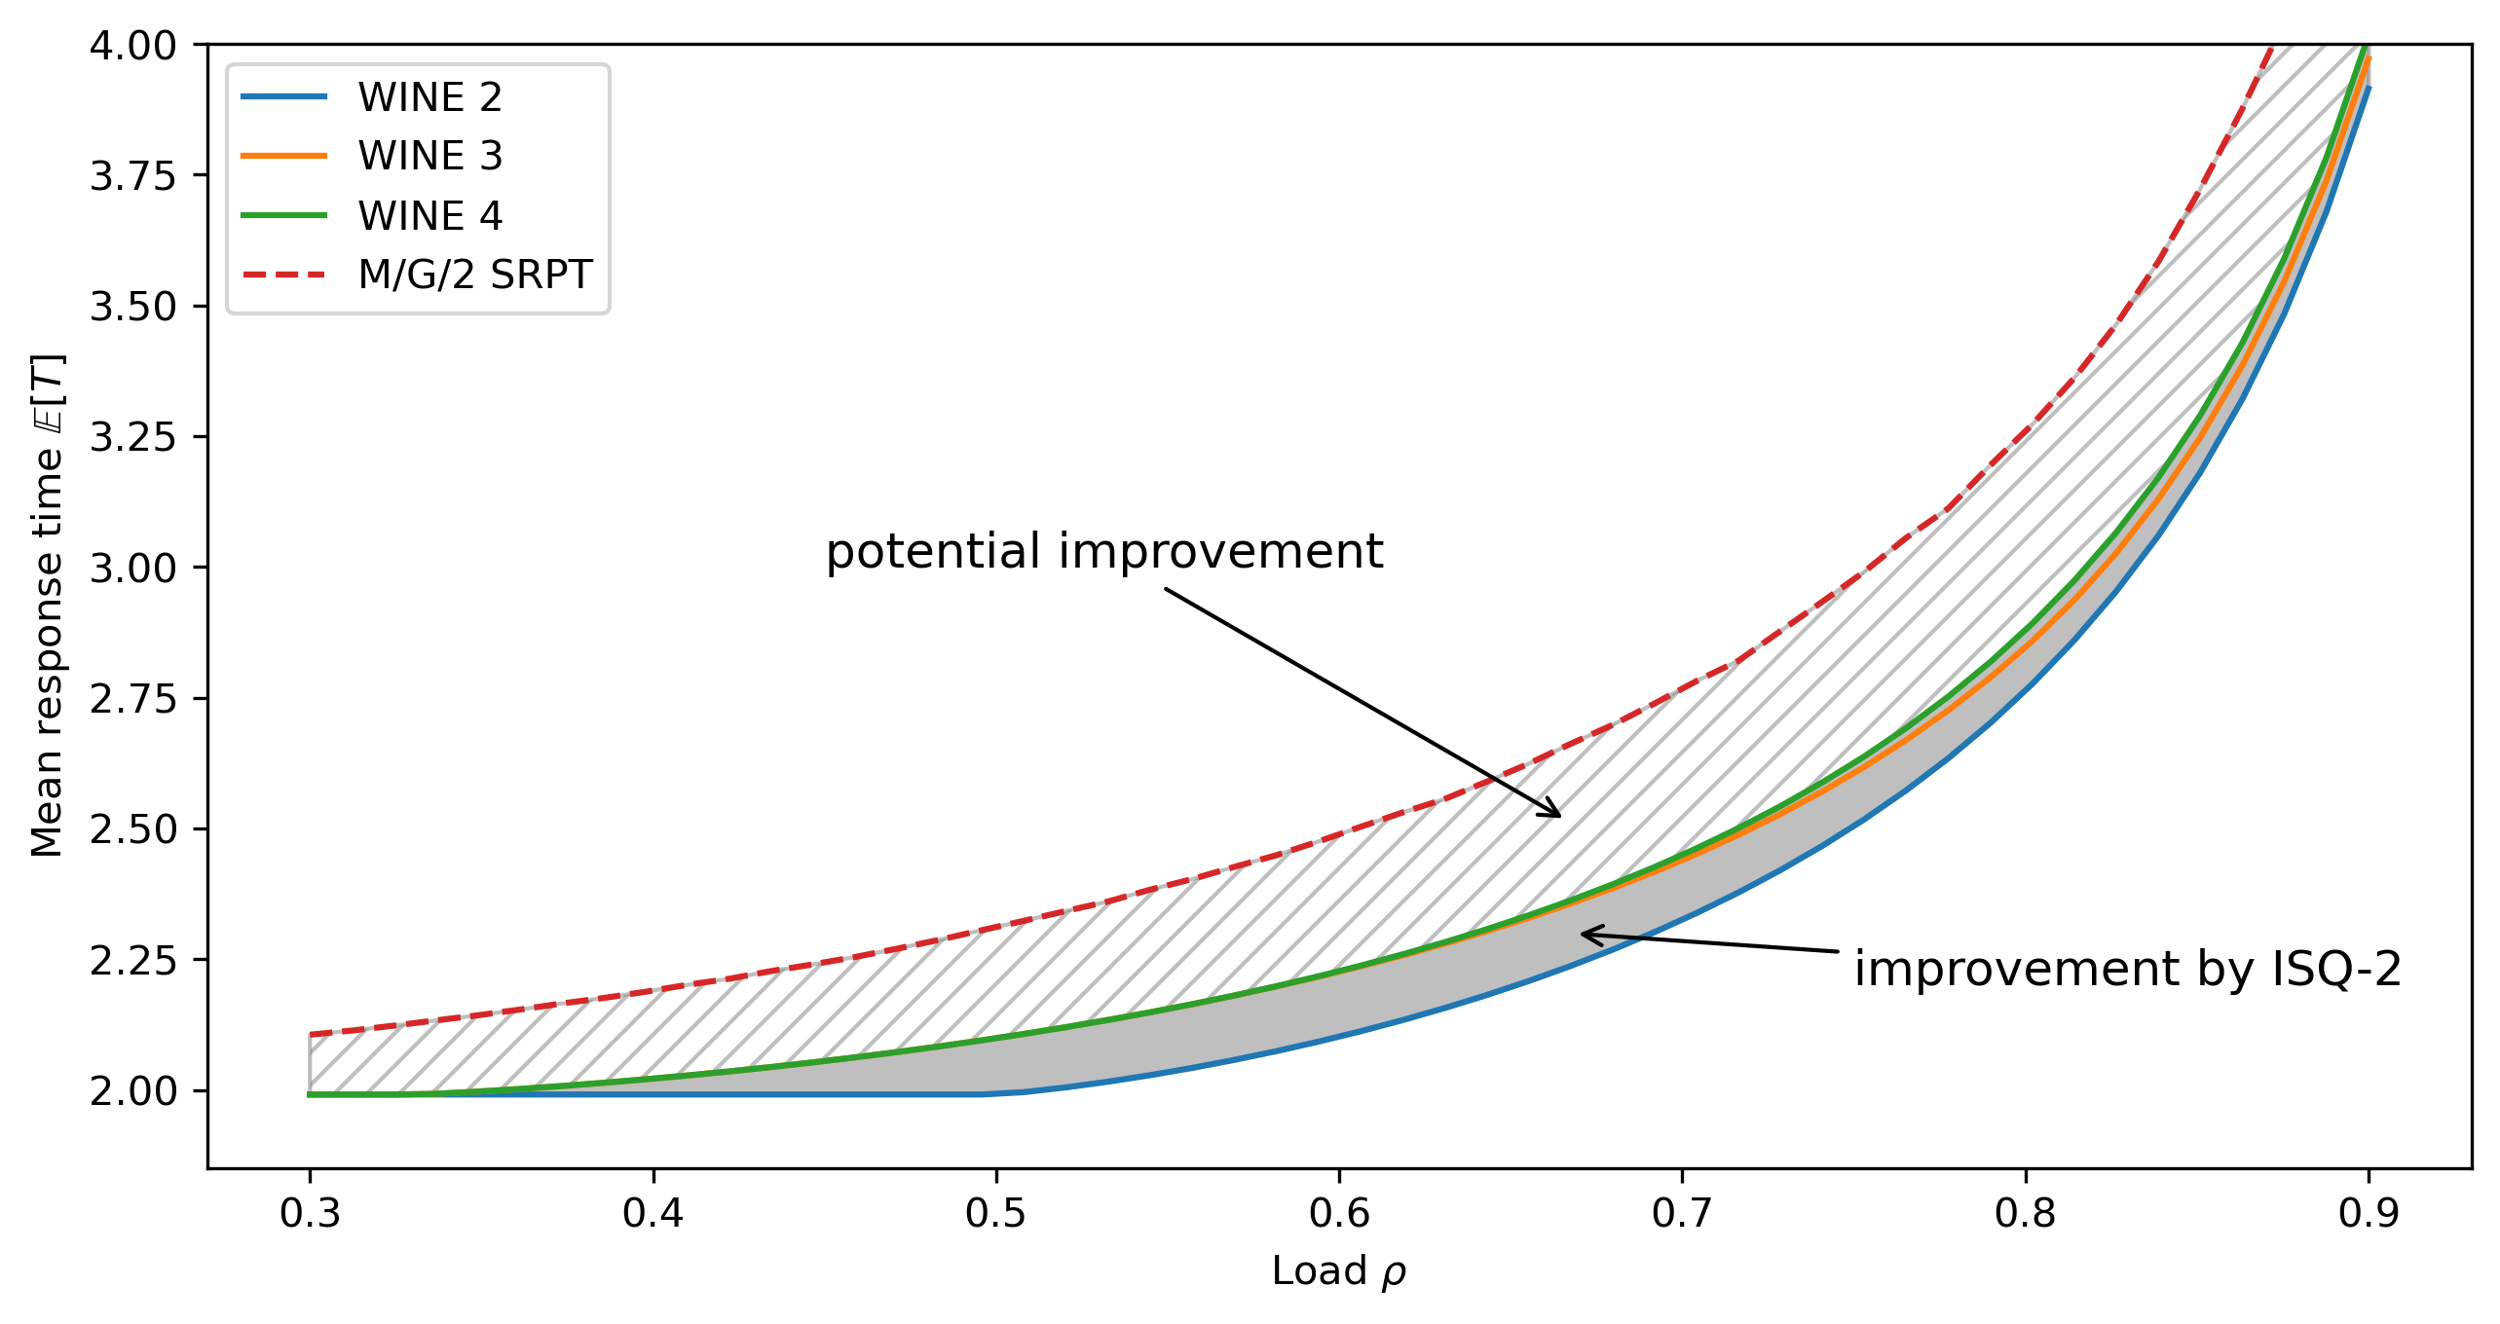

ISQ Lower bounds: Plot
Setting: $k=2$ servers, Exp(1) job sizes
SRPT-2
Our bounds
Best prior

Slide 18
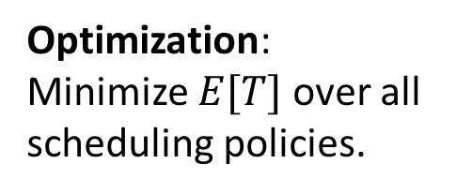
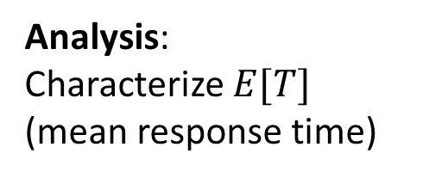
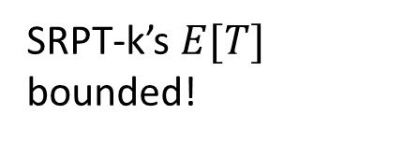
Prior Work: Single-server & Multiserver Scheduling
Multiserver 1 server/job
1 server
Analysis: Characterize $E[T]$ (mean response time)
Well understood! [Pollaczek ‘30], [Schrage & Miller ‘66], [Scully ‘18].
SRPT-k’s $E[T]$ bounded!
Optimization: Minimize $E[T]$over all scheduling policies.
SRPT is optimal! [Schrage ‘68].
SRPT-k in heavy-traffic!
SEK is even better!
Stronger lower bound!

Slide 19
Prior Work: Single-server & Multiserver Scheduling
Multiserver 1 server/job
Multiserver many servers/job
1 server
3
3
2
2
4
2
1
Analysis: Characterize $E[T]$ (mean response time)
Well understood! [Pollaczek ‘30], [Schrage & Miller ‘66], [Scully ‘18].
SRPT-k’s $E[T]$ bounded!
No analysis for any scheduling policy.
Optimization: Minimize $E[T]$over all scheduling policies.
SRPT is optimal! [Schrage ‘68].
SRPT-k in heavy-traffic!
SEK is even better!
Stronger lower bound!
Completely open

Slide 20

Multiserver-job (MSJ) Model
Motivated by Google Borg scheduler [Tirmazi et al. ‘20].
Trace: Factor of ${10}^{5}$ variation in server need.
Prior scheduling: Heuristics and/or poor response time
3
4
2
2
3
3
1
Notes:
I went looking in their trace data.

Slide 21

Prior MSJ projects (from PhD)
First-Come First-Served: First $E[T]$ analysis!
ServerFilling: Analysis & throughput optimality
ServerFillingSRPT: Heavy-traffic optimal mean response time!
But: ServerFilling and ServerFillingSRPT are preemptive & restricted settings
Least remaining size order
2
4
1
2
8
1
k=8
1
4
4
1
2
1
1
Notes:
Fill all the servers, while also being nearly the smallest in the system. Powers of 2, that’s how we can guarantee this combination will always exist

Slide 22
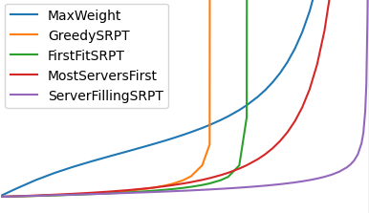
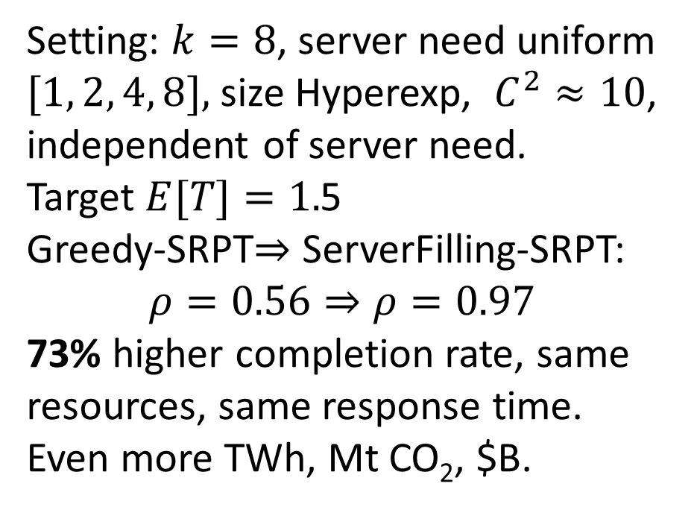

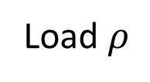
Empirical Impact
Setting: $k=8$, server need uniform $[1, 2, 4, 8],$ size Hyperexp, $C^{2}≈10$, independent of server need.
Target $E[T]=1.$5
Greedy-SRPT$⇒$ ServerFilling-SRPT:
$$ρ=0.56⇒ρ=0.97$$
73% higher completion rate, same resources, same response time.
Even more TWh, Mt CO₂, $B.
5
4
3
$$E[T]$$
2
1
0
0
0.2
0.4
0.6
0.8
1.0
Load $ρ$
Notes:
Admit as many customers as possible subject to E[T] limit.

Slide 23
New MSJ projects
General server needs
Heavy traffic optimality, unrestricted server needs
Idea: Serve small jobs, while also balancing # of jobs of each server need
Smallest Equalizing Bucket (SEB)
w/ Runhan Xie (Berkeley) and Ziv Scully (Cornell)
No preemption, or preemption overhead
Need to control switching frequency
2 approaches:
SMASH (window-based) Diletta, Andrea, Marco, Adityo (Italy)
MSR (timer-based) Ben Berg & Zhongrui Chen (UNC)

Slide 24
MSJ: Switching frequency
Simple MSJ example: Jobs need 1 or all servers.
Too frequent switching: Too much waste, bad performance.
Too rare switching: Highly variable completion rate, bad performance.
Switch on timer (UNC) or on window of jobs (Italy)
Waste!
Time

Slide 25
Tandem queues
Abandon
Model for web requests, especially microservices architectures & RPCs
Jobs often time-sensitive. Model with abandonment
Past works: either no abandonment or all abandonment.
Important to model hybrid abandonment Transaction model, critical segments
Notes:
Showing 2 stages here, ideas applicable to wide variety of models

Slide 26


Tandem queues: Results
Abandon
With Cameron Curtis (IEMS PhD Student) and Seyed Iravani (IEMS Prof.)
Mean response time analysis
Full distributional analysis (Moment generating function)
Theoretical guarantees in heavy traffic (2nd queue at capacity)
Empirically tight at all loads
Notes:
Showing 2 stages here, ideas applicable to wide variety of models

Slide 27
Future direction: Collaboration
I want to model, analyze, and optimize the computing systems & networks that you’re working on!
Do they look like these models? Or do they look fully different?
These techniques are widely applicable!

Slide 28
Conclusion: Multiserver Analysis & Optimality
3
Parallel, one server/job
Multiple servers/job
2
4
1
3
3
1
Multiple stages of processing (Tandem)

