Slide 1
Graph Structure Product Form
Izzy Grosof
Northwestern University, IEMS
Céline Comte

Slide 2
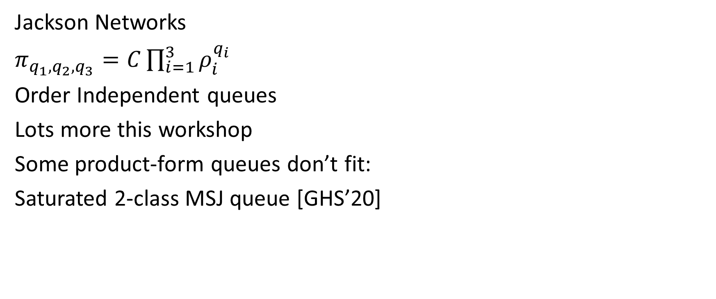
Families of Product Form Queues
M/M/1
M/M/1
Jackson Networks
$π_{q_{1},q_{2}, q_{3}}=C\prod_{i=1}^{3}{ρ_{i}^{q_{i}}}$
Order Independent queues
Lots more this workshop
Some product-form queues don’t fit:
Saturated 2-class MSJ queue [GHS’20]
M/M/1
New arrival!
FCFS
1
1
1
1
4
4

Slide 3
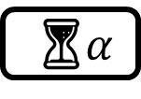
A family of robust product-form queues
New arrival!
Graph-based product form:
Saturated 2-class MSJ
Exclusive arrivals
Modulus arrival batches
More robust than prior product form. Ex: allow state-dependent transition rates.
Key idea: Markov chain transition graph.
Paper under submission, on arXiv: “Graph-Based Product Form” [CG’25]
1
1
1
1
4
4
⏳$α$

Slide 4
Prior Work: Product Form Queues
Time-reversibility: Jackson networks [J’57], Whittle networks
BCMP networks: [BCMP’75]
Quasi-reversibility: Order-independent queues [BKK’95], pass-and-swap queues [CD’21]
Partial balance: Token-based OI queues [ABDV’22].
None based on structure of transition-graph.

Slide 5
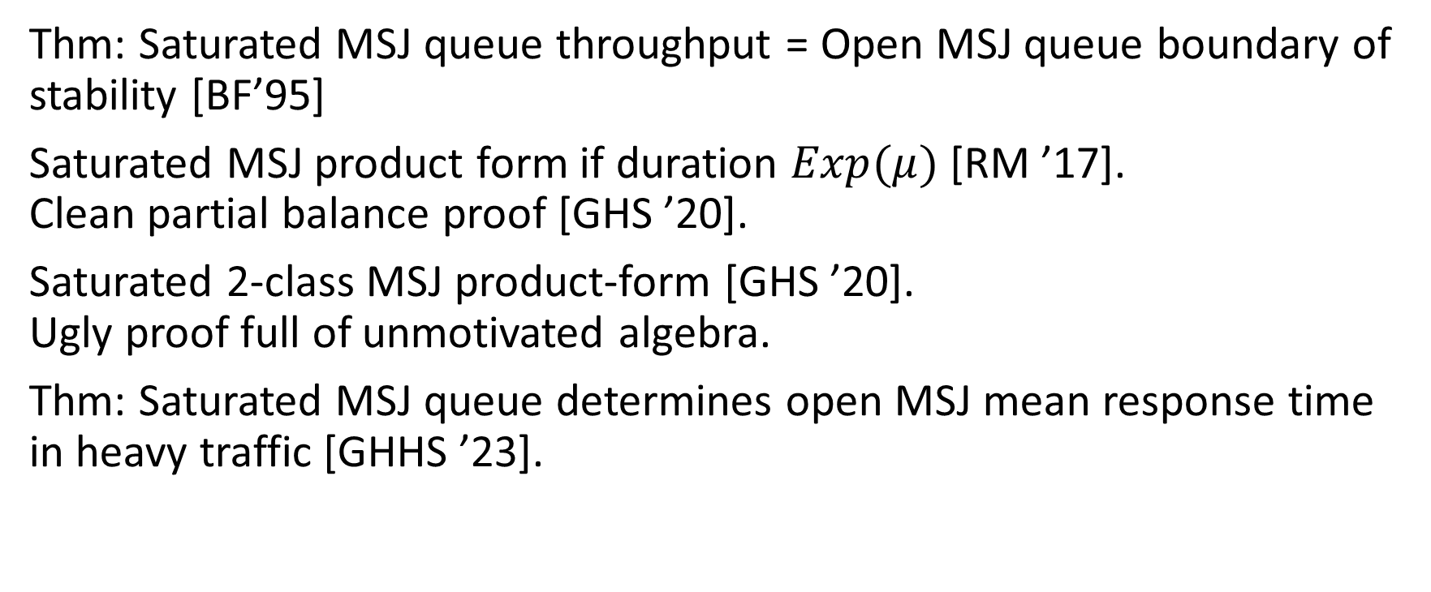
Prior Work: Saturated MSJ Queues
Thm: Saturated MSJ queue throughput = Open MSJ queue boundary of stability [BF’95]
Saturated MSJ product form if duration $Exp(μ)$ [RM ’17]. Clean partial balance proof [GHS ’20].
Saturated 2-class MSJ product-form [GHS ’20]. Ugly proof full of unmotivated algebra.
Thm: Saturated MSJ queue determines open MSJ mean response time in heavy traffic [GHHS ’23].

Slide 6
Outline
Define MSJ model (specifically 2-class saturated model).
Transition graph cuts and product-form relationships.
Define graph-based product form
Joint-ancestor freedom
More examples

Slide 7
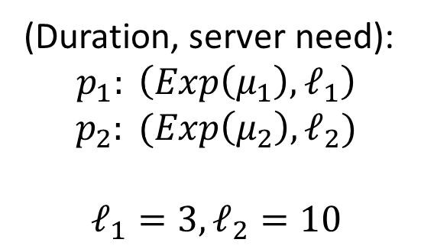
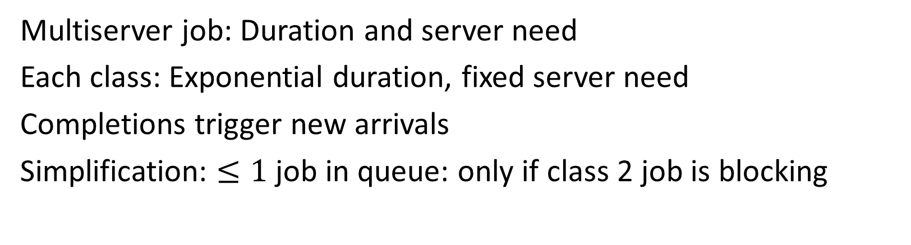

Two-class Saturated Multiserver Job
New arrival!
(Duration, server need):
$$p_{1}: \left(Exp\left(μ_{1}\right),ℓ_{1}\right)$$
$$p_{2}: (Exp\left(μ_{2}\right),ℓ_{2})$$
$$ℓ_{1}=3, ℓ_{2}=10$$
FCFS
10
3
3
3
10
$$k=30$$
10
10
10
3
Multiserver job: Duration and server need
Each class: Exponential duration, fixed server need
Completions trigger new arrivals
Simplification: $≤1$ job in queue: only if class 2 job is blocking

Slide 8
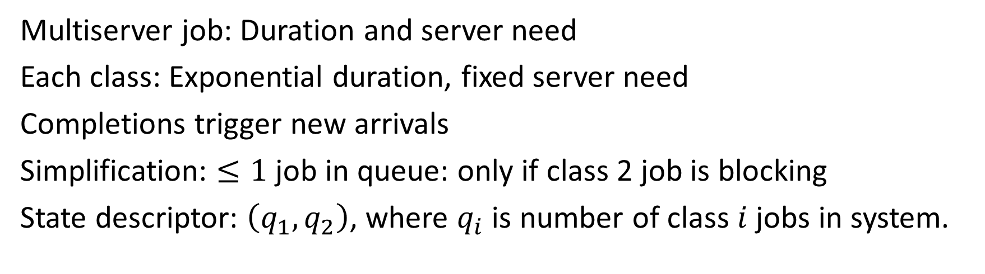
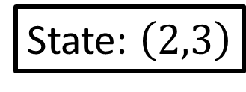
Two-class Saturated Multiserver Job
New arrival!
(Duration, server need):
$$p_{1}: \left(Exp\left(μ_{1}\right),ℓ_{1}\right)$$
$$p_{2}: (Exp\left(μ_{2}\right),ℓ_{2})$$
$$ℓ_{1}=3, ℓ_{2}=10$$
10
3
State: $\left(2,3\right)$
10
$$k=30$$
10
10
3
Multiserver job: Duration and server need
Each class: Exponential duration, fixed server need
Completions trigger new arrivals
Simplification: $≤1$ job in queue: only if class 2 job is blocking
State descriptor: $\left(q_{1}, q_{2}\right)$, where $q_{i}$ is number of class $i$ jobs in system.

Slide 9
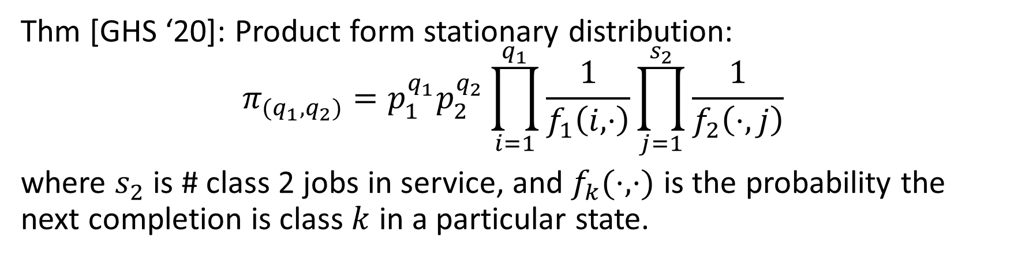
Two-class Saturated Multiserver Job
New arrival!
(Duration, server need):
$$p_{1}: \left(Exp\left(μ_{1}\right),ℓ_{1}\right)$$
$$p_{2}: (Exp\left(μ_{2}\right),ℓ_{2})$$
$$ℓ_{1}=3, ℓ_{2}=10$$
10
3
State: $\left(2,3\right)$
10
$$k=30$$
10
10
3
Thm [GHS ‘20]: Product form stationary distribution:
$$π_{(q_{1},q_{2})}=p_{1}^{q_{1}}p_{2}^{q_{2}}\prod_{i=1}^{q_{1}}{\frac{1}{f_{1}\left(i,⋅\right)}\prod_{j=1}^{s_{2}}{\frac{1}{f_{2}\left(⋅,j\right)}}}$$
where $s_{2}$ is # class 2 jobs in service, and $f_{k}(⋅,⋅)$ is the probability the next completion is class $k$ in a particular state.
Why product form?

Slide 10
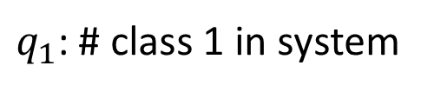
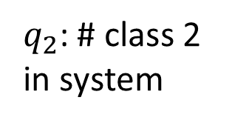
Embedded Markov Chain: Default
New arrival!
10
3
10
10
10
3
(0,3)
(1,3)
(2,3)
3
(3,2)
(4,2)
(5,2)
Nothing in queue
$q_{2}$: # class 2 in system
(6,1)
(7,1)
(8,1)
(9,1)
Class 2 in queue
0
(10,0)
Arrival needed
0
$q_{1}$: # class 1 in system
10
DTMC: Update after completion + any needed arrivals
Many long-distance transitions ☹

Slide 11
Embedded Markov Chain: Default
New arrival!
10
3
10
10
3
(0,3)
(1,3)
(2,3)
3
(0,2)
(1,2)
(2,2)
(3,2)
(4,2)
(5,2)
Nothing in queue
$q_{2}$: # class 2 in system
(3,1)
(4,1)
(5,1)
(6,1)
(7,1)
(8,1)
(9,1)
Class 2 in queue
0
(6,0)
(7,0)
(8,0)
(9,0)
(10,0)
Arrival needed
0
$q_{1}$: # class 1 in system
10
DTMC: Update after completion or arrival
Local transitions only! ☺

Slide 12
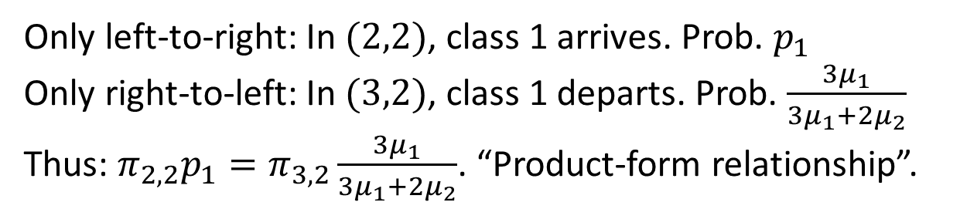
Cuts imply product-form relationships
New arrival!
10
3
10
10
3
(0,3)
(1,3)
(2,3)
3
(0,2)
(1,2)
(2,2)
(3,2)
(4,2)
(5,2)
Nothing in queue
(3,1)
(4,1)
(5,1)
(6,1)
(7,1)
(8,1)
(9,1)
Class 2 in queue
0
(6,0)
(7,0)
(8,0)
(9,0)
(10,0)
Arrival needed
Only left-to-right: In $(2,2)$, class 1 arrives. Prob. $p_{1}$
Only right-to-left: In $(3,2)$, class 1 departs. Prob. $\frac{3μ_{1}}{3μ_{1}+2μ_{2}}$
Thus: $π_{2,2}p_{1}=π_{3,2}\frac{3μ_{1}}{3μ_{1}+2μ_{2}}$. “Product-form relationship”.

Slide 13
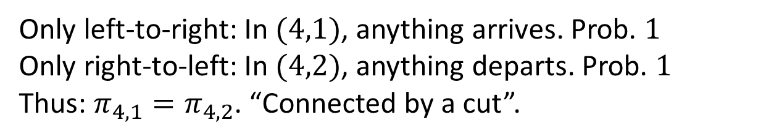
Cuts imply product-form relationships
New arrival!
10
3
10
10
3
(0,3)
(1,3)
(2,3)
3
(0,2)
(1,2)
(2,2)
(3,2)
(4,2)
(5,2)
Nothing in queue
(3,1)
(4,1)
(5,1)
(6,1)
(7,1)
(8,1)
(9,1)
Class 2 in queue
0
(6,0)
(7,0)
(8,0)
(9,0)
(10,0)
Arrival needed
Only left-to-right: In $(4,1)$, anything arrives. Prob. $1$
Only right-to-left: In $(4,2)$, anything departs. Prob. $1$
Thus: $π_{4,1}=π_{4,2}$. “Connected by a cut”.

Slide 14
Cut graph
New arrival!
10
3
10
10
3
(0,3)
(1,3)
(2,3)
3
(0,2)
(1,2)
(2,2)
(3,2)
(4,2)
(5,2)
Nothing in queue
(3,1)
(4,1)
(5,1)
(6,1)
(7,1)
(8,1)
(9,1)
Class 2 in queue
0
(6,0)
(7,0)
(8,0)
(9,0)
(10,0)
Arrival needed
Cut graph: Undirected edge if states connected by a cut.
If path in cut graph: Combine sequence of product form relationships
Thm: Connected cut graph = product form stationary distribution

Slide 15
Connected cut graph
Thm: Connected cut graph = product form stationary distribution
Proof: Every state has product-form relationship with every other state.
Write every state’s stationary probability as multiplier of home state.
Up to normalizing constant, stationary probability is given by the sequence of transitions on the path to home state.
(0,3)
(1,3)
(2,3)
(0,2)
(1,2)
(2,2)
(3,2)
(4,2)
(5,2)
(3,1)
(4,1)
(5,1)
(6,1)
(7,1)
(8,1)
(9,1)
(6,0)
(7,0)
(8,0)
(9,0)
(10,0)

Slide 16
Graph-based product form
If cut graph is connected, graph-based product form
Only transition edges (nonzero probabilities) affect graph-based product form.
Very robust: State-specific transition probabilities are fine.
Thm: If and only if cut graph is connected, graph-based product form.
More generally, if and only if nodes are connected by a cut, have product-form relationship.

Slide 17

Cut-finding algorithm: Joint Ancestor Free
Hard to efficiently find a cut – sometimes clear from drawing, but brute force takes exponential time.
States $a$ and $b$ are joint ancestor free if there is no state $c$ that is separately an ancestor of each of $a$ and $b$.
(0,3)
(1,3)
(2,3)
(0,2)
(1,2)
(2,2)
(3,2)
(4,2)
(5,2)
(3,1)
(4,1)
(5,1)
(6,1)
(7,1)
(8,1)
(9,1)
(6,0)
(7,0)
(8,0)
(9,0)
(10,0)

Slide 18
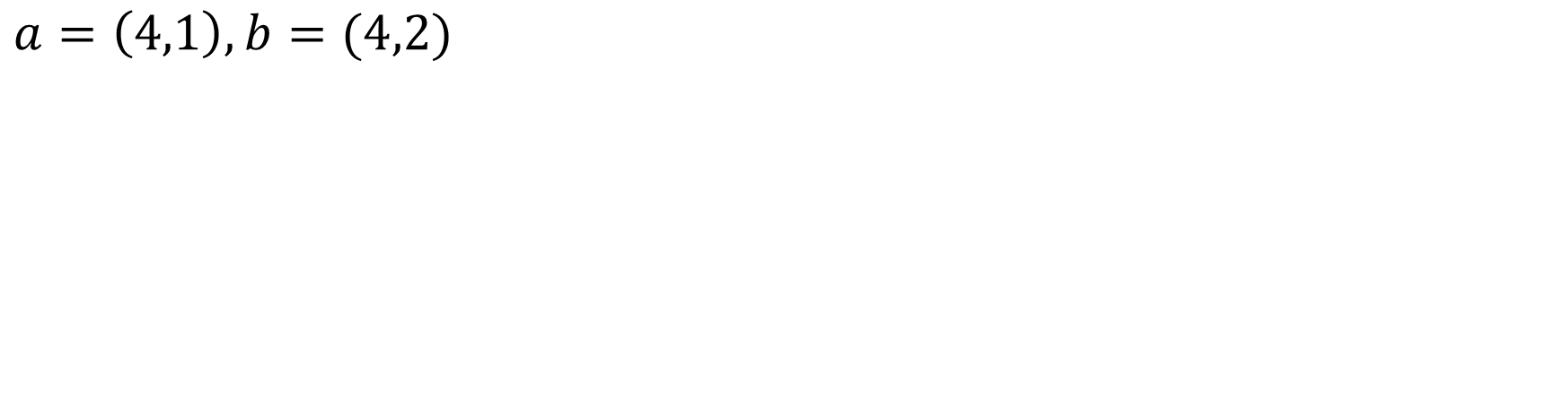
Cut-finding algorithm: Joint Ancestor Free
(0,3)
(1,3)
(2,3)
(0,2)
(1,2)
(2,2)
(3,2)
(4,2)
(5,2)
(3,1)
(4,1)
(5,1)
(6,1)
(7,1)
(8,1)
(9,1)
(6,0)
(7,0)
(8,0)
(9,0)
(10,0)
$a=\left(4,1\right), b=(4,2)$

Slide 19
Cut-finding algorithm: Joint Ancestor Free
(0,3)
(1,3)
(2,3)
(0,2)
(1,2)
(2,2)
(3,2)
(4,2)
(5,2)
(3,1)
(4,1)
(5,1)
(6,1)
(7,1)
(8,1)
(9,1)
(6,0)
(7,0)
(8,0)
(9,0)
(10,0)
$a=\left(4,1\right), b=(4,2)$

Slide 20
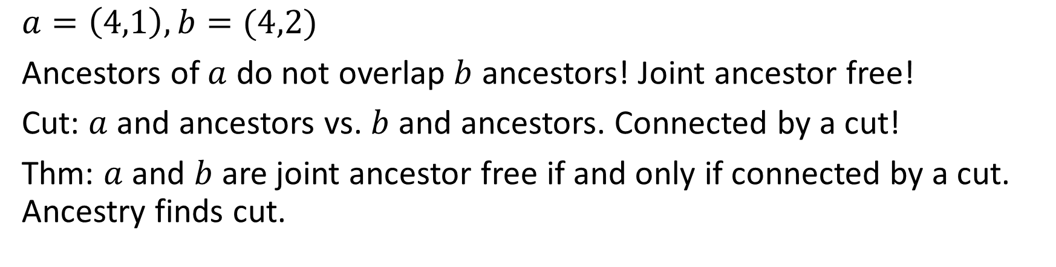
Cut-finding algorithm: Joint Ancestor Free
(0,3)
(1,3)
(2,3)
(0,2)
(1,2)
(2,2)
(3,2)
(4,2)
(5,2)
(3,1)
(4,1)
(5,1)
(6,1)
(7,1)
(8,1)
(9,1)
(6,0)
(7,0)
(8,0)
(9,0)
(10,0)
$a=\left(4,1\right), b=(4,2)$
Ancestors of $a$ do not overlap $b$ ancestors! Joint ancestor free!
Cut: $a$ and ancestors vs. $b$ and ancestors. Connected by a cut!
Thm: $a$ and $b$ are joint ancestor free if and only if connected by a cut. Ancestry finds cut.

Slide 21
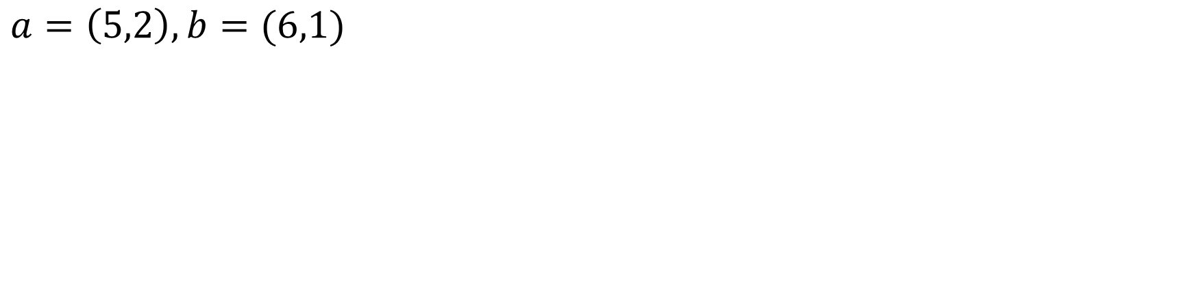
Cut-finding algorithm: Joint Ancestor Free
(0,3)
(1,3)
(2,3)
(0,2)
(1,2)
(2,2)
(3,2)
(4,2)
(5,2)
(3,1)
(4,1)
(5,1)
(6,1)
(7,1)
(8,1)
(9,1)
(6,0)
(7,0)
(8,0)
(9,0)
(10,0)
$a=\left(5,2\right), b=(6,1)$

Slide 22
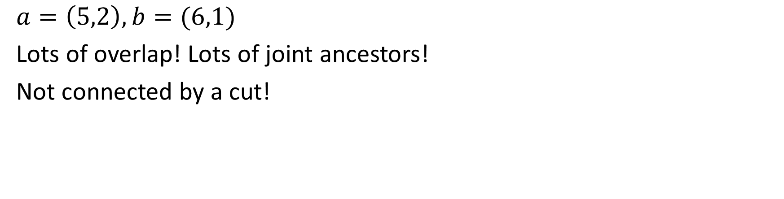
Cut-finding algorithm: Joint Ancestor Free
(0,3)
(1,3)
(2,3)
(0,2)
(1,2)
(2,2)
(3,2)
(4,2)
(5,2)
(3,1)
(4,1)
(5,1)
(6,1)
(7,1)
(8,1)
(9,1)
(6,0)
(7,0)
(8,0)
(9,0)
(10,0)
$a=\left(5,2\right), b=(6,1)$
Lots of overlap! Lots of joint ancestors!
Not connected by a cut!

Slide 23

Product-form algorithm
For each pair of nodes, explore graph to find all (separate) ancestors. If none, JAF. Time complexity $O({\left|V\right|}^{2}|E|)$ to construct cut graph.
Future work/open question: More efficient algorithm?

Slide 24
Outline
Define MSJ model (specifically 2-class saturated model).
Transition graph cuts and product-form relationships.
Define graph-based product form
Joint-ancestor freedom
Infinite graph-based product form
Second-level product form
⏳$α$

Slide 25


Beyond finite graphs: Exclusive arrivals
⏳$α$
Either arrivals or completions, not both.
$Poisson(λ)$ arrivals or $Exp(μ)$ completions, switch after $Exp(α)$.

Slide 26
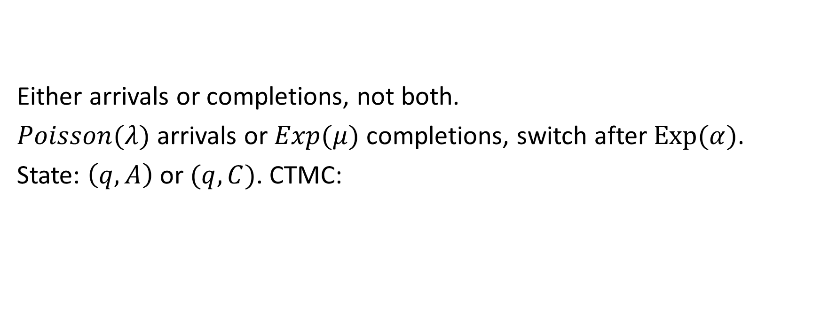
Beyond finite graphs: Exclusive arrivals
⏳$α$
Either arrivals or completions, not both.
$Poisson(λ)$ arrivals or $Exp(μ)$ completions, switch after $Exp(α)$.
State: $\left(q,A\right)$ or $(q, C)$. CTMC:
(0,C)
(1,C)
(2,C)
(3,C)
(4,C)
(5,C)
(6,C)
(7,C)
…
(8,C)
(9,C)
(0,A)
(1,A)
(2,A)
(3,A)
(4,A)
(5,A)
(6,A)
(7,A)
(8,A)
(9,A)

Slide 27
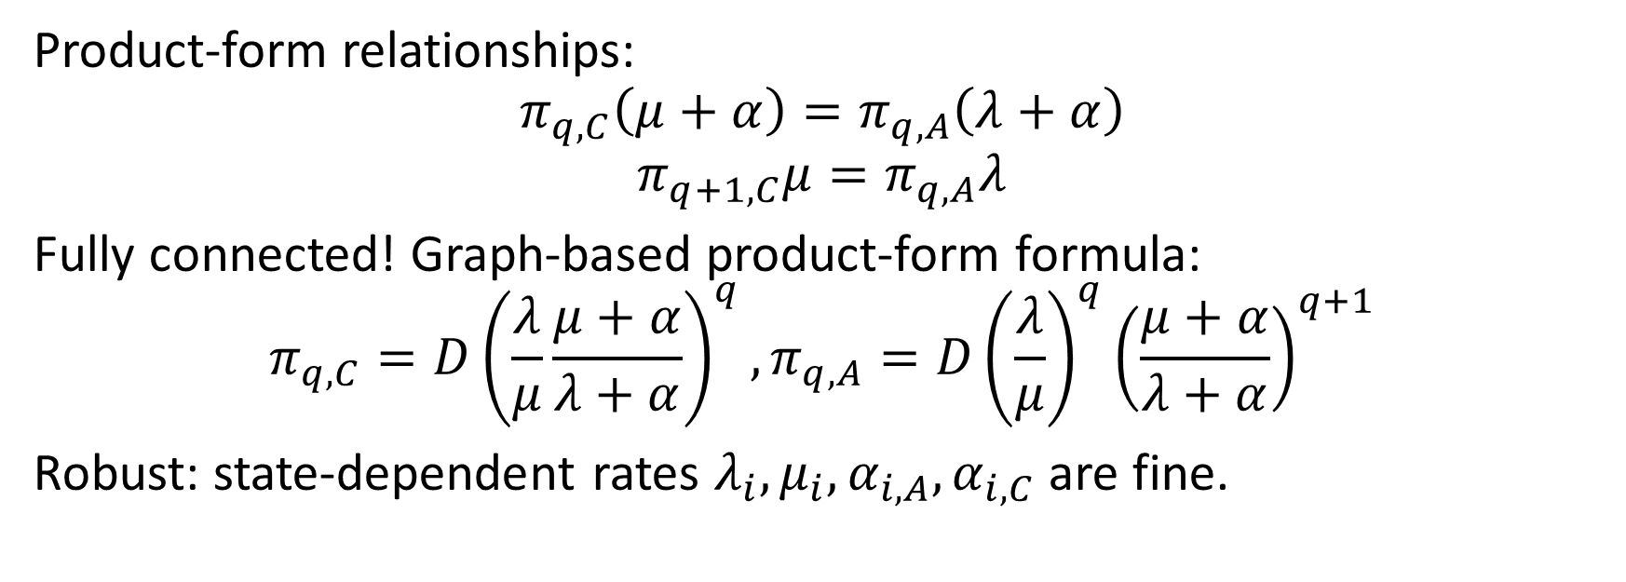
Exclusive arrivals: cut graph
(0,C)
(1,C)
(2,C)
(3,C)
(4,C)
(5,C)
(6,C)
(7,C)
…
(8,C)
(9,C)
(0,A)
(1,A)
(2,A)
(3,A)
(4,A)
(5,A)
(6,A)
(7,A)
(8,A)
(9,A)
Product-form relationships:
$$π_{q,C}\left(μ+α\right)=π_{q,A}\left(λ+α\right)$$
$$π_{q+1,C}μ=π_{q,A}λ$$
Fully connected! Graph-based product-form formula:
$$π_{q,C}=D{\left(\frac{λ}{μ}\frac{μ+α}{λ+α}\right)}^{q},π_{q,A}=D{\left(\frac{λ}{μ}\right)}^{q}{\left(\frac{μ+α}{λ+α}\right)}^{q+1}$$
Robust: state-dependent rates $λ_{i}, μ_{i},α_{i,A},α_{i,C}$ are fine.

Slide 28
Second-level cuts: Batch arrivals, modulus
Consider: M/M/1 with batch arrivals. Geometric number of arriving jobs, truncated to multiple of 3.
Key idea: Embedded DTMC with completion states, mid-batch states:
(0,C)
(1,C)
(2,C)
(3,C)
(4,C)
(5,C)
(6,C)
(7,C)
…
(8,C)
(9,C)
(1,A)
(2,A)
(3,A)
(4,A)
(5,A)
(6,A)
(7,A)
(8,A)
(9,A)

Slide 29
Second-level cuts: Batch arrivals, modulus
(0,C)
(1,C)
(2,C)
(3,C)
(4,C)
(5,C)
(6,C)
(7,C)
…
(8,C)
(9,C)
(1,A)
(2,A)
(3,A)
(4,A)
(5,A)
(6,A)
(7,A)
(8,A)
(9,A)
Smaller clusters of product-form relationships. Not connected.

Slide 30
Second-level cuts: Batch arrivals, modulus
(0,C)
(1,C)
(2,C)
(3,C)
(4,C)
(5,C)
(6,C)
(7,C)
…
(8,C)
(9,C)
(1,A)
(2,A)
(3,A)
(4,A)
(5,A)
(6,A)
(7,A)
(8,A)
(9,A)
Smaller clusters of product-form relationships. Not connected.
Second-level cuts: Cut only crossed by transitions from two clusters.
Contrast to first-level: Only crossed from two states.
Fully connected by second-level cuts: More complex product-form formula.
Still robust: Only depends on graph structure.

Slide 31
Future work
Holistic characterization of MCs with fully connected cut graphs, or fully connected by second-level cuts.
Local characterization: Absence of certain subgraphs? Certain minors?
…
A
…
B
C

Slide 32
Conclusion
Connected cut graph
Graph-based product form
2-class saturated MSJ
(0,3)
(1,3)
(2,3)
(0,3)
(1,3)
(2,3)
(0,2)
(1,2)
(2,2)
(3,2)
(4,2)
(5,2)
(0,2)
(1,2)
(2,2)
(3,2)
(4,2)
(5,2)
(3,1)
(4,1)
(5,1)
(6,1)
(7,1)
(8,1)
(9,1)
(3,1)
(4,1)
(5,1)
(6,1)
(7,1)
(8,1)
(9,1)
(6,0)
(7,0)
(8,0)
(9,0)
(10,0)
(6,0)
(7,0)
(8,0)
(9,0)
(10,0)
Exclusive arrivals
M/M/1, Batch modulo arrivals
(0,C)
(1,C)
(2,C)
(3,C)
(4,C)
(5,C)
(6,C)
(7,C)
(8,C)
(9,C)
…
(0,C)
(1,C)
(2,C)
(3,C)
(4,C)
(5,C)
(6,C)
(7,C)
(8,C)
(9,C)
…
(0,A)
(1,A)
(2,A)
(3,A)
(4,A)
(5,A)
(6,A)
(7,A)
(8,A)
(9,A)
(1,A)
(2,A)
(3,A)
(4,A)
(5,A)
(6,A)
(7,A)
(8,A)
(9,A)

Slide 34
Backup: Second-level algorithm
Broad second-level cut: Crossed only by transitions from two clusters.
Narrow second-level cut: Cut in quotient graph: contract first-level cuts.
Narrow is efficient to find.
Conjecture: If broad cut exists, then narrow cut exists.
Without narrow cuts, exponential search for broad cut.

