Slide 1
Stability for Two-Class Multiserver-job Systems
Isaac Grosof
Mor Harchol-Balter
Alan Scheller-Wolf
Speaking Skills talk
Notes:
We’re going to talk about Multiserver systems
Stability – doesn’t explode
Before we get into that, I need to tell you about the framework I’m using stochastic analysis

Slide 2
Two Types of Analysis
This talk
Worst-case Analysis
Adversarial Inputs
“How does this algorithm perform on its worst-case input?”
Very general
Typical behavior in practice may not resemble worst-case behavior
Stochastic Analysis
Random Inputs
“How well does my algorithm perform on average?”
Results about averages
More realistic setting
Can reveal practical insights

Slide 3
Stochastic Models of Data Centers
FCFS ordering
Traditional Multiserver Model: M/G/k
i.i.d. job duration distribution
Identical Servers
Poisson process with arrival rate λ
k
Q: Why does one-dimensional job model no longer resemble data centers?
A: Many jobs now parallel.
Notes:
Poisson: Image time broken into tiny steps, flip a coin at each step to see if you get an arrival
Width is duration

Slide 4
Parallel Job Model
4
3
# servers required
2
1
3.2s
4.1s
5.5s
Job duration

Slide 5
Modern Model: Multiserver Jobs
i.i.d. joint distribution of
(# of servers, duration)
Duration
λ
# servers
Closely resembles modern datacenters, e.g. Google’s Borg scheduler [Tirmazi et al. ‘20]
Notes:
Jobs may require concurrent service at several servers

Slide 6


Vital Question: Stability/Throughput
Stable: Queue stays short – doesn’t explode in length.
Q: Maximum stable arrival rate? (i.e. max throughput?)
M/G/k
Multiserver-job
$$λ<\frac{k}{E[Duration]}$$
$$λE[Duration]<k$$
Waste: # empty servers despite jobs in queue
$λ<$???
Rate work arrives
Rate work is completed
Notes:
Remember, the M/G/k has 1 server/job
Note that in contrast, the M/G/k never has any wasted servers, makes it so simple.

Slide 7



Outline
Introduce multiserver-job model
Introduce stability problem
Discuss waste
Prior results on stability
Introduce our specific model
Key idea: Saturated System
Elegant analytical results
Insights from results
Notes:
Maximum stable arrival rate
At this point we’ll have finished introducing everything.
Now we’ll start talking about our actual results.
Turns out this system on the right admits these really beautiful results
We’ll then translate these to the system on the left.

Slide 8
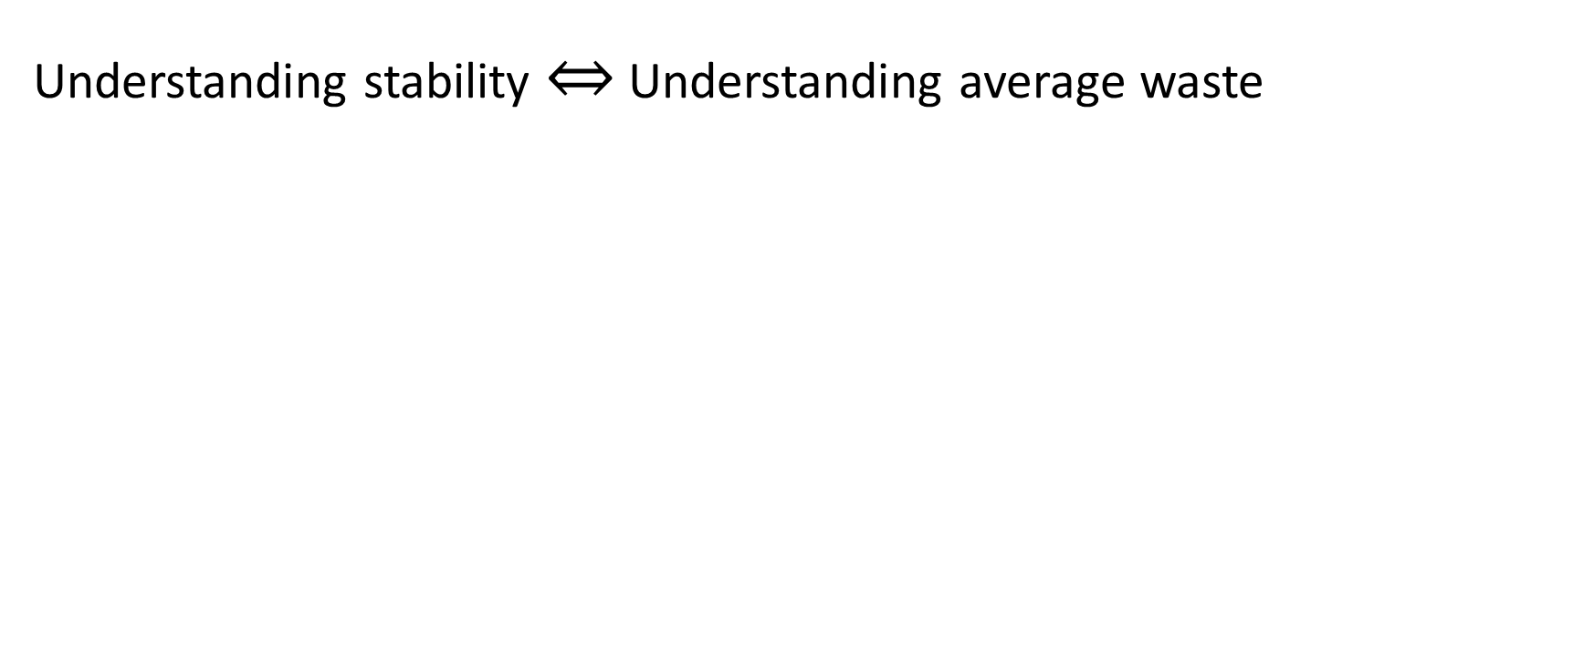
Waste
Understanding stability Understanding average waste
Key question: What fraction of time in each scenario?
Notes:
Very little prior work on understanding stability and waste. Let me tell you about it.

Slide 9
Prior Results on Multiserver-Job Stability
Past results:
Brill & Green ‘84, Filippopoulos & Karatza ‘07:
Two servers
Single duration distribution, independent of # of servers
Rumyantsev & Morozov ‘16:
Arbitrary # of servers
Single duration distribution, independent of # of servers
Our result:
Arbitrary # of servers
Jobs requiring different #s of servers have different job size distributions.
Specifically: 2 job classes.
First model to handle correlation between # of servers and duration.
Real data centers: # of servers and duration are correlated by default.
Notes:
Ugly Quartic
Correlations are common in practice.

Slide 10
Contributions
Derive first analytical formula for stability for the two-class multiserver-job model.
Introduce a novel technique for analyzing multiserver-job systems: Saturated System.
Notes:
First result outside of the single-distribution models

Slide 11

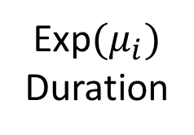
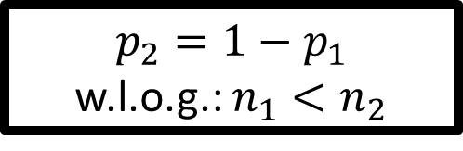

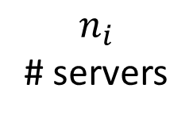

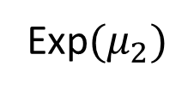
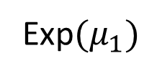

Two-class Model Specifics
$$n_{i}$$
# servers
i
1
Exp$(μ_{i})$
Duration
2
λ
2
2
2
1
1
# servers required
Service duration
Prob.
$$p_{2}={1−p}_{1}$$
w.l.o.g.: $n_{1}<n_{2}$
Job requirements distribution:
$$p_{1}$$
$$n_{1}$$
Exp$(μ_{1})$
$$p_{2}$$
$$n_{2}$$
Exp$(μ_{2})$
Notes:
Here class 2 happens to take longer than class 1 on average, but that’s not required – just n_2 > n_1.

Slide 12
Outline
Introduce multiserver-job model
Introduce stability problem
Discuss waste
Prior results on stability
Introduce our specific model
Key idea: Saturated System
Elegant analytical results
Insights from results

Slide 13
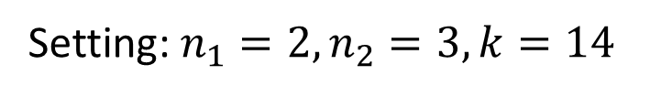
Example of system evolution
$$n_{i}$$
# servers
i
Exp$(μ_{i})$
Duration
Setting: $n_{1}=2,n_{2}=3, k=14$
2
1
2
2
2
4
Servers can be saturated
1
# class 2 in service
3
2
1
0
0
1
2
3
4
5
6
7
# class 1 in service
Notes:
Explain why 4 and why 7, to explain the setting.
“After 5 arrivals: at this point, the server is saturated: Further arrivals won’t change what’s in service – only completions will.”

Slide 14
Example of system evolution
$$n_{i}$$
# servers
i
Exp$(μ_{i})$
Duration
Setting: $n_{1}=2,n_{2}=3, k=14$
2
1
2
2
1
1
1
1
2
4
Servers can be saturated
2
# class 2 in service
3
2
1
0
0
1
2
3
4
5
6
7
# class 1 in service

Slide 15
Example of system evolution
$$n_{i}$$
# servers
i
Exp$(μ_{i})$
Duration
Setting: $n_{1}=2,n_{2}=3, k=14$
2
1
2
1
1
1
1
2
4
Servers can be saturated
2
# class 2 in service
3
2
1
0
0
1
2
3
4
5
6
7
# class 1 in service

Slide 16
Example of system evolution
$$n_{i}$$
# servers
i
Exp$(μ_{i})$
Duration
Setting: $n_{1}=2,n_{2}=3, k=14$
2
1
2
1
1
1
2
4
Servers can be saturated
2
# class 2 in service
3
2
1
0
0
1
2
3
4
5
6
7
# class 1 in service

Slide 17
Example of system evolution
$$n_{i}$$
# servers
i
Exp$(μ_{i})$
Duration
Setting: $n_{1}=2,n_{2}=3, k=14$
2
1
1
1
1
1
1
1
2
4
Servers can be saturated
2
# class 2 in service
3
2
1
0
0
1
2
3
4
5
6
7
# class 1 in service

Slide 18
Example of system evolution
$$n_{i}$$
# servers
i
Exp$(μ_{i})$
Duration
Setting: $n_{1}=2,n_{2}=3, k=14$
2
1
1
1
1
1
1
1
1
1
4
Servers can be saturated
2
# class 2 in service
3
2
1
0
0
1
2
3
4
5
6
7
# class 1 in service

Slide 19
Example of system evolution
$$n_{i}$$
# servers
i
Exp$(μ_{i})$
Duration
Setting: $n_{1}=2,n_{2}=3, k=14$
2
1
1
1
1
1
1
1
4
Servers can be saturated
2
# class 2 in service
3
2
1
0
0
1
2
3
4
5
6
7
# class 1 in service

Slide 20
Example of system evolution
$$n_{i}$$
# servers
i
Exp$(μ_{i})$
Duration
Setting: $n_{1}=2,n_{2}=3, k=14$
2
1
1
1
1
1
1
1
4
Servers can be saturated
2
# class 2 in service
3
Key insight:
Only states with saturated servers matter for stability
2
1
0
0
1
2
3
4
5
6
7
# class 1 in service
Notes:
Servers can be saturated only in certain states.
In order to formalize this insight, define a new system around these saturated states.

Slide 21
Defining the Saturated System
Saturated System: only include states where no more jobs can enter service. More jobs are always available.
State descriptor: [Blocking job?, # class 1, # class 2]
“Blocking job”
1
1
1
1
2
1
1
2
1
2
1
2
1
1
1
2
2
2
1
2
2
2
2
[0, 4, 2]
[0, 5, 1]
[1, 3, 2]
[1, 0, 4]
Notes:
Note that the blocking job is always a class 2 job.

Slide 22


Our Saturated System Theorem
Let $λ^{∗}=\sup_{λ}{\{}$Original system is stable with arrival rate $λ\}$
i.e. system is stable if ${λ<λ}^{∗}$, and unstable if${λ>λ}^{∗}$.
Theorem: $λ^{∗}=$ Throughput of saturated system.
Saturated system
Original system
λ
Notes:
Throughput is the long-run average completion rate
Not covering proof here

Slide 23
Zoomed-in Outline
Goal: analyze stability in original system
To do so: Analyze saturated system
Detailed structure of Saturated State Space
Elegant analytical result
0,7,0
0,5,1
1,3,2
0,4,2
0,2,3
1,0,4
0,1,4

Slide 24
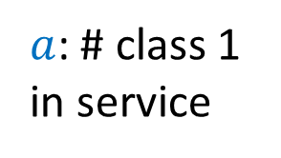
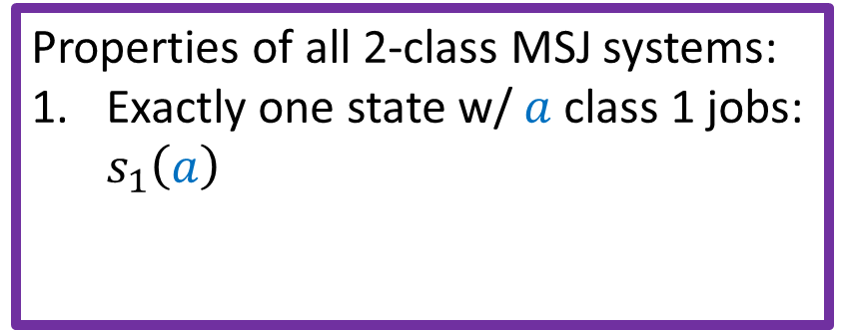

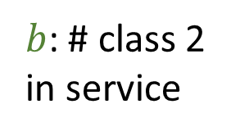
Saturated State Space Structure
Properties of all 2-class MSJ systems:
Exactly one state w/ $a$ class 1 jobs: $s_{1}\left(a\right)$
1,0,4
0,1,4
0,2,3
$b$: # class 2 in service
1,3,2
0,4,2
0,5,1
$$s_{1}\left(3\right)$$
1,6,0
0,7,0
$a$: # class 1 in service
Notes:
We will call that specific state s_1(a)

Slide 25

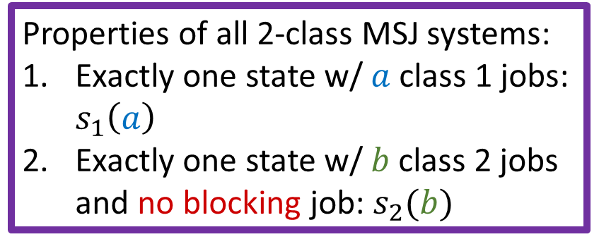
Saturated State Space Structure
Properties of all 2-class MSJ systems:
Exactly one state w/ $a$ class 1 jobs: $s_{1}\left(a\right)$
Exactly one state w/ $b$ class 2 jobs and no blocking job: $s_{2}(b)$
1,0,4
0,1,4
0,2,3
$b$: # class 2 in service
$$s_{2}\left(3\right)$$
1,3,2
0,4,2
0,5,1
1,6,0
0,7,0
$a$: # class 1 in service

Slide 26
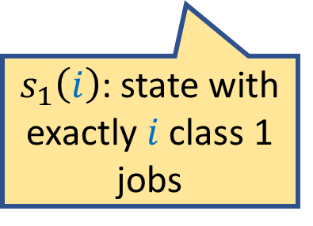
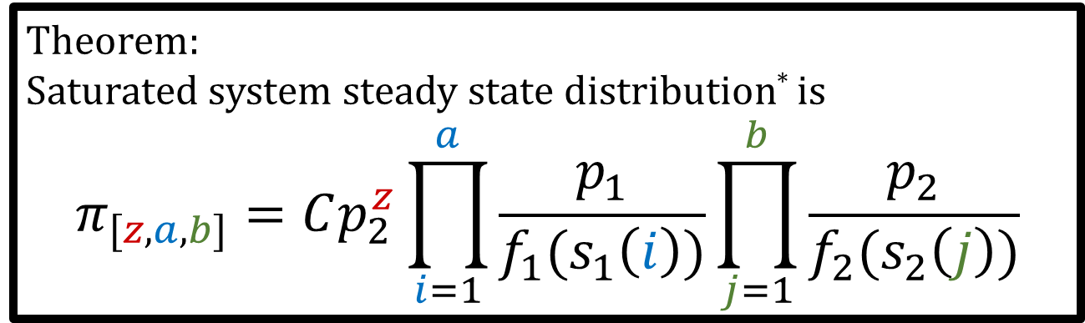
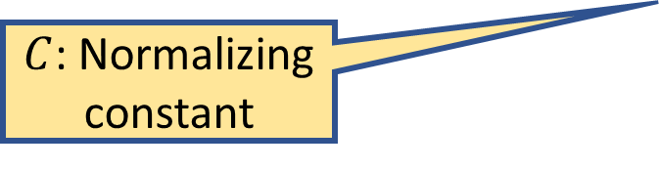
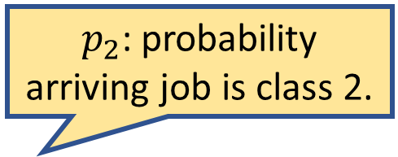
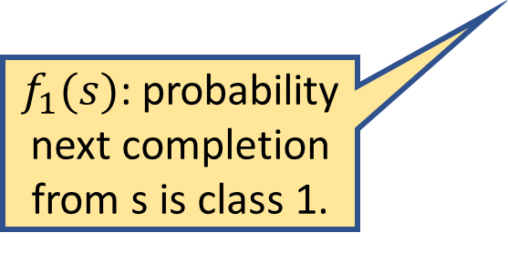
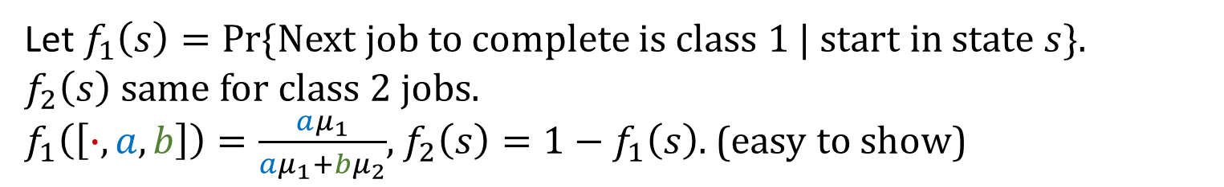

Our Steady State Result
$$n_{i}$$
# servers
i
Exp$(μ_{i})$
Duration
Let $f_{1}\left(s\right)=Pr⁡\{$Next job to complete is class 1 | start in state $s\}$.
$f_{2}\left(s\right)$same for class 2 jobs.
$f_{1}\left(\left[∙,a,b\right]\right)=\frac{aμ_{1}}{aμ_{1}+bμ_{2}}$, $f_{2}\left(s\right)=1−f_{1}\left(s\right)$. (easy to show)
Theorem:
Saturated system steady state distribution* is
$$π_{[z,a,b]}=Cp_{2}^{z}\prod_{i=1}^{a}{\frac{p_{1}}{f_{1}(s_{1}\left(i\right))}}\prod_{j=1}^{b}{\frac{p_{2}}{f_{2}(s_{2}\left(j\right))}}$$
$p_{2}$: probability arriving job is class 2.
$C$: Normalizing constant
$f_{1}(s)$: probability next completion from s is class 1.
$s_{1}\left(i\right)$: state with exactly $i$ class 1 jobs
$s_{2}\left(j\right)$: state with exactly $j$ class 2 jobs and no blocking job
* Specifically, steady state of the embedded chain.
Notes:
Remind all notation.
F2 same as f1
P1 same as p2
“Product form, prettiest kind of solution”
As beautiful and simple as it gets in queueing theory.
Formula is uniform over all possible choices of system parameter. As clean as possible.
Insight was defining the state space the right way: saturated system, discrete process
Mu_1 and mu_2 in f_1 and f_2, while n_1, n_2, k show up in which states exist, and s_1 and s_2.

Slide 27
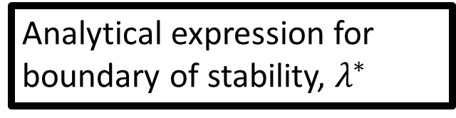
Our Stability Result
Q: For what arrival rates is the original system stable?
Analytical expression for boundary of stability, $λ^{∗}$
Analytical expression for Saturated System throughput
Analyze Saturated System throughput
Product-form steady-state expression for Saturated System
Notes:
Theorem labels from our paper
Proof is very nice, but I don’t have time to tell you about it here.

Slide 28
Outline
Introduce multiserver-job model
Introduce stability problem
Discuss waste
Prior results on stability
Introduce our specific model
Key idea: Saturated System
Elegant analytical results
Insights from results

Slide 29
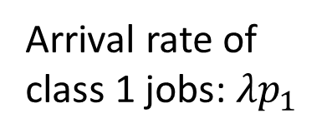
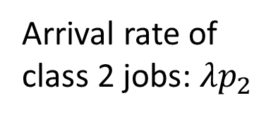
Insight: Average Waste can be High
$$n_{i}$$
# servers
i
Exp$(μ_{i})$
Duration
Setting: $n_{1}=1, μ_{1}=2, n_{2}=200, μ_{2}=1, k=200$
1
0.8
0.6
0.4
0.2
0
Idealized stability region without waste
Arrival rate of class 2 jobs: $λp_{2}$
Analytically-derived stability region
Loss due to waste
0 100 200 300 400
Q: Why so much waste?
Arrival rate of class 1 jobs: $λp_{1}$

Slide 30
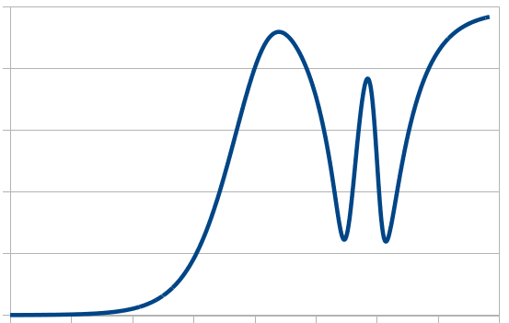
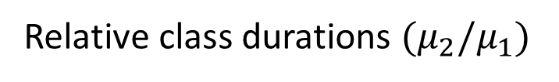
Insight: Waste can be Nonmonotonic
$$n_{i}$$
# servers
i
Exp$(μ_{i})$
Duration
Setting: $n_{1}=1, n_{2}=67, p_{1}=p_{2}=0.5, k=201$
100%
80%
60%
40%
20%
0%
Average waste, relative to max. possible waste
10⁻⁴ 10⁻² 1 10² 10⁴
Class 2 slower Same duration Class 1 slower
Relative class durations ${(μ}_{2}/μ_{1})$
Notes:
3 wiggles – 3 class 2s fit in the servers.

Slide 31

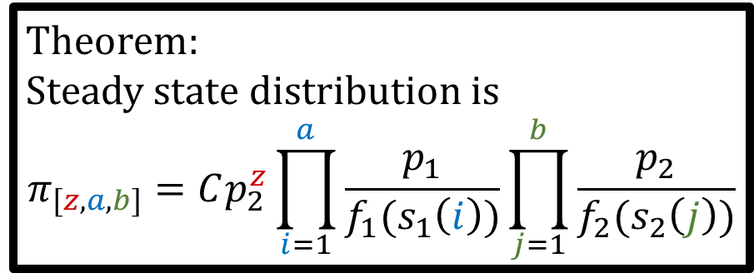
Conclusion & Future Directions
Derived analytical formula for stability for two-class multiserver-job systems.
Proof based on saturated system, gives beautiful product-form result.
Open problems:
Can we go beyond 2 classes?
Can we go beyond stability?
Can we go beyond FCFS?
Are there more product form solutions out there?
Theorem:
Steady state distribution is
$$π_{[z,a,b]}=Cp_{2}^{z}\prod_{i=1}^{a}{\frac{p_{1}}{f_{1}(s_{1}\left(i\right))}}\prod_{j=1}^{b}{\frac{p_{2}}{f_{2}(s_{2}\left(j\right))}}$$
pause

Slide 32

Backup: Saturated ⬄ Original Proof Sketch
Thus, If Saturated System’s throughput > λ, stable.

Slide 33
Backup: Other prior work
Dropping multiserver-job model: Fully general solutions by Arthurs and Kaufman ’79, Whitt ‘85, many more.
General scheduling (not just FCFS): Convex hull of all packings, by Maguluri et al. ’12, many more.

Slide 34
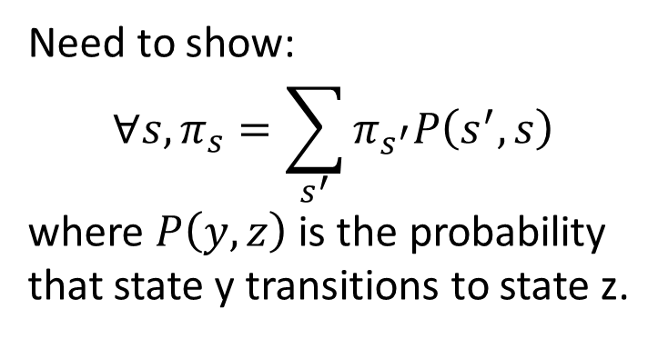
Backup: Proof Sketch: Stationary Equations
Need to show:
$$∀s, π_{s}=\sum_{s^{′}}{π_{s^{′}}P\left(s^{′},s\right)}$$
where $P\left(y,z\right)$ is the probability that state y transitions to state z.
1,6,0
0,7,0
0,5,1
1,3,2
0,4,2
0,2,3
1,0,4
0,1,4

Slide 35
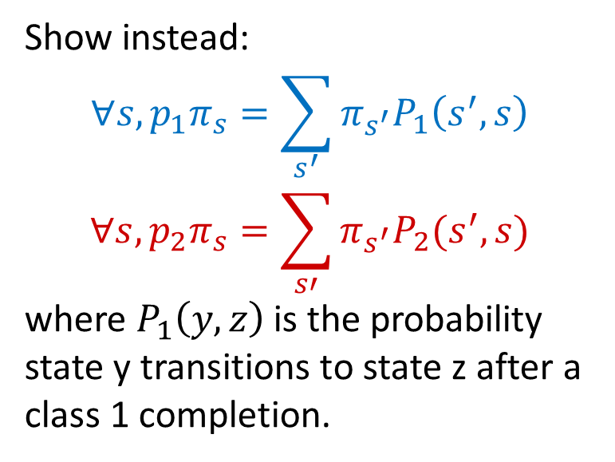
Key Idea: Decomposed Stationary Equations
Show instead:
$$∀s, {p_{1}π}_{s}=\sum_{s^{′}}{π_{s^{′}}P_{1}\left(s^{′},s\right)}$$
$$∀s, {p_{2}π}_{s}=\sum_{s′}{π_{s^{′}}P_{2}(s^{′},s)}$$
where $P_{1}\left(y,z\right)$is the probability state y transitions to state z after a class 1 completion.
1,6,0
0,7,0
0,5,1
1,3,2
0,4,2
0,2,3
1,0,4
0,1,4

