Slide 1


Bounds on M/G/k Scheduling Under Moderate Load
Izzy Grosof (Isaac) (they/she)
CMU $→$ Georgia Tech $→$ UIUC $→$ Northwestern IEMS
Ziyuan Wang (Northwestern IEMS)
Ziyuan Wang

Slide 2

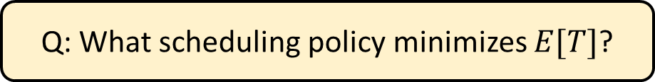




M/G/k Scheduling
Job duration $\sim S$, i.i.d.
Scheduling w/ known sizes
Load $ρ=λE[S]<1$
1/k
1/k
Poisson($λ$)
$$k$$
Response time $T$
Q: What scheduling policy minimizes $E[T]$?
Shortest Remaining Processing Time?

Slide 3
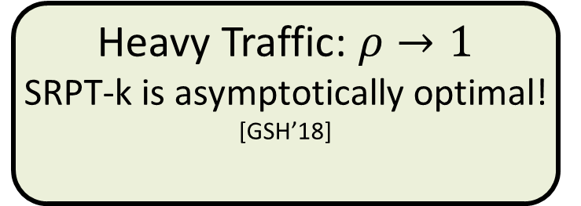

SRPT: Optimal?
SRPT-k
SRPT-k: k jobs with least remaining size.
SRPT-1 is always optimal [Schrage ‘68]. What about SRPT-k?
0
Load $ρ$
1
No arrivals:
SRPT-k is optimal! [McNaughton ’59] + [Conway et al. ’67]
Heavy Traffic: $ρ→1$
SRPT-k is asymptotically optimal! [GSH’18]
Medium load:
??????

Slide 4
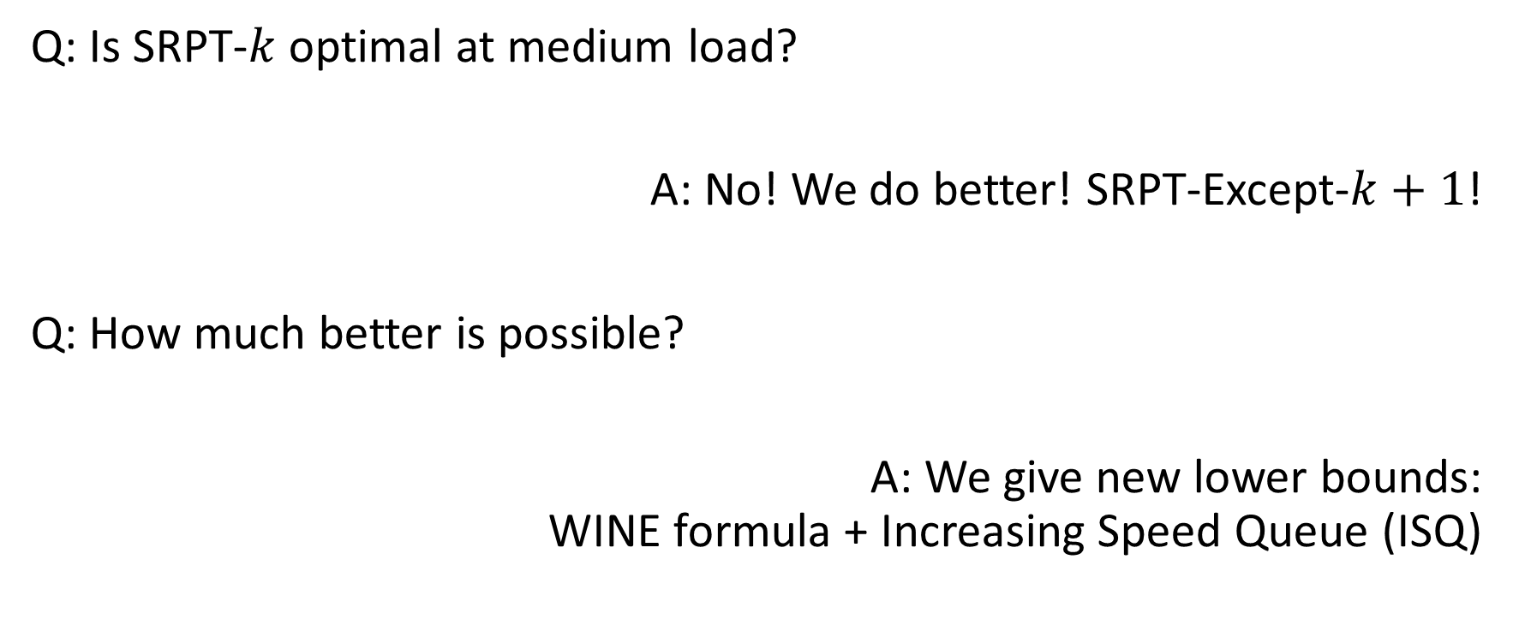
Questions of This Talk
Q: Is SRPT-$k$ optimal at medium load?
A: No! We do better! SRPT-Except-$k+1$!
Q: How much better is possible?
A: We give new lower bounds: WINE formula + Increasing Speed Queue (ISQ)

Slide 5
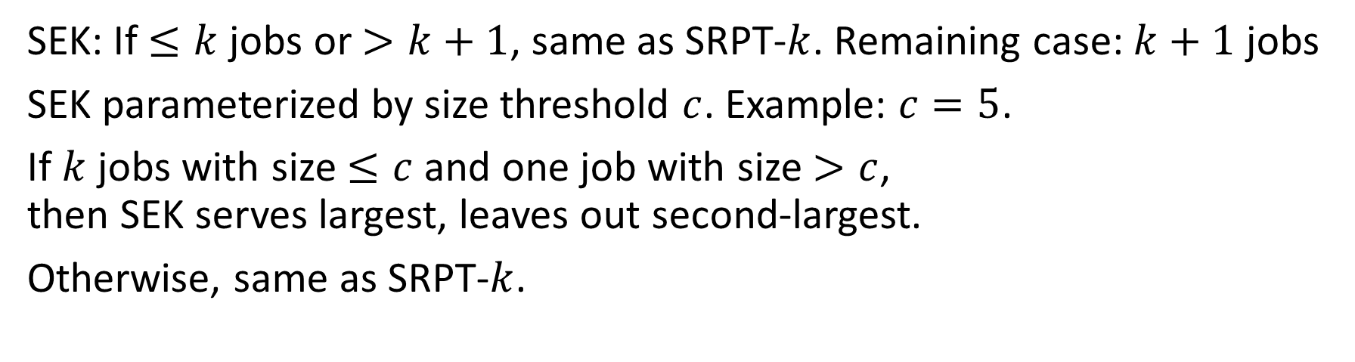

SRPT-Except-$k+1$ (SEK)
SRPT-k
SEK(5)
10
3
3
4
10
4
SEK: If $≤k$ jobs or $>k+1$, same as SRPT-$k$. Remaining case: $k+1$ jobs
SEK parameterized by size threshold $c$. Example: $c=5$.
If $k$ jobs with size $≤c$ and one job with size $>c$, then SEK serves largest, leaves out second-largest.
Otherwise, same as SRPT-$k$.

Slide 6
SEK Intuition
SRPT-k
SEK(5)
10
3
3
4
10
4
13
4
3
0
10
10
7
3
0
Time
Time
10
4
3
4
3
Servers
Servers
Total response time, no arrivals: SRPT: 3 + 4 + 13 = 20. SEK: 3 + 7 + 10 = 20
Time of first wasted capacity: SRPT: 4. SEK: 7.
SEK: “Same response time, might as well waste less”.

Slide 7
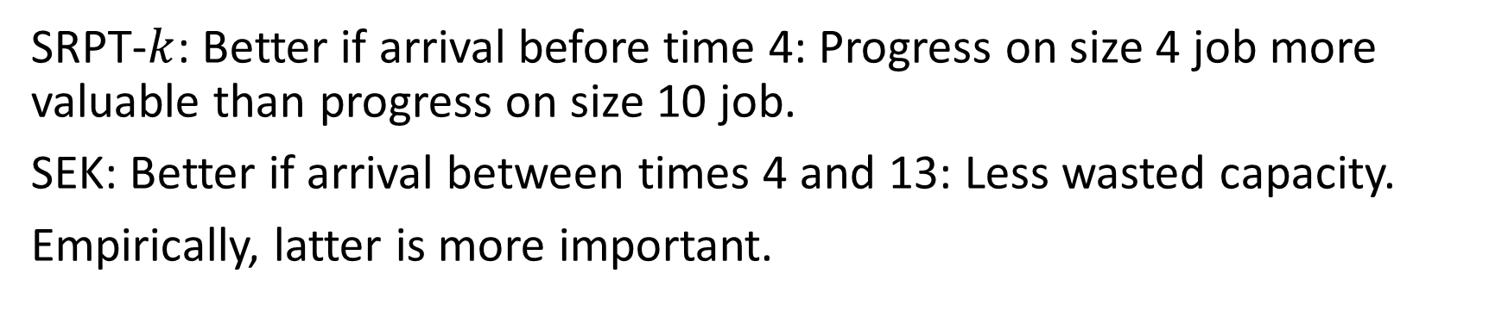
Further SEK Intuition
SRPT-k
SEK(5)
10
3
3
4
10
4
13
4
3
0
10
10
7
3
0
Time
Time
10
4
3
4
3
Servers
Servers
SRPT-$k$: Better if arrival before time 4: Progress on size 4 job more valuable than progress on size 10 job.
SEK: Better if arrival between times 4 and 13: Less wasted capacity.
Empirically, latter is more important.

Slide 8
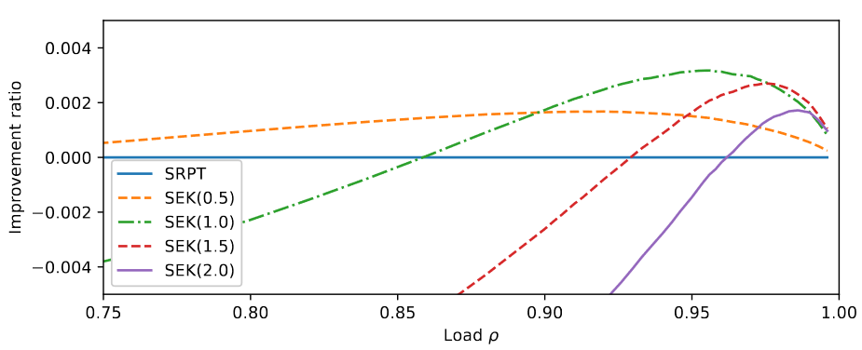



SEK Plot: Improvement over SRPT-$k$
Setting: M/M/2, size Exp(1). Improvement ratio: $1−\frac{E\left[T^{SEK}\right]}{E\left[T^{SRPT}\right]}$
$ρ≤0.996$ simulated

Slide 9

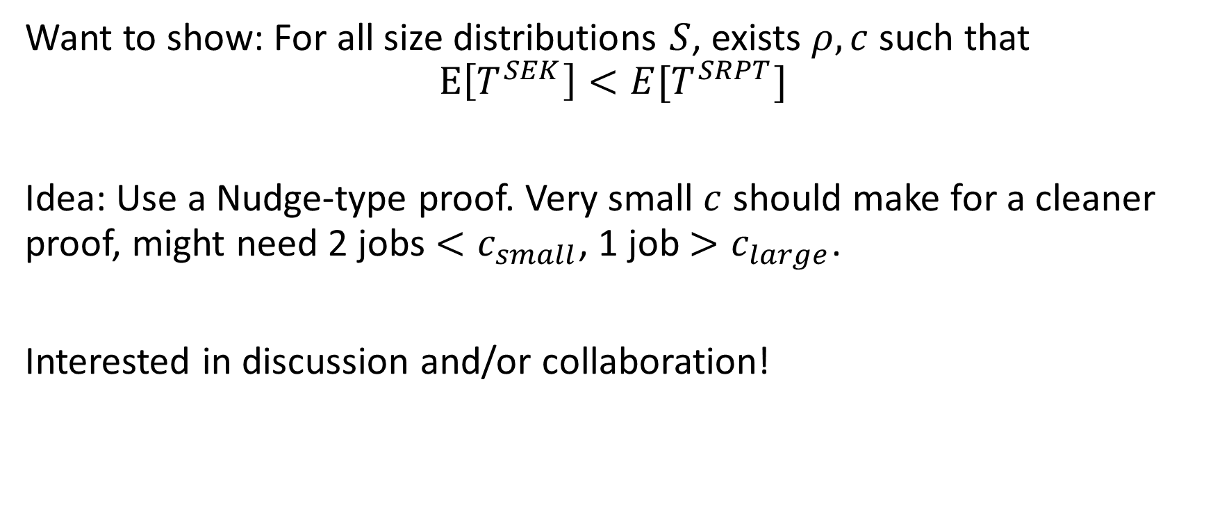
SEK Proof: Open
Want to show: For all size distributions $S$, exists $ρ, c$ such that $$E\left[T^{SEK}\right]<E[T^{SRPT}]$$
Idea: Use a Nudge-type proof. Very small $c$ should make for a cleaner proof, might need 2 jobs $<c_{small}$, 1 job $>c_{large}$.
Interested in discussion and/or collaboration!

Slide 10

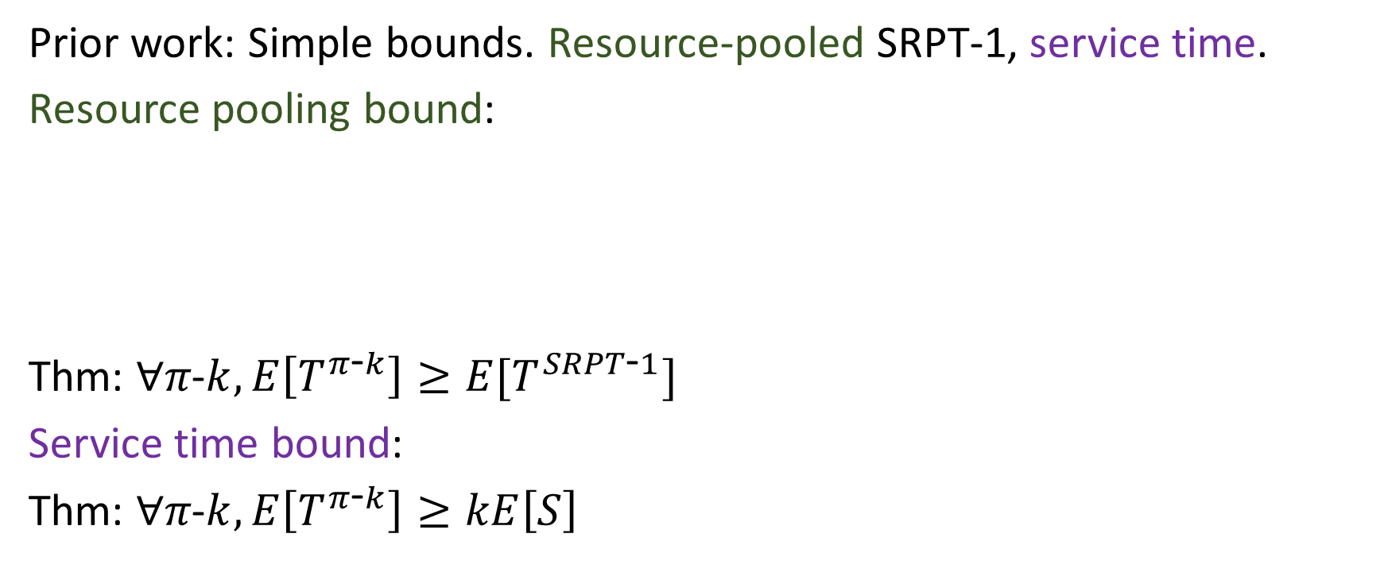
Lower bounds on M/G/k scheduling: Prior
Prior work: Simple bounds. Resource-pooled SRPT-1, service time.
Resource pooling bound:
Thm: $∀π\text{−}k, E\left[T^{π\text{−}k}\right]≥E[T^{SRPT\text{−}1}]$
Service time bound:
Thm: $∀π\text{−}k, E\left[T^{π\text{−}k}\right]≥kE\left[S\right]$
$$≥$$

Slide 11
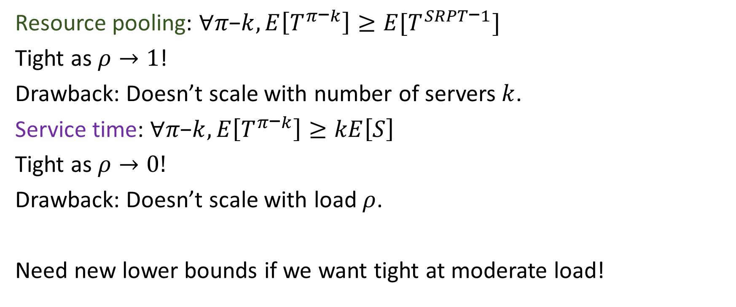
Lower Bounds: Prior - Drawbacks
Resource pooling: $∀π\text{−}k, E\left[T^{π\text{−}k}\right]≥E[T^{SRPT\text{−}1}]$
Tight as $ρ→1$!
Drawback: Doesn’t scale with number of servers $k$.
Service time: $∀π\text{−}k, E\left[T^{π\text{−}k}\right]≥kE\left[S\right]$
Tight as $ρ→0!$
Drawback: Doesn’t scale with load $ρ$.
Need new lower bounds if we want tight at moderate load!

Slide 12

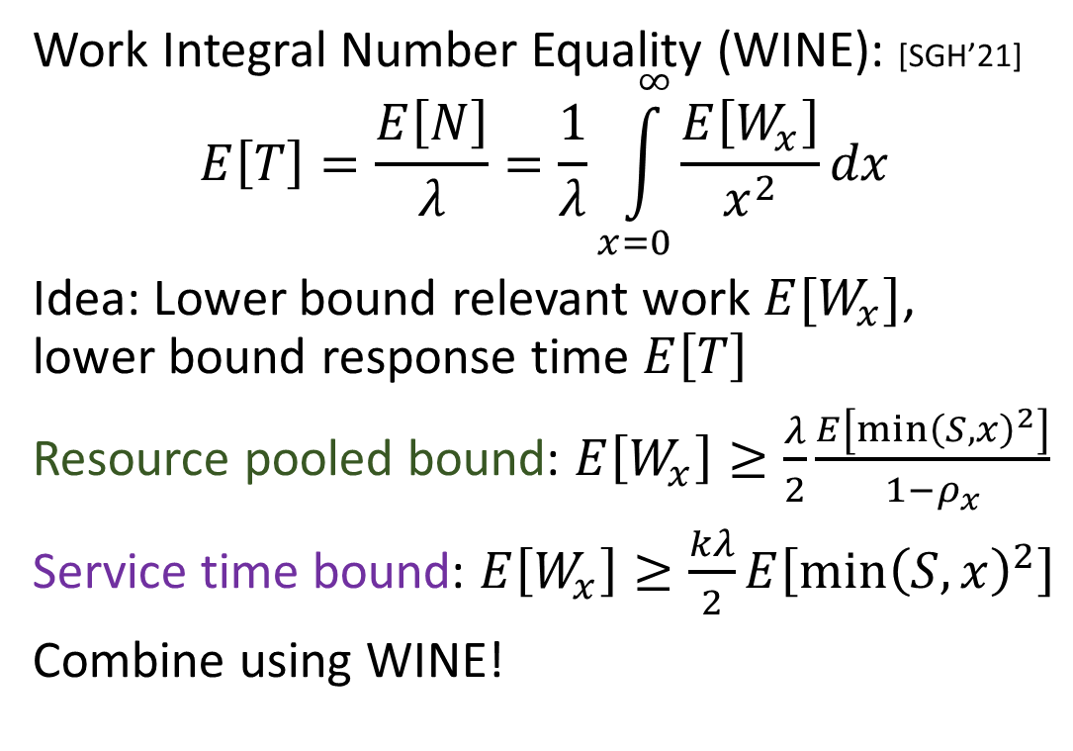
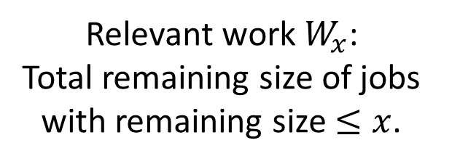
WINE for Lower Bounds
Work Integral Number Equality (WINE): [SGH’21]
$$E\left[T\right]=\frac{E\left[N\right]}{λ}=\frac{1}{λ}\int_{x=0}^{∞}{\frac{E\left[W_{x}\right]}{x^{2}}dx}$$
Idea: Lower bound relevant work $E[W_{x}]$, lower bound response time $E\left[T\right]$
Resource pooled bound: $E\left[W_{x}\right]≥\frac{λ}{2}\frac{E\left[\min{{\left(S,x\right)}^{2}}\right]}{1−ρ_{x}}$
Service time bound: $E\left[W_{x}\right]≥\frac{kλ}{2}E\left[{\min\left(S,x\right)}^{2}\right]$
Combine using WINE!
$$≤x$$
Relevant work $W_{x}$: Total remaining size of jobs with remaining size $≤x$.

Slide 13
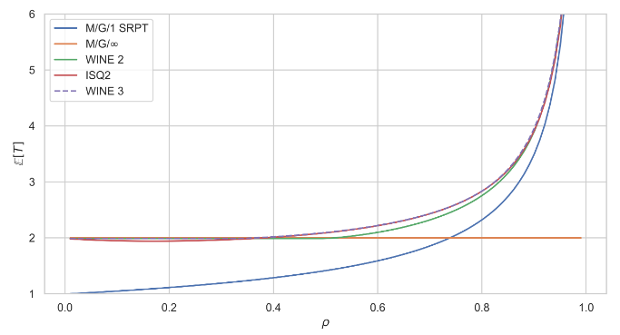

WINE Lower Bound: Plot
Resource pooled SRPT-1
Service time
WINE combination
Big improvement!
WINE
SRPT-1
Service
M/M/2, $E\left[S\right]=1$

Slide 14

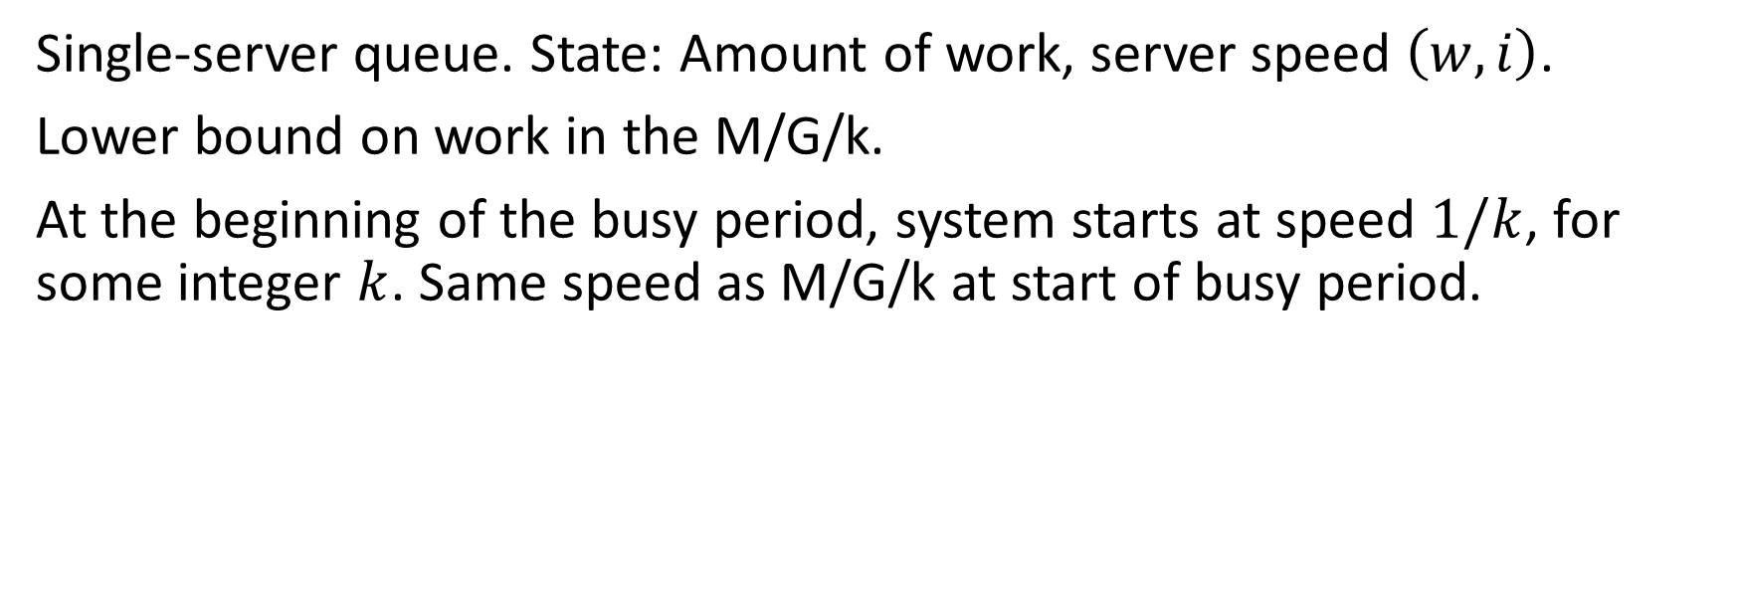
Increasing Speed Queue (ISQ)
$$(w=2.4,i=1/2)$$
Single-server queue. State: Amount of work, server speed $\left(w, i\right)$.
Lower bound on work in the M/G/k.
At the beginning of the busy period, system starts at speed $1/k$, for some integer $k$. Same speed as M/G/k at start of busy period.

Slide 15

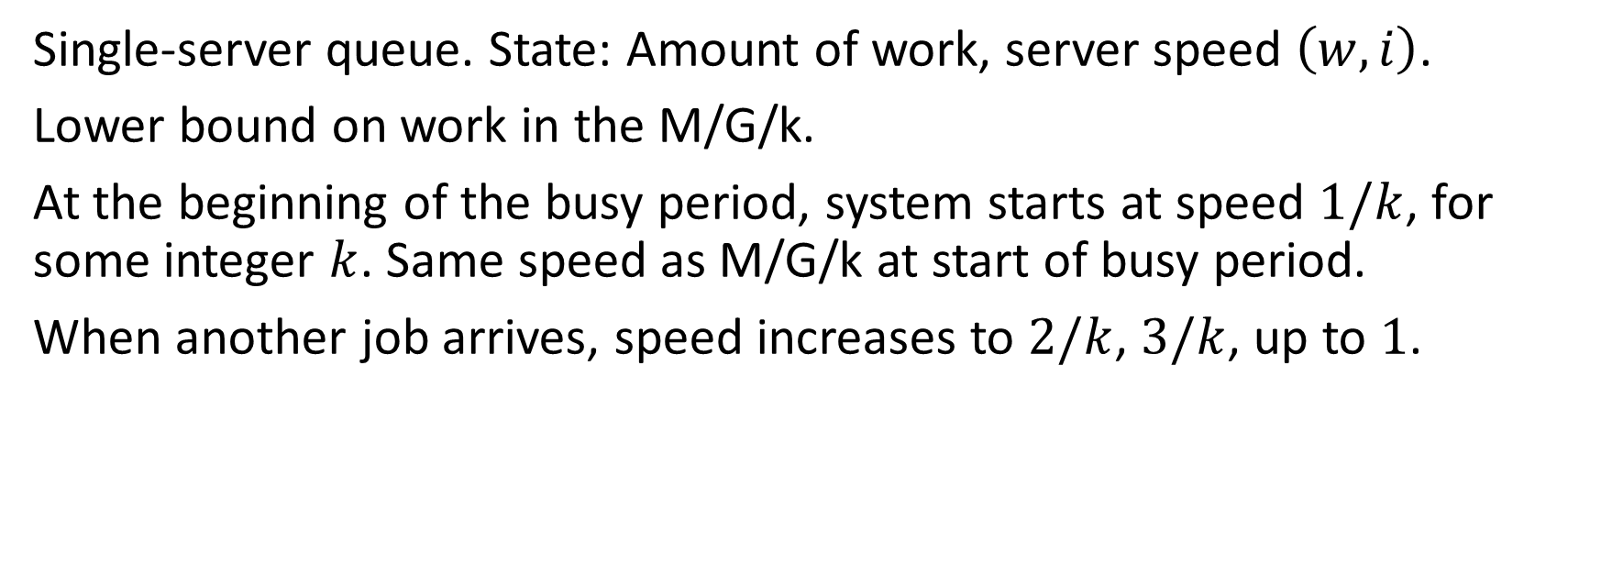
Increasing Speed Queue (ISQ)
$$(w=1.9,i=1/2)$$
Single-server queue. State: Amount of work, server speed $\left(w, i\right)$.
Lower bound on work in the M/G/k.
At the beginning of the busy period, system starts at speed $1/k$, for some integer $k$. Same speed as M/G/k at start of busy period.
When another job arrives, speed increases to $2/k$, $3/k$, up to $1$.

Slide 16

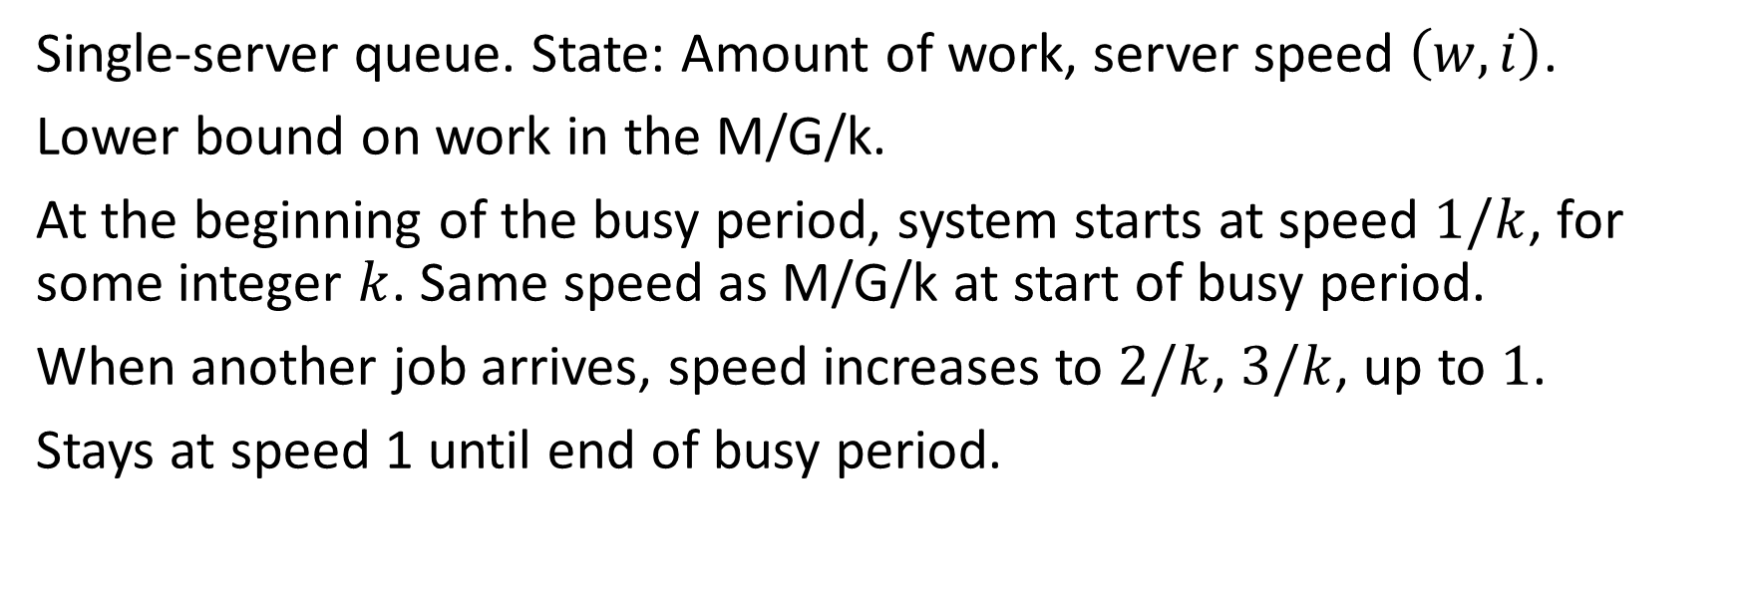
Increasing Speed Queue (ISQ)
$$(w=4.2,i=1)$$
Single-server queue. State: Amount of work, server speed $\left(w, i\right)$.
Lower bound on work in the M/G/k.
At the beginning of the busy period, system starts at speed $1/k$, for some integer $k$. Same speed as M/G/k at start of busy period.
When another job arrives, speed increases to $2/k$, $3/k$, up to $1$.
Stays at speed 1 until end of busy period.

Slide 17

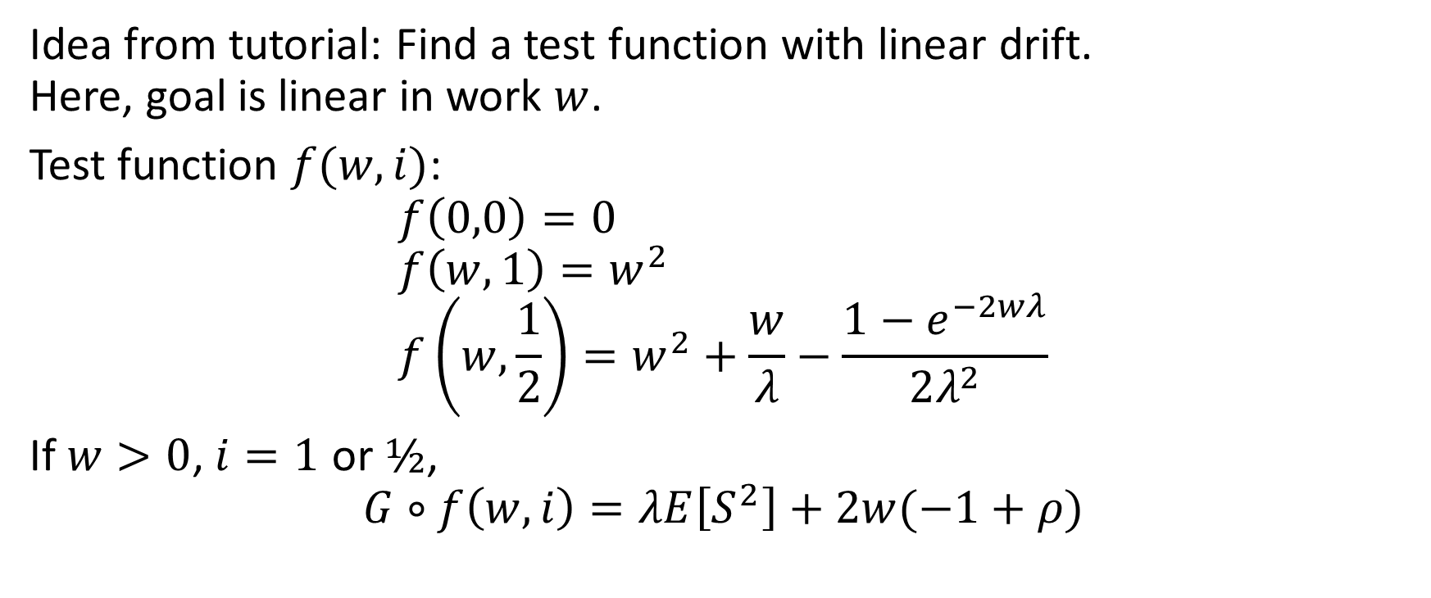
ISQ: Drift-based Analysis
Idea from tutorial: Find a test function with linear drift. Here, goal is linear in work $w$.
Test function $f(w, i)$:
$$f\left(0,0\right)=0 \\ f\left(w,1\right)=w^{2} \\ f\left(w,\frac{1}{2}\right)=w^{2}+\frac{w}{λ}−\frac{1−e^{−2wλ}}{2λ^{2}}$$
If $w>0$, $i=1$ or $½$, $$G∘f\left(w,i\right)=λE\left[S^{2}\right]+2w(−1+ρ)$$

Slide 18
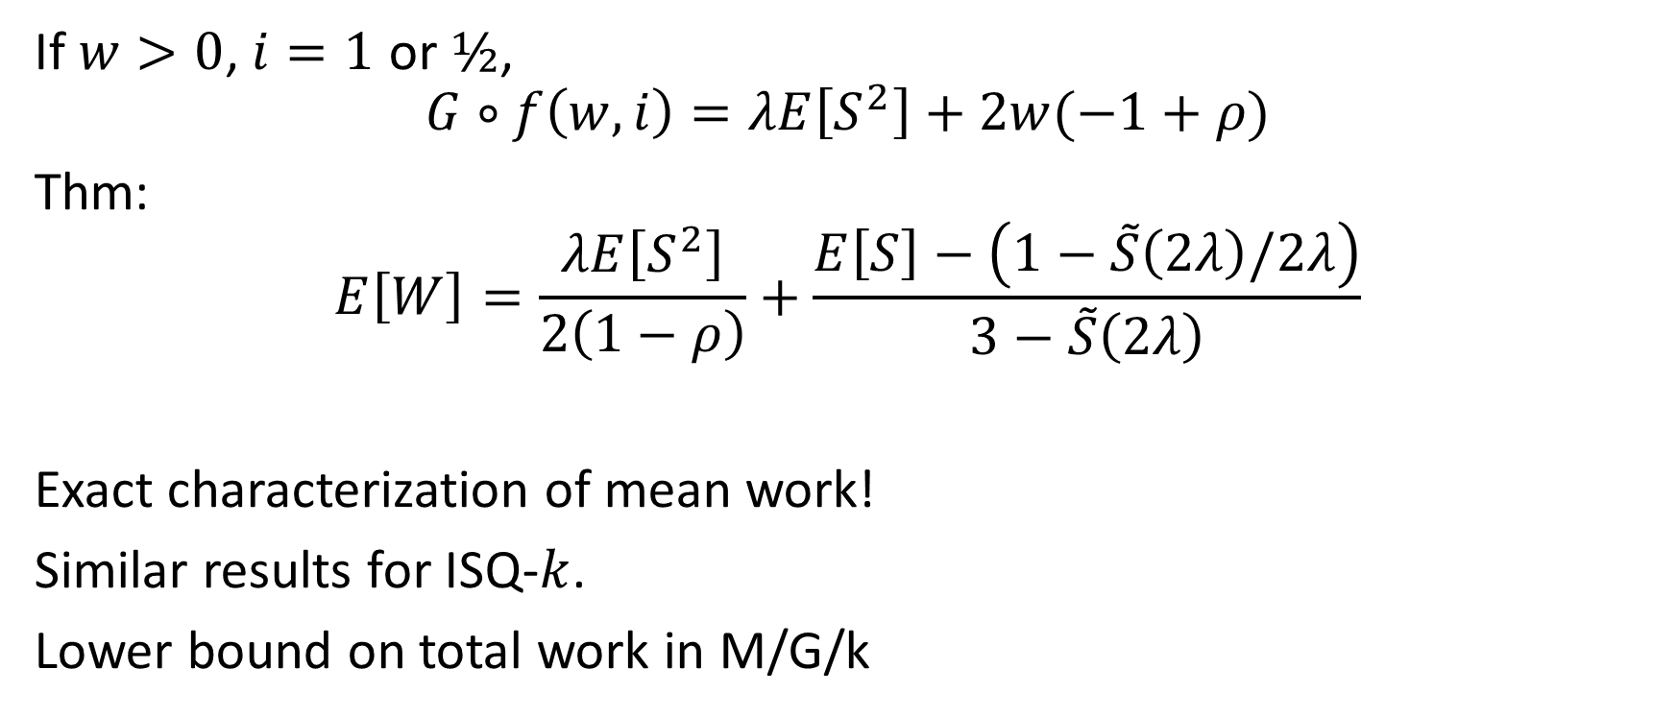
ISQ: Mean Work
If $w>0$, $i=1$ or $½$, $$G∘f\left(w,i\right)=λE\left[S^{2}\right]+2w(−1+ρ)$$
Thm:
$$E\left[W\right]=\frac{λE\left[S^{2}\right]}{2\left(1−ρ\right)}+\frac{E\left[S\right]−\left(1−\tilde{S}\left(2λ\right)/2λ\right)}{3−\tilde{S}\left(2λ\right)}$$
Exact characterization of mean work!
Similar results for ISQ-$k$.
Lower bound on total work in M/G/k

Slide 19

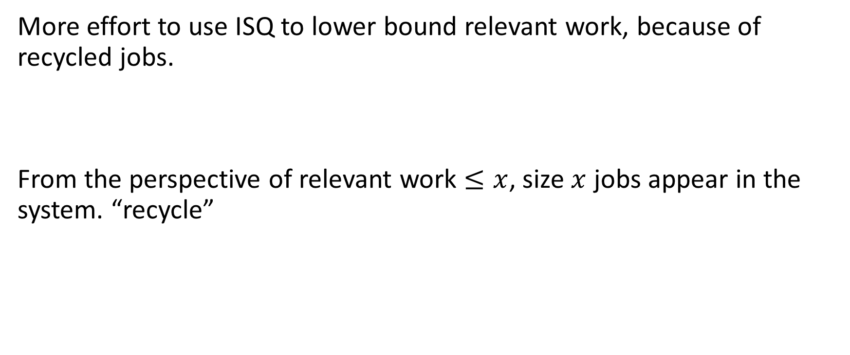
ISQ: Relevant Work Bounds
More effort to use ISQ to lower bound relevant work, because of recycled jobs.
From the perspective of relevant work $≤x$, size $x$ jobs appear in the system. “recycle”
$$≤x$$

Slide 20
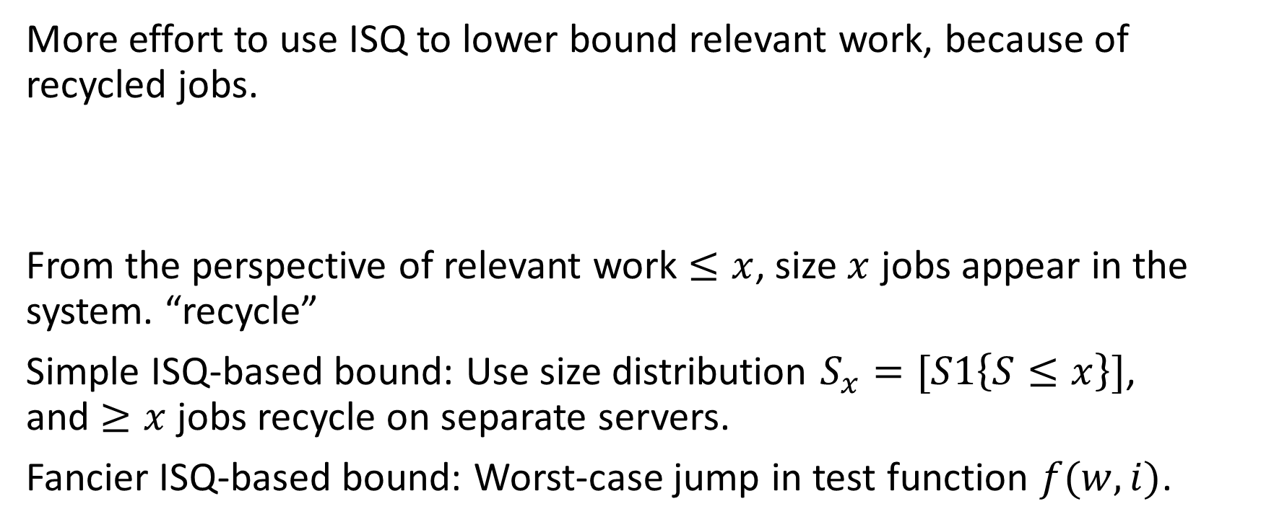
ISQ: Relevant Work Bounds
More effort to use ISQ to lower bound relevant work, because of recycled jobs.
From the perspective of relevant work $≤x$, size $x$ jobs appear in the system. “recycle”
Simple ISQ-based bound: Use size distribution $S_{x}=[S1\left\{S≤x\right\}]$, and $≥x$ jobs recycle on separate servers.
Fancier ISQ-based bound: Worst-case jump in test function $f(w, i)$.
$$≤x$$
=x

Slide 21

ISQ: Detailed relevant work bounds
Definitions: $λ_{x}=λF_{S}\left(x\right), S_{x}=\left[S | S≤x\right],$ $ρ_{x}=λ_{x}E\left[S_{x}\right] ,ρ_{\overline{x}}=λE[min\left(S, x\right)]$
Separate-servers ISQ:
$$E\left[W_{x}\right]≥\frac{λ_{x}E\left[S_{x}^{2}\right]}{2\left(1−ρ_{x}\right)}+\frac{E\left[S_{x}\right]−\left(1−\frac{\tilde{S_{x}}\left(2λ_{x}\right)}{2λ_{x}}\right)}{3−{\tilde{S}}_{x}\left(2λ_{x}\right)}+\left(λ−λ_{x}\right)x^{2}$$
Worst-case jump (recycling) ISQ:
$$E\left[W_{x}\right]≥\frac{λ_{x}E\left[S_{x}^{2}\right]}{2\left(1−ρ_{x}\right)}+\frac{E\left[S_{x}\right]−\left(1−\frac{\tilde{S_{x}}\left(2λ_{x}\right)}{2λ_{x}}\right)}{3−{\tilde{S}}_{x}\left(2λ_{x}\right)}\frac{1−ρ_{\overline{x}}}{1−ρ_{x}}+\frac{\left(λ−λ_{x}\right)x^{2}}{2\left(1−ρ_{x}\right)}$$
ISQ
Recycling
ISQ
Recycling

Slide 22
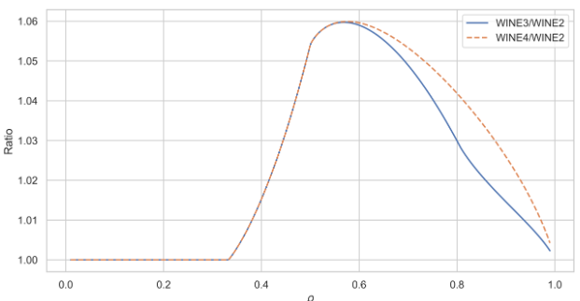
Stronger response time lower bounds
Red: Simple ISQ bound. Purple: Combine all 3 with WINE.
Improvement of WINE 3 over WINE 2. WINE 4: Add in fancy ISQ bound.

Slide 23
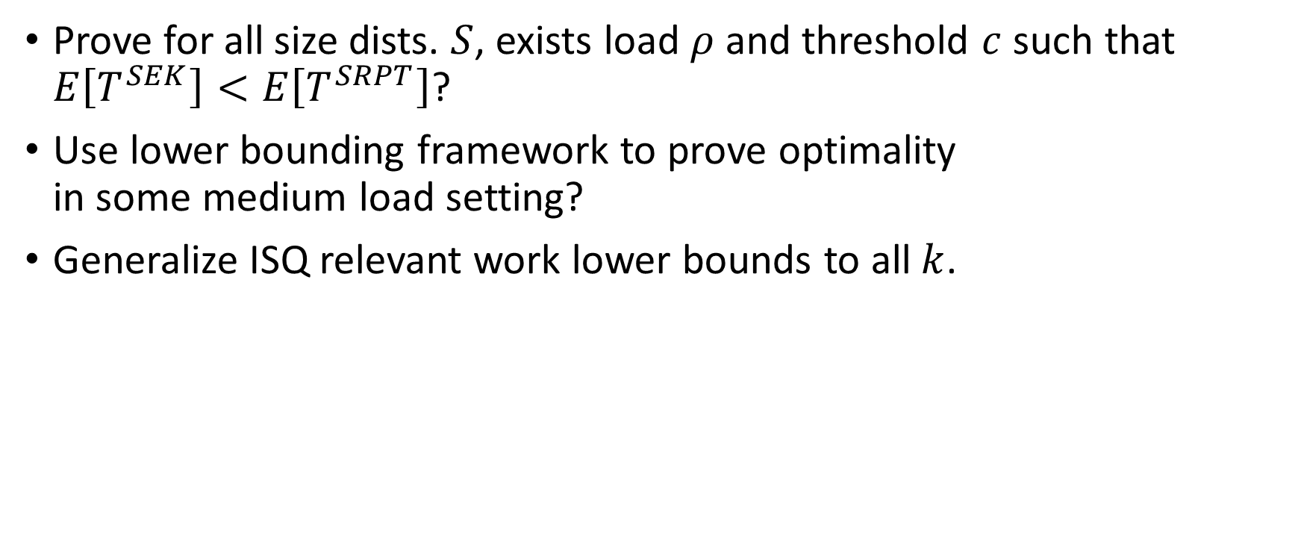
Future Directions
Prove for all size dists. $S$, exists load $ρ$ and threshold $c$ such that $E\left[T^{SEK}\right]<E\left[T^{SRPT}\right]$?
Use lower bounding framework to prove optimality in some medium load setting?
Generalize ISQ relevant work lower bounds to all $k$.

Slide 24
Conclusion
SRPT-k
SEK(5)
10
3
3
4
10
4

Slide 25
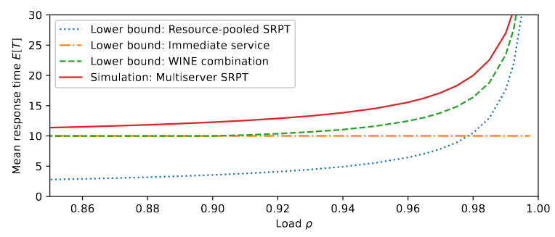
Bonus: Lower bound comparison to SRPT-k
M/M/10

