Slide 1
Nudge: Stochastically Improving Upon FCFS
Isaac Grosof – CMU
Kunhe Yang – Tsinghua University
Ziv Scully – CMU
Mor Harchol-Balter – CMU

Slide 2
M/G/1 Scheduling
Poisson arrivals, arrival rate: λ
General job size distribution: S, i.i.d.
Response time: T
Q: How should we schedule?

Slide 3
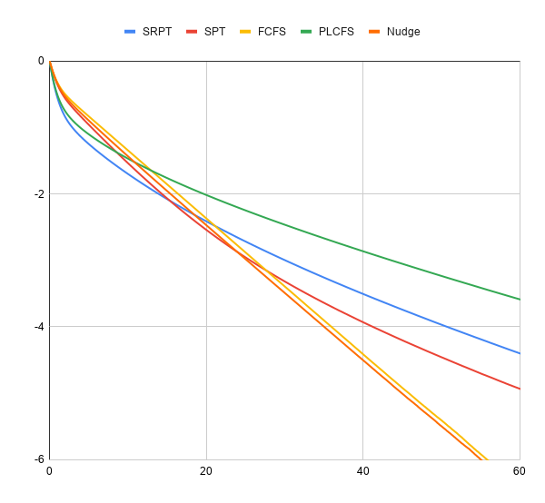
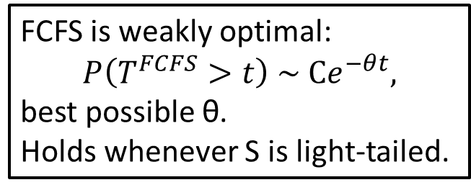
Baseline: First-Come First-Served
FCFS: Simple, practical, good theoretical properties
Threshold t
0 20E[S] 40E[S] 60E[S]
1
FCFS is weakly optimal:
$$P\left(T^{FCFS}>t\right) \sim Ce^{−θt},$$
best possible θ.
Holds whenever S is light-tailed.
10⁻²
Tail prob.
P(T>t)
PLCFS
10⁻⁴
Tradeoff
SRPT
SPT
10⁻⁶
FCFS
Weakly optimal!
Setting: S ~ Hyperexponential with C² =3, ρ=0.4
Notes:
Light tailed: exponential, hyperexponential phase type, Weibull, etc.

Slide 4
FCFS versus SRPT
FCFS
FCFS: Large or small, similar response time

Slide 5
FCFS versus SRPT
SRPT
L
L
S
FCFS: Large or small, similar response time

Slide 6
FCFS versus SRPT
SRPT
L
L
FCFS: Large or small, similar response time

Slide 7
FCFS versus SRPT
SRPT
L
L
S
FCFS: Large or small, similar response time
Notes:
Really fundamental question

Slide 8
FCFS versus SRPT
SRPT
L
L
S
S
FCFS: Large or small, similar response time
SRPT:
Helps small jobs, better P(T>t) for small t.
Delays large jobs, worse P(T>t) for large t.
Notes:
Really fundamental question

Slide 9

Fundamental question of tradeoffs
All previous policies have tradeoffs:
Better than FCFS at small t, worse than FCFS at large t.
Is that inevitable?
Is it possible to beat FCFS everywhere? ($∀t$)
Yes, with Nudge!
Notes:
Can we overcome the tradeoffs?

Slide 10
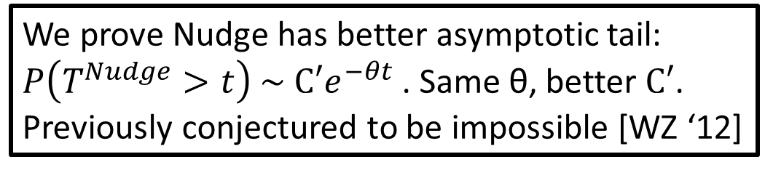
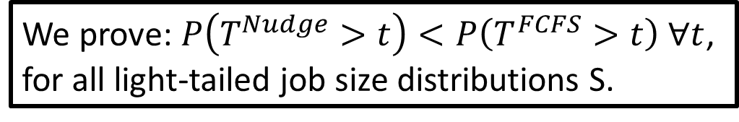
Nudge: Stochastic Improvement
We introduce a new policy: Nudge
Threshold t
0 20E[S] 40E[S] 60E[S]
1
We prove: $P\left(T^{Nudge}>t\right)<P\left(T^{FCFS}>t\right) ∀t$,
for all light-tailed job size distributions S.
10⁻²
We prove Nudge has better asymptotic tail: $P\left(T^{Nudge}>t\right) \sim C′e^{−θt}$. Same θ, better $C′$.
Previously conjectured to be impossible [WZ ‘12]
Tail prob.
P(T>t)
10⁻⁴
12% improvement
10⁻⁶
FCFS
Nudge
Setting: S ~ Hyperexponential with C² =3, ρ=0.4
Notes:
Weak optimality

Slide 11
Our contribution: Nudge
S
L
S
S
Default: FCFS
Classify jobs as small or large by size
When small arrives, if large is last in queue,
small nudges ahead of large
Small
Large
Job size distribution

Slide 12
Our contribution: Nudge
S
Nudged!
L
L
S
S
S
Default: FCFS
Classify jobs as small or large by size
When small arrives, if large is last in queue,
small nudges ahead of large
Large can only be nudged once.
Small
Large
Job size distribution

Slide 13
Our contribution: Nudge
Nudged!
L
L
S
S
S
S
Default: FCFS
Classify jobs as small or large by size
When small arrives, if large is last in queue,
small nudges ahead of large
Large can only be nudged once.
Small
Large
Job size distribution

Slide 14






Nudge intuition: Jack and the Giant
Nudge policy: Jack gets to go ahead of the giant,
Notes:
Bunch of people in line: Some humans, some giants. Jack comes along.
Needs to sell his cow at the market – not messing around with any magic beans.
Nudge policy says: Go ahead, Jack, the giant will barely notice.

Slide 15
Nudge intuition: Jack and the Giant
Nudge policy: Jack gets to go ahead of the giant,
Nudge policy: Jack gets to go ahead of the giant, but nobody else gets to.
Notes:
Nudge policy says: Go ahead, Jack, the giant will barely notice.
But then come some of Jack’s friends, who also want to go ahead of the giant.
And the giant is getting angry just thinking of all these humans slowing him down.
So Nudge says: No more. Only one little human goes ahead of the giant.
This is in contrast to a policy like SRPT, where all the little humans would go ahead of the giant, making the giant angry and ruining our tail performance. Nudge is gentle.

Slide 16


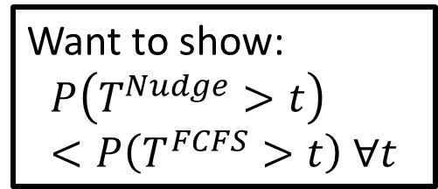
Proof intuition
FCFS
Want to show:
$$P\left(T^{Nudge}>t\right)<P\left(T^{FCFS}>t\right) ∀t$$
L
…
S
2
# Jobs with T > t
1
0
$$T_{Small}^{FCFS}$$
$$T_{Large}^{FCFS}$$
Threshold t

Slide 17


Proof intuition
Nudge
Nudged!
Want to show:
$$P\left(T^{Nudge}>t\right)<P\left(T^{FCFS}>t\right) ∀t$$
L
…
S
Nudge improves!
Nudge degrades
2
# Jobs with T > t
1
0
$$T_{Small}^{Nudge}$$
$$T_{Small}^{FCFS}$$
$$T_{Large}^{FCFS}$$
$$T_{Large}^{Nudge}$$
Threshold t

Slide 18
Proof intuition: One t, many nudges
t
T
Threshold t
Want to show: Rate of improve exceeds degrade.
Key idea 1: Rates of improve and degrade determined by FCFS tail and pdf.
Key idea 2: Bound FCFS tail and pdf relative to limiting exponential.
Bounds imply more improve than degrade, given correct small and large cutoffs.
Tail prob.
P(T>t)
FCFS
Notes:
FCFS’s tail is well understood.
Lower bound implies improve often, Upper bound implies degrade rarely.

Slide 19
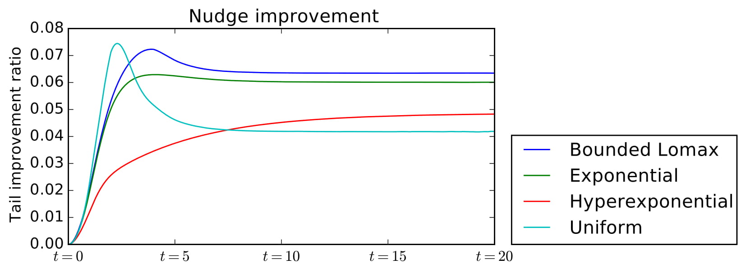
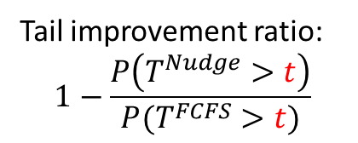
Empirical results
8%
Bounded Lomax
6%
Exponential
Tail improvement ratio:
$$1−\frac{P\left(T^{Nudge}>t\right)}{P(T^{FCFS}>t)}$$
Hyperexponential
4%
Uniform
2%
0
0 5E[S] 10E[S] 15E[S] 20E[S]
Threshold t
Load ρ=0.8
Notes:
How much better Nudge is than FCFS

Slide 20
Future directions
What about 2+ swaps per job? Constant # is important.
What range of size cutoffs work?
Single threshold, all jobs either large or small?
Beyond FCFS, what other policies can be improved everywhere?
Current cutoffs:
Future result?
Small
Large
Small
Large
Job size distribution
Job size distribution

Slide 21
Conclusion
Introduce policy called Nudge.
First policy to achieve stochastic improvement over FCFS, for any light-tailed job size distribution.
First policy to achieve multiplicative asymptotic improvement over FCFS.
8%
Bounded Lomax
S
Exponential
6%
Hyperexponential
L
4%
Uniform
S
S
2%
0
0 5E[S] 10E[S] 15E[S] 20E[S]
Notes:
Which works by giving small jobs just a little bit of priority over large jobs.

