Slide 1
Optimal Scheduling in the Multiserver-job Model
Isaac Grosof (CMU)
Ziv Scully, Mor Harchol-Balter, Alan Scheller-Wolf

Slide 2




Scheduling in computing
Scheduling Matters
Databases
Webservers
Network Switches
Processor
Notes:
Databases
Web servers
Switches
Processors

Slide 3
Two Models of Scheduling
Worst Case
Adversarially chosen jobs, arrival times
Negative results: NP-hard, unbounded competitive ratio.
Stochastic
Randomly distributed jobs, arrival times
Many open problems.

Slide 4
Stochastic Model
Arrivals: many independent arrival sequences
Service time
Time
…

Slide 5
Stochastic Model
Arrivals: many independent arrival sequences
Large-scale limit:
Arrivals form Poisson process
i.i.d. service times
Service time
Time

Slide 6




Basic Queueing Model: Background
Job duration $\sim S$, i.i.d.
Load $ρ=λE[S]<1$
Poisson($λ$)
Response time $T$
Notes:
Server
Queue
Jobs
Size
Minimize mean response time
Organize
SRPT
Worst case is great when it works

Slide 7
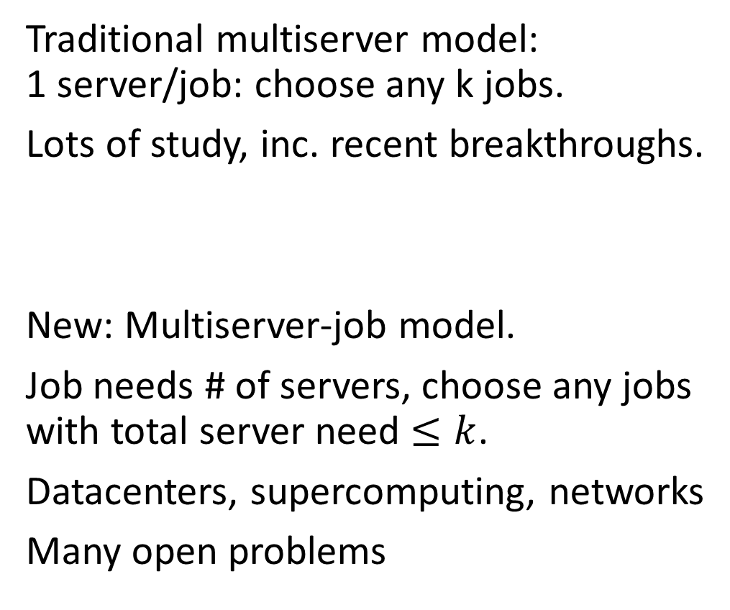
Multiserver Scheduling Models
Traditional multiserver model: 1 server/job: choose any k jobs.
Lots of study, inc. recent breakthroughs.
New: Multiserver-job model.
Job needs # of servers, choose any jobs with total server need $≤k$.
Datacenters, supercomputing, networks
Many open problems
k

Slide 8
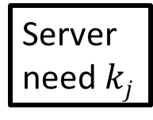
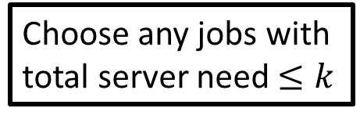
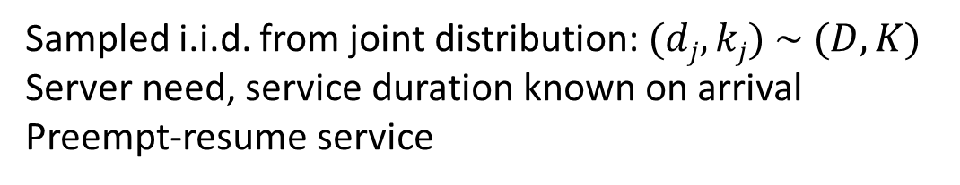

Multiserver-job model
Size = need * duration
Ex: 16 CPUs * 3 hours = 48 CPU-hours
Server need $kj$
j
Service duration $dj$
Choose any jobs with total server need $≤k$
Sampled i.i.d. from joint distribution: $(dj, kj) \sim (D, K)$
Server need, service duration known on arrival
Preempt-resume service
Notes:
CPU-hours

Slide 9
Prior Stochastic Work on Multiserver-job Model
Throughput
Naïve and heuristic policies: [Brill & Green, ‘84], [Rumyantsev & Morozov ‘18], etc.
Throughput-optimal policies: MaxWeight [Maguluri & Srikant ‘12], Randomized Timers [Psychas & Ghaderi ‘18]
Vast majority of prior work.
Mean response time E[T]
No prior policies for which E[T] is understood.
Wasteful policies: inherently hard. Prior throughput-optimal policies: too complicated
Notes:
Packing is NP-hard
MaxWeight has appeared in other contexts, specialized here.

Slide 10
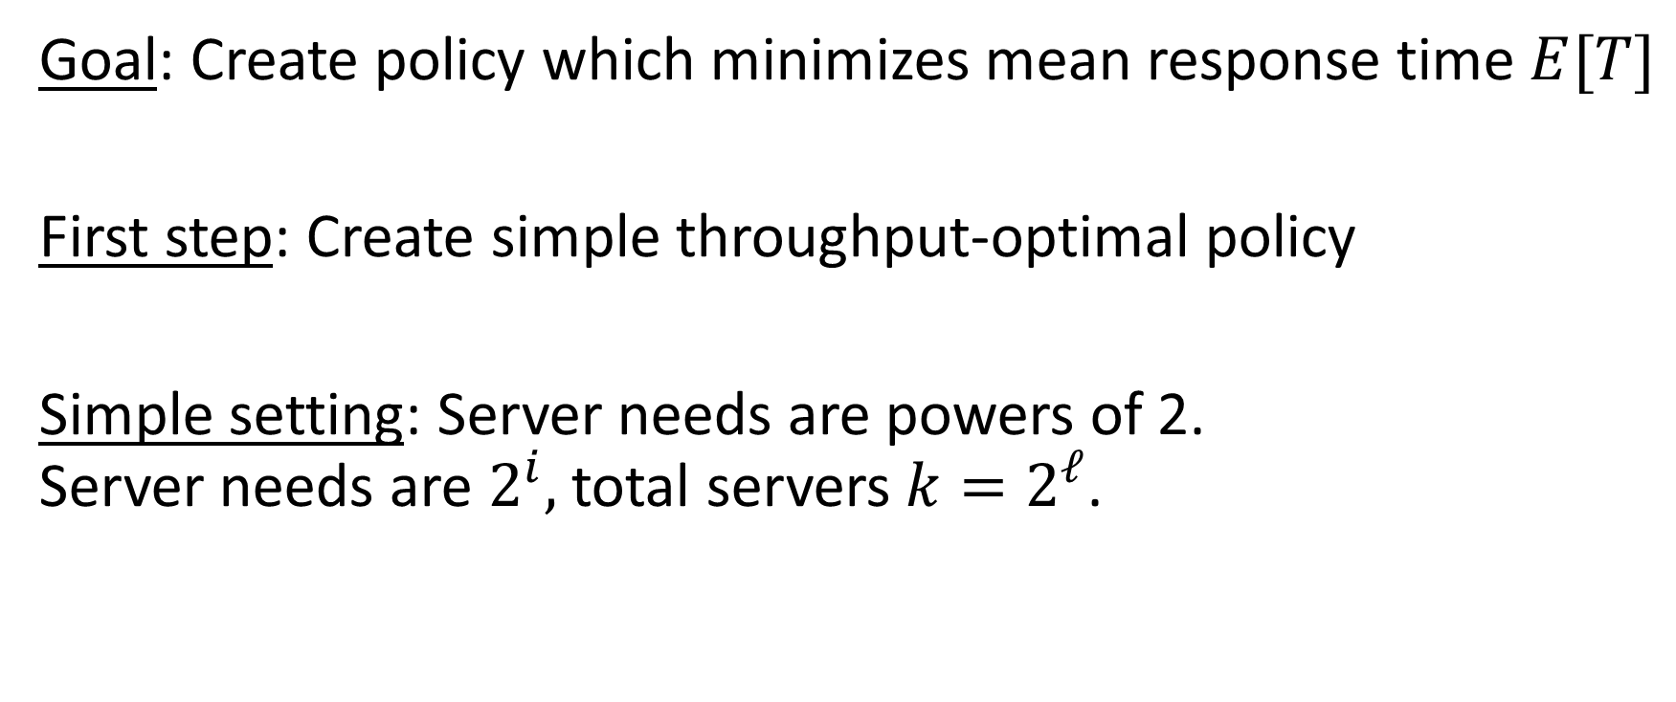
Outline
Goal: Create policy which minimizes mean response time $E[T]$
First step: Create simple throughput-optimal policy
Simple setting: Server needs are powers of 2. Server needs are $2^{i},$ total servers $k=2^{ℓ}$.
Notes:
With the hope that we can then understand mean response time, and from there minimize it.
This is a practical setting – supercomputers.

Slide 11
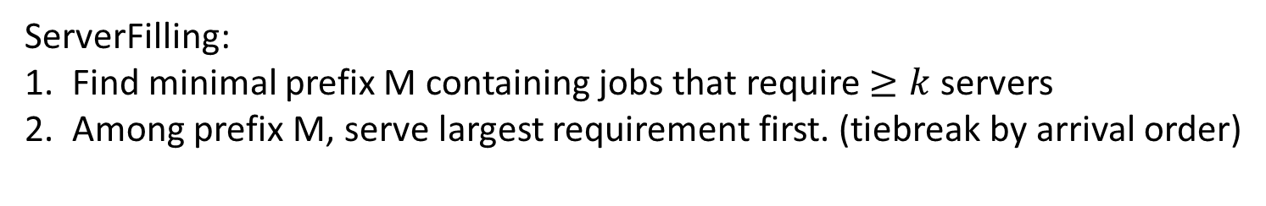
Define ServerFilling
M
Arrival order
4
k=8
2
2
2
2
1
1
1
1
1
2
1
1
1
ServerFilling:
Find minimal prefix M containing jobs that require $≥k$servers
Among prefix M, serve largest requirement first. (tiebreak by arrival order)

Slide 12
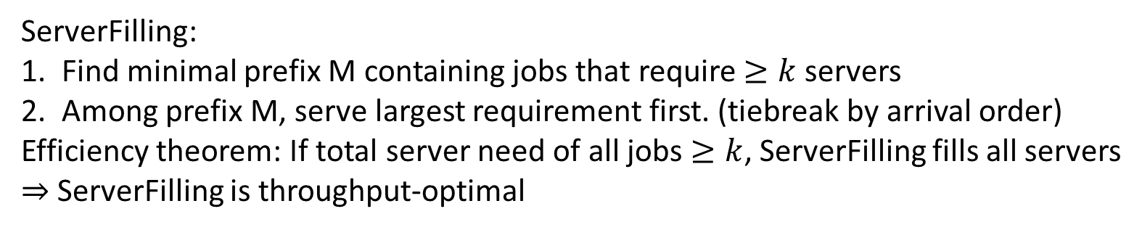
Define ServerFilling
M
4
Arrival order
k=8
2
2
2
2
2
1
1
1
1
1
2
1
1
1
1
1
ServerFilling:
Find minimal prefix M containing jobs that require $≥k$servers
Among prefix M, serve largest requirement first. (tiebreak by arrival order)
Efficiency theorem: If total server need of all jobs $≥k$, ServerFilling fills all servers
$⇒$ ServerFilling is throughput-optimal
Server need is power of 2

Slide 13

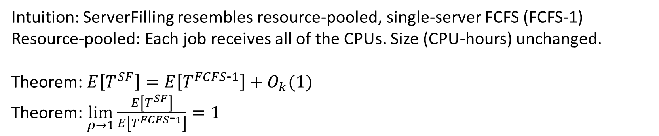
Understand E[T] for ServerFilling
Size = need * duration
Server need
1/k
1/k
1/k
1/k
1/k
1/k
1/k
1/k
Service duration
ServerFilling
FCFS-1
$$⟺$$
1
Intuition: ServerFilling resembles resource-pooled, single-server FCFS (FCFS-1)
Resource-pooled: Each job receives all of the CPUs. Size (CPU-hours) unchanged.
Theorem: $E\left[T^{SF}\right]=E\left[T^{FCFS\text{‐}1}\right]+O_{k}(1)$
Theorem: $\lim_{ρ→1}\frac{E\left[T^{SF}\right]}{E\left[T^{FCFS\text{‐}1}\right]}=1$

Slide 14

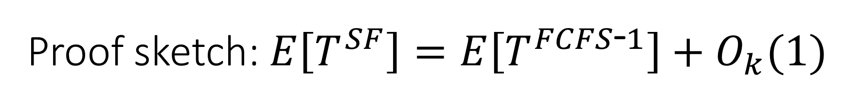
Proof sketch: $E\left[T^{SF}\right]=E\left[T^{FCFS\text{‐}1}\right]+O_{k}(1)$
Work W: Total remaining size of all jobs
1. $E\left[T^{SF}\right]=E\left[W^{SF}\right]+O_{k}\left(1\right)$ (And $E\left[T^{FCFS\text{‐}1}\right]=E\left[W^{FCFS\text{‐}1}\right]+O(1)$)
2. $E\left[W^{SF}\right]=E\left[W^{FCFS\text{‐}1}\right]+O_{k}(1)$
Size = need * duration
Server need
Service duration

Slide 15

Intuition: $E\left[T^{SF}\right]=E\left[W^{SF}\right]+O_{k}\left(1\right)$
4
4
*
2
2
2
2
2
1
1
1
1
1
2
1
1
1
2
Response time T
Notes:
For FCFS-1, the same reasoning applies.

Slide 16
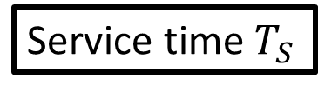
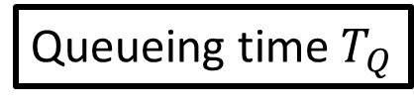
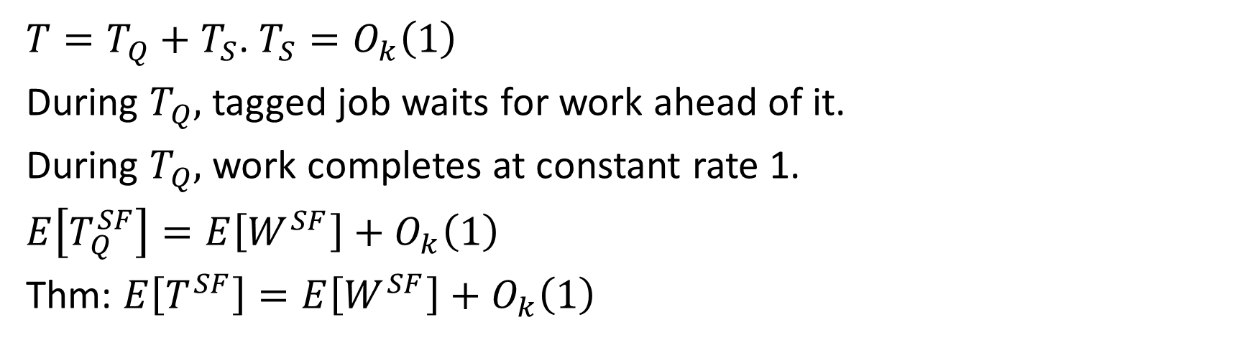
Intuition: $E\left[T^{SF}\right]=E\left[W^{SF}\right]+O_{k}\left(1\right)$
4
4
*
2
2
2
2
2
1
1
1
1
1
2
1
1
1
2
Queueing time $T_{Q}$
$T=T_{Q}+T_{S}$. $T_{S}=O_{k}\left(1\right)$
During $T_{Q},$ tagged job waits for work ahead of it.
During $T_{Q},$ work completes at constant rate 1.
$E\left[T_{Q}^{SF}\right]=E\left[W^{SF}\right]+O_{k}\left(1\right)$
Thm: $E\left[T^{SF}\right]=E\left[W^{SF}\right]+$ $O_{k}\left(1\right)$
Service time $T_{S}$
Notes:
For FCFS-1, the same reasoning applies.

Slide 17
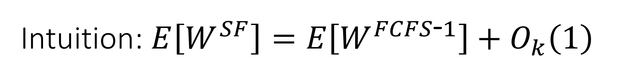
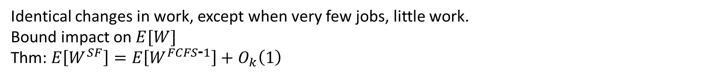
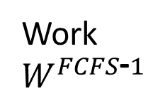
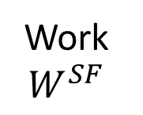
Intuition: $E\left[W^{SF}\right]=E\left[W^{FCFS\text{‐}1}\right]+O_{k}\left(1\right)$
ServerFilling
FCFS-1
Job arrives
Work at rate 1
Work $W^{SF}$
Work $W^{FCFS\text{‐}1}$
Too few jobs: lower rate
Time
Time
Identical changes in work, except when very few jobs, little work.
Bound impact on $E[W]$
Thm: $E\left[W^{SF}\right]=E\left[W^{FCFS\text{‐}1}\right]+O_{k}\left(1\right)$

Slide 18

Outline
Goal: Create policy which minimizes mean response time $E[T]$
First step: Create simple throughput-optimal policy ServerFilling, understand its mean response time $E\left[T\right].$
Notes:
With the hope that we can then understand mean response time, and from there minimize it.
This is a practical setting – supercomputers.

Slide 19

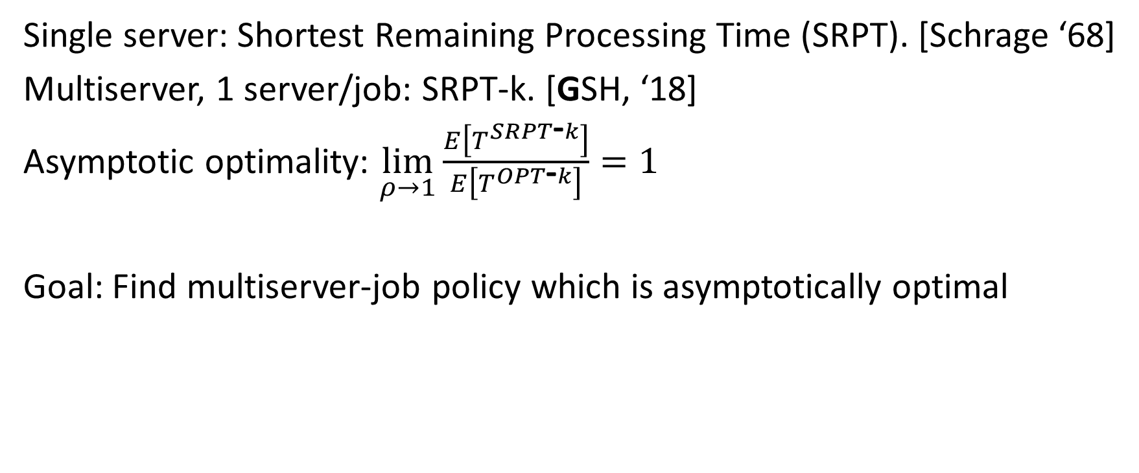
History of optimizing $E[T]$
Single server: Shortest Remaining Processing Time (SRPT). [Schrage ‘68]
Multiserver, 1 server/job: SRPT-k. [GSH, ‘18]
Asymptotic optimality: $\lim_{ρ→1}\frac{E\left[T^{SRPT\text{‐}k}\right]}{E\left[T^{OPT\text{‐}k}\right]}=1$
Goal: Find multiserver-job policy which is asymptotically optimal
Notes:
Least duration.
Best optimality result known in that setting, so that’s what we can hope for here.

Slide 20

Define ServerFilling-SRPT
Idea: Adjust ServerFilling with new job ordering.
Q: How should we order jobs to minimize $E[T]$?
A: Least duration?
B: Least server need?
C: Least size (product)?

Slide 21
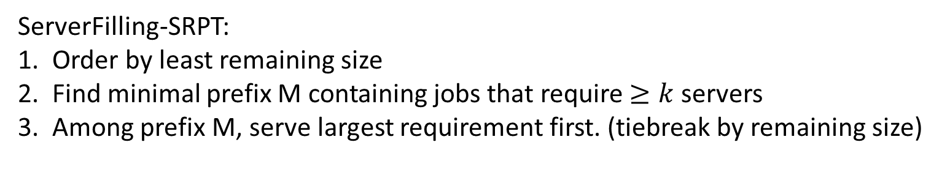
Define ServerFilling-SRPT
M
Least remaining size order
4
k=8
2
2
2
2
1
1
2
1
1
1
1
1
ServerFilling-SRPT:
Order by least remaining size
Find minimal prefix M containing jobs that require $≥k$servers
Among prefix M, serve largest requirement first. (tiebreak by remaining size)

Slide 22
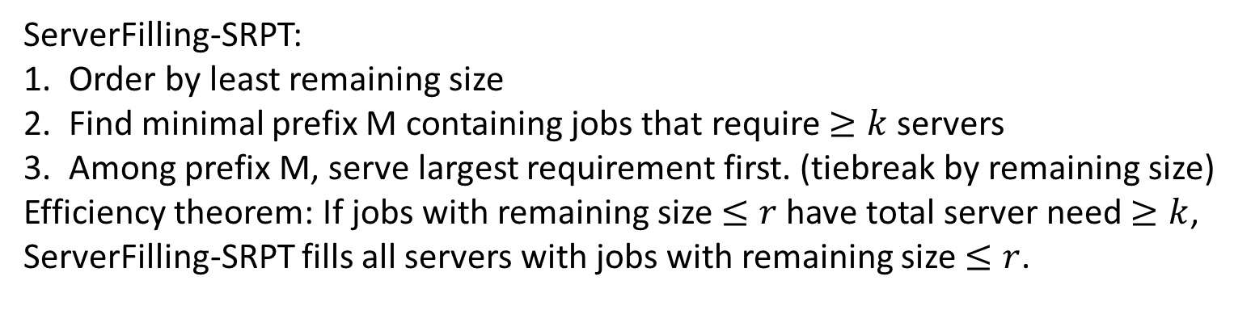
Define ServerFilling-SRPT
M
2
Least remaining size order
2
4
k=8
2
2
1
1
1
2
1
1
1
1
1
1
1
1
ServerFilling-SRPT:
Order by least remaining size
Find minimal prefix M containing jobs that require $≥k$servers
Among prefix M, serve largest requirement first. (tiebreak by remaining size)
Efficiency theorem: If jobs with remaining size $≤r$ have total server need $≥k$, ServerFilling-SRPT fills all servers with jobs with remaining size $≤r$.
Server need is power of 2

Slide 23
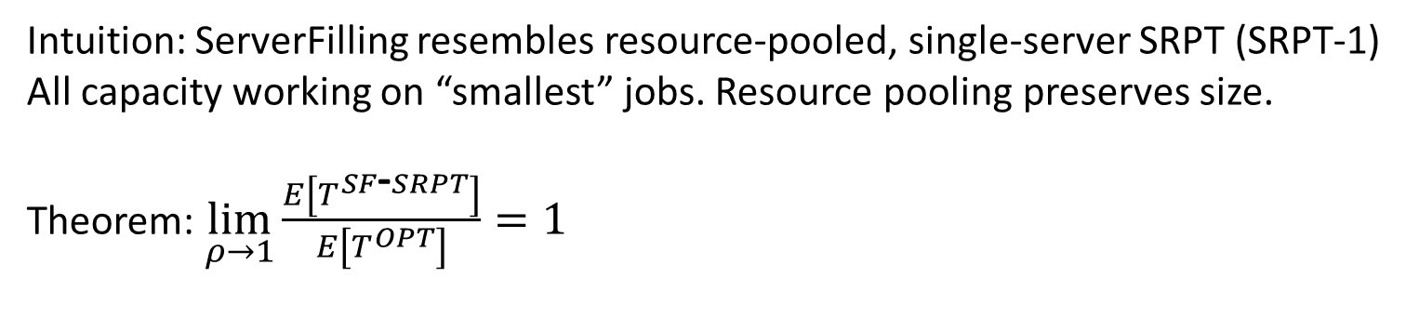

ServerFilling-SRPT: Optimal E[T]
2
1/k
1/k
1/k
1/k
1/k
1/k
1/k
1/k
ServerFilling-SRPT
SRPT-1
2
$$⟺$$
1
1
1
1
1
Intuition: ServerFilling resembles resource-pooled, single-server SRPT (SRPT-1)
All capacity working on “smallest” jobs. Resource pooling preserves size.
Theorem: $\lim_{ρ→1}\frac{E\left[T^{SF\text{‐}SRPT}\right]}{E\left[T^{OPT}\right]}=1$

Slide 24
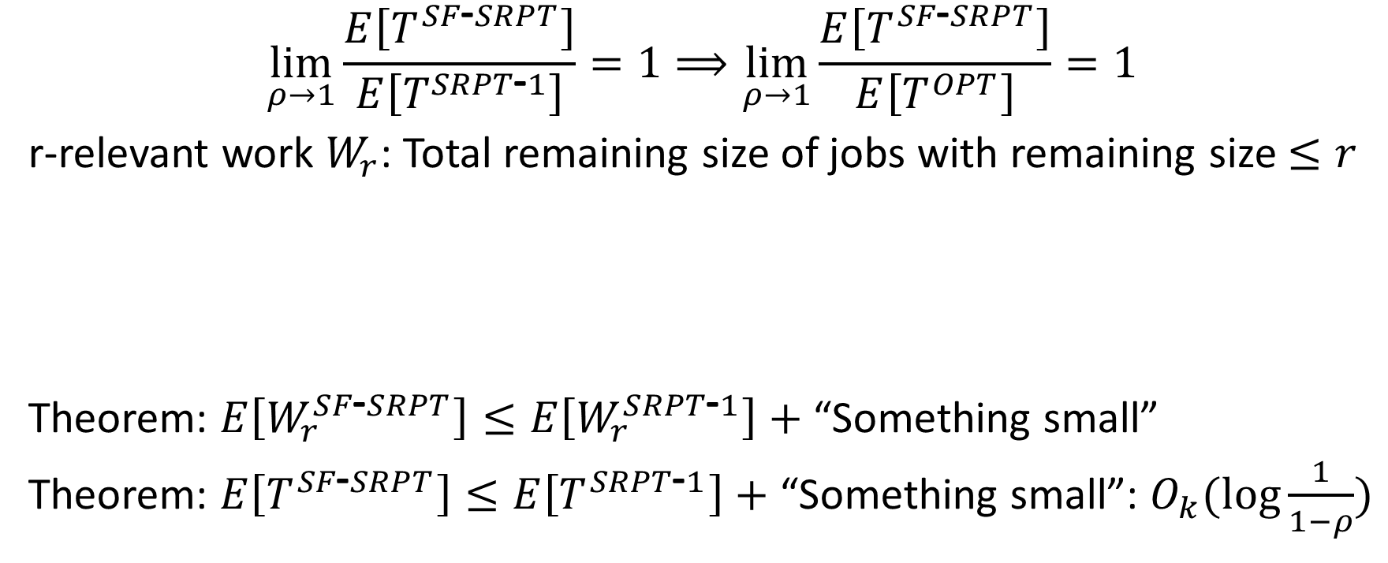
Proof Sketch: ServerFilling-SRPT optimality
$$\lim_{ρ→1}\frac{E\left[T^{SF\text{‐}SRPT}\right]}{E\left[T^{SRPT\text{‐}1}\right]}=1⟹\lim_{ρ→1}\frac{E\left[T^{SF\text{‐}SRPT}\right]}{E\left[T^{OPT}\right]}=1$$
r-relevant work $W_{r}$: Total remaining size of jobs with remaining size $≤r$
Theorem: $E\left[W_{r}^{SF\text{‐}SRPT}\right]≤E\left[W_{r}^{SRPT\text{‐}1}\right]+$ “Something small”
Theorem: $E\left[T^{SF\text{‐}SRPT}\right]≤E\left[T^{SRPT\text{‐}1}\right]+$ “Something small”: $O_{k}(\log{\frac{1}{1−ρ}})$

Slide 25


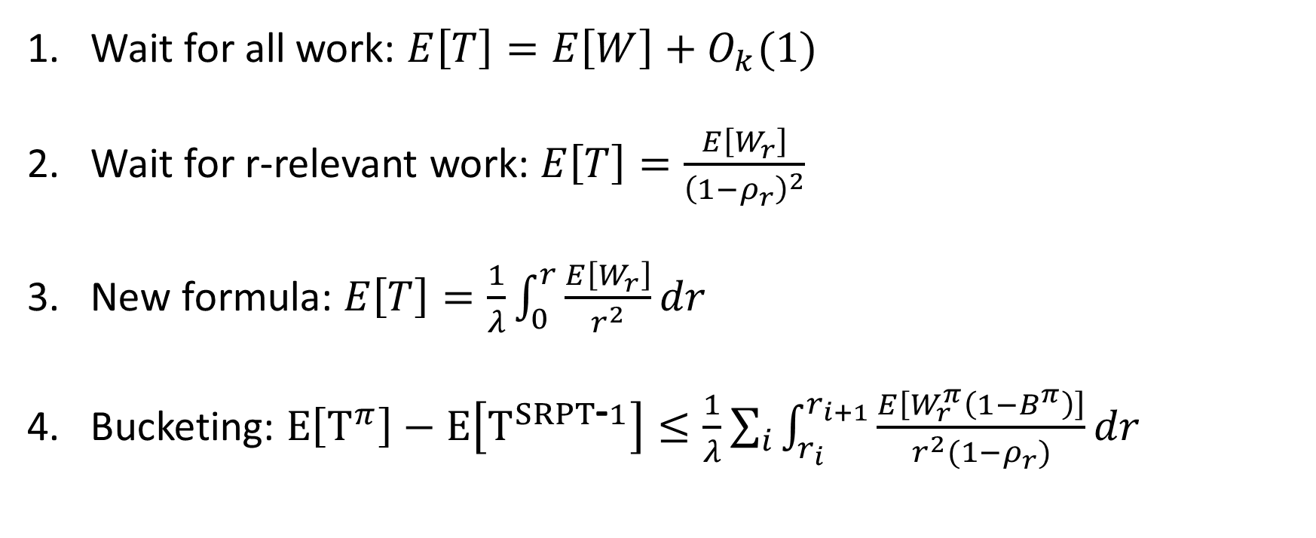







Proof attempts
Arrival order only
Wait for all work: $E\left[T\right]=E\left[W\right]+O_{k}(1)$
Wait for r-relevant work: $E\left[T\right]=\frac{E\left[W_{r}\right]}{{\left(1−ρ_{r}\right)}^{2}}$
New formula: $E\left[T\right]=\frac{1}{λ}\int_{0}^{r}{\frac{E\left[W_{r}\right]}{r^{2}}dr}$
Bucketing: $E\left[T^{π}\right]−E\left[T^{SRPT\text{‐}1}\right]≤\frac{1}{λ}\sum_{i}{\int_{r_{i}}^{r_{i+1}}{\frac{E\left[W_{r}^{π}\left(1−B^{π}\right)\right]}{r^{2}(1−ρ_{r})}dr}}$
*
*
SRPT-1 only
$$W_{r}$$
Enough for 1 server/job
Not enough for MSJ
$$r$$
$$≤1$$
$$≤1$$
$$≤1$$
$$≤1$$
$$≤1$$
$$≤1$$
$$≤1$$
$r_{0} r_{1} r_{2} … r_{i} … r_{\log{\frac{1}{1−ρ}}}$

Slide 26
Conclusion
2
2
Introduced multiserver-job model
First simple, throughput-optimal policy, first mean response time: ServerFilling
First optimality result, by appropriately adjusting job ordering: ServerFilling-SRPT
1
1
1
Server need
1
Service duration
Notes:
]

Slide 27
Relaxing assumptions
Assumptions:
Poisson arrivals, i.i.d. job sizes
Server needs are powers of 2
Job durations known on arrival
Can relax assumptions.
Have proven equivalent results in more general settings
Notes:
Future, hope to relax further.

Slide 28
Conclusion
2
2
Introduced multiserver-job model
First simple, throughput-optimal policy, first mean response time: ServerFilling
First optimality result, by appropriately adjusting job ordering: ServerFilling-SRPT
1
1
1
Server need
1
Service duration
Papers (see my website, isaacg1.github.io):
Multiserver-job model: “WCFS: A new framework for analyzing multiserver systems”, Queuing Systems ‘22
“Optimal Scheduling in the Multiserver-job Model under Heavy Traffic”, under submission
1 server/job models: “SRPT for Multiserver Systems”, Performance ‘18
“Load Balancing Guardrails”, SIGMETRICS ‘19
“Optimal Multiserver Scheduling with Unknown Job Sizes in Heavy Traffic”, Performance ‘20
“The Gittins Policy is Nearly Optimal in the M/G/k under Extremely General Conditions”, SIGMETRICS ’21
Notes:
Add papers

