Slide 1

Convergence for Natural Policy Gradient on Infinite-State Average-Reward Markov Decision Processes Natural Policy Gradient for Queues
Izzy Grosof (Isaac) (they/she)
Georgia Tech $→$ UIUC $→$ Northwestern IEMS
Siva Theja Maguluri (Georgia Tech)
R. Srikant (UIUC)

Slide 2

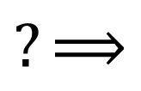

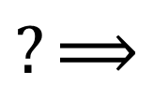

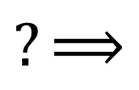
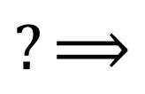

Problem: Optimize Queueing System
Queueing system with unknown parameters (generalized switch)
Want to optimize policy. Ex: Minimize mean queue length.
Challenge 1: Unknown system dynamics
Challenge 2: Even if knew dynamics, how to pick an optimal policy?
Reinforcement learning!
$$?⟹$$
$$?$$
$$?⟹$$
$$?$$
$$?⟹$$
$$?$$
$$?⟹$$
$$?$$

Slide 3
Reinforcement Learning for Queueing Systems
Framework: Queueing system as Markov Decision Process (MDP) with unknown parameters
Policy gradient methods: Actor-critic, Trust Region Policy Optimization, Proximal Policy Optimization [Schulman et al. ’15, ‘17]
Developed for finite state-space settings
Empirically, highly effective for countably-infinite queues! Recent variance reduction work, even better empirically! [Dai & Gluzman ’22]
Want to analyze: Converge to global optimum? Convergence rate?
Underpinning: Natural Policy Gradient

Slide 4
Natural Policy Gradient for Queueing Systems
Natural Policy Gradient: Algorithm for MDP optimization
Perfect information, tabular policy space. Simplest setting.
Open problem!
Key challenges: Average cost, countably-infinite state space
Q: Does NPG converge to the globally optimal policy, for queueing MDPs? If so, how fast?

Slide 5








Outline
$$?⟹$$
$$?$$
$$?⟹$$
$$?$$
Setting: RL for queueing systems
Define NPG algorithm
Challenges & prior work
The expert-advice framework
Result! First convergence for NPG on queues
$$?⟹$$
$$?$$
$$?⟹$$
$$?$$

Slide 6
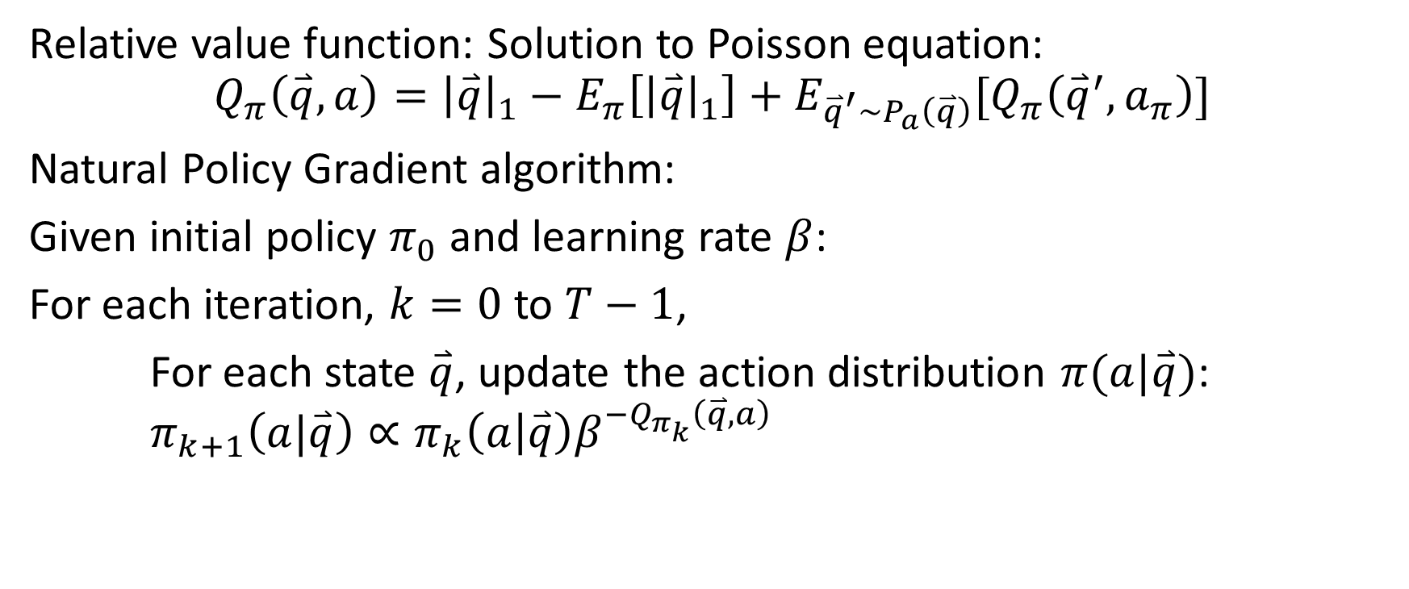
Natural Policy Gradient: Definition
Relative value function: Solution to Poisson equation:
$$Q_{π}\left(\overset{⃑}{q}, a\right)={\left|\overset{⃑}{q}\right|}_{1}−E_{π}\left[{\left|\overset{⃑}{q}\right|}_{1}\right]+E_{{\overset{⃑}{q}}^{′}∼P_{a}\left(\overset{⃑}{q}\right)}[Q_{π}\left({\overset{⃑}{q}}^{′},a_{π}\right)]$$
Natural Policy Gradient algorithm:
Given initial policy $π_{0}$ and learning rate $β$:
For each iteration, $k=0$ to $T−1$,
For each state $\overset{⃑}{q}$, update the action distribution $π(a|\overset{⃑}{q})$: $π_{k+1}\left(a|\overset{⃑}{q}\right)∝π_{k}\left(a | \overset{⃑}{q}\right)β^{{−Q}_{π_{k}}\left(\overset{⃑}{q},a\right)}$
Q: Does NPG converge to the globally optimal policy, for queueing MDPs?
Notes:
_i

Slide 7

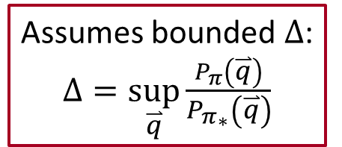

Prior work on NPG
Investigate further!
Average cost, infinite state
Results for specialized settings [Kunnumkal & Topaloglu ’08], [Fazel et al. ‘14]
Open in general, incl. queueing systems
Average cost, finite state
Even-Dar et al. ‘09: $O(1/\sqrt{T})$ convergence
Murthy & Srikant ‘23: $O(1/T)$ convergence
Discounted cost
$O(1/T)$ convergence [Geist et al. ‘19] [Agarwal et al. ‘21]
To transfer to average cost, need better dependence on discount rate
Assumes bounded mixing time
Assumes bounded $Δ$: $Δ=\sup_{\overset{⃑}{q}}\frac{P_{π}\left(\overset{⃑}{q}\right)}{P_{π_{∗}}\left(\overset{⃑}{q}\right)}$

Slide 8

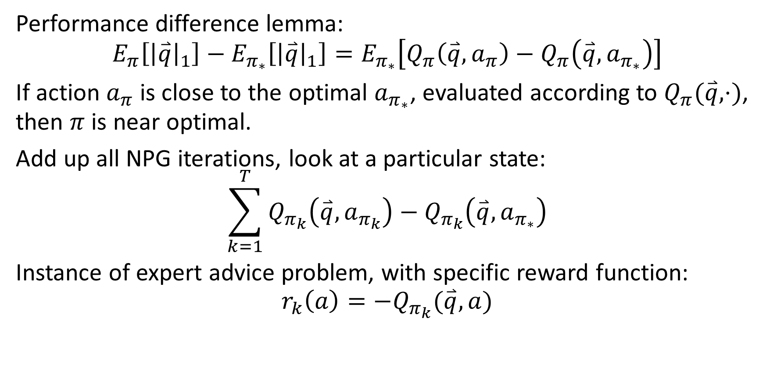
Expert-advice Framework [Even-dar et al. ’09]
Performance difference lemma: $$E_{π}\left[{\left|\overset{⃑}{q}\right|}_{1}\right]−E_{π_{∗}}\left[{\left|\overset{⃑}{q}\right|}_{1}\right]=E_{π_{∗}}\left[Q_{π}\left(\overset{⃑}{q},a_{π}\right)−Q_{π}\left(\overset{⃑}{q},a_{π_{∗}}\right)\right]$$
If action $a_{π}$ is close to the optimal $a_{π_{∗}}$, evaluated according to $Q_{π}(\overset{⃑}{q},⋅)$, then $π$ is near optimal.
Add up all NPG iterations, look at a particular state:
$$\sum_{k=1}^{T}{Q_{π_{k}}\left(\overset{⃑}{q},a_{π_{k}}\right)−Q_{π_{k}}\left(\overset{⃑}{q},a_{π_{∗}}\right)}$$
Instance of expert advice problem, with specific reward function: $$r_{k}\left(a\right)=−Q_{π_{k}}(\overset{⃑}{q},a)$$

Slide 9

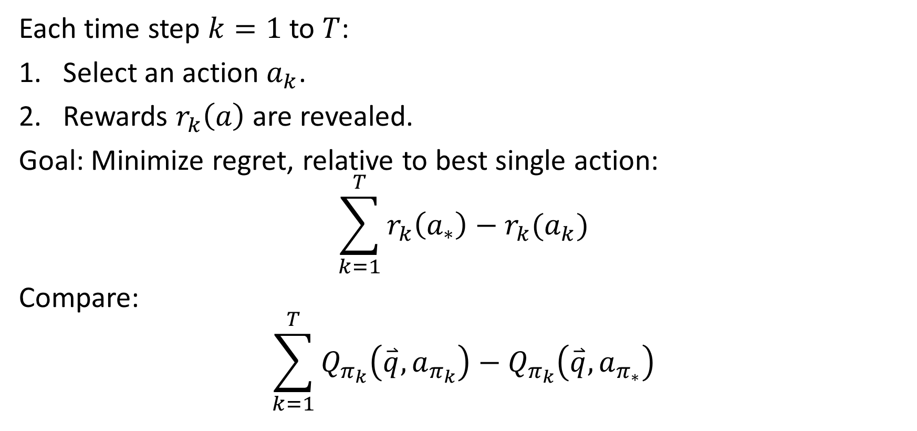
Expert Advice Problem: Background
$$r_{k}\left(a\right)=−Q_{π_{k}}(\overset{⃑}{q},a)$$
Each time step $k=1$ to $T$:
Select an action $a_{k}$.
Rewards $r_{k}\left(a\right)$ are revealed.
Goal: Minimize regret, relative to best single action: $$\sum_{k=1}^{T}{r_{k}\left(a_{∗}\right)−r_{k}(a_{k})}$$
Compare: $$\sum_{k=1}^{T}{Q_{π_{k}}\left(\overset{⃑}{q},a_{π_{k}}\right)−Q_{π_{k}}\left(\overset{⃑}{q},a_{π_{∗}}\right)}$$

Slide 10
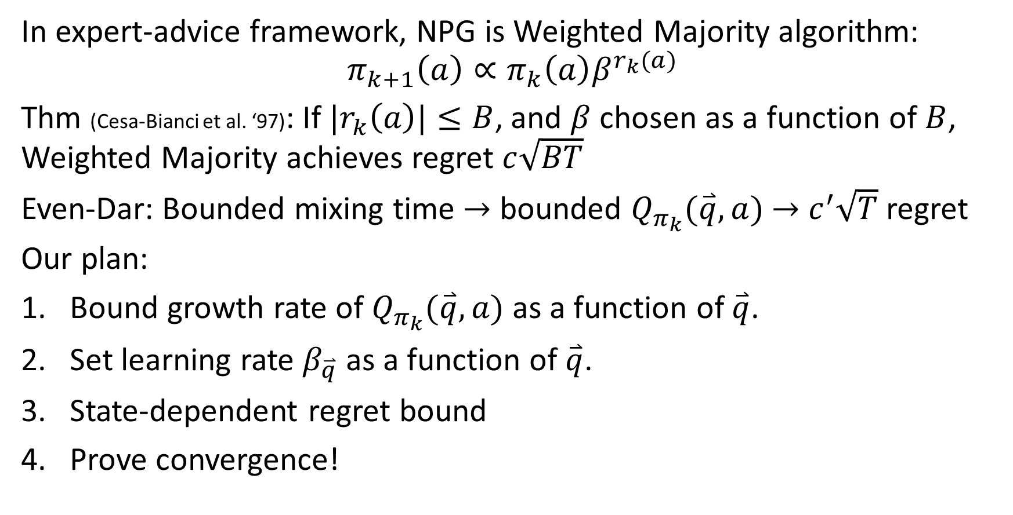
NPG and the expert-advice framework
$$r_{k}\left(a\right)=−Q_{π_{k}}(\overset{⃑}{q},a)$$
In expert-advice framework, NPG is Weighted Majority algorithm:
$$π_{k+1}\left(a\right)∝π_{k}\left(a\right)β^{r_{k}(a)}$$
Thm (Cesa-Bianci et al. ‘97): If $|r_{k}\left(a\right)|≤B$, and $β$ chosen as a function of $B$, Weighted Majority achieves regret $c\sqrt{BT}$
Even-Dar: Bounded mixing time $→$ bounded $Q_{π_{k}}(\overset{⃑}{q},a)$ $→$ $c^{′}\sqrt{T}$ regret
Our plan:
Bound growth rate of $Q_{π_{k}}(\overset{⃑}{q},a)$ as a function of $\overset{⃑}{q}$.
Set learning rate $β_{\overset{⃑}{q}}$ as a function of $\overset{⃑}{q}$.
State-dependent regret bound
Prove convergence!
New!

Slide 11









Outline
$$?⟹$$
$$?$$
$$?⟹$$
$$?$$
Setting: RL for queueing systems
Define NPG algorithm
Challenges & prior work
The expert-advice framework
Bound relative value
Analyze MaxWeight
Result!
$$?⟹$$
$$?$$
$$?⟹$$
$$?$$

Slide 12

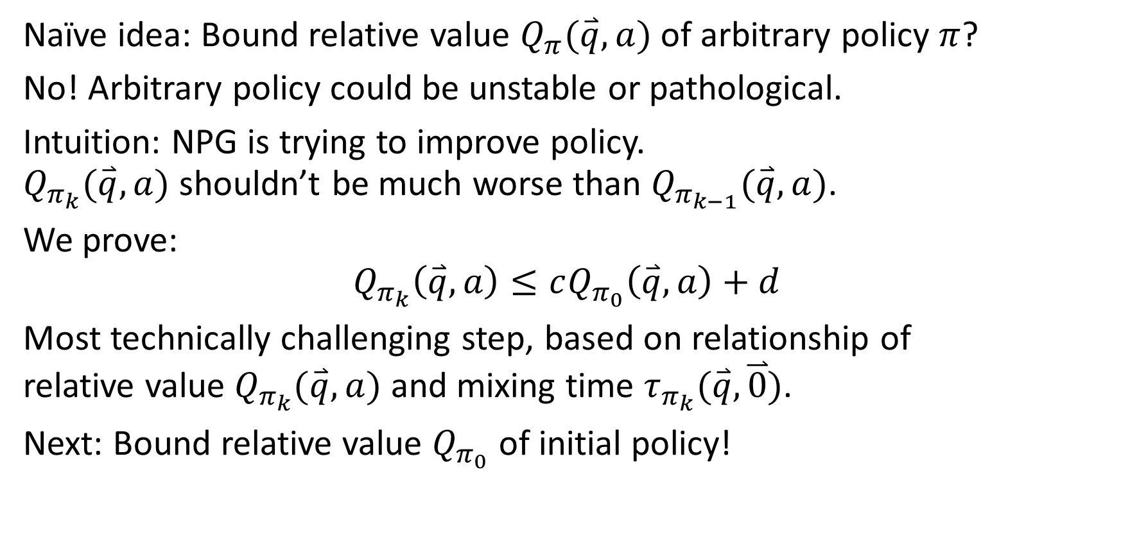

Bound on Relative Value $Q_{π_{k}}(\overset{⃑}{q},a)$
Naïve idea: Bound relative value $Q_{π}(\overset{⃑}{q},a)$ of arbitrary policy $π$?
No! Arbitrary policy could be unstable or pathological.
Intuition: NPG is trying to improve policy. $Q_{π_{k}}(\overset{⃑}{q},a)$ shouldn’t be much worse than $Q_{π_{k−1}}(\overset{⃑}{q},a)$.
We prove: $$Q_{π_{k}}\left(\overset{⃑}{q},a\right)≤cQ_{π_{0}}\left(\overset{⃑}{q},a\right)+d$$
Most technically challenging step, based on relationship of relative value $Q_{π_{k}}(\overset{⃑}{q},a)$ and mixing time $τ_{π_{k}}(\overset{⃑}{q},\overset{⃑}{0})$.
Next: Bound relative value $Q_{π_{0}}$ of initial policy!

Slide 13
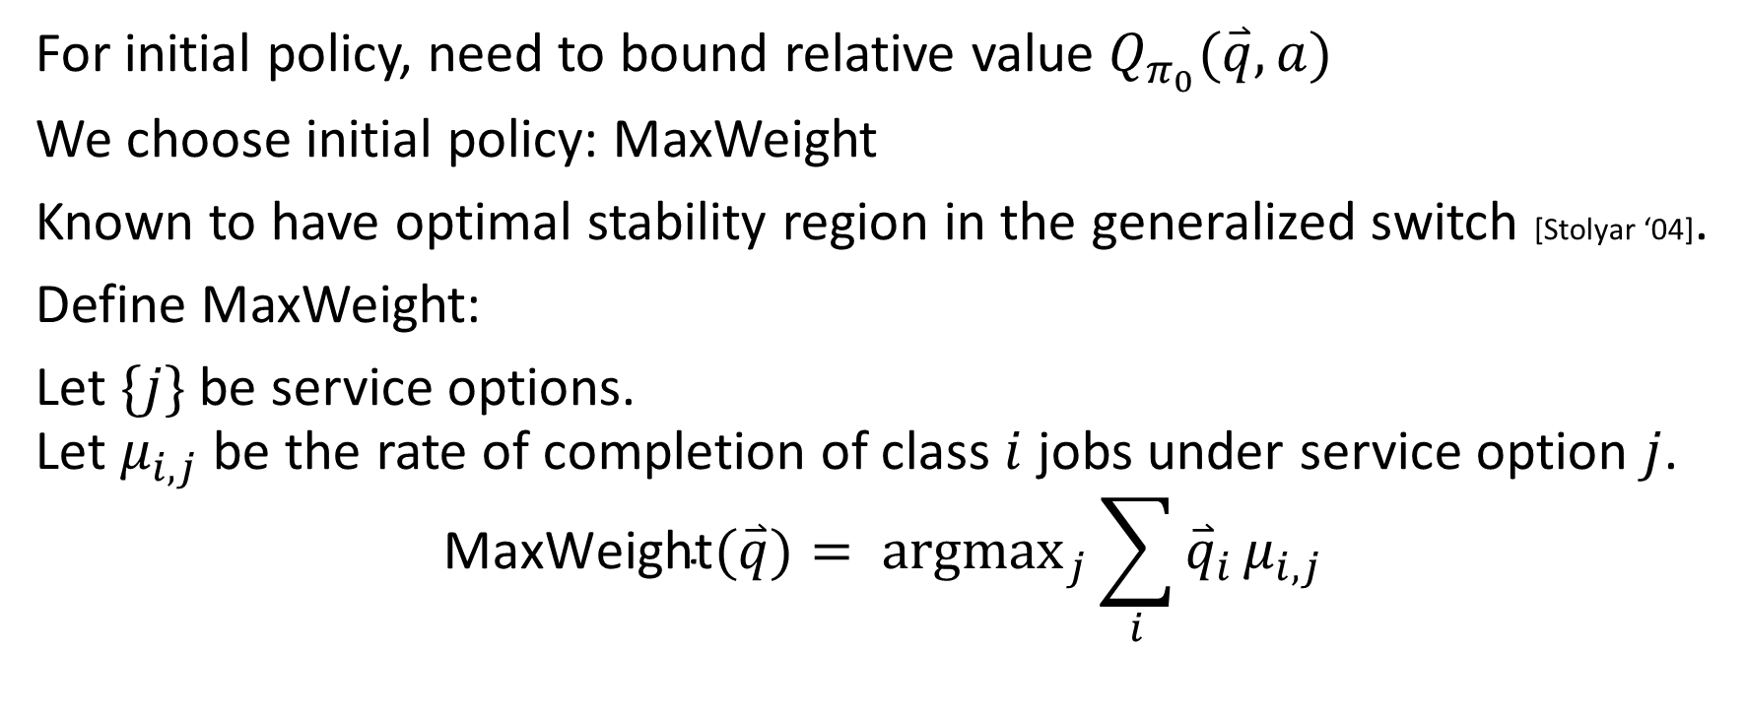
Initial policy: MaxWeight
For initial policy, need to bound relative value $Q_{π_{0}}(\overset{⃑}{q},a)$
We choose initial policy: MaxWeight
Known to have optimal stability region in the generalized switch [Stolyar ‘04].
Define MaxWeight:
Let $\{j\}$ be service options. Let $μ_{i,j}$ be the rate of completion of class $i$ jobs under service option $j$.
$$\text{MaxWeight}(\overset{⃑}{q})= {argmax}_{j}\sum_{i}{{\overset{⃑}{q}}_{i}}μ_{i,j}$$

Slide 14
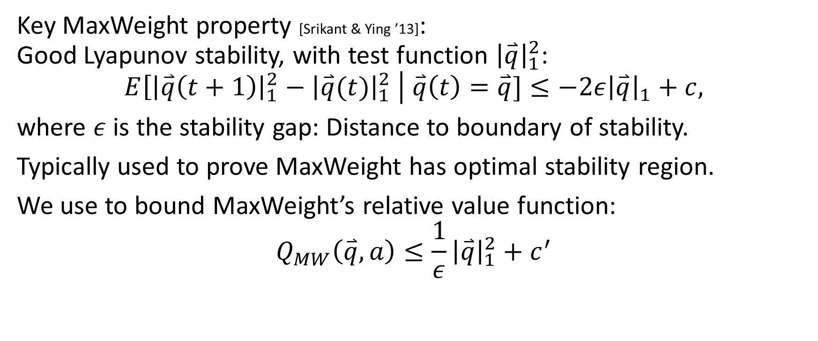
Relative Value for MaxWeight
Key MaxWeight property [Srikant & Ying ’13]: Good Lyapunov stability, with test function ${\left|\overset{⃑}{q}\right|}_{1}^{2}$:
$$E\left[{\left|\overset{⃑}{q}\left(t+1\right)\right|}_{1}^{2}−{\left|\overset{⃑}{q}(t)\right|}_{1}^{2} \right| \overset{⃑}{q}\left(t\right)=\overset{⃑}{q}]≤−2ε{\left|\overset{⃑}{q}\right|}_{1}+c,$$
where $ε$ is the stability gap: Distance to boundary of stability.
Typically used to prove MaxWeight has optimal stability region.
We use to bound MaxWeight’s relative value function:
$$Q_{MW}\left(\overset{⃑}{q},a\right)≤\frac{1}{ε}{\left|\overset{⃑}{q}\right|}_{1}^{2}+c^{′}$$

Slide 15
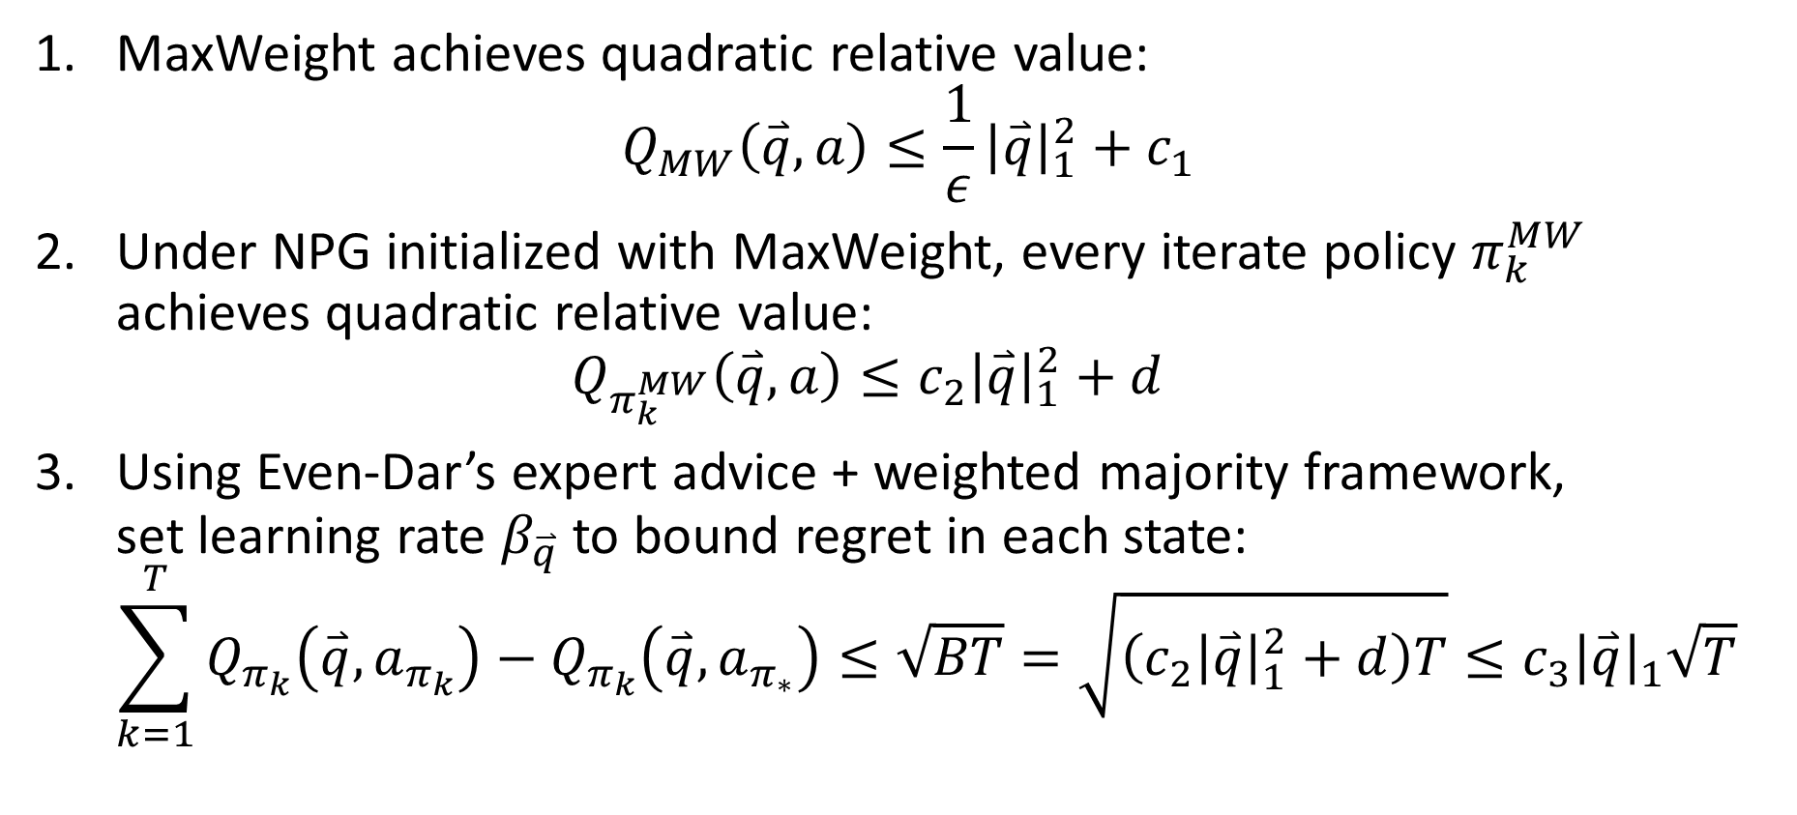
Putting the result together
MaxWeight achieves quadratic relative value: $Q_{MW}\left(\overset{⃑}{q},a\right)≤\frac{1}{ε}{\left|\overset{⃑}{q}\right|}_{1}^{2}+c_{1}$
Under NPG initialized with MaxWeight, every iterate policy $π_{k}^{MW}$ achieves quadratic relative value: $Q_{π_{k}^{MW}}\left(\overset{⃑}{q},a\right)≤c_{2}{\left|\overset{⃑}{q}\right|}_{1}^{2}+d$
Using Even-Dar’s expert advice + weighted majority framework, set learning rate $β_{\overset{⃑}{q}}$ to bound regret in each state: $\sum_{k=1}^{T}{Q_{π_{k}}\left(\overset{⃑}{q},a_{π_{k}}\right)−Q_{π_{k}}\left(\overset{⃑}{q},a_{π_{∗}}\right)}≤\sqrt{BT}=\sqrt{\left(c_{2}{\left|\overset{⃑}{q}\right|}_{1}^{2}+d\right)T}≤c_{3}{\left|\overset{⃑}{q}\right|}_{1}\sqrt{T}$

Slide 16
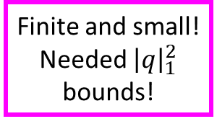
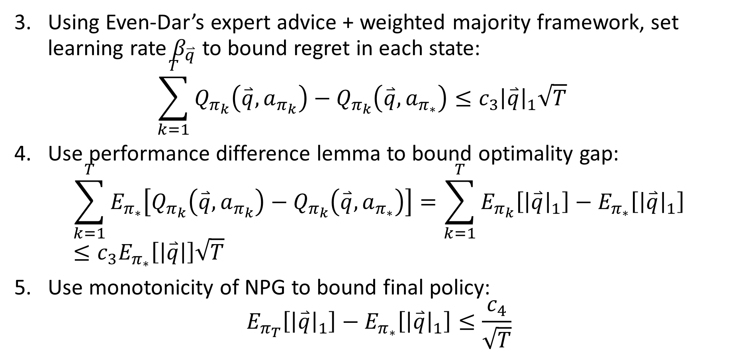
Putting the result together
Using Even-Dar’s expert advice + weighted majority framework, set learning rate $β_{\overset{⃑}{q}}$ to bound regret in each state: $\sum_{k=1}^{T}{Q_{π_{k}}\left(\overset{⃑}{q},a_{π_{k}}\right)−Q_{π_{k}}\left(\overset{⃑}{q},a_{π_{∗}}\right)}≤c_{3}{\left|\overset{⃑}{q}\right|}_{1}\sqrt{T}$
Use performance difference lemma to bound optimality gap: $\sum_{k=1}^{T}{E_{π_{∗}}\left[Q_{π_{k}}\left(\overset{⃑}{q},a_{π_{k}}\right)−Q_{π_{k}}\left(\overset{⃑}{q},a_{π_{∗}}\right)\right]}=\sum_{k=1}^{T}{E_{π_{k}}\left[{\left|\overset{⃑}{q}\right|}_{1}\right]−E_{π_{∗}}\left[{\left|\overset{⃑}{q}\right|}_{1}\right]}≤c_{3}E_{π_{∗}}\left[\left|\overset{⃑}{q}\right|\right]\sqrt{T}$
Use monotonicity of NPG to bound final policy: $E_{π_{T}}\left[{\left|\overset{⃑}{q}\right|}_{1}\right]−E_{π_{∗}}\left[{\left|\overset{⃑}{q}\right|}_{1}\right]≤\frac{c_{4}}{\sqrt{T}}$
Finite and small! Needed ${\left|q\right|}_{1}^{2}$ bounds!

Slide 17
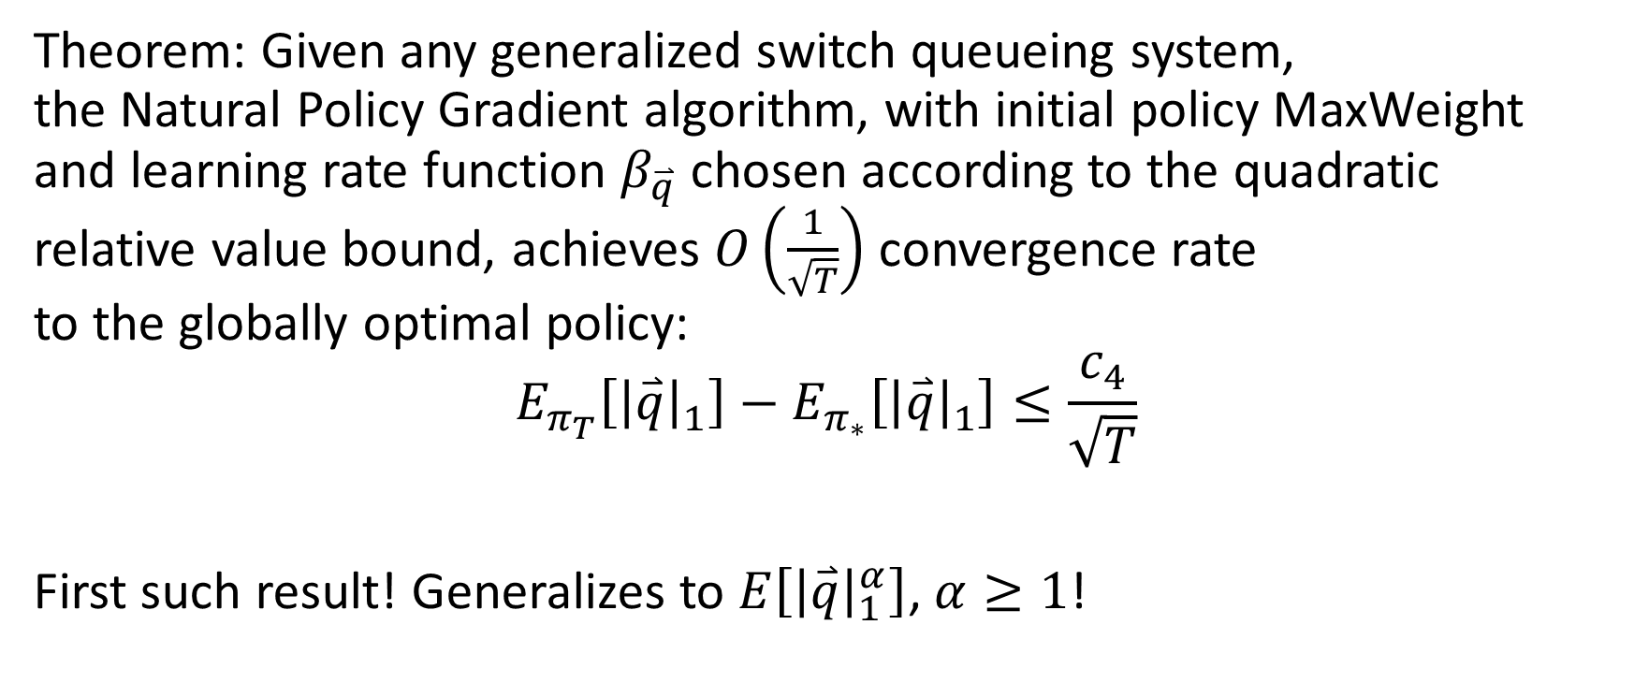
Main Result
New!
New!
Theorem: Given any generalized switch queueing system, the Natural Policy Gradient algorithm, with initial policy MaxWeight and learning rate function $β_{\overset{⃑}{q}}$ chosen according to the quadratic relative value bound, achieves $O\left(\frac{1}{\sqrt{T}}\right)$ convergence rate to the globally optimal policy:
$$E_{π_{T}}\left[{\left|\overset{⃑}{q}\right|}_{1}\right]−E_{π_{∗}}\left[{\left|\overset{⃑}{q}\right|}_{1}\right]≤\frac{c_{4}}{\sqrt{T}}$$
First such result! Generalizes to $E\left[{\left|\overset{⃑}{q}\right|}_{1}^{α}\right]$, $α≥1$!

Slide 18
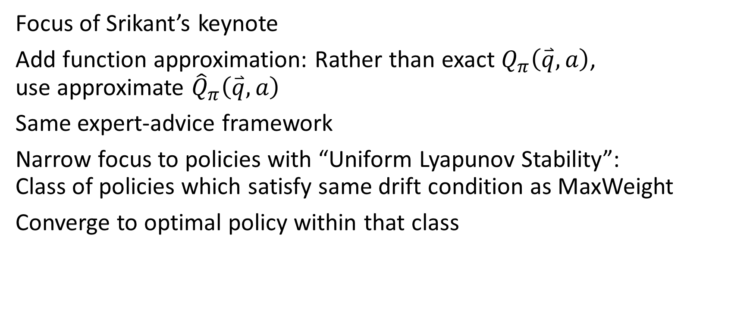
Follow-up work
Focus of Srikant’s keynote
Add function approximation: Rather than exact $Q_{π}\left(\overset{⃑}{q},a\right)$, use approximate ${\hat{Q}}_{π}\left(\overset{⃑}{q},a\right)$
Same expert-advice framework
Narrow focus to policies with “Uniform Lyapunov Stability”: Class of policies which satisfy same drift condition as MaxWeight
Converge to optimal policy within that class

Slide 19

Future directions
$O\left(\frac{1}{T}\right)$ convergence?
Tighter dependence on parameters of queueing system?
More general class of MDPs?
Sampling/learning?

Slide 20



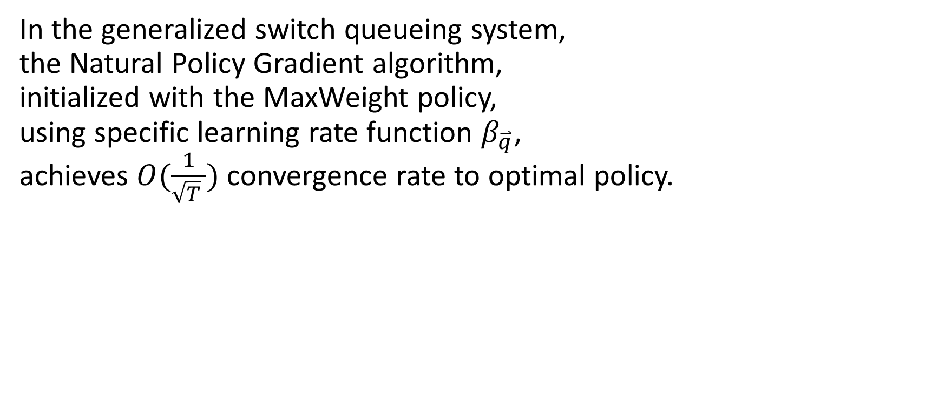





Conclusion
$$?⟹$$
$$?$$
In the generalized switch queueing system, the Natural Policy Gradient algorithm, initialized with the MaxWeight policy, using specific learning rate function $β_{\overset{⃑}{q}}$, achieves $O(\frac{1}{\sqrt{T} })$ convergence rate to optimal policy.
$$?⟹$$
$$?$$
$$?⟹$$
$$?$$
$$?⟹$$
$$?$$

