Slide 1
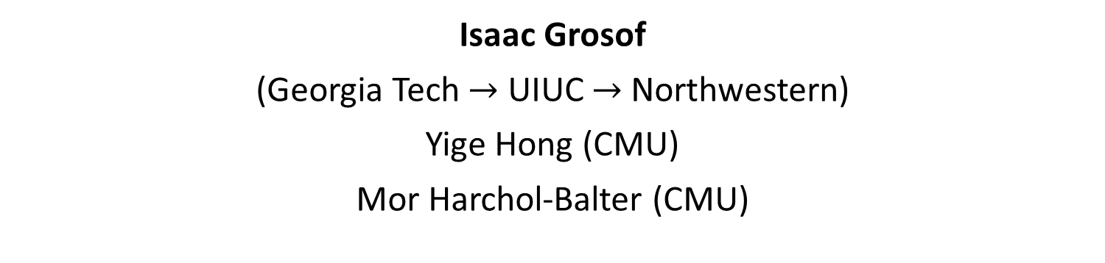
Relative Arrivals: A New Drift Method for Time-Varying Arrivals
Isaac Grosof
(Georgia Tech $→$ UIUC $→$ Northwestern)
Yige Hong (CMU)
Mor Harchol-Balter (CMU)

Slide 2
Markov-modulated arrivals
Arrival rate
Average arrival rate
Time
Common situation: light load at baseline, occasional bursts of arrivals
Standard in many application areas: Computing, health care, retail, etc.

Slide 3











This Talk: Two-level Arrivals Queue
$$α_{H}$$
$$μ$$
$$λ_{H}$$
$$λ_{L}$$
$$α_{L}$$
Q: What is mean queue length $E[Q]$?
Result widely applicable – all Markov-modulated queues
$$λ_{H}$$
Arrival rate
Average: $λ$
$$λ_{L}$$
$$Exp(α_{H})$$
$$Exp(α_{L})$$
Time
Notes:
Example of Markov-modulated

Slide 4
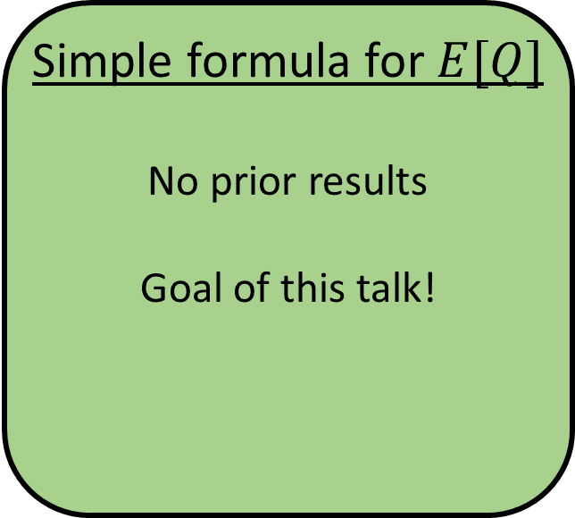
Prior work on two-level arrivals
Computational Methods
Generating functions [Yechiali & Naor ‘71], [Gupta et al. ‘06]
Matrix analytic methods [Neuts ‘78], [Ramaswami ‘80], [Latouche & Ramaswami ‘99], …
Symbolic Results
Heavy-traffic, semi-closed form [Mou & Maguluri ’20]
Structural and monotonicity results [Gupta et al. ‘06], [Vesilo, Harchol-Balter & Scheller-Wolf’21]
Simple formula for $E[Q]$
No prior results
Goal of this talk!
Notes:
TODO: Spell out names

Slide 5

Outline
Drift Method: Background
New idea: Relative Arrivals
Result: Mean queue length $E[Q]$ for all Markov-modulated queues

Slide 6
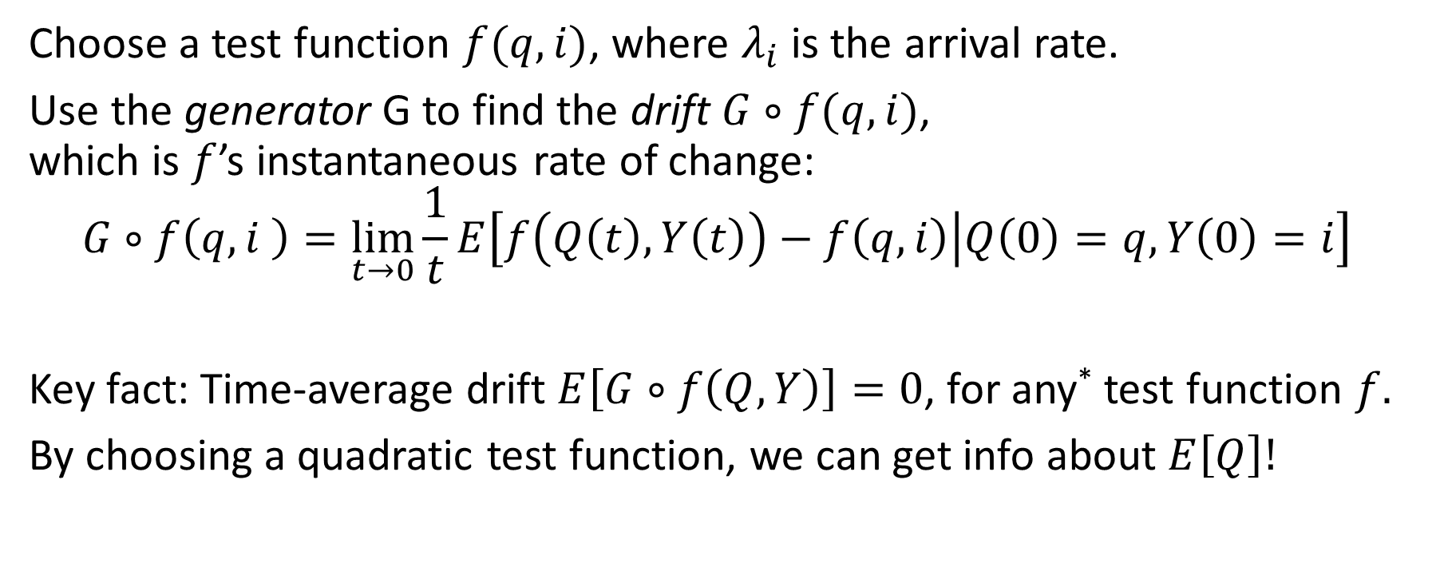
Drift Method: Background
Choose a test function $f(q,i)$, where $λ_{i}$ is the arrival rate.
Use the generator G to find the drift $G∘f(q,i)$, which is $f$’s instantaneous rate of change:
$$G∘f\left(q,i \right)=\lim_{t→0}\frac{1}{t}E\left[f\left(Q\left(t\right),Y\left(t\right)\right)−f\left(q,i\right) | Q\left(0\right)=q,Y\left(0\right)=i\right]$$
Key fact: Time-average drift $E\left[G∘f\left(Q,Y\right)\right]=0$, for any* test function $f.$
By choosing a quadratic test function, we can get info about $E\left[Q\right]!$
Notes:
Follows straightforwardly from the transition rates of the system

Slide 7
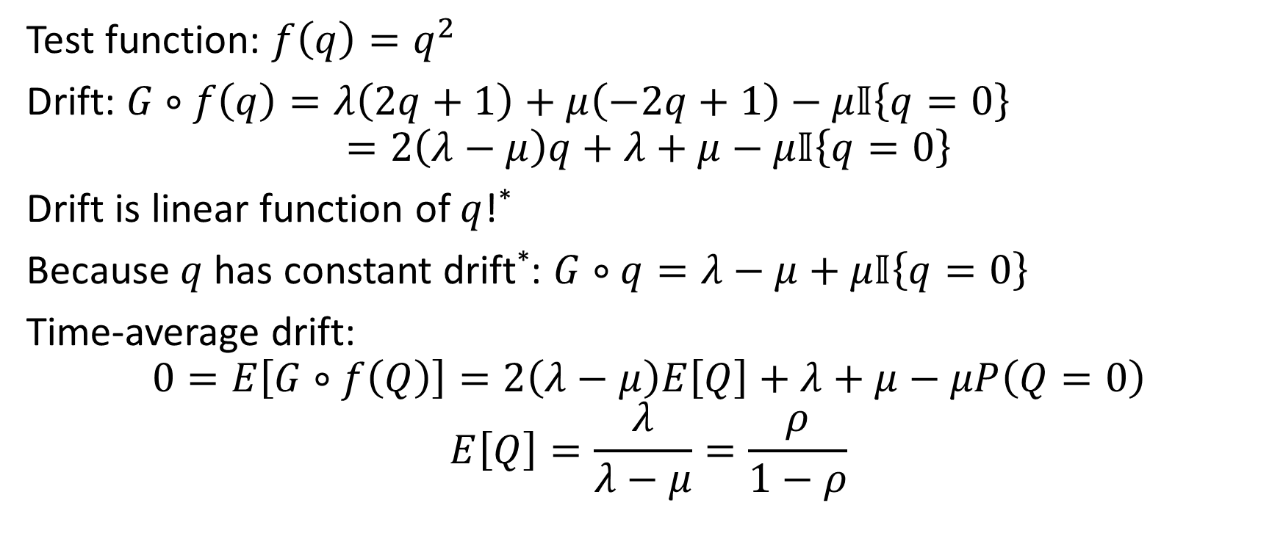
Drift method: M/M/1
Test function: $f\left(q\right)=q^{2}$
Drift: $G∘f\left(q\right)=λ\left(2q+1\right)+μ\left(−2q+1\right)−μ𝕀\left\{q=0\right\}$
$$=2\left(λ−μ\right)q+λ+μ−μ𝕀\left\{q=0\right\}$$
Drift is linear function of $q$!*
Because $q$ has constant drift*: $G∘q=λ−μ+μ𝕀\left\{q=0\right\}$
Time-average drift:
$$0=E\left[G∘f\left(Q\right)\right]=2\left(λ−μ\right)E\left[Q\right]+λ+μ−μP\left(Q=0\right)$$
$$E\left[Q\right]=\frac{λ}{λ−μ}=\frac{ρ}{1−ρ}$$
Notes:
Can compute using drift of q

Slide 8

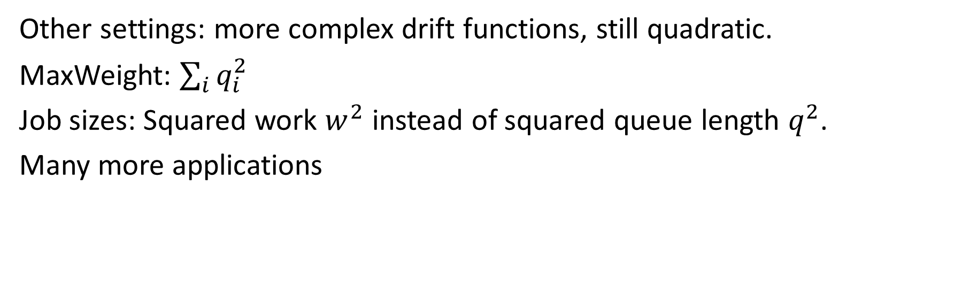


Key idea of Drift Method
$q$ has constant drift
$f\left(q\right)=q^{2}$ has linear drift
Can solve for $E[Q]$!
Other settings: more complex drift functions, still quadratic.
MaxWeight: $\sum_{i}{q_{i}^{2}}$
Job sizes: Squared work $w^{2}$ instead of squared queue length $q^{2}$.
Many more applications

Slide 9


Challenge: Drift under varying arrival rates
Problem: $q$ does not have constant drift!
In time-varying setting, $G∘q=λ_{i}−μ+μ𝕀\left\{q=0\right\}$
Test function $f\left(q,λ_{i}\right)=q^{2}$ gives no useful information about $E[Q]$.
Drift $G∘q$
Time

Slide 10
Outline
Drift Method: Background
New idea: Relative Arrivals
Result: Mean queue length $E[Q]$ for all Markov-modulated queues

Slide 11



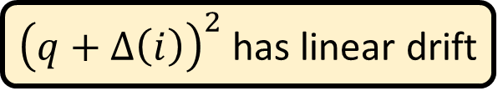

Our idea: Smooth out drift of $q$
Our test function needs to incorporate current arrival rate $λ_{i}$.
Plan:
Find a correction function $Δ(i)$ such that $q+Δ(i)$ has constant drift.
${\left(q+Δ\left(i\right)\right)}^{2}$ has linear drift
Can find $E\left[Q\right]$!

Slide 12

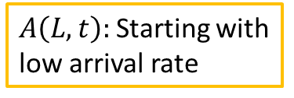



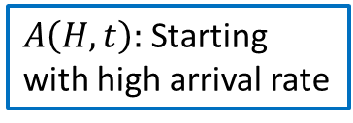
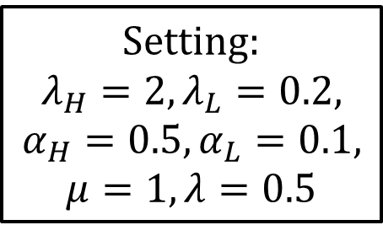
New idea: Relative arrivals
Setting:
$$λ_{H}=2, λ_{L}=0.2, α_{H}=0.5, α_{L}=0.1, μ=1, λ=0.5$$
Relative arrivals:
$$Δ\left(i\right)=\lim_{t→∞}\left(E\left[A\left(i,t\right)\right]−λt\right)$$
10
$A\left(H,t\right):$Starting with high arrival rate
8
$λt:$Long-term rate
Expected arrivals
6
$$Δ(H)$$
$A\left(L,t\right):$Starting with low arrival rate
4
$$Δ(L)$$
2
0
0
3
6
9
12
15
Time

Slide 13
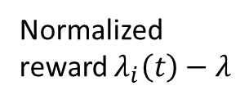
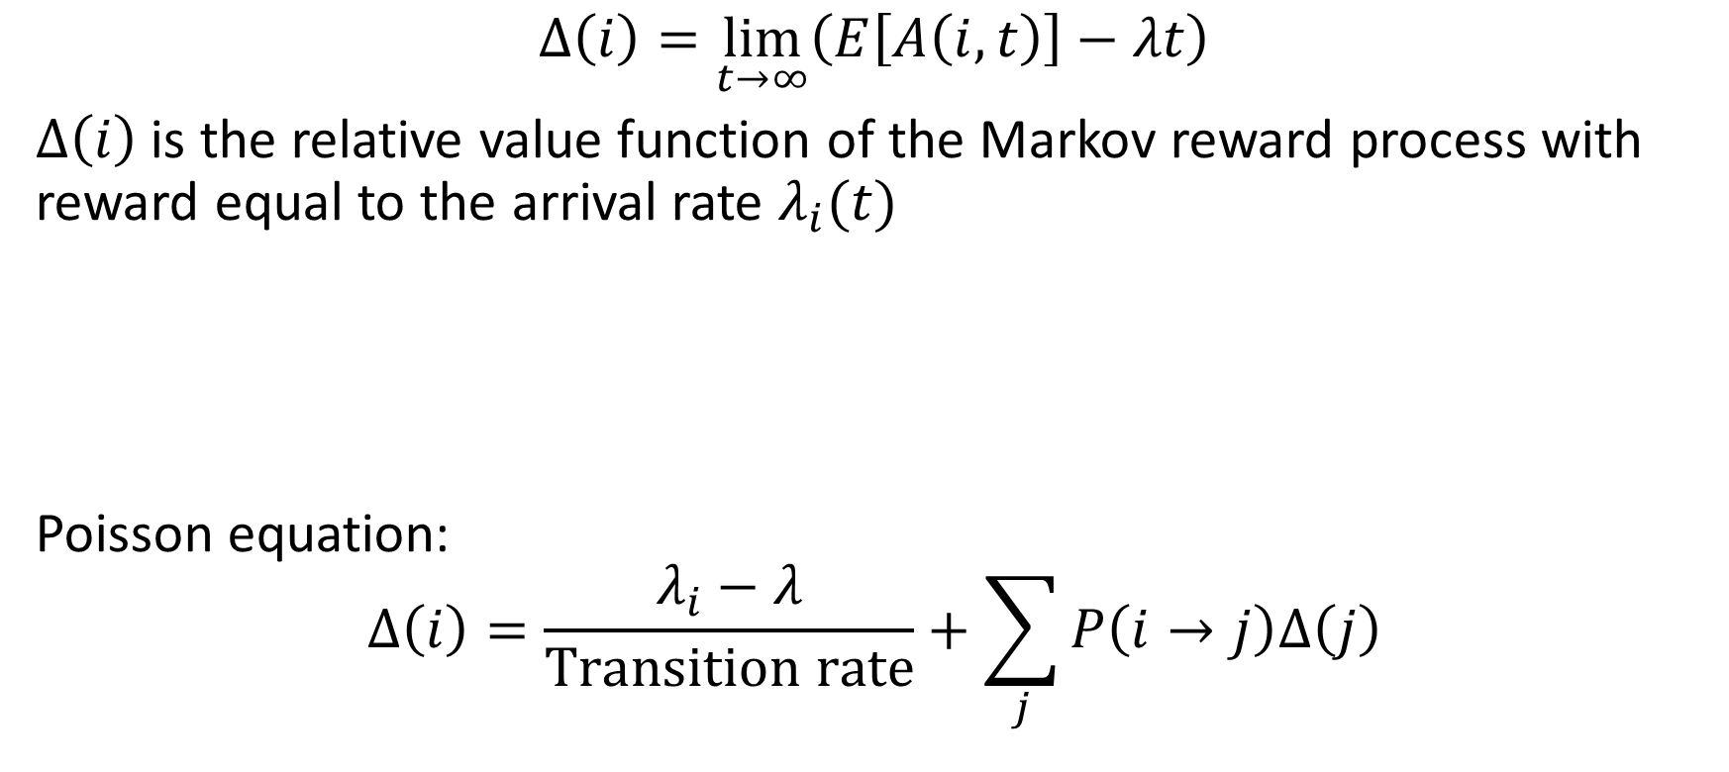
Alternate perspective: Relative value function
$$Δ\left(i\right)=\lim_{t→∞}\left(E\left[A\left(i,t\right)\right]−λt\right)$$
$Δ\left(i\right)$ is the relative value function of the Markov reward process with reward equal to the arrival rate $λ_{i}(t)$
Poisson equation:
$$Δ\left(i\right)=\frac{λ_{i}−λ}{Transition rate}+\sum_{j}{P\left(i→j\right)Δ\left(j\right)}$$
Normalized reward $λ_{i}\left(t\right)−λ$
Time

Slide 14
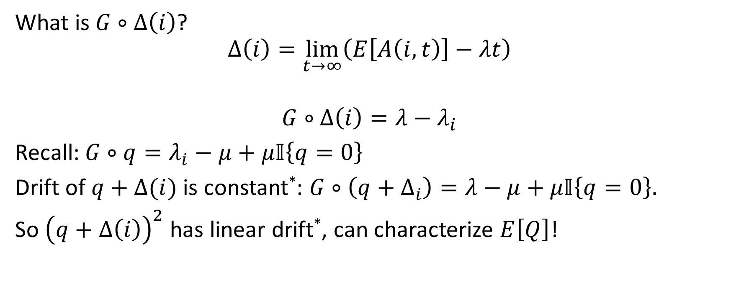


Relative arrivals smooth out drift
What is $G∘Δ\left(i\right)$?
$$Δ\left(i\right)=\lim_{t→∞}\left(E\left[A\left(i,t\right)\right]−λt\right)$$
$$G∘Δ\left(i\right)=λ−λ_{i}$$
Recall: $G∘q=λ_{i}−μ+μ𝕀\left\{q=0\right\}$
Drift of $q+Δ(i)$ is constant*: $G∘\left(q+Δ_{i}\right)=λ−μ+μ𝕀\left\{q=0\right\}.$
So ${\left(q+Δ\left(i\right)\right)}^{2}$ has linear drift*, can characterize $E\left[Q\right]$!
Drift: $λ_{i}$
Drift: $λ$
Notes:
Contributes to drift

Slide 15
Outline
Drift Method: Background
New idea: Relative Arrivals
Result: Mean queue length $E[Q]$ for all Markov-modulated queues

Slide 16
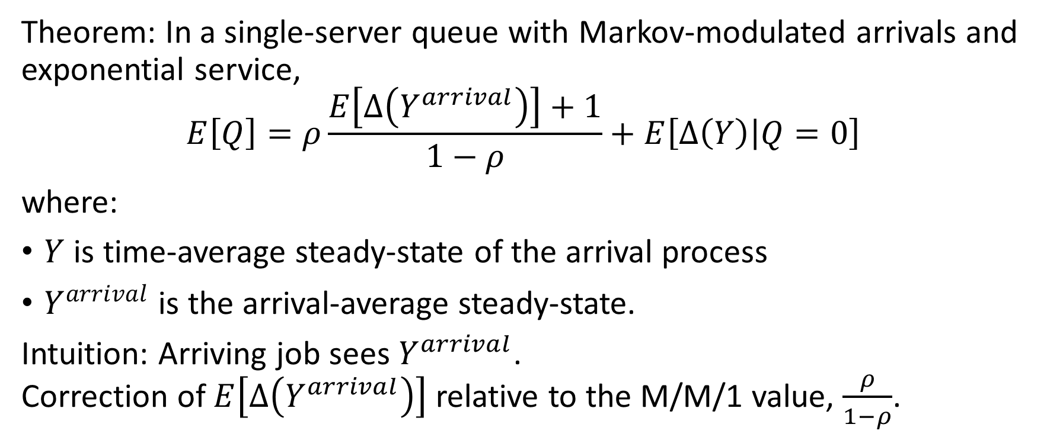
Result: Mean queue length characterization
Theorem: In a single-server queue with Markov-modulated arrivals and exponential service,
$$E\left[Q\right]=ρ\frac{E\left[Δ\left(Y^{arrival}\right)\right]+1}{1−ρ}+E\left[Δ\left(Y\right) | Q=0\right]$$
where:
$Y$ is time-average steady-state of the arrival process
$Y^{arrival}$ is the arrival-average steady-state.
Intuition: Arriving job sees $Y^{arrival}$. Correction of $E\left[Δ\left(Y^{arrival}\right)\right]$ relative to the M/M/1 value, $\frac{ρ}{1−ρ}$.
Arrival moments
Notes:
Got to here

Slide 17
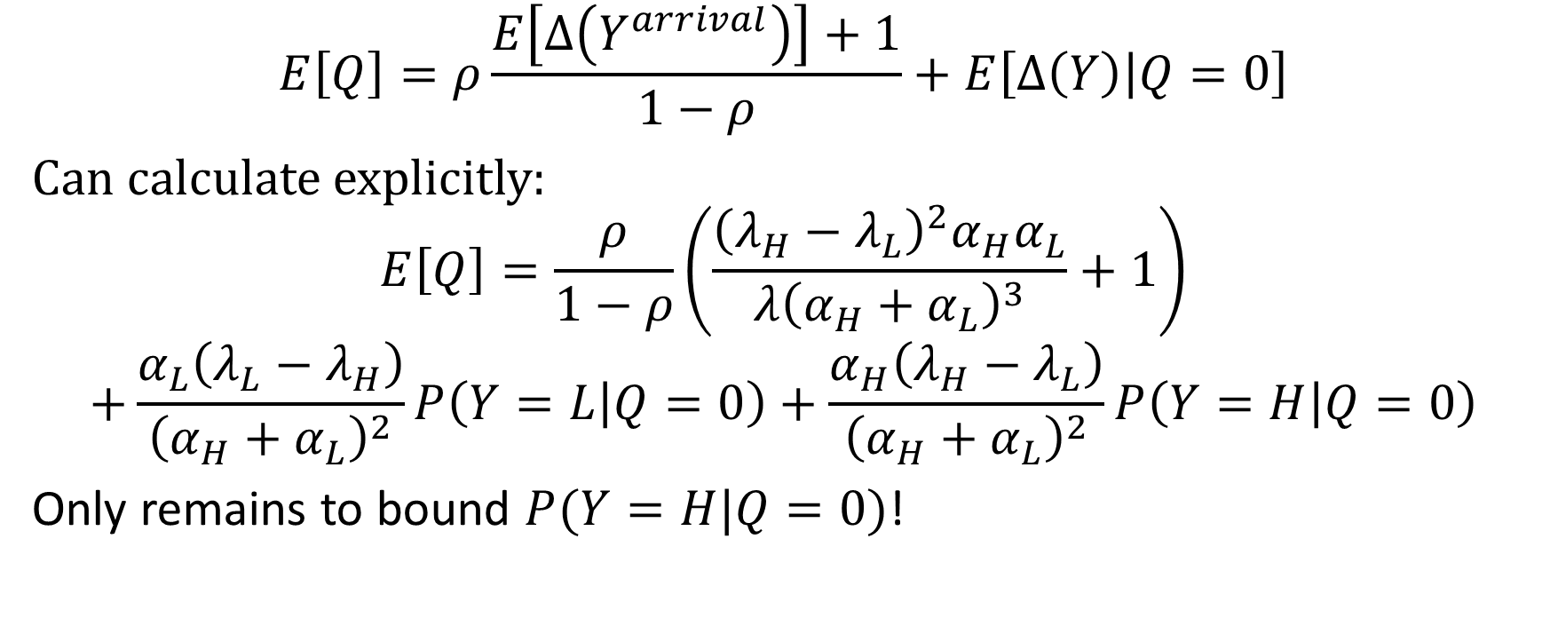
Calculations of values in two-level system
$$E\left[Q\right]=ρ\frac{E\left[Δ\left(Y^{arrival}\right)\right]+1}{1−ρ}+E\left[Δ\left(Y\right) | Q=0\right]$$
Can calculate explicitly:
$$E\left[Q\right]=\frac{ρ}{1−ρ}\left(\frac{{\left(λ_{H}−λ_{L}\right)}^{2}α_{H}α_{L}}{λ{\left(α_{H}+α_{L}\right)}^{3}}+1\right)$$
$$+\frac{α_{L}\left(λ_{L}−λ_{H}\right)}{{\left(α_{H}+α_{L}\right)}^{2}}P\left(Y=L | Q=0\right)+\frac{α_{H}\left(λ_{H}−λ_{L}\right)}{{\left(α_{H}+α_{L}\right)}^{2}}P\left(Y=H | Q=0\right)$$
Only remains to bound $P(Y=H|Q=0)$!
$$α_{H}$$
$$λ_{H}$$
$$λ_{L}$$
Dominates in heavy traffic
$$α_{L}$$

Slide 18
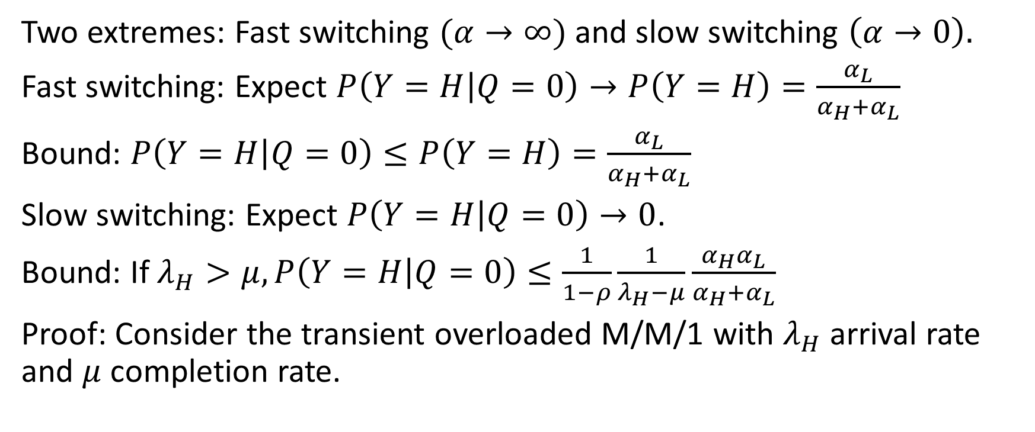
Bounds on empty-queue behavior
$$α_{H}$$
$$λ_{H}$$
$$λ_{L}$$
$$α_{L}$$
Two extremes: Fast switching $(α→∞)$ and slow switching $\left(α→0\right).$
Fast switching: Expect $P\left(Y=H | Q=0\right)→P\left(Y=H\right)=\frac{α_{L}}{α_{H}+α_{L}}$
Bound: $P\left(Y=H | Q=0\right)≤P\left(Y=H\right)=\frac{α_{L}}{α_{H}+α_{L}}$
Slow switching: Expect $P\left(Y=H | Q=0\right)→0$.
Bound: If $λ_{H}>μ, P\left(Y=H | Q=0\right)≤\frac{1}{1−ρ}\frac{1}{λ_{H}−μ}\frac{α_{H}α_{L}}{α_{H}+α_{L}}$
Proof: Consider the transient overloaded M/M/1 with $λ_{H}$ arrival rate and $μ$ completion rate.

Slide 19



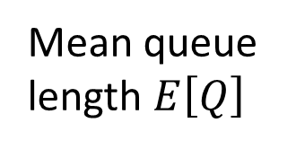
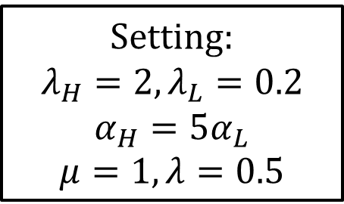
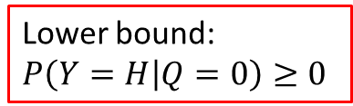







Bounds vs. Simulation
$$α_{H}$$
$$λ_{H}$$
$$λ_{L}$$
$$α_{L}$$
Setting:
$$λ_{H}=2, λ_{L}=0.2$$
$$α_{H}=5α_{L}$$
$$μ=1, λ=0.5$$
$${10}^{1.5}$$
Mean queue length $E\left[Q\right]$
Slow switching bound
$${10}^{1}$$
Simulated $E\left[Q\right]$
$${10}^{0.5}$$
Lower bound:
$P\left(Y=H | Q=0\right)≥0$
Fast switching bound
$${10}^{0}$$
$${10}^{−2}$$
$${10}^{−1}$$
$${10}^{0}$$
$${10}^{1}$$
Switching rate $α=\frac{α_{H}+α_{L}}{2}$

Slide 20
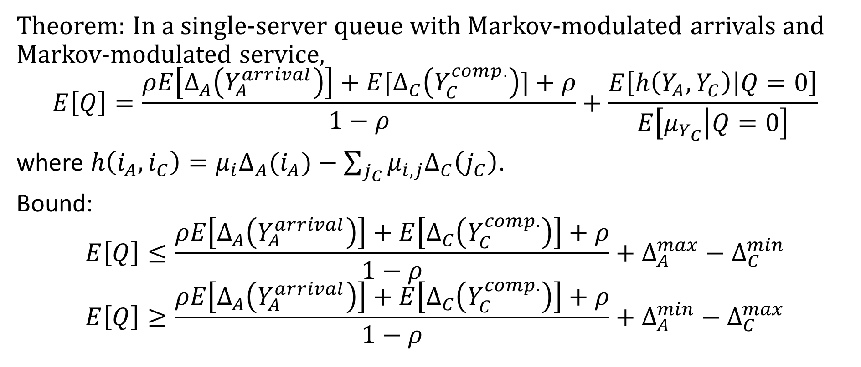
Generalization: Markovian arrivals, Markovian service
Theorem: In a single-server queue with Markov-modulated arrivals and Markov-modulated service,
$$E\left[Q\right]=\frac{ρE\left[Δ_{A}\left(Y_{A}^{arrival}\right)\right]+E[Δ_{C}\left(Y_{C}^{comp.}\right)]+ρ}{1−ρ}+\frac{E\left[h\left(Y_{A},Y_{C}\right) | Q=0\right]}{E\left[μ_{Y_{C}} | Q=0\right]}$$
where $h\left(i_{A},i_{C}\right)={μ_{i}Δ}_{A}(i_{A})−\sum_{j_{C}}{μ_{i,j}Δ_{C}\left(j_{C}\right)}$.
Bound:
$$E\left[Q\right]≤\frac{ρE\left[Δ_{A}\left(Y_{A}^{arrival}\right)\right]+E\left[Δ_{C}\left(Y_{C}^{comp.}\right)\right]+ρ}{1−ρ}+Δ_{A}^{max}−Δ_{C}^{min}$$
$$E\left[Q\right]≥\frac{ρE\left[Δ_{A}\left(Y_{A}^{arrival}\right)\right]+E\left[Δ_{C}\left(Y_{C}^{comp.}\right)\right]+ρ}{1−ρ}+Δ_{A}^{min}−Δ_{C}^{max}$$

Slide 21
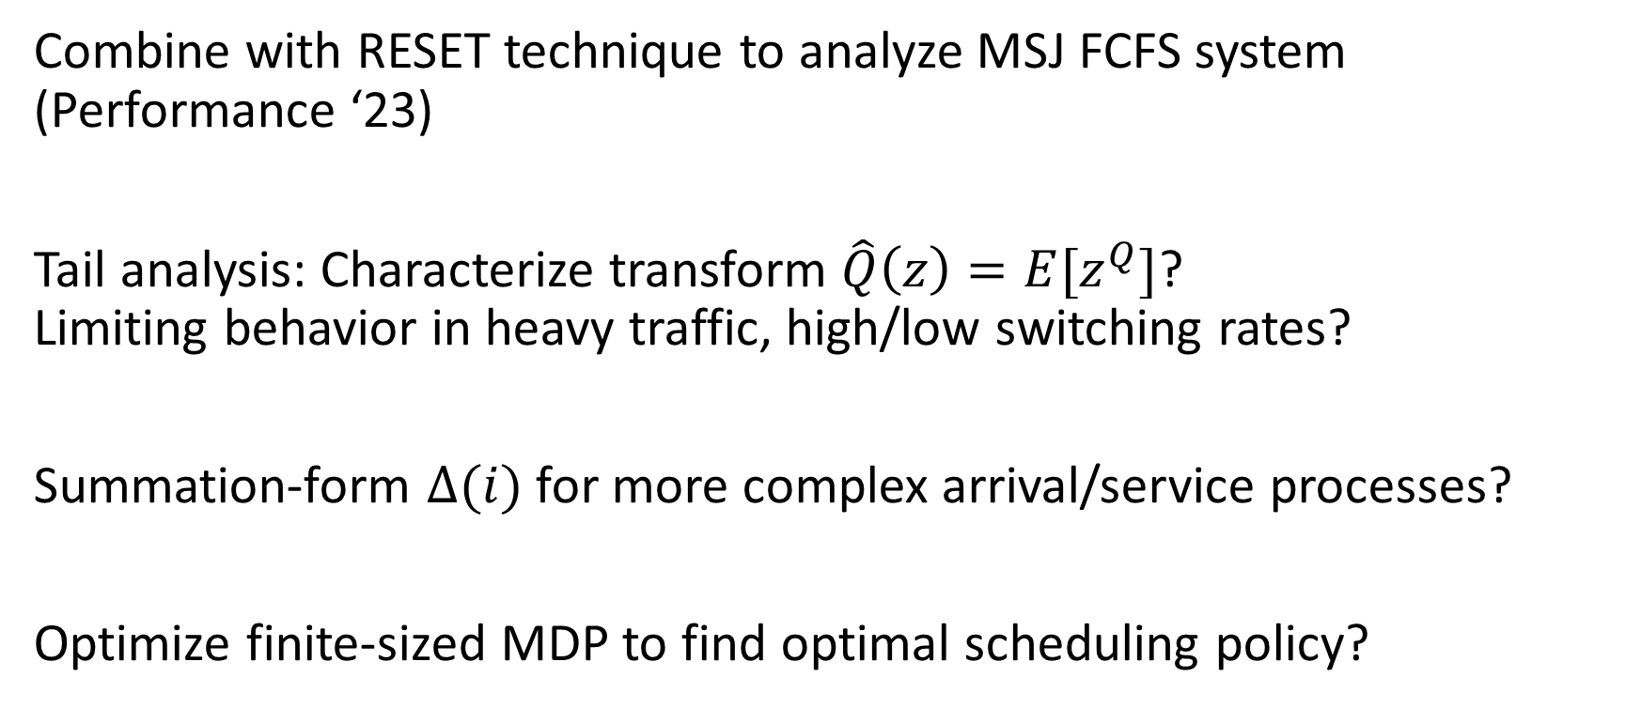
Future directions
Combine with RESET technique to analyze MSJ FCFS system (Performance ‘23)
Tail analysis: Characterize transform $\hat{Q}\left(z\right)=E[z^{Q}]$? Limiting behavior in heavy traffic, high/low switching rates?
Summation-form $Δ(i)$ for more complex arrival/service processes?
Optimize finite-sized MDP to find optimal scheduling policy?

Slide 22

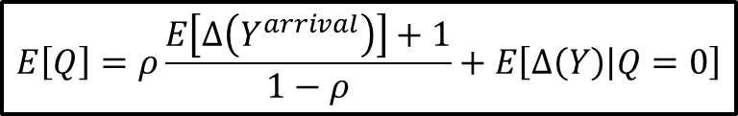








Conclusion
Markov-modulated arrivals, e.g. two-level arrivals:
$$α_{H}$$
$$μ$$
$$λ_{H}$$
$$λ_{L}$$
$$α_{L}$$
$$E\left[Q\right]=ρ\frac{E\left[Δ\left(Y^{arrival}\right)\right]+1}{1−ρ}+E\left[Δ\left(Y\right) | Q=0\right]$$
Relative arrivals $Δ(i)$
10
$$A(H,t)$$
8
$$λt$$
6
$$E\left[Q\right]$$
Expected arrivals
4
$$Δ(H)$$
2
0
0
3
6
9
12
15
Switching rate $α$
Time

