Slide 1

Optimal Scheduling for Multiserver Queues
Thesis Defense – 7/20
Isaac Grosof
CMU $→$ GATech & UIUC $→$ Northwestern

Slide 2







Collaborators – Thank you!
Mor Harchol-Balter Ziv Scully Alan Scheller-Wolf Yige Hong
Kunhe Yang Michael Mitzenmacher Ben Berg

Slide 3

Theory of Large-Scale Computing Systems
Datacenters, Supercomputers
1% of world’s electricity
Need systems to be:
Fast: low response time
Efficient: minimal resources
Scheduling is a key tool

Slide 4

Stochastic Scheduling Theory
Response time: $T$
Stochastic model: Randomized job sizes, randomized arrival times
Scheduling policy: In which order should we serve the jobs?
Notes:
Show many servers, emphasize stochastic, less animations & time

Slide 5
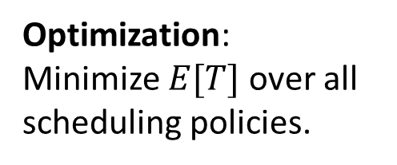
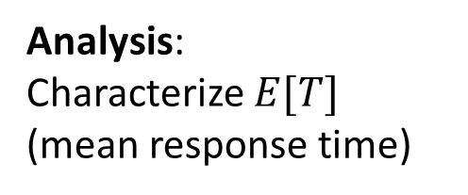
Prior work: Single-server & Multiserver Scheduling
1 server
Multiserver
This thesis!
Analysis: Characterize $E[T]$ (mean response time)
Well understood! [Pollaczek ‘30], [Schrage & Miller ‘66], [Scully ‘18].
Analysis only for First-Come First-Served (FCFS) [Köllerström ‘74 & ‘79]. Nothing for complex scheduling policies.
Optimization: Minimize $E[T]$over all scheduling policies.
Shortest Remaining Processing Time (SRPT) is optimal! [Schrage ‘68].
Entirely open. Negative worst-case results [Leonardi & Raz ‘97].

Slide 6

Outline: Optimal Multiserver Scheduling
Chp. 2: Central queue for many servers
Chp. 3: Dispatching to many servers
Chp. 4: Many servers per job: Analysis
Chp. 5: Many servers per job: Optimality
Chp. 6: Many servers per job: FCFS
Chp. 7: Tail of response time
SRPT for Multiserver Systems [GSH’18]
Load Balancing Guardrails [GSH’19]
WCFS: A new framework for analyzing multiserver systems [GHS’22]
Optimal Scheduling in the Multiserver-job Model under Heavy Traffic [GSHS’23]
The RESET and MARC Techniques, with Application to Multiserver-Job Analysis [GHHS]
Nudge: Stochastically Improving upon FCFS [GYSH’21]
1
1
2
2
4
2
1
2
2
4
1
2
1
1
3
4
2

Slide 7
Outline: Optimal Multiserver Scheduling
Chp. 2: Central queue for many servers
Chp. 3: Dispatching to many servers
Chp. 4: Many servers per job: Analysis
Chp. 5: Many servers per job: Optimality
Chp. 6: Many servers per job: FCFS
Chp. 7: Tail of response time
SRPT for Multiserver Systems [GSH’18]
Load Balancing Guardrails [GSH’19]
WCFS: A new framework for analyzing multiserver systems [GHS’22]
Optimal Scheduling in the Multiserver-job Model under Heavy Traffic [GSHS’23]
The RESET and MARC Techniques, with Application to Multiserver-Job Analysis [GHHS]
Nudge: Stochastically Improving upon FCFS [GYSH’21]
1
1
2
2
4
2
1
2
2
4
1
2
1
1
3
4
2

Slide 8



Problem: Central-queue Multiserver Scheduling
Load $ρ=λE\left[S\right]<1$
Poisson($λ$)
k servers
Size: $S$, i.i.d.
Q: What scheduling policy is optimal?
Notes:
Size is amount of service necessary to complete the job.
Load is long-term fraction of busy servers.
Specify Poisson, I.i.d.
How to make optimal? Paper, award.
SRPT-1
SRPT-k? Worst-case not competitive, so not exact optimum, can still say something?
First analysis
Prove opt as rho -> 1

Slide 9
Problem: Central-queue Multiserver Scheduling
SRPT-k
Load $ρ=λE\left[S\right]<1$
Poisson($λ$)
k servers
Size: $S$, i.i.d.
Q: What scheduling policy is optimal?
A: SRPT-k, but how to prove?
Notes:
Size is amount of service necessary to complete the job.
Load is long-term fraction of busy servers.
Specify Poisson, I.i.d.
How to make optimal? Paper, award.
SRPT-1
SRPT-k? Worst-case not competitive, so not exact optimum, can still say something?
First analysis
Prove opt as rho -> 1

Slide 10






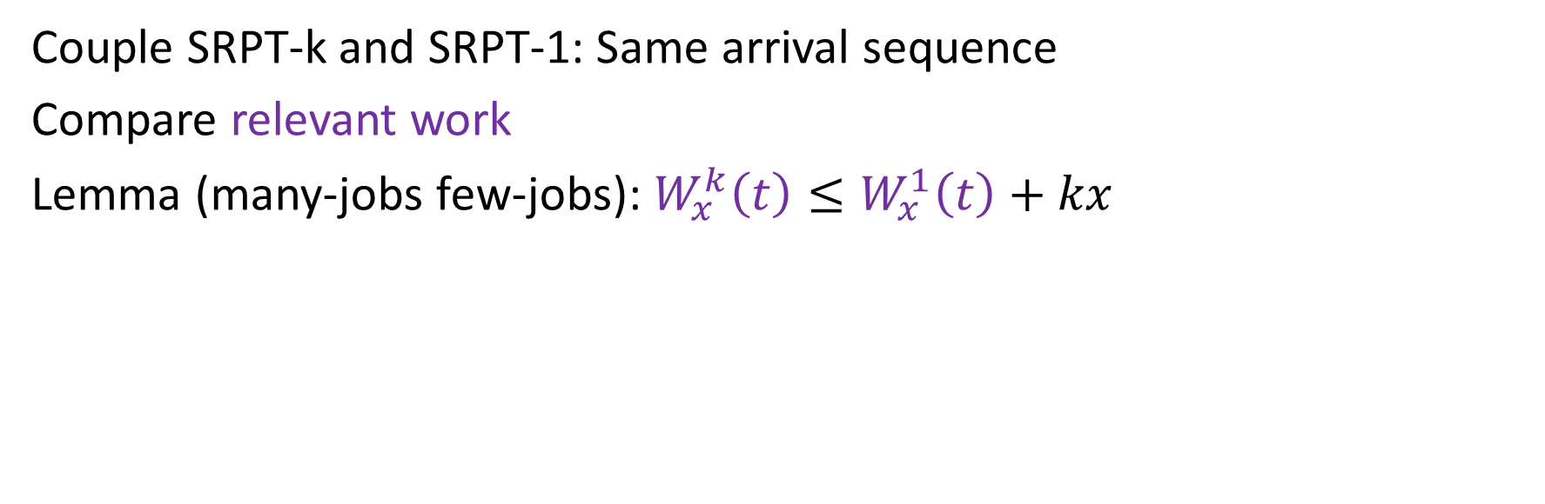

Technique: Resource-pooled SRPT
Speed $1/k$
Speed $1$
$$≤x$$
SRPT-k
SRPT-1
$$≤x$$
Speed $1/k$
$$⟺$$
Speed $1/k$
Couple SRPT-k and SRPT-1: Same arrival sequence
Compare relevant work
Lemma (many-jobs few-jobs): $W_{x}^{k}\left(t\right)≤W_{x}^{1}\left(t\right)+kx$
Notes:
Compare to SRPT-1
Dream of a Parallel computing person.
Bound W_r: Coupling, worst-case.
W_r -> T: Tagged job, work that runs while tagged job in system
Thm: Bound T.
Thm: Near SRPT-1. OPT.

Slide 11
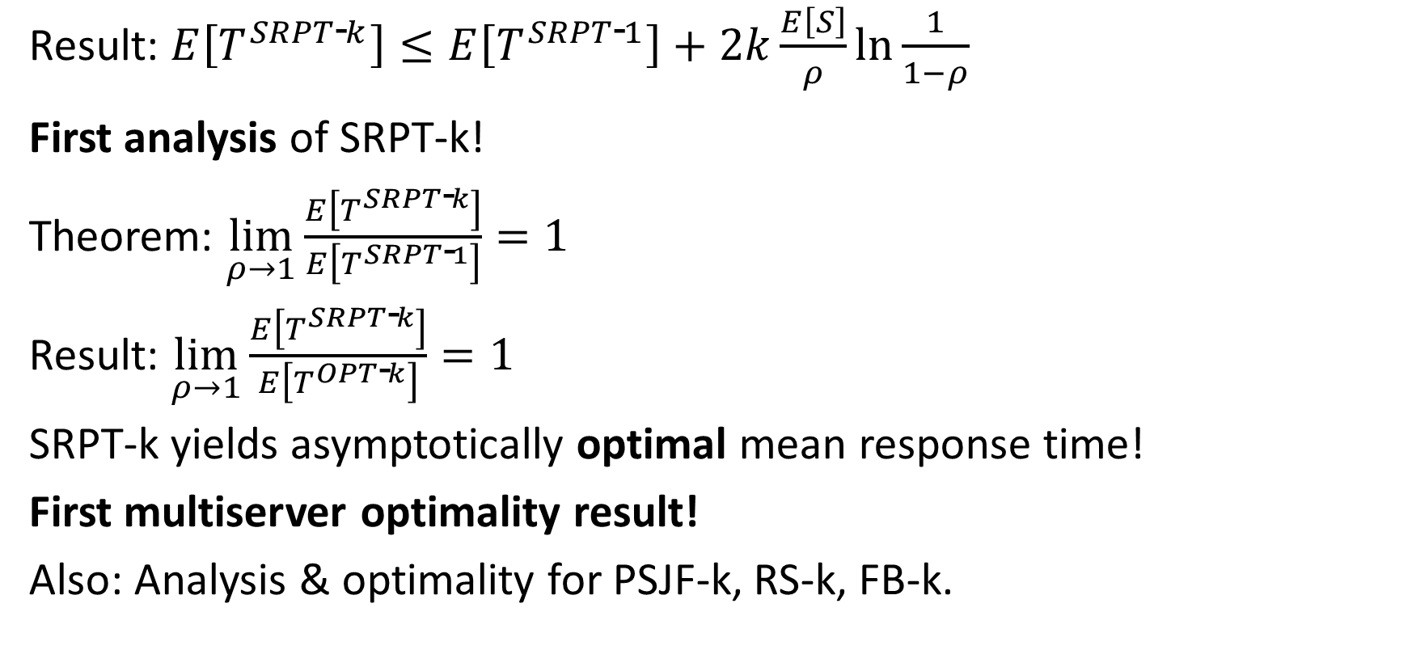
Result: Analysis & Optimality
SRPT-k
Result: $E\left[T^{SRPT\text{‐}k}\right]≤E\left[T^{SRPT\text{‐}1}\right]+2k\frac{E\left[S\right]}{ρ}\ln{\frac{1}{1−ρ}}$
First analysis of SRPT-k!
Theorem: $\lim_{ρ→1}{\frac{E\left[T^{SRPT\text{‐}k}\right]}{E\left[T^{SRPT\text{‐}1}\right]}=1}$
Result: $\lim_{ρ→1}{\frac{E\left[T^{SRPT\text{‐}k}\right]}{E\left[T^{OPT\text{‐}k}\right]}=1 }$
SRPT-k yields asymptotically optimal mean response time!
First multiserver optimality result!
Also: Analysis & optimality for PSJF-k, RS-k, FB-k.

Slide 12
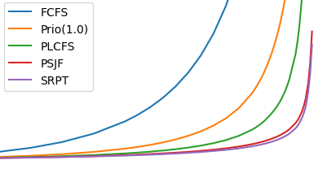

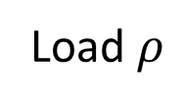
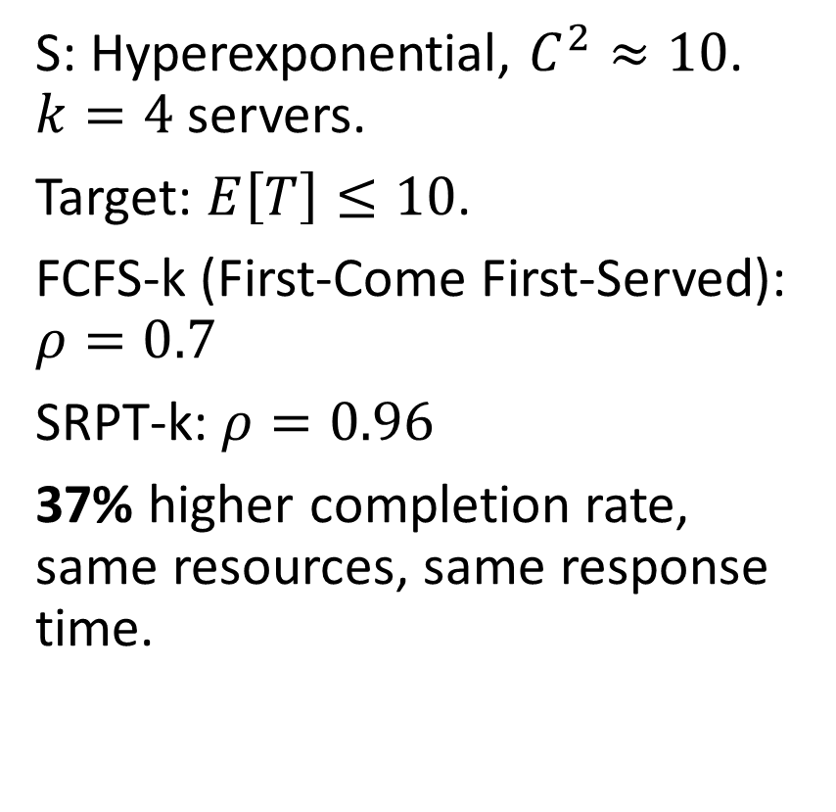
Empirical Impact of SRPT-k
30
S: Hyperexponential, $C^{2}≈10$. $k=4$ servers.
Target: $E\left[T\right]≤10$.
FCFS-k (First-Come First-Served): $ρ=0.7$
SRPT-k: $ρ=0.96$
37% higher completion rate, same resources, same response time.
FCFS-k
Prio-k
PLCFS-k
PSJF-k
SRPT-k
25
20
$$E[T]$$
15
10
5
0
0.5
0.6
0.7
0.8
0.9
1.0
Load $ρ$
Notes:
Load rho=0.5 to 1, interesting behavior.
High variance, k=4
Lower is better, SRPT is the best – PSJF policy also really good - we also prove it’s asymptotically optimal in our paper.

Slide 13
Outline: Optimal Multiserver Scheduling
Chp. 2: Central queue for many servers
Chp. 3: Dispatching to many servers
Chp. 4: Many servers per job: Analysis
Chp. 5: Many servers per job: Optimality
Chp. 6: Many servers per job: FCFS
Chp. 7: Tail of response time
SRPT for Multiserver Systems [GSH’18]
Load Balancing Guardrails [GSH’19]
WCFS: A new framework for analyzing multiserver systems [GHS’22]
Optimal Scheduling in the Multiserver-job Model under Heavy Traffic [GSHS’23]
The RESET and MARC Techniques, with Application to Multiserver-Job Analysis [GHHS]
Nudge: Stochastically Improving upon FCFS [GYSH’21]
1
1
2
2
4
2
1
2
2
4
1
2
1
1
3
4
2

Slide 14
Outline: Optimal Multiserver Scheduling
Chp. 2: Central queue for many servers
Chp. 3: Dispatching to many servers
Chp. 4: Many servers per job: Analysis
Chp. 5: Many servers per job: Optimality
Chp. 6: Many servers per job: FCFS
Chp. 7: Tail of response time
SRPT for Multiserver Systems [GSH’18]
Load Balancing Guardrails [GSH’19]
WCFS: A new framework for analyzing multiserver systems [GHS’22]
Optimal Scheduling in the Multiserver-job Model under Heavy Traffic [GSHS’23]
The RESET and MARC Techniques, with Application to Multiserver-Job Analysis [GHHS]
Nudge: Stochastically Improving upon FCFS [GYSH’21]
1
1
2
2
4
2
1
2
2
4
1
2
1
1
3
4
2

Slide 15
Problem: Dispatching + Scheduling
SRPT
?
SRPT
SRPT
How to schedule, how to dispatch?
State of the art: Dispatch to FCFS. Join-the-Shortest-Queue, Least-Work-Left.
LWL+SRPT can be terrible!
Idea: Spread out small jobs

Slide 16
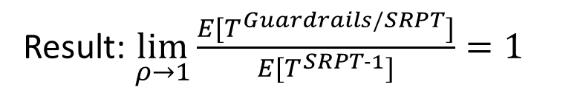
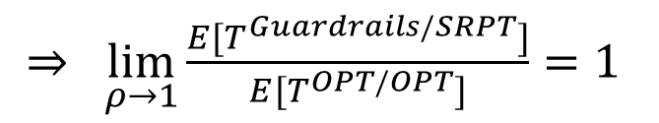
Contribution: Guardrails Dispatching
SRPT
Guard.
SRPT
SRPT
Guardrails policy:
Bucket sizes multiplicatively,
Equalize dispatched work in each bucket across servers.
...
...
1 2 4 8
Size
Result: $\lim_{ρ→1}{\frac{E[T^{Guardrails/SRPT}]}{E[T^{SRPT‐1}]}}=1$
$⇒ \lim_{ρ→1}{\frac{E[T^{Guardrails/SRPT}]}{E[T^{OPT/OPT}]}}=1$
Notes:
Full benefit of SRPT scheduling

Slide 17
Outline: Optimal Multiserver Scheduling
Chp. 2: Central queue for many servers
Chp. 3: Dispatching to many servers
Chp. 4: Many servers per job: Analysis
Chp. 5: Many servers per job: Optimality
Chp. 6: Many servers per job: FCFS
Chp. 7: Tail of response time
SRPT for Multiserver Systems [GSH’18]
Load Balancing Guardrails [GSH’19]
WCFS: A new framework for analyzing multiserver systems [GHS’22]
Optimal Scheduling in the Multiserver-job Model under Heavy Traffic [GSHS’23]
The RESET and MARC Techniques, with Application to Multiserver-Job Analysis [GHHS]
Nudge: Stochastically Improving upon FCFS [GYSH’21]
1
1
2
2
4
2
1
2
2
4
1
2
1
1
3
4
2

Slide 18
Outline: Optimal Multiserver Scheduling
Chp. 2: Central queue for many servers
Chp. 3: Dispatching to many servers
Chp. 4: Many servers per job: Analysis
Chp. 5: Many servers per job: Optimality
Chp. 6: Many servers per job: FCFS
Chp. 7: Tail of response time
SRPT for Multiserver Systems [GSH’18]
Load Balancing Guardrails [GSH’19]
WCFS: A new framework for analyzing multiserver systems [GHS’22]
Optimal Scheduling in the Multiserver-job Model under Heavy Traffic [GSHS’23]
The RESET and MARC Techniques, with Application to Multiserver-Job Analysis [GHHS]
Nudge: Stochastically Improving upon FCFS [GYSH’21]
1
1
2
2
4
2
1
2
2
4
1
2
1
1
3
4
2

Slide 19
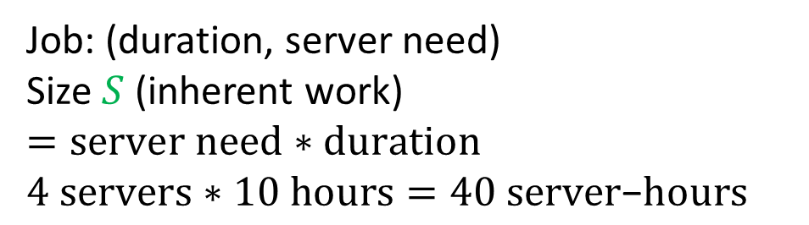
Problem: Many Servers/Job Scheduling
3
Size
2
Server need
2
4
2
3
3
1
Wasted Server
Jobs can need several servers
All servers concurrently utilized
Challenge: Wasted servers
Job: (duration, server need)
Size $S$ (inherent work) $=server need∗duration$
$4 servers∗10 hours=40 server\text{−}hours$
Notes:
Emphasize: Uses all servers for full duration

Slide 20
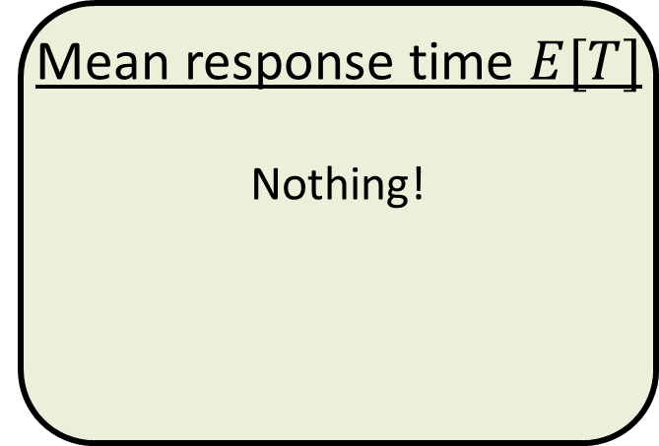
State of the Art on MSJ Scheduling
Stability region
(e.g. Throughput, Utilization)
Analysis: MSJ FCFS [RM’17]
Optimization:
MaxWeight [MSY’12]
Randomized Timers [PG’18]
Mean response time $E[T]$
Nothing!
Poor stability, hard analysis
Complex policies
Q: Analyze mean response time for even a single policy?
Idea: Simple policy + max stability $⇒$Mean response time analysis

Slide 21
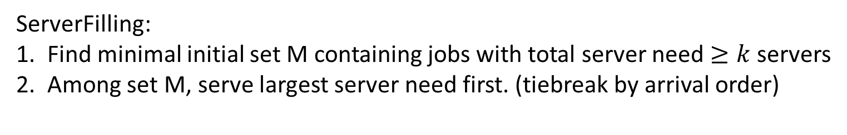
Contribution: ServerFilling
Setting: Server needs are powers of 2, $k$ is power of 2
k=8
M
Arrival order
1
2
1
1
2
1
2
4
2
1
2
1
1
1
ServerFilling:
Find minimal initial set M containing jobs with total server need $≥k$servers
Among set M, serve largest server need first. (tiebreak by arrival order)

Slide 22
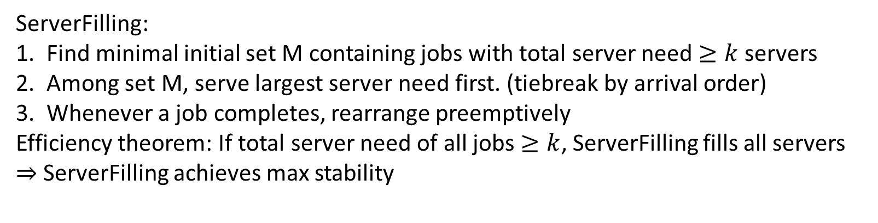
Contribution: ServerFilling
Setting: Server needs are powers of 2, $k$ is power of 2
k=8
M
Arrival order
4
1
2
1
1
2
1
2
2
2
1
2
1
1
1
1
ServerFilling:
Find minimal initial set M containing jobs with total server need $≥k$servers
Among set M, serve largest server need first. (tiebreak by arrival order)
Whenever a job completes, rearrange preemptively
Efficiency theorem: If total server need of all jobs $≥k$, ServerFilling fills all servers
$⇒$ ServerFilling achieves max stability
1
Notes:
We’ve got what we want: Simple & max stability. Now, analyze!

Slide 23
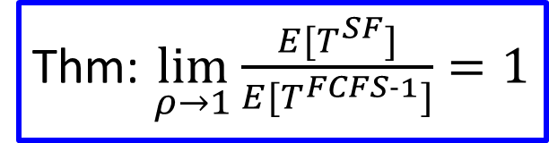

Result: Analyze Mean Response Time
ServerFilling
4
Resource-pooled FCFS
$$⟺$$
2
4
2
1
2
1
1
Want to show: Same total work in both systems
Key idea: Complete work at same rate, whenever not wasting servers
Thm: $\lim_{ρ→1}{\frac{E[T^{SF}]}{E[T^{FCFS‐1}]}}=1$

Slide 24

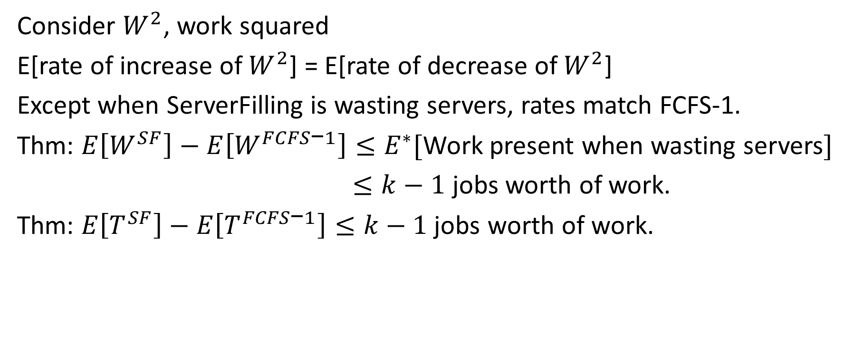
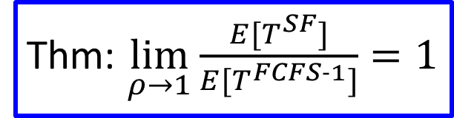

Technique: $W^{2}$ Method
ServerFilling
4
FCFS-1
$$⟺$$
2
4
2
2
1
1
1
Consider $W^{2}$, work squared
E[rate of increase of $W^{2}$] = E[rate of decrease of $W^{2}$]
Except when ServerFilling is wasting servers, rates match FCFS-1.
Thm: $E\left[W^{SF}\right]−E\left[W^{FCFS\text{−}1}\right]≤E^{∗}[$Work present when wasting servers$]$
$≤k−1$ jobs worth of work.
Thm: $E\left[T^{SF}\right]−E\left[T^{FCFS\text{−}1}\right]≤k−1 \text{jobs} \text{worth} \text{of} \text{work}\text{.}$
Thm: $\lim_{ρ→1}{\frac{E[T^{SF}]}{E[T^{FCFS‐1}]}}=1$

Slide 25
Outline: Optimal Multiserver Scheduling
Chp. 2: Central queue for many servers
Chp. 3: Dispatching to many servers
Chp. 4: Many servers per job: Analysis
Chp. 5: Many servers per job: Optimality
Chp. 6: Many servers per job: FCFS
Chp. 7: Tail of response time
SRPT for Multiserver Systems [GSH’18]
Load Balancing Guardrails [GSH’19]
WCFS: A new framework for analyzing multiserver systems [GHS’22]
Optimal Scheduling in the Multiserver-job Model under Heavy Traffic [GSHS’23]
The RESET and MARC Techniques, with Application to Multiserver-Job Analysis [GHHS]
Nudge: Stochastically Improving upon FCFS [GYSH’21]
1
1
2
2
4
2
1
2
2
4
1
2
1
1
3
4
2

Slide 26
Outline: Optimal Multiserver Scheduling
Chp. 2: Central queue for many servers
Chp. 3: Dispatching to many servers
Chp. 4: Many servers per job: Analysis
Chp. 5: Many servers per job: Optimality
Chp. 6: Many servers per job: FCFS
Chp. 7: Tail of response time
SRPT for Multiserver Systems [GSH’18]
Load Balancing Guardrails [GSH’19]
WCFS: A new framework for analyzing multiserver systems [GHS’22]
Optimal Scheduling in the Multiserver-job Model under Heavy Traffic [GSHS’23]
The RESET and MARC Techniques, with Application to Multiserver-Job Analysis [GHHS]
Nudge: Stochastically Improving upon FCFS [GYSH’21]
1
1
2
2
4
2
1
2
2
4
1
2
1
1
3
4
2

Slide 27

Problem: Optimal MSJ Scheduling
Contribution: ServerFilling-SRPT
ServerFilling-SRPT:
Find minimal subset M of jobs of least remaining size with total server need $≥k$servers
Among M, serve largest server need first. (tiebreak by remaining size)
k=8
M
Least remaining size order
2
4
1
2
8
1
1
4
4
1
2
1
1
Notes:
Small means small size.

Slide 28

Problem: Optimal MSJ Scheduling
Contribution: ServerFilling-SRPT
ServerFilling-SRPT:
Find minimal subset M of jobs of least remaining size with total server need $≥k$servers
Among M, serve largest server need first. (tiebreak by remaining size)
Whenever M changes, rearrange preemptively.
Theorem: If $≥k$ jobs present, fills all servers
k=8
M
Least remaining size order
4
2
4
1
2
8
1
1
4
1
2
1
1
2
1
1
Notes:
Small means small size.

Slide 29
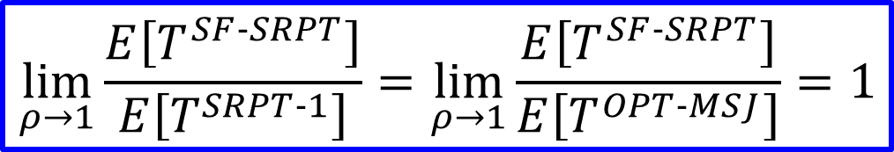

Result: ServerFilling-SRPT Optimality
ServerFilling-SRPT
4
SRPT-1
$$⟺$$
1
2
4
1
2
2
$$\lim_{ρ→1}\frac{E\left[T^{SF‐SRPT}\right]}{E\left[T^{SRPT‐1}\right]}=\lim_{ρ→1}{\frac{E\left[T^{SF‐SRPT}\right]}{E\left[T^{OPT‐MSJ}\right]}=1}$$
Notes:
TODO: Redo work w/ server need.

Slide 30



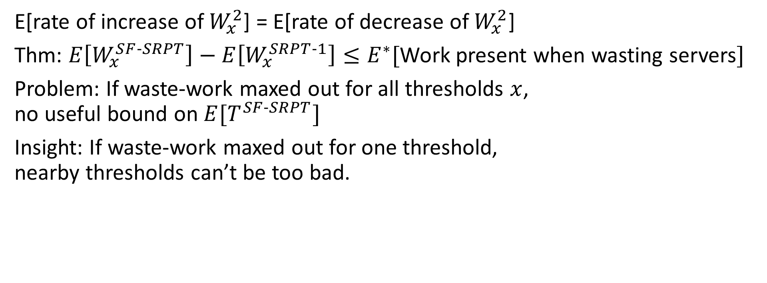
Technique: $W_{x}^{2}$ method
ServerFilling-SRPT
4
SRPT-1
2
$$⟺$$
4
1
2
2
1
1
E[rate of increase of $W_{x}^{2}$] = E[rate of decrease of $W_{x}^{2}$]
Thm: $E\left[W_{x}^{SF‐SRPT}\right]−E\left[W_{x}^{SRPT‐1}\right]≤E^{∗}[$Work present when wasting servers$]$
Problem: If waste-work maxed out for all thresholds $x$, no useful bound on $E[T^{SF‐SRPT}]$
Insight: If waste-work maxed out for one threshold, nearby thresholds can’t be too bad.
Result: $E\left[T^{SF‐SRPT}\right]−E\left[T^{SRPT‐1}\right]≤\frac{\left(e+1\right)\left(k−1\right)}{λ}ln\frac{1}{1−ρ}+\frac{e}{λ}$
$$\lim_{ρ→1}\frac{E\left[T^{SF‐SRPT}\right]}{E\left[T^{SRPT‐1}\right]}=\lim_{ρ→1}{\frac{E\left[T^{SF‐SRPT}\right]}{E\left[T^{OPT‐MSJ}\right]}=1}$$
Notes:
Again negligible in heavy traffic

Slide 31
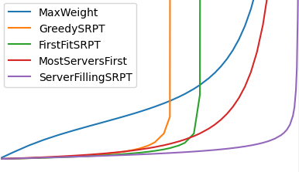
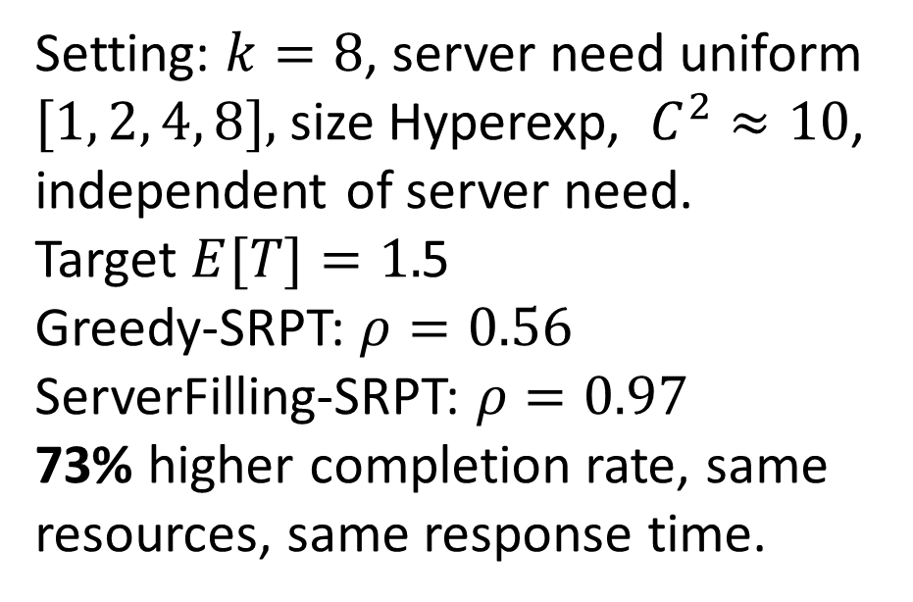

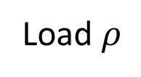
Empirical Impact of ServerFilling-SRPT
5
Setting: $k=8$, server need uniform $[1, 2, 4, 8],$ size Hyperexp, $C^{2}≈10$, independent of server need.
Target $E[T]=1.$5
Greedy-SRPT: $ρ=0.56$
ServerFilling-SRPT: $ρ=0.97$
73% higher completion rate, same resources, same response time.
4
3
$$E[T]$$
2
1
0
0
0.2
0.4
0.6
0.8
1.0
Load $ρ$
Notes:
Admit as many customers as possible subject to E[T] limit.

Slide 32
Outline: Optimal Multiserver Scheduling
Chp. 2: Central queue for many servers
Chp. 3: Dispatching to many servers
Chp. 4: Many servers per job: Analysis
Chp. 5: Many servers per job: Optimality
Chp. 6: Many servers per job: FCFS
Chp. 7: Tail of response time
SRPT for Multiserver Systems [GSH’18]
Load Balancing Guardrails [GSH’19]
WCFS: A new framework for analyzing multiserver systems [GHS’22]
Optimal Scheduling in the Multiserver-job Model under Heavy Traffic [GSHS’23]
The RESET and MARC Techniques, with Application to Multiserver-Job Analysis [GHHS]
Nudge: Stochastically Improving upon FCFS [GYSH’21]
1
1
2
2
4
2
1
2
2
4
1
2
1
1
3
4
2

Slide 33
Outline: Optimal Multiserver Scheduling
Chp. 2: Central queue for many servers
Chp. 3: Dispatching to many servers
Chp. 4: Many servers per job: Analysis
Chp. 5: Many servers per job: Optimality
Chp. 6: Many servers per job: FCFS
Chp. 7: Tail of response time
SRPT for Multiserver Systems [GSH’18]
Load Balancing Guardrails [GSH’19]
WCFS: A new framework for analyzing multiserver systems [GHS’22]
Optimal Scheduling in the Multiserver-job Model under Heavy Traffic [GSHS’23]
The RESET and MARC Techniques, with Application to Multiserver-Job Analysis [GHHS]
Nudge: Stochastically Improving upon FCFS [GYSH’21]
1
1
2
2
4
2
1
2
2
4
1
2
1
1
3
4
2

Slide 34
Problem: Analyze MSJ FCFS
Problem: How to analyze if not filling the servers?
Important practical policy
Rate of work-completion is changing
No resource pooling
Don’t know how to analyze any rate changing system.
Subproblems:
Rate-changing system
Analyze MSJ FCFS
3
FCFS
2
4
2
3
1
1
Wasted Server

Slide 35

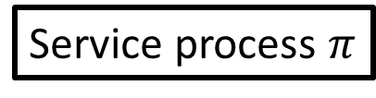
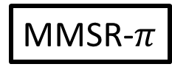
Rate-changing system: Markovian Service Rate
MMSR-$π$
Service process $π$
$$μ_{i}$$
y
M/M/1 with Markovian Service Rate (MMSR)
Service rate varies according to finite-state Markov chain
Important model for lots of computing systems
No closed-form response time analysis

Slide 36
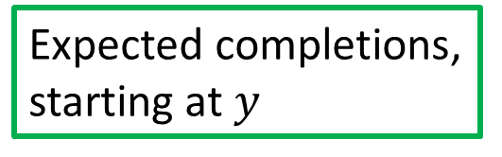

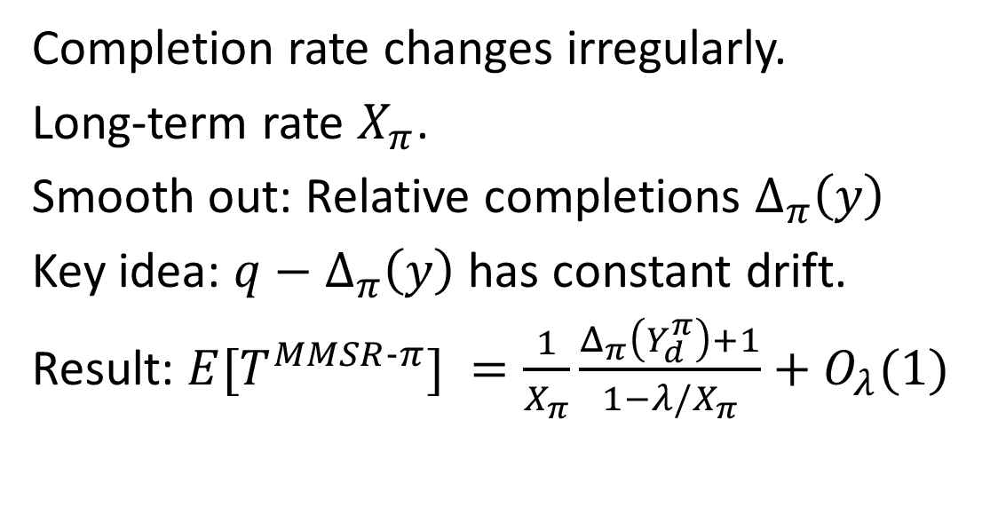
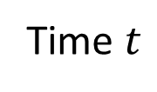



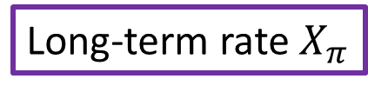
Technique: Relative Completions
MMSR-$π$
Service process $π$
y
Expected completions, starting at $y$
Completion rate changes irregularly.
Long-term rate $X_{π}$.
Smooth out: Relative completions $Δ_{π}\left(y\right)$
Key idea: $q−Δ_{π}\left(y\right)$ has constant drift.
Result: $E[T^{MMSR‐π}] =\frac{1}{X_{π}}\frac{Δ_{π}\left(Y_{d}^{π}\right)+1}{1−λ/X_{π}}+O_{λ}(1)$
Completions
$$Δ_{π}\left(y\right)$$
$Y_{d}$: Departure-average distribution
Long-term rate $X_{π}$
$λ/X_{π}≡ρ$ (load)
Time $t$

Slide 37

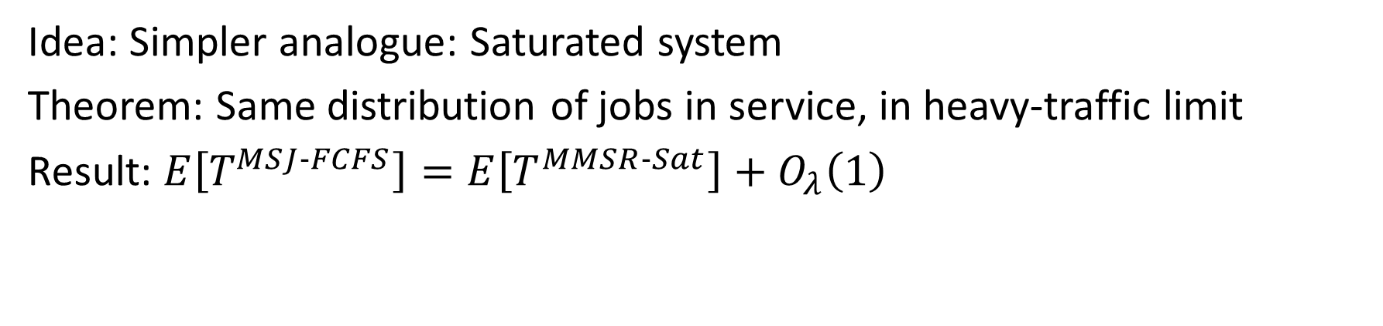
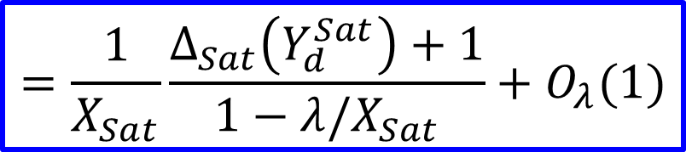
Technique: Saturated System
MMSR-Sat
FCFS
1
Saturated System
$$⟺$$
New job
1
2
1
3
4
2
3
4
Idea: Simpler analogue: Saturated system
Theorem: Same distribution of jobs in service, in heavy-traffic limit
Result: $E\left[T^{MSJ‐FCFS}\right]=E\left[T^{MMSR‐Sat}\right]+O_{λ}\left(1\right)$
$$=\frac{1}{X_{Sat}}\frac{Δ_{Sat}\left(Y_{d}^{Sat}\right)+1}{1−λ/X_{Sat}}+O_{λ}(1)$$

Slide 38
Outline: Optimal Multiserver Scheduling
Chp. 2: Central queue for many servers
Chp. 3: Dispatching to many servers
Chp. 4: Many servers per job: Analysis
Chp. 5: Many servers per job: Optimality
Chp. 6: Many servers per job: FCFS
Chp. 7: Tail of response time
SRPT for Multiserver Systems [GSH’18]
Load Balancing Guardrails [GSH’19]
WCFS: A new framework for analyzing multiserver systems [GHS’22]
Optimal Scheduling in the Multiserver-job Model under Heavy Traffic [GSHS’23]
The RESET and MARC Techniques, with Application to Multiserver-Job Analysis [GHHS]
Nudge: Stochastically Improving upon FCFS [GYSH’21]
1
1
2
2
4
2
1
2
2
4
1
2
1
1
3
4
2

Slide 39
Outline: Optimal Multiserver Scheduling
Chp. 2: Central queue for many servers
Chp. 3: Dispatching to many servers
Chp. 4: Many servers per job: Analysis
Chp. 5: Many servers per job: Optimality
Chp. 6: Many servers per job: FCFS
Chp. 7: Tail of response time
SRPT for Multiserver Systems [GSH’18]
Load Balancing Guardrails [GSH’19]
WCFS: A new framework for analyzing multiserver systems [GHS’22]
Optimal Scheduling in the Multiserver-job Model under Heavy Traffic [GSHS’23]
The RESET and MARC Techniques, with Application to Multiserver-Job Analysis [GHHS]
Nudge: Stochastically Improving upon FCFS [GYSH’21]
1
1
2
2
4
2
1
2
2
4
1
2
1
1
3
4
2

Slide 40
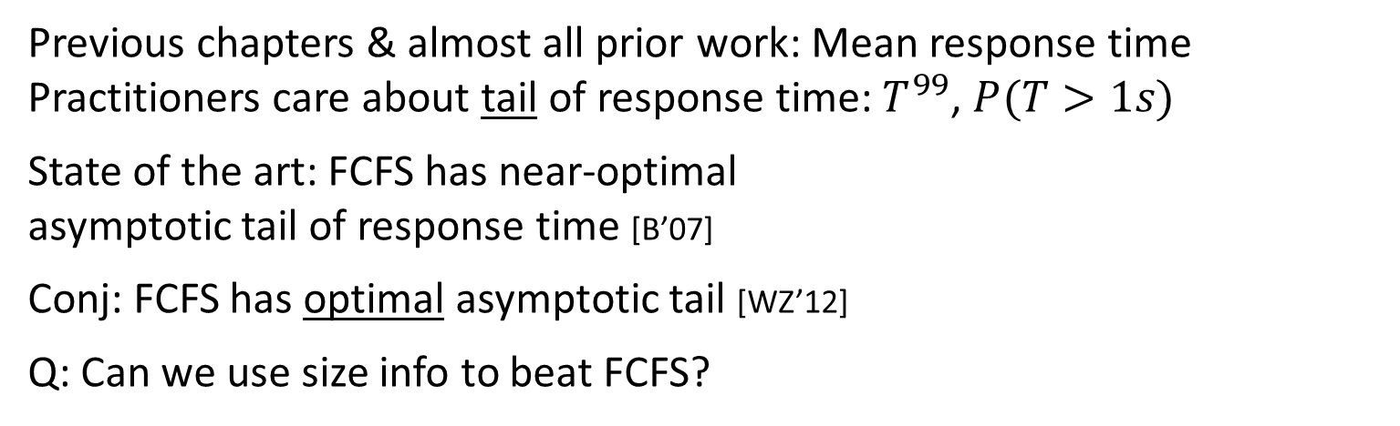


Problem: Tail of Response Time
Previous chapters & almost all prior work: Mean response time
Practitioners care about tail of response time: $T^{99}$, $P(T>1s)$
State of the art: FCFS has near-optimal asymptotic tail of response time [B’07]
Conj: FCFS has optimal asymptotic tail [WZ’12]
Q: Can we use size info to beat FCFS?
Threshold $t$
$$\log{P(T>t)}$$
SRPT
FCFS
Notes:
Mention that SRPT is terrible - large jobs dominate the tail.

Slide 41
Contribution: Nudge
Excuse me!
Starting point: FCFS
Classify jobs as small or large by size
When small arrives, if large is last in queue, small nudges ahead of large

Slide 42
Contribution: Nudge
Nudged!
Starting point: FCFS
Classify jobs as small or large by size
When small arrives, if large is last in queue, small nudges ahead of large
Large can only be nudged once.

Slide 43
Contribution: Nudge
Nudged!
L
Starting point: FCFS
Classify jobs as small or large by size
When small arrives, if large is last in queue, small nudges ahead of large
Large can only be nudged once.

Slide 44
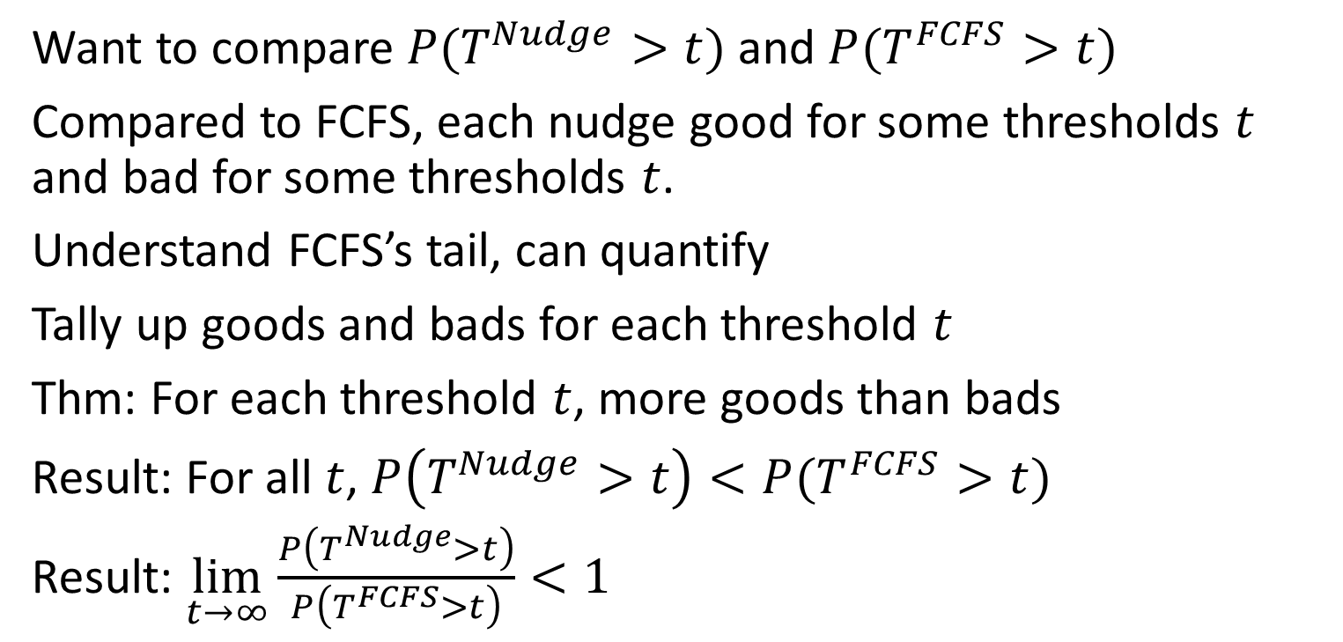
Technique: Relative analysis
Excuse me!
Want to compare $P(T^{Nudge}>t)$ and $P(T^{FCFS}>t)$
Compared to FCFS, each nudge good for some thresholds $t$ and bad for some thresholds $t$.
Understand FCFS’s tail, can quantify
Tally up goods and bads for each threshold $t$
Thm: For each threshold $t$, more goods than bads
Result: For all $t$, $P\left(T^{Nudge}>t\right)<P(T^{FCFS}>t)$
Result: $\lim_{t→∞}\frac{P\left(T^{Nudge}>t\right)}{P\left(T^{FCFS}>t\right)}<1$

Slide 45
Outline: Optimal Multiserver Scheduling
Chp. 2: Central queue for many servers
Chp. 3: Dispatching to many servers
Chp. 4: Many servers per job: Analysis
Chp. 5: Many servers per job: Optimality
Chp. 6: Many servers per job: FCFS
Chp. 7: Tail of response time
SRPT for Multiserver Systems [GSH’18]
Load Balancing Guardrails [GSH’19]
WCFS: A new framework for analyzing multiserver systems [GHS’22]
Optimal Scheduling in the Multiserver-job Model under Heavy Traffic [GSHS’23]
The RESET and MARC Techniques, with Application to Multiserver-Job Analysis [GHHS]
Nudge: Stochastically Improving upon FCFS [GYSH’21]
1
1
2
2
4
2
1
2
2
4
1
2
1
1
3
4
2

Slide 46

Thesis structure
Chp. 1: Accessible introduction and motivation
Each technical chapter 2-7:
Introduction for lay-person
Conclusion: Potential impact for computer system scheduling, and for scheduling people. Also, further applications of techniques.
Chp. 8: Five open problems with discussion of future directions.

Slide 47
Conclusion: Optimal Multiserver Scheduling
Chp. 2: Central queue for many servers
Chp. 3: Dispatching to many servers
Chp. 4: Many servers per job: Analysis
Chp. 5: Many servers per job: Optimality
Chp. 6: Many servers per job: FCFS
Chp. 7: Tail of response time
SRPT for Multiserver Systems [GSH’18]
Load Balancing Guardrails [GSH’19]
WCFS: A new framework for analyzing multiserver systems [GHS’22]
Optimal Scheduling in the Multiserver-job Model under Heavy Traffic [GSHS’23]
The RESET and MARC Techniques, with Application to Multiserver-Job Analysis [GHHS]
Nudge: Stochastically Improving upon FCFS [GYSH’21]
1
1
2
2
4
2
1
2
2
4
1
2
1
1
3
4
2

Slide 48
Backup slides

Slide 49
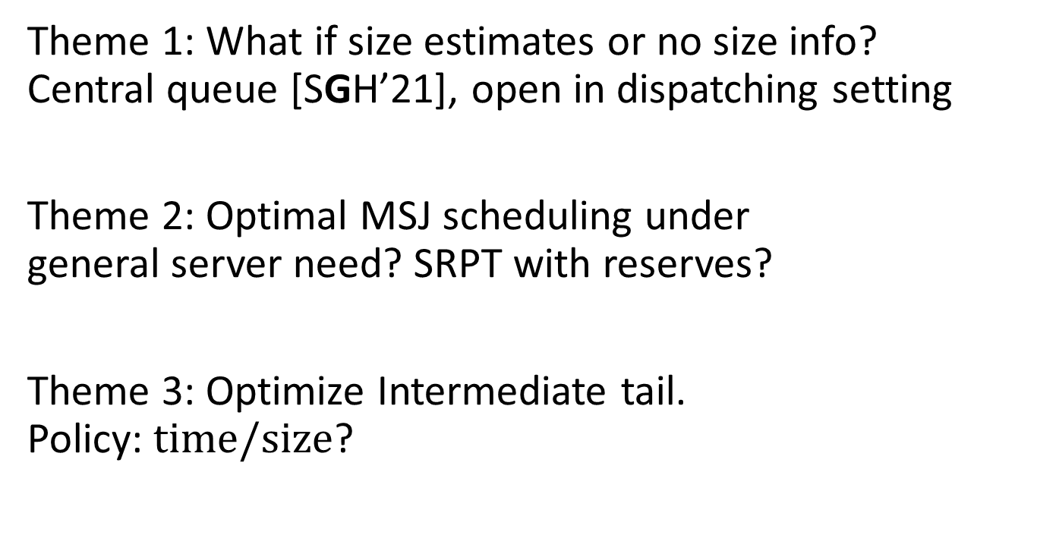
Future directions & Open problems
Theme 1: What if size estimates or no size info? Central queue [SGH’21], open in dispatching setting
Theme 2: Optimal MSJ scheduling under general server need? SRPT with reserves?
Theme 3: Optimize Intermediate tail. Policy: $time/size$?
?
3
2
1
4
3
2
SRPT
Intermediate tail
Nudge

Slide 50


Optimal Scheduling for Multiserver Queues
Theme 1: Multiserver Scheduling
Theme 2: Multiserver-job Scheduling
2
1
2
4
1
2
Theme 3: Tail of Response Time
$$P(T>t)$$
Threshold $t$

