Slide 1


Asymptotically Optimal Multiserver Scheduling
Isaac Grosof
Ziv Scully
Mor Harchol-Balter
Carnegie Mellon University
YEQT 2021

Slide 2
Two papers on Multiserver Scheduling
“SRPT for Multiserver Systems”. Grosof, Scully, and Harchol-Balter. IFIP Performance 2018
“The Gittins Policy is Nearly Optimal in the M/G/k under Extremely General Conditions”. Grosof, Scully, and Harchol-Balter. ACM SIGMETRICS 2021
View at my website: isaacg1.github.io

Slide 3
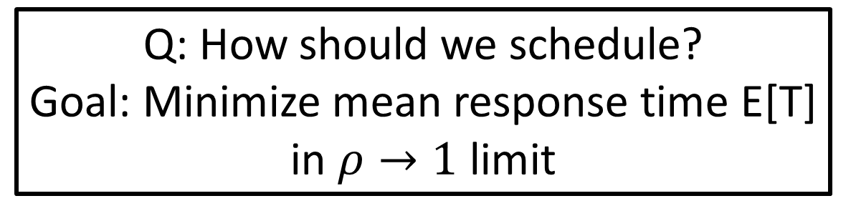
Multiserver scheduling: M/G/k
Mean fraction of servers busy:
Load: ρ = λE[S]<1
Jobs
Poisson arrivals with rate λ
k servers
Remaining size
General job size distribution: S, i.i.d.
Q: How should we schedule?
Goal: Minimize mean response time E[T] in $ρ→1$ limit
Response time: T
Time from arrival to completion
Notes:
Preempt-resume service, so jobs can be put back when they’re partially complete.
Most often analyzed under FCFS, we’re going to thing about how to schedule.
Q: Too cluttered?

Slide 4

Known size M/G/k
“SRPT for Multiserver Systems”. IFIP Performance 2018
First paper to bound $E[T^{SRPT−k}]$
First paper to prove heavy-traffic optimality of SRPT-k.
Bonus: Also handles PSJF, SMART, FB, etc. See paper.
SRPT-k
Notes:
It’s the optimal policy in a single-server setting, so it makes sense to examine here.
Ordered by remaining size
I’m going to walk you through how we do this.

Slide 5
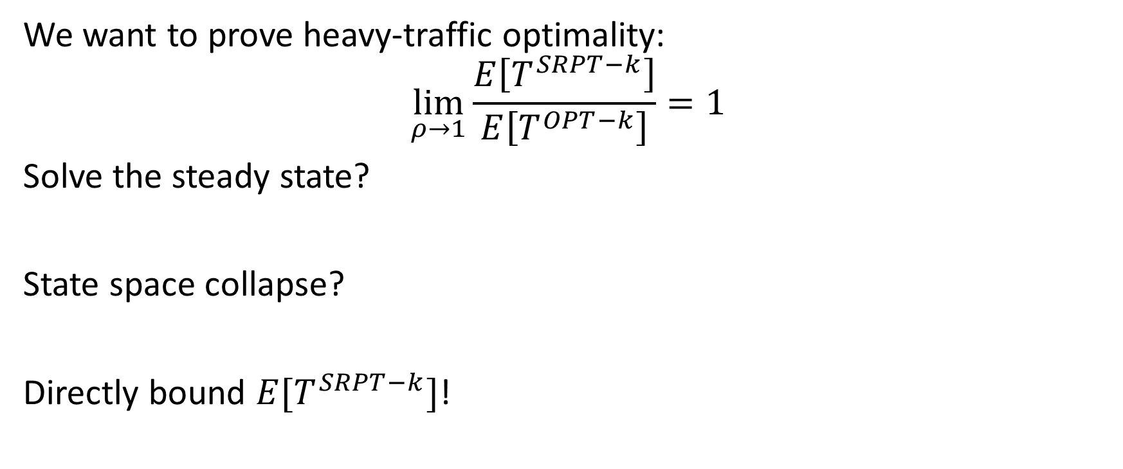
Proof structure
We want to prove heavy-traffic optimality:
$$\lim_{ρ→1}\frac{E\left[T^{SRPT−k}\right]}{E\left[T^{OPT−k}\right]}=1$$
Solve the steady state?
State space collapse?
Directly bound $E[T^{SRPT−k}]$!
SRPT-k
Notes:
Infinite dimensional, sounds awful.
How are we going to bound
Consider for cut

Slide 6
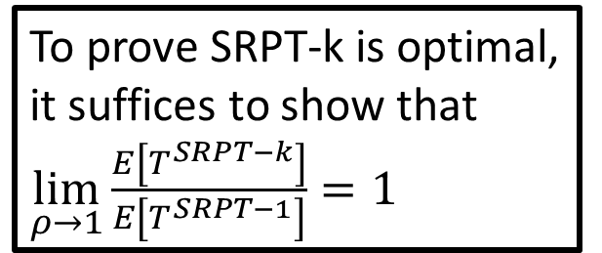
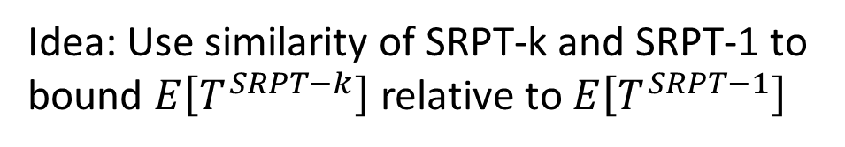
Idea: Compare to M/G/k to M/G/1
SRPT-k
SRPT-1
Speed 1/k
Speed 1/k
Speed 1/k
Speed 1/k
Idea: Use similarity of SRPT-k and SRPT-1 to bound $E\left[T^{SRPT−k}\right]$ relative to $E\left[T^{SRPT−1}\right]$
To prove SRPT-k is optimal, it suffices to show that $\lim_{ρ→1}\frac{E\left[T^{SRPT−k}\right]}{E\left[T^{SRPT−1}\right]}=1$
$$E\left[T^{SRPT−k}\right]≥E\left[T^{OPT−k}\right]≥E\left[T^{OPT−1}\right]=E[T^{SRPT−1}]$$
Notes:
Why is that useful?

Slide 7
Background for bound: Relevant work
SRPT-k
x
RelevantWork(x): Total remaining size of jobs with remaining size $≤x$.
Notes:
Important concept in the M/G/1 analysis.

Slide 8
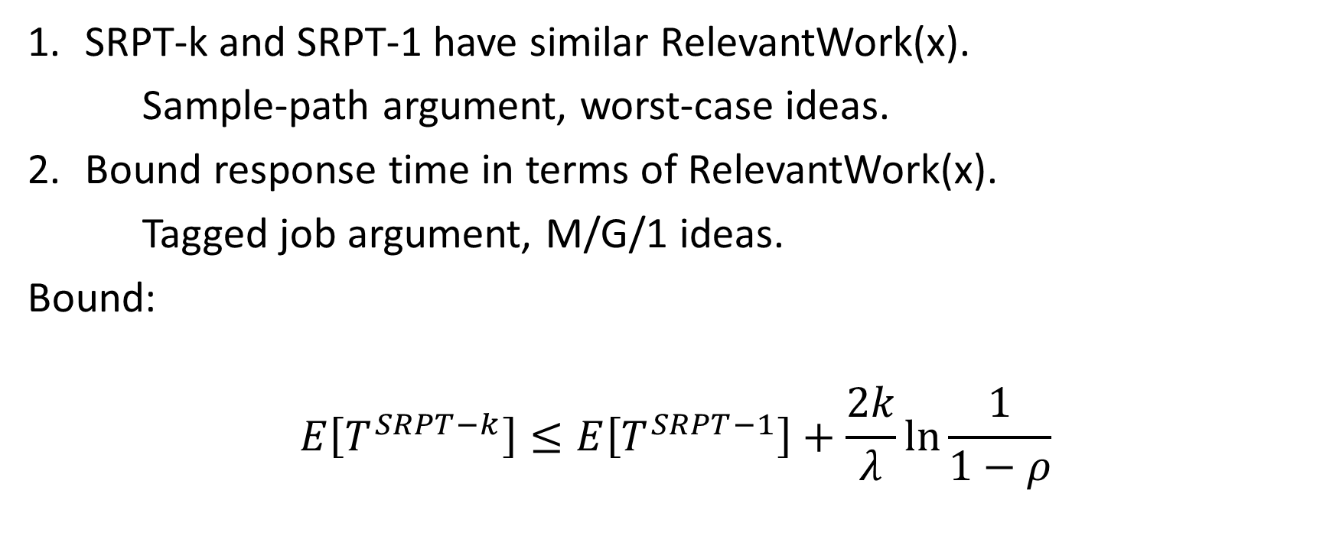
Sketch of SRPT-k bound
SRPT-k and SRPT-1 have similar RelevantWork(x).
Sample-path argument, worst-case ideas.
Bound response time in terms of RelevantWork(x).
Tagged job argument, M/G/1 ideas.
Bound:
$$E\left[T^{SRPT−k}\right]≤E\left[T^{SRPT−1}\right]+\frac{2k}{λ}\ln{\frac{1}{1−ρ}}$$
Notes:
Job of size x sees similar relevant work, so similar response time.

Slide 9


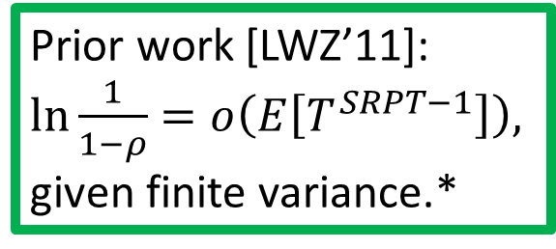
SRPT-k Optimality (Performance ’18)
$$E\left[T^{SRPT−k}\right]≤E\left[T^{SRPT−1}\right]+\frac{2k}{λ}\ln{\frac{1}{1−ρ}}$$
Proven: $\lim_{ρ→1}\frac{E\left[T^{SRPT−k}\right]}{E\left[T^{SRPT−1}\right]}=1$
Therefore: SRPT-k is heavy-traffic optimal.
Prior work [LWZ’11]: $\ln{\frac{1}{1−ρ}}=o\left(E\left[T^{SRPT−1}\right]\right),$ given finite variance.*
*Actually, $E\left[S^{2}{\left(\log{S}\right)}^{+}\right]<∞$
Notes:
Let’s look at this term here, the difference.

Slide 10
Unknown size M/G/k
“The Gittins Policy is Nearly Optimal in the M/G/k under Extremely General Conditions”. ACM SIGMETRICS 2021
Remaining size distribution
What’s a good policy for minimizing mean response time?
Notes:
Order by that rank. Details aren’t important for us

Slide 11
Unknown size M/G/1: Gittins
8
6.2
5
3
1
Optimal policy known: Gittins Policy [G ‘79]
Gittins also optimal for estimated sizes, staged jobs, more
Gittins assigns a rank to every remaining size distribution.
Over time, remaining size distributions change, ranks go up or down.
Notes:
Been known since the 70’s
Some complicated formula to do so, and I’m not going to get into that here.
Run the job of least rank.

Slide 12
Unknown size M/G/1: Gittins
8
6.2
5
3
4
Optimal policy known: Gittins Policy [G ‘79]
Gittins also optimal for estimated sizes, staged jobs, more
Gittins assigns a rank to every remaining size distribution.
Over time, remaining size distributions change, ranks go up or down.
Notes:
Been known since

Slide 13
Unknown size M/G/1: Gittins
8
6.2
5
4
3
Optimal policy known: Gittins Policy [G ‘79]
Gittins also optimal for estimated sizes, staged jobs, more
Gittins assigns a rank to every remaining size distribution.
Over time, remaining size distributions change, ranks go up or down.
Notes:
Been known since

Slide 14

Unknown size M/G/k
“The Gittins Policy is Nearly Optimal in the M/G/k under Extremely General Conditions”. ACM SIGMETRICS 2021
8
6.2
5
3
1
1.7
2.1
2.4
First paper to bound $E\left[T^{Gittins−k}\right]$
First paper to prove heavy-traffic optimality for Gittins-k.
Bonus: More settings. See paper.
Notes:
Order by that rank. Details aren’t important for us

Slide 15
Revision to relevant work
Relevant to rank r=4
8
6.2
5
3
1
1.7
2.1
2.4
RelevantWork(r): Total service until all jobs complete or reach rank >r
Notes:
Less important than r. How long the job’s going to take to get out of my way.

Slide 16
Sketch of Gittins-k bound
8
6.2
5
3
1
Gittins-k and Gittins-1 have similar RelevantWork(r)
Bound response time in terms of RelevantWork(r)
Bound
1.7
2.1
2.4

Slide 17
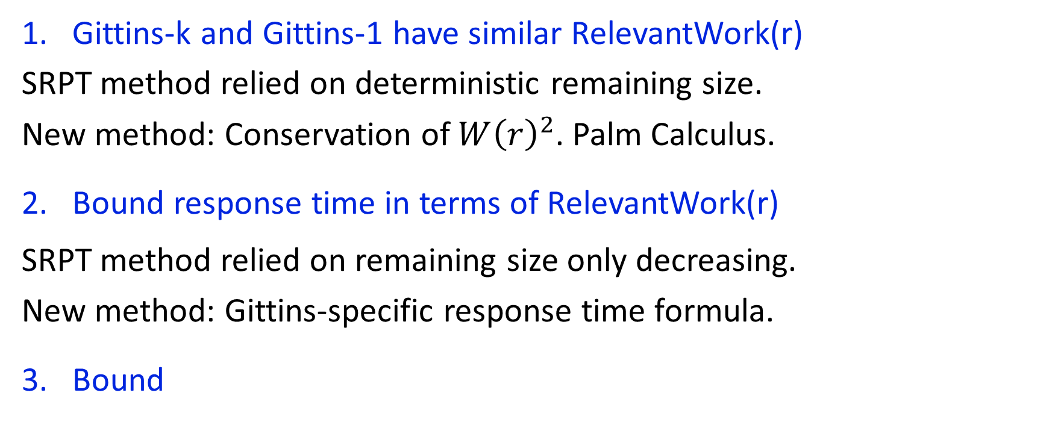
Sketch of Gittins-k bound
8
6.2
5
3
1
Gittins-k and Gittins-1 have similar RelevantWork(r)
SRPT method relied on deterministic remaining size.
New method: Conservation of $W{\left(r\right)}^{2}$. Palm Calculus.
Bound response time in terms of RelevantWork(r)
SRPT method relied on remaining size only decreasing.
New method: Gittins-specific response time formula.
Bound
1.7
2.1
2.4
$E\left[T^{Gittins−k}\right]≤E\left[T^{Gittins−1}\right]+\left(k−1\right)E\left[S\right]\left(ln\frac{1}{1−ρ}+ln\frac{E[S^{2}]}{E{\left[S\right]}^{2}}+4.811\right)$

Slide 18
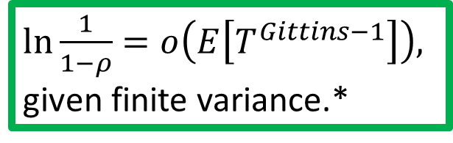
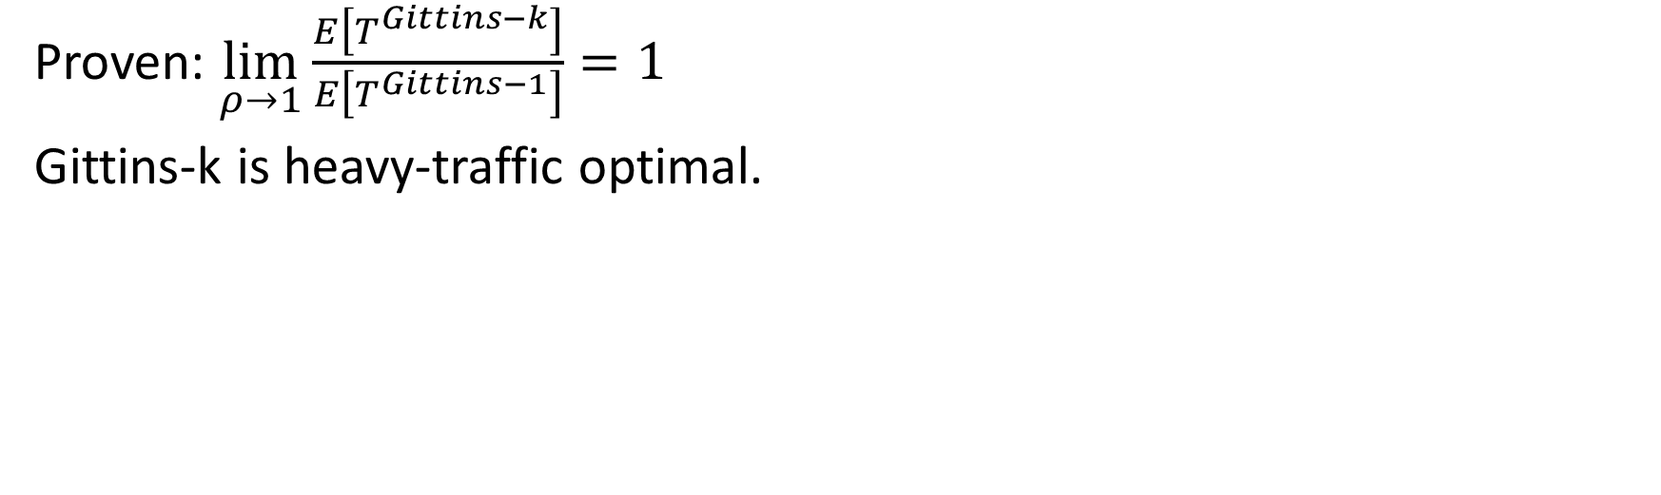
Gittins-k Optimality (SIGMETRICS ‘21)
$E\left[T^{Gittins−k}\right]≤E\left[T^{Gittins−1}\right]+\left(k−1\right)E\left[S\right]\left(ln\frac{1}{1−ρ}+ln\frac{E[S^{2}]}{E{\left[S\right]}^{2}}+4.811\right)$
$\ln{\frac{1}{1−ρ}}=o\left(E\left[T^{Gittins−1}\right]\right),$ given finite variance.*
Proven: $\lim_{ρ→1}\frac{E\left[T^{Gittins−k}\right]}{E\left[T^{Gittins−1}\right]}=1$
Gittins-k is heavy-traffic optimal.
*Actually, $E\left[S^{2}{\left(\log{S}\right)}^{+}\right]<∞$
Notes:
Everything else is constants. Still small, same argument.

Slide 19
Future directions
We proved heavy traffic optimality for SRPT-k and Gittins-k. Heavy traffic optimality often indicates good performance at all loads. Outside of heavy traffic: Better upper bounds? Better lower bounds?
We bounded response time in terms of work for monotonic policies like SRPT, and for the Gittins family of policies. Can we derive a tight bound for non-monotonic, non-Gittins policies?
We proved that Gittins is heavy-traffic optimal under unknown sizes. However, Gittins is complicated and hard to implement. Can optimality be achieved by a simple policy?

Slide 20

Conclusion
“SRPT for Multiserver Systems”. IFIP Performance 2018
Known size: First bound on $E[T^{SRPT−k}]$, first heavy-traffic optimality.
“The Gittins Policy is Nearly Optimal in the M/G/k under Extremely General Conditions. ACM SIGMETRICS 2021
Unknown size: First bound on $E\left[T^{Gittins−k}\right]$, first heavy-traffic optimality.
8
6.2
5
3
1
1.7
2.1
2.4

