Slide 1
Analyzing Queues with Markovian Arrivals and Markovian Service
Isaac Grosof (Izzy) (UIUC -> Northwestern IEMS)
Designed with Mor Harchol-Balter (CMU)

Slide 2






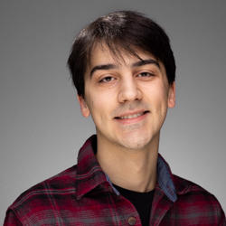
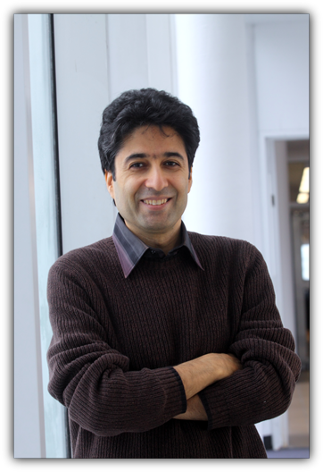




Collaborators: Thank You!
Mor Harchol-Balter
Yige Hong
Alan Scheller-Wolf
R. Srikant
Siva Theja Maguluri
Daniela Hurtado-Lange
Cameron Curtis
Seyed Irvani
Ziyuan Wang
Hayriye Ayhan
Ben Berg
Zhongrui Chen

Slide 3
Fluctuating Load
Vast majority of queueing theory: i.i.d. arrivals, i.i.d. service, fixed load.
Reality: correlated arrivals, correlated service, fluctuating load.
Retail:
Checkout line
Restaurants:
Seating
Datacenters:
Carbon efficiency
Queues with
fluctuating load
Healthcare:
Emergency room
Networks:
Environment
Your application!

Slide 4


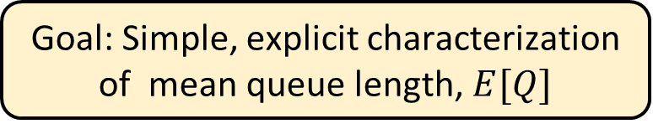
Model: Markovian Arrivals & Markovian Service
H
H
L
M
L
M
$$λ_{H}$$
$$λ_{M}$$
$$λ_{L}$$
$$μ_{H}$$
$$μ_{M}$$
$$μ_{L}$$
Arrival rate
Completion rate
Time
Time
Goal: Simple, explicit characterization of mean queue length, $E[Q]$

Slide 5



Outline
H
H
L
M
L
M
MAMS Model
Simple MAMS: 2-level Arrivals
Drift Method
Relative Arrivals
2-level results
⟵ ⟵ ⟵ Break time ⟶ ⟶ ⟶
Generalizing to Full MAMS
Applications!
H
$$μ$$
$$α_{L}$$
$$α_{H}$$
L

Slide 6
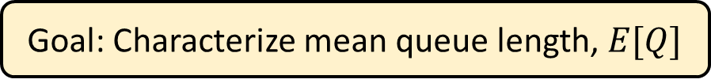






Simple MAMS: 2-level arrivals
H
$$μ$$
$$α_{L}$$
$$α_{H}$$
L
Goal: Characterize mean queue length, $E[Q]$
$$λ_{H}$$
$$λ_{L}$$
Arrival rate
$$Exp(α_{H})$$
Time
$$Exp(α_{L})$$

Slide 7
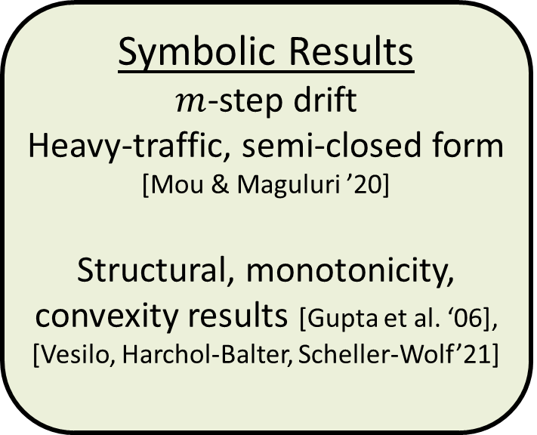
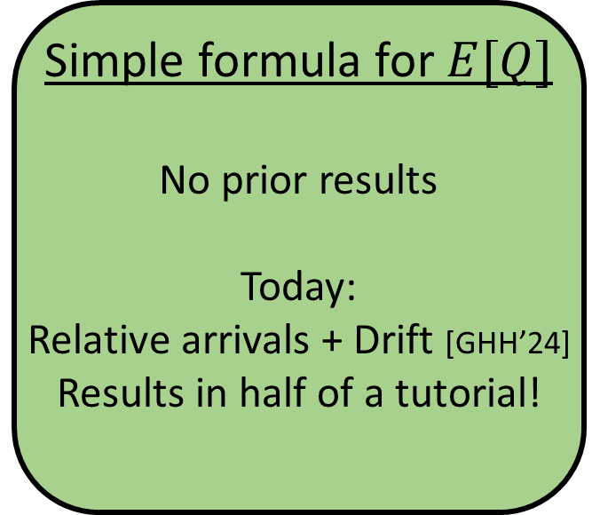
Prior work on Markov-modulated arrivals
Computational Methods
Generating functions [Yechiali & Naor ‘71], [Gupta et al. ‘06]
Matrix analytic methods [Neuts ‘78], [Ramaswami ‘80], [Latouche & Ramaswami ‘99], …
Symbolic Results
$m$-step drift
Heavy-traffic, semi-closed form [Mou & Maguluri ’20]
Structural, monotonicity, convexity results [Gupta et al. ‘06], [Vesilo, Harchol-Balter, Scheller-Wolf’21]
Simple formula for $E[Q]$
No prior results
Today: Relative arrivals + Drift [GHH’24] Results in half of a tutorial!
Notes:
TODO: Spell out names

Slide 8
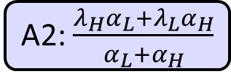
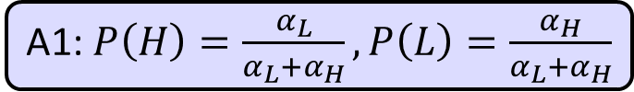
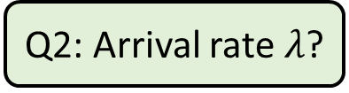
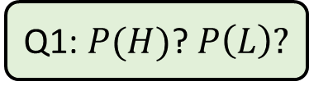
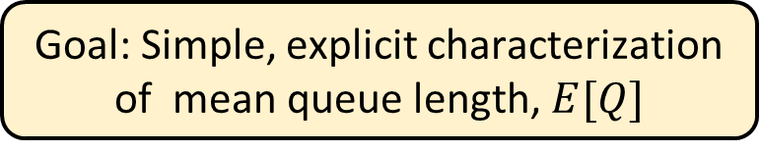
Simple MAMS: 2-level arrivals
H
$$μ$$
$$α_{L}$$
$$α_{H}$$
L
Goal: Simple, explicit characterization of mean queue length, $E[Q]$
Q1: $P(H)$? $P\left(L\right)?$
Q2: Arrival rate $λ$?
A1: $P\left(H\right)=\frac{α_{L}}{α_{L}+α_{H}}, P\left(L\right)=\frac{α_{H}}{α_{L}+α_{H}}$
A2: $\frac{λ_{H}α_{L}+λ_{L}α_{H}}{α_{L}+α_{H}}$

Slide 9
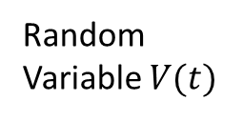


Drift Method: Background
Choose any random variable $V$.
Idea: Increases match decreases
Thm: In stationarity, expected increase matches expected decrease
Random Variable $V(t)$
Time $t$

Slide 10




Drift Method: M/M/1
Example: Random variable $Q^{2}$. Let’s use drift method to calculate $E\left[Q\right]$.
$$λ$$
$$μ$$
10
8
6
4
2
0
$${Q(t)}^{2}$$
Time $t$

Slide 11
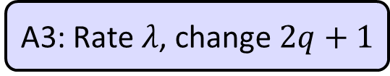

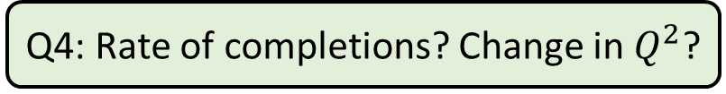
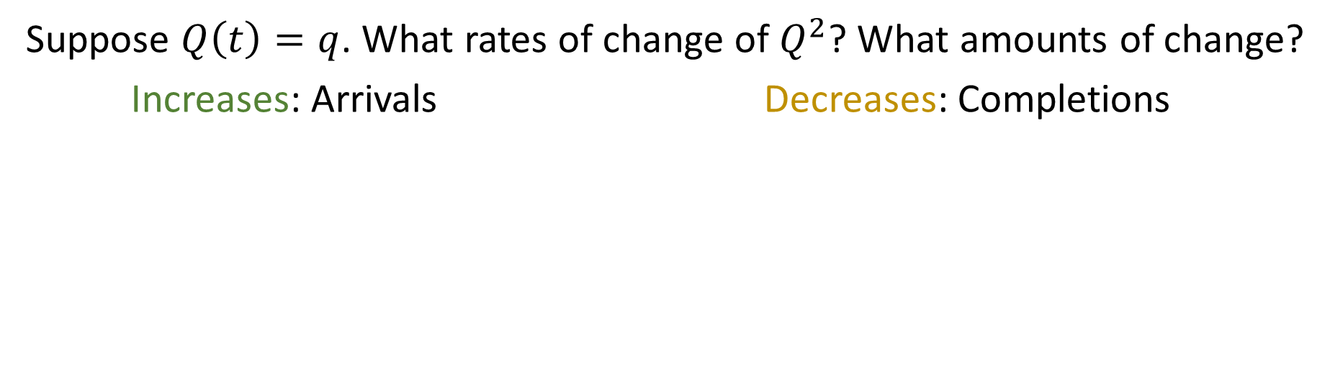
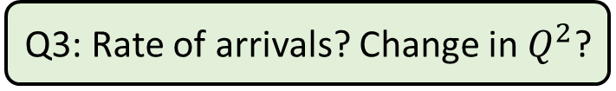


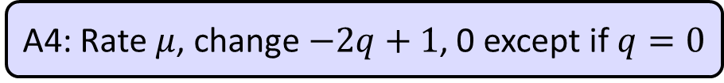
Drift Method: M/M/1
$$λ$$
$$μ$$
10
8
6
4
2
0
$$Q^{2}$$
Time
Suppose $Q\left(t\right)=q$. What rates of change of $Q^{2}$? What amounts of change?
Increases: Arrivals Decreases: Completions
Q3: Rate of arrivals? Change in $Q^{2}$?
Q4: Rate of completions? Change in $Q^{2}$?
A3: Rate $λ$, change $2q+1$
A4: Rate $μ$, change $−2q+1$, 0 except if $q=0$

Slide 12
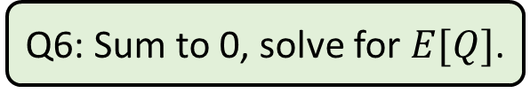
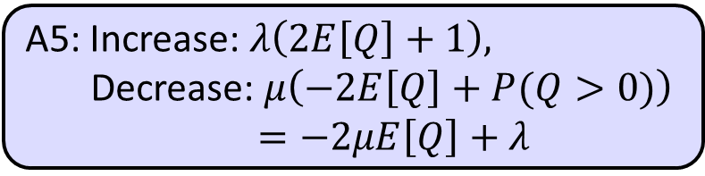
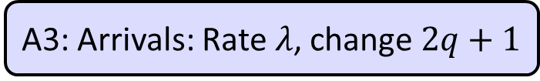

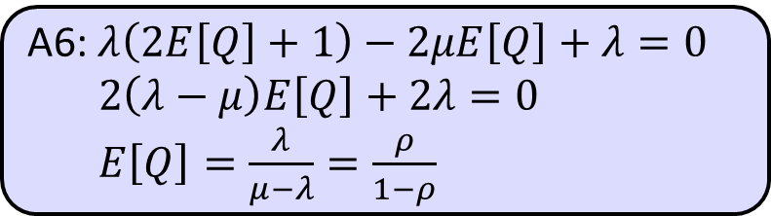
Drift Method: M/M/1
$$λ$$
$$μ$$
10
8
6
4
2
0
A3: Arrivals: Rate $λ$, change $2q+1$
$$Q^{2}$$
A4: Completions: Rate $μ$, change $−2q+1$, except if $q=0$
Time
A5: Increase: $λ\left(2E\left[Q\right]+1\right),$
Decrease: $μ\left(−2E\left[Q\right]+P(Q>0)\right)$
$=−2μE\left[Q\right]+λ$
Q5: Expected increase, in stationarity?
Expected decrease, in stationarity?
A6: $λ\left(2E\left[Q\right]+1\right)−2μE\left[Q\right]+λ=0$
$2\left(λ−μ\right)E\left[Q\right]+2λ=0$
$E\left[Q\right]=\frac{λ}{μ−λ}=\frac{ρ}{1−ρ}$
Q6: Sum to 0, solve for $E[Q]$.

Slide 13
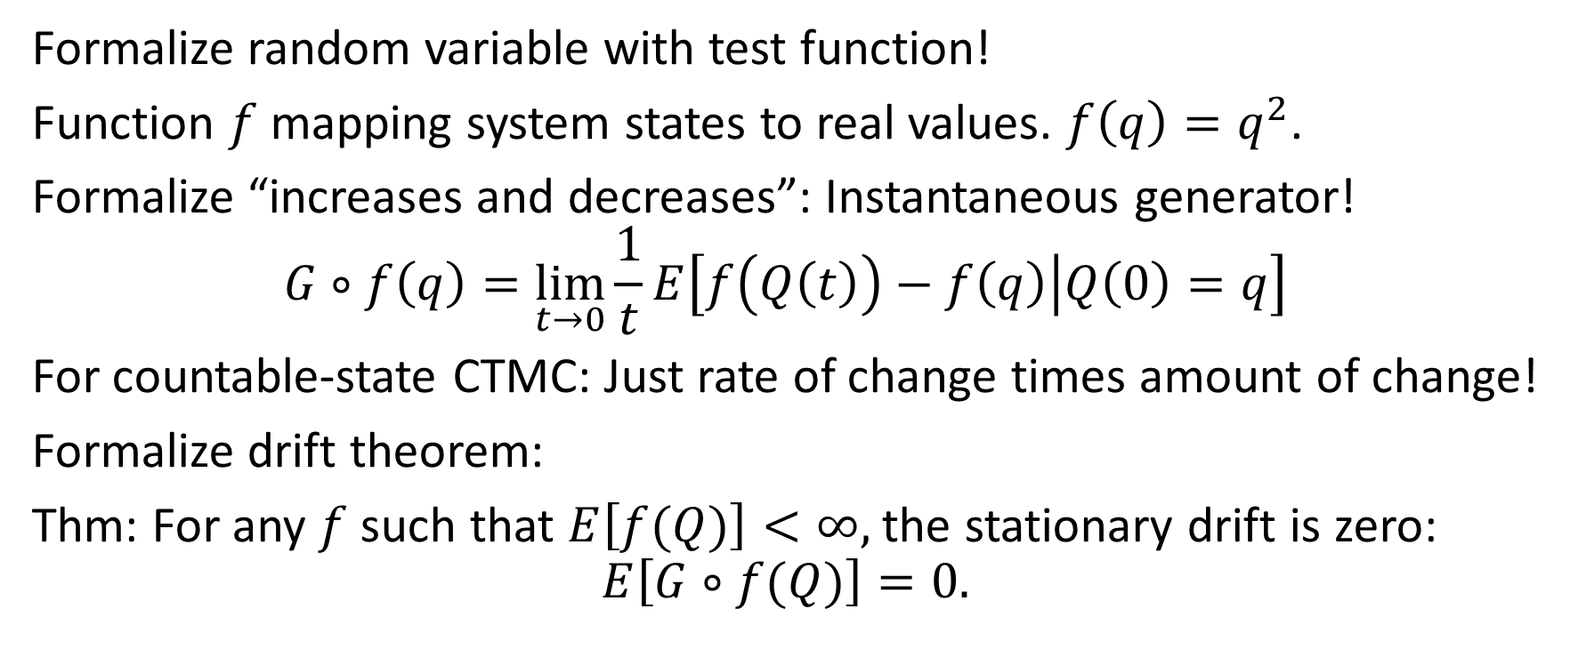
Drift Method: Formalize
Formalize random variable with test function!
Function $f$ mapping system states to real values. $f\left(q\right)=q^{2}$.
Formalize “increases and decreases”: Instantaneous generator!
$$G∘f\left(q\right)=\lim_{t→0}\frac{1}{t}E\left[f\left(Q\left(t\right)\right)−f\left(q\right) | Q\left(0\right)=q\right]$$
For countable-state CTMC: Just rate of change times amount of change!
Formalize drift theorem:
Thm: For any $f$ such that $E\left[f(Q)\right]<∞,$the stationary drift is zero:
$$E\left[G∘f(Q)\right]=0.$$

Slide 14

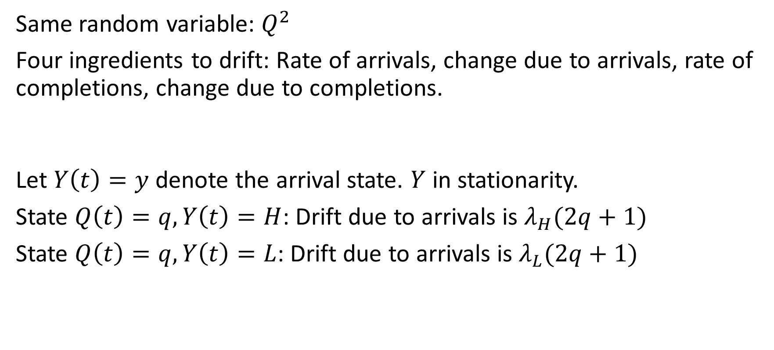
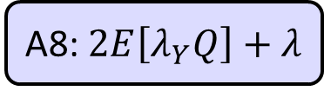


Drift Method: 2-level, first attempt
H
$$μ$$
$$α_{L}$$
$$α_{H}$$
Same random variable: $Q^{2}$
Four ingredients to drift: Rate of arrivals, change due to arrivals, rate of completions, change due to completions.
Let $Y\left(t\right)=y$ denote the arrival state. $Y$ in stationarity.
State $Q\left(t\right)=q, Y\left(t\right)=H$: Drift due to arrivals is $λ_{H}(2q+1)$
State $Q\left(t\right)=q, Y\left(t\right)=L$: Drift due to arrivals is $λ_{L}(2q+1)$
L
Q7: What’s different between the M/M/1 and the 2-level?
A7: Rate of arrivals is now state dependent!
Q8: Expected drift due to arrivals, in stationarity?
A8: $2E\left[λ_{Y}Q\right]+λ$

Slide 15

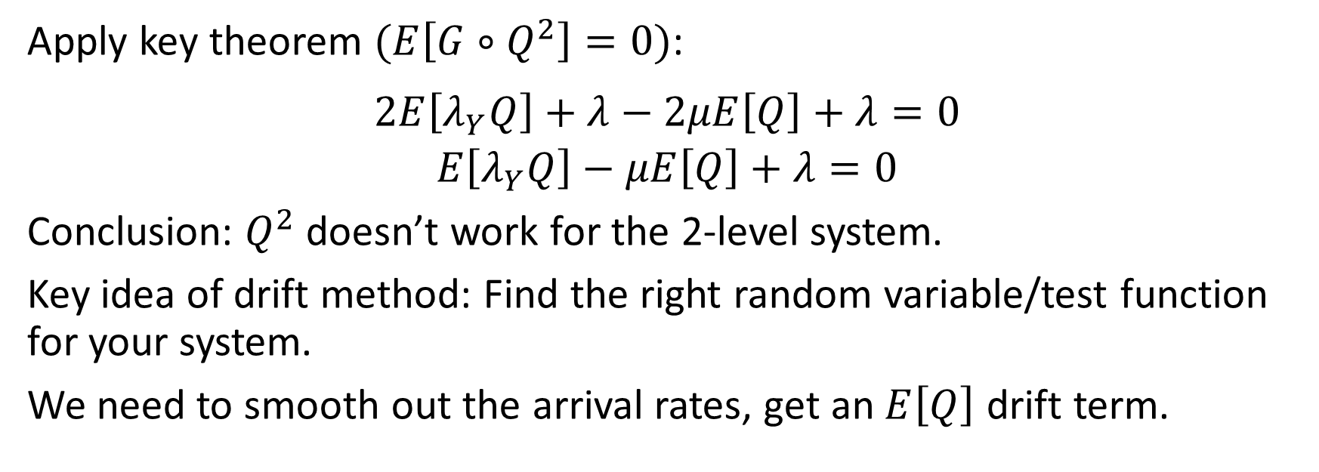
Drift Method: 2-level, first attempt
H
$$μ$$
$$α_{L}$$
$$α_{H}$$
L
Apply key theorem $(E\left[G∘Q^{2}\right]=0)$:
$$2E\left[λ_{Y}Q\right]+λ−2μE\left[Q\right]+λ=0$$
$$E\left[λ_{Y}Q\right]−μE\left[Q\right]+λ=0$$
Conclusion: $Q^{2}$ doesn’t work for the 2-level system.
Key idea of drift method: Find the right random variable/test function for your system.
We need to smooth out the arrival rates, get an $E\left[Q\right]$ drift term.

Slide 16

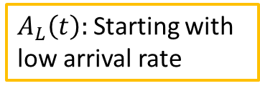




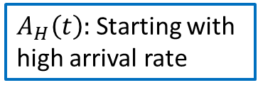

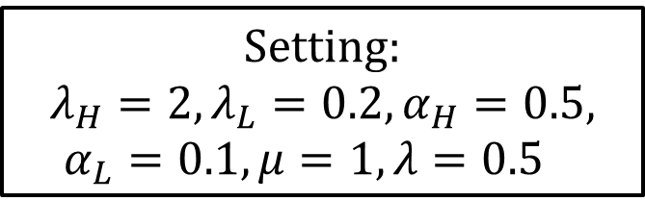

New idea: Relative arrivals
H
$$μ$$
$$α_{L}$$
$$α_{H}$$
L
Setting:
$$λ_{H}=2, λ_{L}=0.2, α_{H}=0.5, α_{L}=0.1, μ=1, λ=0.5$$
Define $A_{y}\left(t\right)$ to be the number of arrivals up to time $t$, with the system initialized in arrival state $y$.
Relative arrivals: $Δ\left(y\right)=\lim_{t→∞}\left(E\left[A_{y}\left(t\right)\right]−λt\right)$
$A_{H}\left(t\right):$Starting with high arrival rate
10
8
$λt:$Long-term rate
Expected arrivals
6
$$Δ(H)$$
$A_{L}\left(t\right):$Starting with low arrival rate
4
$$Δ(L)$$
2
0
0
3
6
9
12
15
Time

Slide 17



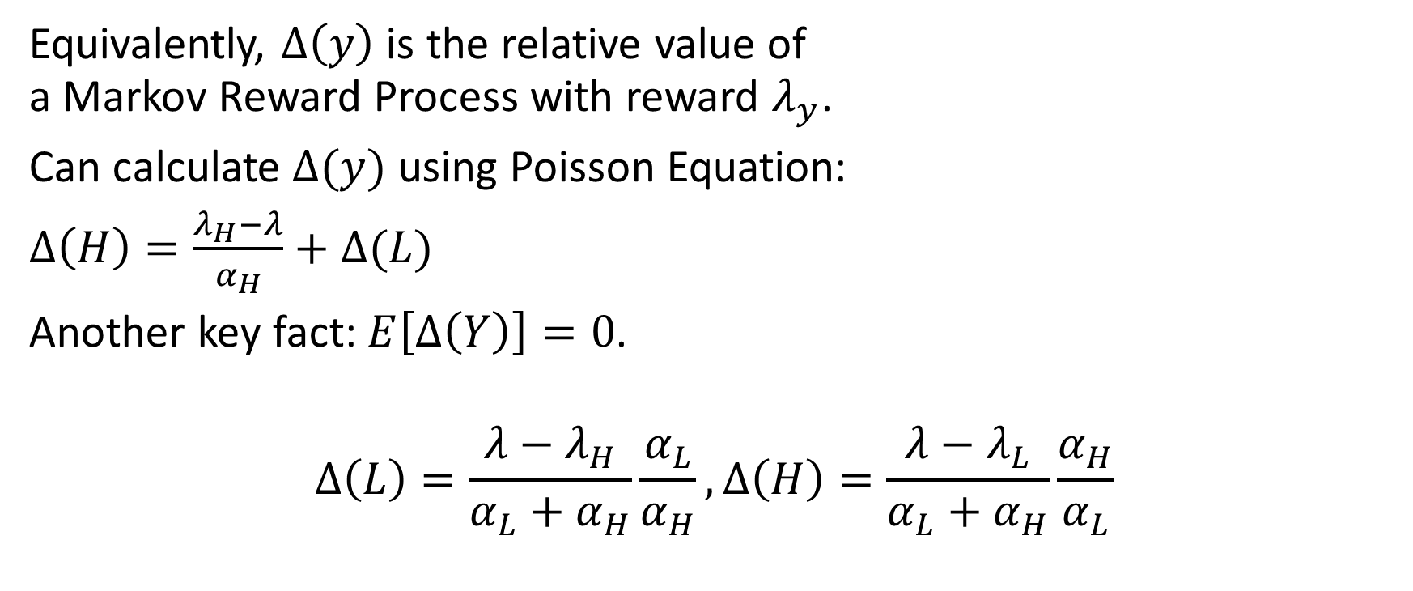



Relative Arrivals: Calculate
10
8
6
$$Δ(H)$$
4
$$Δ(L)$$
2
Equivalently, $Δ\left(y\right)$ is the relative value of a Markov Reward Process with reward $λ_{y}$.
Can calculate $Δ(y)$ using Poisson Equation:
$Δ\left(H\right)=\frac{λ_{H}−λ}{α_{H}}+Δ(L)$
Another key fact: $E\left[Δ\left(Y\right)\right]=0$.
$$Δ\left(L\right)=\frac{λ−λ_{H}}{α_{L}+α_{H}}\frac{α_{L}}{α_{H}}, Δ\left(H\right)=\frac{λ−λ_{L}}{α_{L}+α_{H}}\frac{α_{H}}{α_{L}}$$
0
0
3
6
9
12
15
H
$$μ$$
$$α_{L}$$
$$α_{H}$$
L
$$Δ\left(y\right)=\lim_{t→∞}\left(E\left[A_{y}\left(t\right)\right]−λt\right)$$

Slide 18
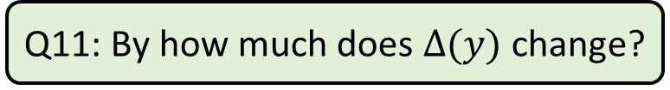


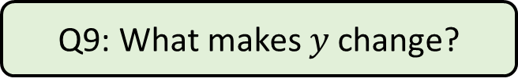
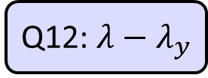

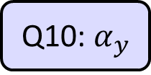
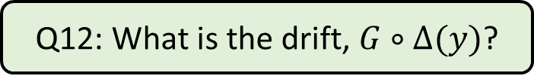
Drift of Relative Arrivals
H
$$μ$$
$$α_{L}$$
$$α_{H}$$
L
What is the drift of $Δ(y)$? Recall: $Δ\left(H\right)=\frac{λ_{H}−λ}{α_{H}}+Δ(L)$
Q9: What makes $y$ change?
Q9: Changing between H and L
Q10: At what rate does it change?
Q10: $α_{y}$
Q11: By how much does $Δ(y)$ change?
Q11: $\frac{λ−λ_{y}}{α_{y}}$
Alternate definition of $Δ\left(y\right):$
“the test function with drift $G∘Δ\left(y\right)=λ−λ_{y}$”
Q12: What is the drift, $G∘Δ(y)$?
Q12: $λ−λ_{y}$
Notes:
Note: Move through with brief pauses

Slide 19
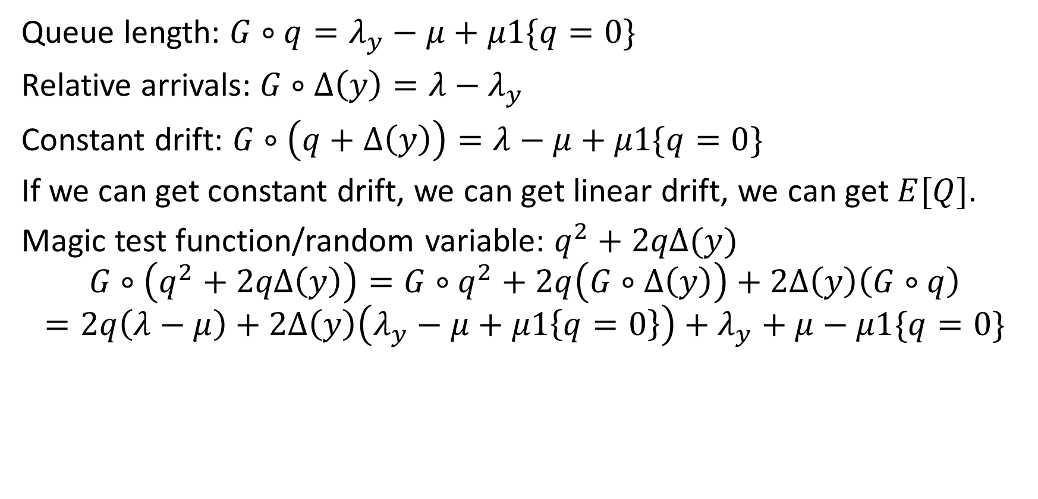
Drift Method + Relative Arrivals
H
$$μ$$
$$α_{L}$$
$$α_{H}$$
L
Queue length: $G∘q=λ_{y}−μ+μ1\{q=0\}$
Relative arrivals: $G∘Δ\left(y\right)=λ−λ_{y}$
Constant drift: $G∘\left(q+Δ\left(y\right)\right)=λ−μ+μ1\{q=0\}$
If we can get constant drift, we can get linear drift, we can get $E[Q]$.
Magic test function/random variable: $q^{2}+2qΔ(y)$
$$G∘\left(q^{2}+2qΔ\left(y\right)\right)=G∘q^{2}+2q\left(G∘Δ\left(y\right)\right)+2Δ\left(y\right)\left(G∘q\right)$$
$$=2q\left(λ−μ\right)+2Δ\left(y\right)\left(λ_{y}−μ+μ1\left\{q=0\right\}\right)+λ_{y}+μ−μ1\{q=0\}$$
Linear!
Bounded!

Slide 20

2-level result
H
$$μ$$
$$α_{L}$$
$$α_{H}$$
L
$$G∘\left(q^{2}+2qΔ\left(y\right)\right)=2q\left(λ−μ\right)+2Δ\left(y\right)\left(λ_{y}−μ+μ1\left\{q=0\right\}\right)$$ $+λ_{y}+μ−μ1\{q=0\}$
Fundamental drift theorem: $E\left[G∘\left(Q^{2}+2QΔ\left(Y\right)\right)\right]=0$.
$$0=2E\left[Q\right]\left(λ−μ\right)+2E\left[Δ\left(Y\right)λ_{Y}\right]+2μE\left[Δ\left(y\right)1\left\{Q=0\right\}\right]+2λ$$
Thm: $$E\left[Q^{2\text{−}level}\right]=\frac{ρ}{1−ρ}\left(E\left[Δ\left(Y\right)λ_{Y}\right]/λ+1\right)+E[Δ(Y)|Q=0]$$
Linear!
Bounded!

Slide 21
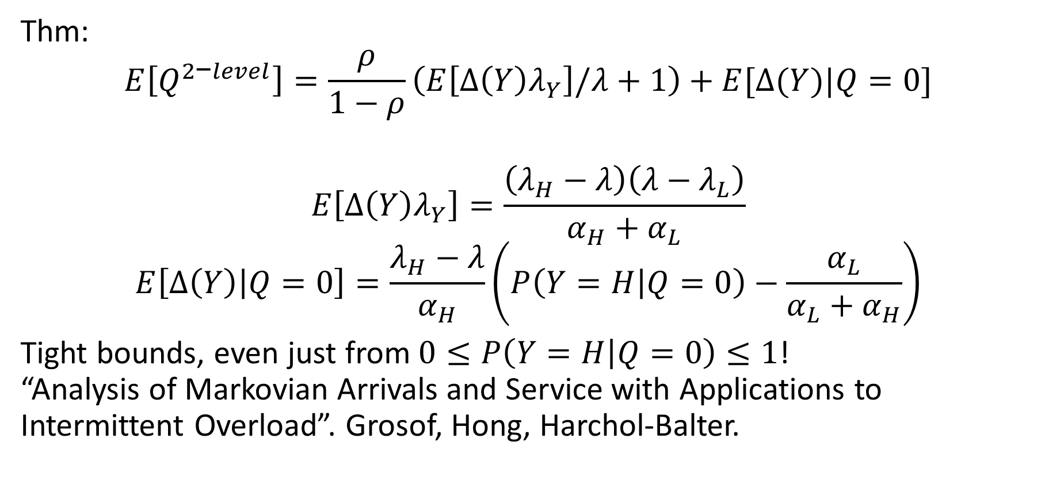
Explicit result
H
$$μ$$
$$α_{L}$$
$$α_{H}$$
L
Thm: $$E\left[Q^{2\text{−}level}\right]=\frac{ρ}{1−ρ}\left(E\left[Δ\left(Y\right)λ_{Y}\right]/λ+1\right)+E[Δ(Y)|Q=0]$$
$$E\left[Δ\left(Y\right)λ_{Y}\right]=\frac{\left(λ_{H}−λ\right)\left(λ−λ_{L}\right)}{α_{H}+α_{L}}$$
$$E\left[Δ\left(Y\right) | Q=0\right]=\frac{λ_{H}−λ}{α_{H}}\left(P\left(Y=H | Q=0\right)−\frac{α_{L}}{α_{L}+α_{H}}\right)$$
Tight bounds, even just from $0≤P\left(Y=H | Q=0\right)≤1$! “Analysis of Markovian Arrivals and Service with Applications to Intermittent Overload”. Grosof, Hong, Harchol-Balter.

Slide 22
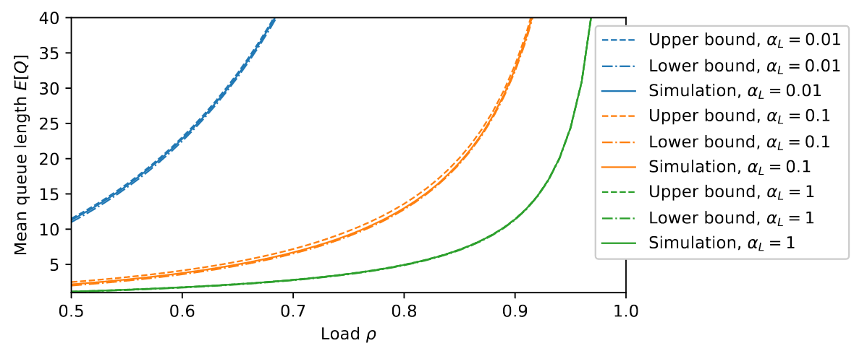
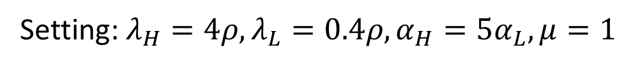
Compare to simulation
H
$$μ$$
$$α_{L}$$
$$α_{H}$$
L
Setting: $λ_{H}=4ρ, λ_{L}=0.4ρ, α_{H}=5α_{L},μ=1$

Slide 23
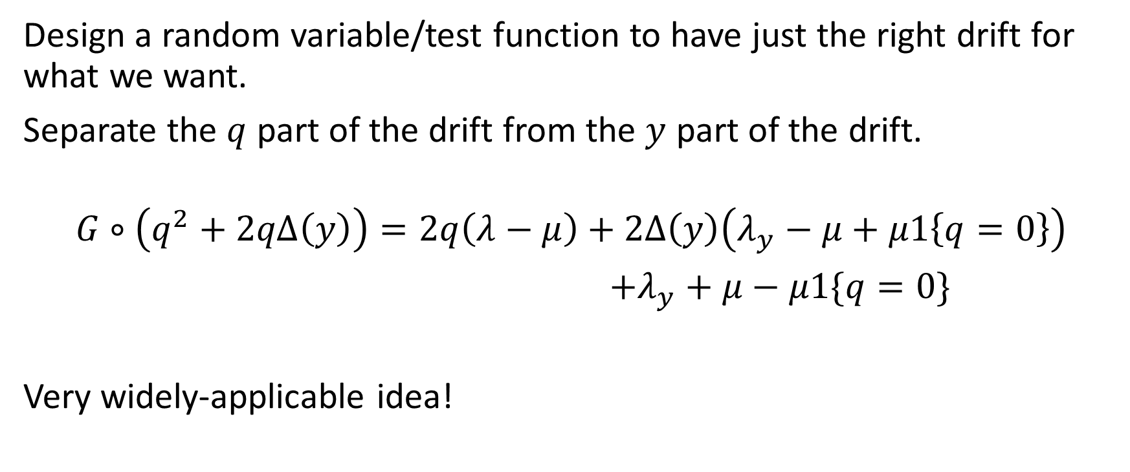
Key Ideas
Design a random variable/test function to have just the right drift for what we want.
Separate the $q$ part of the drift from the $y$ part of the drift.
$$G∘\left(q^{2}+2qΔ\left(y\right)\right)=2q\left(λ−μ\right)+2Δ\left(y\right)\left(λ_{y}−μ+μ1\left\{q=0\right\}\right)$$ $+λ_{y}+μ−μ1\{q=0\}$
Very widely-applicable idea!
Linear!
Bounded!

Slide 24




Break Time!
Thm: $$E\left[Q^{2\text{−}level}\right]=\frac{ρ}{1−ρ}\left(E\left[Δ\left(Y\right)λ_{Y}\right]/λ+1\right)+E[Δ(Y)|Q=0]$$
H
$$μ$$
$$α_{L}$$
$$α_{H}$$
L

Slide 25
Outline
H
$$μ$$
$$α_{L}$$
$$α_{H}$$
L
Simple MAMS: 2-level Arrivals
Drift Method + Relative Arrivals
⟵ ⟵ ⟵ Break time ⟶ ⟶ ⟶
Generalizing to Full MAMS
Applications: Fluctuating Load
Multiserver Jobs
Networks with Abandonment (e.g. Quantum switching network)
H
H
L
M
L
M

Slide 26
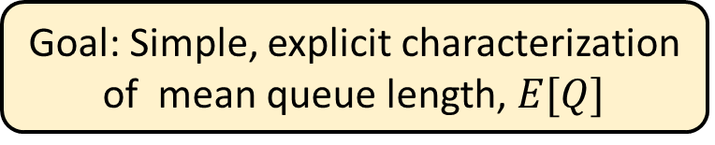
General Markovian Arrivals & Markovian Service
H
H
L
M
L
M
$$λ_{H}$$
$$λ_{M}$$
$$λ_{L}$$
$$μ_{H}$$
$$μ_{M}$$
$$μ_{L}$$
Arrival rate
Completion rate
Time
Time
Goal: Simple, explicit characterization of mean queue length, $E[Q]$

Slide 27









Generalizing: Relative Arrivals & Completions
Relative Arrivals: Same definition: $Δ_{A}\left(y_{A}\right)=\lim_{t→∞}\left(E\left[A_{y_{A}}\left(t\right)\right]−λt\right)$
Relative Completions: Same idea: $Δ_{C}\left(y_{C}\right)$ $=\lim_{t→∞}\left(E\left[C_{y_{C}}\left(t\right)\right]−λt\right)$
$E\left[A_{y_{A}}\left(t\right)\right]:$Starting with general arrival state $y_{A}$
$$y_{A}$$
$$y_{C}$$
10
$E\left[C_{y_{C}}\left(t\right)\right]$: Starting with general completions state $y_{C}$
$$Δ_{A}(y_{A})$$
8
8
$λt:$Long-term rate
$$Δ_{C}(y_{C})$$
Expected arrivals
6
Expected completions
6
4
$λt:$Long-term rate
4
2
2
0
0
0
3
6
9
12
15
0
3
6
9
12
15
Time
Time

Slide 28

Drift for MAMS
H
H
L
M
L
M
Queue length: $G∘q=λ_{y_{A}}−μ_{y_{C}}+μ_{y_{C}}1\{q=0\}$
Relative arrivals: $G∘Δ_{A}\left(y_{A}\right)=λ−λ_{y_{A}}$
Relative completions: $G∘Δ_{C}\left(y_{C}\right)=μ−μ_{y_{C}}$
Constant drift: $G∘\left(q+Δ_{A}\left(y_{A}\right)−Δ_{C}\left(y_{C}\right)\right)=λ−μ+μ_{y_{C}}1\{q=0\}$
If we can get constant drift, we can get linear drift, we can get $E[Q]$.
Magic test function/random variable: $q^{2}+2qΔ_{A}\left(y_{A}\right)−2qΔ_{C}\left(y_{C}\right)$
$$G∘\left(q^{2}+2qΔ_{A}\left(y_{A}\right)−2qΔ_{C}\left(y_{C}\right)\right)=2q\left(λ−μ\right)+f\left(y_{A},y_{C},1\left\{q=0\right\}\right)$$
Same drift as before!
Linear!
Bounded!

Slide 29

General MAMS Result
Thm: $$E\left[Q^{MAMS}\right]=\frac{E\left[Δ_{A}\left(Y_{A}\right)λ_{Y_{A}}\right]/μ+E\left[Δ_{C}\left(Y_{C}\right)μ_{Y_{C}}\right]/μ+ρ}{1−ρ}+E_{U}[Δ_{A}\left(Y_{A}\right)−Δ_{C}\left(Y_{C}\right)]$$
$E_{U}[⋅]$: Expectation over moments of unused service.
Tight bounds, even just from $$E_{U}\left[Δ_{A}\left(Y_{A}\right)−Δ_{C}\left(Y_{C}\right)\right]∈\left[Δ_{A}^{min}−Δ_{C}^{max},Δ_{A}^{max}−Δ_{C}^{min}\right]$$

Slide 30
Outline
H
$$μ$$
$$α_{L}$$
$$α_{H}$$
L
Simple MAMS: 2-level Arrivals
Drift Method + Relative Arrivals
⟵ ⟵ ⟵ Break time ⟶ ⟶ ⟶
Generalizing to Full MAMS
Applications: Fluctuating Load
Multiserver Jobs
Networks with Abandonment (e.g. Quantum switching network)
H
H
L
M
L
M

Slide 31

Applications: Fluctuating Load
Example: Datacenter
Arrivals: Normal load ($\sim$), off hours ($−$), peak load ($+$), rare event ($++$)
?
?

Slide 32




Applications: Fluctuating Load
Example: Datacenter
Arrivals: Normal load ($\sim$), off hours ($−$), peak load ($+$), rare event ($++$)
Service: Full operation (😊), maintenance (🛠️), outage (❌)
?
$$−$$
$$\sim$$
$$+$$
++

Slide 33

Applications: Fluctuating Load
Example: Datacenter
Arrivals: Normal load ($\sim$), off hours ($−$), peak load ($+$), rare event ($++$)
Service: Full operation (😊), maintenance (🛠️), outage (❌)
MAMS Model: Performance characterization from relative arrivals and relative completions.
😊
$$−$$
$$\sim$$
$$+$$
++
🛠️
❌

Slide 34



Application: Multiserver-job Model
FCFS
Job: (duration, server need)
2
2
Server need
Poisson($λ$)
3
4
1
2
1
Sampled i.i.d. from joint distribution, phase-type job durations
Simple example: 2 servers.
Distribution: $\left(Exp\left(μ_{1}\right),1\right) \& (Exp\left(μ_{2}\right),2)$
1
Goal: Simple, explicit characterization of mean queue length, $E[Q]$
2
1
1
2
Notes:
Topic of this talk: MSJ model. Different jobs require different numbers of servers. Motivated by big compute clusters, where we see this behavior.

Slide 35





Applications: Multiserver Jobs
1
2
1
1
2
Jobs: $\left(Exp\left(μ_{1}\right),1\right), (Exp\left(μ_{2}\right),2)$
Service rate fluctuations!
Internal fluctuation, not external.
Use MAMS anyways!
Compare with MAMS:
Q13: What service rates are possible?
A13: $μ_{1},2μ_{1}, μ_{2}$
$${ μ}_{1}$$
$$2μ_{1}$$
$${ μ}_{2}$$

Slide 36




Applications: Multiserver Jobs
$${ μ}_{1}$$
1
2
1
1
2
$$2μ_{1}$$
$${ μ}_{2}$$
Almost identical – delay sampling job type until service.
However: Different if no jobs in system. Or one job.
Same if 2+ jobs in system.
“Near-MAMS”
Thm (RESET): $E\left[Q^{Near\text{−}MAMS}\right]=E\left[Q^{MAMS}\right]+O_{ρ}\left(1\right)$
The RESET and MARC Techniques, with Application to Multiserver-Job Analysis. [GHHS ’23]

Slide 37

















Application: Tandem queue with abandonment
$$γ$$
$$μ_{1^{st}}$$
$$μ_{2^{nd}}$$
Poisson($λ$)
Coffeeshop: First, customers queue to order and pay. May abandon. Second, customers queue to pick up their drinks. No abandonment.
Idea: First queue as Markovian Arrival process!
$$λ$$
$$λ$$
$$λ$$
$$λ$$
Q14: Draw Markov Chain of arrival rates to second queue
A14:
$$0$$
$$μ_{1^{st}}$$
$$μ_{1^{st}}$$
$$μ_{1^{st}}$$
$$…$$
$$μ_{1^{st}}$$
$$μ_{1^{st}}+γ$$
$$μ_{1^{st}}+2γ$$
$$μ_{1^{st}}+3γ$$

Slide 38














Application: Tandem queue with abandonment
$$γ$$
$$μ_{1^{st}}$$
$$μ_{2^{nd}}$$
Poisson($λ$)
$$λ$$
$$λ$$
$$λ$$
$$λ$$
$$0$$
$$μ_{1^{st}}$$
$$μ_{1^{st}}$$
$$μ_{1^{st}}$$
$$…$$
Infinite-MAMS – Uniform positive recurrence
Still define relative arrivals, $Δ(y)$
Same mean queue length result:
$$E\left[Q^{2\text{−}level}\right]=\frac{ρ}{1−ρ}\left(E\left[Δ\left(Y\right)λ_{Y}\right]/λ+1\right)+E[Δ(Y)|Q=0]$$
$$μ_{1^{st}}$$
$$μ_{1^{st}}+γ$$
$$μ_{1^{st}}+2γ$$
$$μ_{1^{st}}+3γ$$
More work to bound

Slide 39



Application: Quantum switching network
1. Switch generates entangled qubit-pairs

Slide 40
Application: Quantum switching network
1. Switch generates entangled qubit-pairs
2. Switch transmits half of entangled pair

Slide 41
Application: Quantum switching network
1. Switch generates entangled qubit-pairs
2. Switch transmits half of entangled pair
3. Switch combines two entangled pairs to make longer-distance pair

Slide 42
Application: Quantum switching network
1. Switch generates entangled qubit-pairs
2. Switch transmits half of entangled pair
3. Switch combines two entangled pairs to make longer-distance pair
“Matching Queues with Abandonments in Quantum Switches: Stability and Throughput Analysis” [ZJM]

Slide 43



Quantum switching: Switch perspective
Requests for longer-distance entanglement
Qubits (halves of pairs)
Combine!
A
AB
AB
Switch
B
BC
BC
$$…$$
C
$$…$$

Slide 44

Quantum switching: Switch perspective
Requests for longer-distance entanglement
Qubits (halves of pairs)
A
AB
AB
Switch
B
BC
BC
$$…$$
C
$$…$$
Goal: Simple, explicit characterization of mean queue length, $E[Q]$

Slide 45

Simplest quantum switch: Y-system
Requests for longer-distance entanglement
Qubits (halves of pairs)
A
AB
AB
Switch
B
Idea: think of qubits as service-rate modulation process.
Uniform positive recurrence – Infinite-MAMS!
Alternative behavior when no requests – Near-MAMS!
Plan: Characterize $E\left[Q\right]$ using near-MAMS + infinite-MAMS

Slide 46

Further Directions
H
H
L
M
L
M
Tail performance: $E[e^{−sQ}]$? $E\left[e^{−s\left(1−ρ\right)Q}\right]$?
MAMS-work: Jobs have sizes, modulate work completion rate
MAMS & drift concepts for scheduling
Two MAMA papers on Friday:
2:15pm: "Bounds on M/G/k Scheduling Under Moderate Load” [G., Wang]
2:45pm: "Simple Policies for Multiresource Job Scheduling” [Chen, G., Berg]
Your application/model/setting!

Slide 47

Conclusion
Markovian Arrivals, Markovian Service
Drift Method
10
8
6
4
2
0
H
H
$$Q^{2}$$
L
M
L
M
Relative Arrivals, Relative Completions
Time
10
Simple, explicit, tight characterization of mean queue length:
$$E\left[Q^{2\text{−}level}\right]=\frac{ρ}{1−ρ}\left(E\left[Δ\left(Y\right)λ_{Y}\right]/λ+1\right)+E[Δ(Y)|Q=0]$$
8
Expected arrivals
6
$$Δ(H)$$
4
$$Δ(L)$$
2
Applications: Fluctuating load, Multiserver jobs, Tandem queues with abandonment, Quantum switching!
0
0
3
6
9
12
15
Time

Slide 48

Bonus: MAMS Plot!

