Slide 1
WCFS Queues: A new analysis framework
Isaac Grosof
Mor Harchol-Balter
Alan Scheller-Wolf

Slide 2



Unexpected Similarity between Queues
Heterogeneous
M/G/k
Speed:
0.4
0.3
0.2
0.1
Limited Processor Sharing
Threshold Parallelism
Multiserver Jobs under ServerFilling
$≤$4
=
4
4
4
2
2
$≤$2
2
2
1
1
=2
$≤$4
=1
Open problem!
=1
Open problem!
Open problem!
Open problem!
Discover commonality
Use commonality to tightly characterize
Notes:
Heterogenous M/G/k
Limited Processor Sharing
Threshold Parallelism
Multiserver Job
Open problem: Analyze
Commonality
Use commonality to tightly characterize

Slide 3

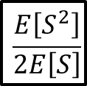
Warmup: M/G/1
Fraction of time busy:
Load: ρ = λE[S]<1
FCFS
Poisson arrivals (memoryless), arrival rate: λ
General job size distribution: S, i.i.d.
Response time: T
$S\sim$Hyperexp
10
3
8
2
$$\frac{E\left[S^{2}\right]}{2E\left[S\right]}$$
6
E[T]
E[T](1-ρ)
4
1
2
M/G/1
0
0
0
0.25
0.5
0.75
1
0
0.25
0.5
0.75
1
Load ρ
Load ρ
Notes:
Poisson Process(\lambda)
Job size distribution S
Load \rho
Plot E[T] versus \rho
Plot E[T](1-\rho) versus \rho

Slide 4
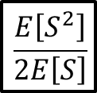
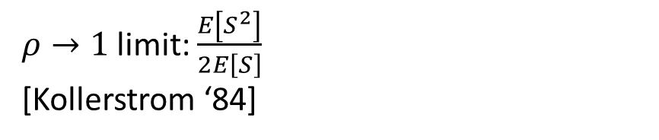
M/G/k
k servers
Speed 1/k
Speed 1/k
Speed 1/k
Speed 1/k
3
M/G/k
2
$$\frac{E\left[S^{2}\right]}{2E\left[S\right]}$$
$ρ→1$ limit: $\frac{E\left[S^{2}\right]}{2E\left[S\right]}$ [Kollerstrom ‘84]
E[T](1-ρ)
1
M/G/1
0
0
0.25
0.5
0.75
1
Load ρ
Notes:
Speed 1/k
We have to simulate
E[T](1-\rho) converges to same point
Intuition: rho to 1 means lots of jobs, not so different.
Kollerstrom ‘84

Slide 5
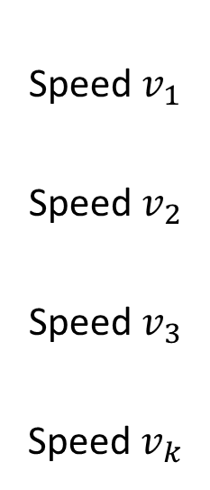

Heterogeneous M/G/k
Speed $v_{1}$
Speed $v_{2}$
Speed $v_{3}$
Speed $v_{k}$
3
Het. M/G/k
M/G/k
2
$$\frac{E\left[S^{2}\right]}{2E\left[S\right]}$$
Mean response time behavior:
Open problem!
E[T](1-ρ)
1
M/G/1
0
0
0.25
0.5
0.75
1
Load ρ
Notes:
We don’t know where it converges to, happens to converge here.
Differing speed
Same convergence
Open problem

Slide 6

M/G/1/Limited Processor Sharing
Multi-programming level k
3
Het. M/G/k
M/G/k
2
$$\frac{E\left[S^{2}\right]}{2E\left[S\right]}$$
Open problem!
(Unlimited) Processor Sharing: Known, different limit: E[S]
E[T](1-ρ)
1
M/G/1
LPS
Unlimited PS
0
0
0.25
0.5
0.75
1
Load ρ
Notes:
First discuss processor sharing, then limit it. Thrashing overheads.
Limited Processor Sharing
Same convergence
Open Problem
Unlimited PS: Different limit

Slide 7
Threshold Parallelism
≤4
4
2
2
≤ 2
1
≤ 4
Notes:
Multiserver, different maximum parallelism
Same convergence, open problem
Different policies: Different limit.

Slide 8
Threshold Parallelism
4
≤ 4
≤ 2
≤ 2
2
2
1
Notes:
Multiserver, different maximum parallelism
Same convergence, open problem
Different policies: Different limit.

Slide 9
Threshold Parallelism
4
≤ 4
≤ 2
2
≤ 2
2
1
1
Notes:
Multiserver, different maximum parallelism
Same convergence, open problem
Different policies: Different limit.

Slide 10
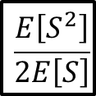
Threshold Parallelism
4
≤ 4
≤ 2
2
≤ 2
1
3
Het. M/G/k
M/G/k
TP Many first
2
TP FCFS
Open problem!
Few first or many first: Different limits
$$\frac{E\left[S^{2}\right]}{2E\left[S\right]}$$
E[T](1-ρ)
1
M/G/1
LPS
TP Few first
0
0
0.25
0.5
0.75
1
Load ρ
Notes:
Multiserver, different maximum parallelism
Same convergence, open problem
Different policies: Different limit.

Slide 11
Multiserver Job Model
4
= 1
=1
= 2
2
2
=4
1
MSJ FCFS
3
Het. M/G/k
M/G/k
2
TP FCFS
MSJ ServerFilling
$$\frac{E\left[S^{2}\right]}{2E\left[S\right]}$$
All existing policies: open problem!
All different limits, many unstable
We create new policy: ServerFilling
E[T](1-ρ)
1
M/G/1
LPS
0
0
0.25
0.5
0.75
1
Load ρ
Notes:
Fixed number of servers required
Many policies: Different limits
Open problem: Any policy
ServerFilling (to be defined): Same limit

Slide 12


Result: Response time bound
3
Het. M/G/k
E[T](1-ρ)
M/G/k
MSJ ServerFilling
Theorem: All models $π∈$ WCFS*:
$\lim_{ρ→1}{E\left[T^{π}\right]\left(1−ρ\right)}=\frac{E\left[S^{2}\right]}{2E\left[S\right]}$
Even stronger theorem:
$E\left[T^{π}\right]−E\left[T^{M\text{/}G\text{/}1}\right]∈[c_{l}^{π},c_{h}^{π}]$
Goals: Define WCFS, prove result
2
TP FCFS
$$\frac{E\left[S^{2}\right]}{2E\left[S\right]}$$
1
M/G/1
LPS
0
0
0.25
0.5
0.75
1
Load ρ
(Subject to minor condition on job size distribution S)
Notes:
Theorem: All Policies \pi in WCFS* (Minor condition on S),
E[T^\pi](1-\rho) => E[S^2]/(2E[S])
Even stronger:
E[T^\pi] – E[T^\M/G/1] \in [c^\pi_lower, c^\pi_higher]
M/G/1, in dark green, we completely understand.
Constant not depending on \rho.
Define WCFS, prove this result.

Slide 13
Base Queueing Model
Service policy
0.5
0.3
0.2
Age
Service policy serves jobs at some service rate
Work completes at service rate, age increases
Notes:
Jobs being served at some service rate
Age increases at service rate
Completes when age reaches size
Normalize maximum total service rate to 1.

Slide 14
Base Queueing Model
Service policy
0.5
0.3
0.2
Age
Service policy serves jobs at some service rate
Work completes at service rate, age increases
Job completes when age reaches size
Notes:
Jobs being served at some service rate
Age increases at service rate
Completes when age reaches size
Height means size here. Size is total work of a job.
Normalize maximum total service rate to 1.

Slide 15
Base Queueing Model
Service policy
0.5
0.3
0.2
Age
Service policy serves jobs at some service rate
Work completes at service rate, age increases
Job completes when age reaches size
Convention: normalize maximum service rate to 1.
Notes:
Jobs being served at some service rate
Age increases at service rate
Completes when age reaches size
Normalize maximum total service rate to 1.

Slide 16
Finite Skip
Front
Service policy
0.6
0.4
Finite skip: Only serve jobs among the n oldest jobs in arrival order.
Front size: n
Notes:
For instance, in an M/G/k, the front size is k.

Slide 17
Work conserving (for Finite Skip policies)
Service policy
0.2
0.2
Notes:
If >= n jobs, total service rate 1 (maximum)

Slide 18
Work conserving (for Finite Skip policies)
Service policy
0.3
0.2
0.3
0.2
Work conserving: If ≥ n jobs present, total service rate 1 (maximum)
Notes:
If >= n jobs, total service rate 1 (maximum)
Clarify: When I talk about Work Conserving, this is different than single-server policies, there 1 is important, here n is important.

Slide 19
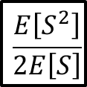
WCFS Policies
Polices that converge:
M/G/1
M/G/k
Heterogeneous M/G/k
Limited Processor Sharing
Threshold Parallelism FCFS
Multiserver-job ServerFilling
Polices that don’t converge:
M/G/1/SRPT
(Unlimited) Processor Sharing
Threshold Parallelism, most servers first
Multiserver-job FCFS
3
Het. M/G/k
E[T](1-ρ)
M/G/k
MSJ ServerFilling
2
TP FCFS
$$\frac{E\left[S^{2}\right]}{2E\left[S\right]}$$
1
M/G/1
LPS
0
0
0.25
0.5
0.75
1
Load ρ
Notes:
Let’s take a look at some examples

Slide 20
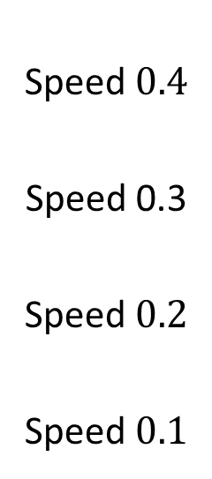
WCFS Example: Heterogeneous M/G/k
Speed $0.4$
Speed 0.3
Speed $0.2$
Speed $0.1$
Is this model WCFS?
Yes!
Is this model WCFS?

Slide 21
WCFS Example: Multiserver-Job FCFS
2
1
2
1
1
1
Is this model WCFS?
No, not work conserving.
Is this model WCFS?

Slide 22
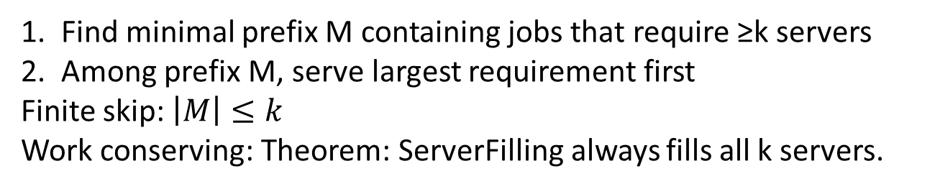
Define ServerFilling for Multiserver-Job model
ServerFilling setting: requirements powers of 2, k is power of 2.
k=8
ServerFilling
1
1/2
1/8
1
1/8
1
1
2
4
1/4
1
2
1
1
2
2
Find minimal prefix M containing jobs that require ≥k servers
Among prefix M, serve largest requirement first
Finite skip: $\left|M\right|≤k$
Work conserving: Theorem: ServerFilling always fills all k servers.
Is this model WCFS?
Is this model WCFS?
Yes!
Notes:
Assumption: k power 2, requirements power 2.
Let M be minimal prefix containing >= k servers
Within M, Largest req. first
Walk through example
Finite skip: Yes, |M| <= k
Work conserving: Yes, If M requires at least k, all servers filled.
After each job placed, # remaining servers multiple of requirement of job just placed.
Also have a more general variant if k is not a power of 2, happy to discuss if people are interested

Slide 23

Key ideas behind response time bound
Want to prove: $E\left[T^{π}\right]−E\left[T^{M\text{/}G\text{/}1}\right]∈[c_{l}^{π},c_{h}^{π}]$
Key ideas based on work W.
$E[T^{π}]≅E[W^{π}]$
$E[W^{π}]≅E[W^{M\text{/}G\text{/}1}]$

Slide 24
Idea 1: E[T] ≅ E[W]
*
Q: Starred job’s response time?
Notes:
Q: Tagged job’s response time?
Time in queue?
Time in front?
Front: Bounded expectation over all jobs
Queue:
Max time: $W^{A}$ - completion rate 1
Min time: $W^{A}−n$ jobs
Differ by constant in expectation.

Slide 25
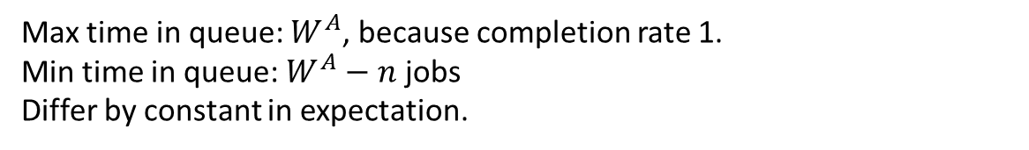
Idea 1: E[T] ≅ E[W]
*
Thm: Time in front bounded in expectation over all jobs.
Time in queue
Time in front
Max time in queue: $W^{A}$, because completion rate 1.
Min time in queue: $W^{A}−n$ jobs
Differ by constant in expectation.
Notes:
Q: Tagged job’s response time?
Time in queue?
Time in front?
Front: Bounded expectation over all jobs
Queue:
Max time: $W^{A}$ - completion rate 1
Min time: $W^{A}−n$ jobs
Differ by constant in expectation.
Because n is a constant, and our assumption.

Slide 26


Idea 2: $E[W] ≅ E\left[W^{M\text{/}G\text{/}1}\right]$ - Intuition
Job arrives: +S work
All servers full: rate 1
Work W
Identical to M/G/1!
Time
Too few jobs: lower rate

Slide 27
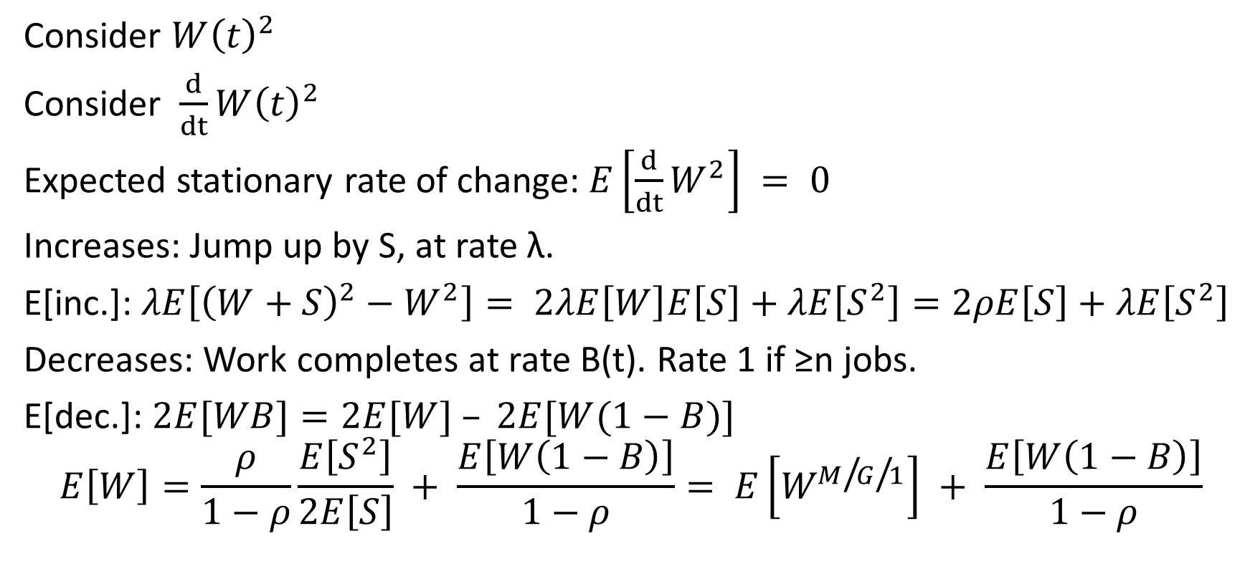

Proof of $E[W] ≅ E\left[W^{M\text{/}G\text{/}1}\right]$
Consider $W{\left(t\right)}^{2}$
Consider $\frac{d}{dt}W{\left(t\right)}^{2}$
Expected stationary rate of change: $E\left[\frac{d}{dt}W^{2}\right] = 0$
Increases: Jump up by S, at rate λ.
E[inc.]: $λE\left[{\left(W+S\right)}^{2}−W^{2}\right]= 2λE\left[W\right]E\left[S\right]+λE\left[S^{2}\right]=2ρE\left[S\right]+λE\left[S^{2}\right]$
Decreases: Work completes at rate B(t). Rate 1 if ≥n jobs.
E[dec.]: $2E[WB]=2E[W] – 2E[W(1−B)]$
$$E\left[W\right]=\frac{ρ}{1−ρ}\frac{E\left[S^{2}\right]}{2E\left[S\right]} + \frac{E\left[W\left(1−B\right)\right]}{1−ρ}= E\left[W^{M\text{/}G\text{/}1}\right] + \frac{E\left[W\left(1−B\right)\right]}{1−ρ}$$

Slide 28

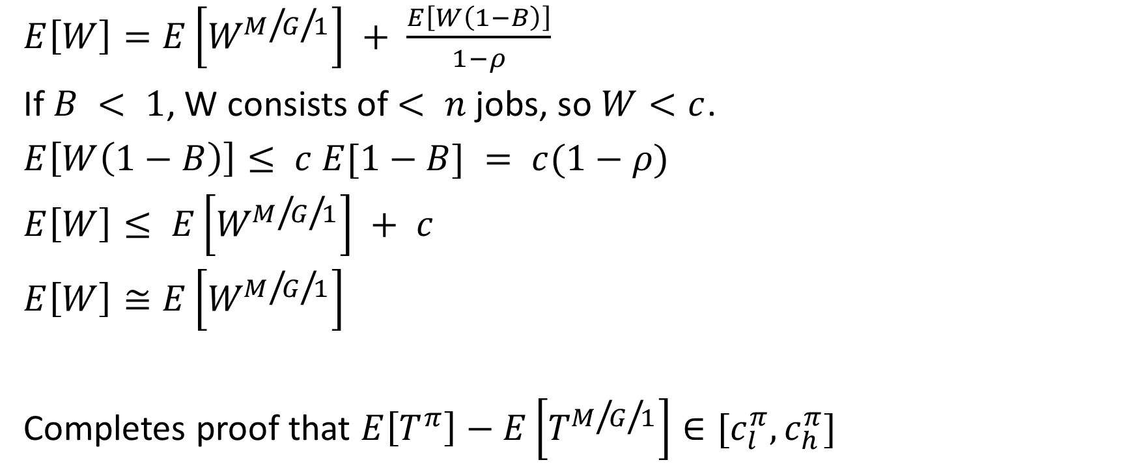
Proof of $E[W] ≅ E\left[W^{M\text{/}G\text{/}1}\right]$
$E\left[W\right]=E\left[W^{M\text{/}G\text{/}1}\right] + \frac{E\left[W\left(1−B\right)\right]}{1−ρ}$
If $B < 1$, W consists of $< n$ jobs, so $W<c$.
$E\left[W\left(1−B\right)\right]≤ c E[1−B] = c(1−ρ)$
$E\left[W\right]≤ E\left[W^{M\text{/}G\text{/}1}\right] + c$
$E\left[W\right]≅E\left[W^{M\text{/}G\text{/}1}\right]$
Completes proof that $E\left[T^{π}\right]−E\left[T^{M\text{/}G\text{/}1}\right]∈[c_{l}^{π},c_{h}^{π}]$
Notes:
<n jobs, bounded work.

Slide 29
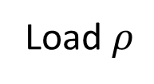
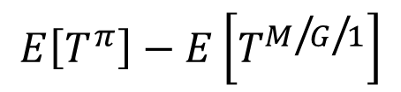
Empirical validation
Threshold Parallelism
2
1
0
-1
-2
MSJ ServerFilling
Heterogeneous M/G/k
$$E\left[T^{π}\right]−E\left[T^{M\text{/}G\text{/}1}\right]$$
Limited Processor Sharing
0.7
0.8
0.9
1
Load $ρ$
Notes:
E[T] – E[T_Q^{M/G/1}] vs. \rho
Converges to a constant.

Slide 30
Future questions
Work conserving and finite skip, relative to a different job ordering, e.g. SRPT?
Finite skip but not work conserving?
Finite skip in expectation?

Slide 31

Conclusion
Explained unexpected similarity between queues
Defined work conserving finite skip models
Tightly bounded mean response for all WCFS models.
3
Het. M/G/k
E[T](1-ρ)
M/G/k
MSJ ServerFilling
2
TP FCFS
$$\frac{E\left[S^{2}\right]}{2E\left[S\right]}$$
1
M/G/1
LPS
0
0
0.25
0.5
0.75
1
Load ρ

Slide 32

Extra: Condition on S
Bounded expected remaining size:
Exists constant c such that for all ages a,
$$E[S – a | S > a] < c$$

Slide 33
Extra: DivisorFilling
Like ServerFilling, MSJ policy that fills all servers if enough jobs available. In particular, WCFS policy.
DivisorFilling works whenever all requirements divide the number of servers k. If k jobs present, will fill all servers.
If jobs can have requirements that don’t divide k, WCFS not possible.

