Slide 1

Scheduling with Massively Heterogeneous Resource Requirements
Izzy Grosof
Heyuan Yao
Willow Kowalik
Northwestern University
Industrial Engineering & Management Science

Slide 2

Datacenter Scheduling: Heterogeneous resources
Datacenters: Huge resource capacities:
CPUs, GPUs, memory, bandwidth, etc.
Extremely heterogeneous job
requirements: Scale & resource mix
Scheduling: Which jobs served when?
Goal: More performance from
existing capacity
Tool: Performance modeling, stochastic queueing theory

Slide 3


Existing theoretical paradigm:
Limited resource heterogeneity
Existing performance modeling theory: Heterogeneity via handful of resource requirement classes – like VMs, small, medium, large
Reality: massive heterogeneity. Google Borg scheduling trace: In first 1M jobs, 3.7k unique memory reqs., 540k unique CPU reqs., 950k unique pairs.
Real systems, and corresponding simulators understand this.
Popular policies: FCFS + Backfilling policies, learning policies.
Need new theory!

Slide 4
Prior theoretical work
Class-based policies: Count jobs with identical reqs.
MaxWeight: Solve knapsack, weight by number with same reqs [MSY ‘12]
Randomized Timers [PG ’18], MSR [CGB ’25]: Long sequences of identical reqs
Upside: Optimal throughput.
Downside: Only useful when more jobs present than classes.
Index-based policies: Simple ordering, greedily place into service.
FCFS with HOL blocking [RM ’17,GHHS ‘23]. Backfilling [CS ’01] and variants.
Unfortunately: Not throughput optimal – wasting some capacity.
Goal: Theoretical guarantees of class-based, applicability of index-based

Slide 5
Outline
.9
.2
.5
.7
Theoretical model
New policies: Controlled Discretization
Theoretical results
Empirical results, using trace data
Extension: Changing requirements over time
.08
.25
.13

Slide 6
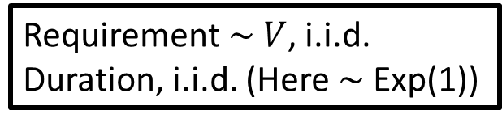
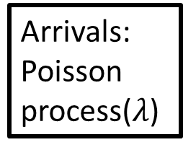


Model
Requirement $\sim V$, i.i.d.
Duration, i.i.d. (Here $\sim$ Exp(1))
.9
.2
Continuous resource distribution: Multi-resource or single resource.
Job needs all resources throughout service.
Policy: Which jobs to serve?
Both preemptive and nonpreemptive models.
Goal: Throughput optimal. If any policy can stabilize, we stabilize
Arrivals: Poisson process($λ$)
.5
.7
.08
$$f_{V}(v)$$
.25
$0$ $v$ $1$
Capacity (normalized to 1)
.13

Slide 7
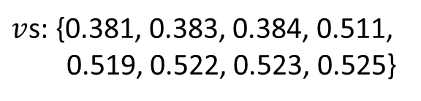
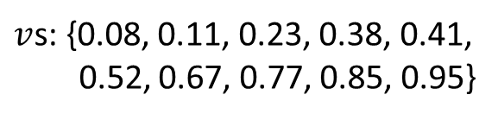
Policy Intuition
$v$s: {0.08, 0.11, 0.23, 0.38, 0.41,
0.52, 0.67, 0.77, 0.85, 0.95}
Pack efficiently – use all available resources
Avoid clumps of jobs of similar requirements
Problem: Very few options!
Multi-resource: Bottleneck on one resource
Single resource: Doesn’t divide cleanly
Class-based policies: prioritize jobs with many identical reqs present. Ex: MaxWeight – weight is number with same reqs.
Our policies: Prioritize jobs with many similar requirements present.
$v$s: {0.381, 0.383, 0.384, 0.511,
0.519, 0.522, 0.523, 0.525}
Notes:
Very clumped: few options

Slide 8

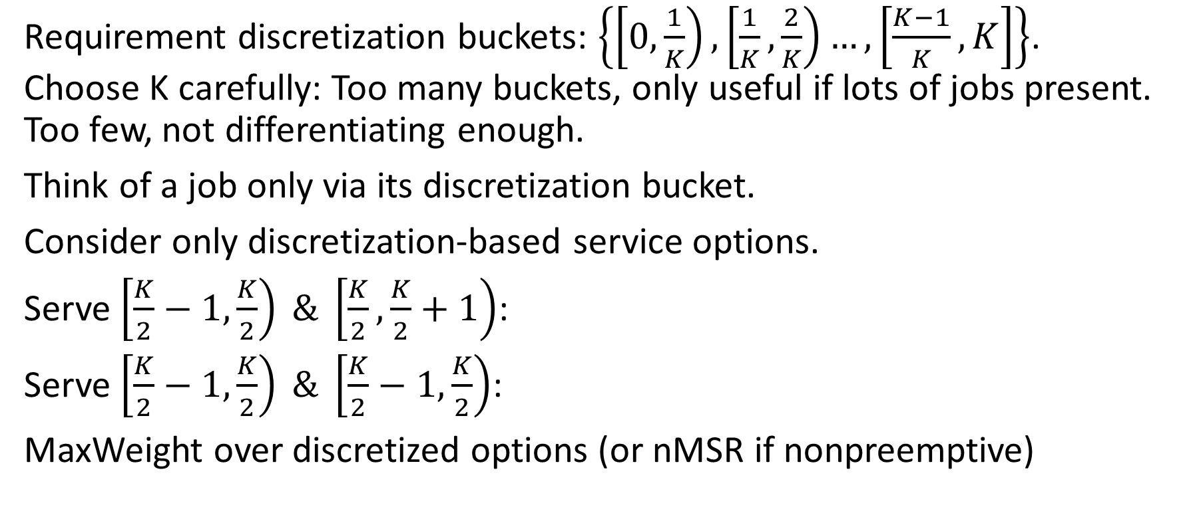

Idea: Calculated discretization!
Requirement discretization buckets: $\left\{\left[0,\frac{1}{K}\right),\left[\frac{1}{K},\frac{2}{K}\right)…,\left[\frac{K−1}{K},K\right]\right\}$.
Choose K carefully: Too many buckets, only useful if lots of jobs present. Too few, not differentiating enough.
Think of a job only via its discretization bucket.
Consider only discretization-based service options.
Serve $\left[\frac{K}{2}−1,\frac{K}{2}\right) \& \left[\frac{K}{2},\frac{K}{2}+1\right)$:
Serve $\left[\frac{K}{2}−1,\frac{K}{2}\right) \& \left[\frac{K}{2}−1,\frac{K}{2}\right)$:
MaxWeight over discretized options (or nMSR if nonpreemptive)
Counts $q_{K}\left(v\right)$
$0$ $v$ $1$

Slide 9

K-Discretized MaxWeight: Result
K-Discretized MaxWeight:
${argmax}_{M_{K}}⟨\vec{q_{K}},M_{K}⟩$, where $M_{K}$ is a K-discretized service option
Thm: The K-Discretized MaxWeight policy family is throughput optimal.
For any arrival rate $λ$ and any Lipschitz-continuous requirement distribution $V$ for which a stabilizing policy exists, there exists a K such that K-MaxWeight is stable.
Thm: Also optimal in any number of requirement dimensions
Thm: K-discretized nMSR (nonpreemptive) also throughput optimal

Slide 10
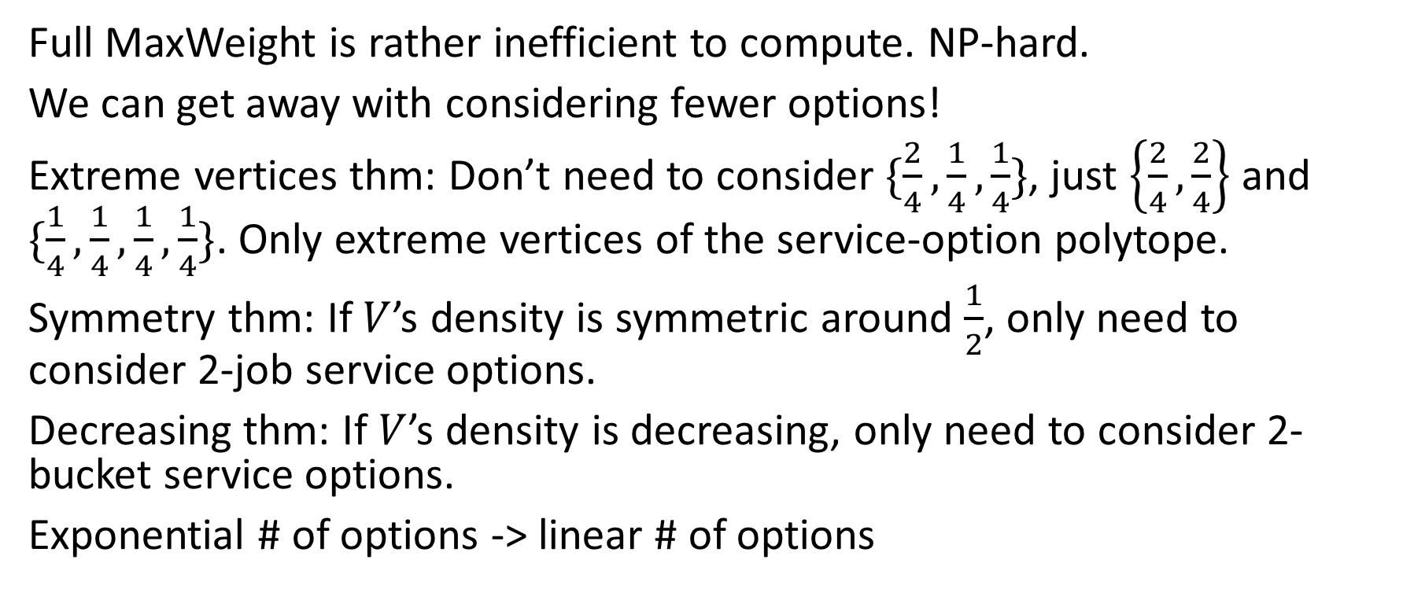
Smaller search space: more efficient
Full MaxWeight is rather inefficient to compute. NP-hard.
We can get away with considering fewer options!
Extreme vertices thm: Don’t need to consider $\{\frac{2}{4},\frac{1}{4},\frac{1}{4}\}$, just $\left\{\frac{2}{4},\frac{2}{4}\right\}$ and $\{\frac{1}{4},\frac{1}{4},\frac{1}{4},\frac{1}{4}\}$. Only extreme vertices of the service-option polytope.
Symmetry thm: If $V$’s density is symmetric around $\frac{1}{2}$, only need to consider 2-job service options.
Decreasing thm: If $V$’s density is decreasing, only need to consider 2-bucket service options.
Exponential # of options -> linear # of options

Slide 11
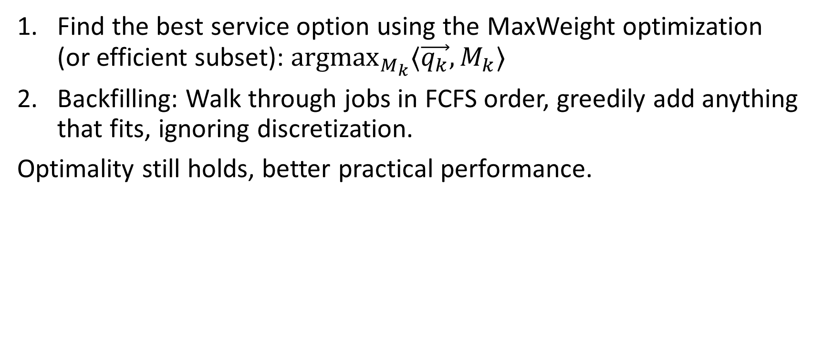
Practical: Discretized MaxWeight + Backfilling
Find the best service option using the MaxWeight optimization
(or efficient subset): ${argmax}_{M_{k}}⟨\vec{q_{k}},M_{k}⟩$
Backfilling: Walk through jobs in FCFS order, greedily add anything that fits, ignoring discretization.
Optimality still holds, better practical performance.

Slide 12
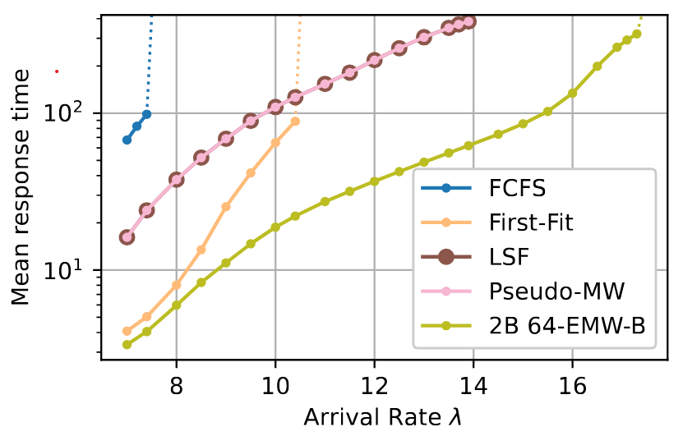
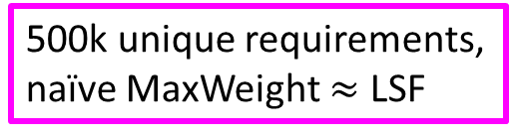
Empirical evaluation – CPU reqs
Google Borg scheduling trace [Tirmazi ’19]: CPU reqs, memory reqs. Not i.i.d.
Focus on 90% of jobs with lower requirements, normalize.
Our policy: K=64 buckets, only consider service options that use at most 2 buckets, add backfilling.
500k unique requirements, naïve MaxWeight $≈$ LSF
Notes:
Dotted lines: over 1000, indistinguishable from unstable.

Slide 13
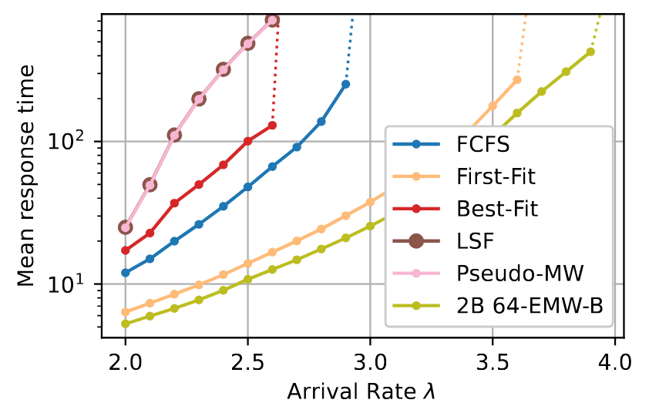
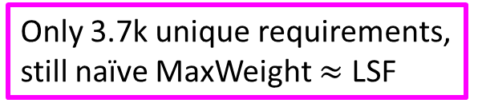
Empirical evaluation – Memory reqs
Our policy: K=64 buckets, only consider service options that use at most 2 buckets, add backfilling.
Only 3.7k unique requirements, still naïve MaxWeight $≈$ LSF

Slide 14
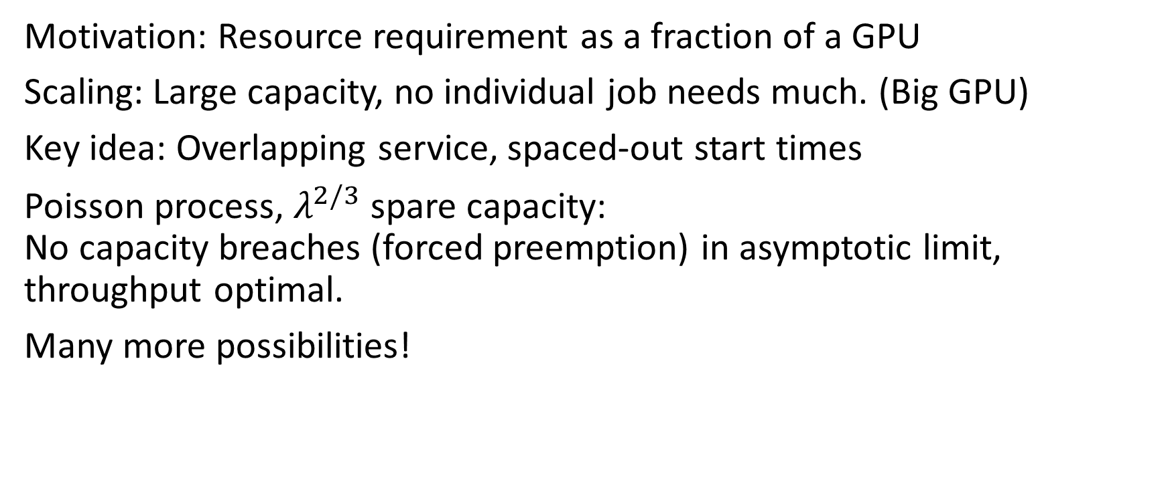
Future: Changing requirements over time
Motivation: Resource requirement as a fraction of a GPU
Scaling: Large capacity, no individual job needs much. (Big GPU)
Key idea: Overlapping service, spaced-out start times
Poisson process, $λ^{2/3}$ spare capacity:
No capacity breaches (forced preemption) in asymptotic limit,
throughput optimal.
Many more possibilities!

Slide 15
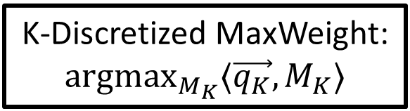


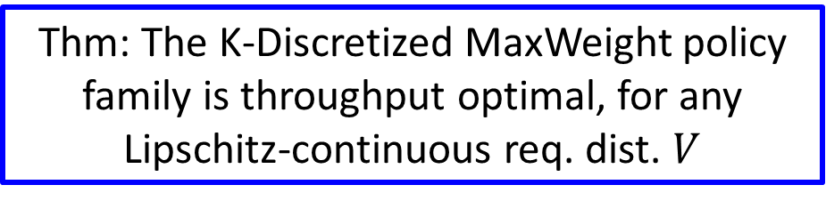
Conclusion
Continuous requirement distributions
.9
.2
.5
.7
.08
$$f_{V}(v)$$
.25
$0$ $v$ $1$
.13
K-Discretized MaxWeight: ${argmax}_{M_{K}}⟨\vec{q_{K}},M_{K}⟩$
Thm: The K-Discretized MaxWeight policy family is throughput optimal, for any Lipschitz-continuous req. dist. $V$

