Slide 1


Optimizing Multiserver Scheduling:
Beyond SRPT-k
Izzy Grosof
Northwestern University, IEMS
Daniela Hurtado-Lange, Kellogg
Ziyuan Wang, IEMS

Slide 2


Motivation: Multiserver User-Computing
User devices serve multiple jobs at once – multicore, “multiserver”
Scheduling: Which jobs to run when? Free performance improvement.
Stochastic models: Many sources of jobs, randomized aggregate model.
Notes:
Personal devices serve jobs. Multiple jobs at once – “multiserver” – 2 cores, 4 cores, hyperthreading, etc. Even phones are multiserver.
Queueing systems: Jobs arrive/are generated, too many to run all at once, must be scheduled – which jobs to run when?
Advanced scheduling is a free source of better performance.
Stochastic models: Many sources of jobs. Results generalize.

Slide 3
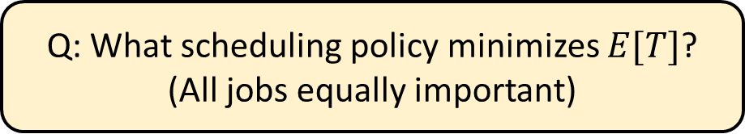




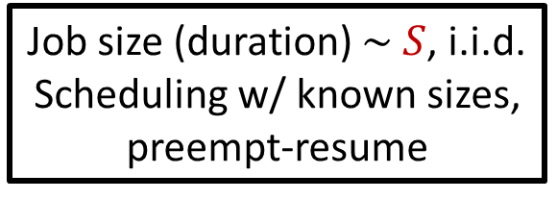
Today’s Model: M/G/k Scheduling
Job size (duration) $\sim S$, i.i.d.
Scheduling w/ known sizes, preempt-resume
Load $ρ=λE[S]<1$
PoissonP($λ$)
$$k≥2$$
Response time $T$
Q: What scheduling policy minimizes $E[T]$?
(All jobs equally important)
Shortest Remaining Processing Time?
(Least remaining service duration)
Notes:
Different service durations, known in advance, equally important. Preempt-resume. Poisson, i.i.d. Mean response time E[T]. Mean number E[N] equivalent. Load rho.
Goal: Scheduling policy which minimizes E[T].

Slide 4
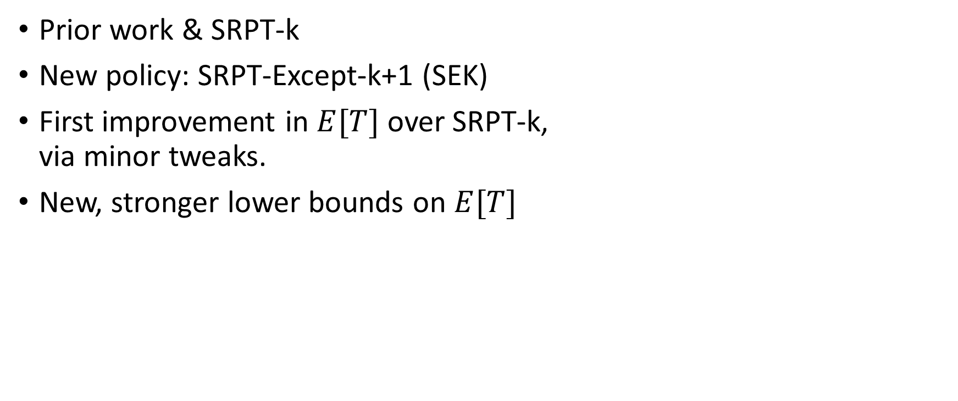
Outline
SRPT-k
Prior work & SRPT-k
New policy: SRPT-Except-k+1 (SEK)
First improvement in $E[T]$ over SRPT-k,
via minor tweaks.
New, stronger lower bounds on $E[T]$
SEK

Slide 5
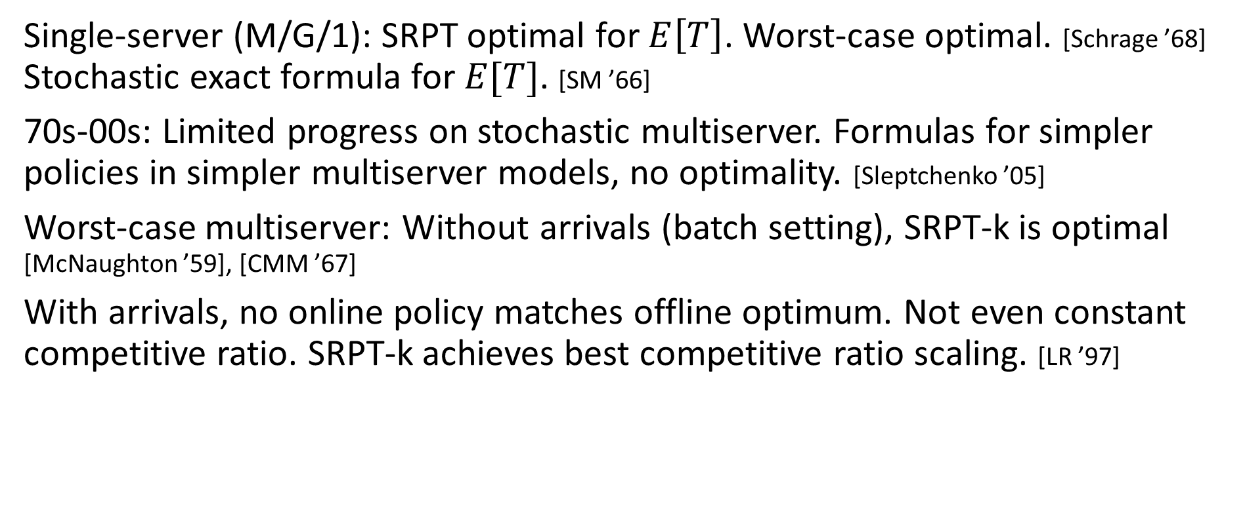
Prior work
Single-server (M/G/1): SRPT optimal for $E\left[T\right]$. Worst-case optimal. [Schrage ’68]
Stochastic exact formula for $E[T]$. [SM ’66]
70s-00s: Limited progress on stochastic multiserver. Formulas for simpler policies in simpler multiserver models, no optimality. [Sleptchenko ’05]
Worst-case multiserver: Without arrivals (batch setting), SRPT-k is optimal [McNaughton ’59], [CMM ’67]
With arrivals, no online policy matches offline optimum. Not even constant competitive ratio. SRPT-k achieves best competitive ratio scaling. [LR ’97]

Slide 6
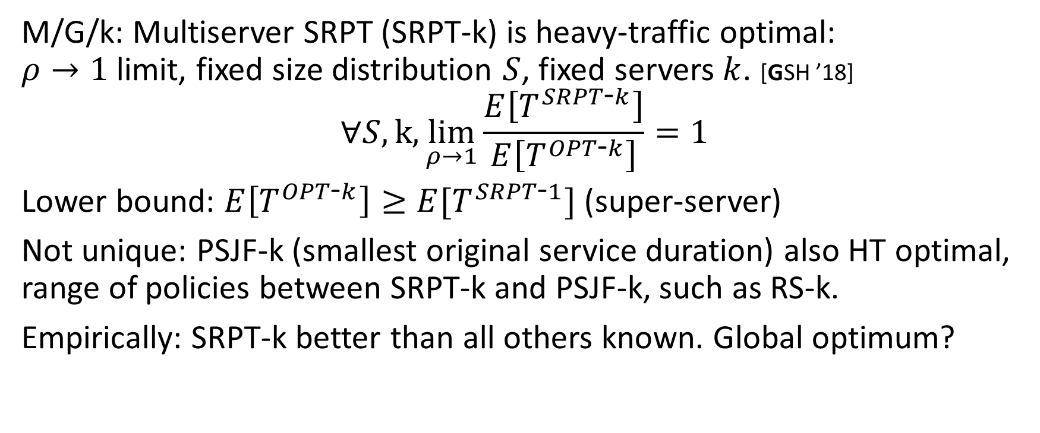
Prior Work: SRPT-k Heavy Traffic Optimality
M/G/k: Multiserver SRPT (SRPT-k) is heavy-traffic optimal:
$ρ→1$ limit, fixed size distribution $S$, fixed servers $k$. [GSH ’18]
$$∀S, k,\lim_{ρ→1}\frac{E\left[T^{SRPT\text{-}k}\right]}{E\left[T^{OPT\text{-}k}\right]}=1$$
Lower bound: $E\left[T^{OPT\text{-}k}\right]≥E[T^{SRPT\text{-}1}]$ (super-server)
Not unique: PSJF-k (smallest original service duration) also HT optimal, range of policies between SRPT-k and PSJF-k, such as RS-k.
Empirically: SRPT-k better than all others known. Global optimum?
Can we stochastically outperform SRPT-k?

Slide 7
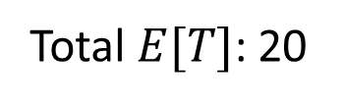
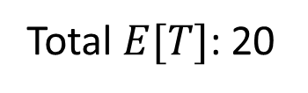
SRPT-k’s weak point
SRPT-k’s problem: last job is inefficient – server(s) idle.
Idea of SRPT-Except-k+1 (SEK): If we see this coming, diverge.
SRPT-k
3
3
10
Total $E[T]$: 20
10
4
4
0 3 4 13
SEK
3
3
4
Total $E[T]$: 20
4
10
10
0 3 7 10

Slide 8
SRPT-k’s weak point
SRPT-k’s problem: last job is inefficient – server idle.
Idea of SRPT-Except-k+1 (SEK): If we see this coming, diverge.
Early arrival: Benefits SRPT-k
SRPT-k
3
10
4
0 3 4 13
SEK
3
4
10
0 3 7 10

Slide 9

SRPT-k’s weak point
SRPT-k’s problem: last job is inefficient – server idle.
Idea of SRPT-Except-k+1 (SEK): If we see this coming, diverge.
Early arrival: Benefits SRPT-k
Late arrivals: Benefit SEK
If SEK diverges when 2 jobs
are very small, almost all upside.
SRPT-k
3
10
4
0 3 4 13
SEK
3
4
10
0 3 7 10

Slide 10
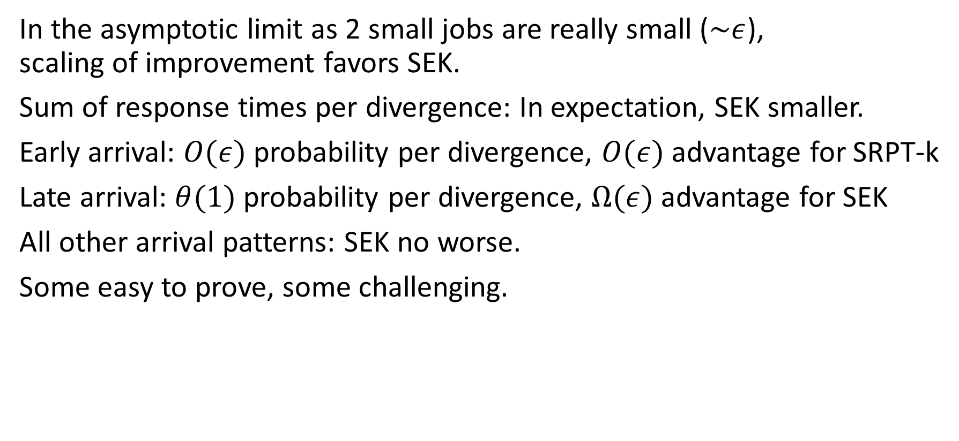
SEK Improvement Intuition
SEK
0.3
0.4
10
In the asymptotic limit as 2 small jobs are really small ($\sim ε$),
scaling of improvement favors SEK.
Sum of response times per divergence: In expectation, SEK smaller.
Early arrival: $O(ε)$ probability per divergence, $O(ε)$ advantage for SRPT-k
Late arrival: $θ(1)$ probability per divergence, $Ω(ε)$ advantage for SEK
All other arrival patterns: SEK no worse.
Some easy to prove, some challenging.

Slide 11
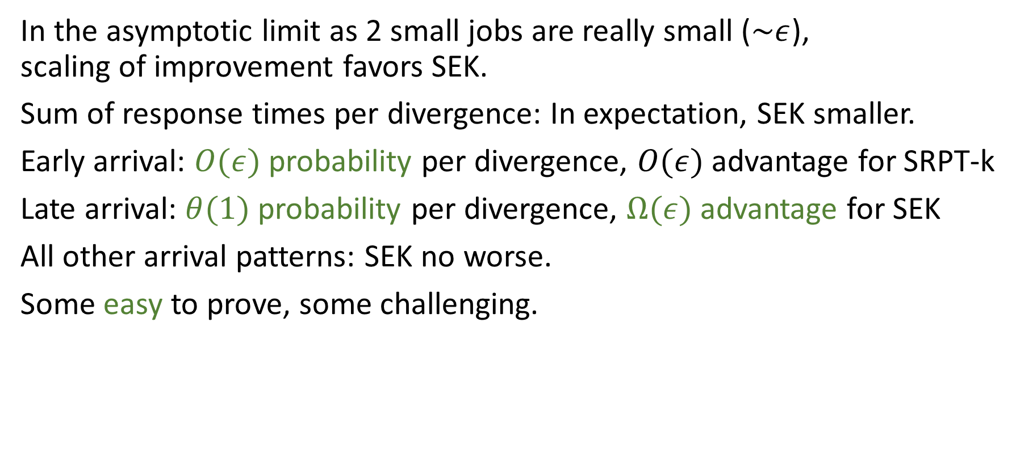
SEK Improvement Intuition
SEK
0.3
0.4
10
In the asymptotic limit as 2 small jobs are really small ($\sim ε$),
scaling of improvement favors SEK.
Sum of response times per divergence: In expectation, SEK smaller.
Early arrival: $O(ε)$ probability per divergence, $O(ε)$ advantage for SRPT-k
Late arrival: $θ(1)$ probability per divergence, $Ω(ε)$ advantage for SEK
All other arrival patterns: SEK no worse.
Some easy to prove, some challenging.

Slide 12
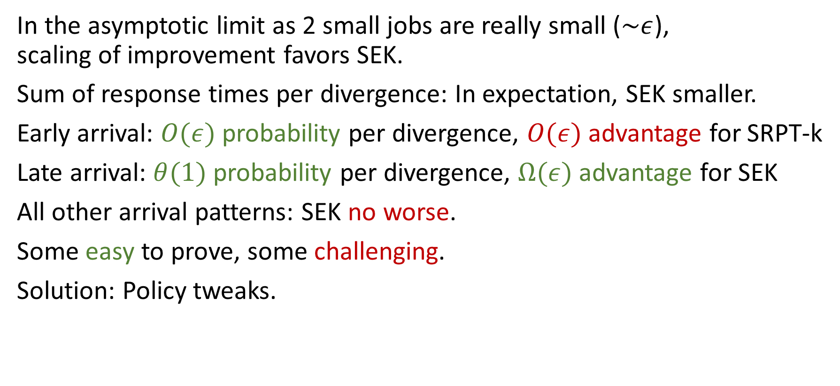
SEK Improvement Intuition
SEK
0.3
0.4
10
In the asymptotic limit as 2 small jobs are really small ($\sim ε$),
scaling of improvement favors SEK.
Sum of response times per divergence: In expectation, SEK smaller.
Early arrival: $O(ε)$ probability per divergence, $O(ε)$ advantage for SRPT-k
Late arrival: $θ(1)$ probability per divergence, $Ω(ε)$ advantage for SEK
All other arrival patterns: SEK no worse.
Some easy to prove, some challenging.
Solution: Policy tweaks.

Slide 13



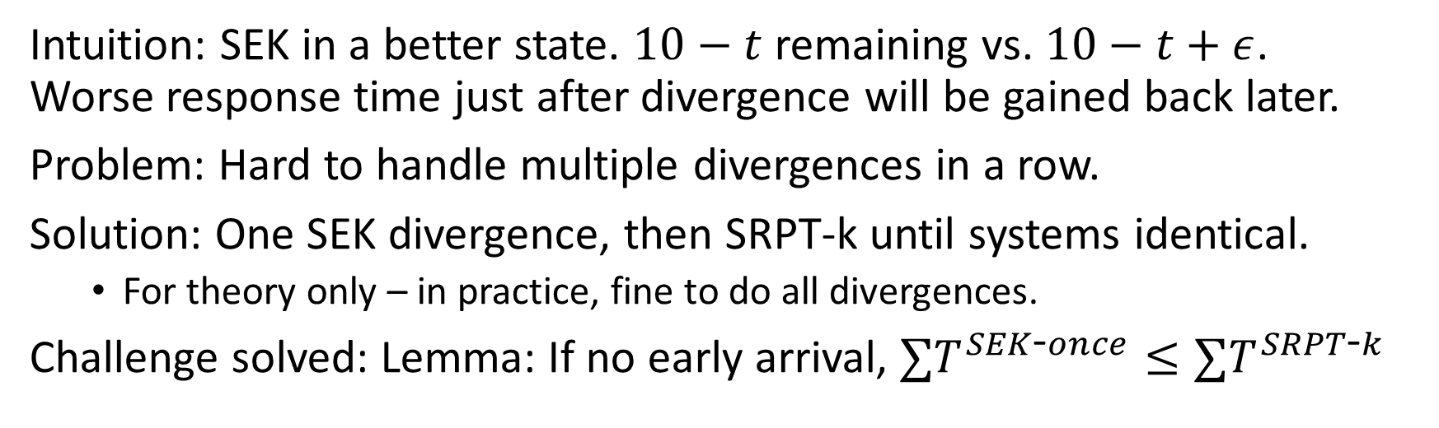





Challenge 1: If not early arrival, SEK better
SRPT-k
SEK
$$ε$$
10
10
$$ε$$
$$ε$$
$$ε$$
$$t$$
$$t$$
0 $ε$ $10+ε$
0 $ε$ $2ε$ $10$
Intuition: SEK in a better state. $10−t$ remaining vs. $10−t+ε$.
Worse response time just after divergence will be gained back later.
Problem: Hard to handle multiple divergences in a row.
Solution: One SEK divergence, then SRPT-k until systems identical.
  For theory only – in practice, fine to do all divergences.
Challenge solved: Lemma: If no early arrival, $∑T^{SEK\text{-}once}≤∑T^{SRPT\text{-}k}$

Slide 14
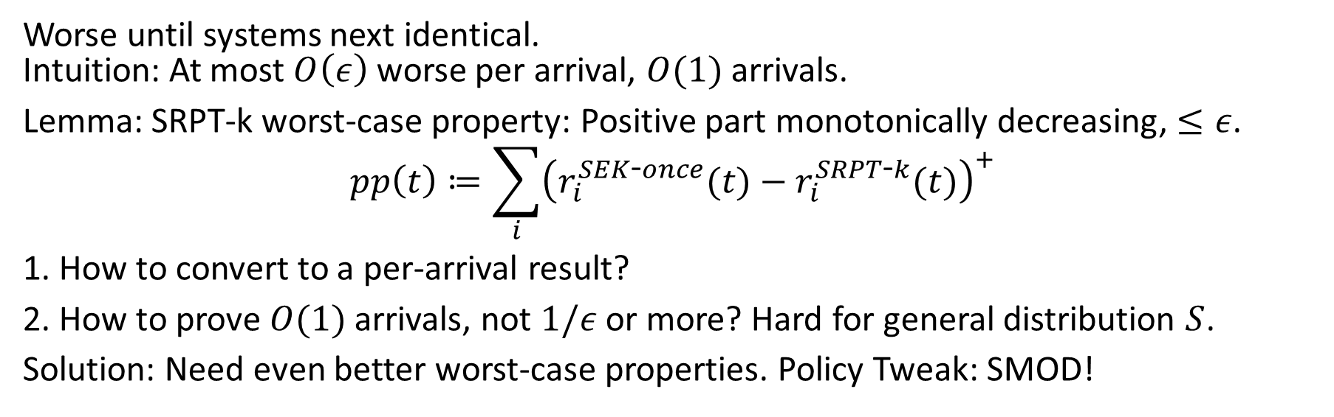
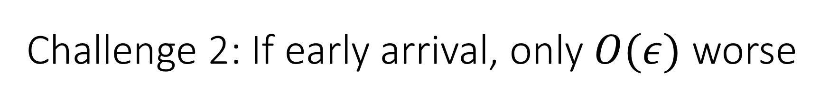


Challenge 2: If early arrival, only $O(ε)$ worse
SRPT-k
SEK
$$ε$$
10
10
$$ε$$
$$ε$$
$$ε$$
$$t$$
0 $ε$ $10+ε$
$$t$$
0 $ε$ $2ε$ $10$
Worse until systems next identical.
Intuition: At most $O\left(ε\right)$ worse per arrival, $O(1)$ arrivals.
Lemma: SRPT-k worst-case property: Positive part monotonically decreasing, $≤ε$.
$$pp\left(t\right)≔\sum_{i}{{\left(r_{i}^{SEK\text{-}once}(t)−r_{i}^{SRPT\text{-}k}(t)\right)}^{+}}$$
1. How to convert to a per-arrival result?
2. How to prove $O(1)$ arrivals, not $1/ε$ or more? Hard for general distribution $S$.
Solution: Need even better worst-case properties. Policy Tweak: SMOD!

Slide 15
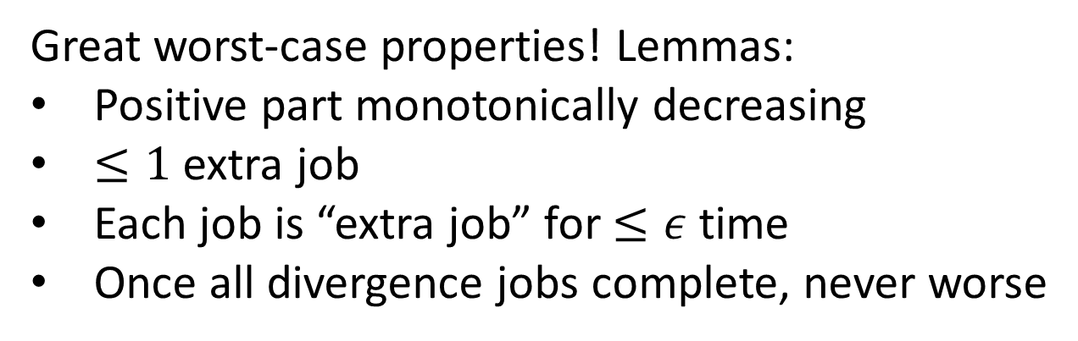
Final tweak: SEK-SMOD
Final policy: SEK-SMOD. 1 SEK divergence, then SMOD until identical.
SMOD: Explicit reference to SRPT-k system with same arrivals. Completely predictable.
SMOD: Prioritize jobs at indexes with equal or larger remaining size than SRPT-k counterpart, then prioritize smallest remaining size secondarily.
Great worst-case properties! Lemmas:
Positive part monotonically decreasing
$≤1$ extra job
Each job is “extra job” for $≤ε$ time
Once all divergence jobs complete, never worse
5
4
SMOD
2
1
6
SRPT-k
3.5
3

Slide 16
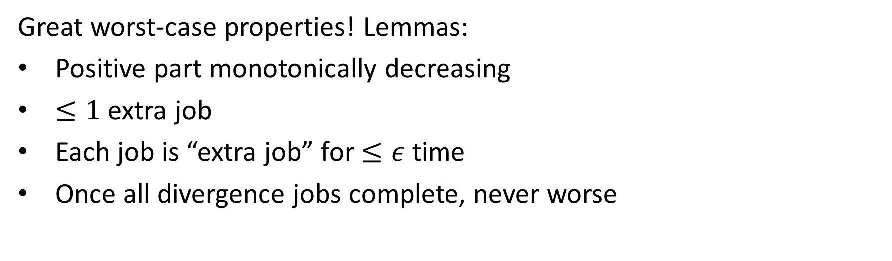
Final tweak: SEK-SMOD
5
4
SMOD
2
1
6
Great worst-case properties! Lemmas:
Positive part monotonically decreasing
$≤1$ extra job
Each job is “extra job” for $≤ε$ time
Once all divergence jobs complete, never worse
SRPT-k
3.5
3

Slide 17
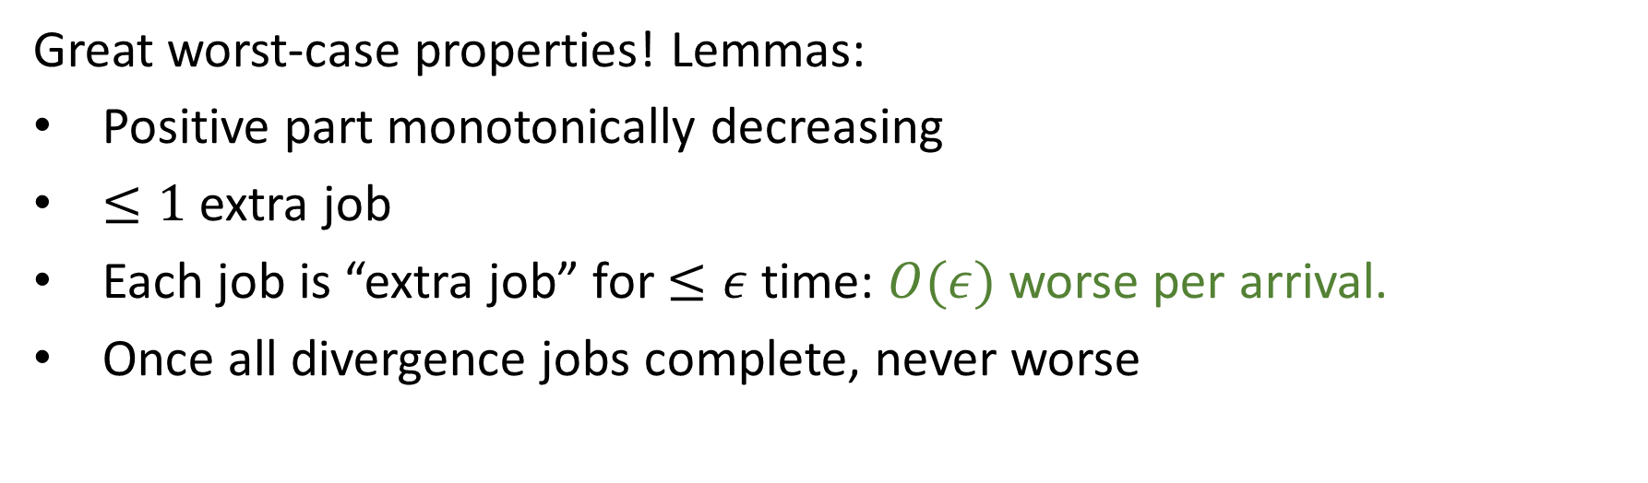
Final tweak: SEK-SMOD
5
4
SMOD
2
1
6
Great worst-case properties! Lemmas:
Positive part monotonically decreasing
$≤1$ extra job
Each job is “extra job” for $≤ε$ time: $O(ε)$worse per arrival.
Once all divergence jobs complete, never worse
SRPT-k
3.5
3

Slide 18
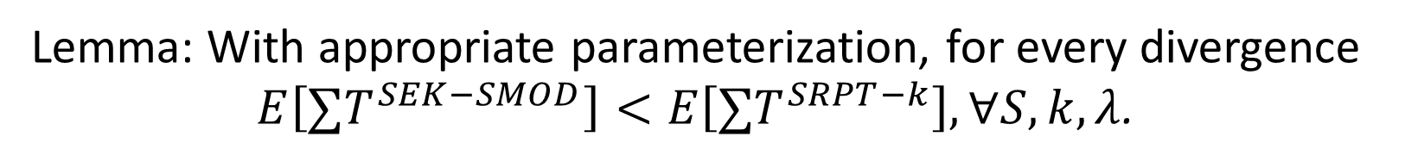
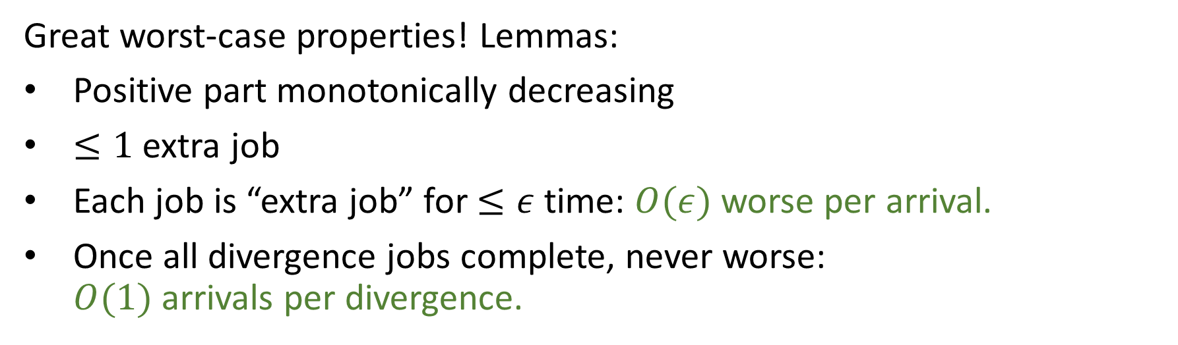
Final tweak: SEK-SMOD
5
4
SMOD
2
1
6
Great worst-case properties! Lemmas:
Positive part monotonically decreasing
$≤1$ extra job
Each job is “extra job” for $≤ε$ time: $O(ε)$worse per arrival.
Once all divergence jobs complete, never worse:
$O(1)$ arrivals per divergence.
SRPT-k
3.5
3
Lemma: With appropriate parameterization, for every divergence
$E\left[∑T^{SEK−SMOD}\right]<E\left[∑T^{SRPT−k}\right], ∀S, k,λ$.

Slide 19
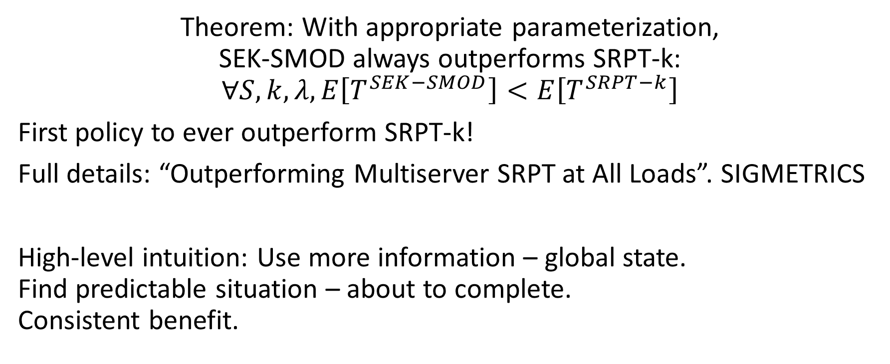
Main Result
Theorem: With appropriate parameterization,
SEK-SMOD always outperforms SRPT-k:
$$∀S, k, λ, E\left[T^{SEK−SMOD}\right]<E\left[T^{SRPT−k}\right]$$
First policy to ever outperform SRPT-k!
Full details: “Outperforming Multiserver SRPT at All Loads”. SIGMETRICS
High-level intuition: Use more information – global state.
Find predictable situation – about to complete.
Consistent benefit.

Slide 20
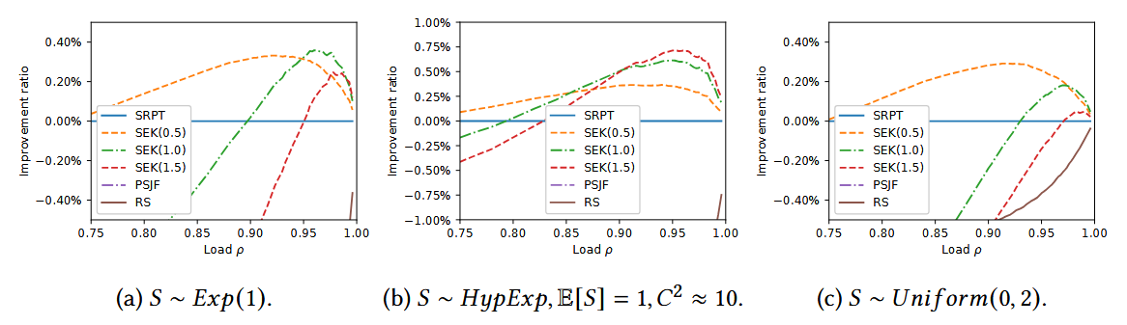
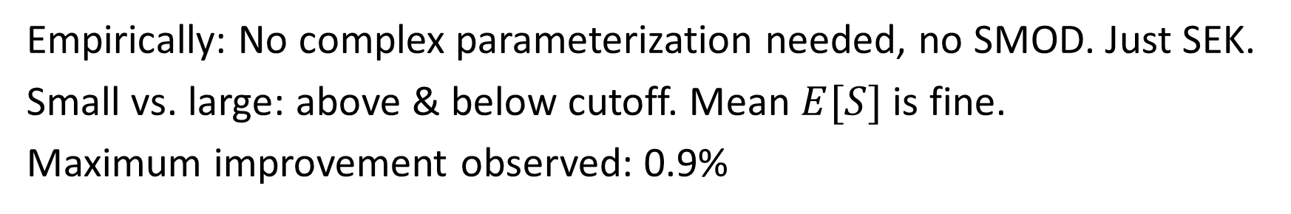
Empirical outperformance
Empirically: No complex parameterization needed, no SMOD. Just SEK.
Small vs. large: above & below cutoff. Mean $E[S]$ is fine.
Maximum improvement observed: 0.9%

Slide 21
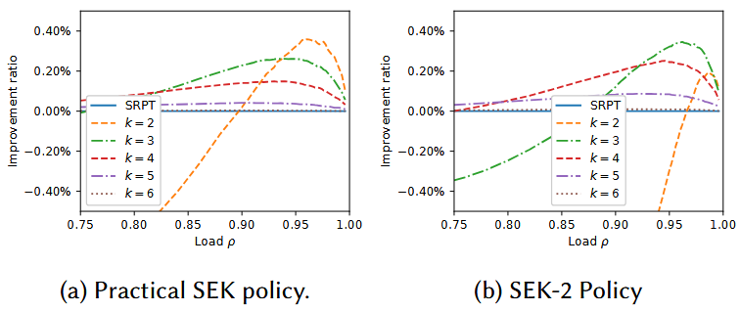
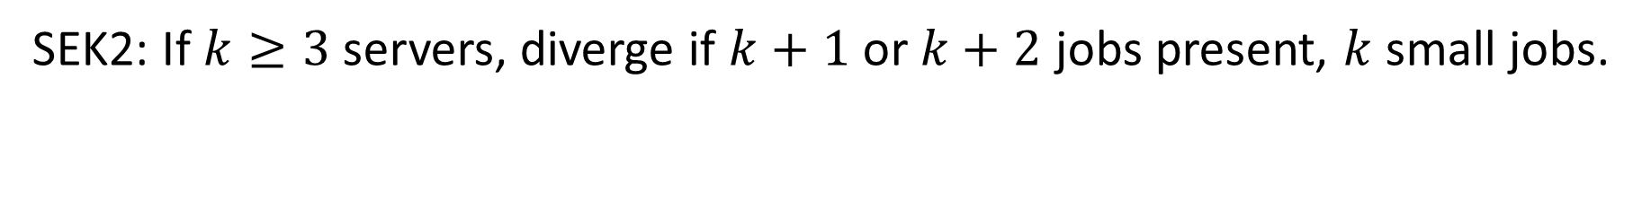
More servers: More divergences
SEK2: If $k≥3$ servers, diverge if $k+1$ or $k+2$ jobs present, $k$ small jobs.

Slide 22
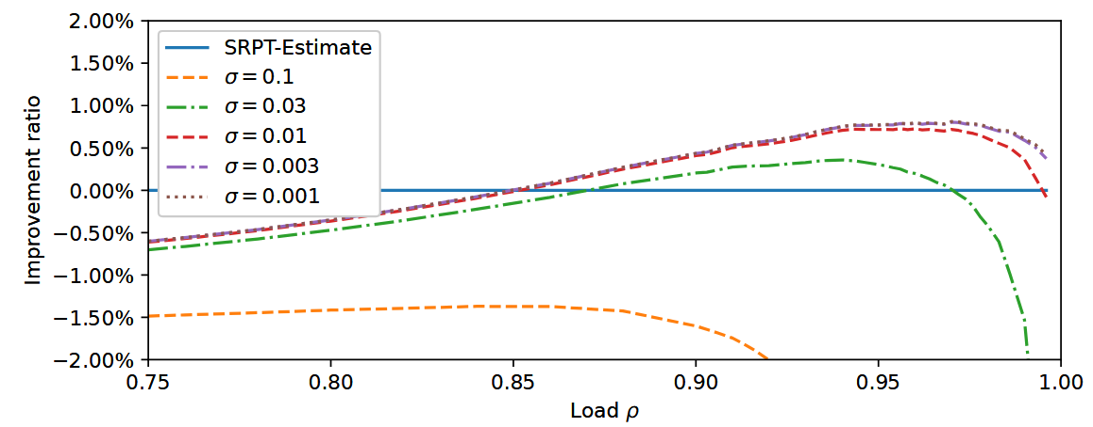
Estimates: SEK still helps, if low noise
S hyperexponential, $C^{2}≈10$. Estimation error $N(0, σ)$.

Slide 23
Distance to optimality
How good is 0.9% improvement, anyways? How close to optimal?
We don’t know! Need better lower bounds!
?
?
?

Slide 24
Outline
SRPT-k
Prior work & SRPT-k
New policy: SRPT-Except-k+1 (SEK)
First improvement in $E[T]$ over SRPT-k,
via minor tweaks.
New, stronger lower bounds on $E[T]$
SEK

Slide 25
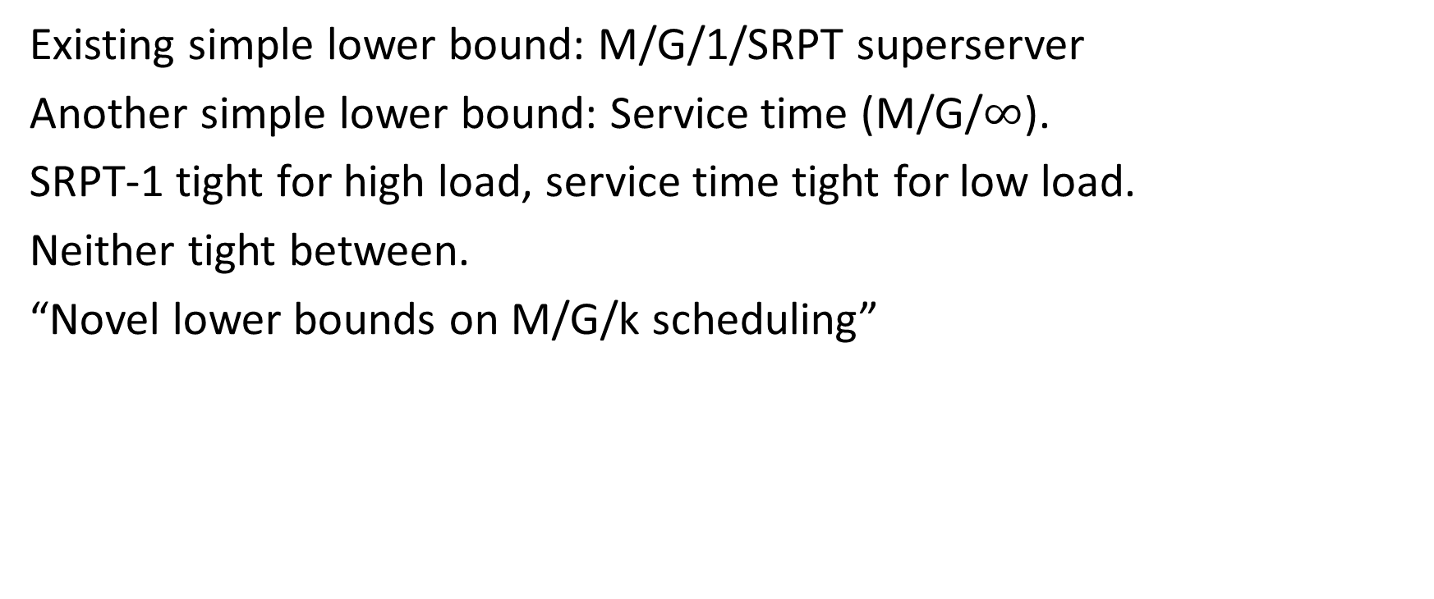
Multiserver lower bounds
Existing simple lower bound: M/G/1/SRPT superserver
Another simple lower bound: Service time (M/G/$∞$).
SRPT-1 tight for high load, service time tight for low load.
Neither tight between.
“Novel lower bounds on M/G/k scheduling”
…

Slide 26
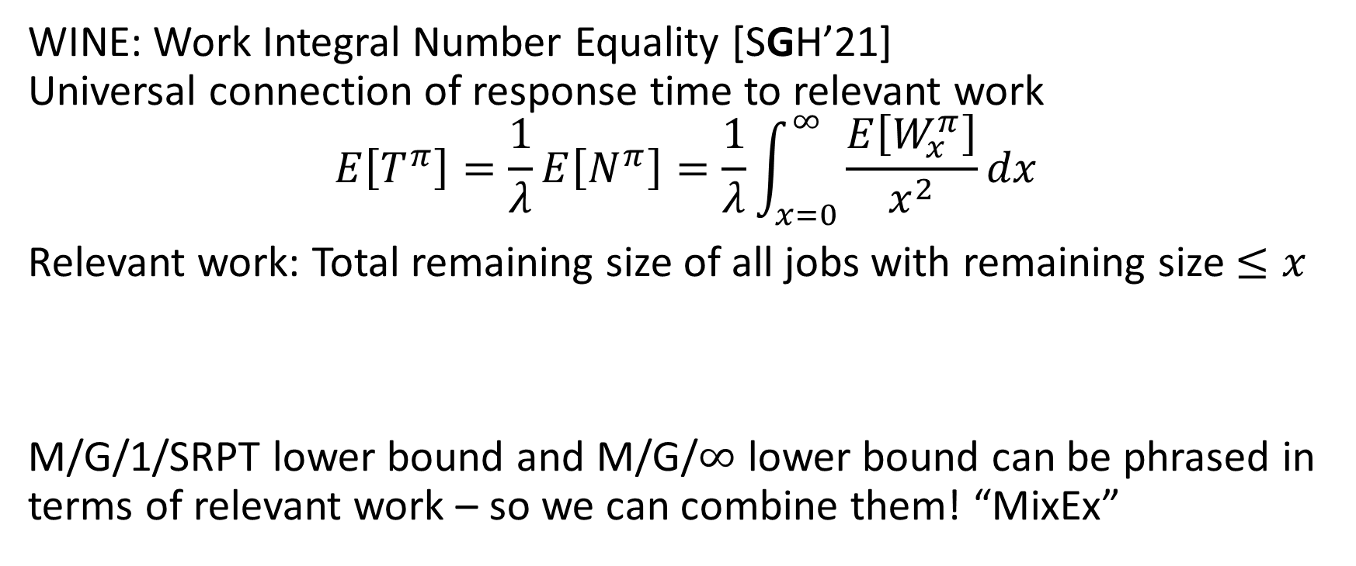
Innovation 1: WINE combination of lower bounds
WINE: Work Integral Number Equality [SGH’21]
Universal connection of response time to relevant work
$$E\left[T^{π}\right]=\frac{1}{λ}E\left[N^{π}\right]=\frac{1}{λ}\int_{x=0}^{∞}{\frac{E\left[W_{x}^{π}\right]}{x^{2}}dx}$$
Relevant work: Total remaining size of all jobs with remaining size $≤x$
M/G/1/SRPT lower bound and M/G/$∞$ lower bound can be phrased in terms of relevant work – so we can combine them! “MixEx”

Slide 27
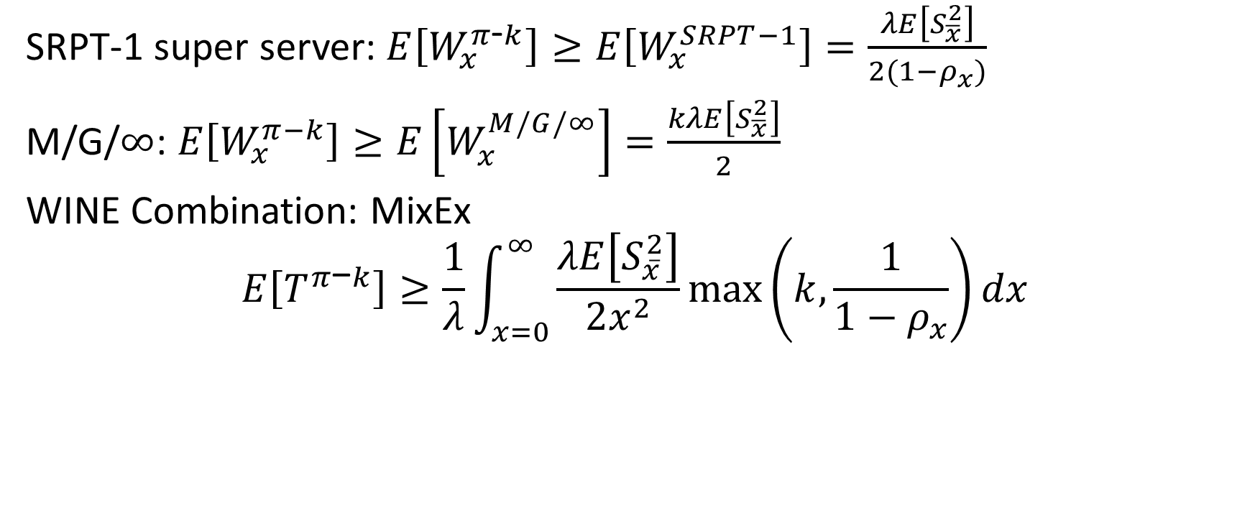
Relevant Work Lower Bounds: MixEx
SRPT-1 super server: $E\left[W_{x}^{π\text{-}k}\right]≥E\left[W_{x}^{SRPT−1}\right]=\frac{λE\left[S_{\overline{x}}^{2}\right]}{2(1−ρ_{x})}$
M/G/$∞$: $E\left[W_{x}^{π−k}\right]≥E\left[W_{x}^{M/G/∞}\right]=\frac{kλE\left[S_{\overline{x}}^{2}\right]}{2}$
WINE Combination: MixEx
$$E\left[T^{π\text{−}k}\right]≥\frac{1}{λ}\int_{x=0}^{∞}{\frac{λE\left[S_{\overline{x}}^{2}\right]}{2x^{2}}\max\left(k,\frac{1}{1−ρ_{x}}\right)dx}$$

Slide 28
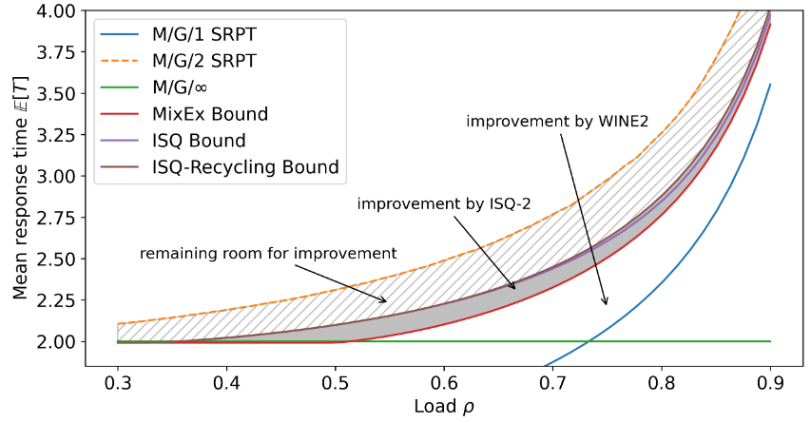
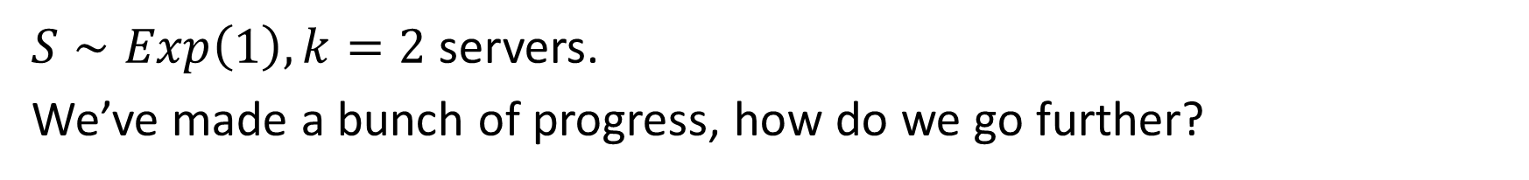
Visualization of bounds
$S∼Exp\left(1\right), k=2$ servers.
We’ve made a bunch of progress, how do we go further?

Slide 29





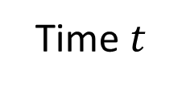

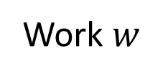





Innovation 2: Increasing Speed Queue (ISQ)
$$(w=2.4,i=1/2)$$
Single-server variable-speed queue.
State: Amount of work, server speed $\left(w, i\right)$.
Each arrival: Speed increases by $1/k$.
Cap at speed 1.
$$2/k$$
$$3/k$$
$$(k−1)/k$$
$$1/k$$
$$…$$
Work $w$
$$1/k$$
$$1$$
$$1$$
$$1$$
Time $t$

Slide 30
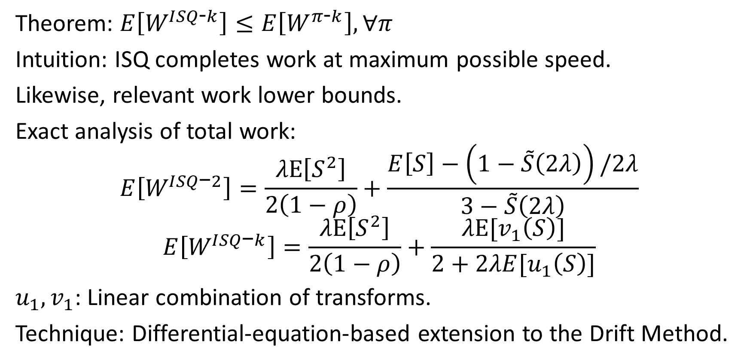
ISQ: Lower bound, exact analysis
Theorem: $E\left[W^{ISQ\text{-}k}\right]≤E\left[W^{π\text{-}k}\right], ∀π$
Intuition: ISQ completes work at maximum possible speed.
Likewise, relevant work lower bounds.
Exact analysis of total work:
$$E\left[W^{ISQ\text{−}2}\right]=\frac{λE\left[S^{2}\right]}{2\left(1−ρ\right)}+\frac{E\left[S\right]−\left(1−\tilde{S}\left(2λ\right)\right)/2λ}{3−\tilde{S}\left(2λ\right)}$$
$$E\left[W^{ISQ\text{−}k}\right]=\frac{λE\left[S^{2}\right]}{2\left(1−ρ\right)}+\frac{λE[v_{1}\left(S\right)]}{2+2λE[u_{1}\left(S\right)]}$$
$u_{1},v_{1}$: Linear combination of transforms.
Technique: Differential-equation-based extension to the Drift Method.
Notes:
Recognize: M/G/1/FCFS work

Slide 31
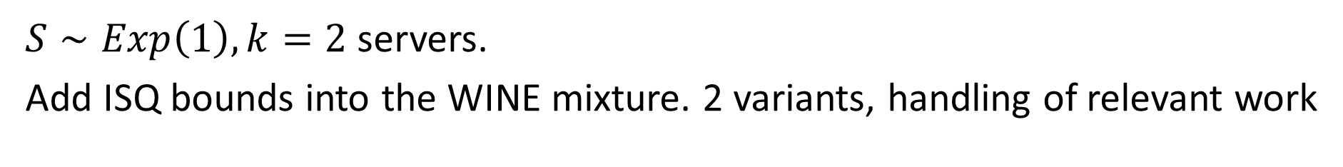
Visualization of bounds
$S∼Exp\left(1\right), k=2$ servers.
Add ISQ bounds into the WINE mixture. 2 variants, handling of relevant work

Slide 32
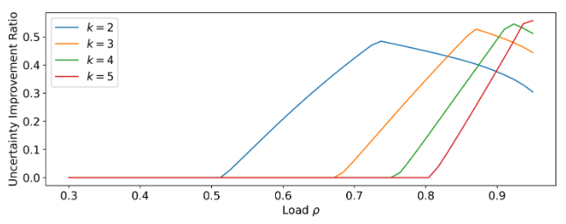
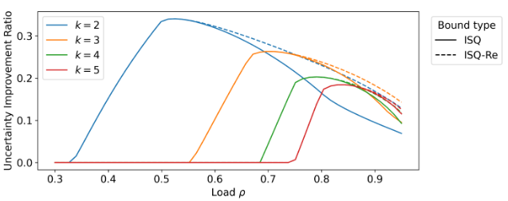

Bound quality: Uncertainty Improvement Ratio
$$UIR=\frac{E\left[T_{novel\text{-}lower}\right]−E\left[T_{old\text{-}lower}\right]}{E\left[T_{old\text{-}lower}\right]−E\left[T_{upper}\right]}$$
MixEx vs. Prior ISQ-based vs. MixEx
$$S∼Exp\left(1\right)$$

Slide 33
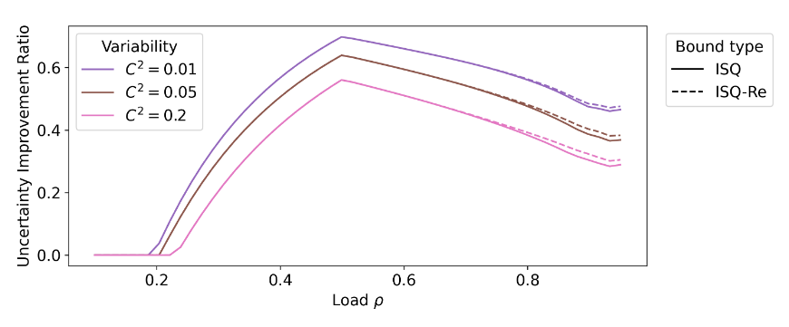
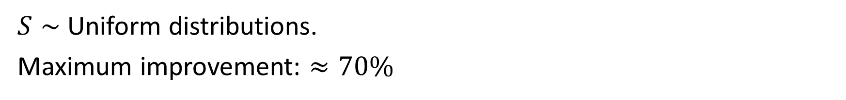
Most improvement: Low Variance
$S∼$ Uniform distributions.
Maximum improvement: $≈70\%$

Slide 34

Narrowing on Optimal, Above and Below
Lower bounds: $34\%$max UIR for $S∼Exp(1)$, $≈70\%$ max UIR overall
Upper bounds (SEK): $3\%$ max UIR for $S∼Exp(1)$, $≈10\%$ overall
Perhaps SEK is close to true optimum?
?

Slide 35

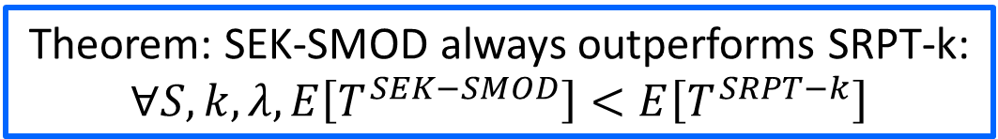





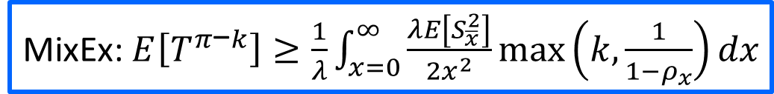

Conclusion
SEK
3
4
10
Theorem: SEK-SMOD always outperforms SRPT-k:
$$∀S, k, λ, E\left[T^{SEK−SMOD}\right]<E\left[T^{SRPT−k}\right]$$
$$w$$
$$2/k$$
$$3/k$$
$$(k−1)/k$$
MixEx: $E\left[T^{π\text{−}k}\right]≥\frac{1}{λ}\int_{x=0}^{∞}{\frac{λE\left[S_{\overline{x}}^{2}\right]}{2x^{2}}\max\left(k,\frac{1}{1−ρ_{x}}\right)dx}$
$$…$$
$$1/k$$
$$1$$
$$1$$
$$1$$
$$t$$

