Slide 1

Outperforming Multiserver SRPT at All Loads
Izzy Grosof
Northwestern University, IEMS
Daniela Hurtado-Lange, NU, Kellogg

Slide 2
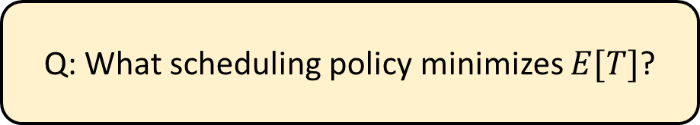




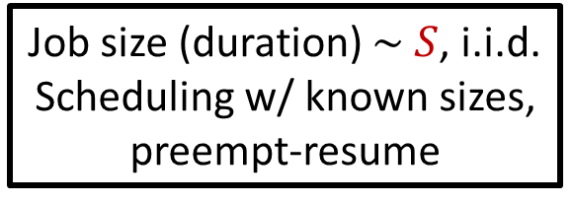
Model: M/G/k Scheduling
Job size (duration) $\sim S$, i.i.d.
Scheduling w/ known sizes, preempt-resume
Load $ρ=λE[S]<1$
PoissonP($λ$)
$$k≥2$$
Response time $T$
Q: What scheduling policy minimizes $E[T]$?
Shortest Remaining Processing Time?
Notes:
Different service durations, known in advance, equally important. Preempt-resume. Poisson, i.i.d. Mean response time E[T]. Mean number E[N] equivalent. Load rho.
Goal: Scheduling policy which minimizes E[T].

Slide 3
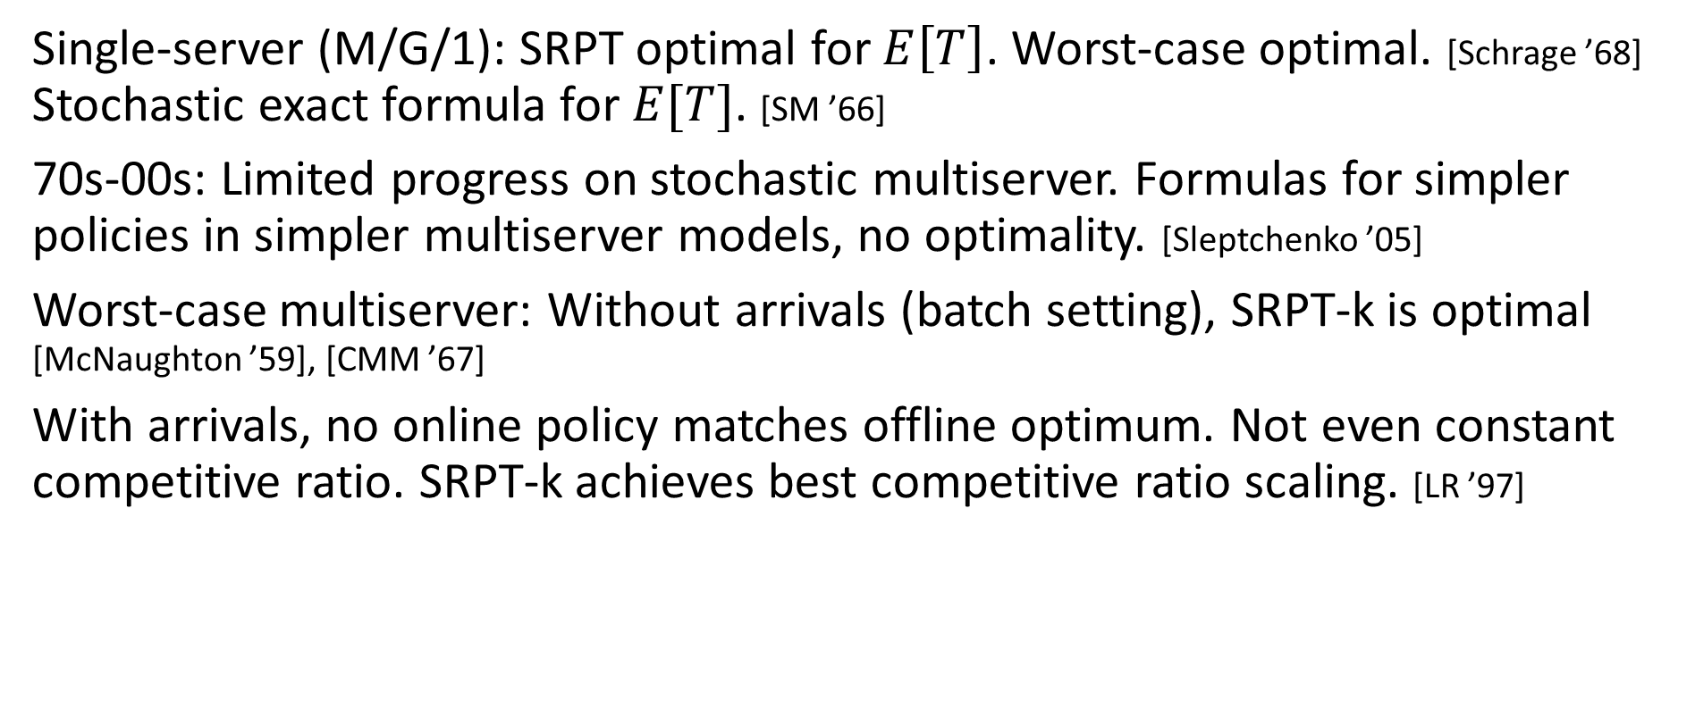
Prior work
Single-server (M/G/1): SRPT optimal for $E\left[T\right]$. Worst-case optimal. [Schrage ’68]
Stochastic exact formula for $E[T]$. [SM ’66]
70s-00s: Limited progress on stochastic multiserver. Formulas for simpler policies in simpler multiserver models, no optimality. [Sleptchenko ’05]
Worst-case multiserver: Without arrivals (batch setting), SRPT-k is optimal [McNaughton ’59], [CMM ’67]
With arrivals, no online policy matches offline optimum. Not even constant competitive ratio. SRPT-k achieves best competitive ratio scaling. [LR ’97]

Slide 4
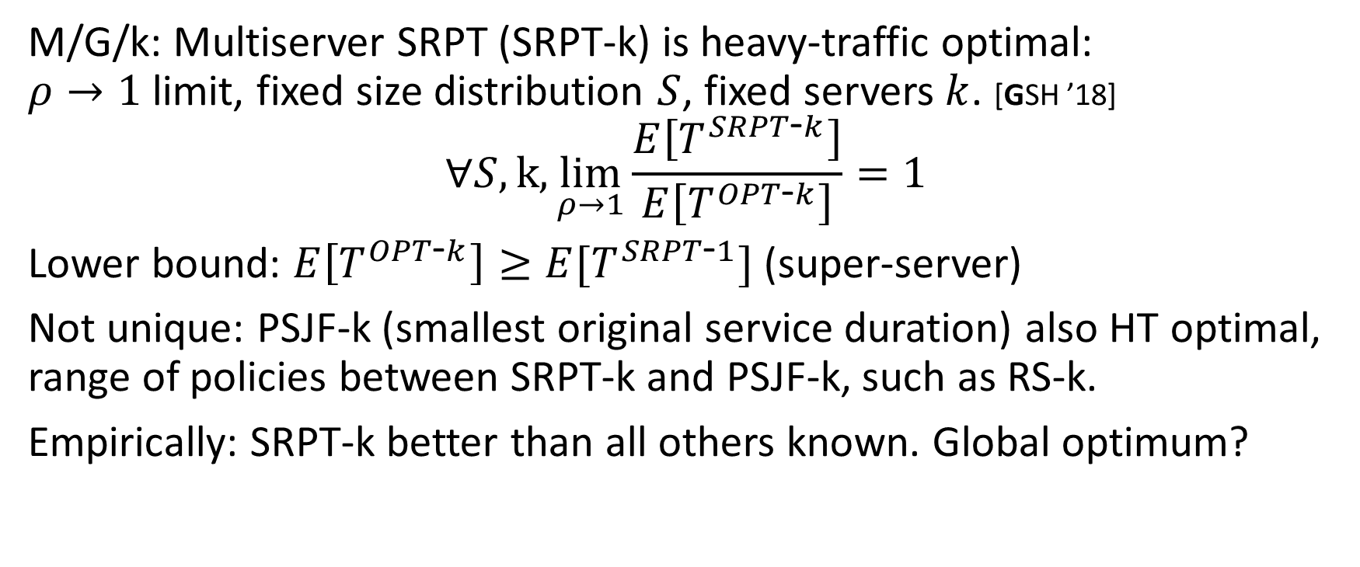
Prior Work: SRPT-k Heavy Traffic Optimality
M/G/k: Multiserver SRPT (SRPT-k) is heavy-traffic optimal:
$ρ→1$ limit, fixed size distribution $S$, fixed servers $k$. [GSH ’18]
$$∀S, k,\lim_{ρ→1}\frac{E\left[T^{SRPT\text{-}k}\right]}{E\left[T^{OPT\text{-}k}\right]}=1$$
Lower bound: $E\left[T^{OPT\text{-}k}\right]≥E[T^{SRPT\text{-}1}]$ (super-server)
Not unique: PSJF-k (smallest original service duration) also HT optimal, range of policies between SRPT-k and PSJF-k, such as RS-k.
Empirically: SRPT-k better than all others known. Global optimum?
Can we stochastically outperform SRPT-k?

Slide 5
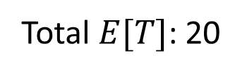
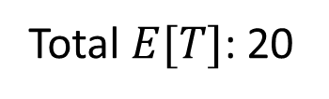
SRPT-k’s weak point
SRPT-k’s problem: last job is inefficient – server(s) idle.
New policy: SRPT-Except-k+1 (SEK). If we see this coming, diverge.
SRPT-k
3
3
10
Total $E[T]$: 20
10
4
4
0 3 4 13
SEK
3
3
4
Total $E[T]$: 20
4
10
10
0 3 7 10

Slide 6
SRPT-k’s weak point
SRPT-k’s problem: last job is inefficient – server idle.
Idea of SRPT-Except-k+1 (SEK): If we see this coming, diverge.
Early arrival: Benefits SRPT-k
SRPT-k
3
10
4
0 3 4 13
SEK
3
4
10
0 3 7 10

Slide 7

SRPT-k’s weak point
SRPT-k’s problem: last job is inefficient – server idle.
Idea of SRPT-Except-k+1 (SEK): If we see this coming, diverge.
Early arrival: Benefits SRPT-k
Late arrivals: Benefit SEK
If SEK diverges when 2 jobs
are very small, almost all upside.
SRPT-k
3
10
4
0 3 4 13
SEK
3
4
10
0 3 7 10

Slide 8
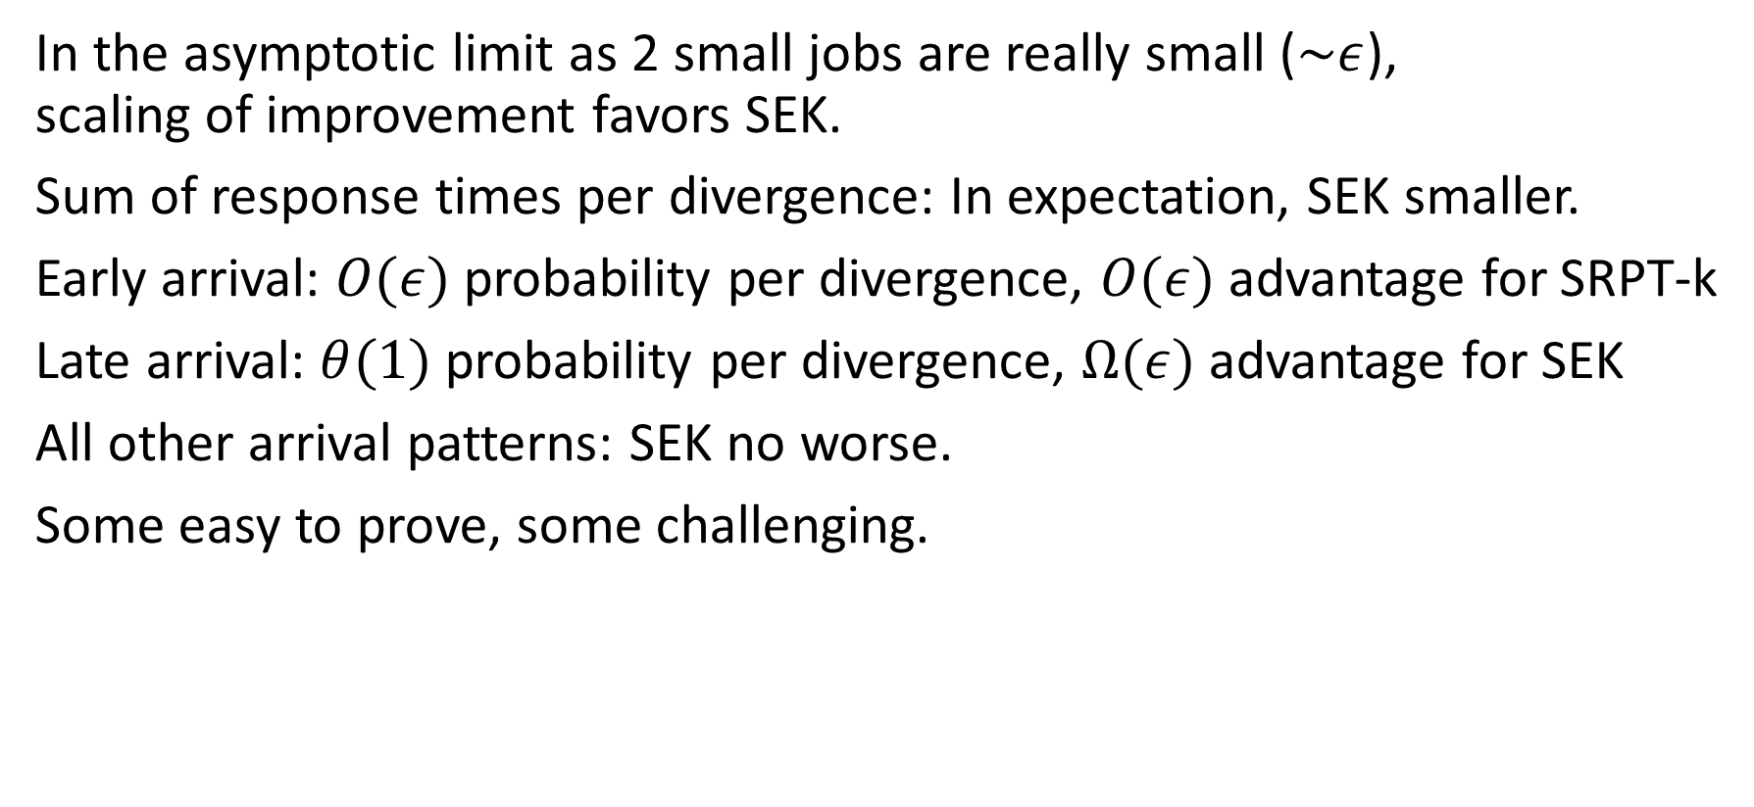
SEK Improvement Intuition
SEK
0.3
0.4
10
In the asymptotic limit as 2 small jobs are really small ($\sim ε$),
scaling of improvement favors SEK.
Sum of response times per divergence: In expectation, SEK smaller.
Early arrival: $O(ε)$ probability per divergence, $O(ε)$ advantage for SRPT-k
Late arrival: $θ(1)$ probability per divergence, $Ω(ε)$ advantage for SEK
All other arrival patterns: SEK no worse.
Some easy to prove, some challenging.

Slide 9
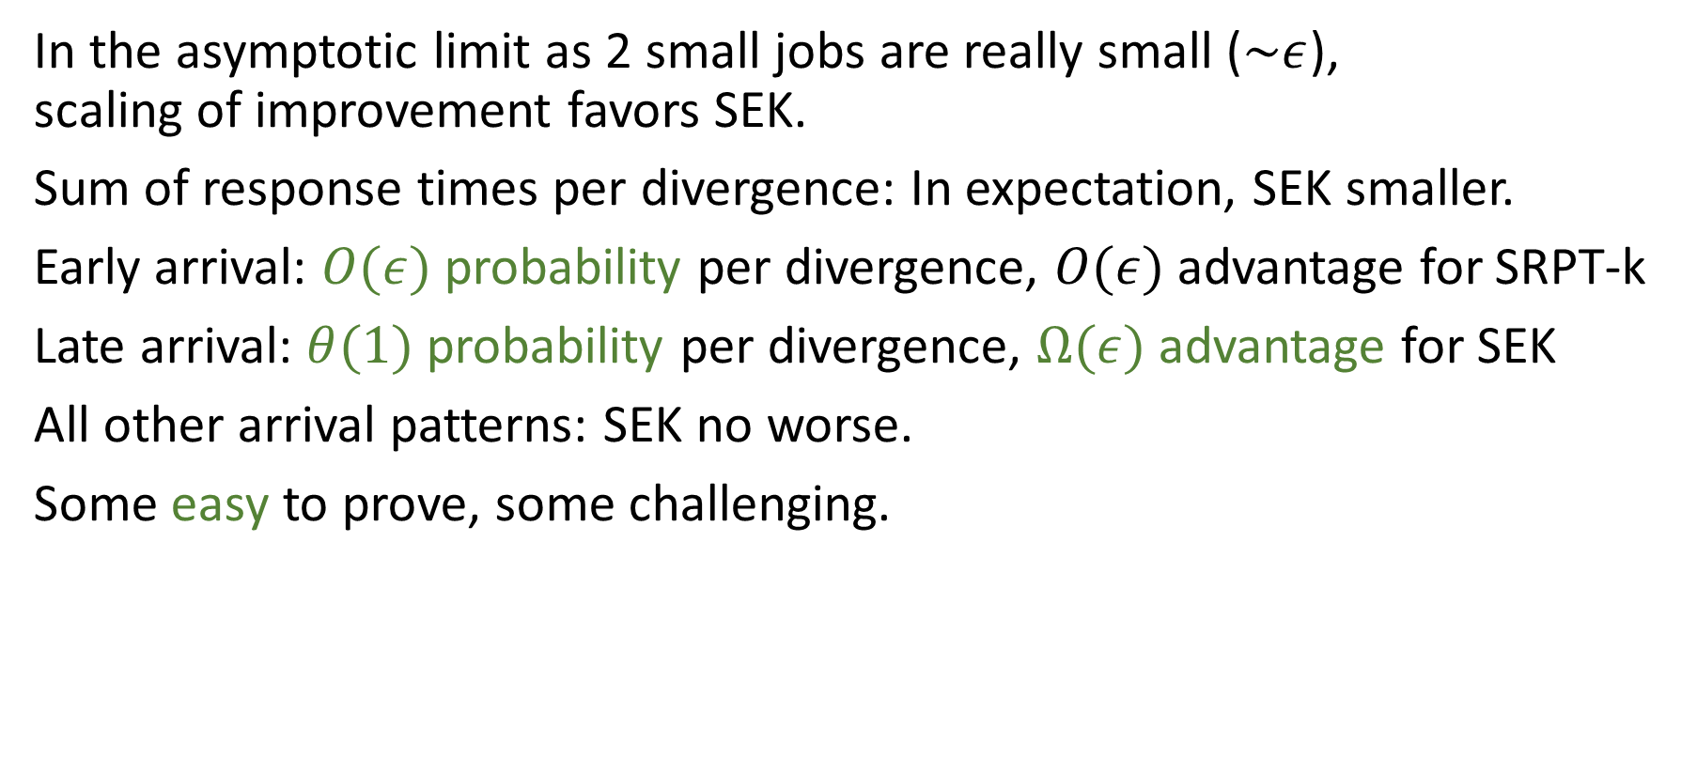
SEK Improvement Intuition
SEK
0.3
0.4
10
In the asymptotic limit as 2 small jobs are really small ($\sim ε$),
scaling of improvement favors SEK.
Sum of response times per divergence: In expectation, SEK smaller.
Early arrival: $O(ε)$ probability per divergence, $O(ε)$ advantage for SRPT-k
Late arrival: $θ(1)$ probability per divergence, $Ω(ε)$ advantage for SEK
All other arrival patterns: SEK no worse.
Some easy to prove, some challenging.

Slide 10
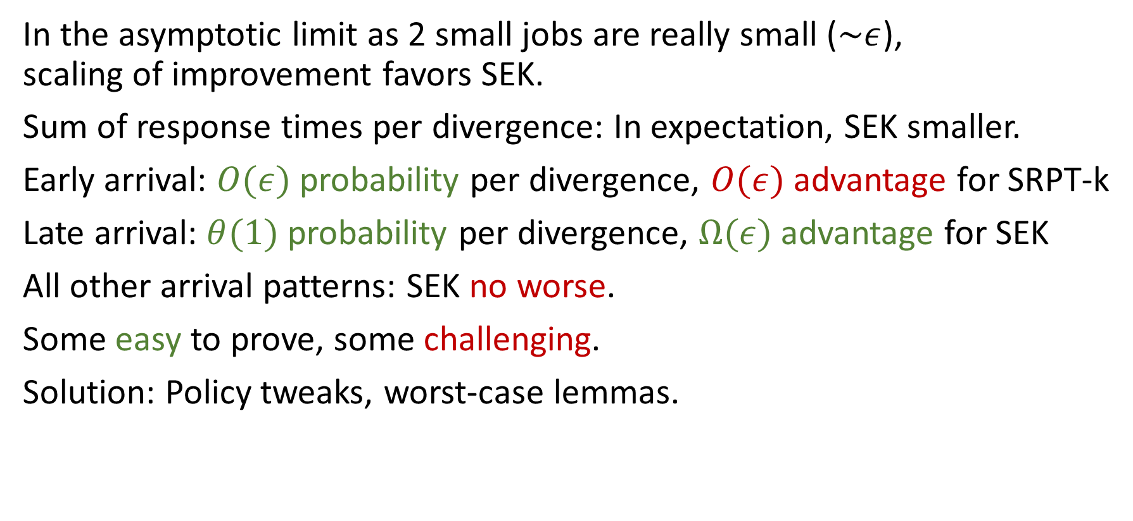
SEK Improvement Intuition
SEK
0.3
0.4
10
In the asymptotic limit as 2 small jobs are really small ($\sim ε$),
scaling of improvement favors SEK.
Sum of response times per divergence: In expectation, SEK smaller.
Early arrival: $O(ε)$ probability per divergence, $O(ε)$ advantage for SRPT-k
Late arrival: $θ(1)$ probability per divergence, $Ω(ε)$ advantage for SEK
All other arrival patterns: SEK no worse.
Some easy to prove, some challenging.
Solution: Policy tweaks, worst-case lemmas.

Slide 11



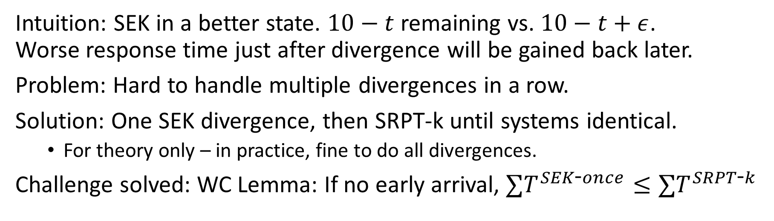





Challenge 1: If not early arrival, SEK no worse
SRPT-k
SEK
$$ε$$
10
10
$$ε$$
$$ε$$
$$ε$$
$$t$$
$$t$$
0 $ε$ $10+ε$
0 $ε$ $2ε$ $10$
Intuition: SEK in a better state. $10−t$ remaining vs. $10−t+ε$.
Worse response time just after divergence will be gained back later.
Problem: Hard to handle multiple divergences in a row.
Solution: One SEK divergence, then SRPT-k until systems identical.
  For theory only – in practice, fine to do all divergences.
Challenge solved: WC Lemma: If no early arrival, $∑T^{SEK\text{-}once}≤∑T^{SRPT\text{-}k}$

Slide 12
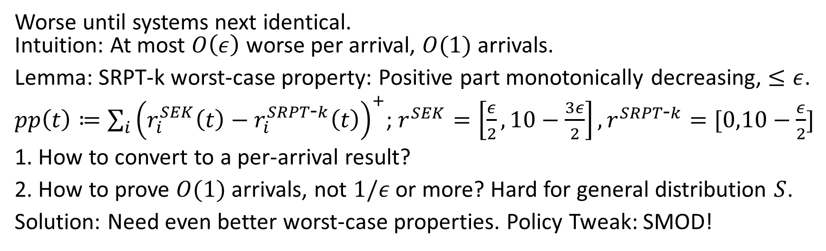
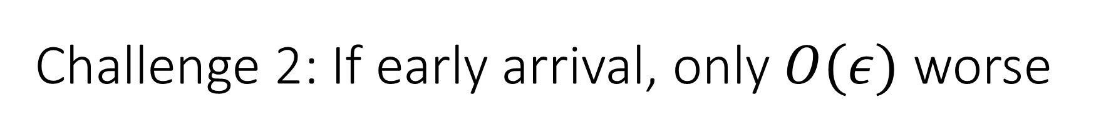


Challenge 2: If early arrival, only $O(ε)$ worse
SRPT-k
SEK
$$ε$$
10
10
$$ε$$
$$ε$$
$$ε$$
$$t$$
0 $ε$ $10+ε$
$$t$$
0 $ε$ $2ε$ $10$
Worse until systems next identical.
Intuition: At most $O\left(ε\right)$ worse per arrival, $O(1)$ arrivals.
Lemma: SRPT-k worst-case property: Positive part monotonically decreasing, $≤ε$.
$pp\left(t\right)≔\sum_{i}{{\left(r_{i}^{SEK}\left(t\right)−r_{i}^{SRPT\text{-}k}\left(t\right)\right)}^{+}}$; $r^{SEK}=\left[\frac{ε}{2},10−\frac{3ε}{2}\right], r^{SRPT\text{-}k}=[0,10−\frac{ε}{2}]$
1. How to convert to a per-arrival result?
2. How to prove $O(1)$ arrivals, not $1/ε$ or more? Hard for general distribution $S$.
Solution: Need even better worst-case properties. Policy Tweak: SMOD!

Slide 13
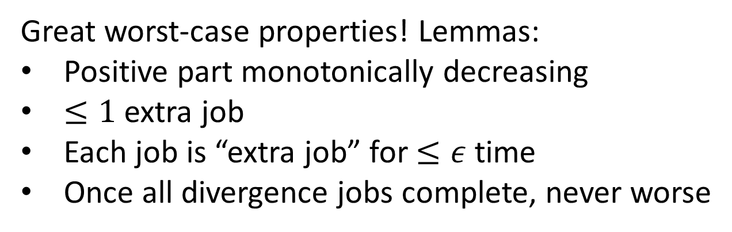
Final tweak: SEK-SMOD
Final policy: SEK-SMOD. 1 SEK divergence, then SMOD until identical.
SMOD: Explicit reference to SRPT-k system with same arrivals. Completely predictable.
SMOD: Prioritize jobs at indexes with equal or larger remaining size than SRPT-k counterpart, then prioritize smallest remaining size secondarily.
Great worst-case properties! Lemmas:
Positive part monotonically decreasing
$≤1$ extra job
Each job is “extra job” for $≤ε$ time
Once all divergence jobs complete, never worse
5
4
SMOD
2
1
6
SRPT-k
3.5
3

Slide 14
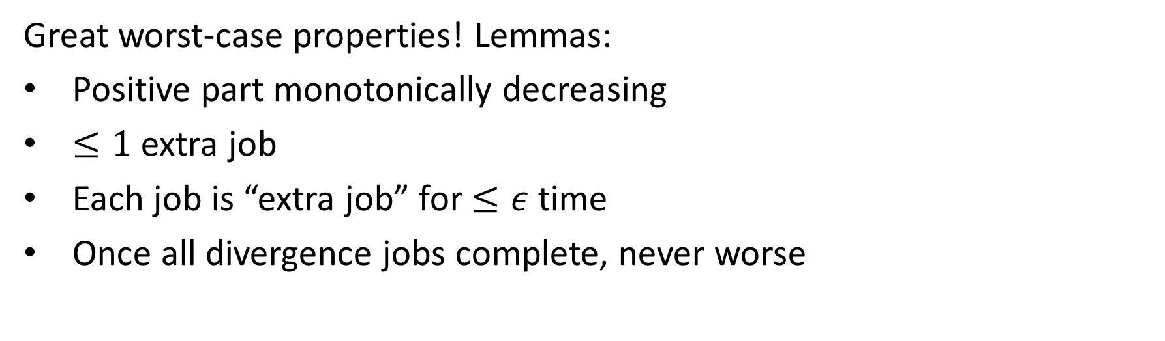
Final tweak: SEK-SMOD
5
4
SMOD
2
1
6
Great worst-case properties! Lemmas:
Positive part monotonically decreasing
$≤1$ extra job
Each job is “extra job” for $≤ε$ time
Once all divergence jobs complete, never worse
SRPT-k
3.5
3

Slide 15
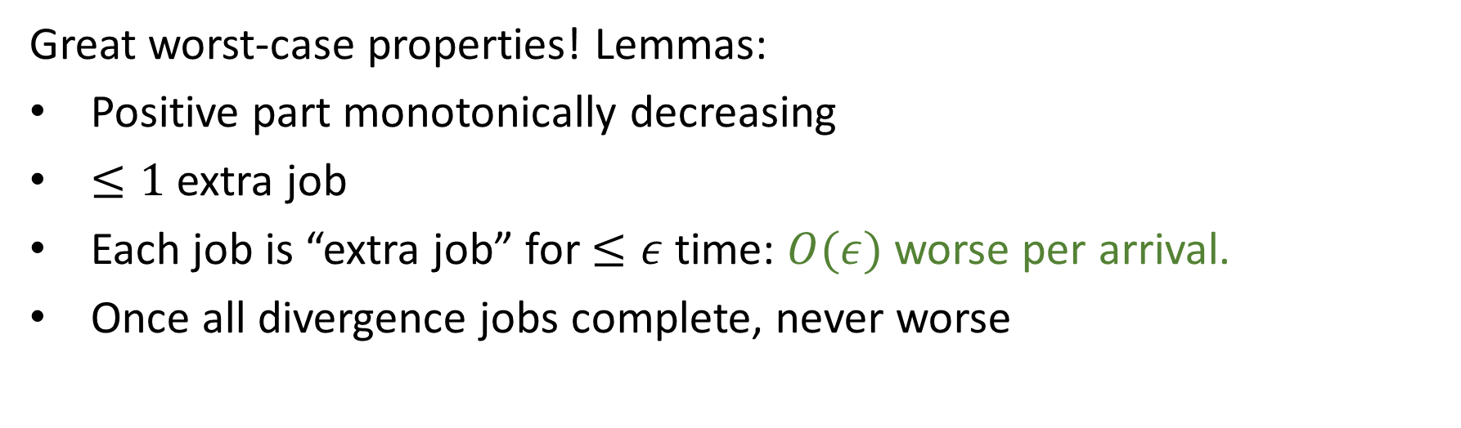
Final tweak: SEK-SMOD
5
4
SMOD
2
1
6
Great worst-case properties! Lemmas:
Positive part monotonically decreasing
$≤1$ extra job
Each job is “extra job” for $≤ε$ time: $O(ε)$worse per arrival.
Once all divergence jobs complete, never worse
SRPT-k
3.5
3

Slide 16
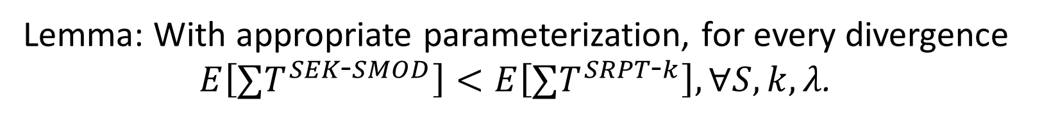
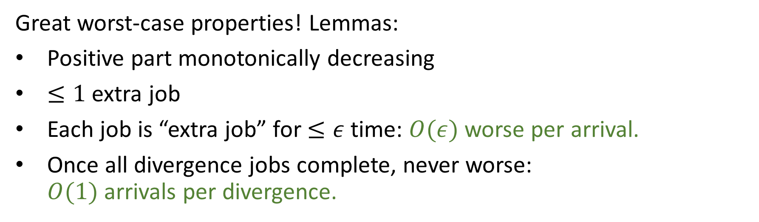
Final tweak: SEK-SMOD
5
4
SMOD
2
1
6
Great worst-case properties! Lemmas:
Positive part monotonically decreasing
$≤1$ extra job
Each job is “extra job” for $≤ε$ time: $O(ε)$worse per arrival.
Once all divergence jobs complete, never worse:
$O(1)$ arrivals per divergence.
SRPT-k
3.5
3
Lemma: With appropriate parameterization, for every divergence
$E\left[∑T^{SEK\text{-}SMOD}\right]<E\left[∑T^{SRPT\text{-}k}\right], ∀S, k,λ$.

Slide 17
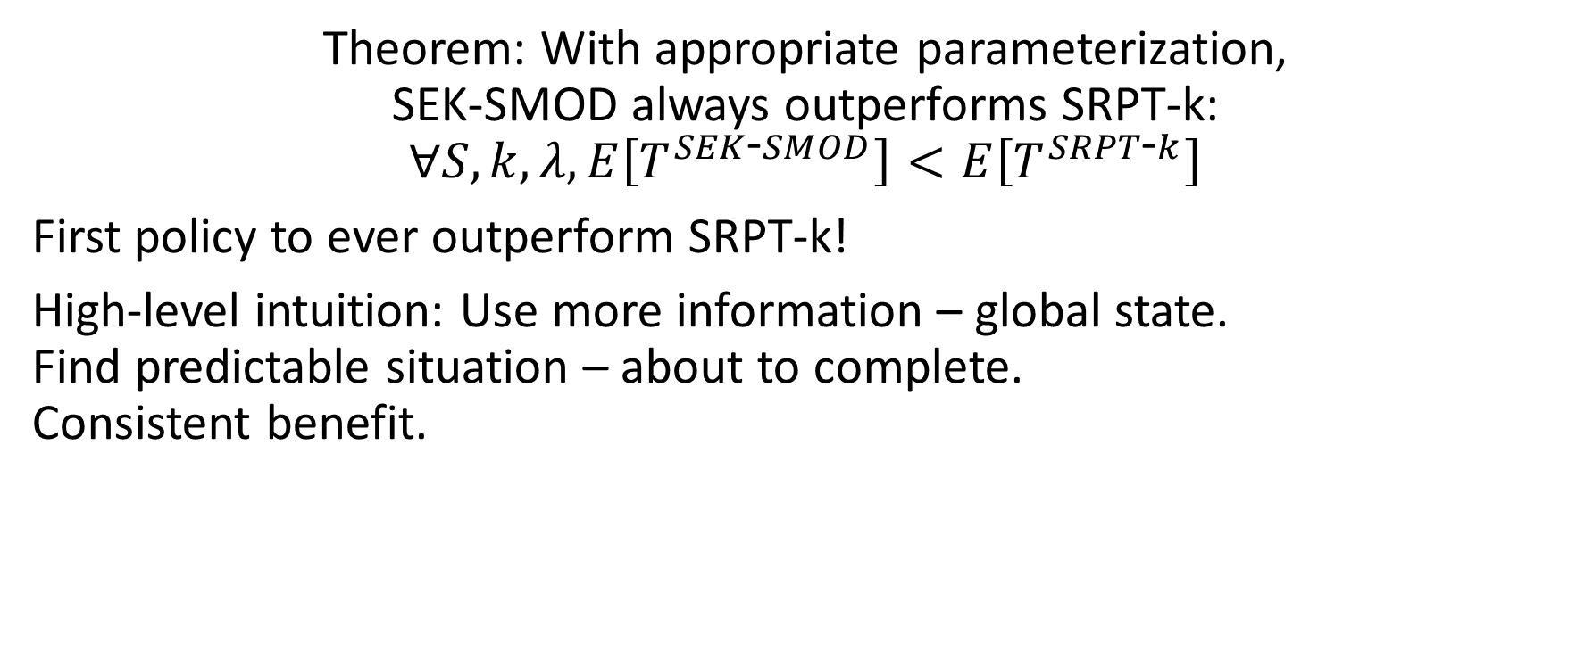
Main Result
Theorem: With appropriate parameterization,
SEK-SMOD always outperforms SRPT-k:
$$∀S, k, λ, E\left[T^{SEK\text{-}SMOD}\right]<E\left[T^{SRPT\text{-}k}\right]$$
First policy to ever outperform SRPT-k!
High-level intuition: Use more information – global state.
Find predictable situation – about to complete.
Consistent benefit.

Slide 18
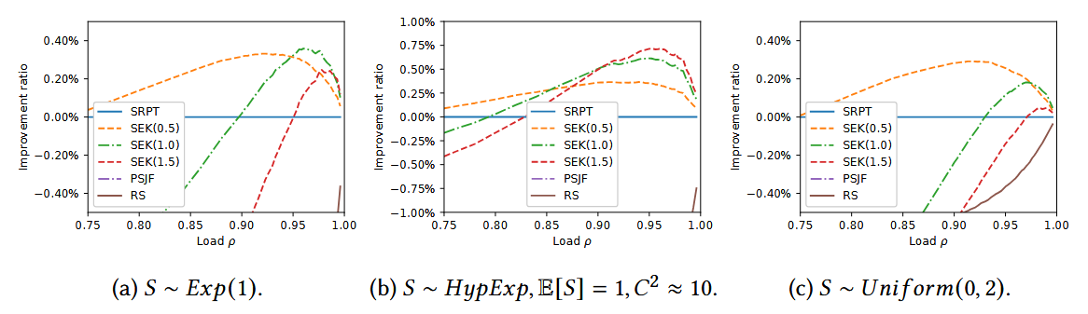
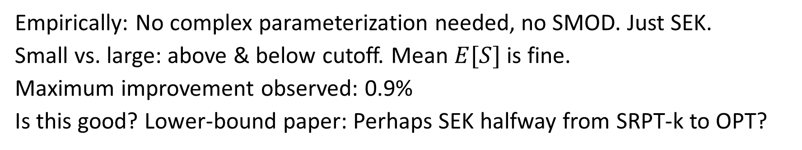
Empirical outperformance
Empirically: No complex parameterization needed, no SMOD. Just SEK.
Small vs. large: above & below cutoff. Mean $E[S]$ is fine.
Maximum improvement observed: 0.9%
Is this good? Lower-bound paper: Perhaps SEK halfway from SRPT-k to OPT?

Slide 19
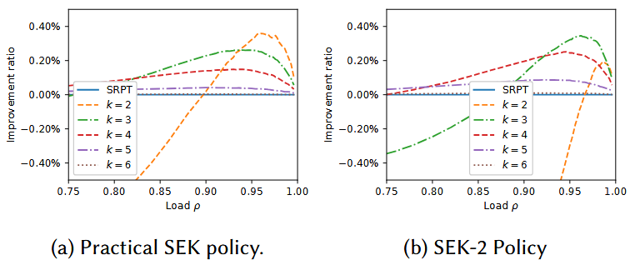
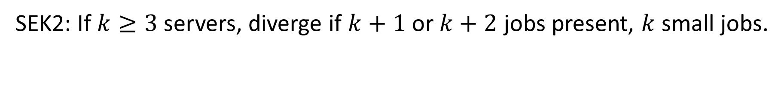
More servers: More divergences
SEK2: If $k≥3$ servers, diverge if $k+1$ or $k+2$ jobs present, $k$ small jobs.

Slide 20
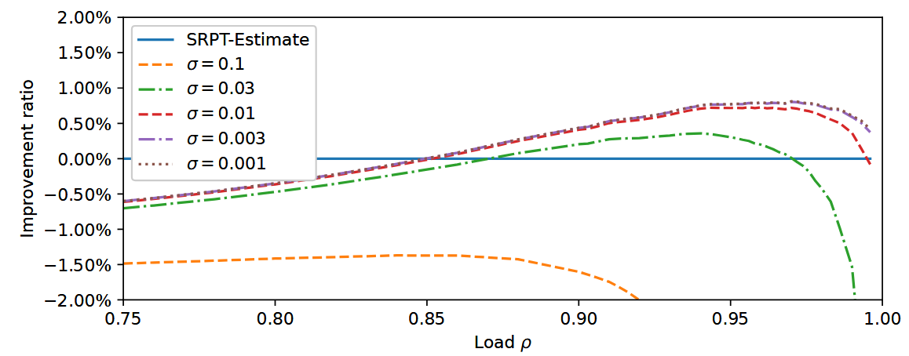
Estimates: SEK still helps, if low noise
S hyperexponential, $C^{2}≈10$. Estimation error $N(0, σ)$.

Slide 21
Future directions
Can we apply SEK-type ideas on top of other priority-index policies?
Gittins-k? ServerFilling-SRPT? Guardrails/SRPT?
When more jobs are present, does SEK still help?
Ex: 0.1, 0.1, 1, 100, 100. Should we prioritize the 1?
SRPT
Gittins
ServerFilling-SRPT
4
1
2
4
Guard.
1
2
2

Slide 22
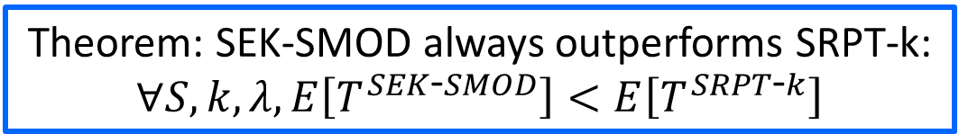
Conclusion
SEK
3
4
10
Theorem: SEK-SMOD always outperforms SRPT-k:
$$∀S, k, λ, E\left[T^{SEK\text{-}SMOD}\right]<E\left[T^{SRPT\text{-}k}\right]$$

